Slide 1
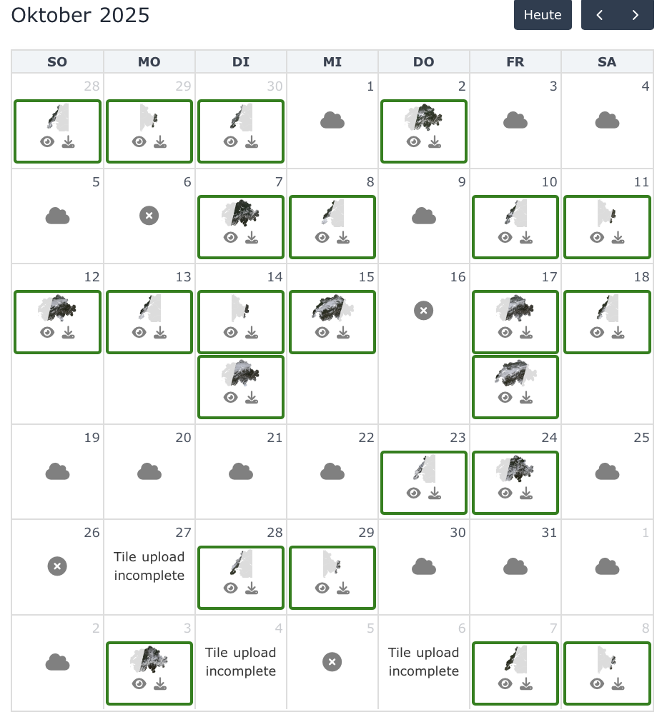
Method for cleaning and smoothing: - outlier detection
- gapfilling
Fabian
Issue: Satellite (Sentinel-2) images
have gaps due to (orbit, clouds, snow)
have measurement errors (outliers) due to (...?)
Goal:
provide cleaned and daily gapfilled NDVI product for forested area in Switzerland
https://www.swisstopo.admin.ch/en/satelliteimage-swisseo-s2-sr

Slide 2
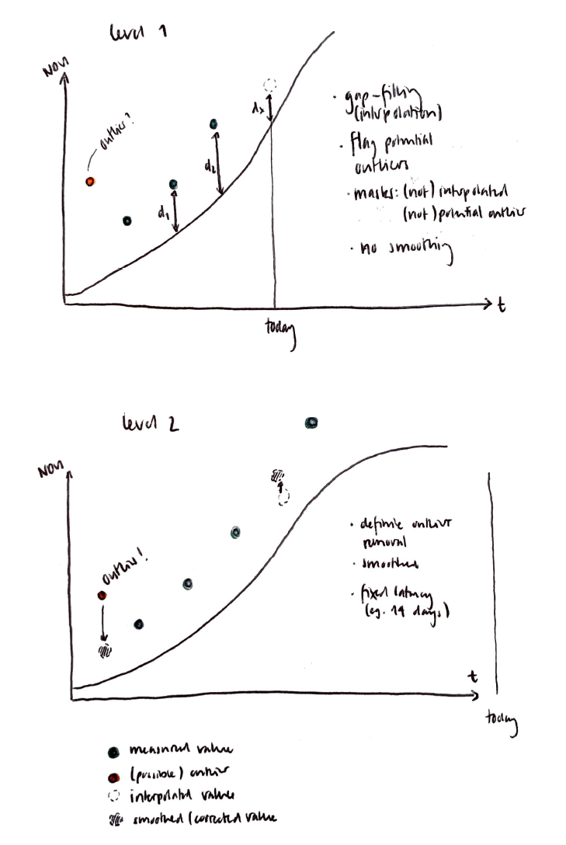
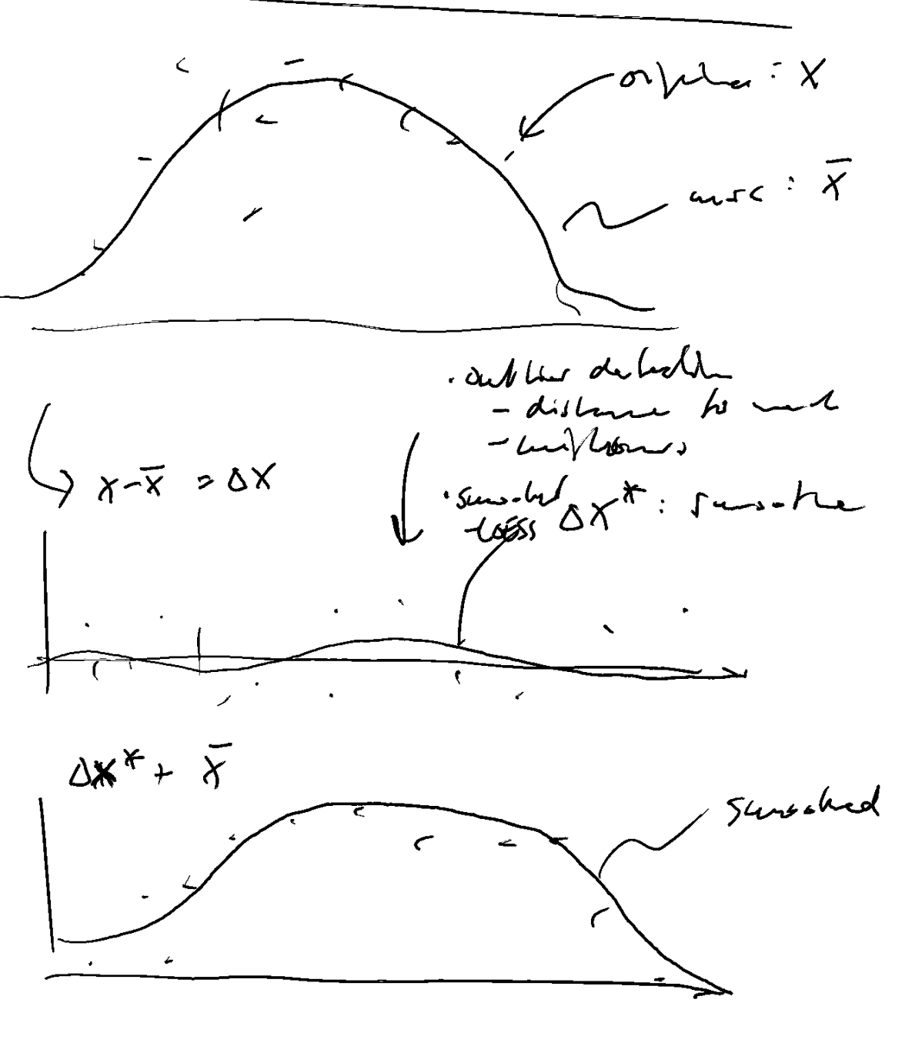
Method for cleaning and smoothing: makes use of sigmoid model as normal reference
In case of extreme negative events (NDVI less than 0.2 compared to interquantile range). The smoothing is performed on the NDVI values and not on the deltas. This represents the fact that vegetation may not follow the expected values given the extreme conditions.
Fabian
Go from NDVI space into delta space
Do outlier detection (cleaning) and LOESS interpolation (smoothing) in delta space
Transform cleaned, smoothed daily delta time series back to NDVI time series

Slide 3
Method for cleaning and smoothing: two step procedure based on moving window
Fabian
7-observation moving window:
t-6
t-5
t-4
L2
t-3
t-2
-
t-1
L1
L1
t0
LOESS interpolation
Linear interpolation
Last known observations:

Slide 4
Method for cleaning and smoothing: two step procedure based on moving window
Fabian
7-observation moving window:
t-6
t-5
L2
t-4
L2
t-3
t-2
t-1
L1
L1
t0
LOESS interpolation
Linear interpolation
Last known observations:
Previously smoothed

Slide 5
How it is:
a) Run with acquisition at t0
7-observation moving window:
Today
-
(outlier)
-
-
-
-
Outlier detection
7-observation moving window:
Today
t-6
t-5
-
t-4
-
t-3
t-2
-
t-1
-
-
t0
-
LOESS smoothing
7-observation moving window:
Center observation
Today
t-6
t-5
L2
t-4
L2
t-3
t-2
-
t-1
L1
L1
t0
L0
Linear interpolation
Linear interpolation
Last
observations
(raw)
Last
observations
(smoothed)
Previously interpolated
Outlier detection
LOESS smoothing
b) Run an acquisition later
7-observation moving window:
Center observation
Yesterday
Today
-
t-6
L2
t-5
L2
t-4
t-3
-
t-2
L1
L1
t-1
L0
t0
Linear interpolation
Outlier detection
LOESS smoothing
c) Run two acquisitions later
Center observation
Day before yesterday
Yesterday
Today
7-observation moving window:
-
-
L2
t-6
L2
t-5
t-4
L2
t-3
L1
L1
t-2
L0
t-1
t0
Linear interpolation
Linear interpolation

Slide 6
a) Run after acquisition at t0
7-observation moving window:
Today
L2
L2
-
(outlier)
-
-
-
-
Outlier detection
7-observation moving window:
Today
L2
t-6
t-5
-
t-4
-
t-3
t-2
-
t-1
-
-
t0
-
LOESS smoothing
Exp. decay
-
L0
7-observation moving window:
Center observation
Today
L2
t-6 (L1)
t-5 (L1)
L1
t-4 (L1)
L1
t-3
t-2
L1
t-1
L1
L1
t0
L0
Linear interpolation
Linear interpolation
Exp. decay
Raw
observations
Smoothed
observations
Previously interpolated
b) Run an acquisition later
Move window
updated
t-6
L2
L1
L2
7-observation moving window:
Center observation
2 days ago
Today
L2
L2
updated
t-6
updated
L1
updated
t-5
L1
updated
t-4
t-3
L1
t-2
L1
L1
t-1
L0
t0
-
Linear interpolation
Outlier detection
LOESS smoothing
Exp. decay
-
L0
7-observation moving window:
Center observation
Yesterday
Today
L2
L2
updated
t-6 (L1)
updated
L1
updated
t-5
(L1)
updated
L1
updated
t-4
(L1)
t-3
updated
L1
t-2
updated
L1
updated
L1
t-1
L1
t0
L0
Linear interpolation
Exp. decay
c) Run two acquisitions later
Move window
updated
t-6
L2
L1
L2
L2
L2
L2
L2
7-observation moving window:
Outlier detection
LOESS smoothing
Exp. decay
-
L0
7-observation moving window:
Center observation
3 days ago
Yesterday
Today
L2
L2
L2
L2
updated
t-6 (L1)
updated
L1
updated t-5 (L1)
updated
t-4 (L1)
L1
t-3
L1
L1
t-2
L1
t-1
L1
t0
Linear interpolation

Slide 7
Fig X: Illustration of continuous processing. Green and blue dots indicate raw and smoothed observations. Black dots and empty dots with dashed contour indicate days without observations. The green box “7-observation moving window” shows the set of observations used for LOESS smoothing, and the dashed red boxes show the updated values (n=3 in this example). [The larger dot-dashed box shows the set of daily values considered (and re-written) at each continuous processing, of which most values remain unchainged.]
a) Run after acquisition at t+1
Today
…
L2
L2
L2
L2
L2
L2
L1
m0
L1 m2
L1 m2
L1
m0
L1 m2
L1
m0
(outlier)
L1 m2
L0
m0
(potential outlier)
-
-
Outlier detection
Drop uncertain outlier
7-observation moving window:
Today
…
L2
L2
t-6 (L2)
t-5 (L2)
L2
t-4
(L2)
L1
m0
t-3
L1/m2
L1
m0
t-1
L1
m0
L1
m0
t0
L1/m2
L0
m0
t+1
L1/m2
-
-
LOESS smoothing
Linear/Exp. decay
-
L0
7-observation moving window:
Center observation
Today
…
L2
L2
t-6 (L2)
t-5 (L2)
L2
t-4 (L2)
New
L2 m1
New L2 m3
t-2 L1/m2
unchanged
L1
t-1 L1/m2
unchanged
L1
unchanged
L1
t0
L1/m2
New
L1
t+1
L1/m2
new L0
new L0 =0
Linear interpolation
Linear interpolation
Linear interpolation to 0 /Exp decay
Raw
observations
Smoothed
observations
L2
Previously interpolated
L1
Previously interpolated
b) Run an acquisition later
Move window
updated
t-6
L2
L1
L2
7-observation moving window:
Center observation
2 days ago
Today
L2
L2
updated
t-6
updated
L1
updated
t-5
L1
updated
t-4
t-3
L1
t-2
L1
L1
t-1
L0
t0
-
Linear interpolation
Outlier detection
LOESS smoothing
Exp. decay
-
L0
7-observation moving window:
Center observation
Yesterday
Today
L2
L2
updated
t-6 (L1)
updated
L1
updated
t-5
(L1)
updated
L1
updated
t-4
(L1)
t-3
updated
L1
t-2
updated
L1
updated
L1
t-1
L1
t0
L0
Linear interpolation
Exp. decay
c) Run two acquisitions later
Move window
updated
t-6
L2
L1
L2
L2
L2
L2
L2
7-observation moving window:
Outlier detection
LOESS smoothing
Exp. decay
-
L0
7-observation moving window:
Center observation
3 days ago
Yesterday
Today
L2
L2
L2
L2
updated
t-6 (L1)
updated
L1
updated t-5 (L1)
updated
t-4 (L1)
L1
t-3
L1
L1
t-2
L1
t-1
L1
t0
Linear interpolation

Slide 8




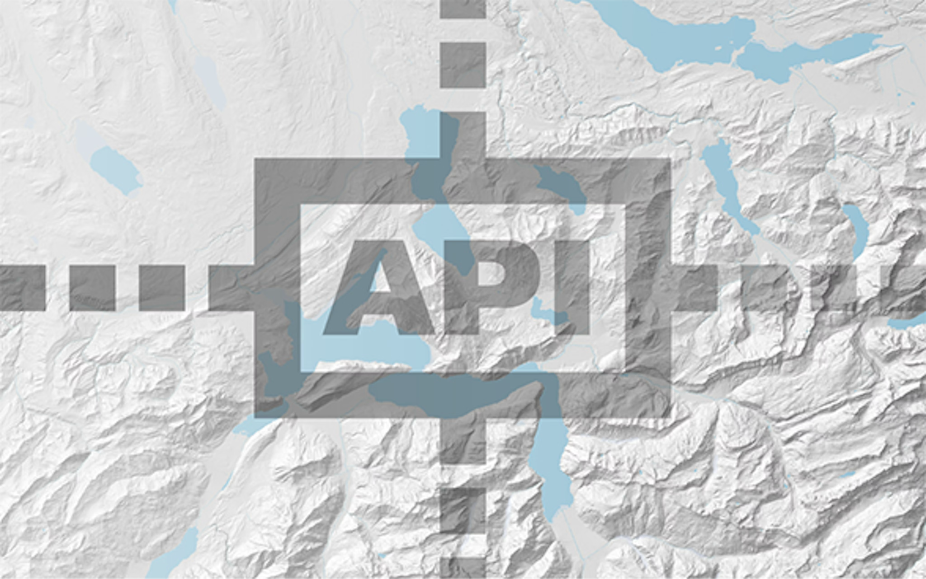
Data pipeline, Implementation
Fabian
Toolchain:
Processing steps for continuous update:
download new data (script 1)
process 105M pixels, pixel-by-pixel (script 4,5)
create raster map (tiff, script 6)
bash 0_1_run_pipeline.sh
Inputs: HISTO_INPUT="/mnt/data1/UniBe-swiss-ndvi/input_data/ndvi_historic_v5_chk_40000_365_100kmX100km.zarr" (historic data set with smoothed daily values)
END_DATE="2025-12-28", START_DATE=$(derived from HISTO_INPUT)
STAC API

