Slide 1

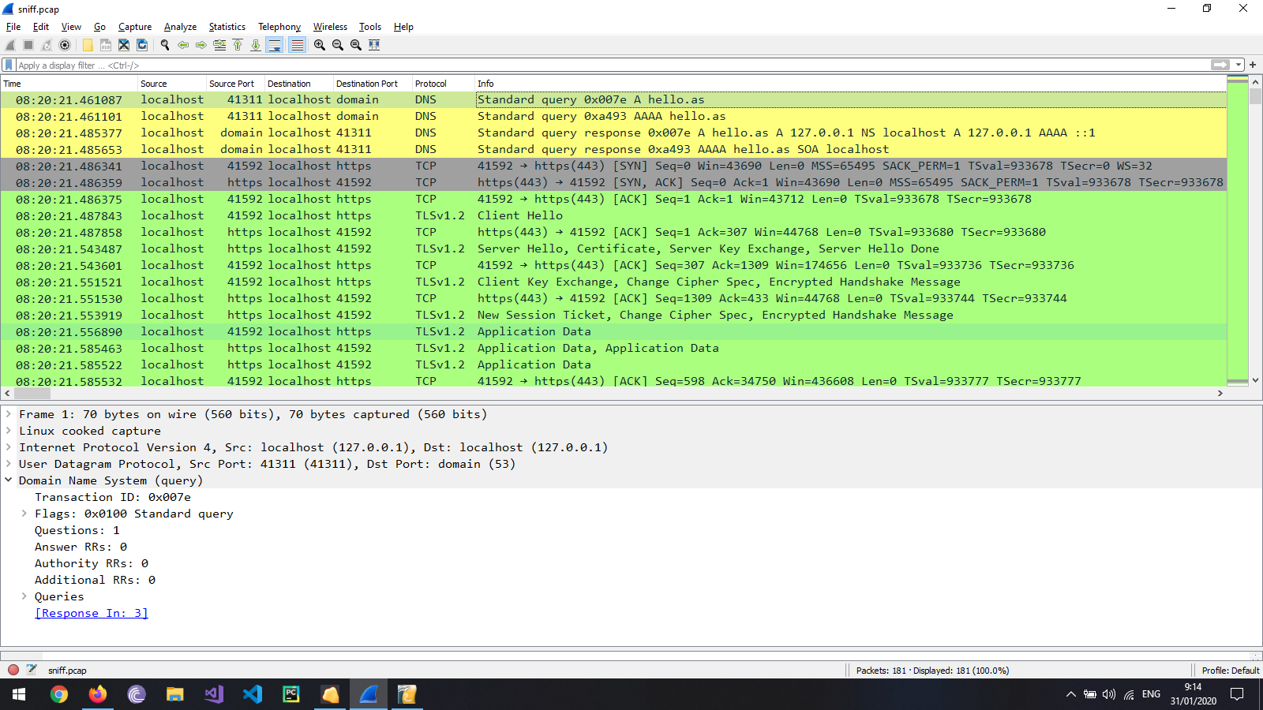
The client sends a query to the DNS server to resolve the ip address for “hello.as”.
Two separate queries: one for Ipv4 (type A) and one for Ipv6 (type AAAA).

Slide 2
The server sends 2 responses: one for each IP version.
The host name “hello.as” resolves to ip address (Ipv4) 127.0.0.1 (localhost).

Slide 3
Before the secure communication can start, a non secure TCP communication occur signaling the clients desire to communicate with the server:
The client sends a SYN signal to the servers 443 port (https) and waits for a response.
The server acknowledges the client signal by sending an ACK response as well as a SYN signal.
The client acknowledges the servers' SYN by sending an ACK signal.

Slide 4
Before the secure communication can start, a non secure TCP communication occur signaling the clients desire to communicate with the server:
The client sends a SYN signal to the servers 443 port (https) and waits for a response.
The server acknowledges the client signal by sending an ACK response as well as a SYN signal.
The client acknowledges the servers' SYN by sending an ACK signal.

Slide 5
The establishment of the SSL/TLS communication:
The client sends a “Client Hello” message to the server, included in the message are the TLS version it supports, the cipher methods preferred and a random 32-byte
number to be used later to generate the encryption key.
2. The server sends a “Server Hello” message: The server chooses a protocol version supported by the client, a random 32-byte number is generated by the server to be used to create the encryption key, a cipher method is chosen from the methods sent in the “Client Hello”, the server sends its TLS/SSL certificate containing its public key. Finally the server sends an “Hello Done” signal.
Right after receiving an ACK from the client, the server sends a “Client Key Exchange” message.
3. The client creates an encrypted pre-master key using the public key in the certificate received from the server, only the server can decrypt the pre-master key using the certificates' private key.

Slide 6
4. The server decrypts the pre-master key using its' private key and sends an ACK signal to the client.
5. At this point both the client and server generate the same master key using the client random and server random exchanged before.
6. All communication further on will be encrypted and secure.

