Slide 1

Le plug-in DataTables js

Slide 2
Sommaire
Introduction
Sources de données
Usage
  DOM
  Tableau JSON
  Ajax
  Variante avec Ajax/PHP/PDO
Conclusion

Slide 3
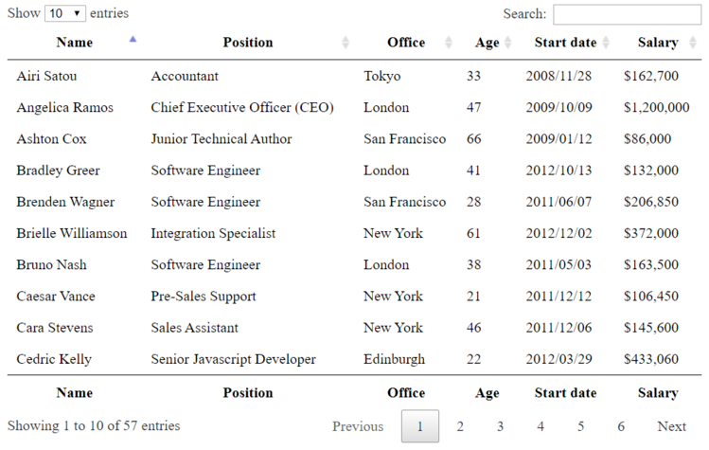
Introduction
DataTables est un plug-in Javascript permettant de rendre un tableau HTML dynamique.
  Rechercher un élément
  Trier selon des colonnes
  Pagination
  Exporter dans divers formats
    csv, pdf, excel, png,...

Slide 4
Source de données
Les données pour remplir le tableau peuvent être fournies de 4 façons:
  DOM : Le tableau est déjà rempli en HTML
  Tableau JSON : Les données sont fournies sous forme de tableau JSON
  Ajax : Les données sont fournies via Ajax (sous forme JSON)
  Server-side : Le tableau est généré coté serveur (PHP/JSON)

Slide 5
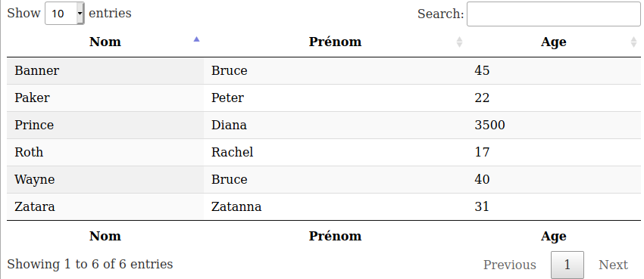
Usage : DOM
<!DOCTYPE html>
<html>
<head>
<title>Exemple DOM datatables</title>
<meta charset="UTF-8">
<meta name="viewport" content="width=device-width, initial-scale=1.0">
<script src="https://code.jquery.com/jquery-3.5.1.js"></script>
<script src="https://cdn.datatables.net/1.10.24/js/jquery.dataTables.min.js"></script>
<script src="table.js" type="text/javascript"></script>
<link href="https://cdn.datatables.net/1.10.24/css/jquery.dataTables.min.css" rel="stylesheet" type="text/css"/>
</head>
<body>
<table id="example" class="display" style="width:100%">
<thead>
<tr>
<th>Nom</th>
<th>Prénom</th>
<th>Age</th>
</tr>
</thead>
<tbody>
<tr>
<td>Wayne</td>
<td>Bruce</td>
<td>40</td>
</tr>
<tr>
<td>Banner</td>
<td>Bruce</td>
<td>45</td>
</tr> ...
</tbody>
<tfoot>
<tr>
<th>Nom</th>
<th>Prénom</th>
<th>Age</th>
</tr>
</tfoot>
</table>
</body>
</html>
$(document).ready(function() {
$('#example').DataTable();
} );
table.js
index.html

Slide 6
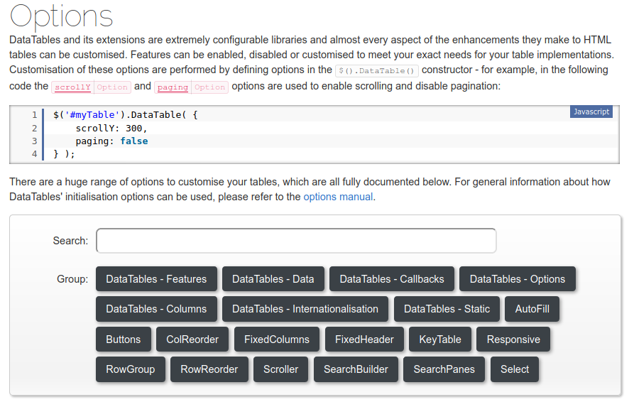
Usage : DOM - Ajouter des options
Il est possible d'ajouter des options lors de la création du DataTables.
https://datatables.net/reference/option/

Slide 7
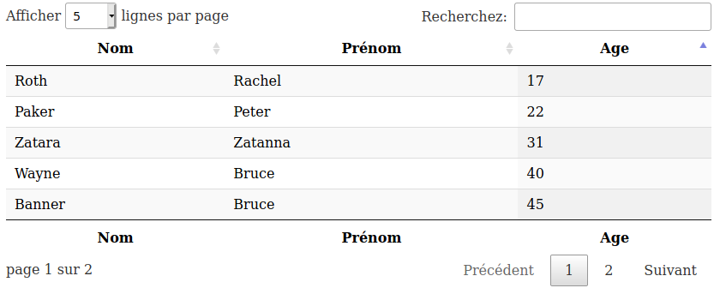
Usage : DOM - Ajouter des options
$(document).ready(function () {
$('#example').DataTable(
{
"lengthMenu": [[5,10, 15, 25, 50, 100, -1], [5,10, 15, 25, 50, 100, "Tous"]],
"pageLength": 5,
"language": {
"lengthMenu": "Afficher _MENU_ lignes par page",
"info": "page _PAGE_ sur _PAGES_",
"infoEmpty": "pas de résultat",
"search": "Recherchez: ",
"paginate": {
"first": "Premier",
"last": "Dernier",
"next": "Suivant",
"previous": "Précédent"
},
},
"order": [[2, "asc"]]
}
);
});
table.js

Slide 8
Usage : DOM
<!DOCTYPE html>
<html>
<head>
<title>Exemple DOM datatables</title>
<meta charset="UTF-8">
<meta name="viewport" content="width=device-width, initial-scale=1.0">
<script src="https://code.jquery.com/jquery-3.5.1.js"></script>
<script src="https://cdn.datatables.net/1.10.24/js/jquery.dataTables.min.js"></script>
<script src="table.js" type="text/javascript"></script>
<link href="https://cdn.datatables.net/1.10.24/css/jquery.dataTables.min.css" rel="stylesheet" type="text/css"/>
</head>
<body>
<table id="example" class="display" style="width:100%">
<thead>
<tr>
<th>Nom</th>
<th>Prénom</th>
<th>Age</th>
</tr>
</thead>
<tbody>
<tr>
<td>Wayne</td>
<td>Bruce</td>
<td>40</td>
</tr>
<tr>
<td>Banner</td>
<td>Bruce</td>
<td>45</td>
</tr> ...
</tbody>
<tfoot>
<tr>
<th>Nom</th>
<th>Prénom</th>
<th>Age</th>
</tr>
</tfoot>
</table>
</body>
</html>
$(document).ready(function() {
$('#example').DataTable();
} );
table.js
index.html

Slide 9
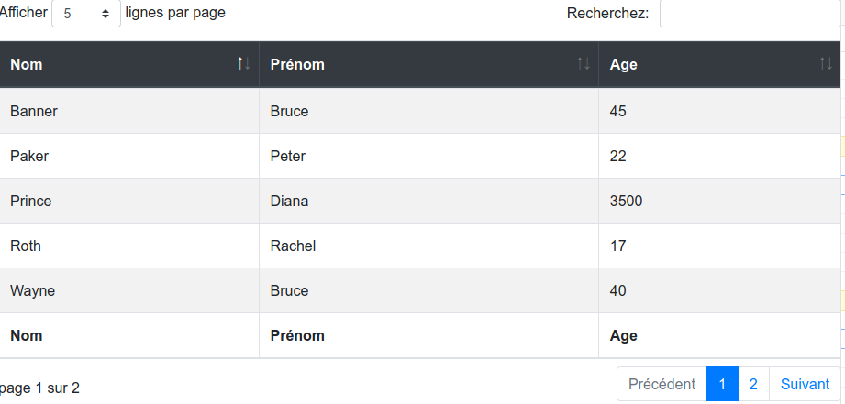
Usage : DOM - Changer de style/boostrap 5
<!DOCTYPE html>
<html>
<head>
<title>TODO supply a title</title>
<meta charset="UTF-8">
<meta name="viewport" content="width=device-width, initial-scale=1.0">
<script src="https://code.jquery.com/jquery-3.5.1.js"></script>
<script src="https://cdn.datatables.net/1.10.24/js/jquery.dataTables.min.js"></script>
<script src="https://cdn.datatables.net/1.13.4/js/dataTables.bootstrap5.min.js"></script>
<script src="table.js" type="text/javascript"></script>
<!--<link href="https://cdn.datatables.net/1.10.24/css/jquery.dataTables.min.css" rel="stylesheet" type="text/css"/>-->
<link href="https://cdnjs.cloudflare.com/ajax/libs/twitter-bootstrap/5.2.0/css/bootstrap.min.css" rel="stylesheet" type="text/css"/>
<link href="https://cdn.datatables.net/1.13.4/css/dataTables.bootstrap5.min.css" rel="stylesheet" type="text/css"/>
</head>
<body>
<table id="example" class="table table-striped table-bordered table-hover" style="width:100%">
<thead class="table-dark">
<tr>
https://datatables.net/extensions/buttons/examples/styling/bootstrap5.html

Slide 10
Usage : Tableau JSON
<!DOCTYPE html>
<html>
<head>
<title>Example DataTable</title>
<meta charset="UTF-8">
<meta name="viewport" content="width=device-width, initial-scale=1.0">
<script src="https://code.jquery.com/jquery-3.5.1.js"></script>
<script src="https://cdn.datatables.net/1.10.24/js/jquery.dataTables.min.js"></script>
<script src="https://cdn.datatables.net/1.13.4/js/dataTables.bootstrap5.min.js"></script>
<script src="table.js" type="text/javascript"></script>
<link href="https://cdnjs.cloudflare.com/ajax/libs/twitter-bootstrap/5.2.0/css/bootstrap.min.css" rel="stylesheet" type="text/css"/>
<link href="https://cdn.datatables.net/1.13.4/css/dataTables.bootstrap5.min.css" rel="stylesheet" type="text/css"/>
</head>
<body>
<table id="example" class="table table-striped table-bordered table-hover" style="width:100%">
</table>
</body>
</html>
index.html
https://datatables.net/examples/data_sources/js_array.html

Slide 11
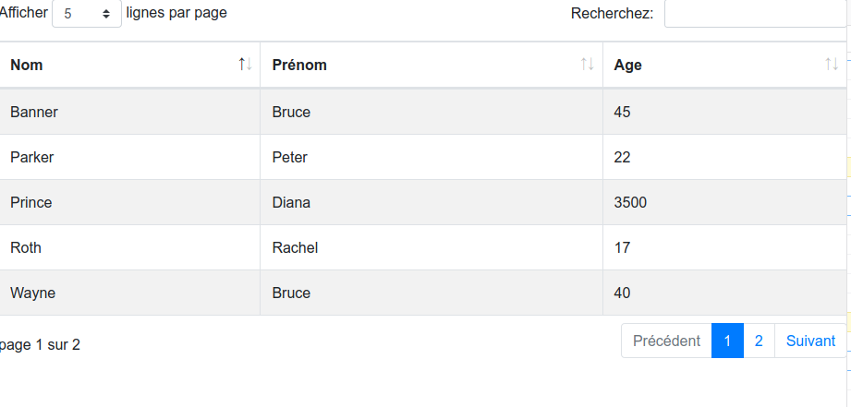
Usage : Tableau JSON
$(document).ready(function () {
var donnees = [
["Wayne", "Bruce", "40"],
["Banner", "Bruce", "45"],
["Parker", "Peter", "22"],
["Prince", "Diana", "3500"],
["Zatara", "Zatanna", "31"],
["Roth", "Rachel", "17"],
];
$('#example').DataTable(
{
"data": donnees,
"columns": [
{title: "Nom"},
{title: "Prénom"},
{title: "Age"},
],
"lengthMenu": [[5, 10, 15, 25, 50, 100, -1], [5, 10, 15, 25, 50, 100, "Tous"]],
"pageLength": 5,
"language": {
"lengthMenu": "Afficher _MENU_ lignes par page",
"info": "page _PAGE_ sur _PAGES_",
"infoEmpty": "pas de résultat",
"search": "Recherchez: ",
"paginate": {
"first": "Premier",
"last": "Dernier",
"next": "Suivant",
"previous": "Précédent"
},
}
}
);
});
table.js

Slide 12
Usage : Ajax
$(document).ready(function () {
$('#example').DataTable(
{
"ajax": "http://monsite.fr/annuaire.json",
"columns": [
{title: "Nom"},
{title: "Prénom"},
{title: "Age"},
],
"lengthMenu": [[5, 10, 15, 25, 50, 100, -1], [5, 10, 15, 25, 50, 100, "Tous"]],
"pageLength": 5,
"language": {
"lengthMenu": "Afficher _MENU_ lignes par page",
"info": "page _PAGE_ sur _PAGES_",
"infoEmpty": "pas de résultat",
"search": "Recherchez: ",
"paginate": {
"first": "Premier",
"last": "Dernier",
"next": "Suivant",
"previous": "Précédent"
},
}
}
);
});
{
"data" : [
["Wayne", "Bruce", "40"],
["Banner", "Bruce", "45"],
["Parker", "Peter", "22"],
["Prince", "Diana", "3500"],
["Zatara", "Zatanna", "31"],
["Roth", "Rachel", "17"],
]
}
annuaire.json
table.js
https://datatables.net/examples/ajax/

Slide 13
Usage : Variante avec Ajax/PHP/PDO
<!DOCTYPE html>
<html>
<head>
<title>Example DataTable</title>
<meta charset="UTF-8">
<meta name="viewport" content="width=device-width, initial-scale=1.0">
<script src="https://code.jquery.com/jquery-3.5.1.js"></script>
<script src="https://cdn.datatables.net/1.10.24/js/jquery.dataTables.min.js"></script>
<script src="https://cdn.datatables.net/1.13.4/js/dataTables.bootstrap5.min.js"></script>
<script src="table.js" type="text/javascript"></script>
<link href="https://cdnjs.cloudflare.com/ajax/libs/twitter-bootstrap/5.2.0/css/bootstrap.min.css" rel="stylesheet" type="text/css"/>
<link href="https://cdn.datatables.net/1.13.4/css/dataTables.bootstrap5.min.css" rel="stylesheet" type="text/css"/>
</head>
<body>
<table id="example" class="table table-striped table-bordered table-hover" style="width:100%">
</table>
</body>
</html>
index.html

Slide 14
Usage : Variante avec
Ajax/PHP/PDO
function remplirTable()
{
$.getJSON('php/controleur.php', {action: 'getAnnuaire'})
.done(function (donnees, stat, xhr) {
$('#example').DataTable(
{
"data": donnees,
"columns": [
{title: "Nom"},
{title: "Prénom"},
{title: "Age"},
],
"lengthMenu": [[5, 10, 15, 25, 50, 100, -1], [5, 10, 15, 25, 50, 100, "Tous"]],
"pageLength": 5,
"language": {
"lengthMenu": "Afficher _MENU_ lignes par page",
"info": "page _PAGE_ sur _PAGES_",
"infoEmpty": "pas de résultat",
"search": "Recherchez: ",
"paginate": {
"first": "Premier",
"last": "Dernier",
"next": "Suivant",
"previous": "Précédent"
},
}
}
);
})
.fail(function (xhr, text, error) {
console.log("param : " + JSON.stringify(xhr));
console.log("status : " + text);
console.log("error : " + error);
})
}
$(document).ready(function () {
remplirTable();
});
table.js

Slide 15
Usage : Variante avec
Ajax/PHP/PDO
<?php
require_once __DIR__.'/fonctions_annuaire.inc.php';
if (filter_input(INPUT_SERVER, 'REQUEST_METHOD') == 'GET') {
$action = filter_input(INPUT_GET, "action");
switch ($action) {
case 'getAnnuaire':
$tabInfosAnnuaire = getInfosAnnuaire();
//envoyer les données au format json
header('Content-Type: application/json; charset=utf-8');
echo json_encode($tabInfosAnnuaire, JSON_NUMERIC_CHECK);
break;
}
}
controleur.php

Slide 16
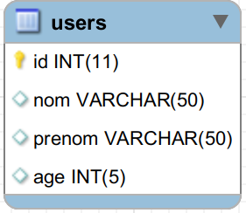
Usage : Variante avec
Ajax/PHP/PDO
fonctions_annuaire.inc.php
function getInfosAnnuaire() {
try {
// connexion à la base de données
$bdd = connexionBdd();
$requete = $bdd->query("SELECT nom, prenom, age from users; ");
$tabInfosAnnuaire = array();
// execution de la requete
while ($ligne = $requete->fetch()) {
array_push($tabInfosAnnuaire, array(
$ligne['nom'],
$ligne['prenom'],
$ligne['age']
));
}
// libération de la ressource
$requete->closeCursor();
return $tabInfosAnnuaire;
} catch (PDOException $e) {
print "Erreur !: " . $e->getMessage() . "<br/>";
die();
}
}

Slide 17
Conclusion
Moyen "simple" de rendre un tableau HTML dynamique.
De très nombreuses possibilités.
documentation : https://datatables.net/manual/

