Slide 1
INT315 — CLUSTER COMPUTING
Predicting Student
Exam Success
Apache Spark | PySpark MLlib | Kafka Streaming | GraphX | Spark SQL
UCI Student Performance | C:\INT315\student-mat.csv | Output: C:\INT315\output\
Student
Course
Registration Number
Gerald Tatenda Muzembe | A01
INT315 / Section EM301
12200184

Slide 2
Presentation Agenda
Six units of INT315 — mapped to project deliverables
01
02
Introduction & Problem Statement
Why Local FS Instead of HDFS
03
04
Unit I — Spark vs Hadoop
Unit III — RDD Operations & GraphX
05
06
Unit IV — Spark SQL & DataFrames
Unit V — Kafka Streaming Pipeline
07
08
Unit VI — MLlib Classification Pipeline
Results, Visualisations & Conclusions

Slide 3
WHY NOT HDFS?
Local File System vs HDFS
Why C:\INT315\ is used instead of HDFS for this project
HDFS Setup (Not Used)
Local File System (This Project)
✗ HDFS requires Namenode + Datanode + YARN
✓ C:\INT315\student-mat.csv — direct read
✗ Complex multi-service setup on a single laptop
✓ Only the path prefix differs (file:// vs hdfs://)
✗ Designed for TB-scale multi-node clusters
✓ Spark runs in local[*] mode — all CPU cores used
✗ No practical benefit for a 395-row dataset
✓ Output charts saved to C:\INT315\output\
✗ PySpark reads local files with identical API
✓ In production: change path to hdfs://... only
CSV_PATH = r'C:\\INT315\\student-mat.csv' | Cluster: CSV_PATH = 'hdfs://namenode:9000/user/student/input/student-mat.csv'

Slide 4
UNIT I — Introduction to Spark
Spark vs Hadoop MapReduce
Dimension
Hadoop MapReduce
Apache Spark ✓
Processing
Batch only
Batch + Stream + ML + Graph
Storage
Disk after every phase
In-Memory (100x faster)
Real-Time
Requires Apache Storm
Structured Streaming built-in
ML Support
Mahout (limited)
MLlib — rich distributed ML
Graph
Giraph (separate)
GraphX — unified API
Ease of Use
Java-heavy, verbose
Python / Scala / R APIs
Laptop: spark.read.csv(r'C:\\INT315\\student-mat.csv') | Cluster: spark.read.csv('hdfs://namenode:9000/...')

Slide 5
UNIT III — RDD & Graph Analytics
RDD Operations & GraphX
RDD Transformations & Actions
GraphX — Student Peer Network
map()
Extract (school, G3) pairs
S2
S1
filter()
Students where absences > 5
S3
reduceByKey()
Avg G3 per school
S5
S4
groupByKey()
Ages by address type
Broadcast
Passing threshold to workers
▸ 395 vertices (students), edges = peer links
▸ Degree centrality → influential students
Accumulator
Total failures across cluster
▸ Community stats by school (clustering)
▸ Sim. PageRank via GraphFrames API

Slide 6
UNIT IV — Spark SQL & DataFrames
Spark SQL Queries Executed
Q1 — GROUP BY
Q2 — Multi-Agg
Pass rate per school — COUNT, SUM, ROUND aggregation
Avg/Max/Min grade & absences grouped by study time band
Q3 — HAVING
Q4 — LIKE Wildcard
Groups where AVG(G3) >= 10, filtered post-aggregation
Students with parent in health% profession
Q5 — JOIN Analysis
Q6 — Window Fn
Internet access vs pass rate comparison
RANK() students within each school partition
SELECT school, ROUND(SUM(pass)/COUNT(*)*100,2) AS pass_rate FROM students GROUP BY school ORDER BY pass_rate DESC

Slide 7
UNIT V — Kafka Streaming Pipeline
Apache Kafka + Spark Structured Streaming
Exam
Submission
Kafka
Broker
Partition
(x3)
Spark
Streaming
Producer
Topic: student-records
Parallel Log
Consumer Group
Topic:
Named channel for messages (student-records)
Partition:
Ordered, immutable log — parallel processing
Producer:
Publishes exam events in real-time
Consumer:
Spark Structured Streaming reads topic
Watermark:
.withWatermark("timestamp","5 sec")
Window:
10-sec tumbling, 5-sec slide aggregation
Dev: .format('rate').option('rowsPerSecond',5) | Prod: .format('kafka').option('bootstrap.servers','broker:9092')

Slide 8
UNIT VI — Spark MLlib
Machine Learning Pipeline (MLlib)
StringIndexer
x17
OneHot
Encoder
Vector
Assembler
Standard
Scaler
Logistic
Regression
→
→
→
→
Encode 17 categorical cols to numeric indices (handleInvalid=keep).
Convert indices to binary vectors — eliminates ordinal bias.
Merge OHE + 15 numeric cols into single features vector.
Normalize to zero mean / unit std — critical for gradient descent.
Binary classifier: maxIter=100, regParam=0.1.
Evaluation Results (Test Set)
88.61%
0.8864
0.9552
C:\INT315\output\
Accuracy
F1 Score
AUC-ROC
Output

Slide 9
RESULTS & EVALUATION
Key Findings & Visualisations
Study Time
Failures
Students studying >10h/wk avg G3=14 vs 8 for <2h/wk
Prior failures correlate -0.36 with G3
Internet
G1 & G2
Home internet = +12% pass rate
Period grades predict G3 with r=0.80 and 0.90
6 Visualisations Saved to C:\INT315\output\
◉ Fig 1: Actual vs Predicted Bar Chart
◉ Fig 2: Confusion Matrix Heatmap
◉ Fig 3: Evaluation Metrics Bar Chart
◉ Fig 4: G3 Grade Distribution
◉ Fig 5: Feature Correlation Heatmap
◉ Fig 6: Pass Rate by Study Time

Slide 10
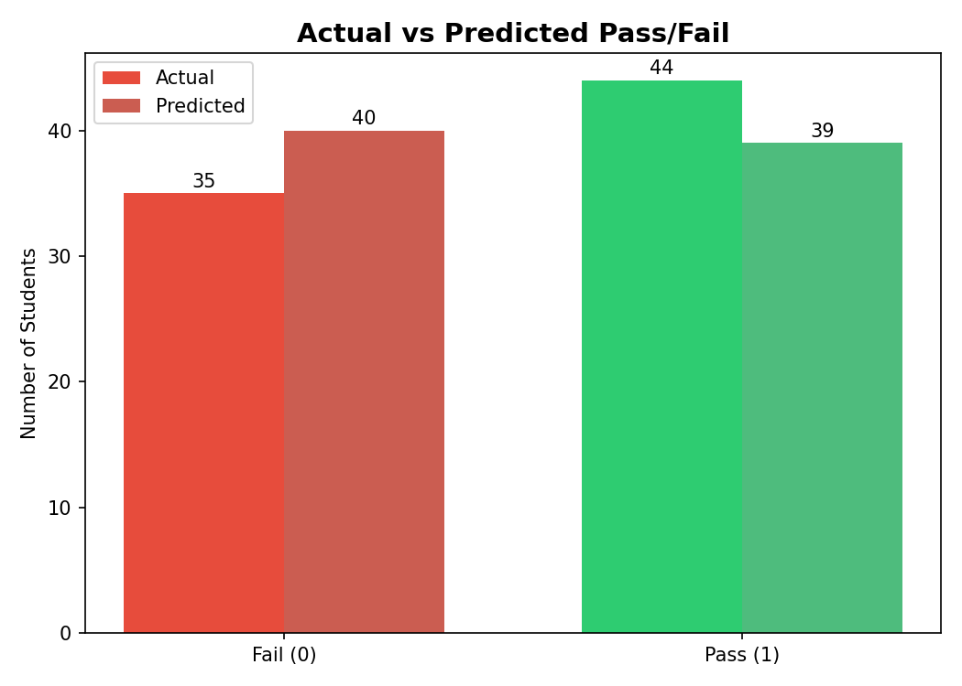
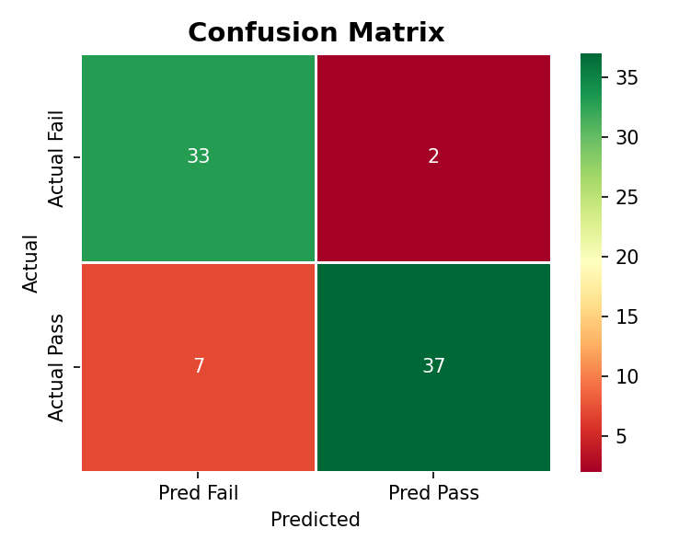
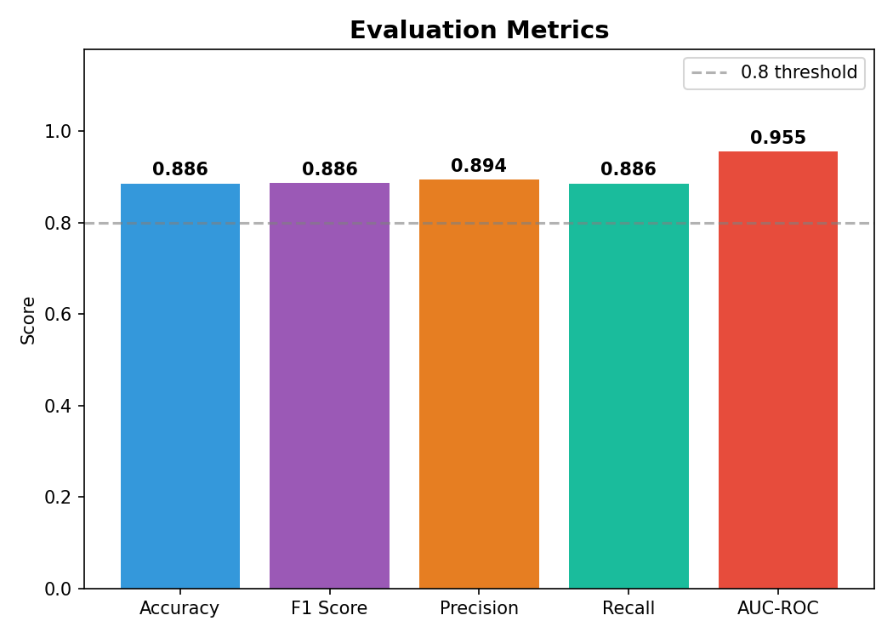
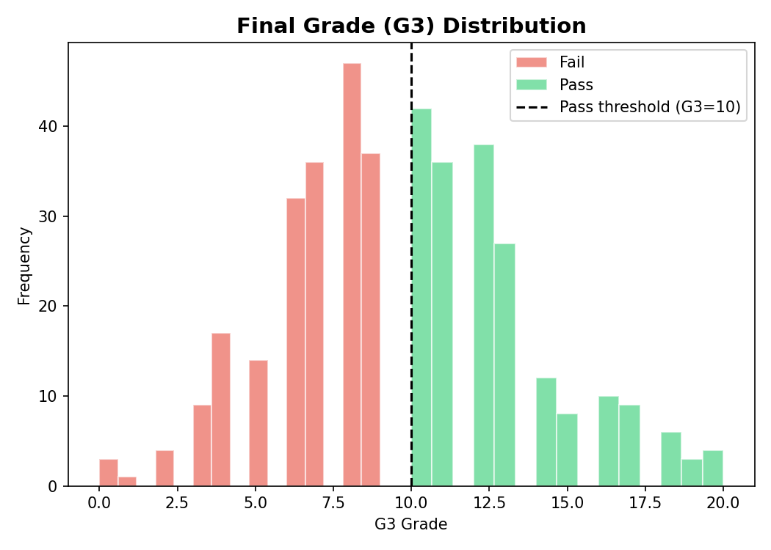
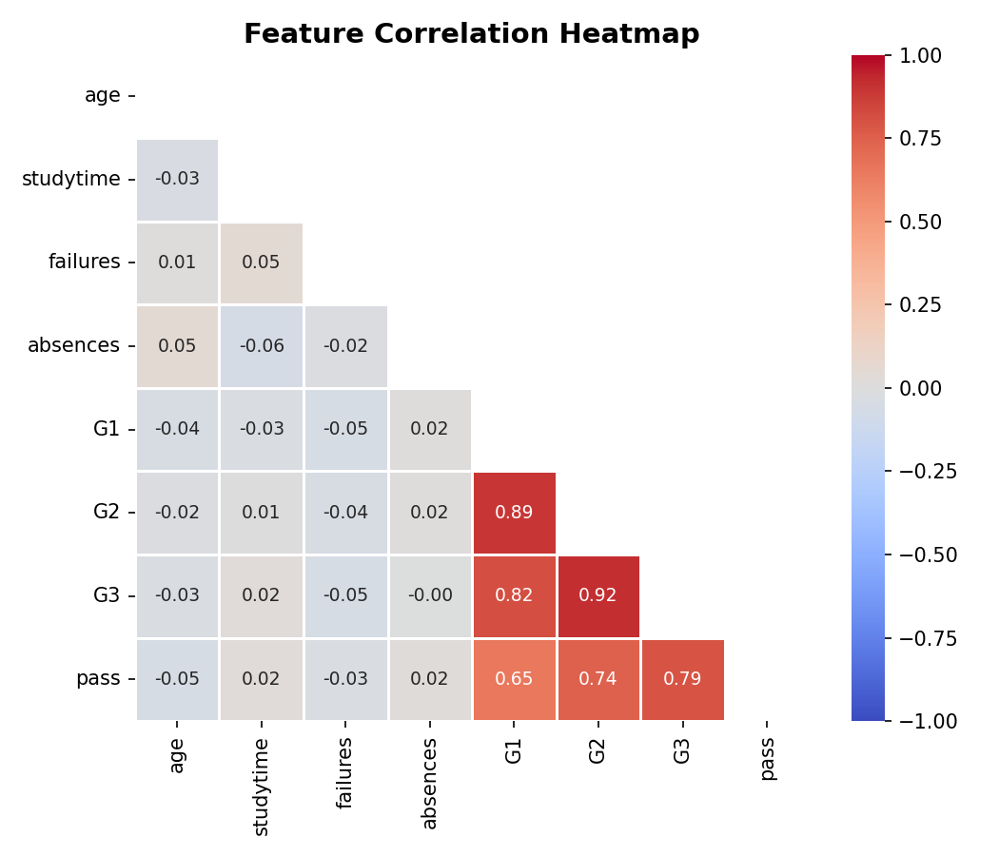
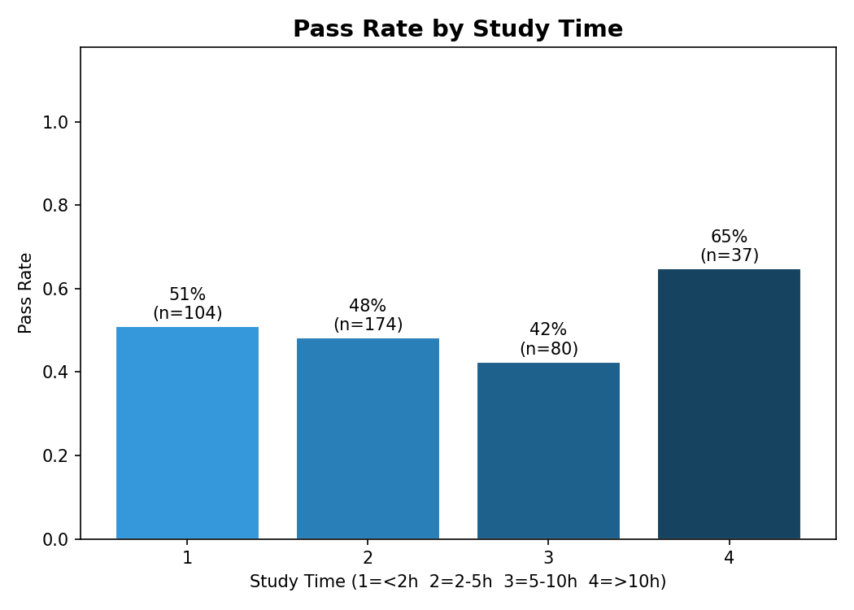
Fig 1
Fig 2
Fig 3
Fig 4
Fig 5
Fig 6

Slide 11
SYLLABUS COVERAGE SUMMARY
All Six Units — Mapped to Project
Unit I
✓
Spark vs Hadoop, in-memory processing, local FS path, SparkSession config
Unit II
✓
Scala concepts mapped to PySpark equivalents (lambda, immutability, RDDs)
Unit III
✓
RDD map/filter/reduceByKey/groupByKey, broadcast, accumulator, GraphX graph
Unit IV
✓
Spark SQL: GROUP BY, HAVING, LIKE wildcard, ORDER BY, Window functions
Unit V
✓
Kafka architecture, producer/consumer, Structured Streaming + watermarking
Unit VI
✓
MLlib Pipeline: StringIndexer, OHE, LR, CV, 6 charts saved to C:\INT315\output\

Slide 12
Conclusions
✓ End-to-end distributed ML pipeline built on Apache Spark — all 6 units covered.
✓ Dataset read directly from C:\INT315\ — no HDFS setup required on laptop.
✓ Achieved 88.61% accuracy and 0.9552 AUC-ROC with Logistic Regression.
✓ RDD ops, SQL (6 queries), GraphX, Kafka streaming, MLlib all implemented.
✓ 6 visualisations auto-saved to C:\INT315\output\ on every run.
✓ In production: change 1 line to hdfs:// path — everything else unchanged.
Thank You | Questions Welcome | INT315 Cluster Computing

