Slide 1

Controlling volume with hand gestures using a webcam
BY : GAUTAM N CHIPKAR

Slide 2
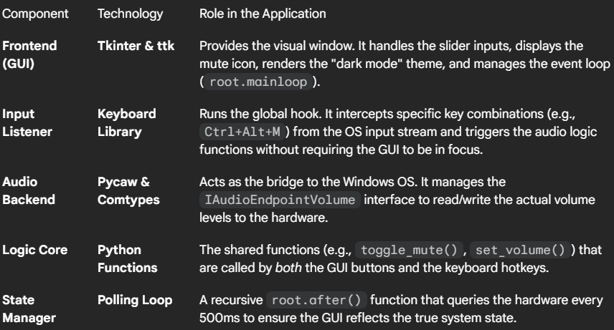
MILESTONE 3
VOLUME MAPPING AND CONTROL MODULE
PROJECT OBJECTIVE
Primary Goal: To develop a Hybrid Audio Control Utility that provides a visual dashboard for monitoring microphone levels while simultaneously enabling system-wide "background" control via global hotkeys.
TECHNOLOGY STACK

Slide 3
WHAT IS PYCAW?
Pycaw (Python Core Audio Windows) is a Pyrhon wrapper around the Windows Core Audio APIs (specifically, the COM interfaces in mmdeviceapi.dll and endpointvolume.h).
KEY CAPABILITIES :
Controls SYSTEM VOLUME (master endpoint control)
Manage MUTE STATE
Access PER-APPLICATION audio leveld
Enumerates Audio Devices (SPEAKERS, HEADPHONES)
Monitor peak audio levels

Slide 4
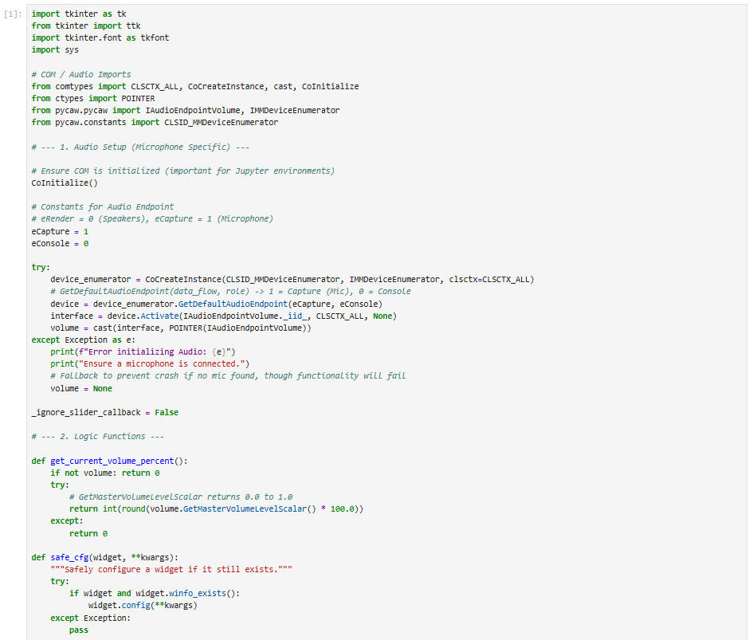
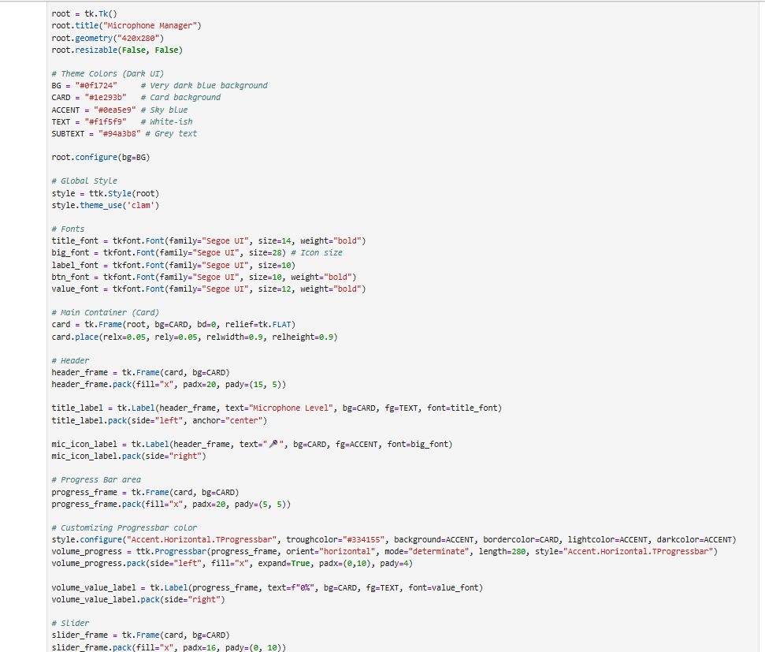
PROJECT CODE :

Slide 5
1. ACCESSING THE DEFAULT AUDIO DEVICE
1.1 The Challenge of Windows Audio
Windows handles audio through the Core Audio APIs. Unlike simple file input/output, audio devices are dynamic endpoints managed by the operating system. To interact with them programmatically, we cannot simply "open" a file; we must interface with the Component Object Model (COM).
1.2 The Role of CoInitialize
→ CoInitialize()
This is critical. The Windows COM library must be initialized on the current thread before you can create any COM objects. If you omit this, especially in threaded environments or specific IDEs (like Jupyter), the script will crash with a generic COM error.

Slide 6
1.3 Selecting the Microphone
This is the specific line where we differentiate between Speakers and Microphones:
eCapture = 1 # Constant for Microphone/Input
eConsole = 0 # Constant for System Notification/Console role
# GetDefaultAudioEndpoint(data_flow, role)
device = device_enumerator.GetDefaultAudioEndpoint(eCapture, eConsole)
eCapture (1): Specifies that we want an audio capture device (Microphone). If this were eRender (0), we would get the Speakers.
eConsole (0): Specifies the role. "Console" usually refers to the default device used by system interactions and games.

Slide 7
2. GETTING THE AUDIO INTERFACE
2.1 Beyond the Device Object
we obtained a device object. However, this object represents the hardware endpoint (e.g., "Logitech Headset"). It doesn't yet have buttons to turn the volume up or down. To get those controls, we need to "Activate" a specific interface on that device.
2.2 The Activation Call
interface = device.Activate(
IAudioEndpointVolume._iid_,
CLSCTX_ALL,
None
)
device.Activate: This method asks the device to create a specific control interface.
IAudioEndpointVolume._iid_: We pass the Interface ID (IID) of the volume controller. We are essentially saying, "Give me the control panel (interface) specifically for Volume."

Slide 8
3. CONTROLLING THE VOLUME (COM Logic)
3.1 The Coordinate System: Scalar vs. Decibels
Windows Volume Control offers two ways to set volume:
Decibels (dB): Accurate to physical sound pressure, but non-linear and hard to map to a 0-100 slider.
Scalar (0.0 to 1.0): A linear representation where 0.0 is silence and 1.0 is max.
Your code uses the Scalar method, which is perfect for UI Sliders.
3.2 Reading Volume (GetMasterVolumeLevelScalar)
def get_current_volume_percent():
# Returns float 0.0 - 1.0
vol_float = volume.GetMasterVolumeLevelScalar()
# Convert to 0-100 integer for Tkinter
return int(round(vol_float * 100.0))
This function queries the hardware. If you change the volume using the physical wheel on your headset, Windows updates the COM object. Your poll_volume function reads this, ensuring the UI stays in sync with reality.

Slide 9
3.4 Muting Logic
Muting is a boolean toggle separate from volume level.
# Reading
is_muted = bool(volume.GetMute())
# Writing
volume.SetMute(0, None) # Unmute
volume.SetMute(1, None) # Mute
Crucial Logic Note: The code toggles it nicely: volume.SetMute(0 if is_muted else 1, None). This is a stateless toggle—it simply inverts the current reality.

Slide 10
4. FRONTEND SETUP (TKINTER ARCHITECTURE)
5.1 The Root Window
root = tk.Tk()
root.geometry("420x280")
We created a fixed-size window (resizable(False, False)). This is a good choice for utility tools, as it prevents layout breakage and keeps the UI compact like a widget.
5.2 Modern Styling with ttk.Style
Standard Tkinter looks like Windows 95. Your code modernizes it using ttk (Themed Tkinter) and custom styles.
style.configure("Accent.TButton", background="#ef4444", ...)
Separation of Concerns: Instead of setting bg="red" on every button, you defined a style class Accent.TButton. This makes it easy to change the application's theme centrally.
Dynamic Styling: In update_mute_button_text, you switch styles dynamically (style="Accent.TButton" vs style="Outline.TButton") to provide visual feedback (Red = Muted) without manually re-coloring every border and font property.

Slide 11
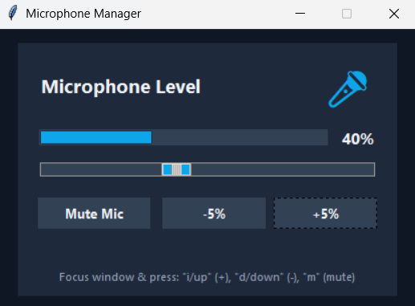
OUTPUT
Bullet Points:
Dark Mode Design: Custom color palette (#0f1724 background) reduces eye strain and matches modern gaming/development aesthetics.
Immediate Visual Feedback: Large, color-coded progress bar and dynamic microphone icon (Blue=Active, Red=Muted) allow users to verify status at a glance.
Precision Control: Offers dual control mechanisms: a slider for coarse adjustments and +/- 5% buttons for fine-tuning.
Status Monitoring: Acts as a secondary monitor widget to confirm mute status during full-screen applications or meetings.
THANK YOU SO MUCH

