Slide 1

Controlling volume with hand gestures using a webcam
BY : GAUTAM N CHIPKAR

Slide 2
MILESTONE 2
GESTURE RECOGNITION AND DISTANCE MEASUREMENT
Core code snippets used for HAND LAND MARK DETECTION
IMPORTING LIBRARIES :
→import cv2, mediapipe as mp, numpy as np
Pandas as pd, matplotlib as plt
Loads all essential libraries for video capture , landmark detection , data handling and visualization
2. INITILAZING MEDIAPIPE HANDS :
mp_hands = mp.solutions.hands
mp_drawing = mp.solutions.drawing_utils
hands = mp_hands.HANDS(
static_image_mode=False,
model_complexity=1,
min_detection_confidence=0.75,
min_tracking_confidence=0.75 )
→Sets up the hand detection model with confidence thresholds and tracking enabled
→ Detects up to 2 hands and tracks 21 key landmarks per hand

Slide 3
3. CAPTURING FRAME FROM WEBCAM:
→cap = cv2.VideoCapture(0,cv2.CAP_DSHOW) ret,
frame = cap.read(); cap.release();
frame = cv2.flip(frame, 1)
frame_rgb = cv2.cvtColor(frame,cv2.Color(frame,cv2.COLOR_BGR2RGB)
Captures a live webcam frame, flips it for a mirror view, and converts it to RGB (required by MEDIAPIPE)
4. PROCESSING THE FRAME:
Results = hands.process(frames_rgb)
if results.multi_hand_landmarks:
Hand_lamdmarks=results.multi_hand_landmarks[0]
→Sends the captured frame to the Mediapie model to detect and extract landmarks

Slide 4
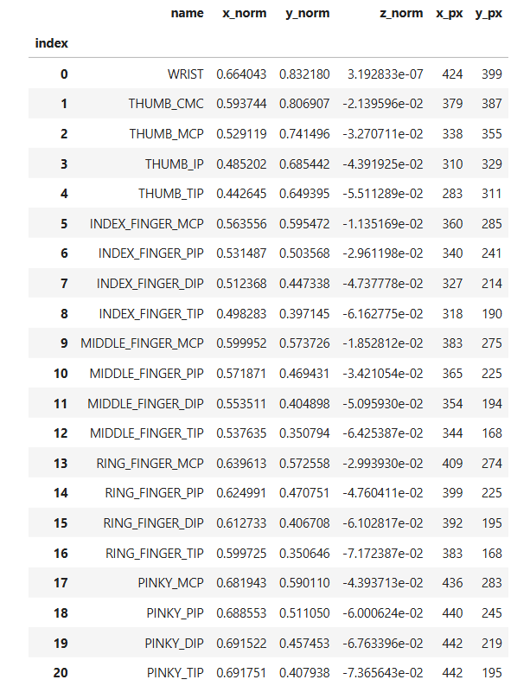
Creating a LANDMARK TABLE:
cap = cv2.VideoCapture(0) # Use 0 for the default webcam
if not cap.isOpened():
print("Error: Cannot open webcam.")
else:
print("Webcam opened. Starting feed...")
print("--- INTERRUPT KERNEL TO STOP ---")
try:
while cap.isOpened():
success, frame = cap.read()
if not success:
print("Ignoring empty camera frame.")
continue
# Flip the image horizontally for a later selfie-view display
frame = cv2.flip(frame, 1)
→ The use case of this code is to process the detected hand landmarks from a single video frame, extract the specific coordinates for each of the 21 points, and organize that data into a structured list. This list is then used to create the pandas DataFrame (the table).

Slide 5
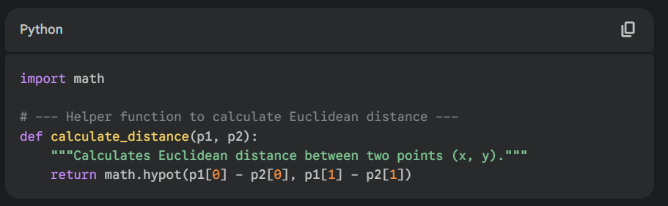
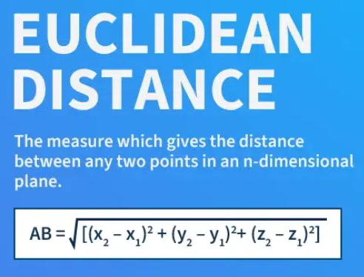
DISTANCE CALCULATION :
Use Case: This function is a general-purpose mathematical tool. Its use case is to calculate the 2D Euclidean (straight-line) distance between any two points (p1, p2) on the screen. It takes two (x, y) coordinate tuples and returns a single distance value in pixels.

Slide 6
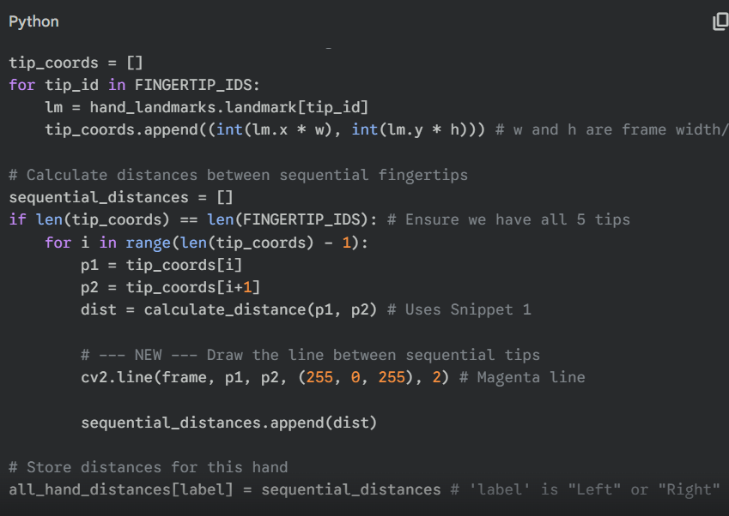
2. SEQUENTIAL DISTANCE CALCULATION & VISUALIZATION
Use Case: This snippet's use case is to process the detected landmarks for a single hand. It gets the pixel coordinates of all 5 fingertips, then calculates the distance between sequential tips (Thumb-to-Index, Index-to-Middle, etc.). It also visualizes these specific distances by drawing a magenta line between the corresponding fingertips.

Slide 7
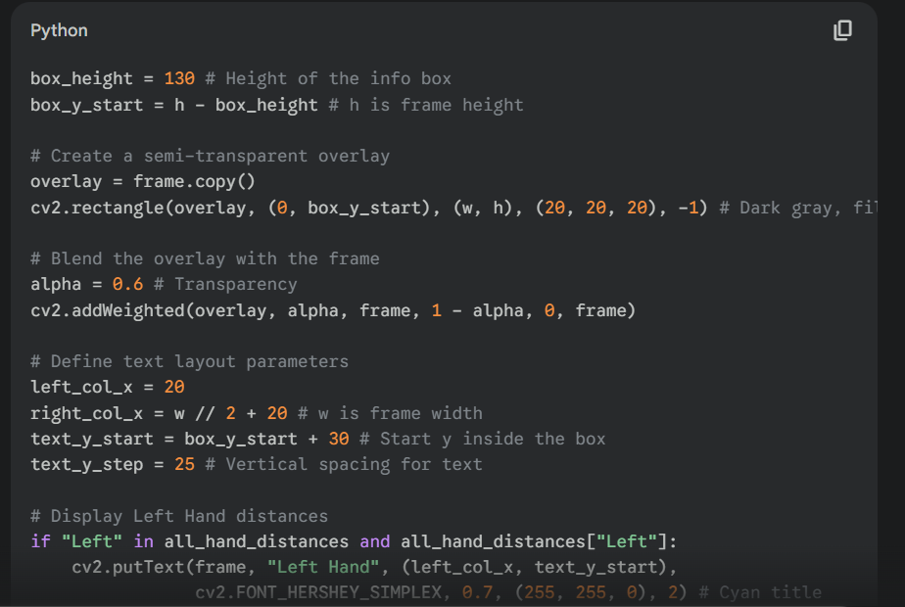
3. LIVE DATA DISPLAY (On-Screen Logging)

Slide 8
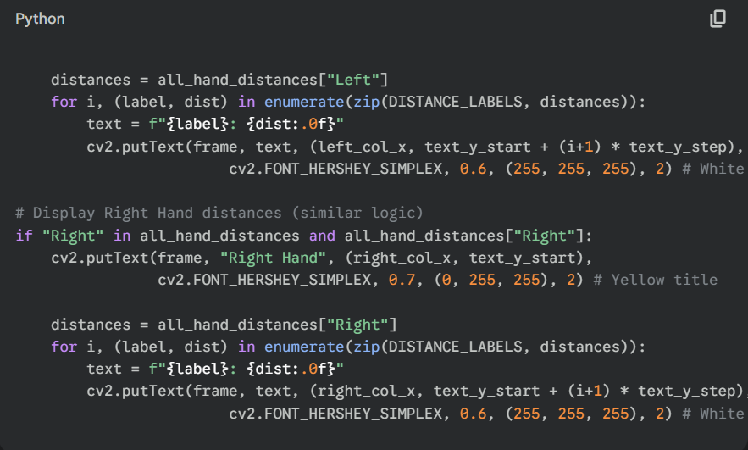
Use Case : This snippet's use case is to create a "dashboard" or "Heads-Up Display (HUD)" on the video feed. It first draws a dark, semi-transparent box at the bottom of the screen to make text readable. Then, it takes the all_hand_distances dictionary (populated by Snippet 2) and uses cv2.putText to "log" the current, real-time distance values for both the left and right hands, neatly organized in columns.

Slide 9
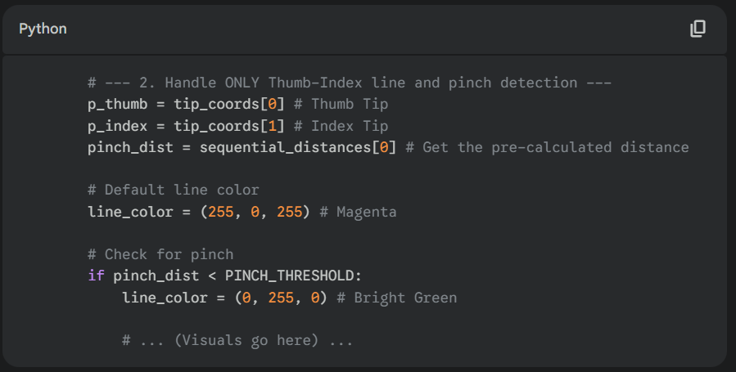
4. PINCH DETECTION LOGIC :
This snippet is where the program calculates the distance and decides if a pinch is happening. It gets the coordinates for the thumb and index tips, retrieves the distance we calculated, and compares it to the PINCH_THRESHOLD.

Slide 10
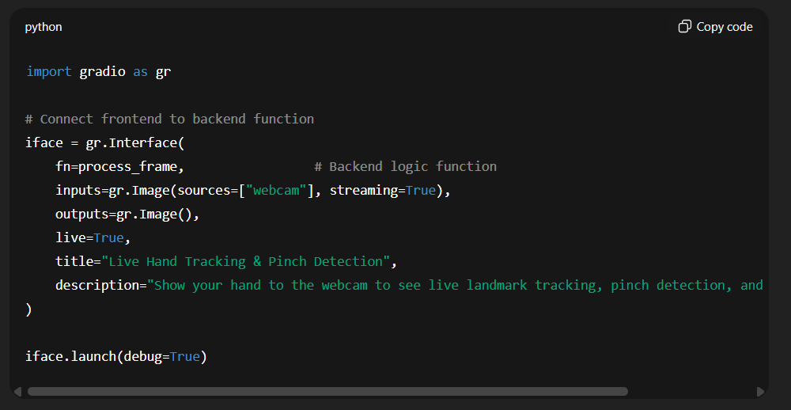
1. Frontend for HAND GESTURE & PINCH DETECTION :
Use case (Gradio): very quick prototyping, local demos, shareable links; no frontend HTML/CSS work required. Best when you control the Python runtime and want a single-file app.

Slide 11
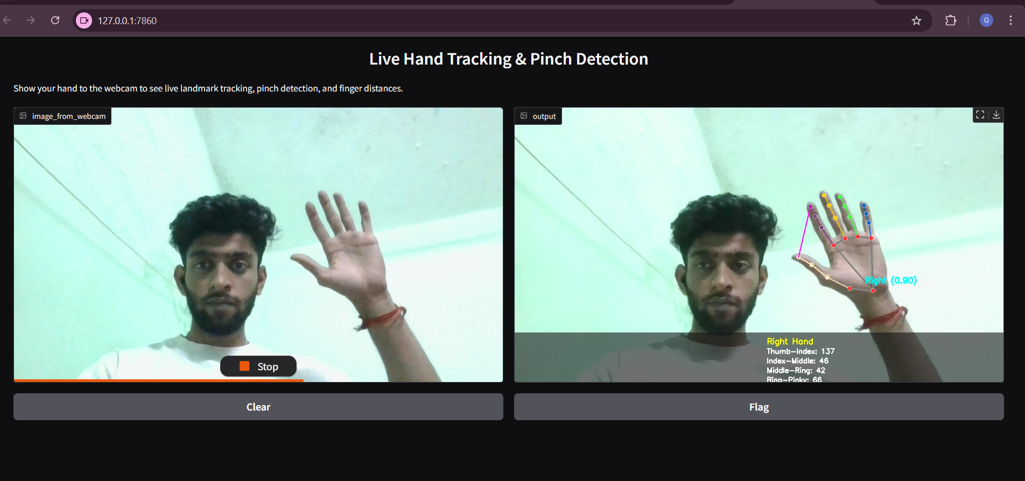
FINAL OUTPUT
THANK YOU

