Slide 1

BACHELOR OF TECHNOLOGY
IN
Artificial Intelligence and Machine Learning
Optimizing Steering Angles and Speed of Autonomous Vehicles Using
Deep Reinforcement Learning and Behavioral Cloning
Batch Number: ZT-18
Project Guide: Prof Sabyasachi Chakraborty Batch Names &Roll Numbers:
Department of AIML, School of Engineering
Malla Reddy University
B. Sreeja - 2111CS020543
V. Sudhiksha - 2111CS020572
R. Swathi - 2111CS020581
G. Swetha - 2111CS020584
G. Thejashwini - 2111CS020589

Slide 2
Objective Of Project
Autonomous vehicles (AVs) have witnessed significant advancements in recent years, driven by the integration of deep reinforcement learning (DRL) and behavioral cloning (BC). These techniques enhance the autonomy and accuracy of AVs by enabling sophisticated decision-making and learning from human drivers. This paper provides a comprehensive review of recent research on DRL and BC in AVs, highlighting their contributions, challenges, and future directions. The synthesis of these methodologies offers promising prospects for achieving higher levels of autonomy and safety in AVs.
Problem Statement
Optimizing Steering Angles and Speed of Autonomous Vehicles using Deep Reinforcement Learning and Behavioral Cloning

Slide 3
Scope Of The Project
Autonomous vehicles (AVs) are transforming transportation by reducing human error, enhancing safety, and improving traffic efficiency. Central to this transformation are advancements in artificial intelligence (AI), particularly deep reinforcement learning (DRL) and behavioral cloning (BC). DRL enables autonomous vehicles to learn optimal driving strategies through interaction with the environment, while behavioral cloning leverages human driving data to replicate expert behaviors. When combined, these methods can significantly enhance the decision-making process, enabling the vehicle to achieve a balanced control of both steering and speed. This paper explores the integration of DRL and BC techniques to optimize the steering angles and speed control of autonomous vehicles, aiming to improve their adaptability in real-world driving conditions.

Slide 4
Analysis Project Planning and Research
Integration of DRL and BC in AVs
Recent research has explored the synergistic use of DRL and BC to enhance AV performance. The combination leverages the strengths of both approaches: DRL's ability to learn from exploration and BC's capability to imitate expert behavior.
DRL for Autonomous Navigation
Wang et al. (2022) developed a DRL-based framework for AVs that optimizes navigation policies in dynamic traffic environments. Their approach demonstrates improved decision-making capabilities and adaptability to unforeseen scenarios.
BC for Imitation Learning
Zhang et al. (2023) proposed a BC model that trains AVs on large-scale driving datasets. Their results indicate that BC can significantly reduce training time and improve the initial performance of AVs by leveraging pre-learned human driving knowledge.

Slide 5
Software Requirement Specification
Software Requirement:
Deep Learning Libraries: TensorFlow or PyTorch for model building and training.
RL Libraries: OpenAI Gym or Stable-Baselines3 for reinforcement learning.
Simulation Environment: Carla or AirSim for simulating autonomous driving scenarios.
Data Processing Libraries: NumPy, Pandas, and OpenCV for handling and preprocessing datasets.
Hardware Requirements:
GPU: NVIDIA RTX 3090, A100, or similar for fast deep learning computations.
CPU: Intel i9 or AMD Ryzen Threadripper for handling complex calculations.
Memory (RAM): 32GB or more for efficient data processing and model training.
Edge Computing Device: NVIDIA Jetson AGX Xavier or Orin for deploying models on real vehicles.
Sensors: LiDAR, cameras, and GPS for environmental data acquisition and vehicle localization.

Slide 6
Model Selection And Architecture
1. Evaluate models on simulation environments (e.g., Carla) to gauge driving performance and adaptability.
2. Prioritize models with good generalization to handle diverse road and weather conditions.
3. Consider models with fine-tuning capabilities, allowing easy adaptation to new environments or vehicle dynamics.
4. Use ensemble approaches if combining multiple behaviors or actions improves accuracy.
5. Test models for robustness in edge cases like sharp turns or obstacle detection to enhance safety and reliability.

Slide 7
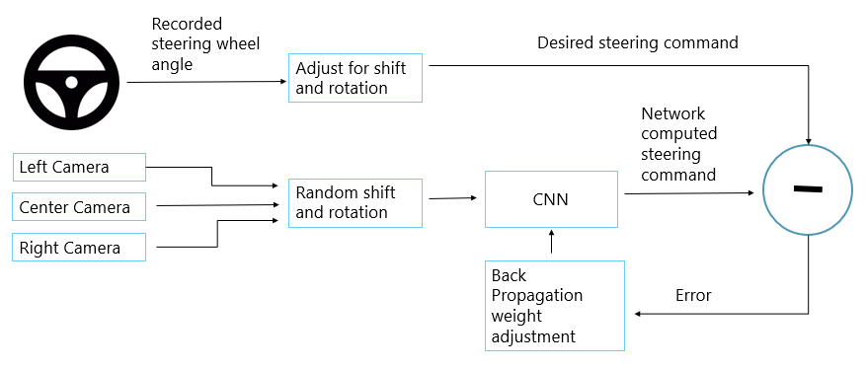

Slide 8
Design
Introduction
The design of an autonomous vehicle control system involves creating a robust architecture that accurately optimizes steering angles and speed based on real-time data inputs.
This system integrates machine learning models, sensor data, and control algorithms to interpret the environment, make decisions, and take actions effectively.
Through behavior cloning and reinforcement learning (RL), the system learns both from human driving behavior and through autonomous trial-and-error in simulated environments.
The design process focuses on achieving real-time processing capabilities, ensuring safety in complex scenarios, and enabling adaptability across varying driving conditions.

Slide 9
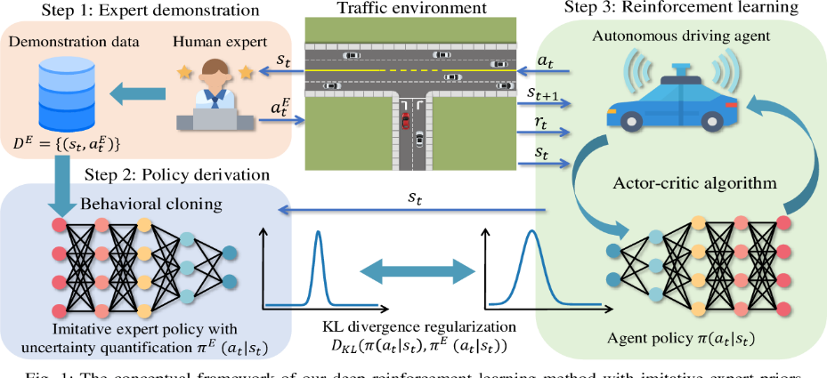
Data Flow Diagram

Slide 10
DataSet Description
The behavioral cloning component utilizes a dataset of over 100,000 samples of human driving behavior collected from the CARLA simulator, which offers a realistic environment for autonomous vehicle research.
Each sample consists of state-action pairs, where states include high-resolution road images, vehicle speed, and distance to lane markings.
These inputs help the model understand the driving context and lane-keeping behavior. Actions correspond to the steering angles applied by human drivers, which the model learns to predict using supervised learning techniques.
The training process minimizes the Mean Squared Error (MSE) between predicted and actual steering angles, allowing the model to generalize effectively across various driving conditions and traffic scenarios, ultimately enhancing its robustness for real-world applications.

Slide 11
Data Preprocessing Techniques
Data preprocessing is essential for preparing autonomous vehicle data for model training. Key techniques include:
Data Cleaning: Remove noise, outliers, or corrupted frames from sensors and images to ensure data quality.
Normalization/Standardization: Scale telemetry data (speed, steering angle) and normalize pixel values in images to improve model performance and convergence.
Data Augmentation: Apply transformations to camera images (e.g., rotation, brightness adjustment, flipping) to simulate varied driving conditions and enhance model generalization.
Sensor Fusion: Combine data from multiple sensors (LiDAR, radar, camera) into a unified representation to provide richer context for the model.
Temporal Smoothing: Apply filters (e.g., Kalman or moving average) to smooth telemetry data, reducing abrupt changes and improving stability in model predictions.

Slide 12
Methods And Algorithms
Behavioral Cloning (BC) and Deep Reinforcement Learning (DRL) are combined to optimize autonomous vehicle control.
BC: supervised learning trains a Convolutional Neural Network (CNN) on human driving data, where sensory inputs (from cameras, lidar) are paired with commands (steering, throttle). The model uses Mean Squared Error (MSE) to minimize differences between predicted and actual steering angles.
DRL:then refines the model in a simulated environment using a Deep Q-Network (DQN) to enable exploration. The state includes processed sensor data, actions involve steering, throttle, and braking, and rewards focus on lane-keeping and collision avoidance. A Q-learning approach updates expected rewards, and an experience replay buffer stabilizes training by sampling past experiences for the Q-network.

Slide 13
Deployments And Results
Introduction
The deployment of our autonomous vehicle control system represents a pivotal transition from theoretical modeling to real-world application, following rigorous training through Behavioral Cloning (BC) and refinement using Deep Reinforcement Learning (DRL). This phase aims to evaluate the model's effectiveness in making real-time decisions based on dynamic sensory inputs while adapting to various driving conditions and maintaining safety standards. By testing the vehicle in controlled environments and on actual roadways, we seek to assess the accuracy of steering and speed control, its ability to navigate complex scenarios, and overall driving behavior compared to human drivers. The results will validate the model’s learning capabilities and provide insights for further enhancements and optimizations in future iterations.

Slide 14
Model Implementation and Training
1. Dataset Collection: Compile sensory data (camera images) and corresponding human driving commands (steering, throttle, braking) for training.
2. CNN Training: Develop and train a Convolutional Neural Network (CNN) using supervised learning to minimize the Mean Squared Error (MSE) between predicted and actual steering angles.
3. Transition to DRL: Refine the model using a Deep Q-Network (DQN) in a simulated environment to learn optimal driving strategies through exploration and exploitation.
4. Define State, Action, and Reward:Establish the state space (sensor inputs), action space (steering and throttle commands), and reward structure (based on performance metrics like lane-keeping).
5. Validation and Testing: Evaluate the trained model's performance in controlled scenarios and prepare for real-world deployment, ensuring it meets safety and performance standards.

Slide 15
Model Evaluation Metrics
The system is evaluated using the following metrics:
Steering Angle Error: The deviation between the desired and actual steering angles.
Lane Deviation: The lateral deviation of the vehicle from the center of the lane.
Smoothness: The smoothness of the steering trajectory, measured by the magnitude of steering angle changes.
Collision Rate: The number of collisions per episode.

Slide 16
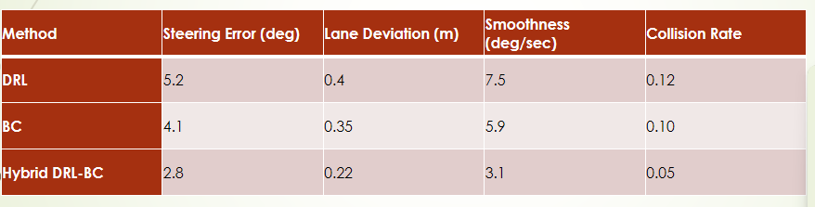
Final Results
The hybrid DRL-BC approach significantly outperforms both standalone DRL and BC methods in terms of steering accuracy and overall driving performance.
Performance Comparison (Hybrid DRL-BC vs DRL vs BC)

Slide 17
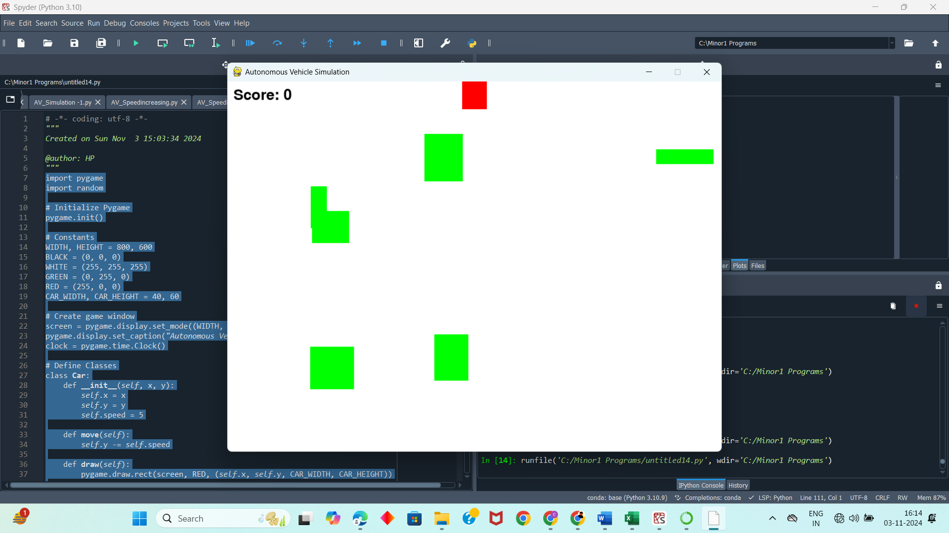
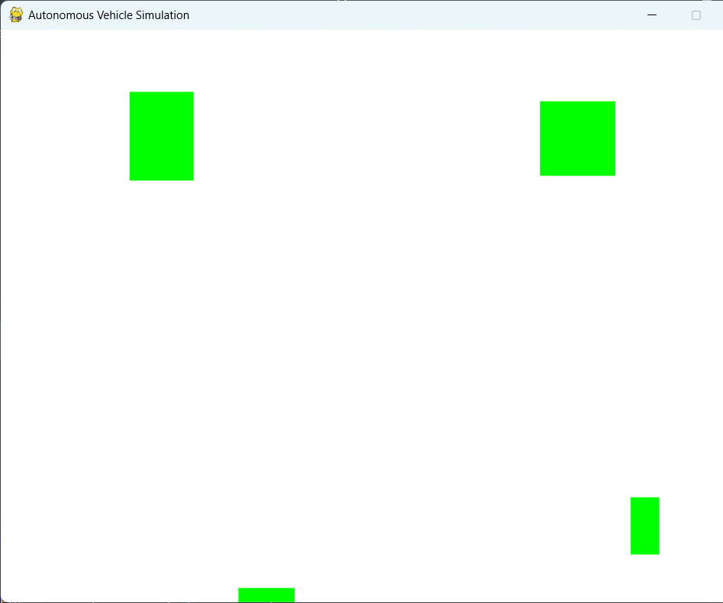

Slide 18
CONCLUSION
PROJECT CONCLUSION:
This paper presents a novel hybrid approach that combines deep reinforcement learning and behavioral cloning to optimize the autonomy of steering angle control in autonomous vehicles.
The proposed method leverages the strengths of both techniques, enabling the system to begin with a strong, human-like steering policy and refine it through learning from interaction with the environment.
Experimental results show that the hybrid approach achieves significant improvements in steering accuracy, lane tracking, and safety over traditional methods. Future work will focus on extending the method to real-world driving data and further enhancing the robustness of the steering control in diverse driving conditions.

Slide 19
References
Wang, Y., Li, Z., & Zhao, X. (2022). Deep Reinforcement Learning for Autonomous Vehicle Navigation in Dynamic Traffic Environments. IEEE Transactions on Intelligent Transportation Systems, 23(4), 1856-1867.
Zhang, H., Chen, L., & Liu, Y. (2023). Behavioral Cloning for Autonomous Driving: A Comprehensive Study on Imitation Learning. IEEE Transactions on Vehicular Technology, 72(2), 1234-1245.
Lee, J., Kim, S., & Park, J. (2023). Enhancing Autonomous Vehicle Performance with Hybrid Deep Reinforcement Learning and Behavioral Cloning. IEEE Robotics and Automation Letters, 8(3), 2578-2585.

Slide 20


