Slide 1
Effect of Global Land & Sea Temperature on Cyclonic Storms
By Glen Dale Davis
DATA 608

Slide 2
An Average Year from 1980-2022
Was 0.53°C hotter than the 30-yr moving average Had 46 hurricanes and typhoons globally Had 1125 tornadoes in the US Had 39 fatalities and $914,700,000 in property loss from tornadoes in the US

Slide 3
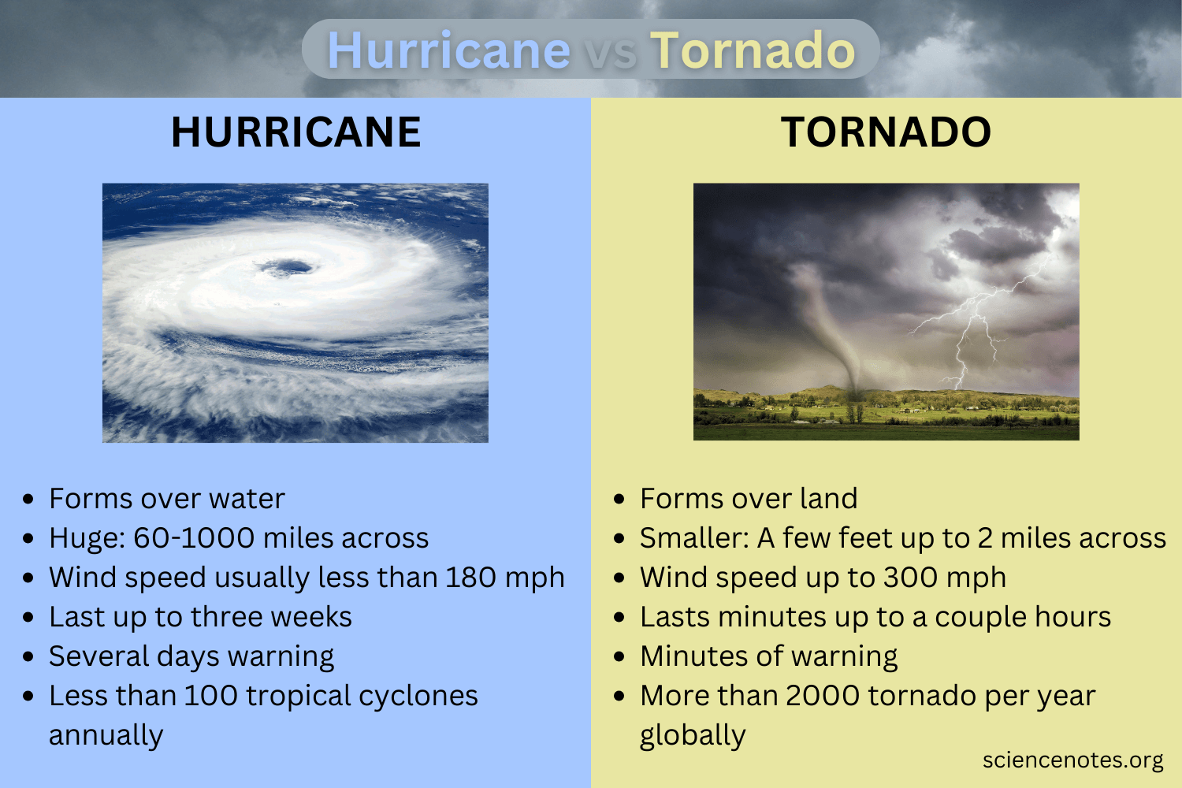

Slide 4
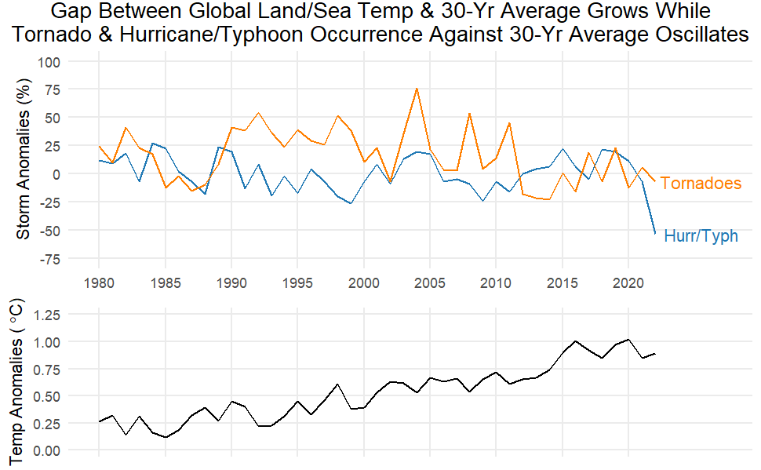

Slide 5
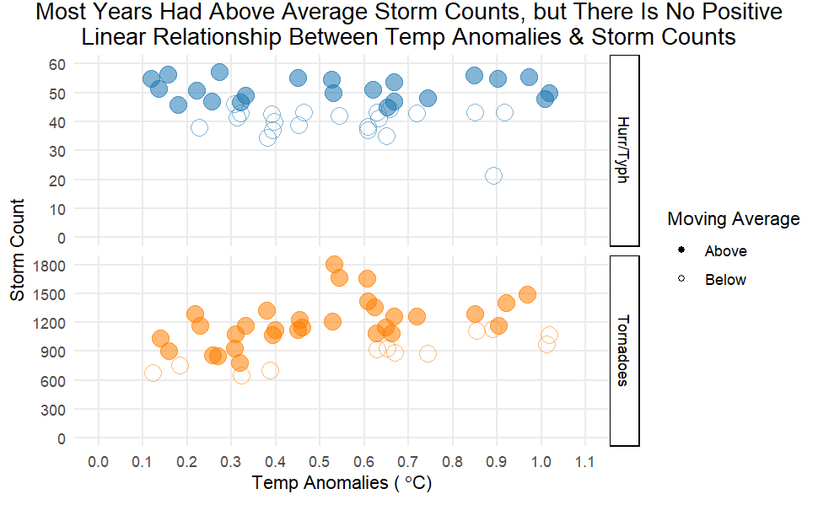

Slide 6
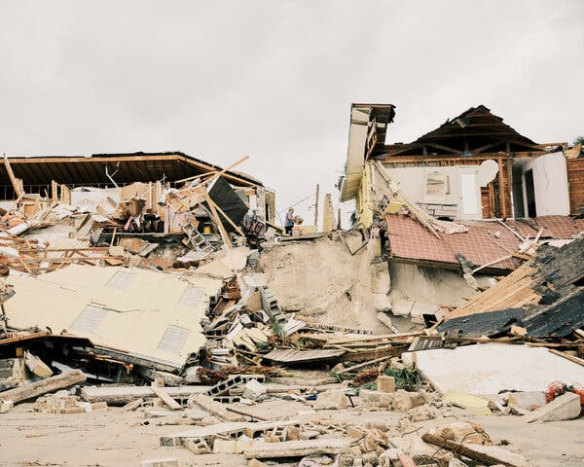
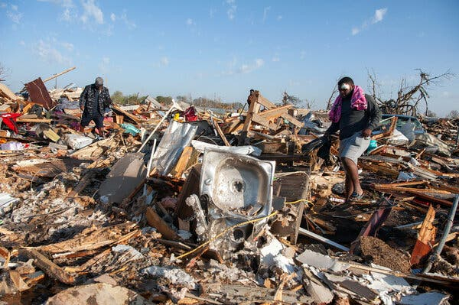
Storm Damage Can Be Severe
Above: People picking through the rubble after a tornado destroyed much of Rolling Fork, Miss. Credit: Rory Doyle for The New York Times
Above: Homes left destroyed after storm surge from Hurricane Nicole in Wilbur-by-the-Sea, Fla., last year. Credit: Zack Wittman for The New York Times

Slide 7
