Slide 1
US Sources of Critical Minerals
DATA 608 | Glen Dale Davis

Slide 2
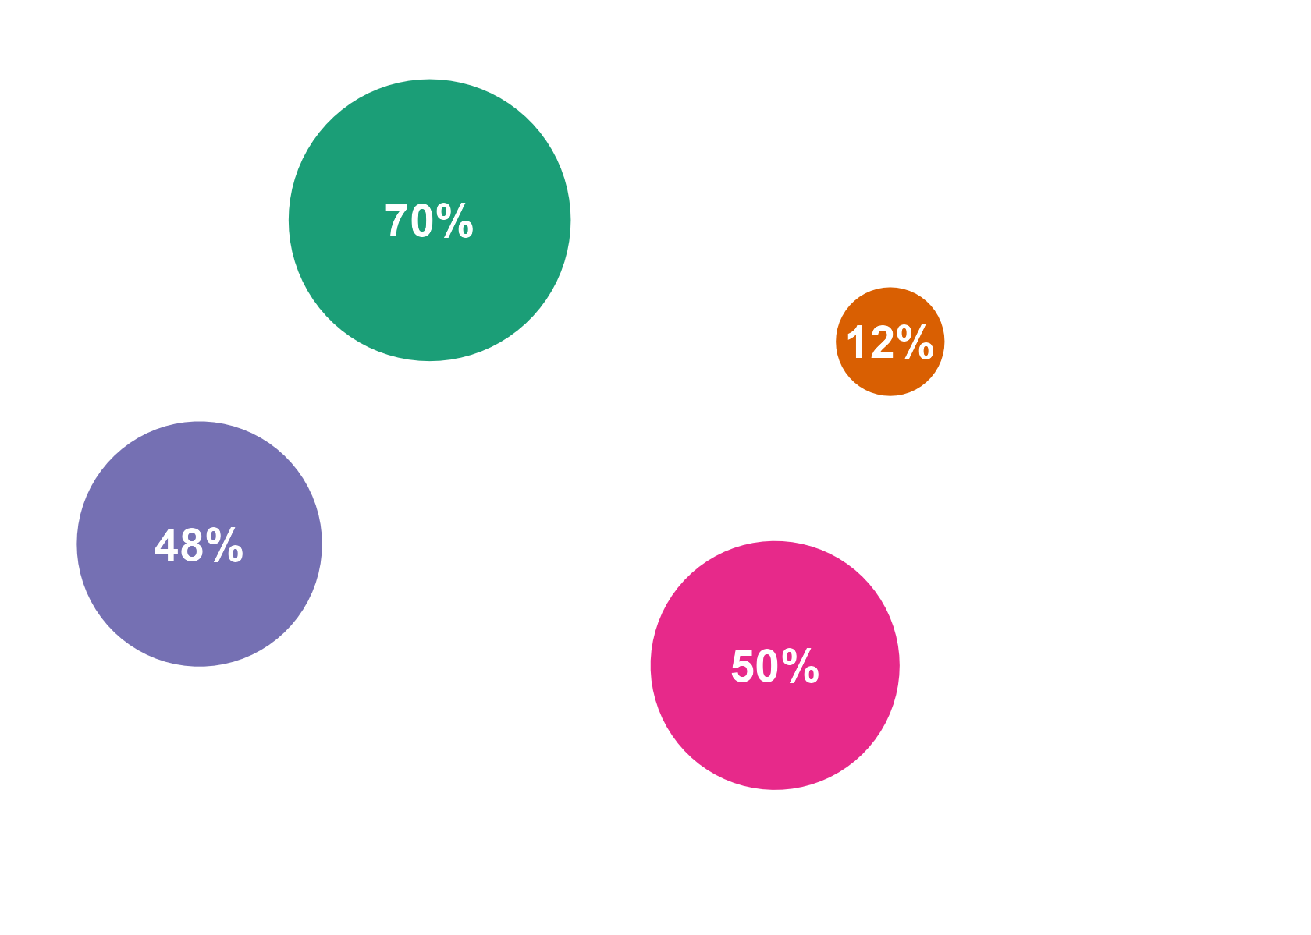
Key Facts
The US is very highly or completely dependent on imports for 70% of critical minerals
The US has no significant ally sources among suppliers for 12% of critical minerals
China is the US’s number one source of 48% of critical minerals
50% of the US's critical mineral sources rank poorly or worse on corruption, gov’t effectiveness, political stability, or regulatory quality

Slide 3
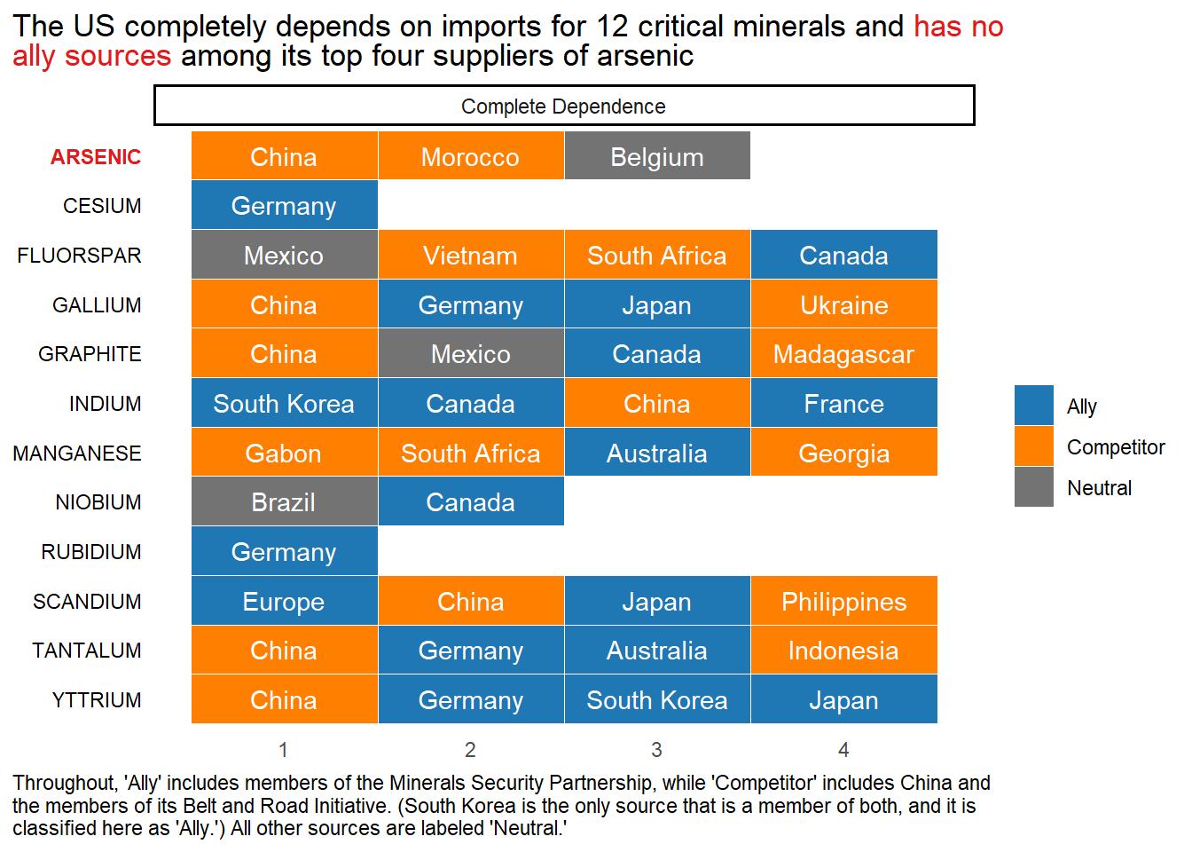

Slide 4
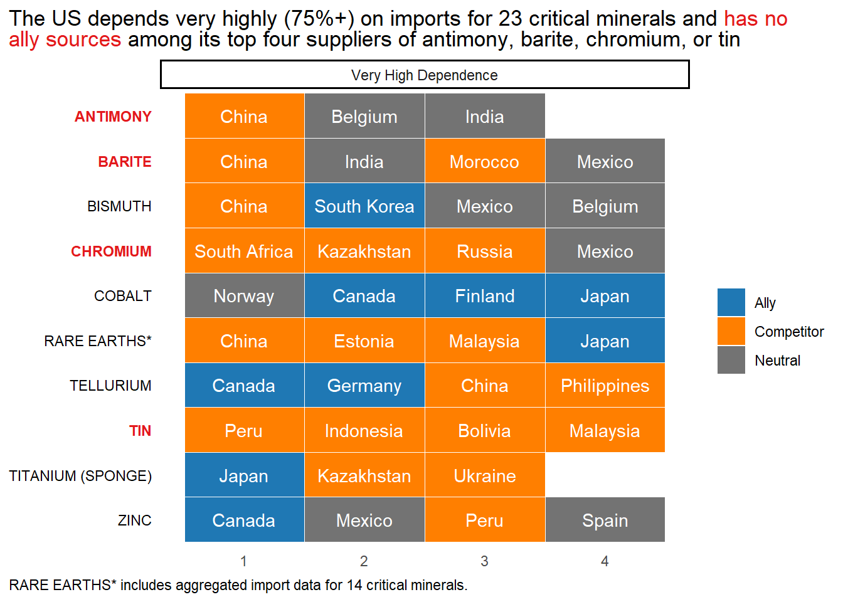

Slide 5
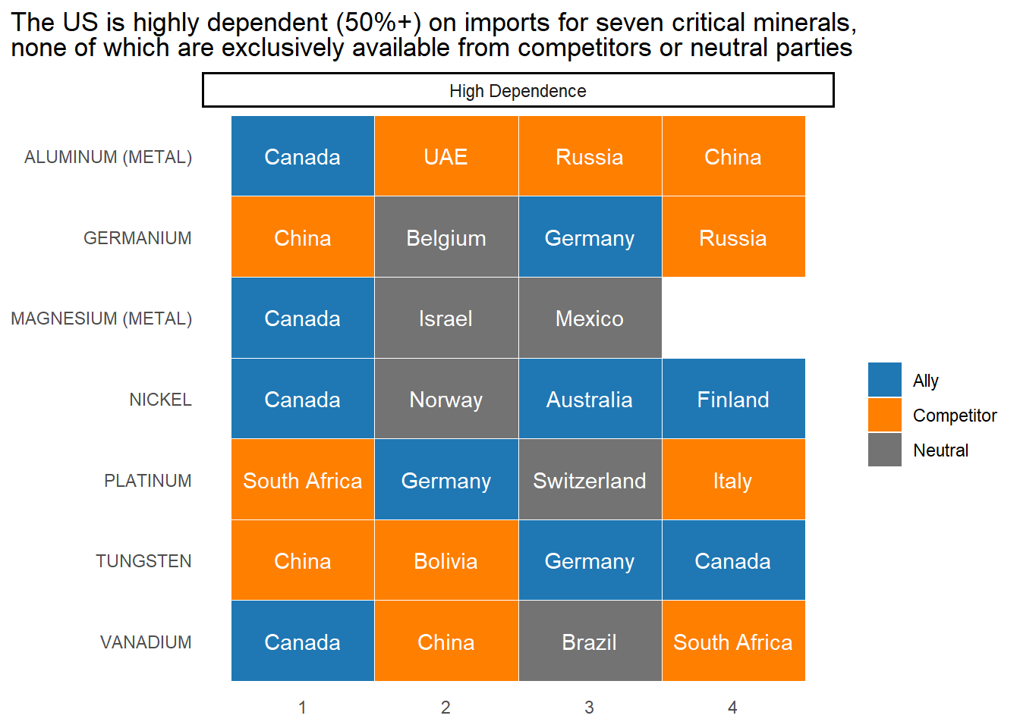

Slide 6
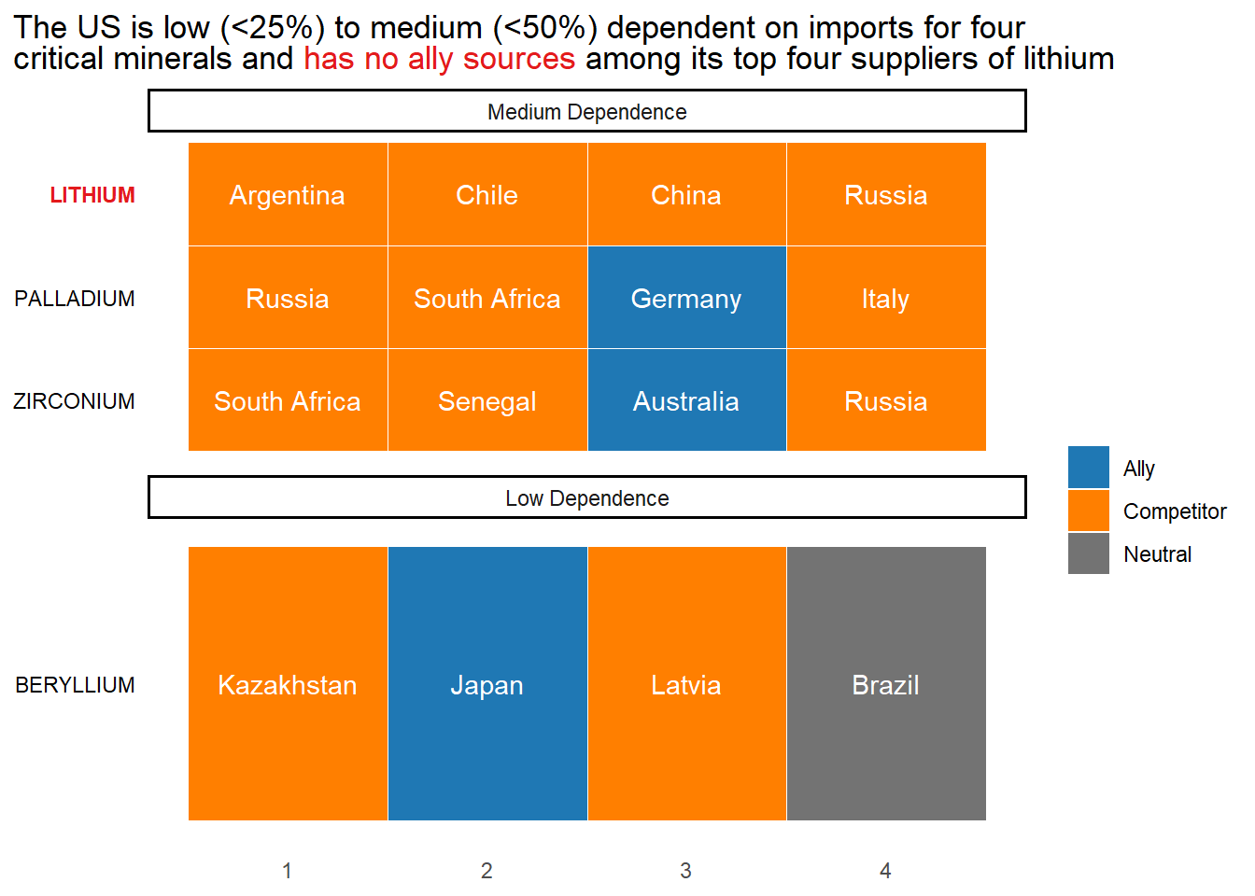

Slide 7
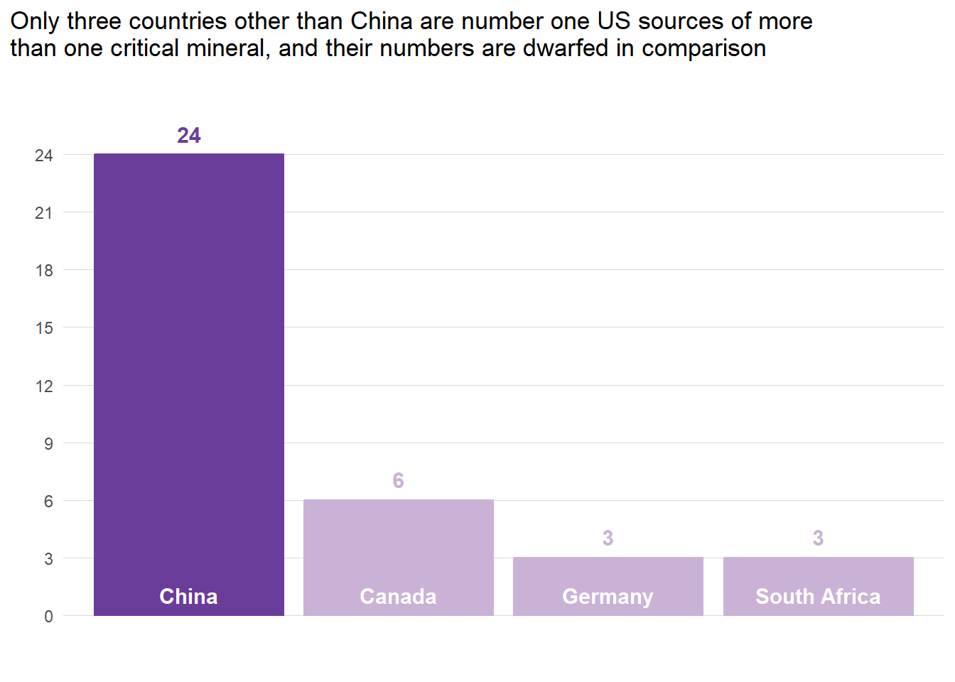

Slide 8
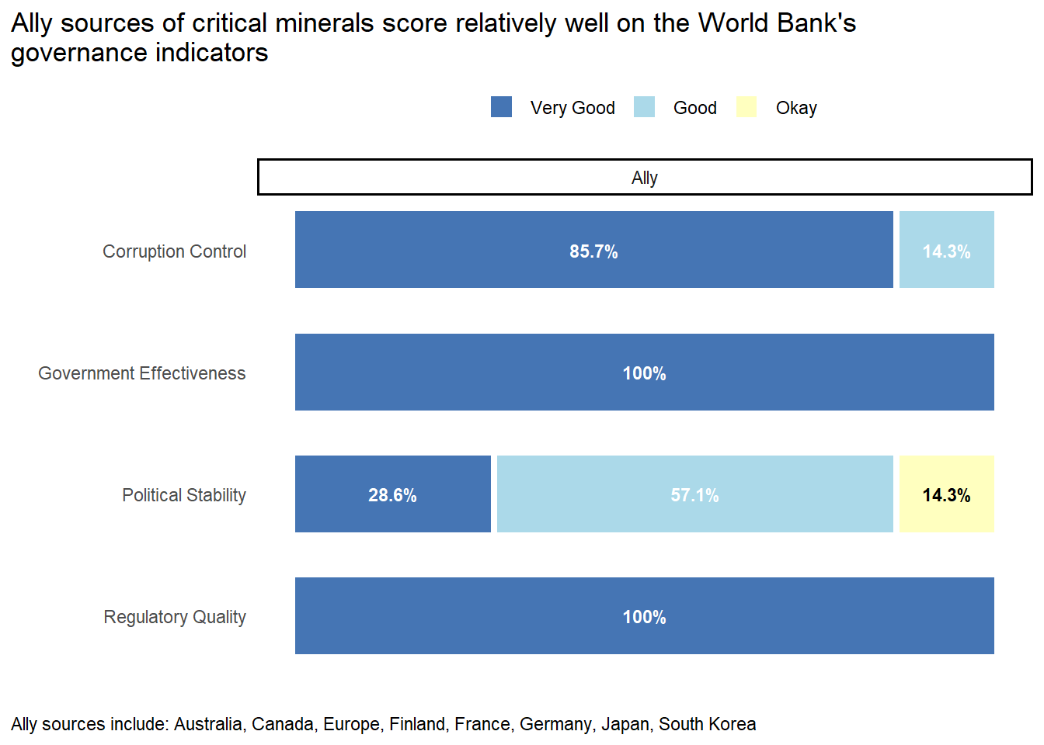

Slide 9
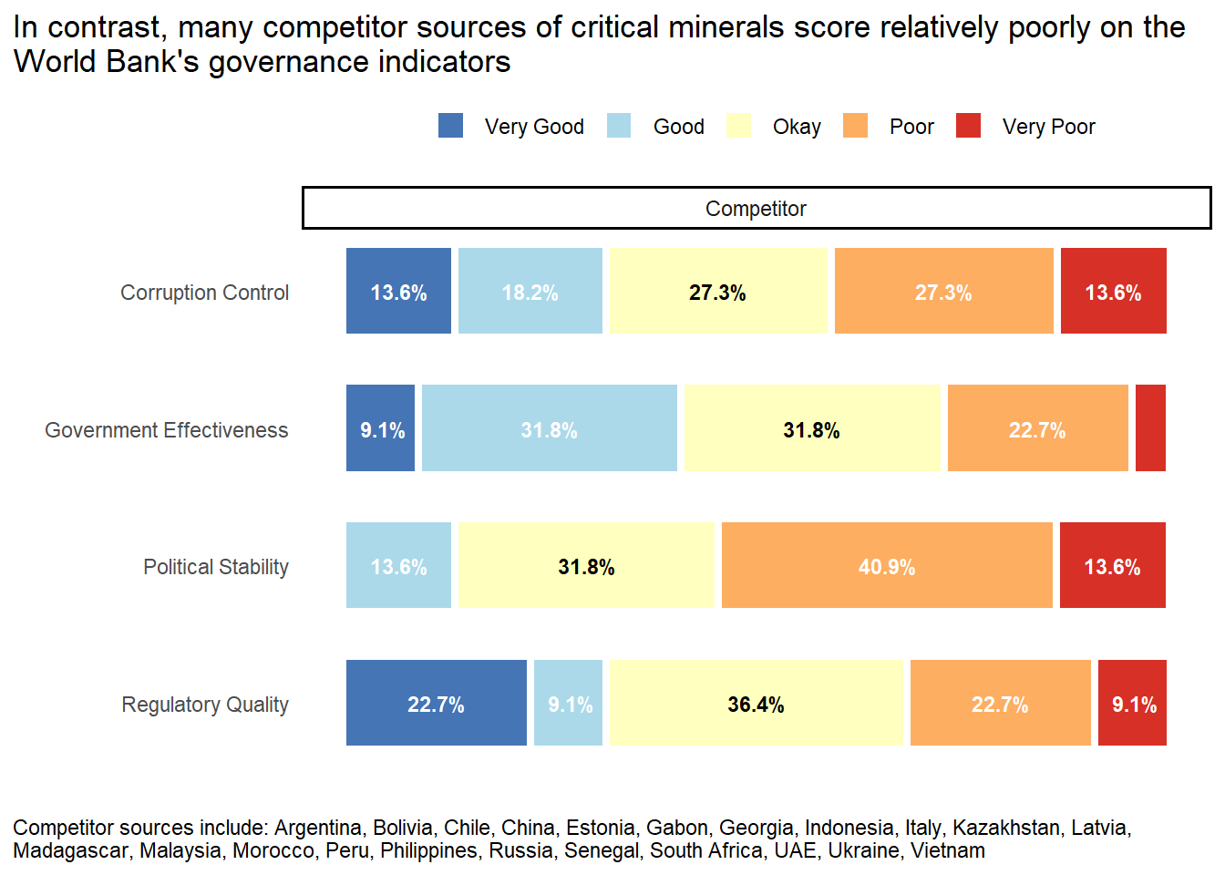

Slide 10
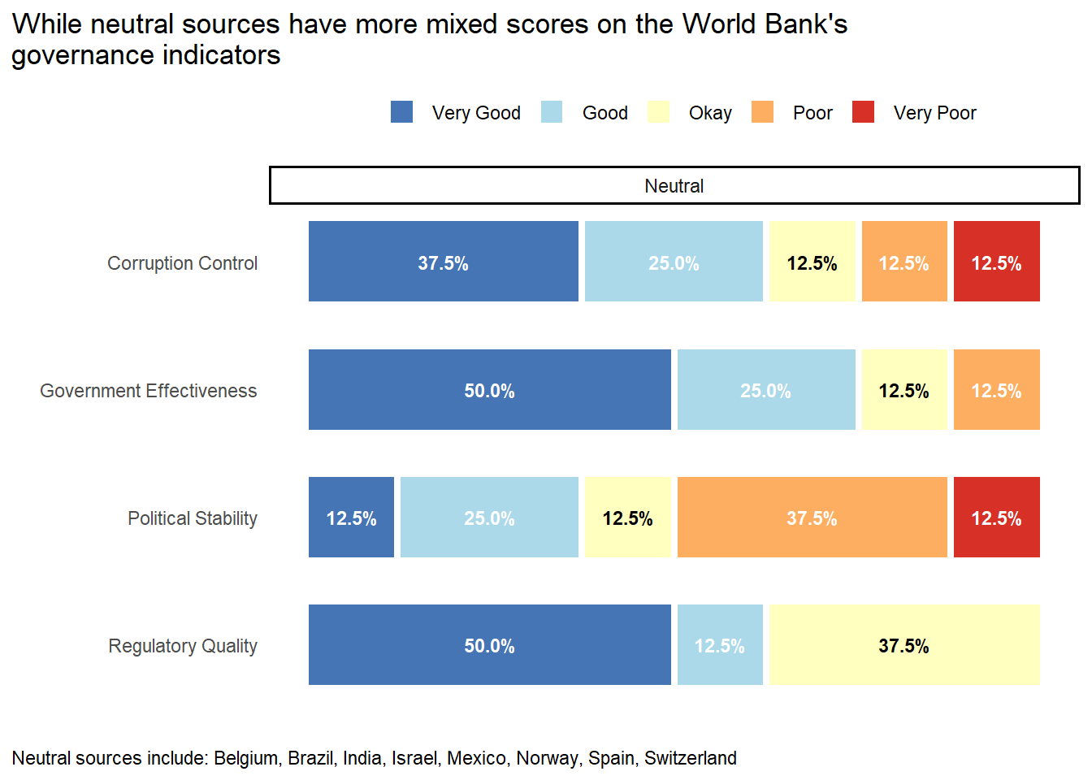

Slide 11
