Slide 1

Julia
Looks Like Python, Speed as C++

Slide 2

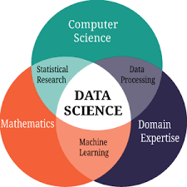

Slide 3
Here, Python become a King
There has been a lot of buzz around Python since last year as according to the Tiobe Index, Python was the programming language of the year in 2018.
It is extremely popular among data scientists and machine learning professionals in particular and is extensively used for Artificial Intelligence.
Python is an open-source programming language; its simplicity and short learning curve are some of the pivotal reasons for its popularity.
The growth of Python has exploded in recent times.

Slide 4
Features of Python:
Easy to code and learn
Free and Open Source with a Python Software Foundation License
Object-Oriented Language
Dynamically Typed Language
GUI Programming Support
High-Level Multi-platform Language
Extensible & Portable Language
Interpreted Language
Large Standard Library

Slide 5
However, Julia, a comparatively newer language, has garnered a lot of buzzes and searches recently.
Julia started development in 2009 and was first released to the public as Julia 1.0 in 2012. Although it is yet to have a big fanbase as indicated by the TIOBE index, Python is the third most popular language after C and Java while Julia ranks somewhere in the 40s, it is still worth a visit.

Slide 6

Well, Julia is a highly efficient high-level language that is designed for the purpose of carrying out numerical and scientific computing.
The language can, however, be used for general programming and web use as well.
This language has a MIT license which makes it open source. The benefit of operating under such a license is that there is a huge online community where the users gather together and solve the common bugs encountered.

Slide 7
Julia Vs Python: Will it unseat the king of programming?
Julia Language: Unique Features:
Julia is compiled and not interpreted making it a fast-programming language
It has a straightforward syntax (similar to that of Python) that can be easily understood by beginners.
It is dynamically typed — you don’t have to specify or sign the variables
Can access libraries belonging to other programming languages including C, Fortran, and Python.

Slide 8
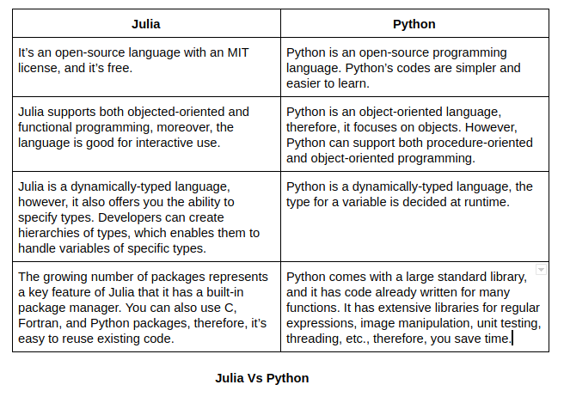

Slide 9
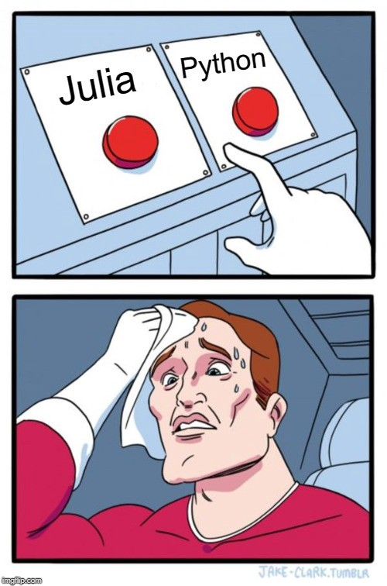
Which one is better?

Slide 10
Speed:
Speed was one of the main objectives in the creation and development of Julia.

Slide 11
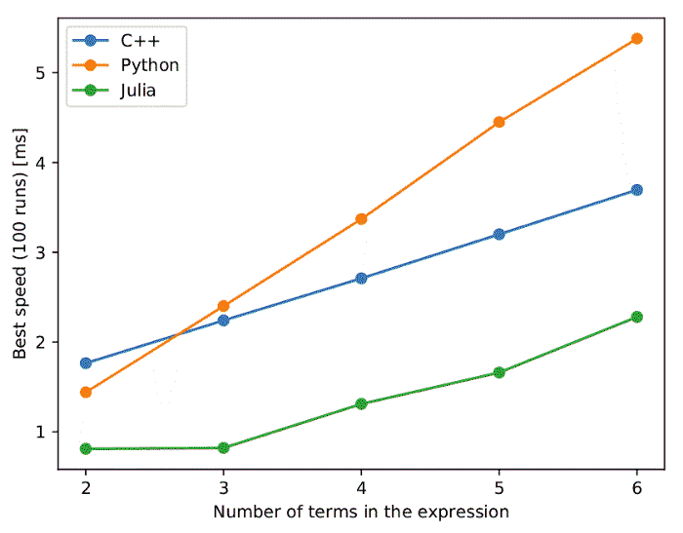

Slide 12
Libraries:
In terms of libraries and packages, Python takes the cake in Python vs Julia face off. Given its infancy, Julia has a limited number of libraries. Besides, the libraries aren’t very well maintained, taking considerably longer to plot and execute data. Regardless, Julia’s library is steadily growing, and it can directly interface with foreign libraries of Fortran, C++, Python, R, Javascript, etc. to handle plots.
In contrast, Python boasts an enormous number and rich set of libraries, mainly due to its lengthy existence and popularity. More so, these libraries are well maintained, making it easy to perform various additional tasks. Python is also supported by a significant number of third-party libraries, which makes it a favorite among developers and programmers.

Slide 13
Open Issues in Julia Programming Language
The greatest challenge with Julia is that there are far fewer available application packages than there are for other high-level languages such as Python.
It is also a young and developing language. It is being updated and there has been a recent version making it relatively stable, but there are still many issues to be solved such as a lack of stable development tools, interfacing with other languages, and a limited number of third-party packages.

