Slide 1

Bayesian stats with Stan and brms()
Béatrice Capolla & Florent Déry
J. Kulich - https://www.elmhurst.edu/blog/thomas-bayes/

Slide 2

An immersion into british philosophy
David Hume: a great skeptic
Criticizes Descartes’ rationalism: our ideas cannot be confirmed by immediate perceptions
1711
1776
Hume’s fork:
Demonstrative statement – irrefutable
(a priori knowledge), 2 + 2 = 4
Probable statement – refutable , needs empirical proof
David Hume
Thomas Bayes
Georgios Magkakis.
- A Treatise of Human Nature: Being an Attempt to introduce the experimental Method of Reasoning into Moral Subjects (1739)
- Enquiries concerning Human Understanding (1748)
Concludes that reports of miracles change nothing regarding our understanding of human existence
Concludes that belief is at the center of rationalism, not reason
Clergy opposes
Richard Price

Slide 3

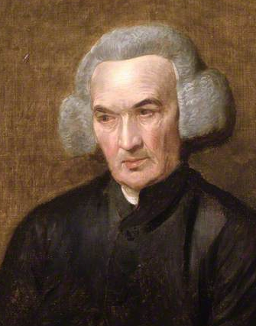
Thomas Bayes’ theorem might be seen as a rebuttal of David Hume’s work
Thomas Bayes :
Highly skilled amateur mathematician & clergyman.
Started working on his theorem shortly after Hume’s conclusion on miracles
An Essay towards solving a Problem in the Doctrine of Chances (1763)
1702
1761
1723
1791
Compiles and complete abandoned notes and essay
Thomas Bayes
Richard Price : Clergyman and pioneer insurance statistician.
Completed and published Bayes works after his death
Richard Price

Slide 4
Thomas Bayes’ theorem might be seen as a rebuttal of David Hume’s work
1711
1776
1702
1761
Bayes theorem combines Hume’s fork:
1723
1791
Demonstrative statement – irrefutable
(a priori knowledge)
Probable statement – refutable , needs empirical proof
David Hume
Thomas Bayes
Georgios Magkakis.
Price uses Bayes’ theorem to explain miracles (improbable events)
Richard Price
https://mindmatters.ai/2020/12/how-bayes-math-rule-can-counter-unreasonable-skepticism/

Slide 5
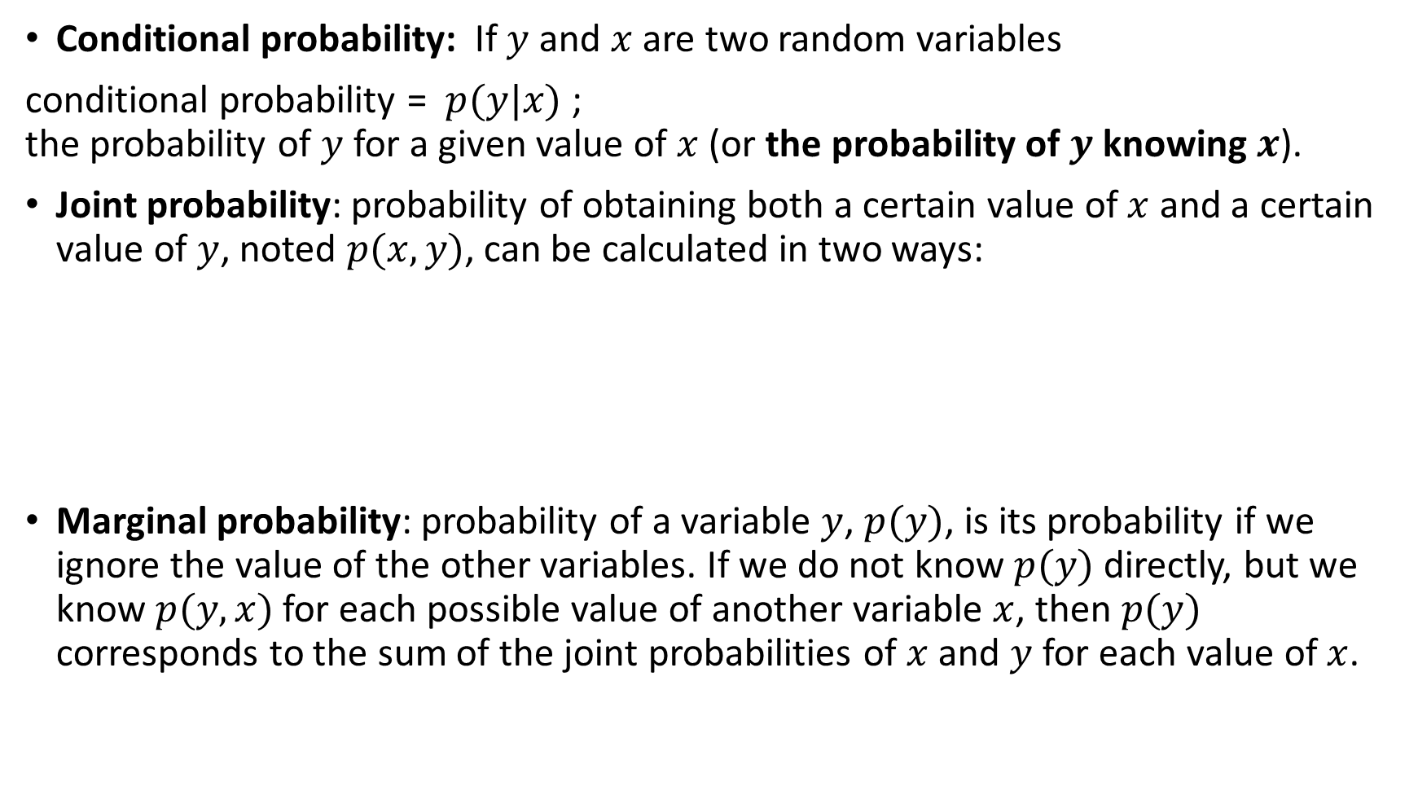
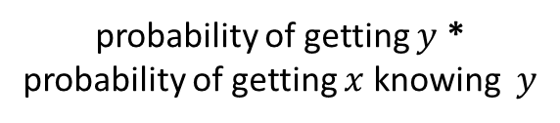
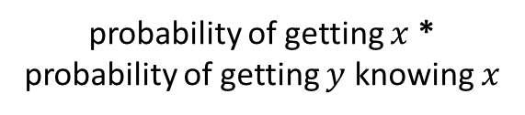
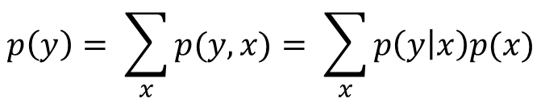
Did you say probable(-ility)?
Conditional probability: If $y$and $x$are two random variables
conditional probability = $p(y|x)$ ; the probability of $y$ for a given value of $x$ (or the probability of $y$ knowing $x$).
Joint probability: probability of obtaining both a certain value of $x$ and a certain value of $y$, noted $p(x,y)$, can be calculated in two ways:
Marginal probability: probability of a variable $y$, $p(y)$, is its probability if we ignore the value of the other variables. If we do not know $p(y)$ directly, but we know $p(y,x)$for each possible value of another variable $x$, then $p(y)$ corresponds to the sum of the joint probabilities of $x$ and $y$ for each value of $x$.
$$p(x, y) = p(x)p(y|x) = p(y)p(x|y)$$
probability of getting $x$ * probability of getting $y$ knowing $x$
probability of getting $y$ * probability of getting $x$ knowing $y$
$$p\left(y\right)= \sum_{x}{p(y,x)}= \sum_{x}{p\left(y | x\right)p(x)}$$

Slide 6

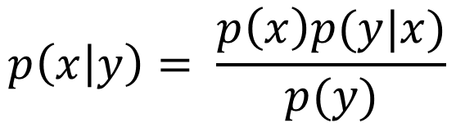
Bayes’ theorem
Frequentist approach !
Prior distribution
Likelihood function
Posterior distribution
$$p\left(x | y\right)= \frac{p\left(x\right)p(y|x)}{p(y)}$$
Probability of data
(Marginal probability)

Slide 7
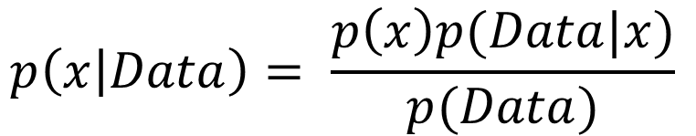
Bayes’ theorem
What we know A Priori
The model
Parameters estimates
$$p\left(x | Data\right)= \frac{p\left(x\right)p(Data|x)}{p(Data)}$$
Probability of data

Slide 8
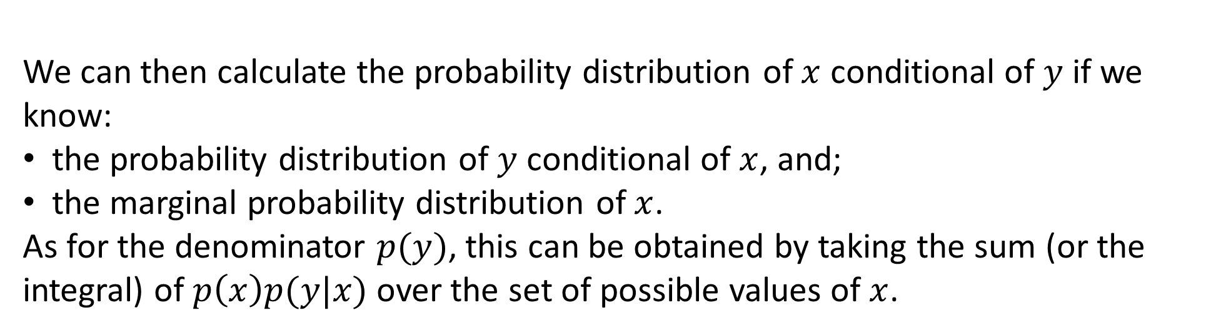
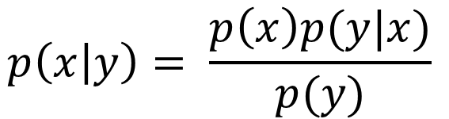
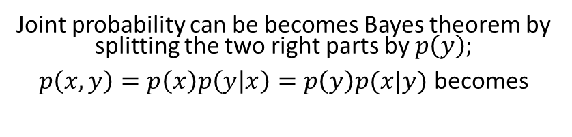
Bayes’ theorem
Joint probability can be becomes Bayes theorem by splitting the two right parts by$p\left(y\right)$;
$p\left(x,y\right)=p\left(x\right)p\left(y | x\right)=p\left(y\right)p(x|y)$ becomes
Prior distribution
Likelihood function (model)
$$p\left(x | y\right)= \frac{p\left(x\right)p(y|x)}{p(y)}$$
Posterior distribution
We can then calculate the probability distribution of $x$ conditional of $y$ if we know:
the probability distribution of $y$ conditional of $x$, and;
the marginal probability distribution of $x$.
As for the denominator $p(y)$, this can be obtained by taking the sum (or the integral) of $p\left(x\right)p(y|x)$over the set of possible values ​​of $x$.
Probability of data

Slide 9
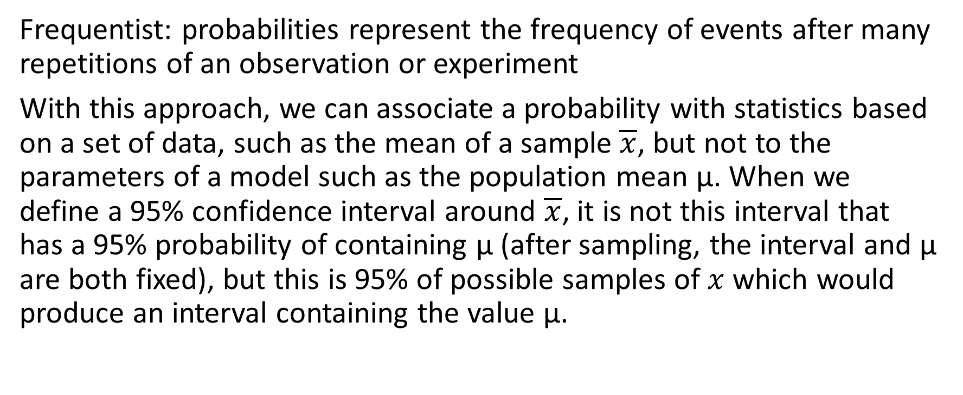
Frequentist VS Bayesian
Frequentist: probabilities represent the frequency of events after many repetitions of an observation or experiment
With this approach, we can associate a probability with statistics based on a set of data, such as the mean of a sample $\overline{x}$, but not to the parameters of a model such as the population mean μ. When we define a 95% confidence interval around $\overline{x}$, it is not this interval that has a 95% probability of containing μ (after sampling, the interval and μ are both fixed), but this is 95% of possible samples of $x$ which would produce an interval containing the value μ.

Slide 10
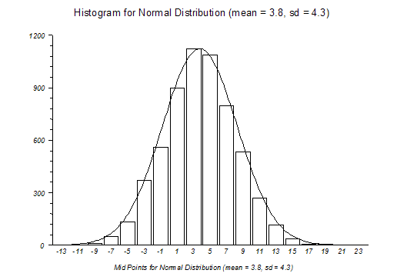
Frequentist VS Bayesian
Bayesian : probabilities represent our uncertainty about the value of a quantity. We can therefore speak of a probability distribution even for a presumed fixed value, e.g .: a model parameter.

Slide 11
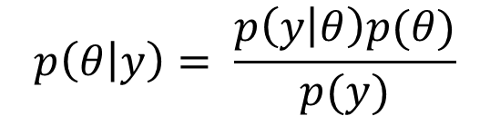
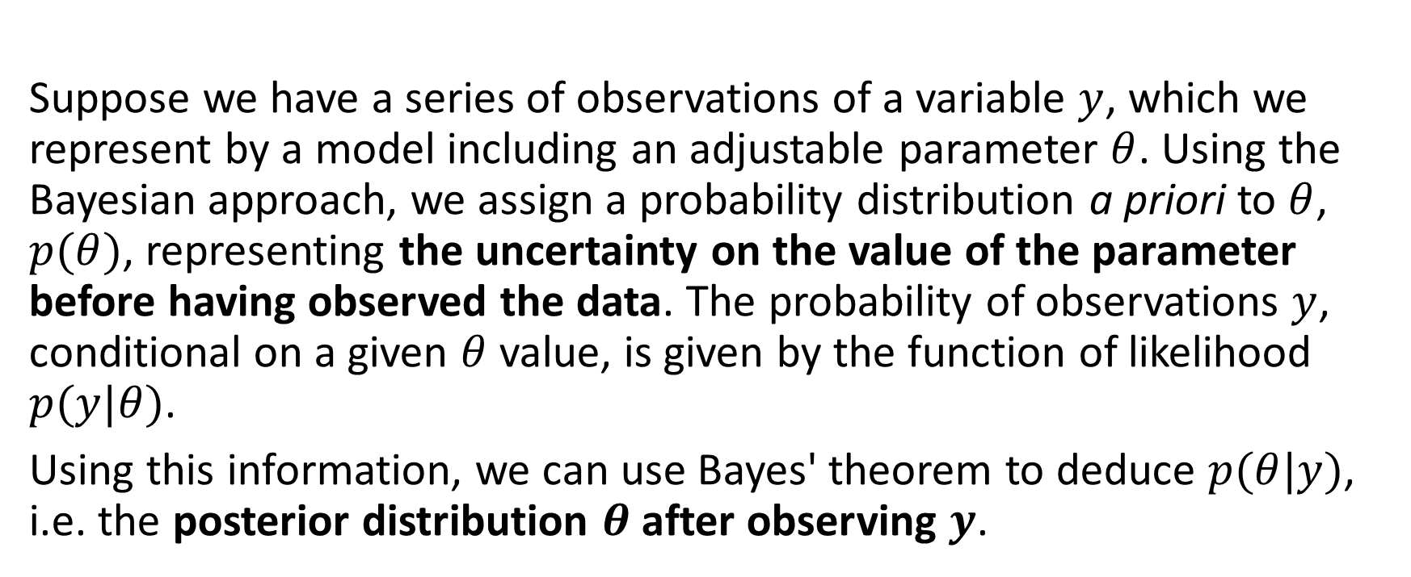
How does bayesian inference work?
Suppose we have a series of observations of a variable $y$, which we represent by a model including an adjustable parameter $θ$. Using the Bayesian approach, we assign a probability distribution a priori to $θ$, $p(θ)$, representing the uncertainty on the value of the parameter before having observed the data. The probability of observations $y$, conditional on a given $θ$ value, is given by the function of likelihood $p(y|θ)$.
Using this information, we can use Bayes' theorem to deduce $p(θ|y)$, i.e. the posterior distribution $θ$ after observing $y$.
$$p\left(θ | y\right)= \frac{p\left(y | θ\right)p(θ)}{p(y)}$$

Slide 12

Stan… who?
https://mc-stan.org/users/interfaces/rstan

Slide 13
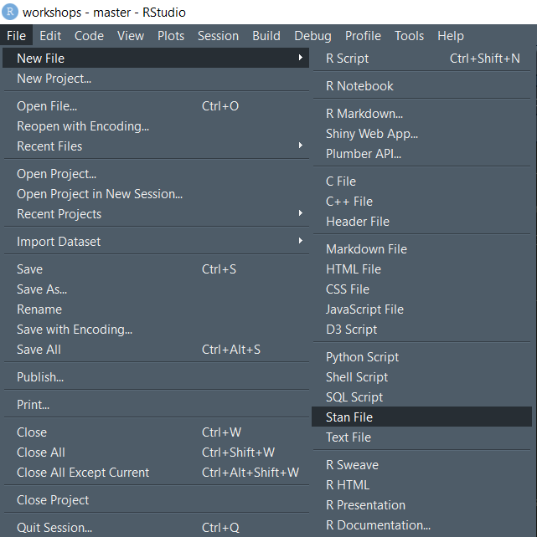
To open a new Stan file

Slide 14
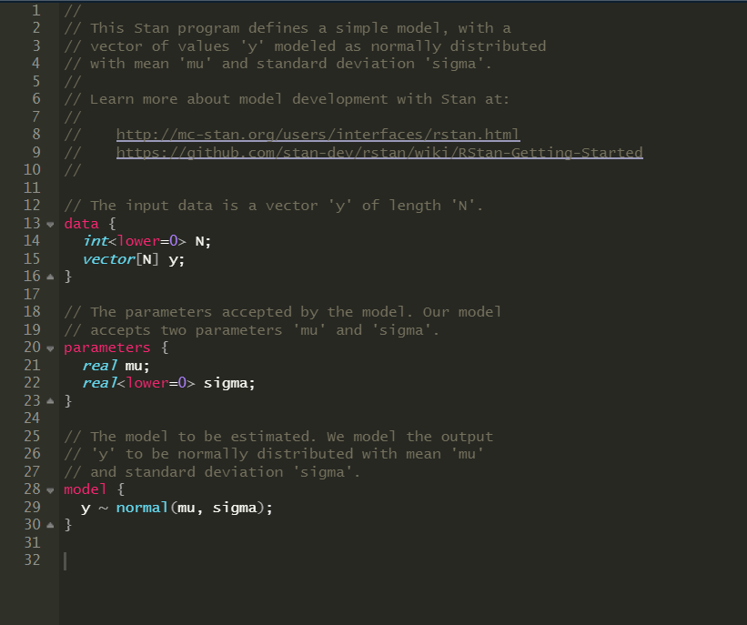
Empty Stan file
Use two forward slashes instead of a pound when you want to write text and not code
Where to clic if you have trouble coding in Stan
Define your data
Define your parameters
Define your model

Slide 15
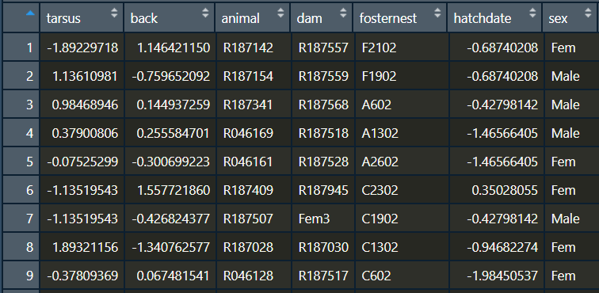
Our data : BTdata.txt
Tarsus length
Bird ID
One measure/ID
Mom ID
Bird sex

Slide 16
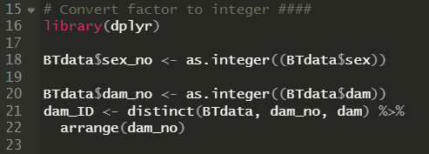
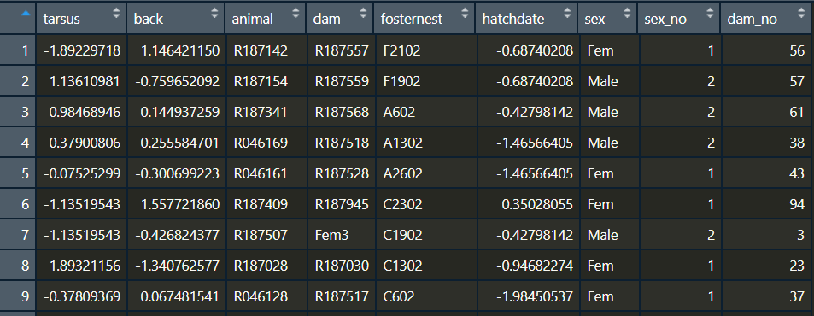
Stan hates factor… so make it integer!
Creates a DF indicating which dam_no corresponds to which dam ID

Slide 17






Our model
$$i=observation number$$
$$μ_{ij}=β_{0j}+β_{i}x_{ij}+ε_{0ij}$$
$$j=group (mother ID)$$
$$β_{0j}=β_{0}+μ_{0j}$$
$$μ_{0j} \sim N(0,σ_{μ_{0}}^{2})$$
$$ε_{0ij}\sim N(0,σ_{e_{0}}^{2})$$
Tarsus length
Intercept
Sex
Error

Slide 18
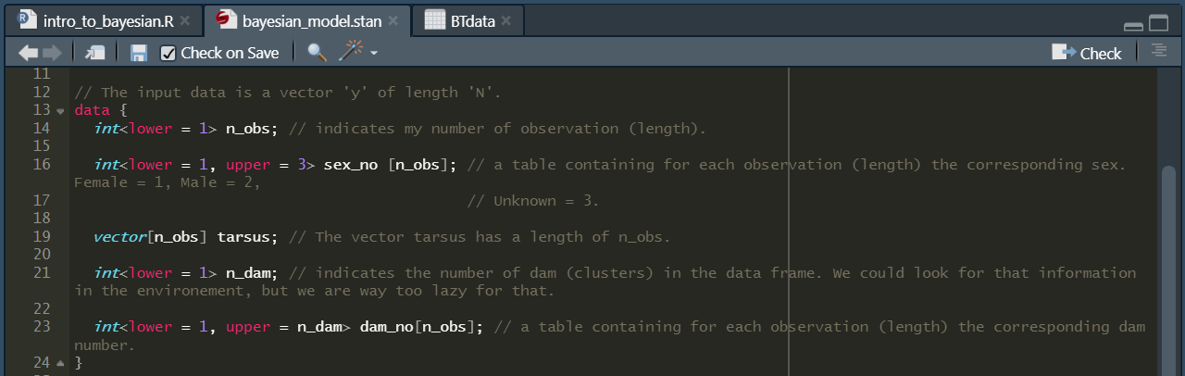
Coding data in Stan
Use chevrons to indicate boundaries!
Use brackets to indicate the length of your data!

Slide 19
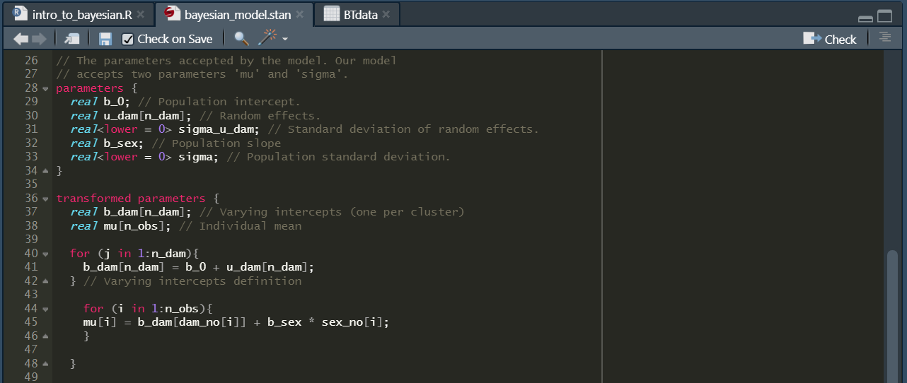
Coding parameters in Stan

Slide 20
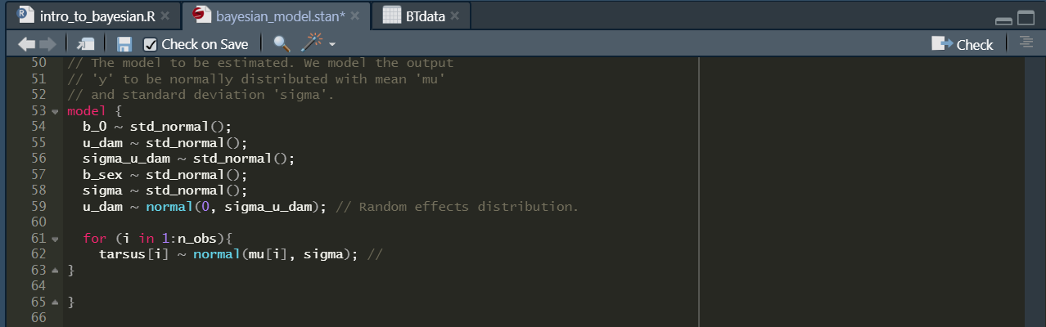
Coding models in Stan

Slide 21
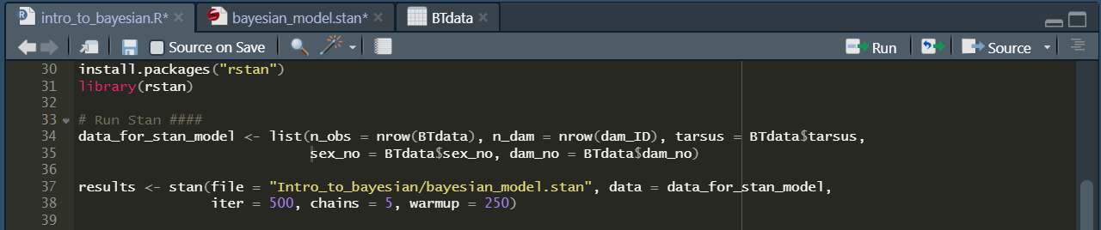
Run your Stan model in R

