Slide 1
What Does Your Zero Mean? : Understanding Structural, Random, and False Zeros
Based on Blasco-Moreno et al. 2018
By Beatrice Capolla
February 10th 2021

Slide 2
Count Data
Frequent in ecology
Two common characteristics:
Overdispersion (variance > mean);
Zero inflation.

Slide 3
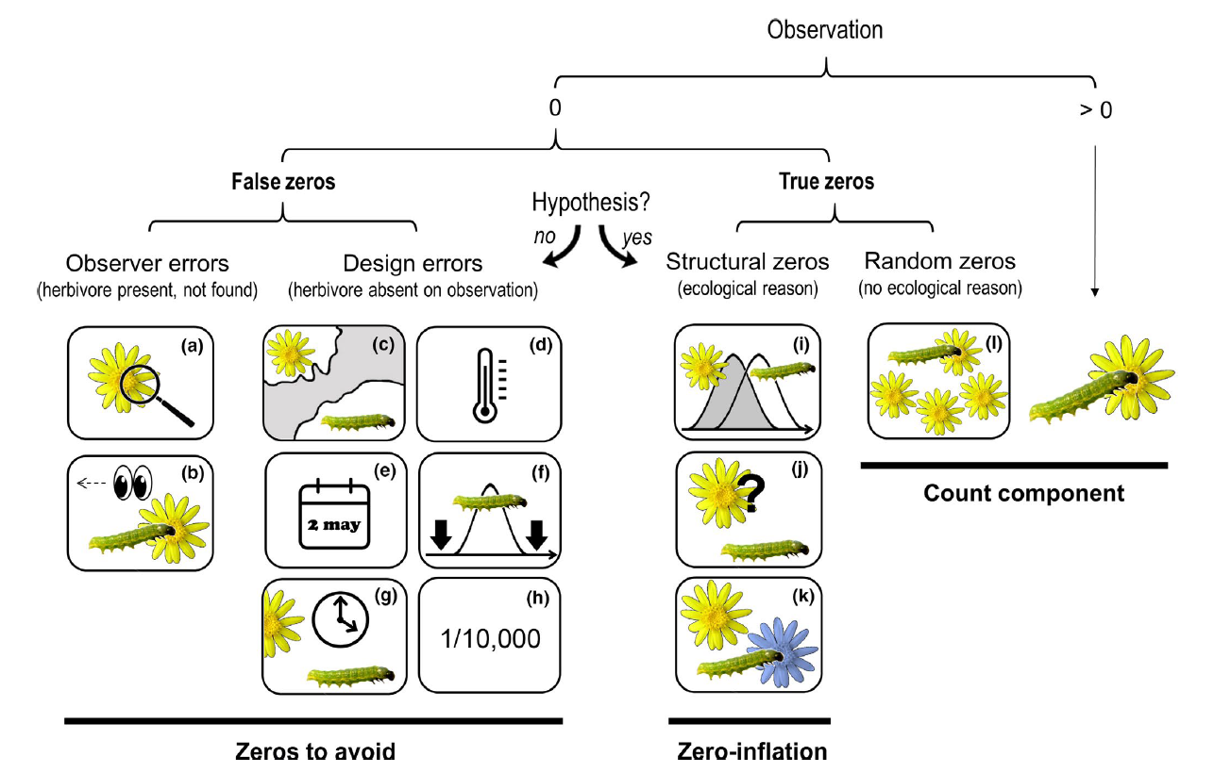
Zeros within Count Data

Slide 4
False Zeros
Observer errors:
Sampling errors due to poor experience of the observer
Design errors:
E.g. Sampling at the wrong time or place
Should be monitored and removed when possible

Slide 5
True Zeros : Structural
Associated with the ecological or evolutionary restrictions of the biological system under study
E.g. herbivores recognize a plant as a host but prefer to feed on another species
Source of zero inflation

Slide 6
True Zeros : Random
Emerge due to the sampling variability and include those events that could potentially occur but do not
E.g. the herbivore population is not large enough to saturate the available plant resources

Slide 7
Asking for a Friend : How Do We Analyze Count Data?
DON’Ts
Log-transform your data in order to reduce overdispersion, and apply mutiple linear regression or ANOVA models
Does not garantee that assumptions are satisfied
Fails to improve data distribution

Slide 8
Asking for a Friend : How Do We Analyze Count Data?
DOs
Use a generalized linear model (GLM) with the appropriate distribution (Poisson, Negative Binomial, etc.)
Determine if you have an excess of zeros in your data, and if so, specify it in your model

