Slide 1
Bayesian stats with Stan and brms()
Florent Déry and Béatrice Capolla

Slide 2
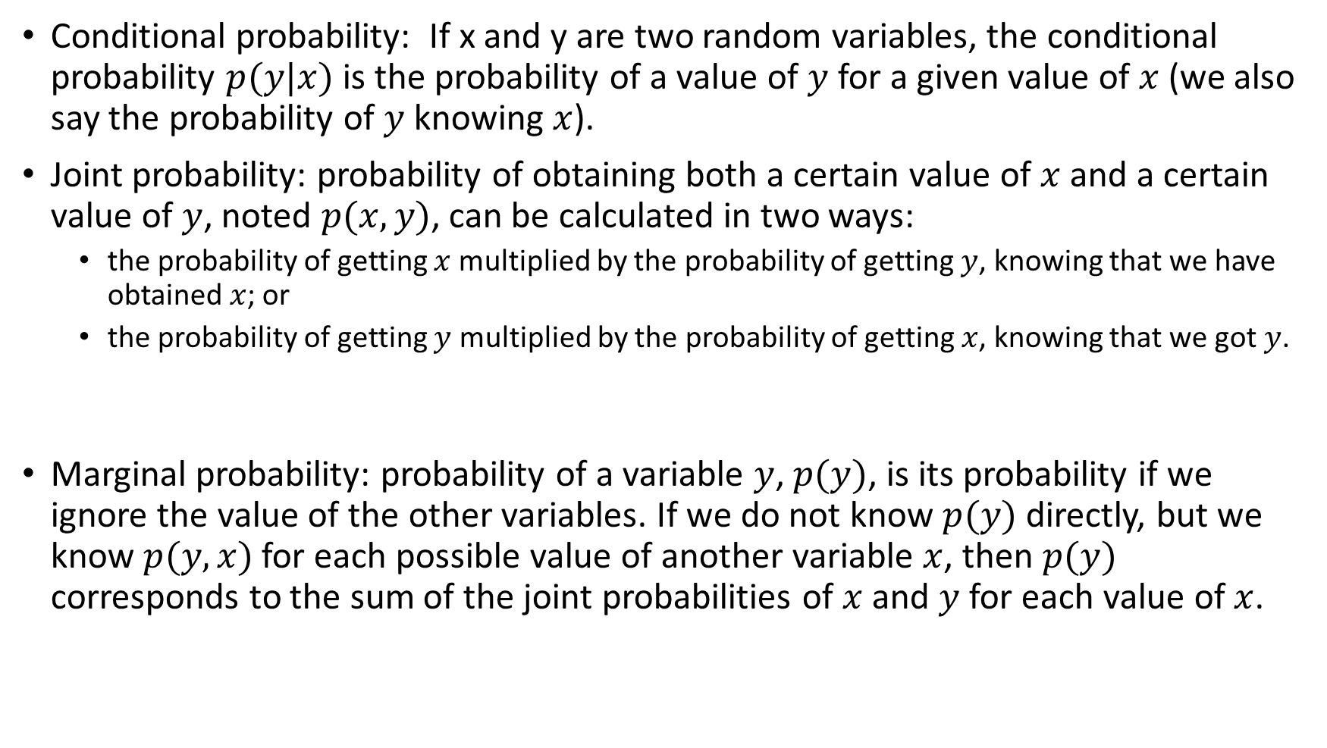
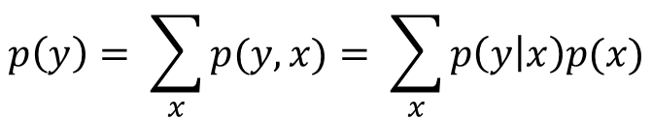
Did you say probability?
Conditional probability: If x and y are two random variables, the conditional probability $p(y|x)$ is the probability of a value of $y$ for a given value of $x$ (we also say the probability of $y$ knowing $x$).
Joint probability: probability of obtaining both a certain value of $x$ and a certain value of $y$, noted $p(x,y)$, can be calculated in two ways:
the probability of getting $x$ multiplied by the probability of getting $y$, knowing that we have obtained $x$; or
the probability of getting $y$ multiplied by the probability of getting $x$, knowing that we got $y$.
Marginal probability: probability of a variable $y$, $p(y)$, is its probability if we ignore the value of the other variables. If we do not know $p(y)$ directly, but we know $p(y,x)$for each possible value of another variable $x$, then $p(y)$ corresponds to the sum of the joint probabilities of $x$ and $y$ for each value of $x$.
$$p(x, y) = p(x)p(y|x) = p(y)p(x|y)$$
$$p\left(y\right)= \sum_{x}{p(y,x)}= \sum_{x}{p\left(y | x\right)p(x)}$$

Slide 3

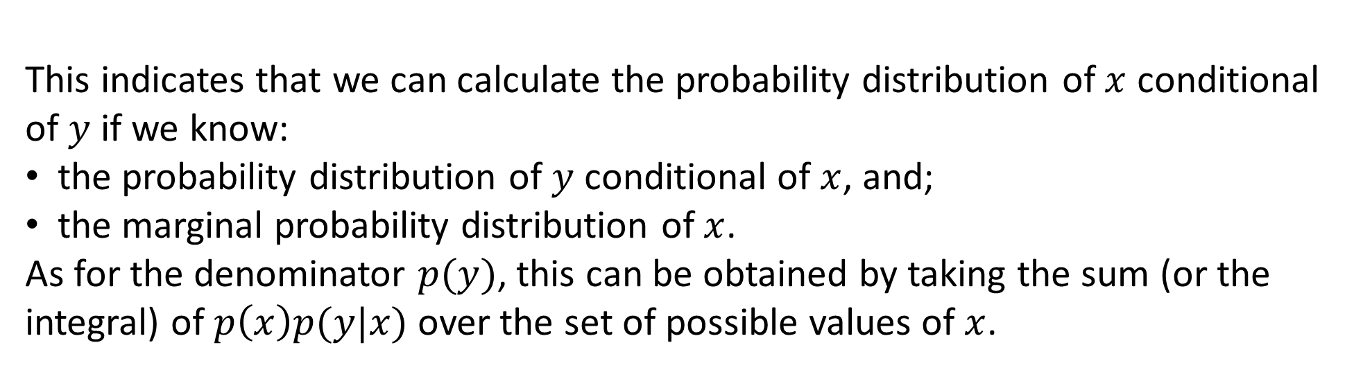
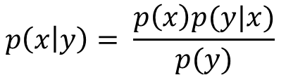
Bayes’ theorem
Considering the joint probability:
$$p\left(x,y\right)=p\left(x\right)p\left(y | x\right)=p\left(y\right)p(x|y)$$
If you divide the two parts on the right by $p(y)$, you obtain the Bayes’ theorem
$$p\left(x | y\right)= \frac{p\left(x\right)p(y|x)}{p(y)}$$
This indicates that we can calculate the probability distribution of $x$ conditional of $y$ if we know:
the probability distribution of $y$ conditional of $x$, and;
the marginal probability distribution of $x$.
As for the denominator $p(y)$, this can be obtained by taking the sum (or the integral) of $p\left(x\right)p(y|x)$over the set of possible values ​​of $x$.

Slide 4
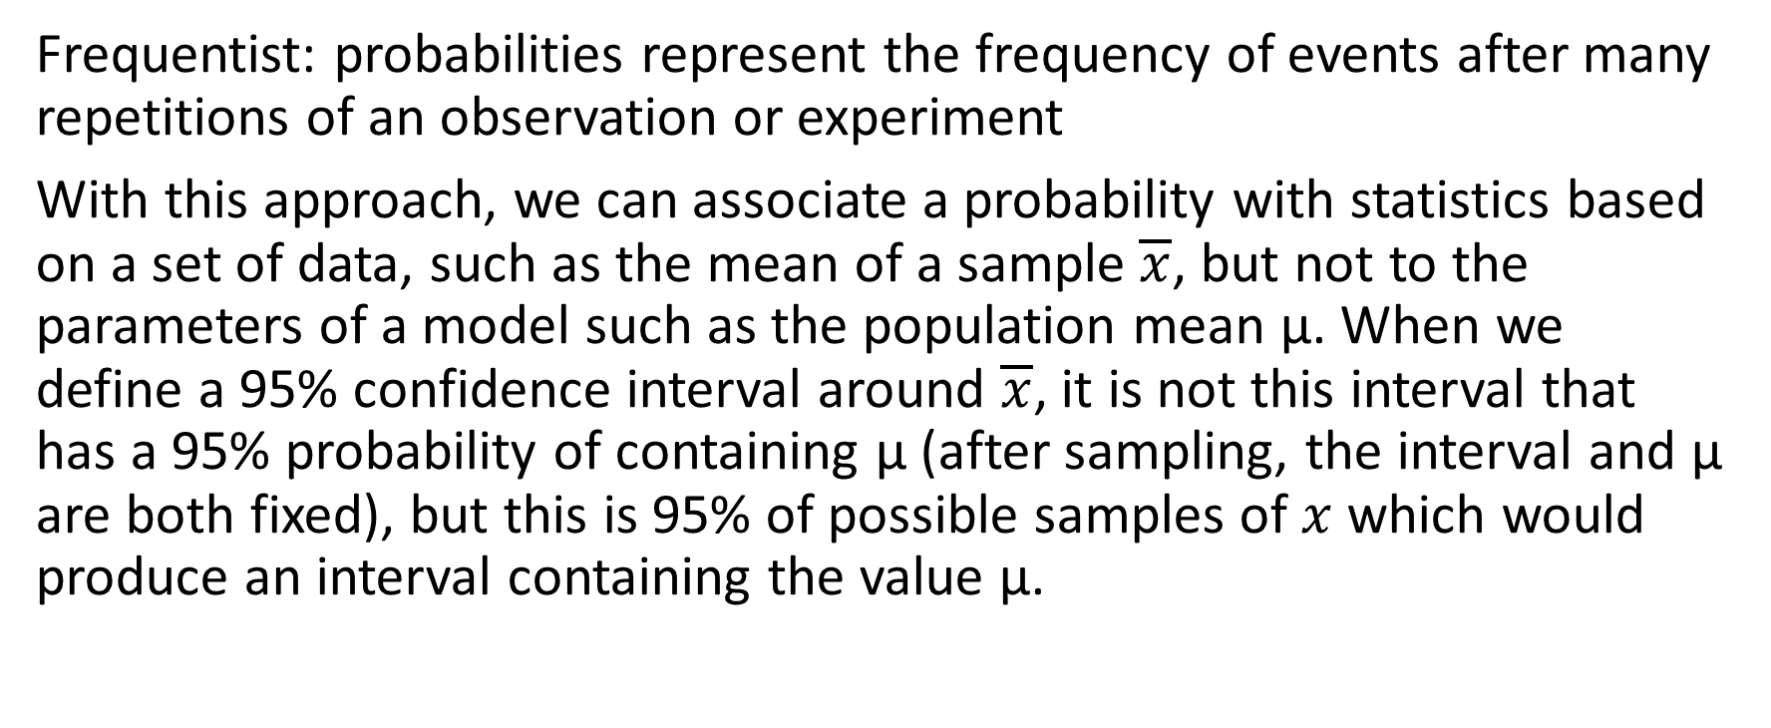
Frequentist VS Bayesian
Frequentist: probabilities represent the frequency of events after many repetitions of an observation or experiment
With this approach, we can associate a probability with statistics based on a set of data, such as the mean of a sample $\overline{x}$, but not to the parameters of a model such as the population mean μ. When we define a 95% confidence interval around $\overline{x}$, it is not this interval that has a 95% probability of containing μ (after sampling, the interval and μ are both fixed), but this is 95% of possible samples of $x$ which would produce an interval containing the value μ.

Slide 5
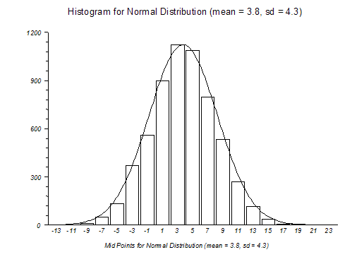
Frequentist VS Bayesian
Bayesian : probabilities represent our uncertainty about the value of a quantity. We can therefore speak of a probability distribution even for a presumed fixed value, e.g .: a model parameter.

Slide 6
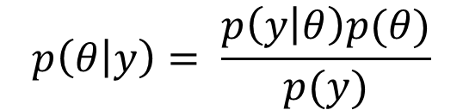
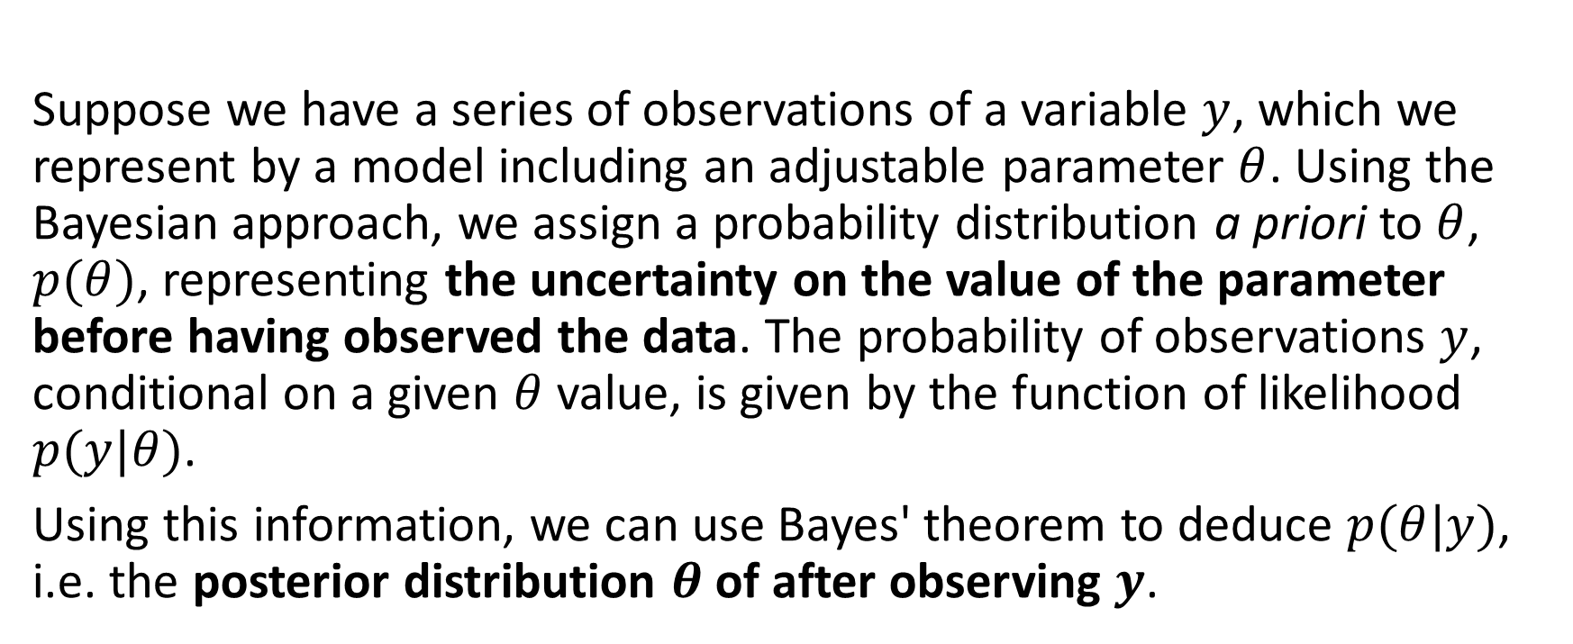
How does bayesian inference work?
Suppose we have a series of observations of a variable $y$, which we represent by a model including an adjustable parameter $θ$. Using the Bayesian approach, we assign a probability distribution a priori to $θ$, $p(θ)$, representing the uncertainty on the value of the parameter before having observed the data. The probability of observations $y$, conditional on a given $θ$ value, is given by the function of likelihood $p(y|θ)$.
Using this information, we can use Bayes' theorem to deduce $p(θ|y)$, i.e. the posterior distribution $θ$ of after observing $y$.
$$p\left(θ | y\right)= \frac{p\left(y | θ\right)p(θ)}{p(y)}$$

