Slide 1

Bayesian stats with Stan and brms()
Béatrice Capolla & Florent Déry
J. Kulich - https://www.elmhurst.edu/blog/thomas-bayes/

Slide 2
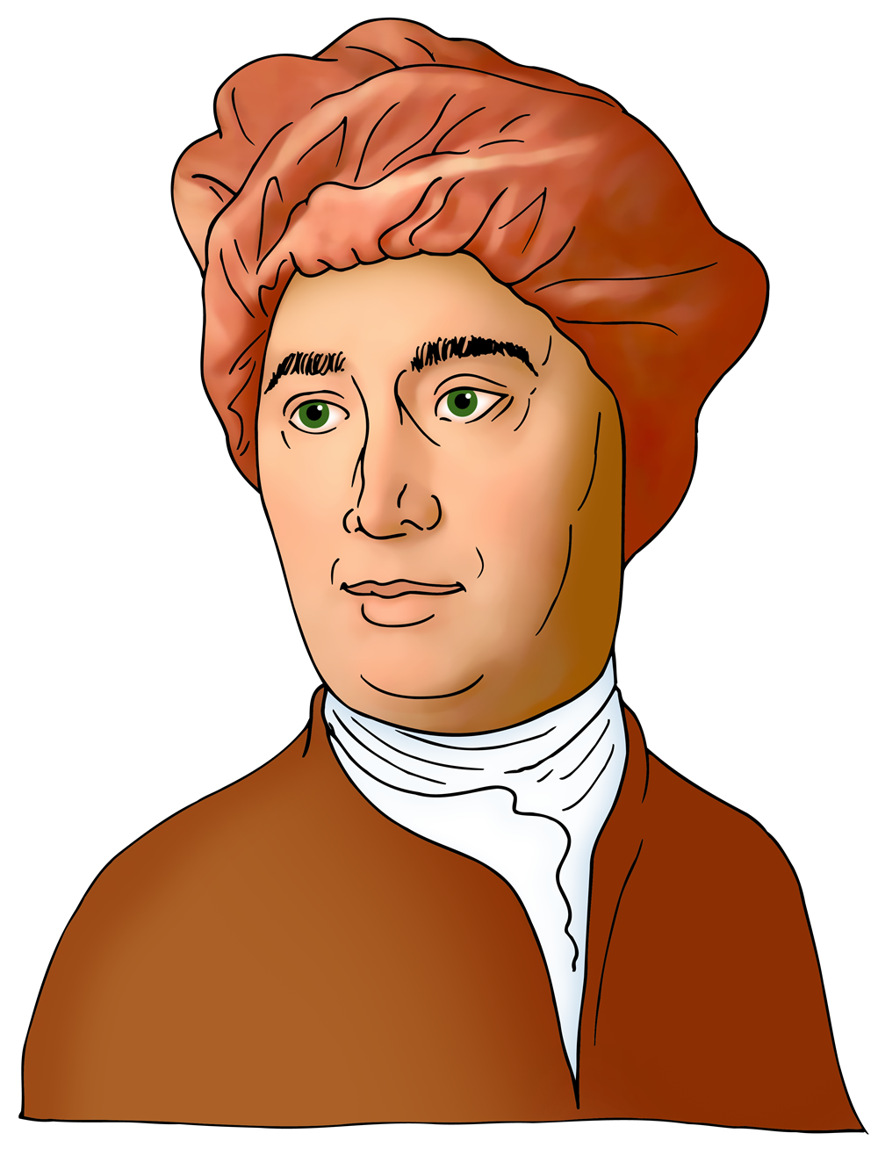
An immersion into british philosophy
David Hume: a great skeptic
Criticizes Descartes’ rationalism: our ideas cannot be confirmed by immediate perceptions
1711
1776
Hume’s fork:
Demonstrative statement – irrefutable
(a priori knowledge), 2 + 2 = 4
Probable statement – refutable , needs empirical proof
David Hume
Thomas Bayes
Georgios Magkakis.
- A Treatise of Human Nature: Being an Attempt to introduce the experimental Method of Reasoning into Moral Subjects (1739)
- Enquiries concerning Human Understanding (1748)
Concludes that reports of miracles change nothing regarding our understanding of human existence
Concludes that belief is at the center of rationalism, not reason
Clergy opposes
Richard Price

Slide 3

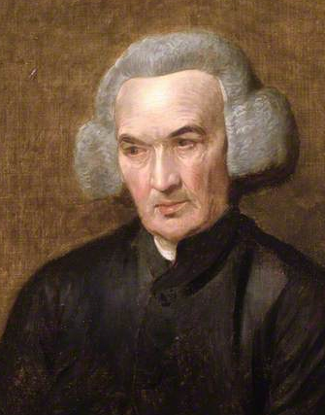
Thomas Bayes’ theorem might be seen as a rebuttal of David Hume’s work
Thomas Bayes :
Highly skilled amateur mathematician & clergyman.
Started working on his theorem shortly after Hume’s conclusion on miracles
An Essay towards solving a Problem in the Doctrine of Chances (1763)
1702
1761
1723
1791
Compiles and complete abandoned notes and essay
Thomas Bayes
Richard Price : Clergyman and pioneer insurance statistician.
Completed and published Bayes works after his death
Richard Price

Slide 4
Thomas Bayes’ theorem might be seen as a rebuttal of David Hume’s work
1711
1776
1702
1761
Bayes theorem combines Hume’s fork:
1723
1791
Demonstrative statement – irrefutable
(a priori knowledge)
Probable statement – refutable , needs empirical proof
David Hume
Thomas Bayes
Georgios Magkakis.
Price uses Bayes’ theorem to explain miracles (improbable events)
Richard Price
https://mindmatters.ai/2020/12/how-bayes-math-rule-can-counter-unreasonable-skepticism/

Slide 5
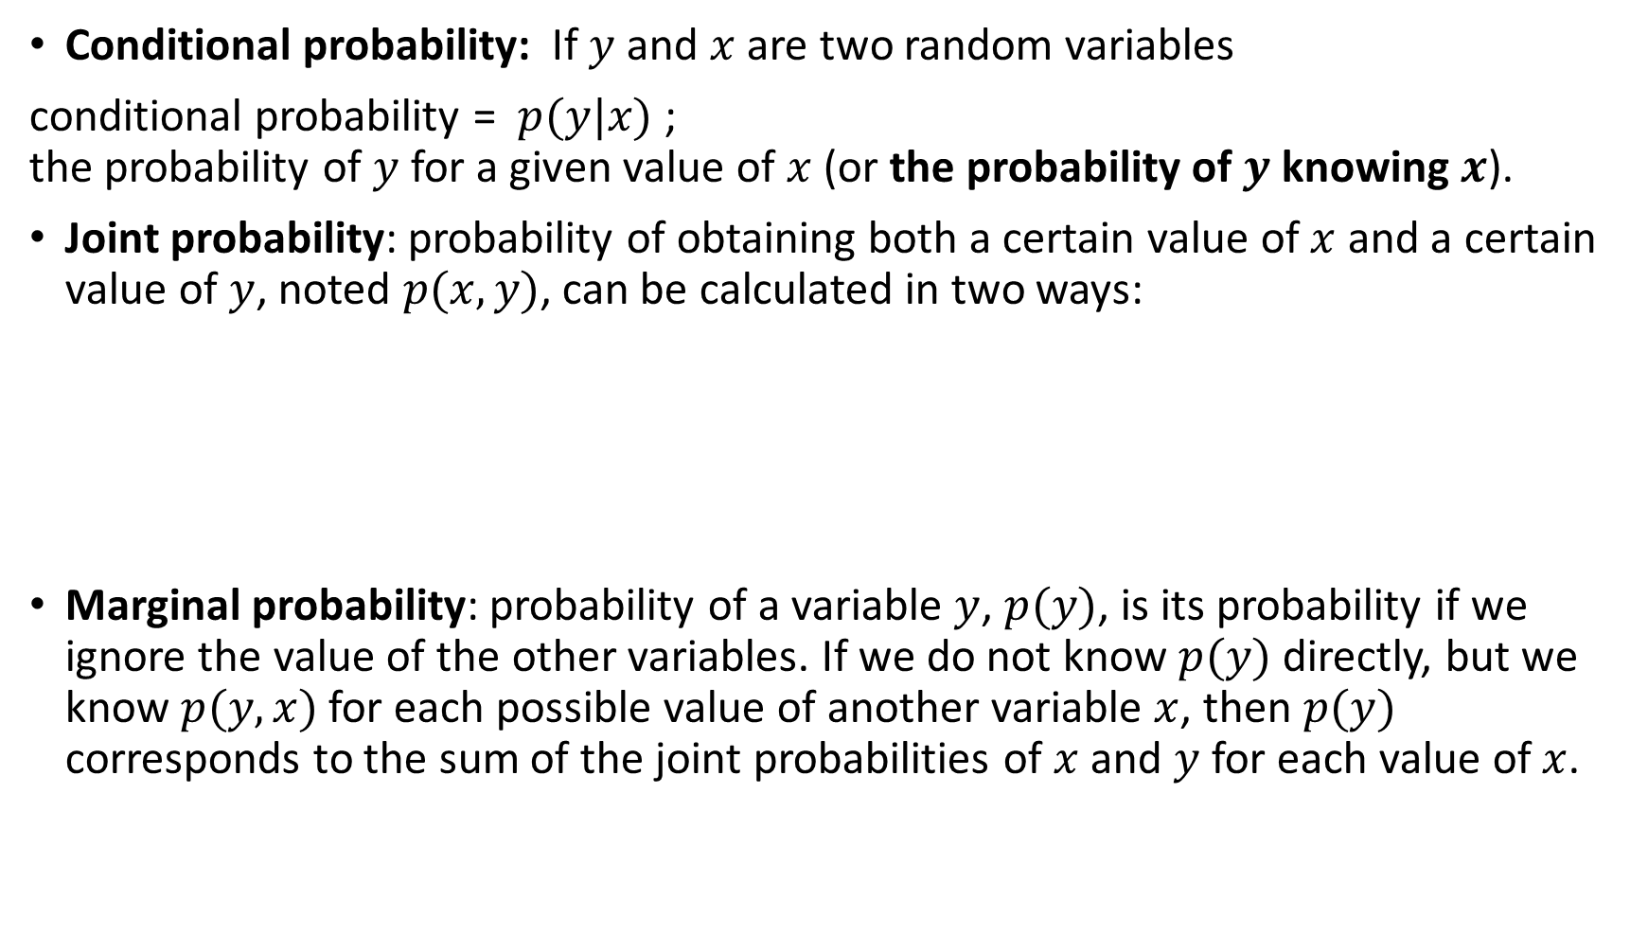
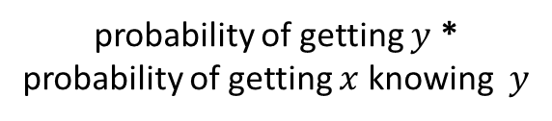
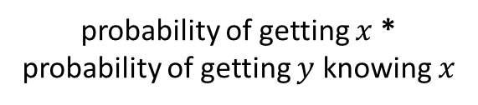
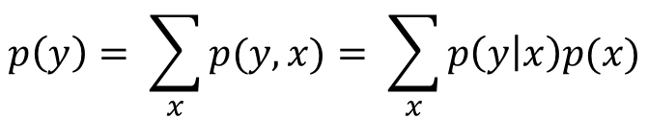
Did you say probable(-ility)?
Conditional probability: If $y$and $x$are two random variables
conditional probability = $p(y|x)$ ; the probability of $y$ for a given value of $x$ (or the probability of $y$ knowing $x$).
Joint probability: probability of obtaining both a certain value of $x$ and a certain value of $y$, noted $p(x,y)$, can be calculated in two ways:
Marginal probability: probability of a variable $y$, $p(y)$, is its probability if we ignore the value of the other variables. If we do not know $p(y)$ directly, but we know $p(y,x)$for each possible value of another variable $x$, then $p(y)$ corresponds to the sum of the joint probabilities of $x$ and $y$ for each value of $x$.
$$p(x, y) = p(x)p(y|x) = p(y)p(x|y)$$
probability of getting $x$ * probability of getting $y$ knowing $x$
probability of getting $y$ * probability of getting $x$ knowing $y$
$$p\left(y\right)= \sum_{x}{p(y,x)}= \sum_{x}{p\left(y | x\right)p(x)}$$

Slide 6

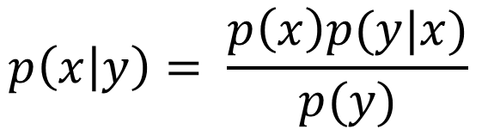
Bayes’ theorem
Frequentist approach !
Prior distribution
Likelihood function
Posterior distribution
$$p\left(x | y\right)= \frac{p\left(x\right)p(y|x)}{p(y)}$$
Probability of data
Marginal probability constant often omitted as it does not change the outcomes

Slide 7
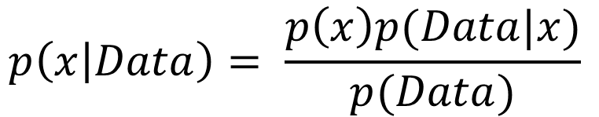
Bayes’ theorem
What we know A Priori
The model
Parameters estimates
$$p\left(x | Data\right)= \frac{p\left(x\right)p(Data|x)}{p(Data)}$$
Probability of data

Slide 8
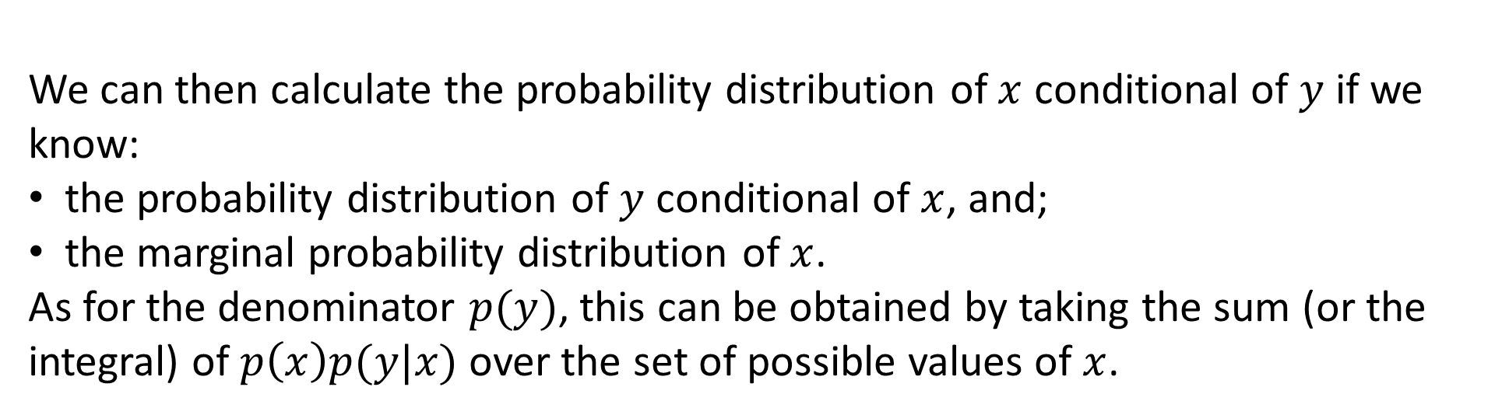
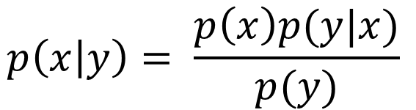
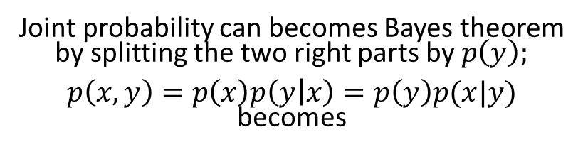
Bayes’ theorem
Joint probability can becomes Bayes theorem by splitting the two right parts by$p\left(y\right)$;
$p\left(x,y\right)=p\left(x\right)p\left(y | x\right)=p\left(y\right)p(x|y)$ becomes
Prior distribution
Likelihood function (model)
$$p\left(x | y\right)= \frac{p\left(x\right)p(y|x)}{p(y)}$$
Posterior distribution
We can then calculate the probability distribution of $x$ conditional of $y$ if we know:
the probability distribution of $y$ conditional of $x$, and;
the marginal probability distribution of $x$.
As for the denominator $p(y)$, this can be obtained by taking the sum (or the integral) of $p\left(x\right)p(y|x)$over the set of possible values ​​of $x$.
Probability of data

Slide 9
So, how do we solve Bayes’ theorem?
Bayes theorem: can be hand solved for simple cases, but not for most of modern day use. --> Need a powerful computer.
Instead of resolving complex integrals, it is estimated by simulating many, many, many posterior distributions
Widely used algorithms:
WinBUGS, BUGS, JAGS, STAN, Nimble

Slide 10
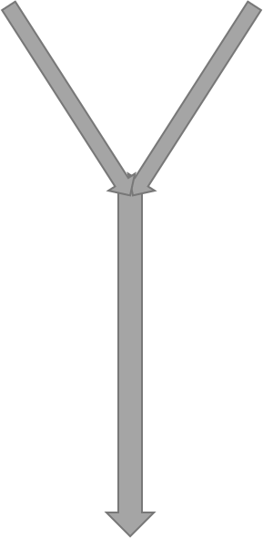

Prior
knowledge
p(x|𝐷𝑎𝑡𝑎)
Posterior distribution
Data

Slide 11
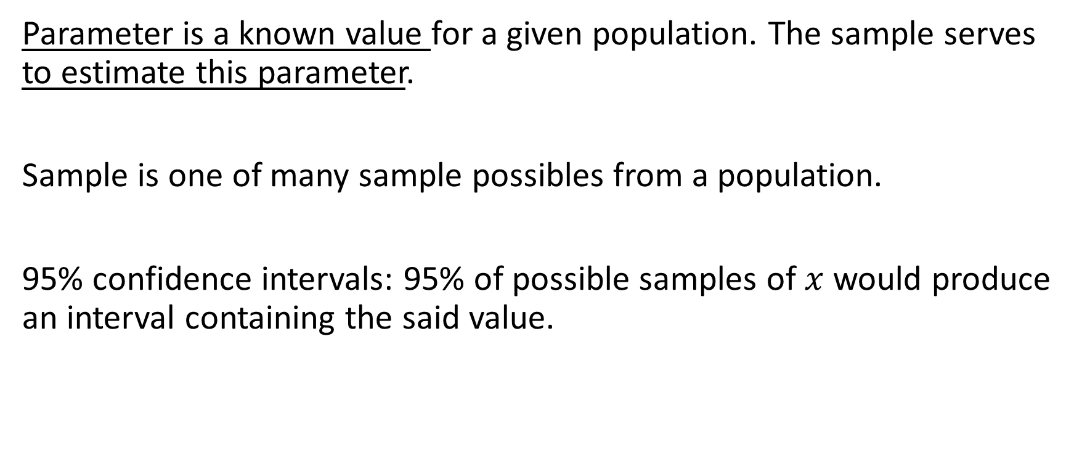
Frequentist
Parameter is a known value for a given population. The sample serves to estimate this parameter.
Sample is one of many sample possibles from a population.
95% confidence intervals: 95% of possible samples of $x$ would produce an interval containing the said value.

Slide 12
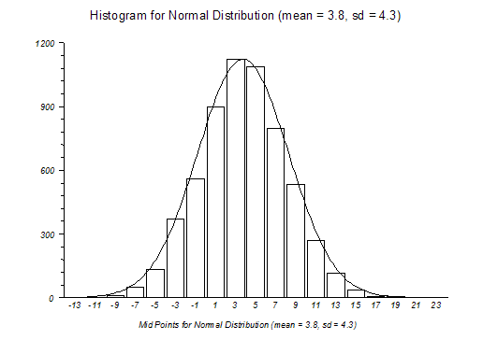
Bayesian
Parameter is a random value drawn from a distribution
Sample represents truth (what we actually know)
95% confidence intervals: Probability to observe the parameter within the interval’s boundary. → credible interval.

Slide 13
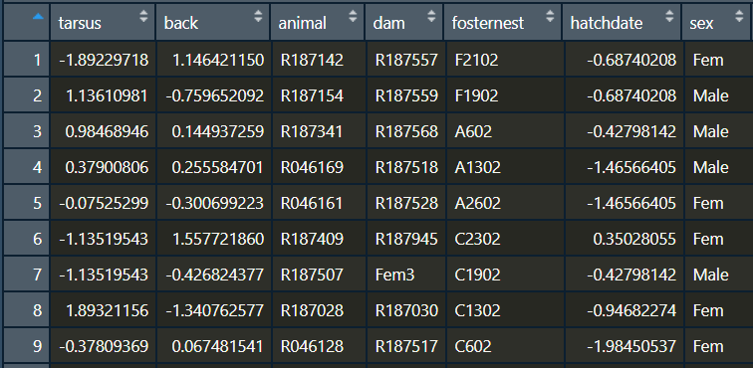
Our data : BTdata.txt
Tarsus length
Bird ID
One measure/ID
Mom ID
Bird sex

Slide 14
A typical frequentist model
require(glmmTMB)
mod_freq -> glmmTMB(Tarsus ~ sex + (1|dam), family=‘gaussian’, data=BTdata)

Slide 15

Stan… who?
https://mc-stan.org/users/interfaces/rstan

Slide 16
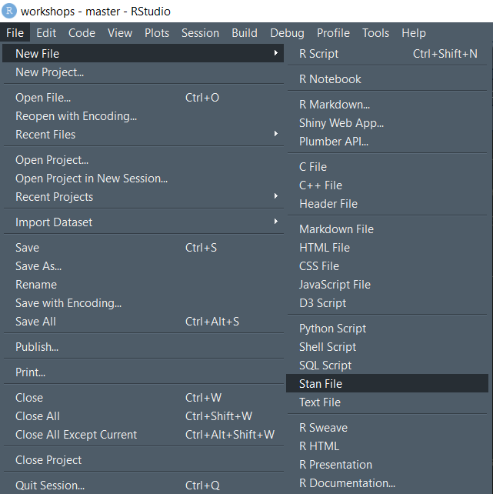
To open a new Stan file

Slide 17
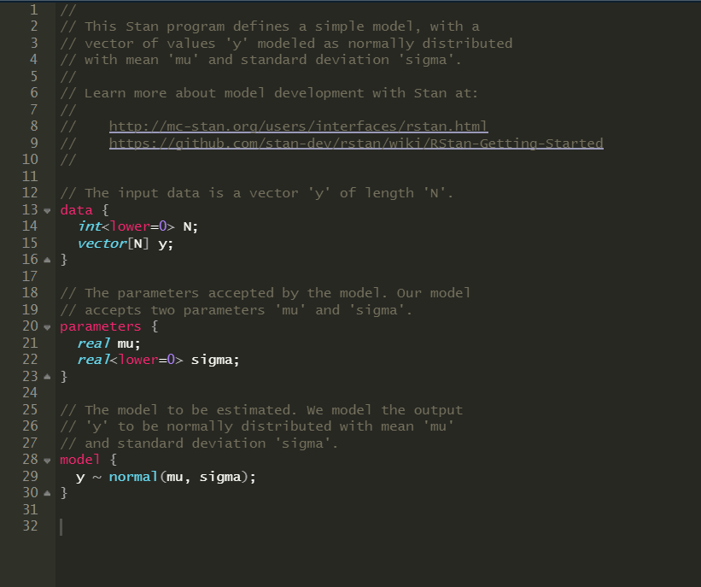
Empty Stan file
Use two forward slashes instead of a pound (#) when you want to write text and not code
Where to click if you have trouble coding in Stan
Define your data
Define your parameters
Define your model

Slide 18
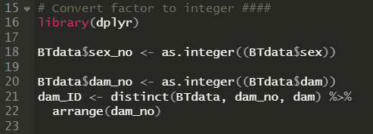
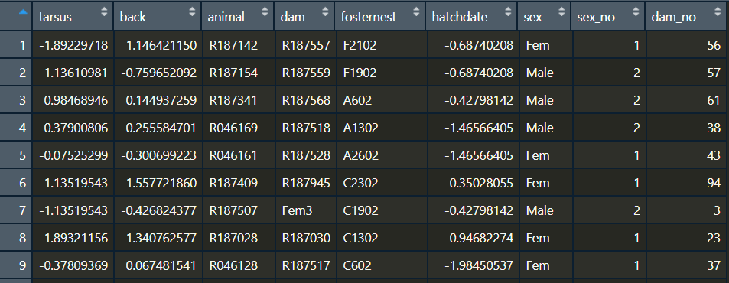
Stan hates factor… so make it integer!
Creates a DF indicating which dam_no corresponds to which dam ID

Slide 19






Our model
$$i=observation number$$
$$μ_{ij}=β_{0j}+β_{i}x_{ij}+ε_{0ij}$$
$$j=group (mother ID)$$
$$β_{0j}=β_{0}+μ_{0j}$$
$$μ_{0j} \sim N(0,σ_{μ_{0}}^{2})$$
$$ε_{0ij}\sim N(0,σ_{e_{0}}^{2})$$
Tarsus length
Intercept
Sex
Error

Slide 20
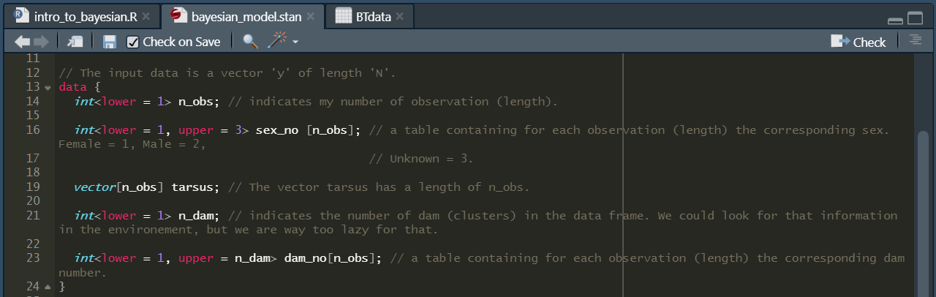
Coding data in Stan
Use chevrons to indicate boundaries!
Use brackets to indicate the length of your data!

Slide 21
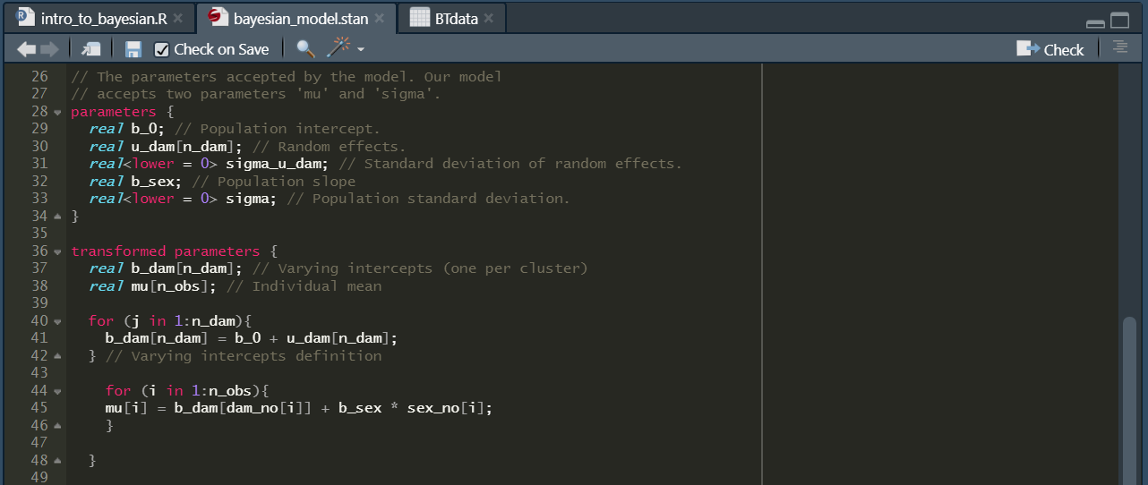
Coding parameters in Stan

Slide 22
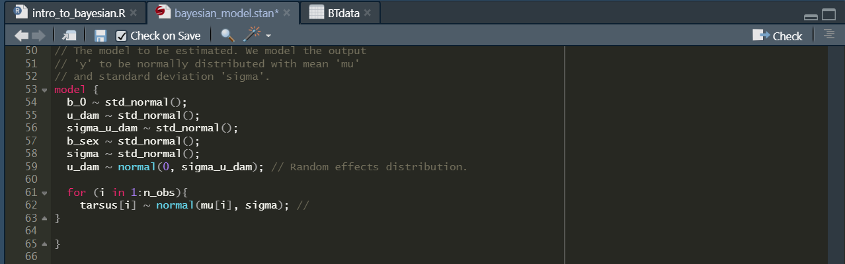
Coding models in Stan

Slide 23
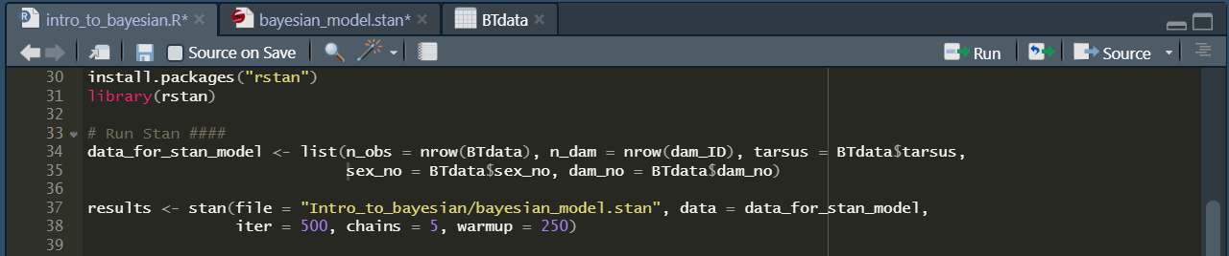
Run your Stan model in R

