Slide 1
A Newish Approach to
Quantum Hash Function
Exploring Quantum Circuits for Secure Hashing
by - Samradh

Slide 2
The Goal of the challenge:
the students will be required to develop a hash function in Python using their quantum simulator of choice. The input to this function will be an array of 2N bytes, where N can be any natural number greater than or equal to 5, and the function must produce the byte output of the same size. The function can only utilize the resulting expectation values for each qubit after conducting quantum simulations.
Why it matters:
Quantum hash functions matter because they offer stronger security by leveraging quantum properties like superposition and entanglement. They can resist quantum attacks that break classical hashes, enabling secure communication, authentication, and blockchain applications in the quantum era. They're key to building quantum-safe cryptographic systems for the future.

Slide 3
What is a Quantum Hash Function?
A quantum hash function uses quantum circuits to encode classical input into quantum states and generate a fixed-length output based on measurement or expectation values.
Core Features
Leverages quantum properties: superposition, entanglement, measurement
Can offer stronger security guarantees
Can increase complexity exponentially with circuit size
My Approach
Uses expectation values (Pauli-Z) and parameterized circuits, not measurements, with some other techniques.

Slide 4
Overview of my Approach
Takes input data of size 2^N bytes
Produces a hash output of the same size (2^N bytes)
Uses a parameterized quantum circuit
Each layer uses rotation gates rx, ry, rz
Entanglement via cx (CNOT) gates
*Output is iteratively rehashed to increase complexity
*This approach makes it different from most of the currently available quantum hash functions

Slide 5
Architecture of the Quantum Hash Function
Input data → Convert to angles for parameterized gates
Build circuit with N qubits, 4 layers of gates
Run the circuit → obtain statevector
Compute Pauli-Z expectation values
Convert to fixed-point → output bytes
Feed output back as input → repeat until output full
IMP: Hash output = Same size as input

Slide 6
Feedback Loop for Complexity
Output of the circuit is re-used as input for next iteration
Increases diffusion and cryptographic complexity
Inspired by multi-round designs in classical cryptography (e.g., Keccak rounds)
Prevents straightforward reverse-engineering
Example
Input → Circuit → Output₁ → Circuit again → Output₂ … until full hash generated

Slide 7
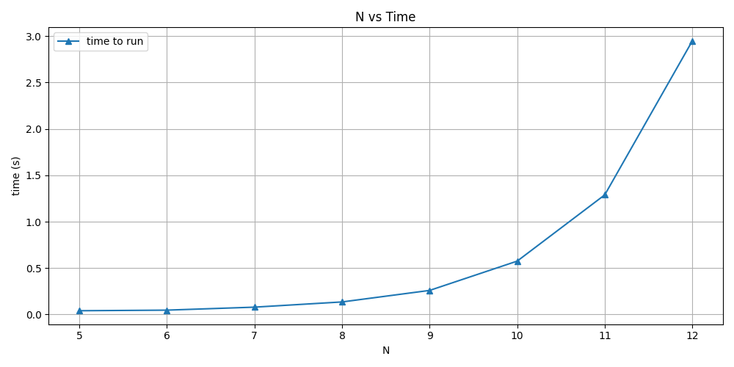
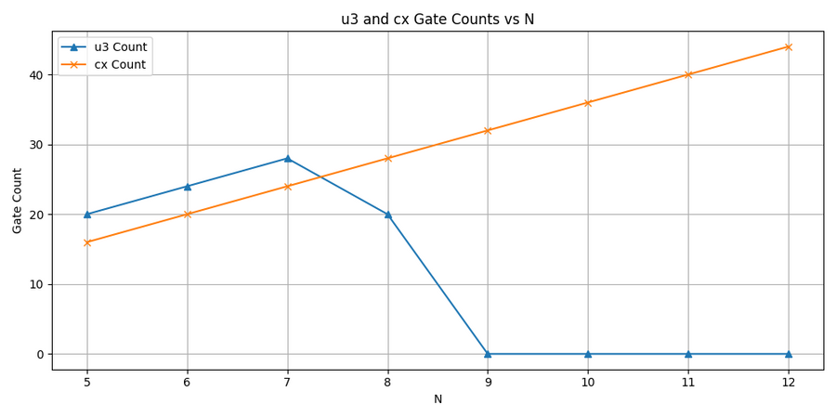
Analysis and Metrics
Determinism: Always same output for same input
Entropy: ~5.65 bits per byte
Pre-image Resistance: No input found for given hash in 1000 trials (N=7)
Collision Resistance: No collisions in 500 trials
Computational Complexity: Time grows exponentially with N

Slide 8
Currently Used Quantum Hash Strategies
1. Quantum Fingerprinting
→ Compares quantum states efficiently
->Not used for secure hashing
2. Phase Estimation-Based Hashing
->Uses eigenvalue mapping to encode data
->More abstract, hard to implement on NISQ devices
3. Grover-Resistant Hashing
->Uses classical hash with large search space
->Only slows down quantum attackers
My Approach:
Combines structured determinism with iterative depth
Uses expectation values → interpretable and circuit-friendly
Compatible with NISQ hardware

Slide 9
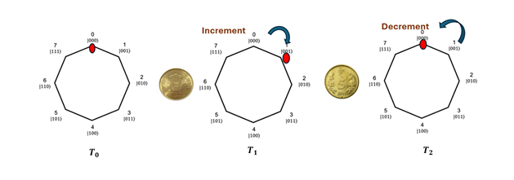
Some works worth to mention
https://arxiv.org/pdf/2408.03672
https://arxiv.org/pdf/2310.17439
https://www.nature.com/articles/s41598-023-33119-w
While these papers provide really helpful insights into designing hash functions, most of them lack necessary properties required. One of such is Quantum walks, it brings in complexity, but it often produce different hash for same input.

Slide 10
Thank You
The code is more detailed. promise :)

