Slide 1
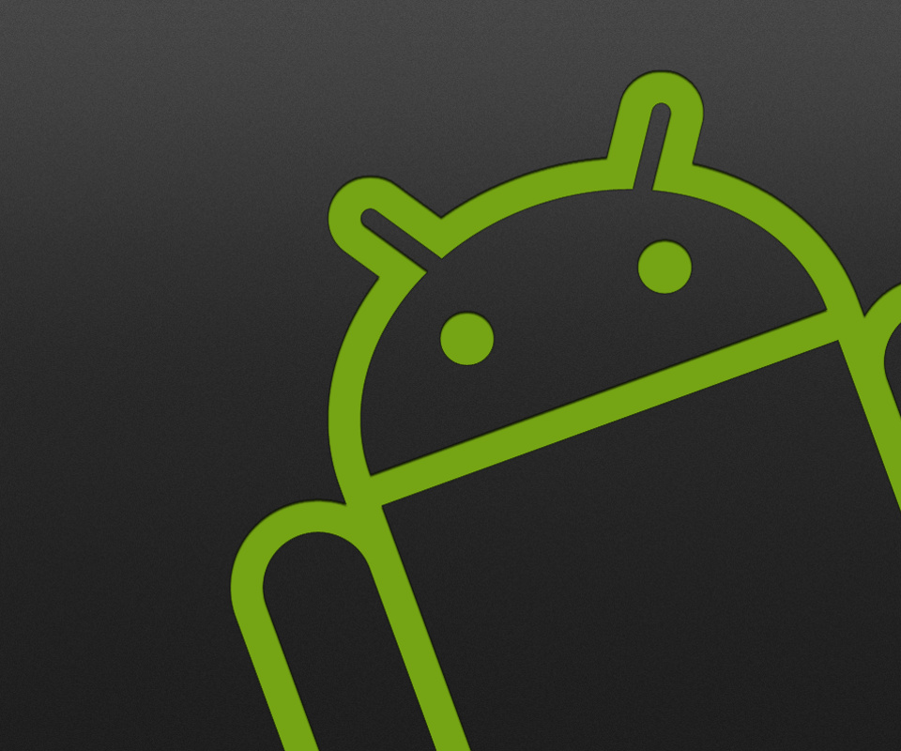
Android
Tariq Almulhim
Joe Donnelly
Cormac Kelly
Keith Nevin
Amandeep Singh
Alexander Witte

Slide 2
Contents:
A biography of Andy Rubin.
A Diagram of the architecture of Android.
The desktop of the Android.
Advantage.
Disadvantage.

Slide 3
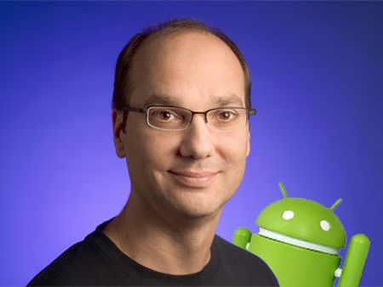
Andy Rubin
Andy Rubin is the founder and former CEO of android.
He oversaw mobile development at google for almost nine years.

Slide 4
Early Life
Born on June 22, 1962.
His father’s firm sold electronic gadgets.
In his teens Rubin ran a computer bulletin board system.
Received a bachelor’s degree in computer science from Utica College in 1986.

Slide 5
Career
After graduating he worked at Carl Zeiss AG in the robotics position.
Rubin met Bill Caswell on holiday and was offered a job at apple.
Working at General Magic in the early 90s he helped develop Magic Cap, an operating system for mobile devices.
When Magic Cap failed he joined Artemis Research and co developed the WebTV which was later acquired my Microsoft.

Slide 6
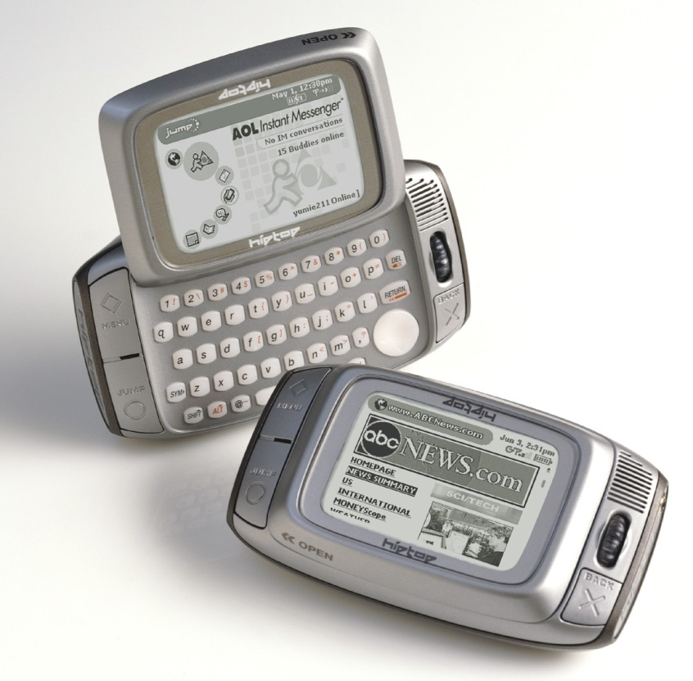
In 1999 he co-founded Danger Inc., most notable for producing an early smartphone of sorts called the Hiptop.
In 2008 long after Rubin had left the company it was also acquired by Microsoft.
Rubin left Danger in 2004, one year after he co-founded Android with Matt Hershenson and Joe Britt.

Slide 7
Working at Android
"Android started from a simple idea, provide a powerful mobile platform and open so that it can encourage more rapid innovation and customer benefit,“ – Andy Rubin.
In their first year of business Rubin ran out of money and had to rely on his friend giving him $10,000 in cash to keep the company afloat.
In August 2005 Android was acquired by google and Rubin followed.

Slide 8
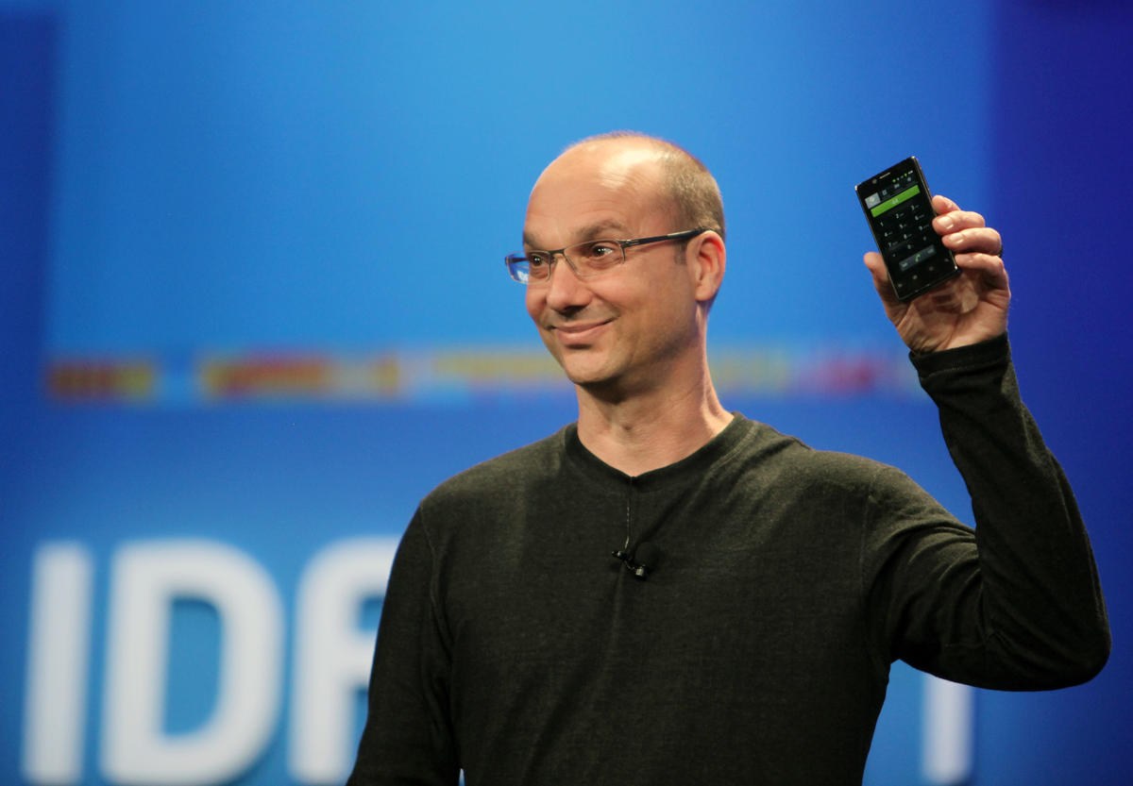
At Google, Rubin led a team which developed a mobile device platform powered by the Linux kernel.
He went on to become Senior Vice President of Mobile and Digital Content at Google.
In October 2014 after briefly managing the robotics division of Google, Rubin left the company to start an incubator for hardware startups.

Slide 9
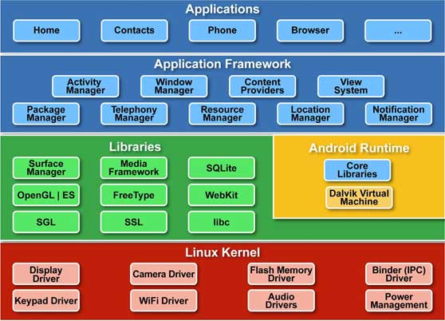
The diagram of the architecture of Android.

Slide 10
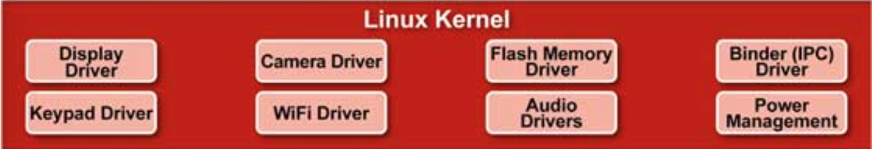
Linux Kernel
Positioned at the bottom of the Android software stack, the Linux Kernel provides a level of abstraction between the device hardware and the upper layers of the Android software stack. Based on Linux version 2.6, the kernel provides preemptive multitasking, low-level core system services such as memory, process and power management in addition to providing a network stack and device drivers for hardware such as the device display, Wi-Fi and audio.

Slide 11
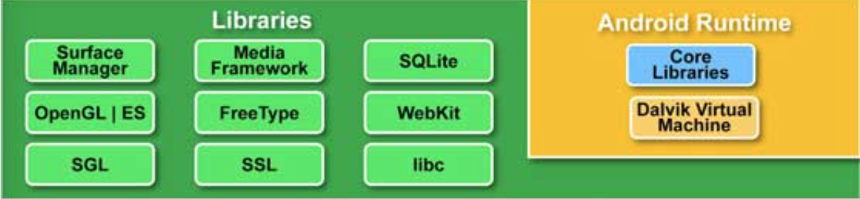
Libraries
On top of Linux kernel there is a set of libraries including open-source Web browser engine WebKit, well known library libc, SQLite database which is a useful repository for storage and sharing of application data, libraries to play and record audio and video, SSL libraries responsible for Internet security etc.

Slide 12
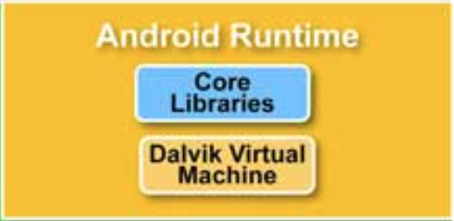
Android Runtime
This is the third section of the architecture and available on the second layer from the bottom. This section provides a key component called Dalvik Virtual Machine which is a kind of Java Virtual Machine specially designed and optimized for Android. The Dalvik VM makes use of Linux core features like memory management and multi-threading, which is intrinsic in the Java language. The Dalvik VM enables every Android application to run in its own process, with its own instance of the Dalvik virtual machine.

Slide 13
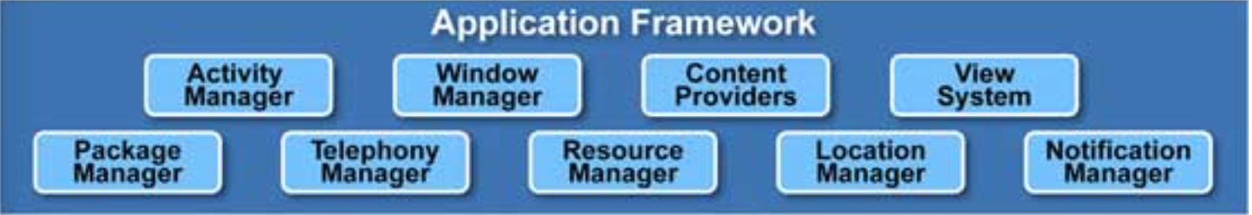
Application Framework
The Application Framework layer provides many higher-level services to applications in the form of Java classes. Application developers are allowed to make use of these services in their applications.

Slide 14
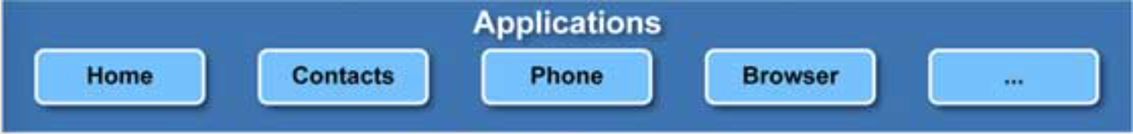
Applications
You will find all the Android application at the top layer. You will write your application to be installed on this layer only. Examples of such applications are Contacts Books, Browser, Games etc.

Slide 15
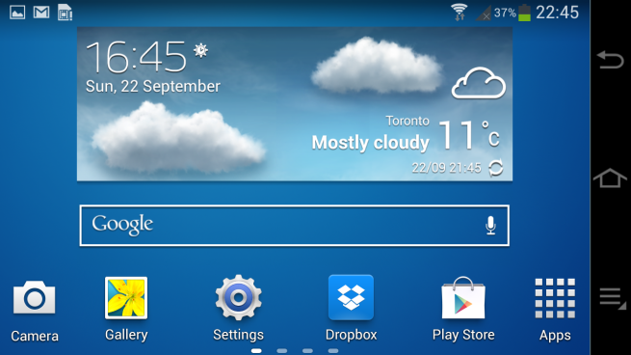
Desktop of Android
This is the desktop of android
It contains many features such as the time, battery usage and widgets.
The feature of widgets allows you to make your desktop the focus point of the system.

Slide 16
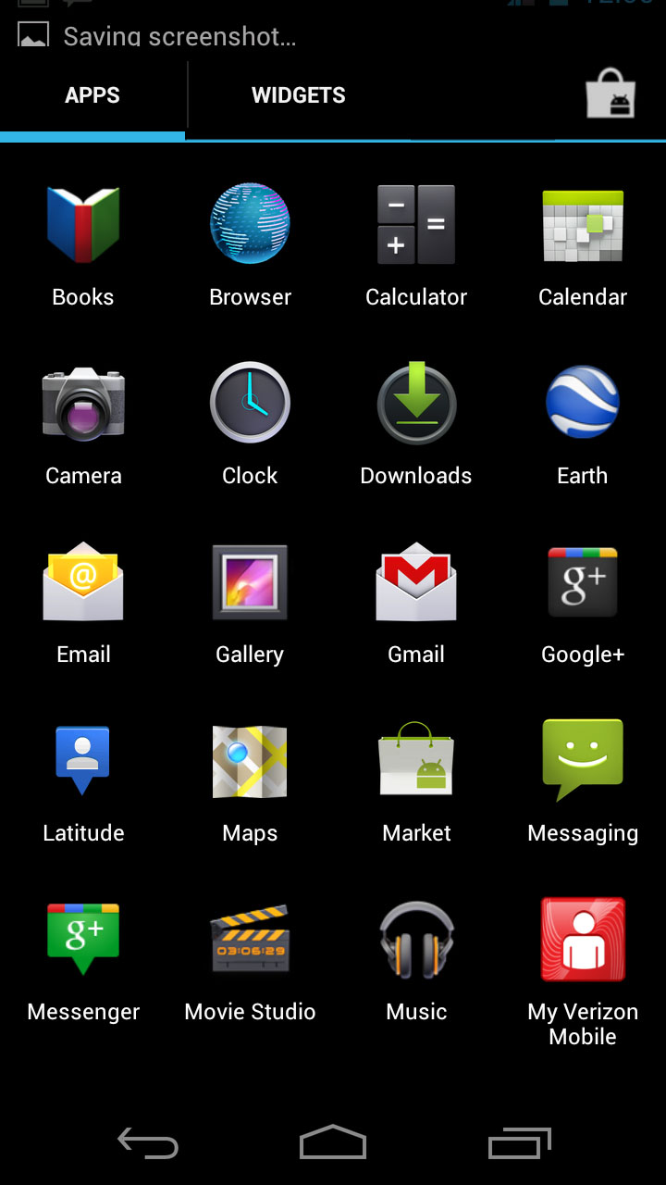
Android Menu
This is the main menu of android.
It contains all your applications.
It is an organized layout with rows
of 4 applications.

Slide 17
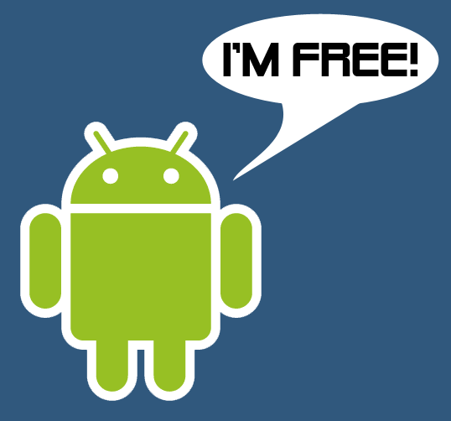
Advantages of android
Applications are easily obtainable on the Google play store.
Android much like most operating systems on phones allows you to multi-task.
Android is also good at dealing with notifications.
Android can be changed using ROMS which can change the look of your operating system.

Slide 18
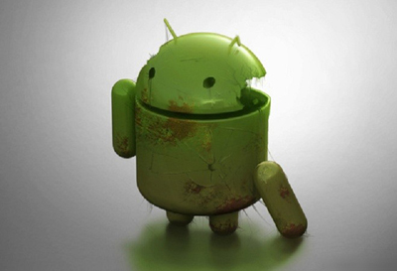
Disadvantages of android
Continuous Internet connection - Most Android phones require a continuous internet connection for a lot of apps to work. This means the User must be prepared to buy phone network subscriptions that allow for a lot of internet usage
Advertising - A lot of applications on the Google Play store contain advertisements. Usually, to get rid of advertisements, the User must pay a small fee that will also allow you to unlock the “full game”. So while most apps are free, you won’t get the most out of the game unless you pay for it.

Slide 19
Lag - The Android OS is prone to lagging when playing games or using multiple programs at once.
Drain battery - Another disadvantage of Android is its very fast battery drain. You play a game for 5 minutes and your battery meter can drop by about 15%.
Over heats – The Android OS often causes phones to overheat. This, in time, damages the phone and causes the battery to expand meaning you’ll need to buy another battery in the near future.
Malware - While the Google Play store has a wide variety of applications, a lot of those apps contain malware and were created by spammers or hackers.

Slide 20
Conclusion
Everyone knows who’s the CEO founder of android.
Understand the of the architecture of Android.
Everyone saw how the environment of desktop.
Advantage and Disadvantage.

