Slide 1
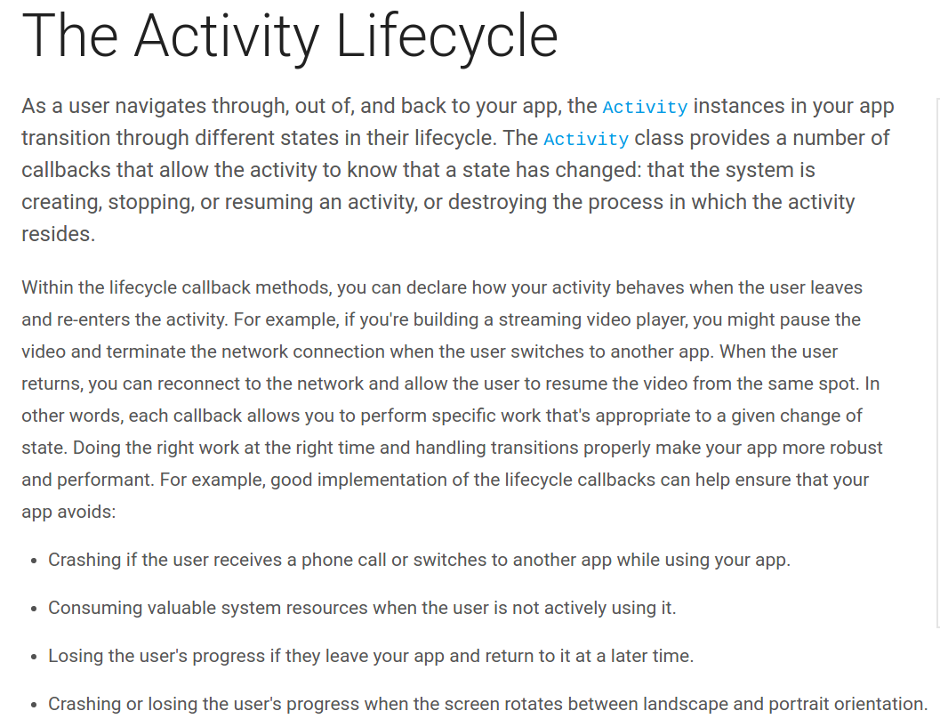

Slide 2
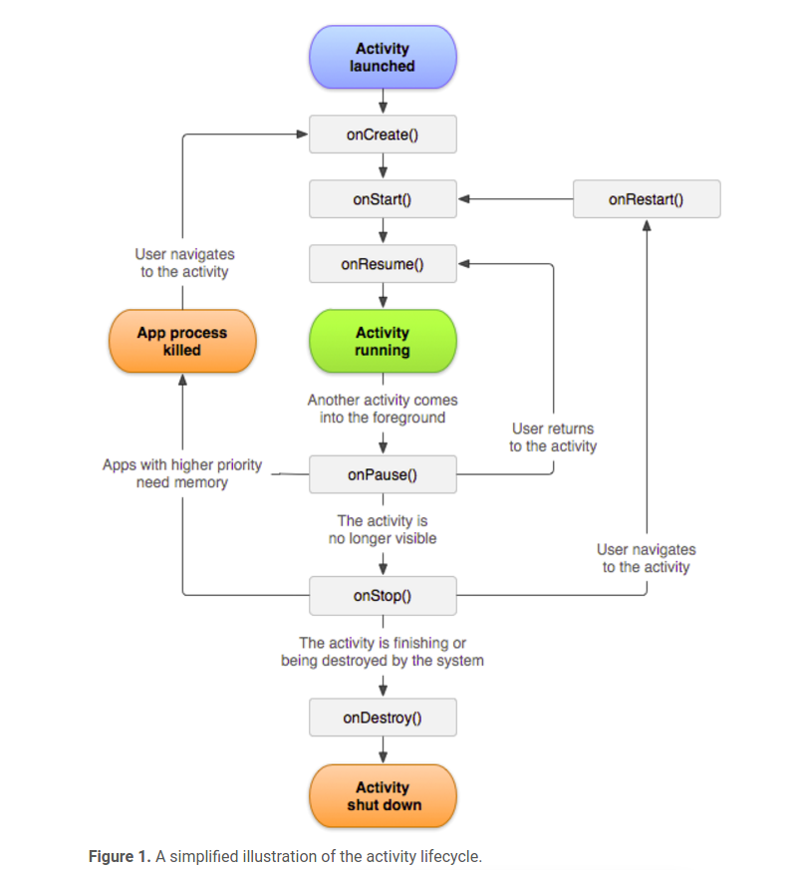

Slide 3


Slide 4


Slide 5
https://developer.android.com/guide/components/activities/activity-lifecycle.html

Slide 6
Using saveInsatanceState to save data which loses during device rotation

Slide 7
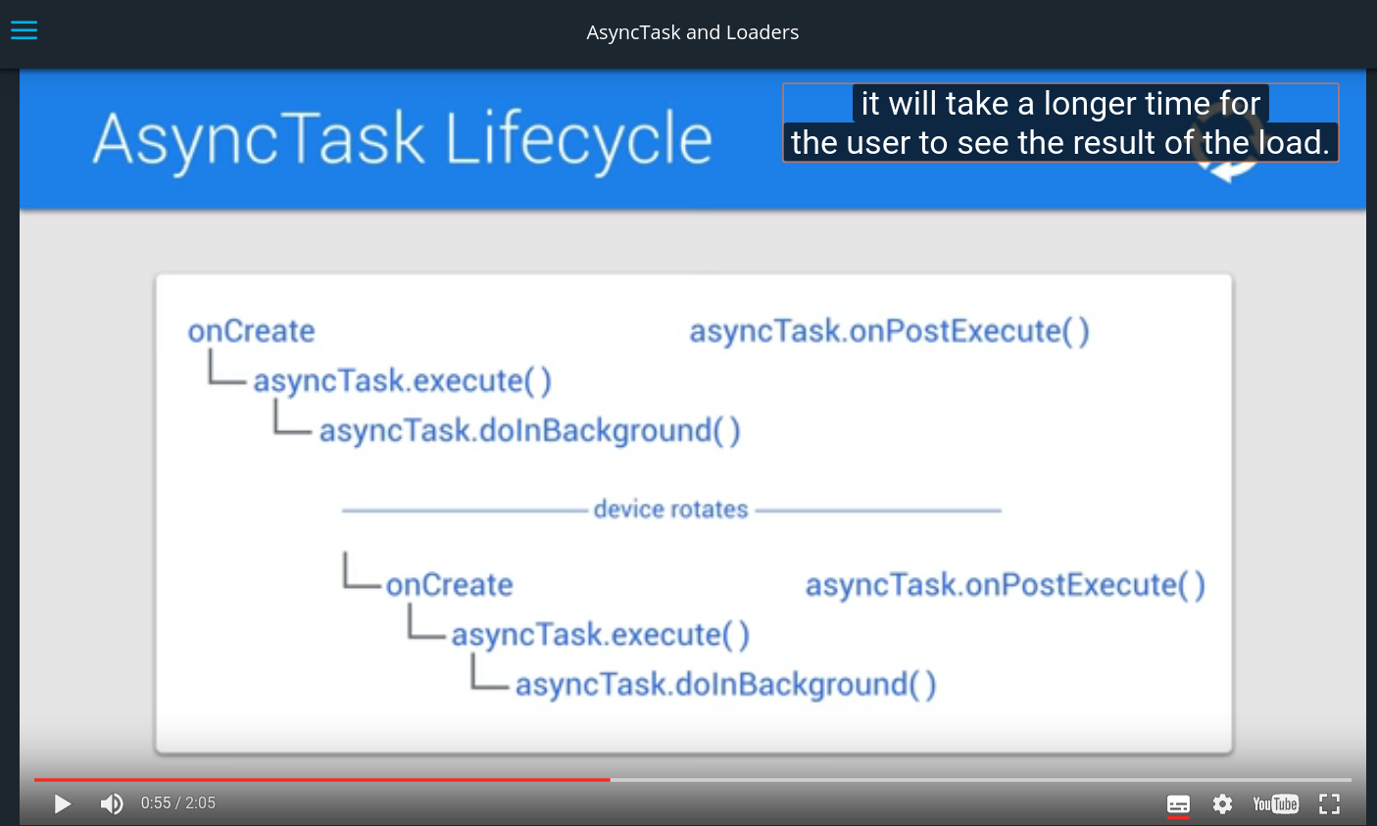
Problem of rotating device when network thread is still running

Slide 8
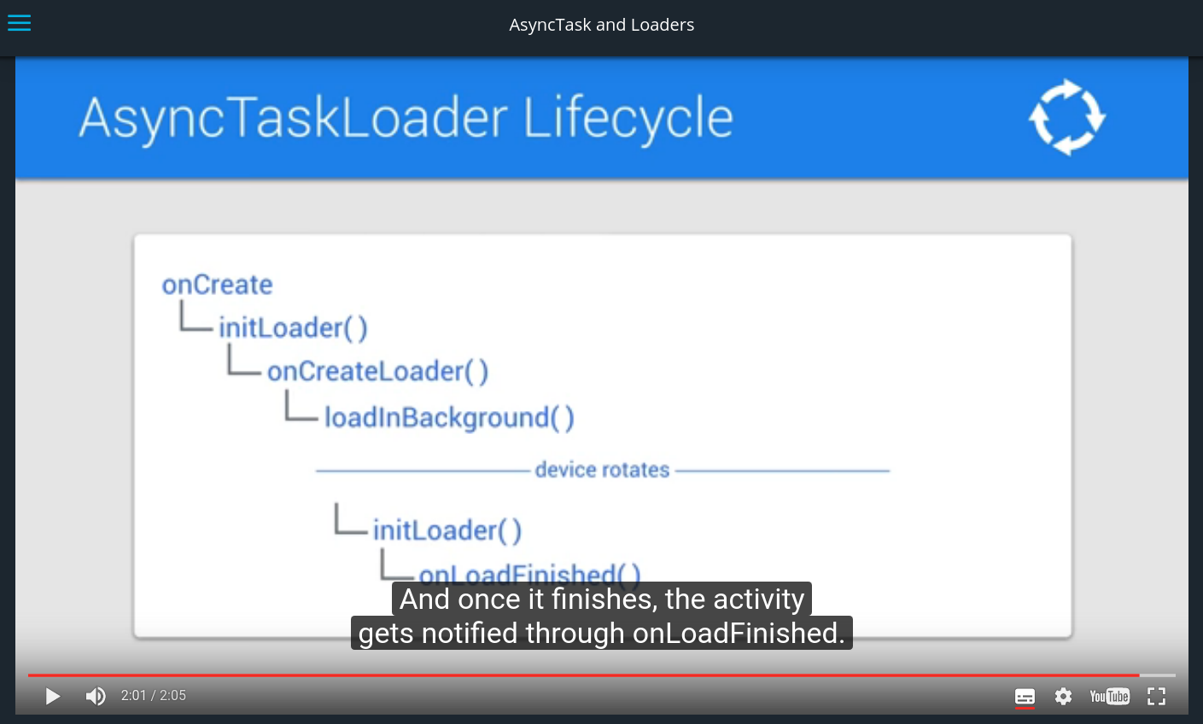
Solution of rotating device when network thread is still running

Slide 9
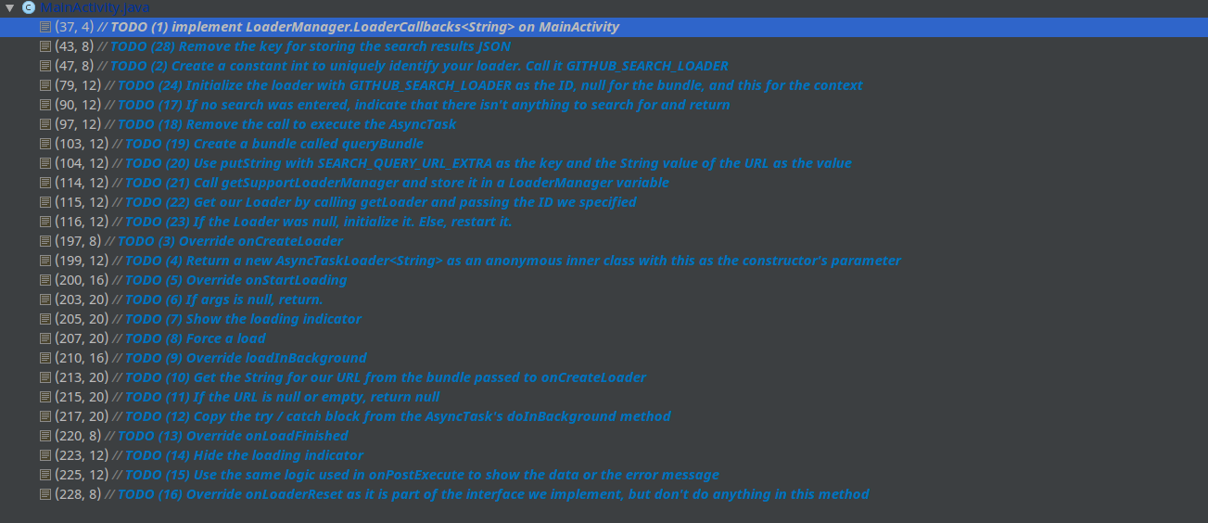
Steps to make async task loader

Slide 10
Code
5.02.asynctaskloader

