Slide 1
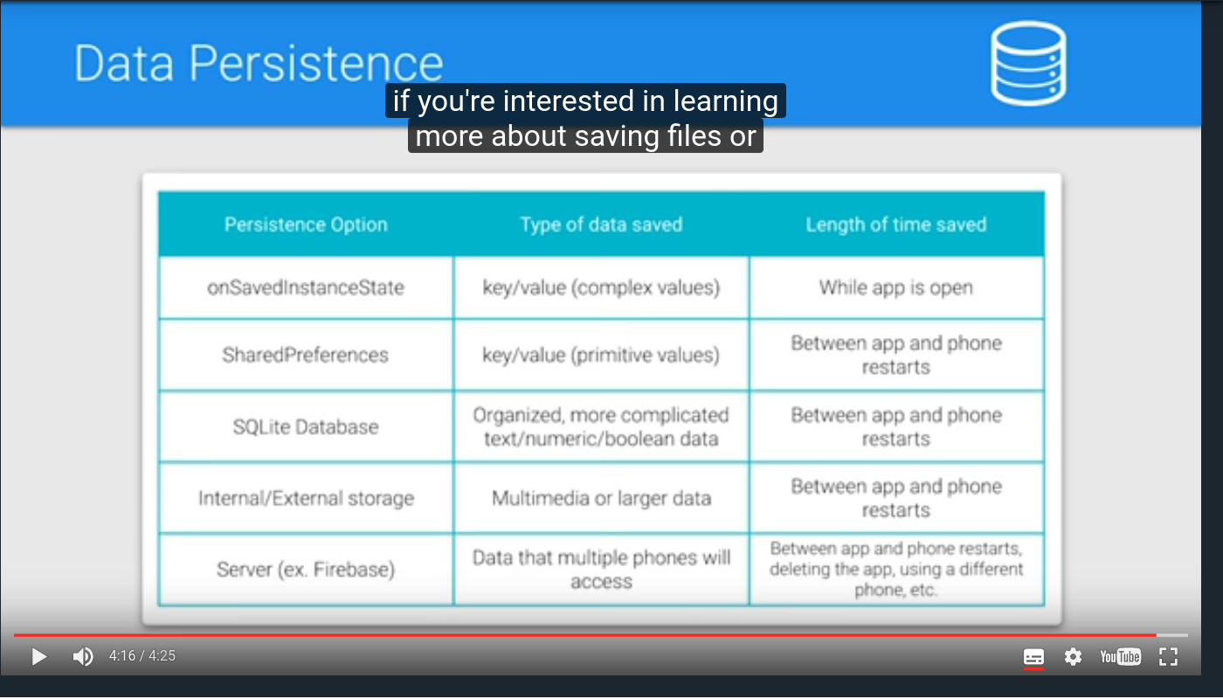

Slide 2

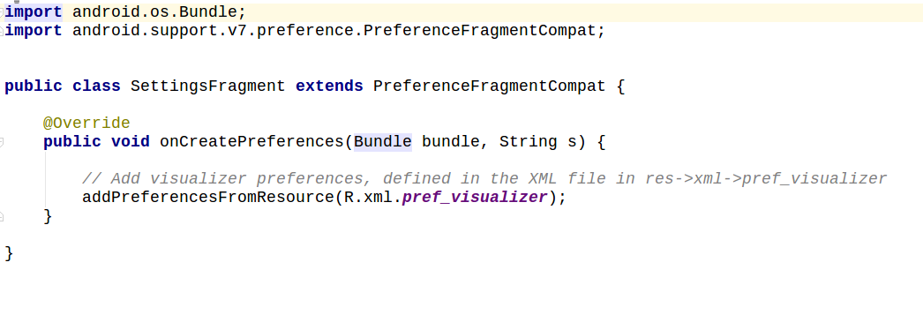
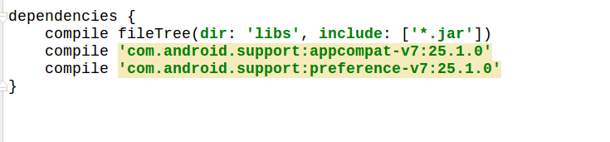

Slide 3
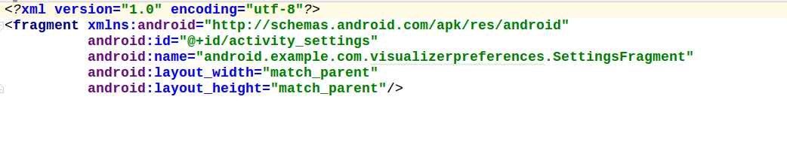
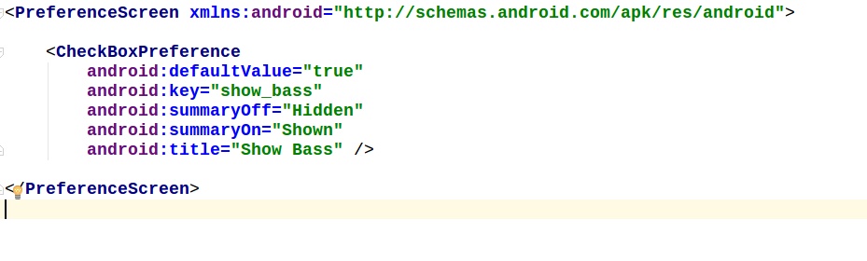
Till now, setting activity is made and value is saved in sharedprefernces but no changes is displayed on UI.

Slide 4
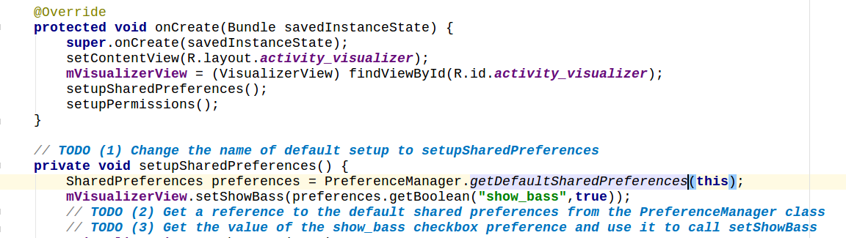
Displaying changes in ui but it will only show changes made in settings activity when application is turned off and then restarted or rotated.
Please note here that “show_bass” is the key of the checkbox and true is the default value for it.

Slide 5
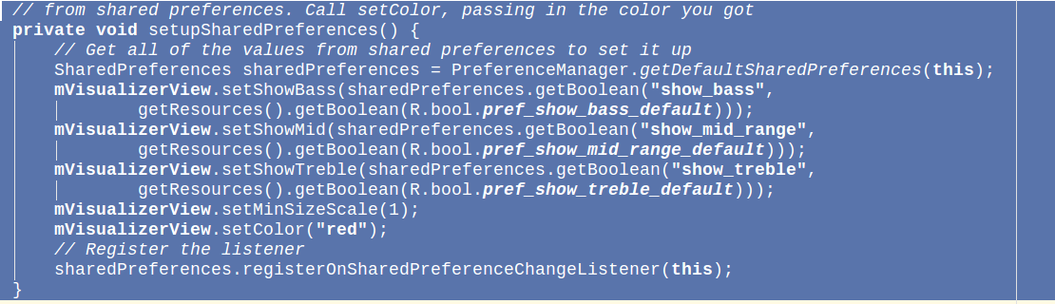
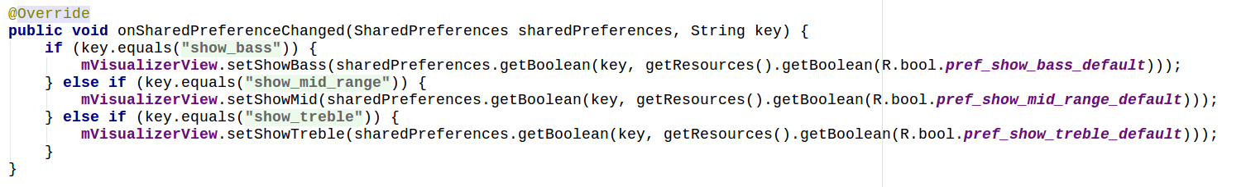
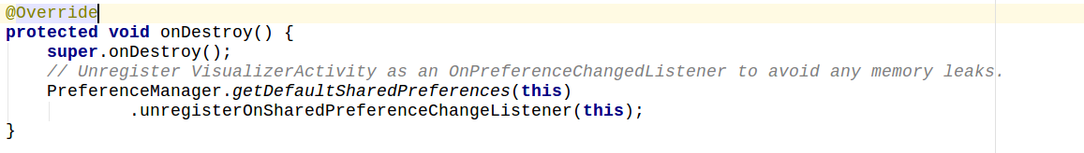
Direct response with sharedPreference

Slide 6
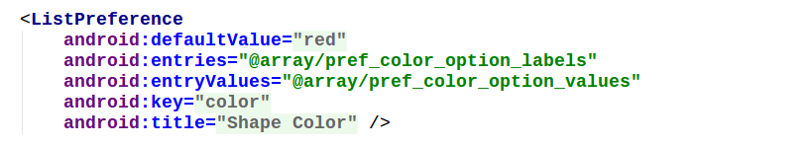
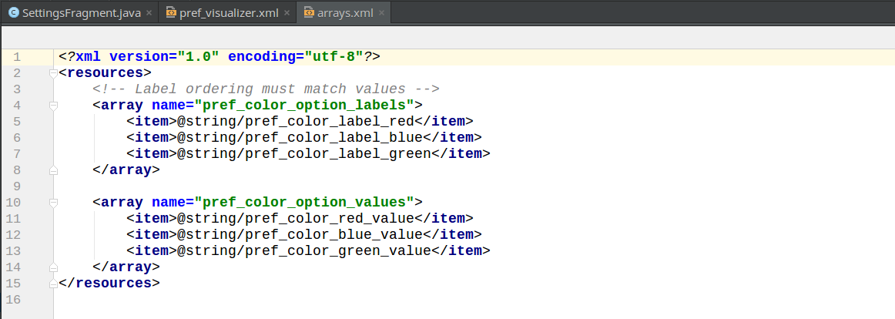
List preference
https://developer.android.com/reference/android/preference/ListPreference.html
here, defaultValue,key and title are just like checked preference but enteries and entryvalues are array
We will make a “arrays” xml file in value directory and inside it, two array one for entries and other for entryValue.

Slide 7
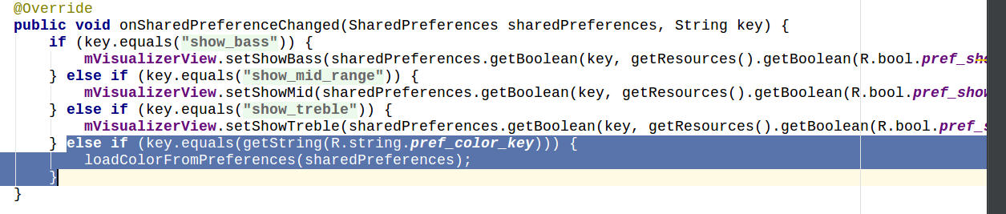

Slide 8
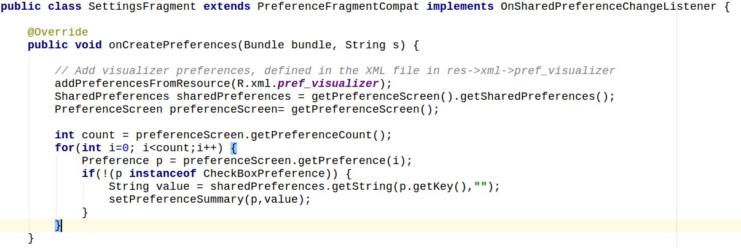
Preference Summary

Slide 9
