Slide 1
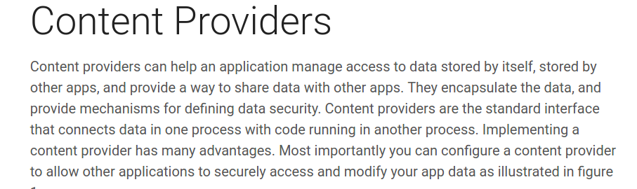
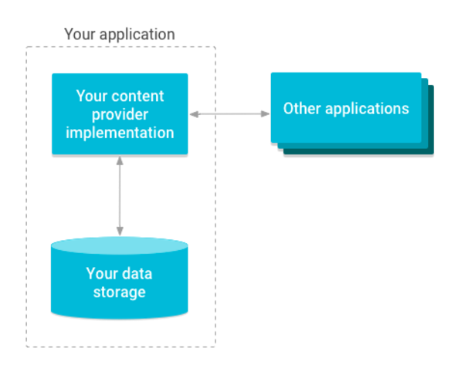

Slide 2
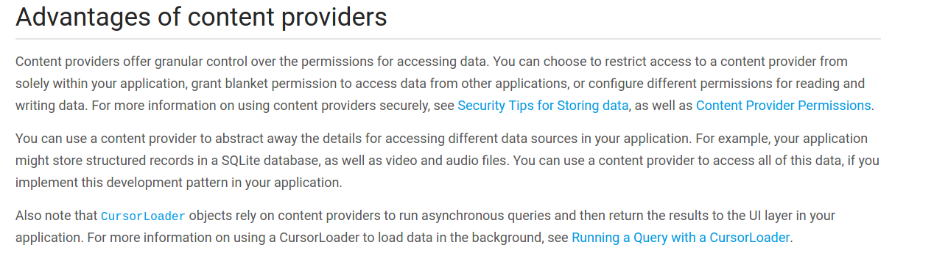

Slide 3
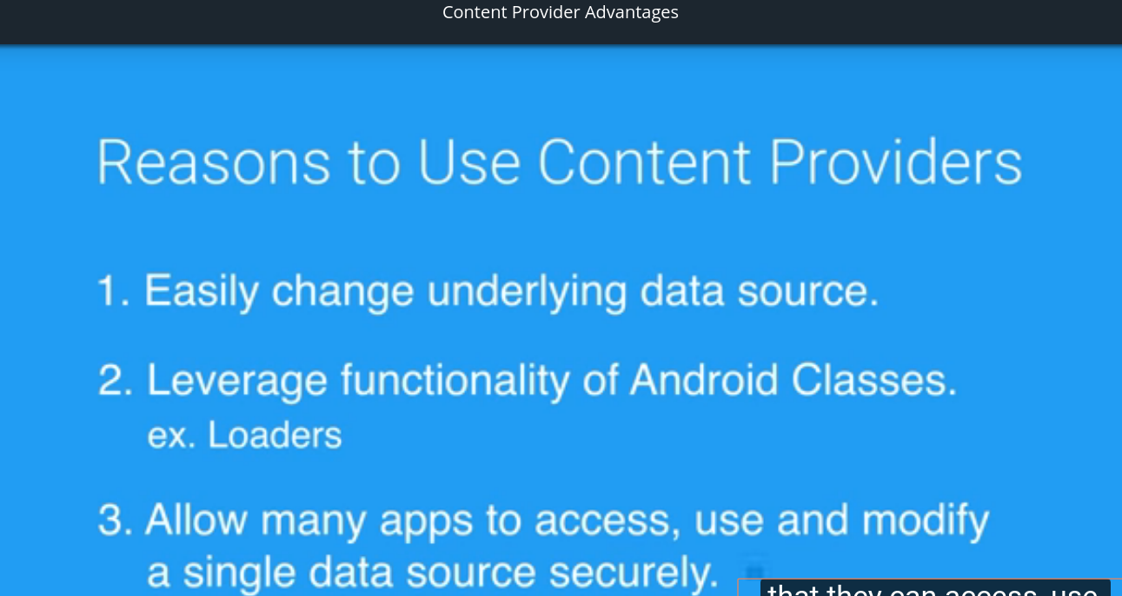

Slide 4
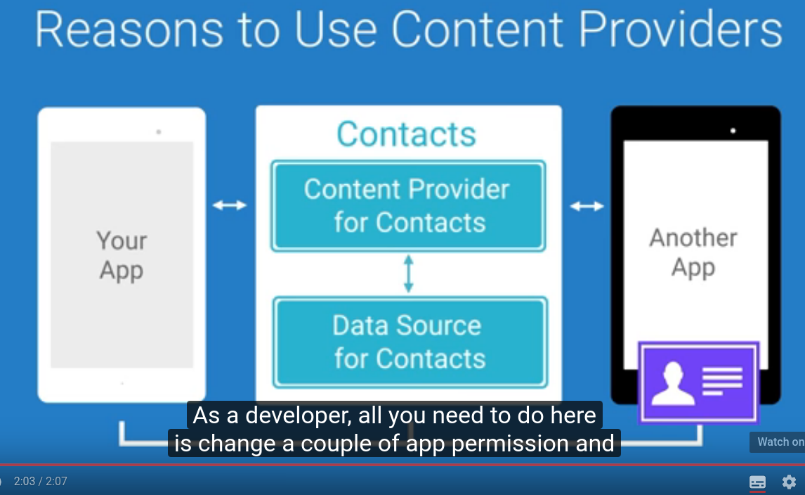

Slide 5
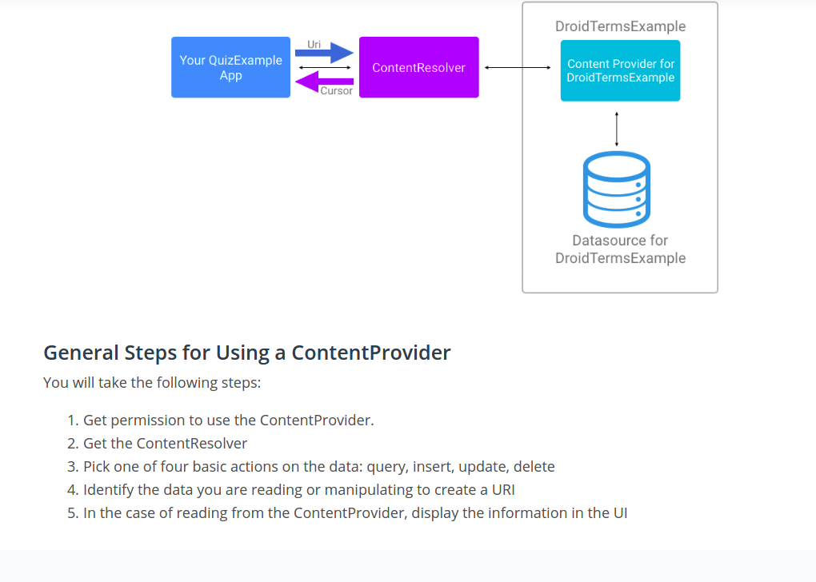

Slide 6
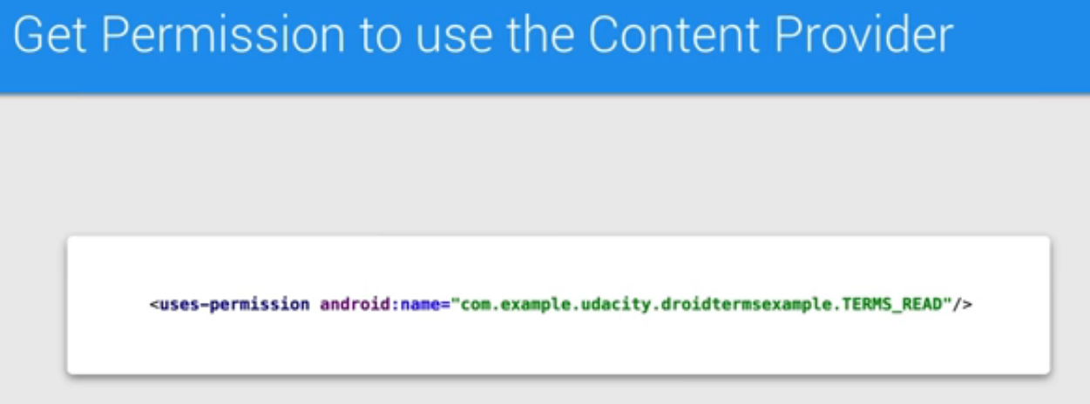
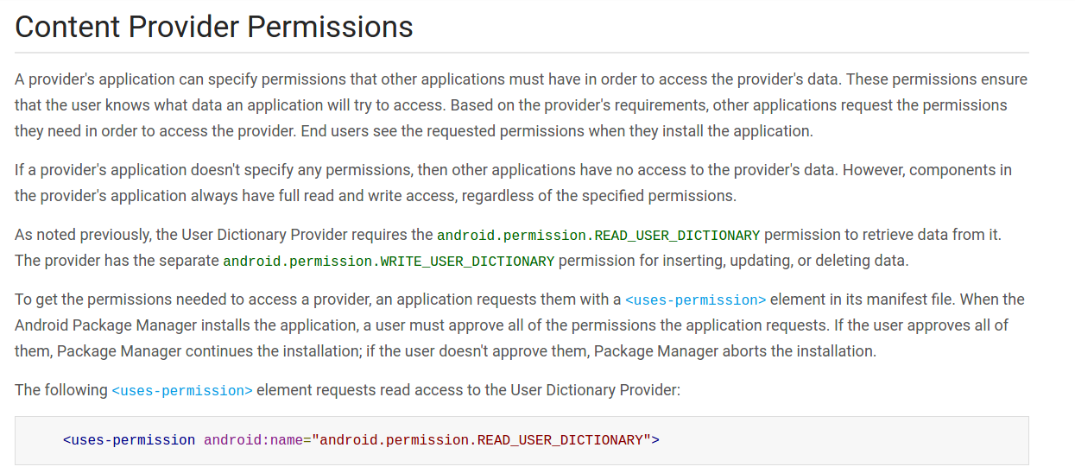

Slide 7
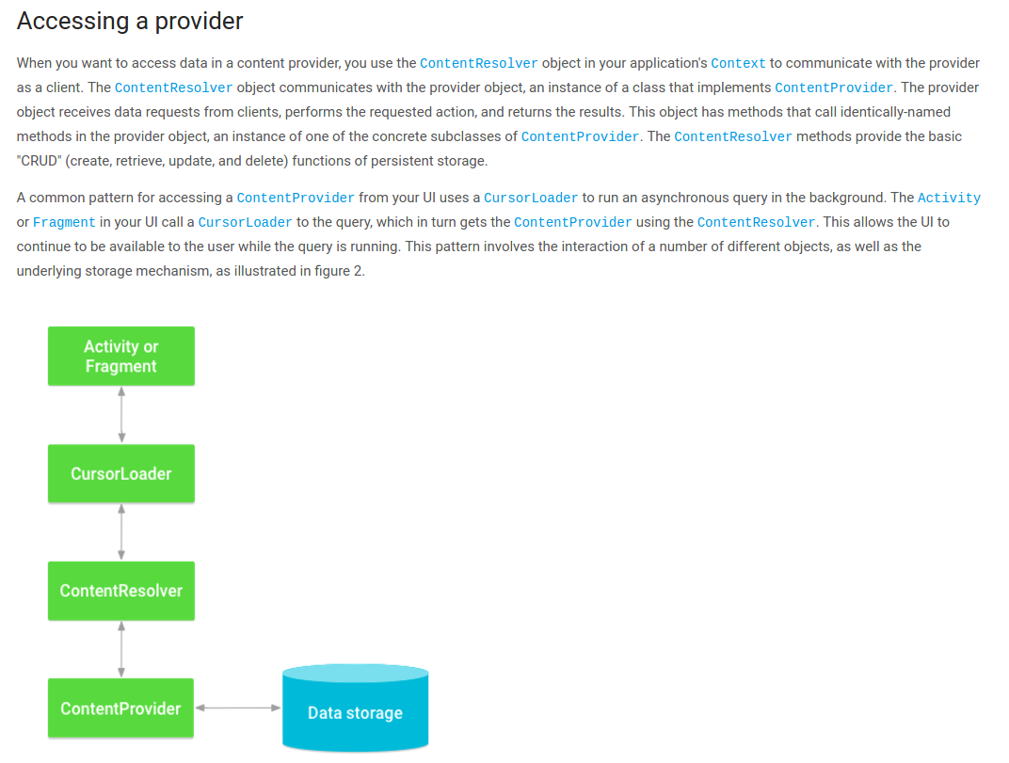

Slide 8
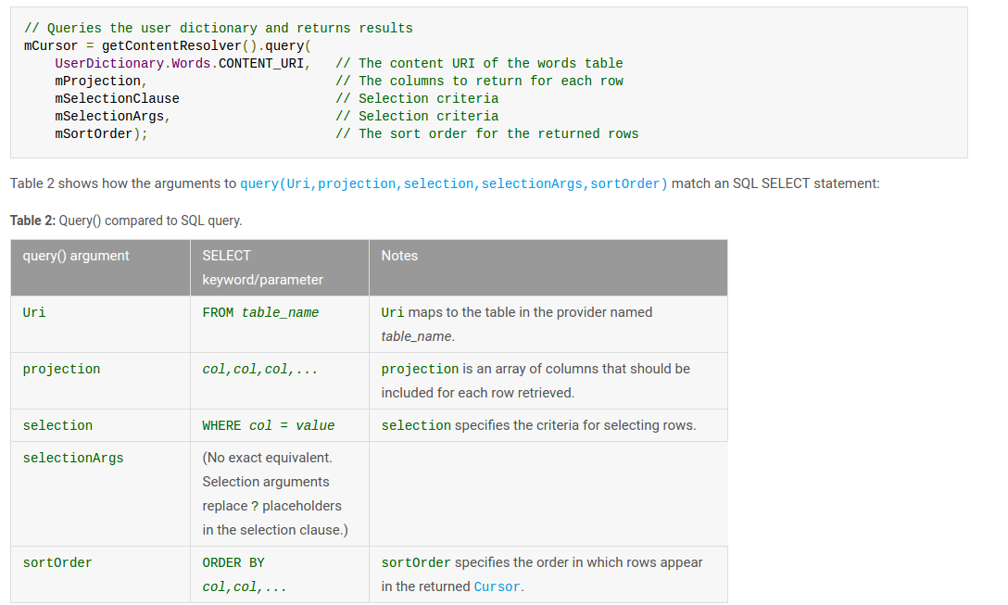

Slide 9

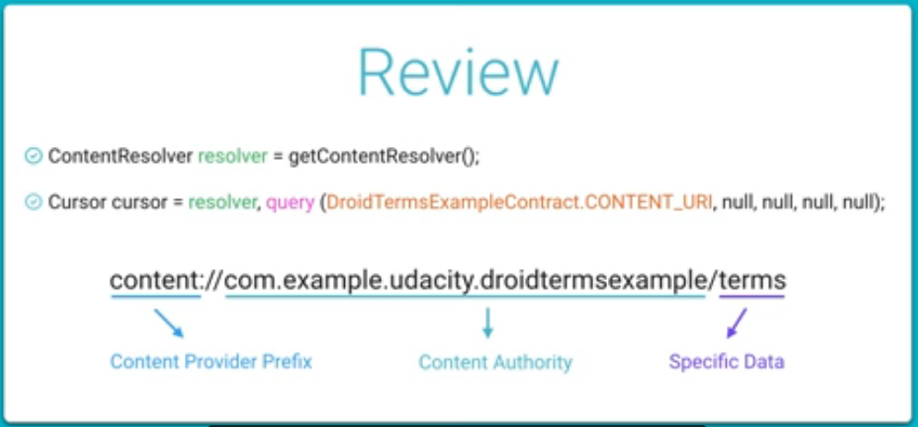

Slide 10
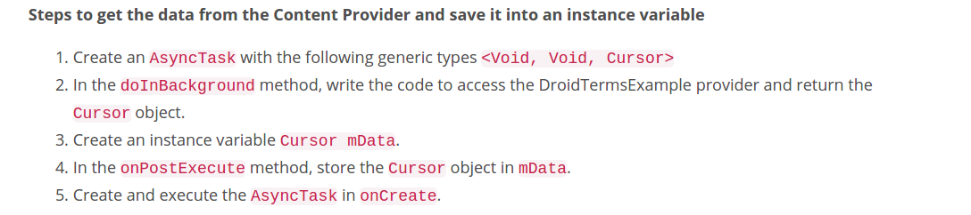
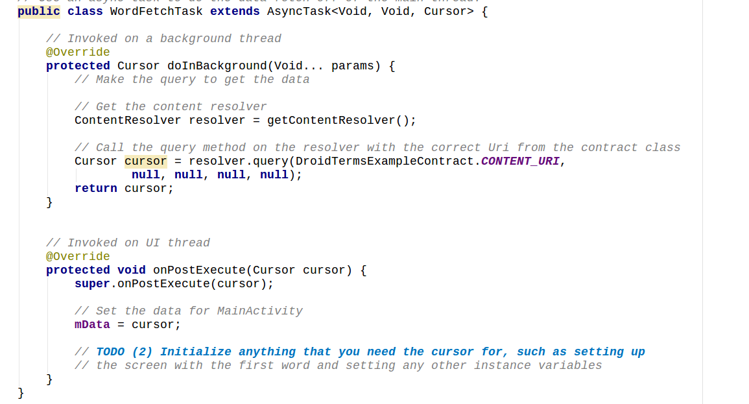

Slide 11
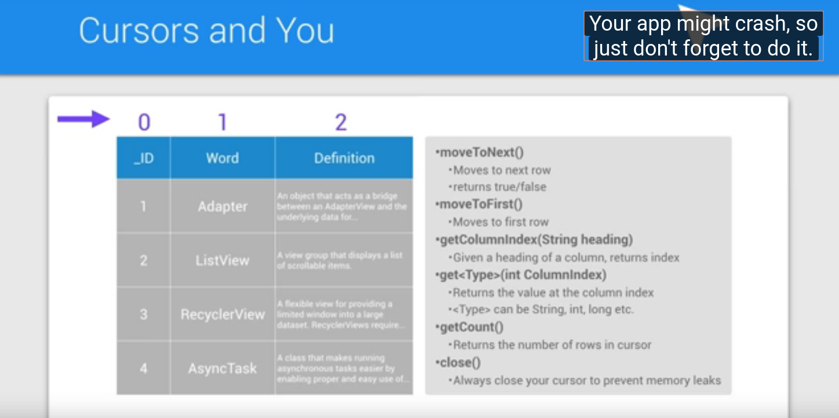

Slide 12
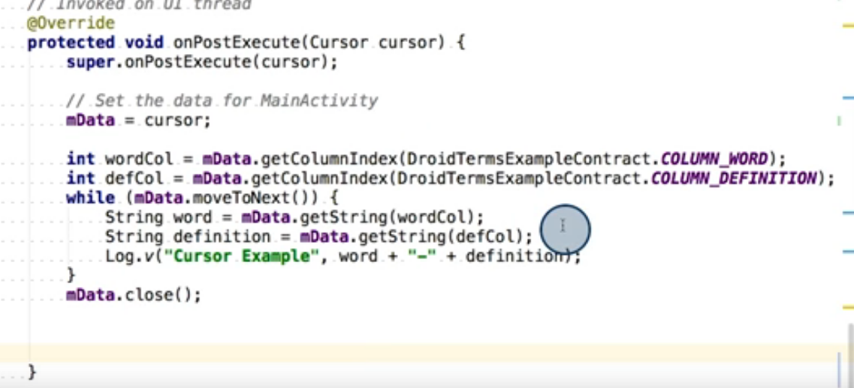
Getting all rows from curson-table and printing it one by one

Slide 13
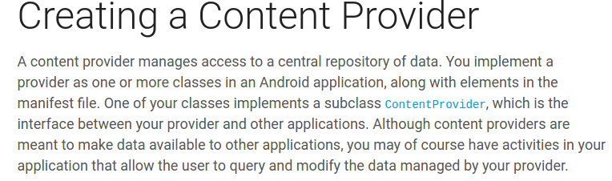

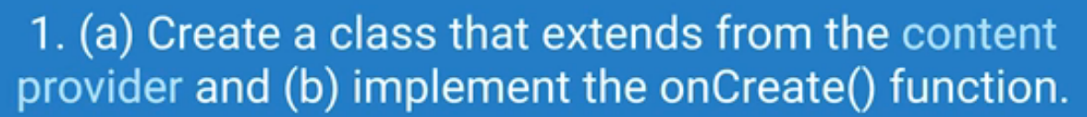



Slide 14
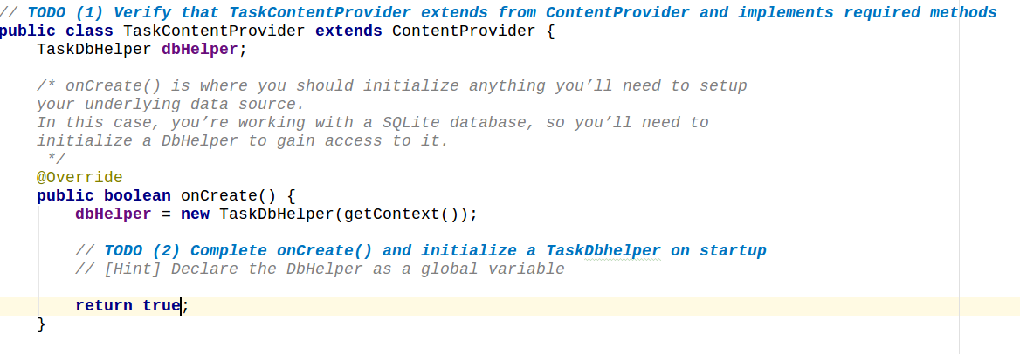
Step 1 :creating a class and extending content provider and implementing it’s methods and make changes in “oncreate”

Slide 15

Step 2 :Registering our provider inside manifest file.

Slide 16
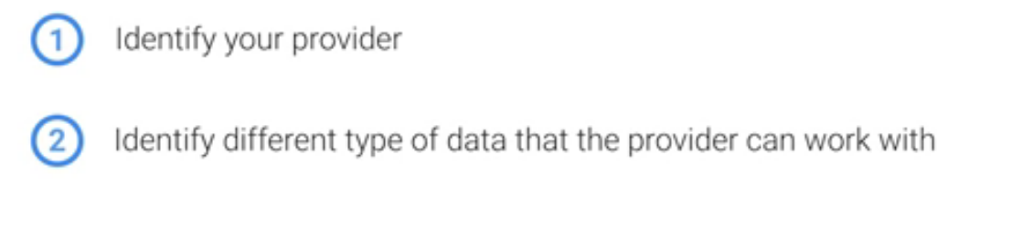
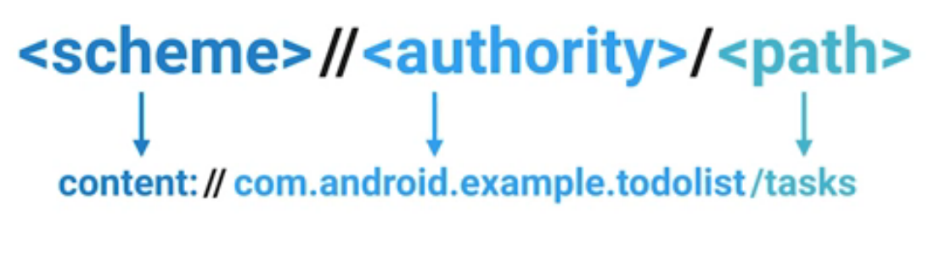




Defining uri structure

Slide 17
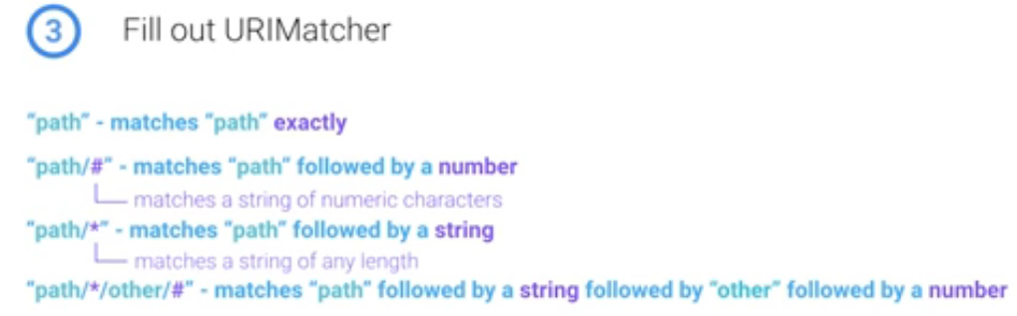
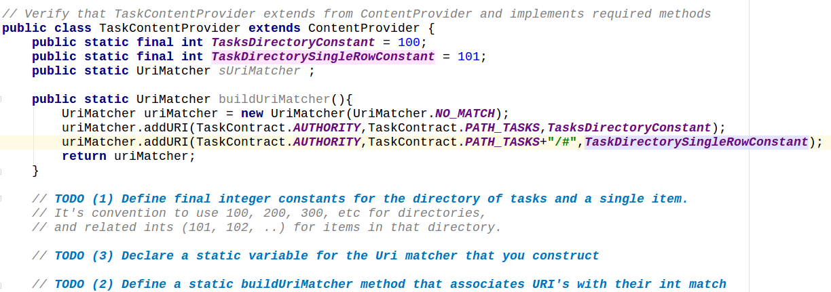
URI matcher

Slide 18

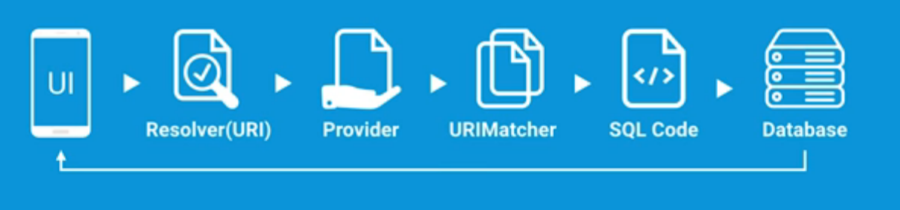

Slide 19
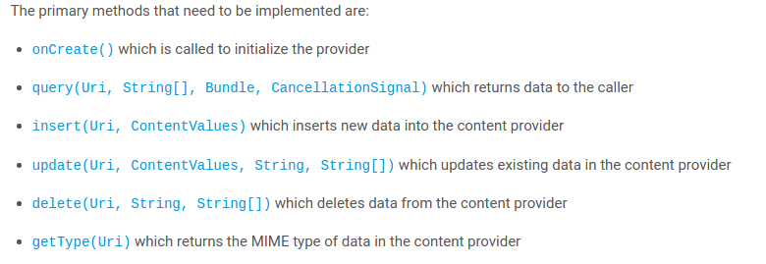
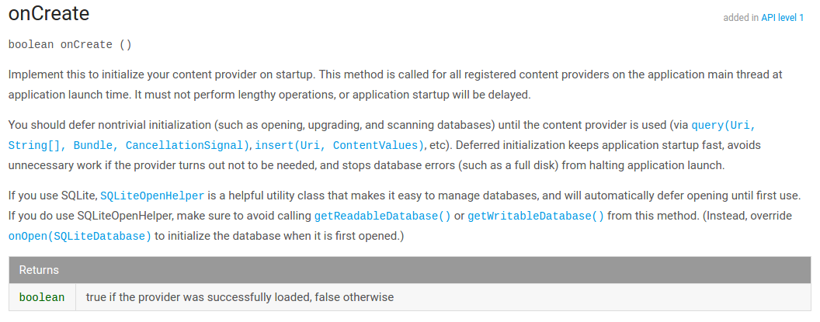
Overview of provider functions

Slide 20
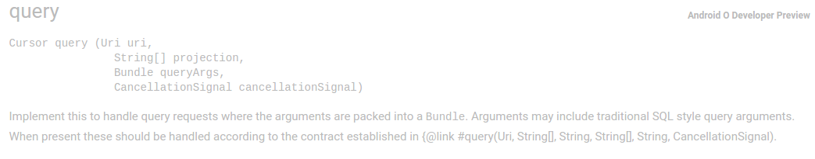
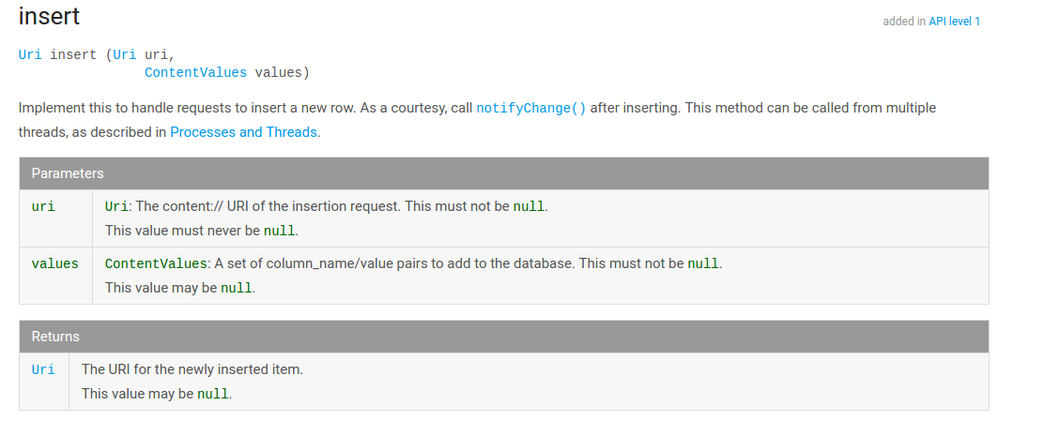

Slide 21
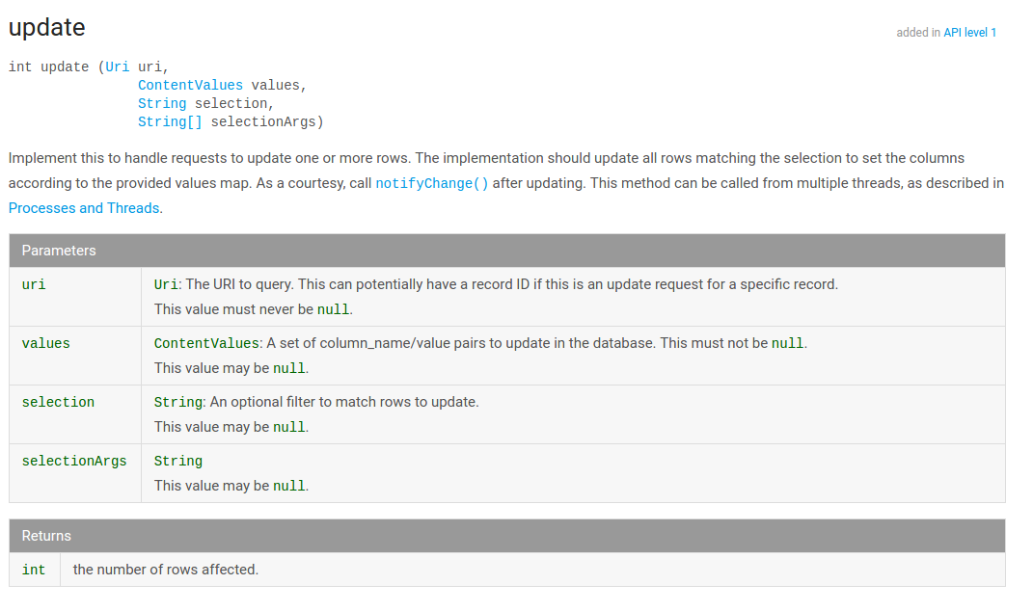

Slide 22
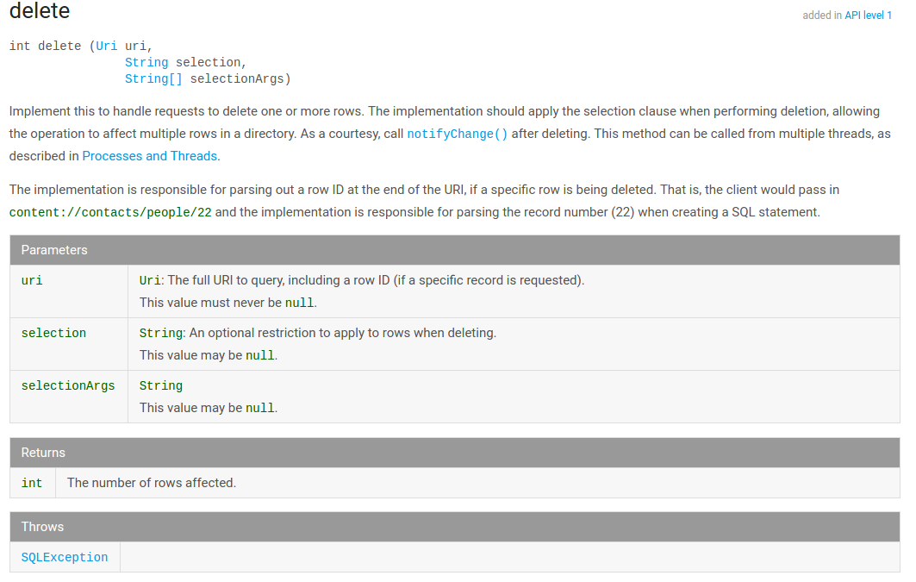

Slide 23
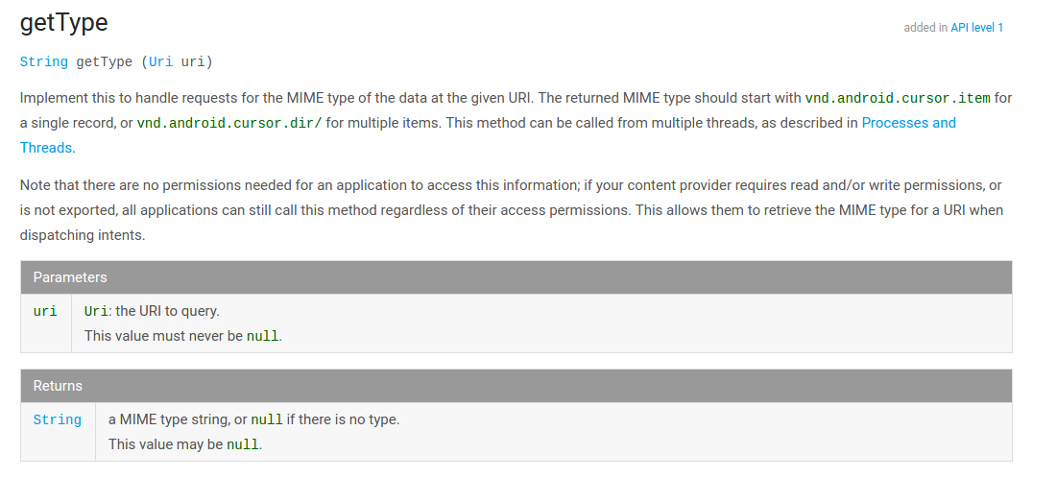

Slide 24
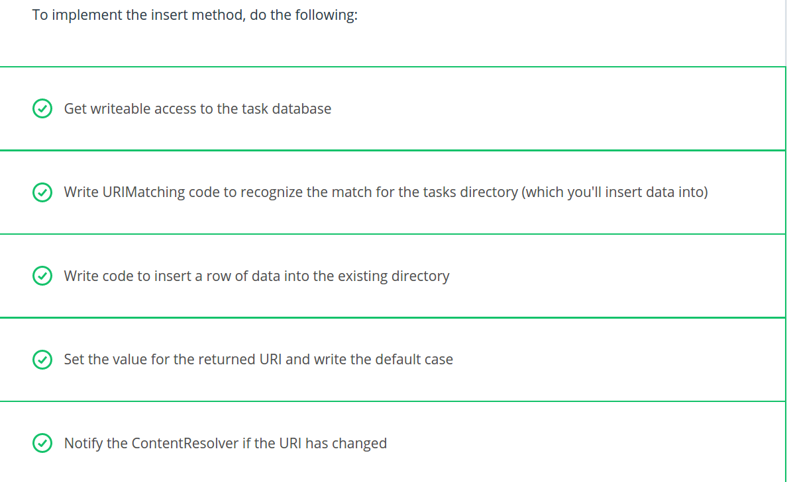

Slide 26
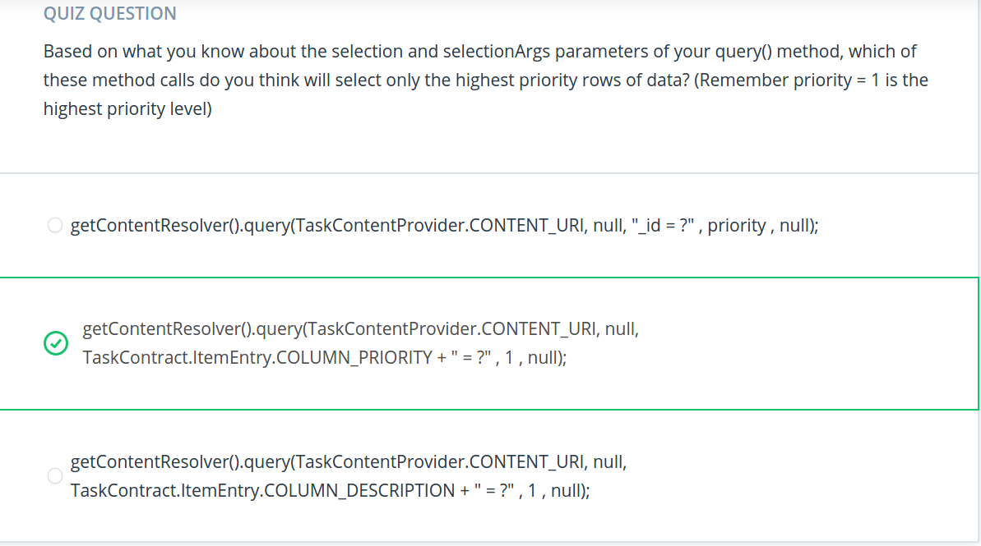

Slide 27
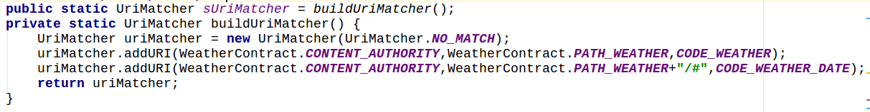
Making a content provider (Example)
1. make a class which is contentProviderclass , it extends ContentProvider and implement it’s all empty functions.
2. implement onCreate on it... inside it, make an instance of our DbHelper class(which provides access to sqlite database) and give it ‘getContext’ as parameter and return true.
3. register the provider in android manifest file -
<provider authority = “”
Name = “”
Exported= “”/>
4. Create static constant integer values named CODE_WEATHER & CODE_WEATHER_WITH_DATE to identify the URIs this ContentProvider can handle (inside same contentProviderClass)
5. write a method called ‘buildUriMatcher’ which matches uri and make a Urimatcher instance which accepts the returned value of buidUriMatcher.
Ex:

Slide 28
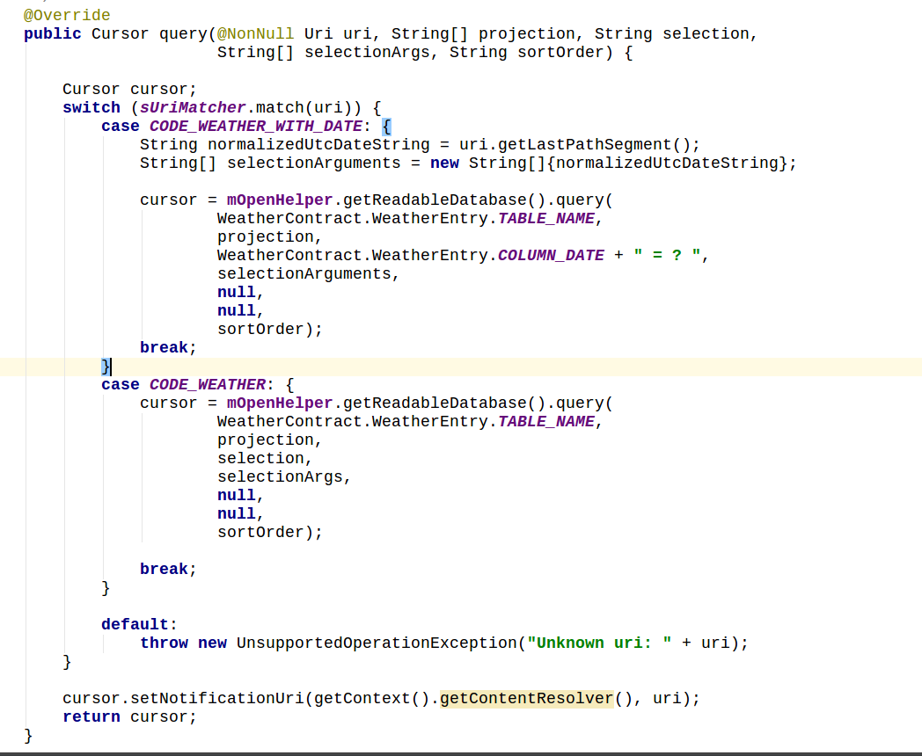
Implementation of query method

Slide 29
Implementation of insert/insert bulk method
(1) Get access to the task database (to write new data to
(2) Write URI matching code to identify the match for the tasks directory
(3) Insert new values into the database
(4) Set the value for the returnedUri and write the default case for unknown URI's
(5) Notify the resolver if the uri has been changed, and return the newly inserted URI

Slide 30
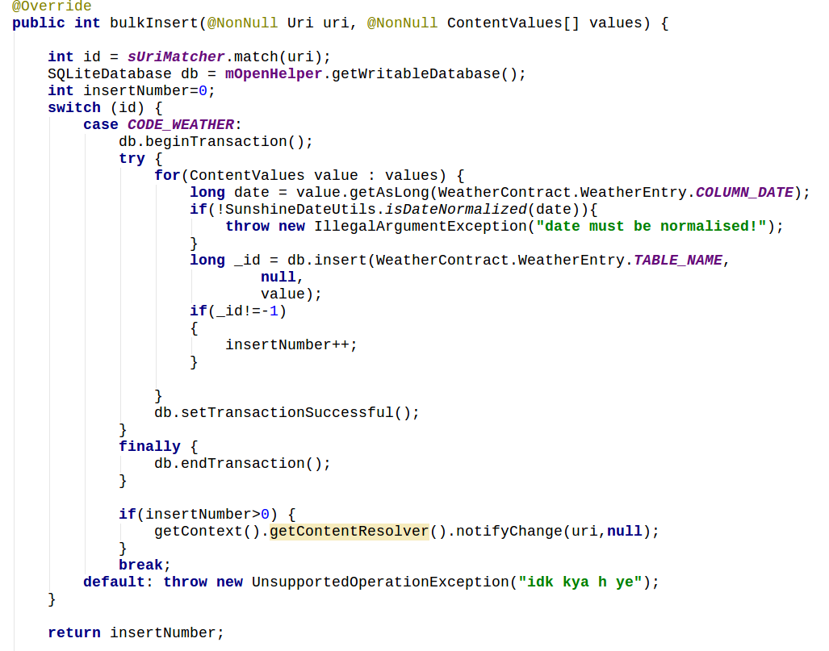
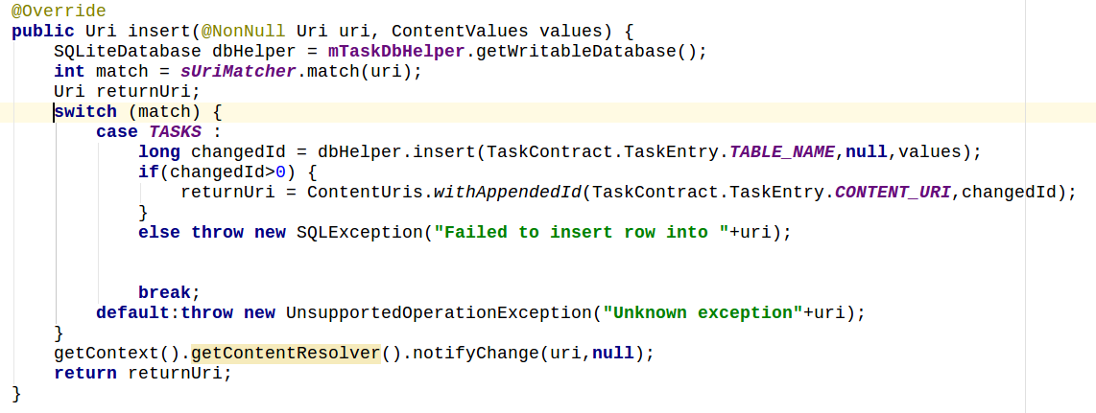

Slide 31


