Slide 1
INTENTS

Slide 2
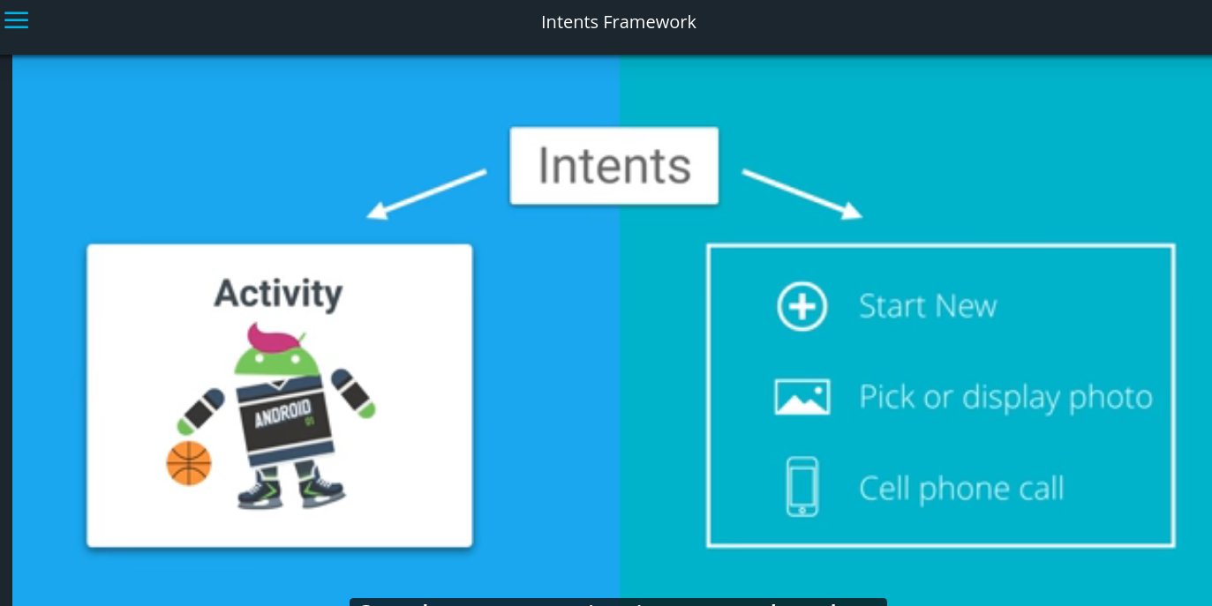

Slide 3
Explicit intent
Create an activity suppose called childactivity
Suppose we will open an activity on button click
Then on click method, write
Intent intent = new Intent(firstclass.this,secondClass.class);
startActivity(intent);
In case, we want to pass some value with intent, we can do that.
For example pass a string value to string class.
Intent.putExtra(“keyForValue”,”stringValue”);
startActivity(intent)
In child class, make an instance of Intent by Intent intent = getIntent();
Check if intent received has some extra value if yes, use it. For ex:
if(intent.hasExra(“keyForValue”){
    textViewSecondClass.setText(intent.getStringExtra(“keyForValue”);
}

Slide 4
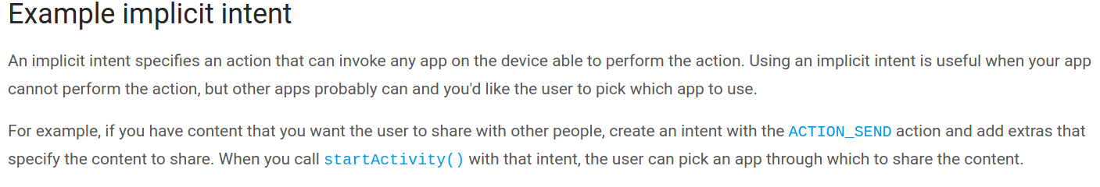
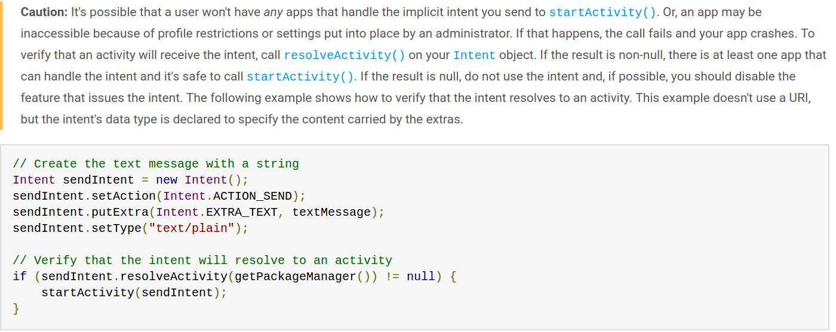
Implicit Intents

Slide 5


example

Slide 6
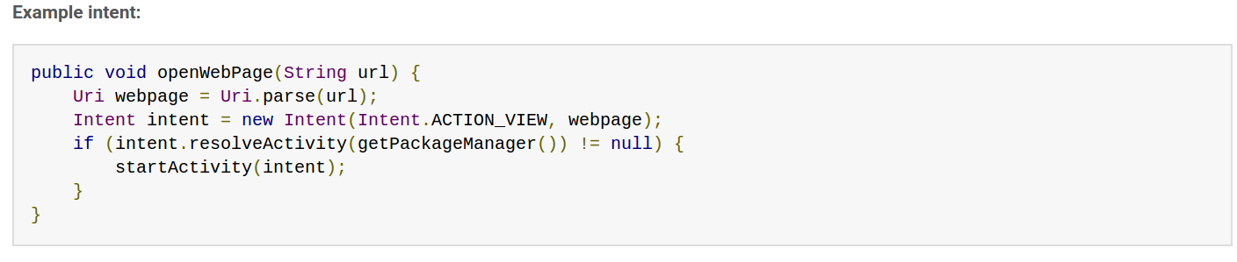

Slide 7
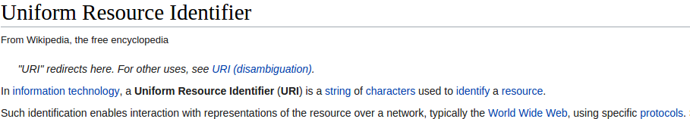
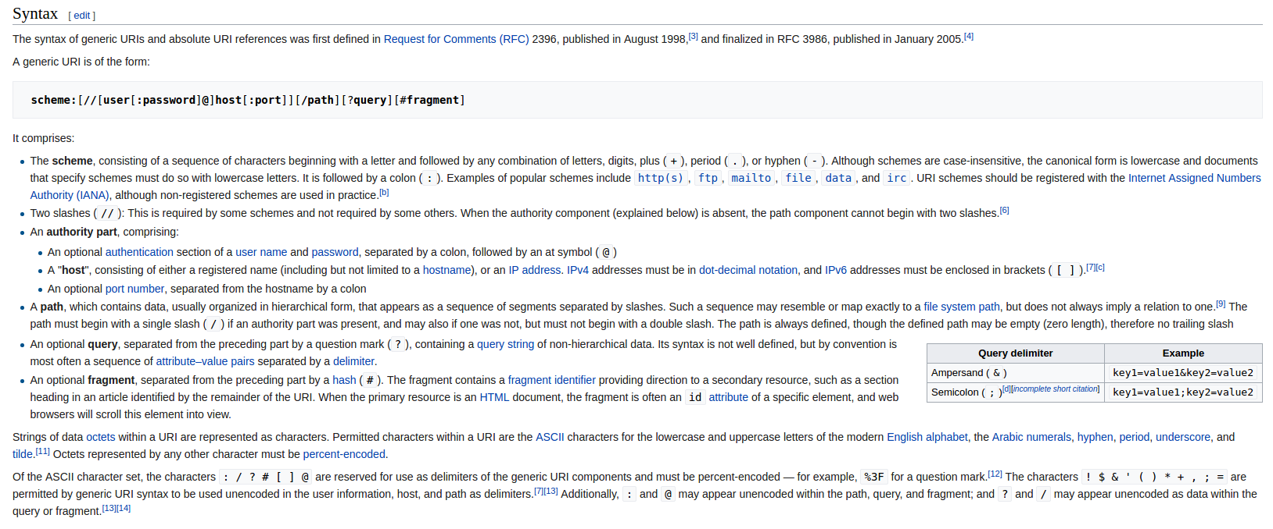

Slide 8
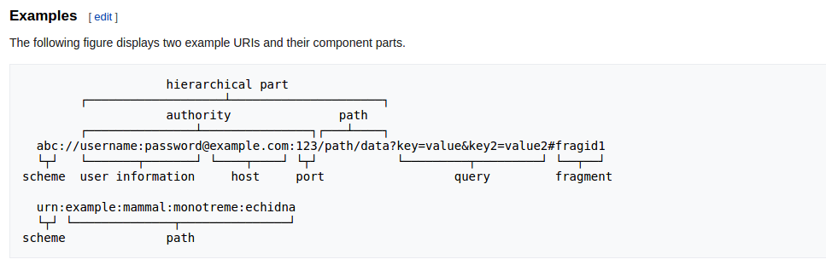

Slide 9
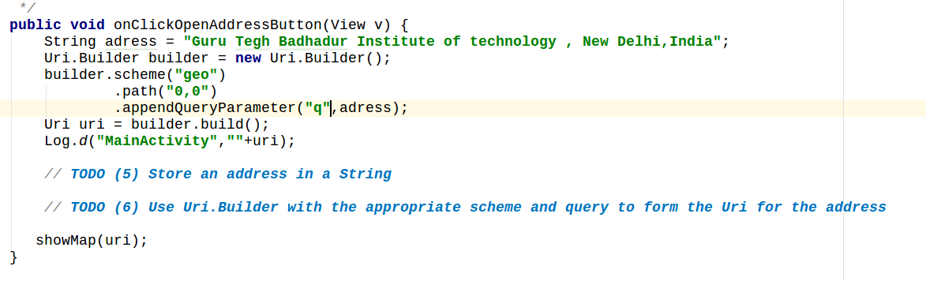

Map intents
many other ways , use stack over flow

Slide 10
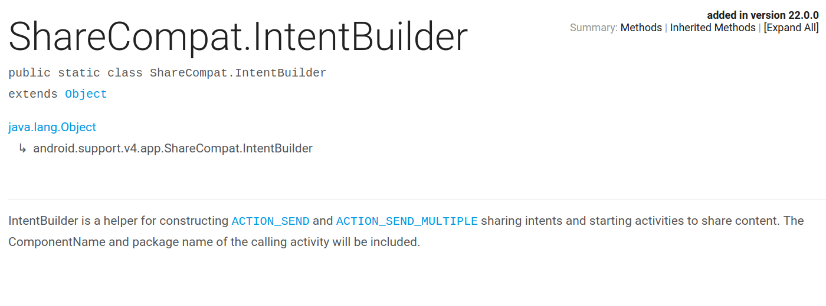
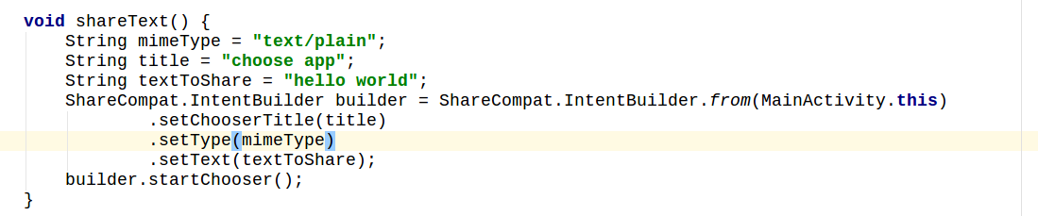
Share Intents
http://www.programcreek.com/java-api-examples/index.php?api=android.support.v4.app.ShareCompat

