Slide 1
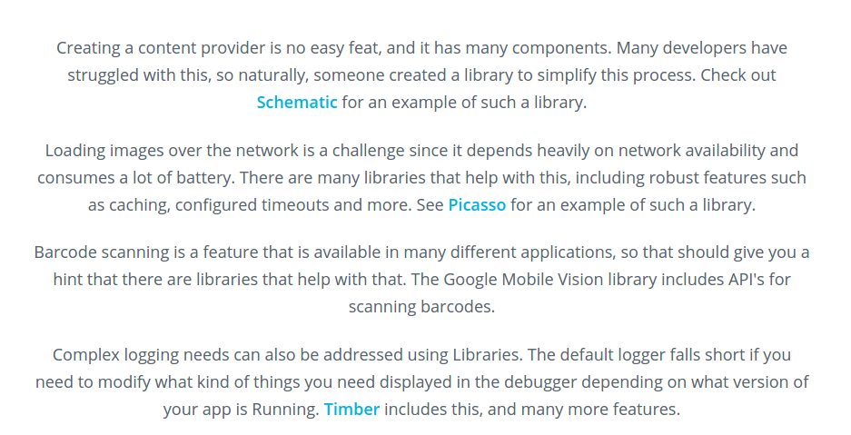

Slide 2
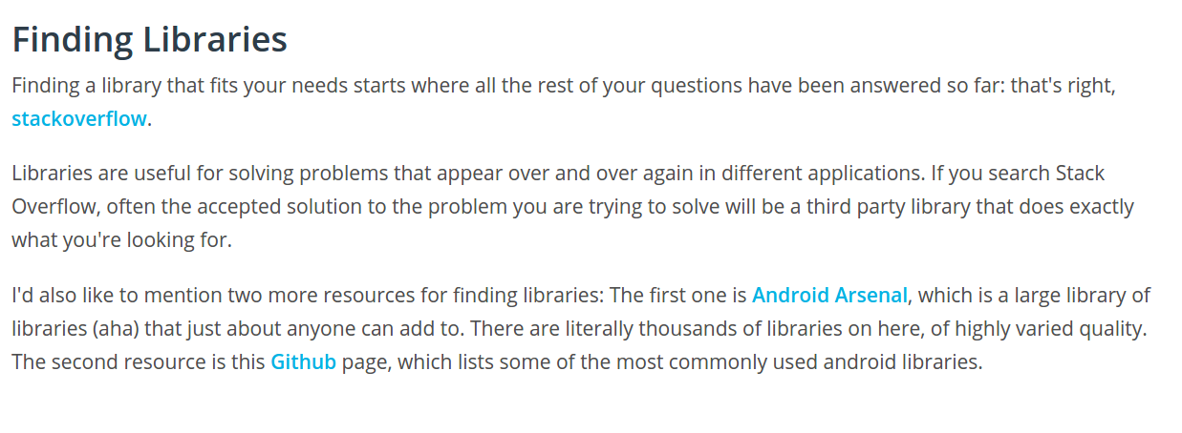
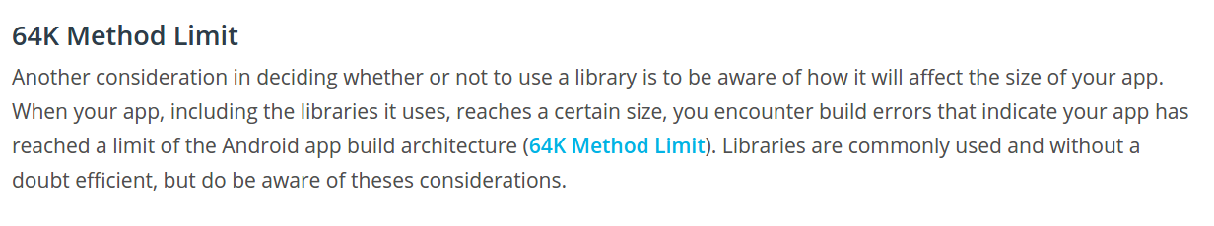

Slide 3
Choose library
1.Updation from their website release notes and github graph section
2.known issues
3.featurs
4.license on github

Slide 4
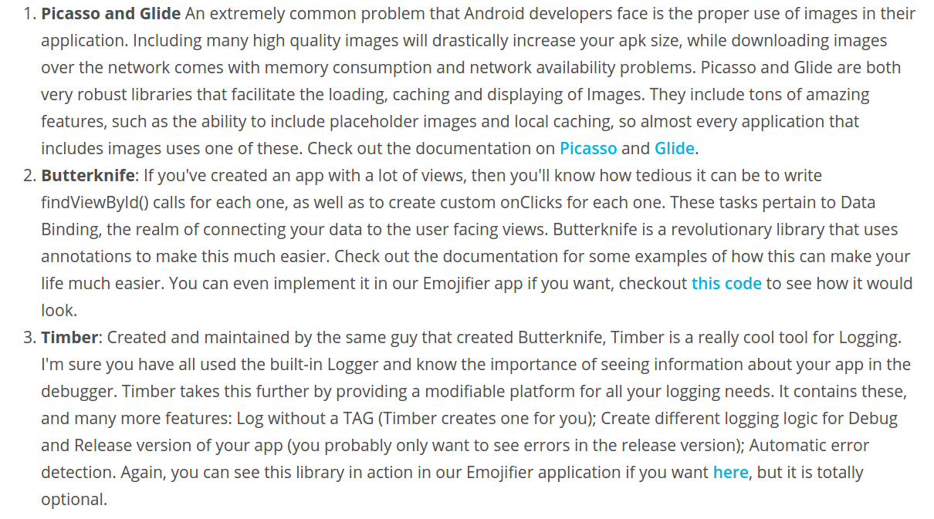

Slide 6
Make your own library
https://developer.android.com/studio/projects/android-library.html

