Slide 1
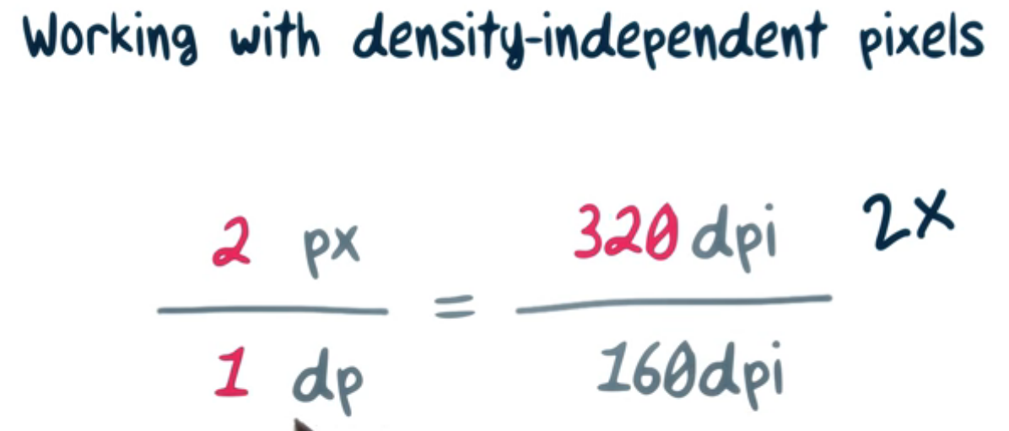

Here dpi = dots per inch dp = densisty independent pixels divide number of total dpi with 160dpi,it will give value of number of pixels in 1dp

Slide 2
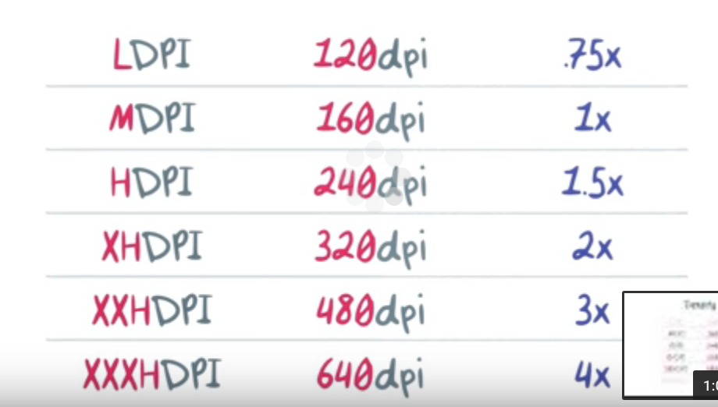
Density Buckets

Slide 3
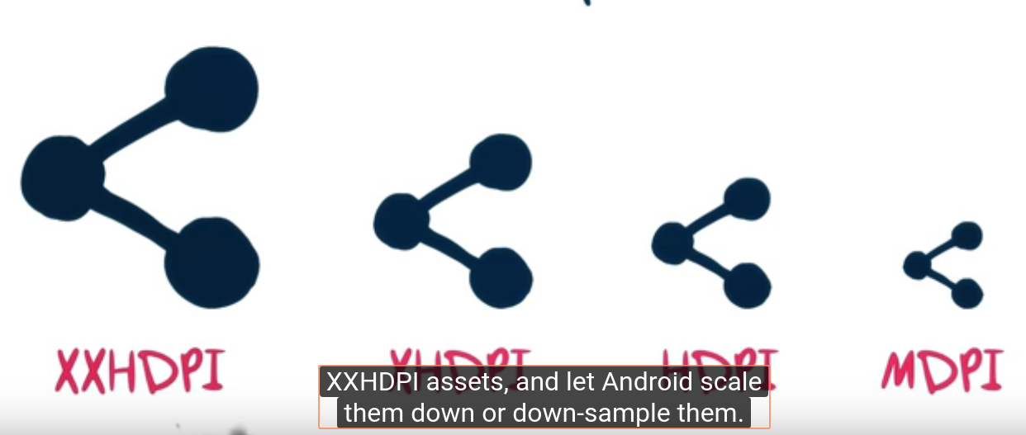

Slide 4
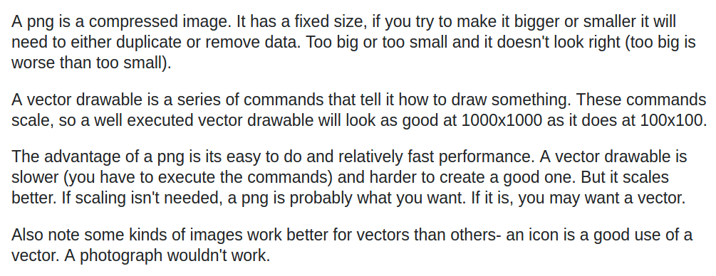

Vector vs bitmap/png

Slide 5

https://romannurik.github.io/AndroidAssetStudio/

Slide 6
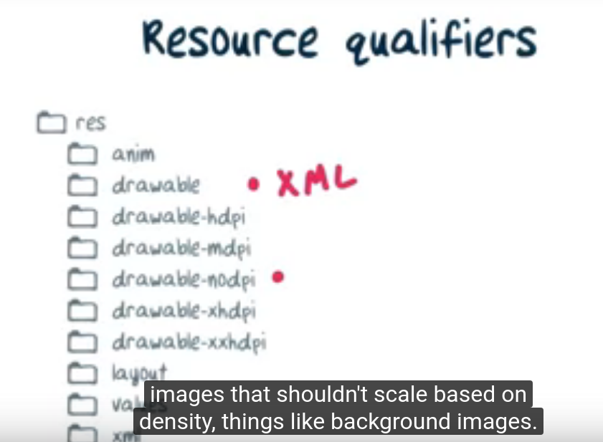
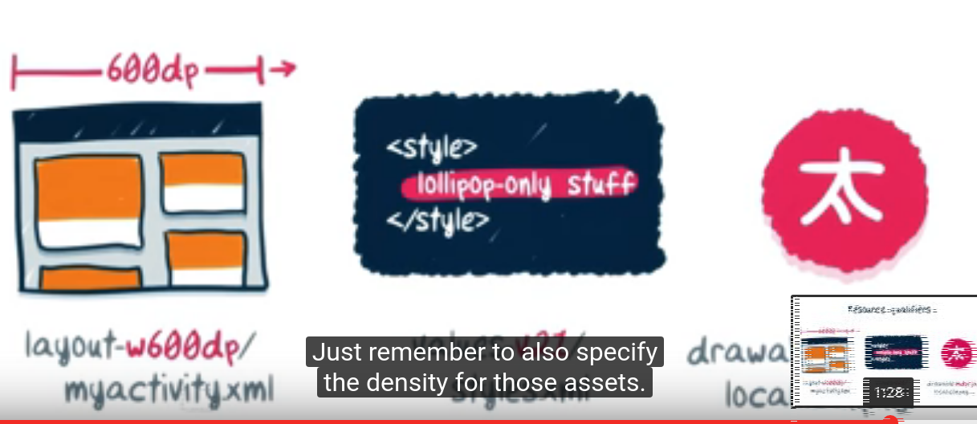
Drawable – used for xml
Drwable no dpi for which do not change according to screen size

Slide 7
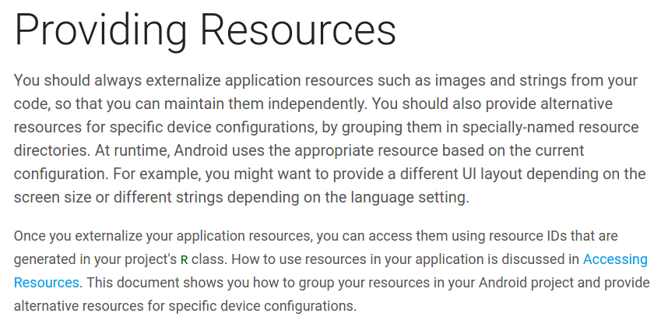
https://developer.android.com/guide/topics/resources/providing-resources.html

Slide 8
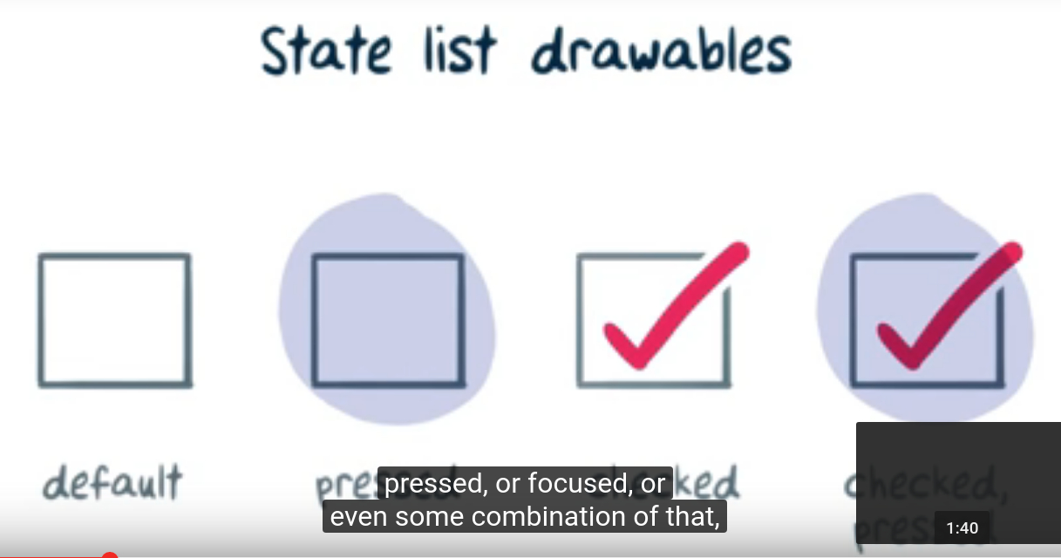
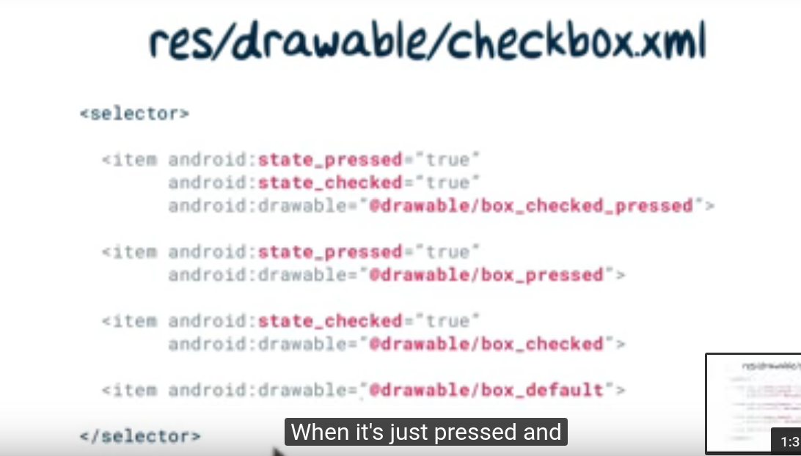

Slide 9
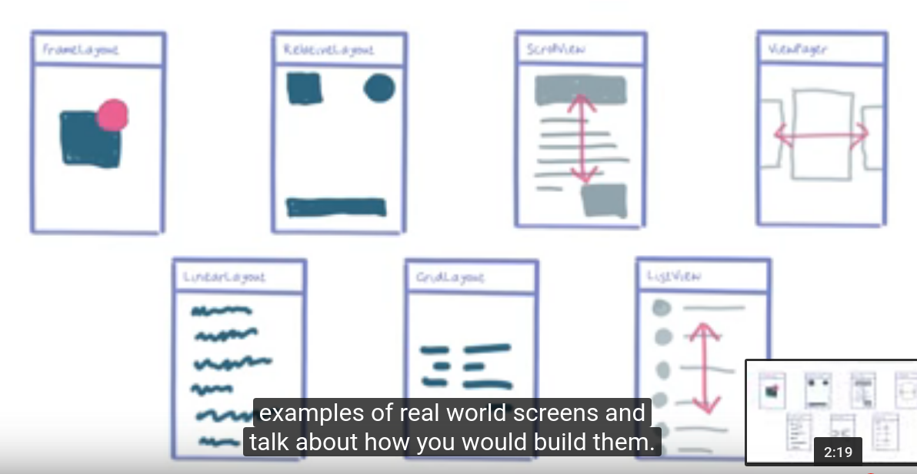

Slide 10
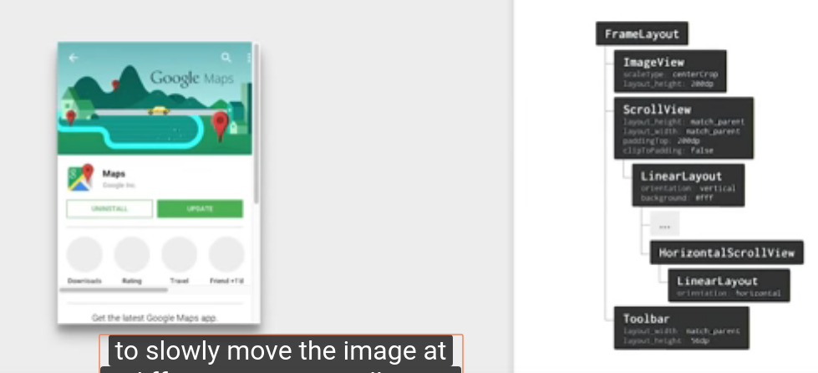
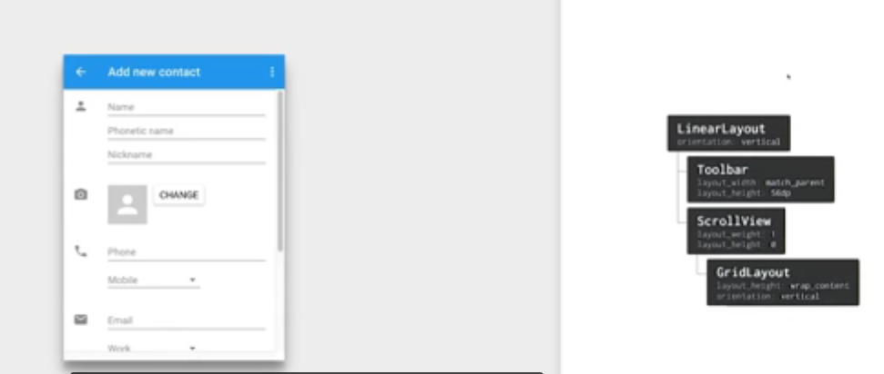

Slide 11
