Slide 1
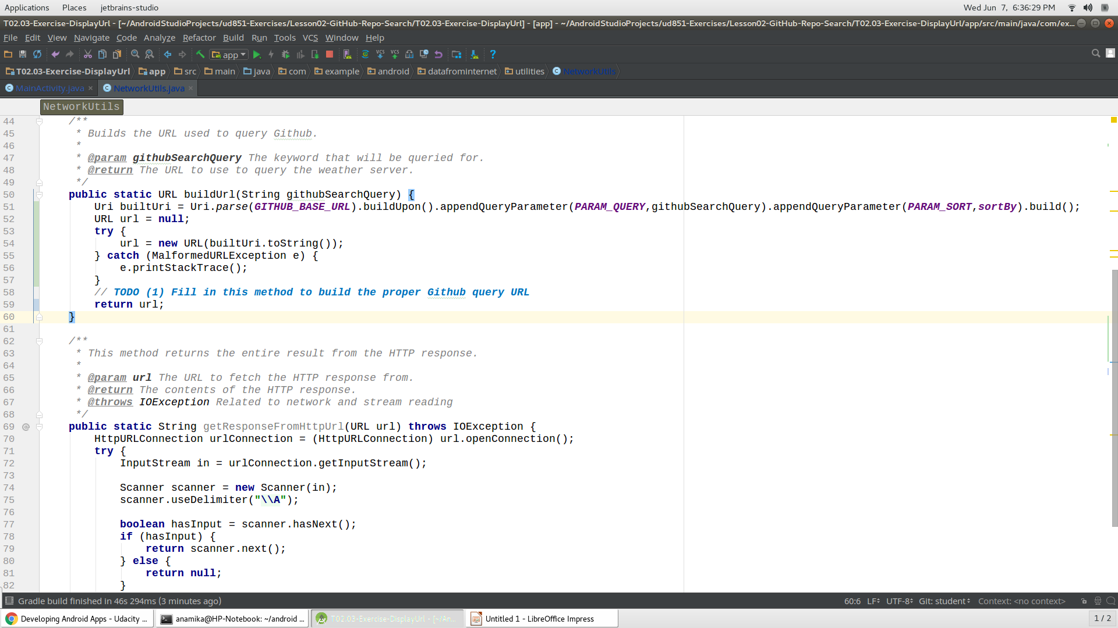
Build url in java from url link

Slide 2
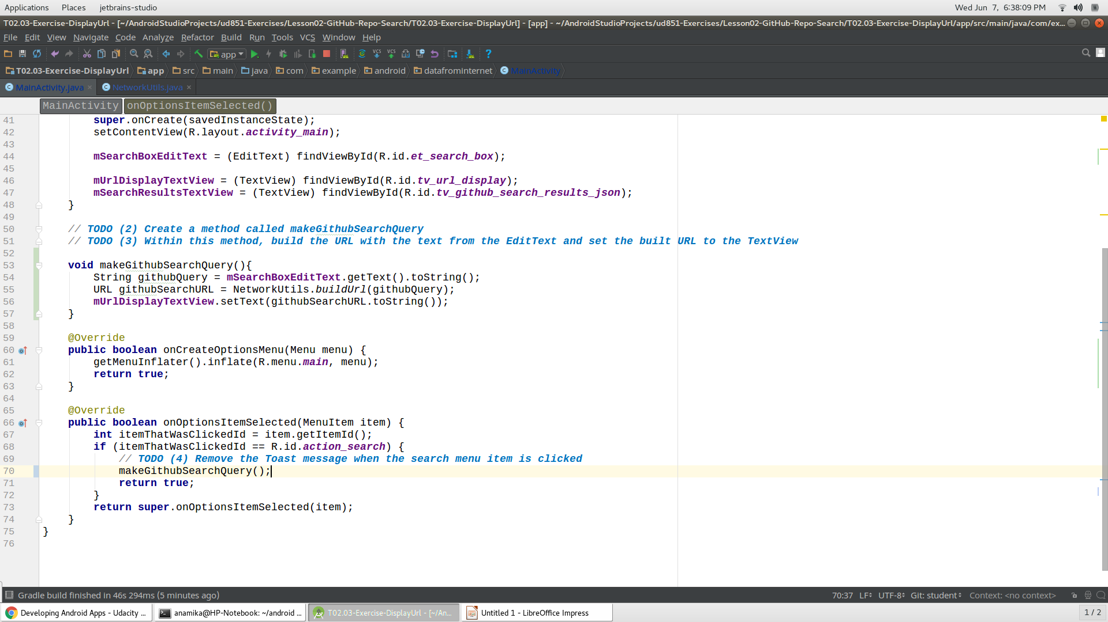
Calling the buildURl method to get returned url and then set it into a editext

Slide 3
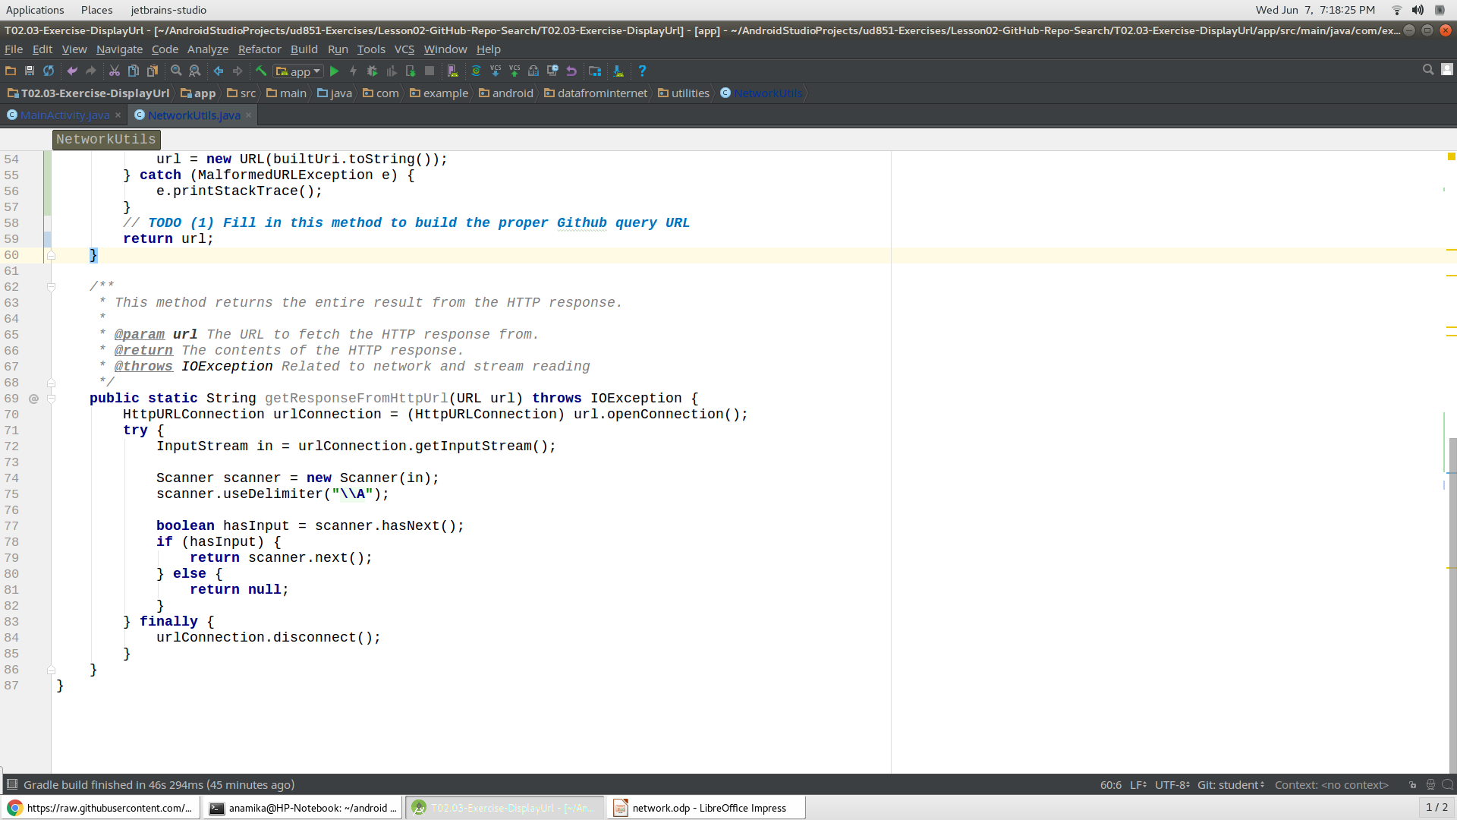
Fetching an HTTP request via Scanner way

Slide 4
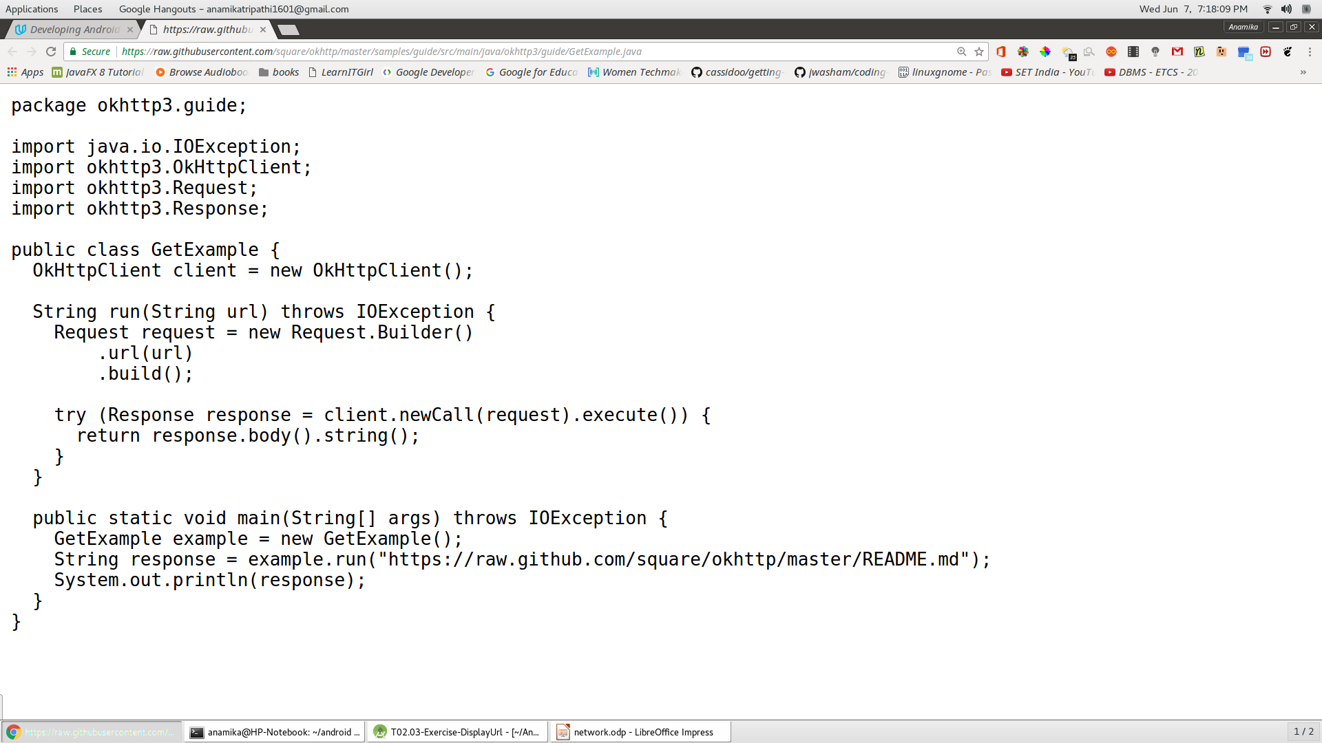
Okhttp way

Slide 5
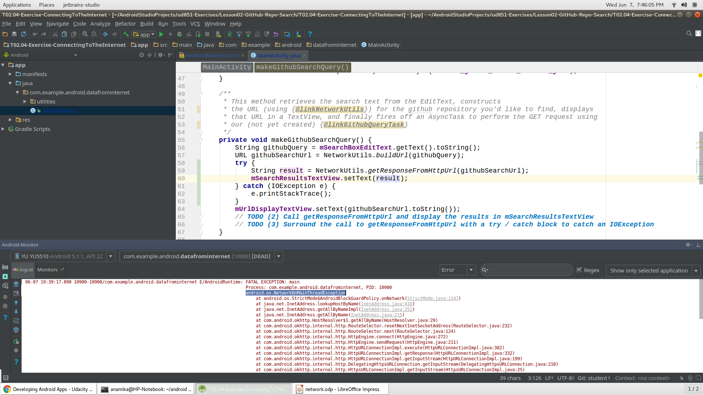
Main thread networkin error

Slide 6
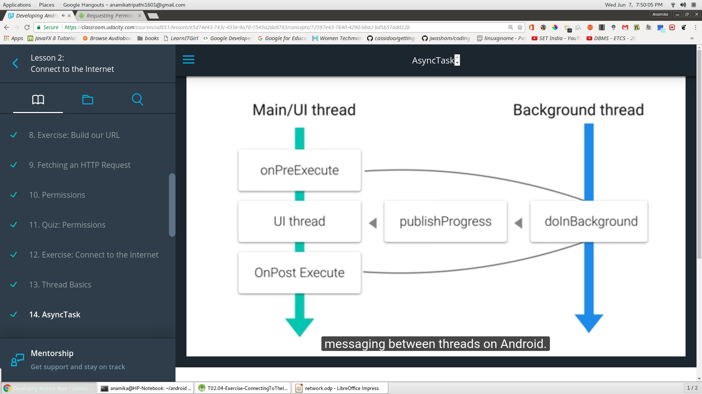
Async task
AsyncTask is designed to be a helper class around Thread and Handler and does not constitute a generic threading framework. AsyncTasks should ideally be used for short operations (a few seconds at the most.) If you need to keep threads running for long periods of time, it is highly recommended you use the various APIs provided by the java.util.concurrentpackage such as Executor, ThreadPoolExecutor and FutureTask.

Slide 7
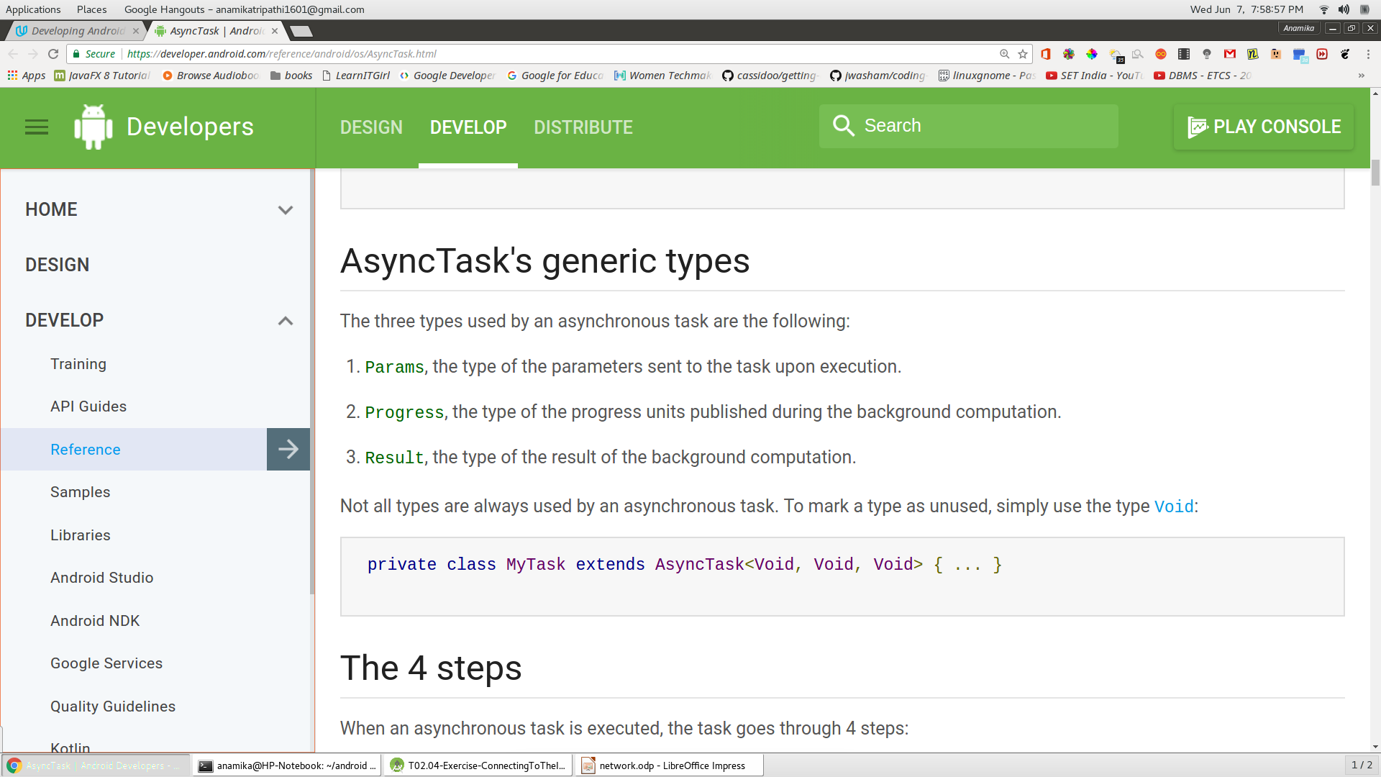

Slide 8
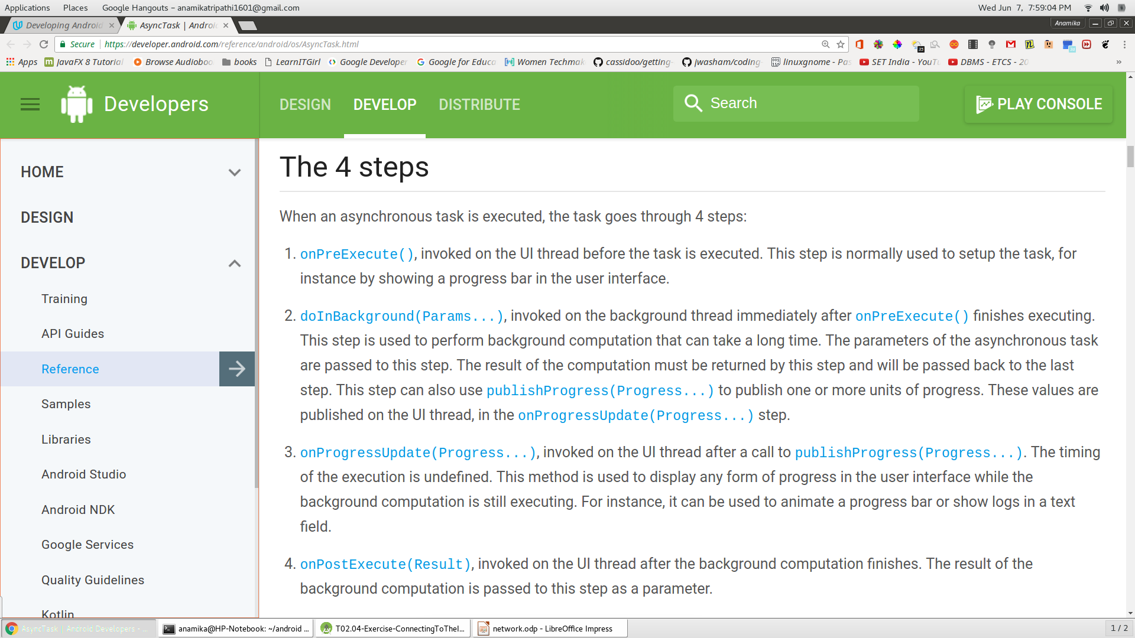

Slide 9
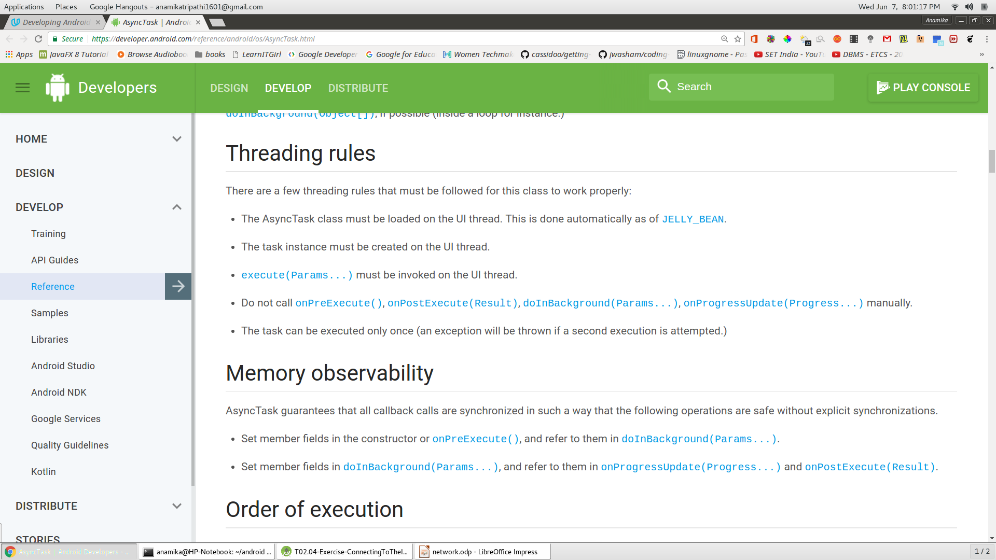

Slide 10
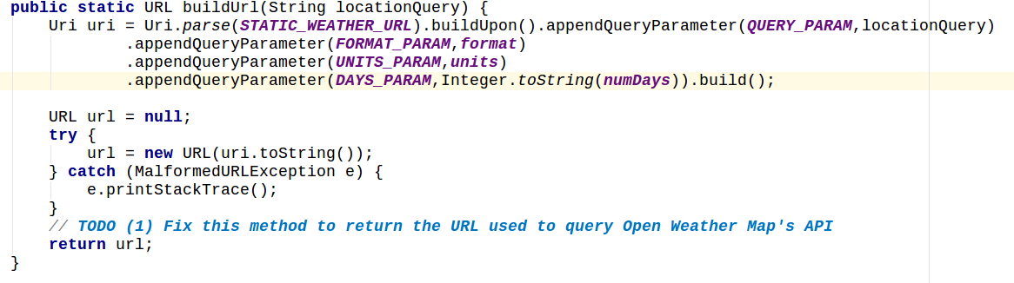
AsyncTask working first take string(url) and convert it into uri and then url

Slide 11
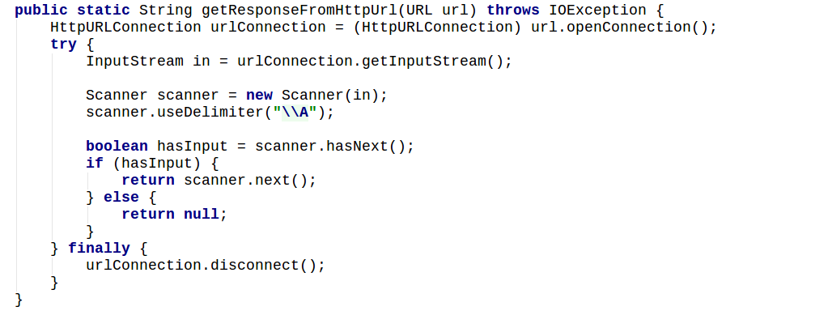
Create a httpurl connection and solve the url and read it.

Slide 12
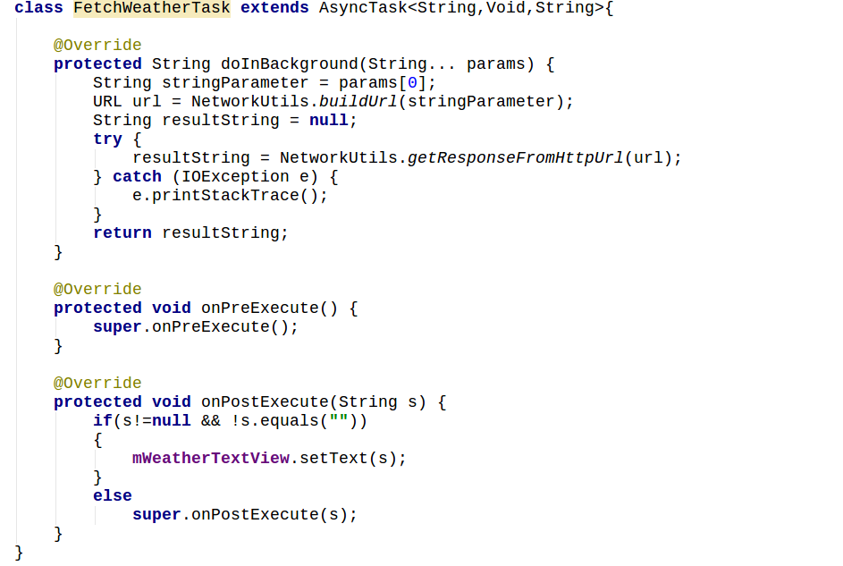
Mean while create a AsyncTask class ,override methods and in dobackground, make string->url and then read it.

Slide 13
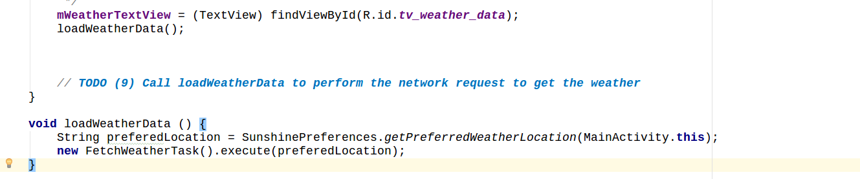
Finally make a functin which will create an instance of that asynctask class and execute it.

Slide 14
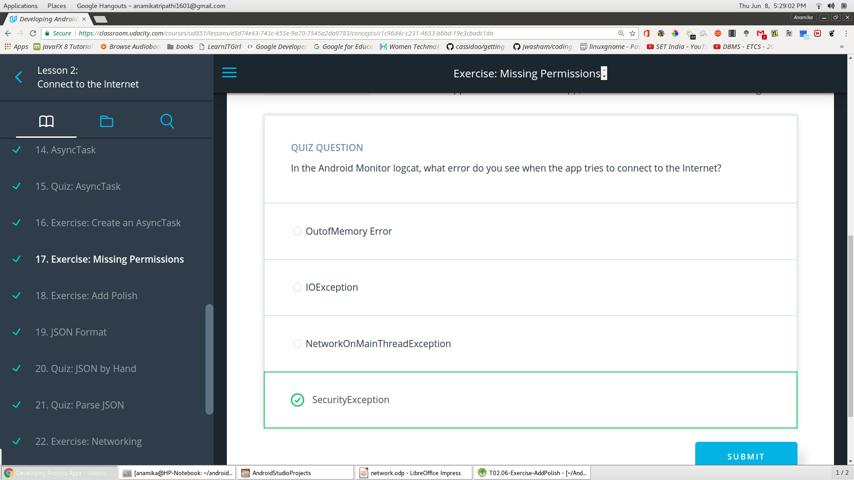
Missing permission error

Slide 15
Add Polish
Add load indicator
Set it invisible in xml
Set it visible in onPreexecute
Set it invisible again in onPostexecute
Add a textView to show error message
Set the string visible when null received and make the result string invisble
Set the error string invisible when json received and make result string visible

Slide 16
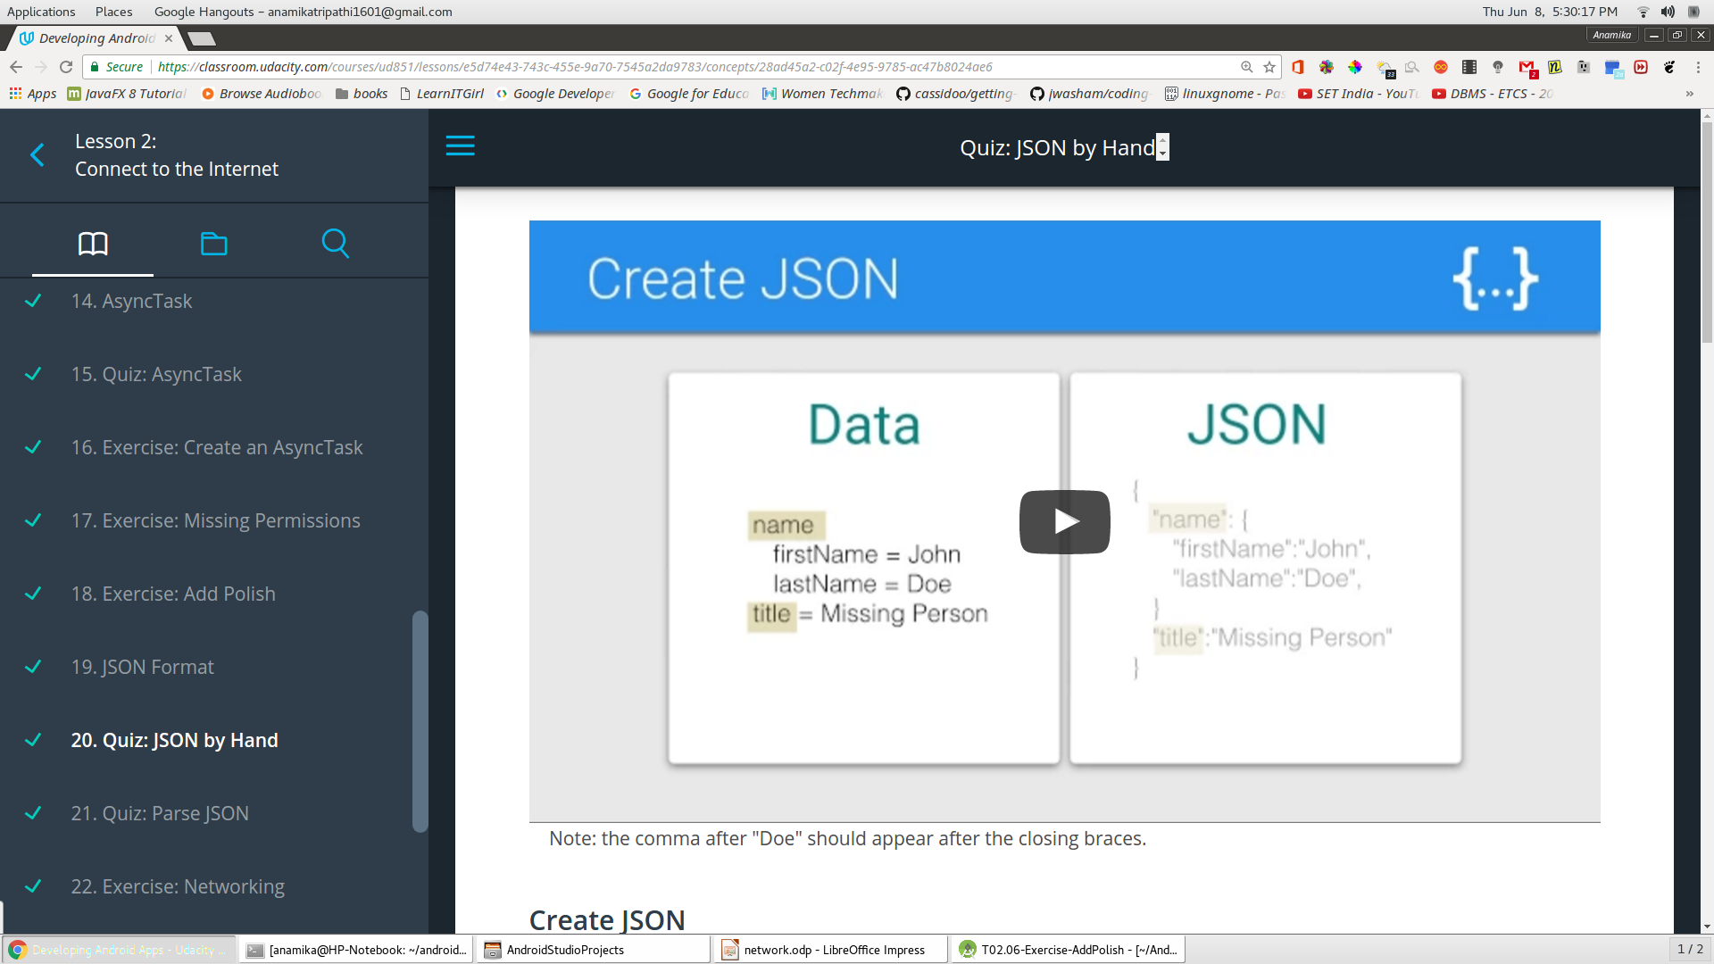
Json format by hand

Slide 17
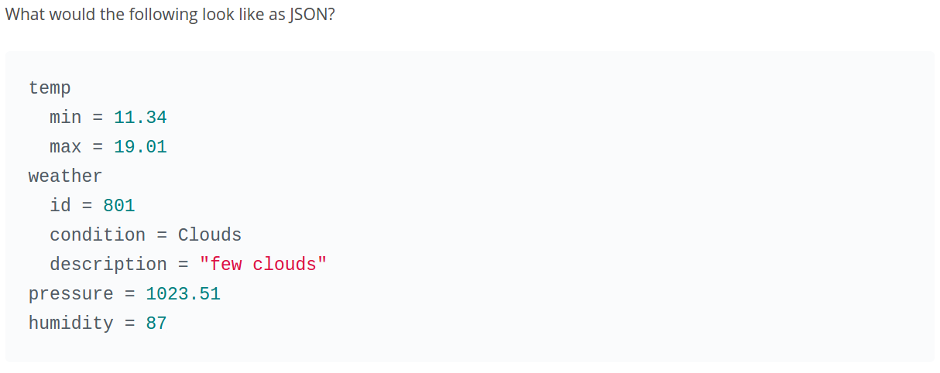
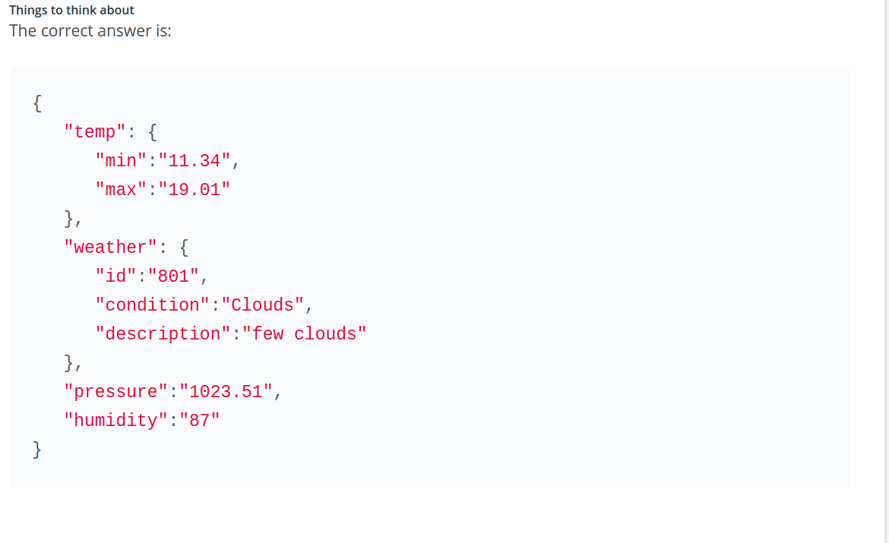
Json example

Slide 18
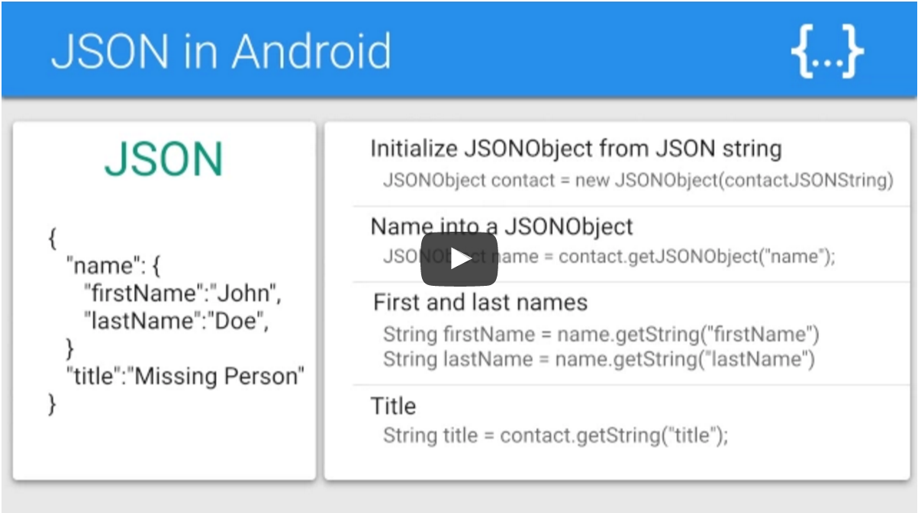

Slide 19
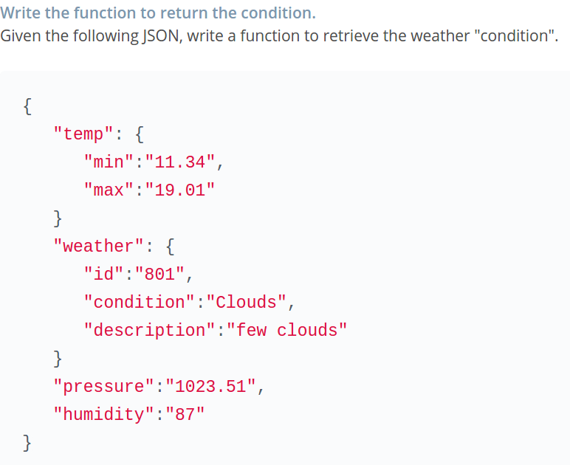
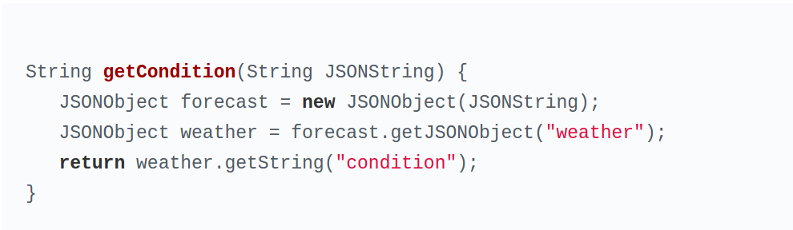

Slide 20
Async task loader in lifecycle ppt

