Slide 1
Color design guidelines
Always choose two colors of very contrast so that u can make it a difference.
For more info :
https://material.io/guidelines/style/color.html#color-color-tool
https://www.materialpalette.com/
These color pairs have contrasting and vibrant colors, so make good choices for primary and accent colors.

Slide 2
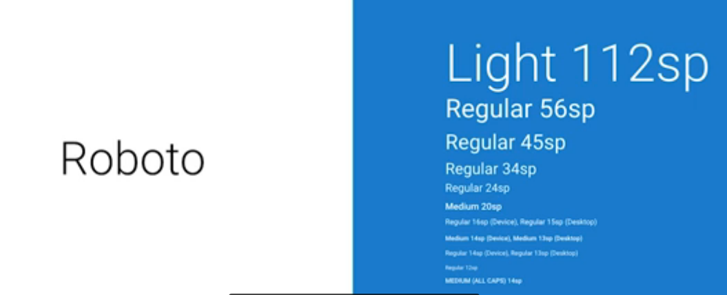
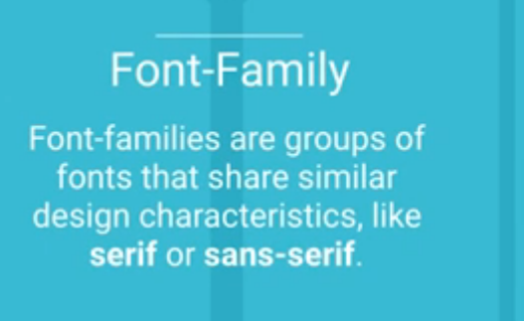
Font family
Default family of android

Slide 3
Fg

