Slide 1
First step:
Adding the dependency and adding the recycler view to layout
Dependency:
compile 'com.android.support:recyclerview-v7:25.3.1'
Recycler view:
<android.support.v7.widget.recyclerView></...>

Slide 2
2nd step
Create a row of layout xml file that needs to be repeated in recyclerView.
Create a viewholder class which will extends recycler view and it’s constructor must call it’s super.
Inside the viewholder , create instance of textView or whatever was there as a child in layout of row and make it’s findViewById inside instructor.
Make a function bind which will accept number as integer and it’s will set to the textView.

Slide 3
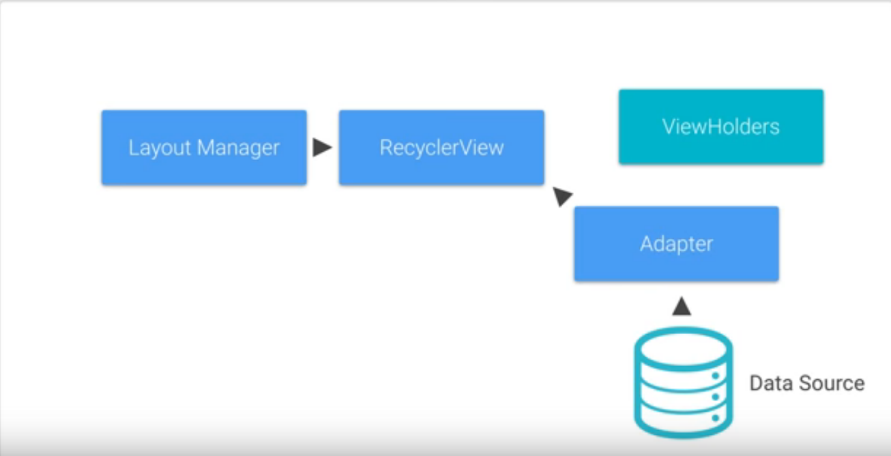

Slide 4
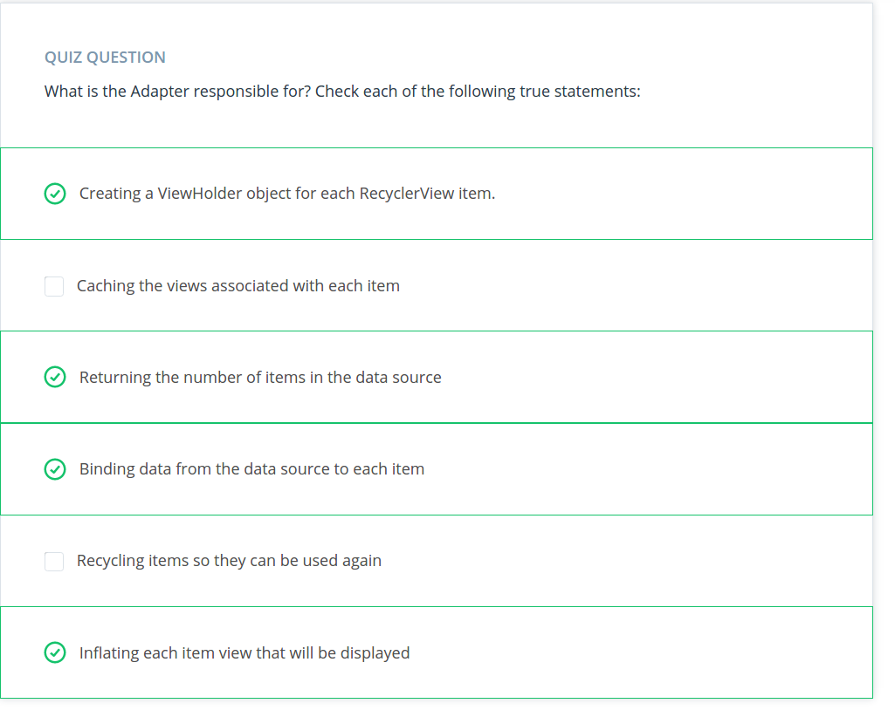

Slide 5
Adapter
First make an private variable which will show that number of list item.
Make an constructor of Adapter class which will set the value of privabte number variable variable with the received int value
Make the adapter class extends recyclerview.adapter<VH> where VH is our own viewholder we created in last step.
Make the class override the oncreate , bindviewholder and getItemcounts method.
In on create , we will accept the parent viewgroup, take the context from by
Context context = parent.getContext();
Then inflate the layout of row, by creating an inflater instance.
ie.
LayoutInflater inflater = new LayoutInflater(context);
View view = inflater.inflate(R.layout.row_xml , parent, false);
Create an object of the view holder adn pass the vview to it.
MyViewholder holder = new MyViewHolder(view);
And finally return the holder instance;

Slide 6
Adapter-ii
In bind view holder, accept the holder returned by oncreate view holder and call the holder.bind function and the number of list items to it.
In itemgetscount function , return the number of row elements.

Slide 7
SetLayout manager
Make instance of Adapter class and make an variable of recyclerview
Instantiate the recyclerview with findviewByid
Make an instance of layout manager, generally Linear layou manager for vertical recycler view.
Pass this as context inside the parameter
Set linearlayout manger to recycler view by
      Recyclerview.setlinearmanager(layoutManager)
Now recycler.sethasfixedtrue(true);
Adapter = new myadapter(inside construct parameter list)
Recyclerview.setAdapter(adapter)

Slide 8
Handle item click
Create an interface inside the adapter which contains only one function , itemclickhandler
Make an object of interface
Make changes in constructor,take an parameter of interface object and instantiate it
Implement view.onclicklistener to our view holder
Override the onclick function inside it
Get item position clicked by clickedPositon = getAdapterposition
Now , call pass this integer value to function of interface by objectInterface.itemclickhandler(clickedPostion)
Inside the viewholder constructor, set view.setclicklistener(This)

Slide 9
Mainactivity click listener part
Implement the interface of itemclick and override it’s function
Make change in adapter instantiation because it will need one extra parameter , pass this.

Slide 10
