Slide 1
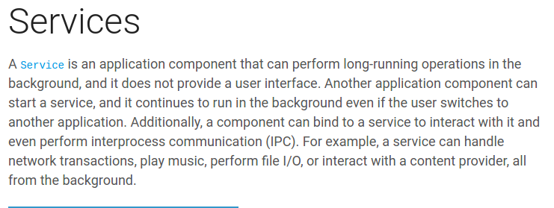

Slide 2
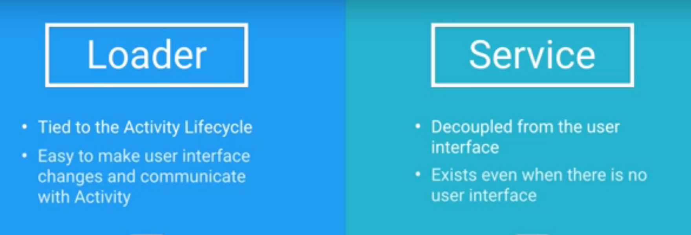

Slide 3
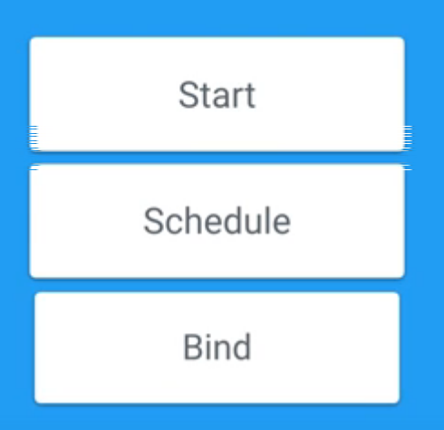
Ways to start a service
https://developer.android.com/guide/components/bound-services.html

Slide 4
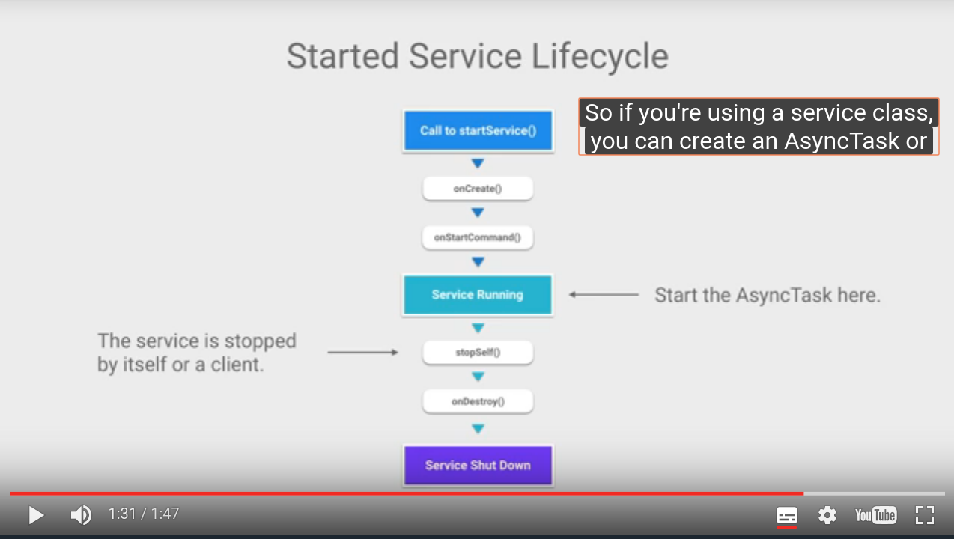

Slide 5
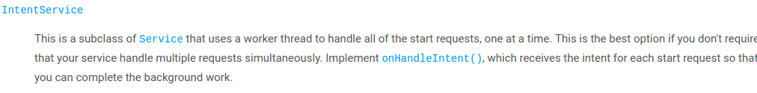
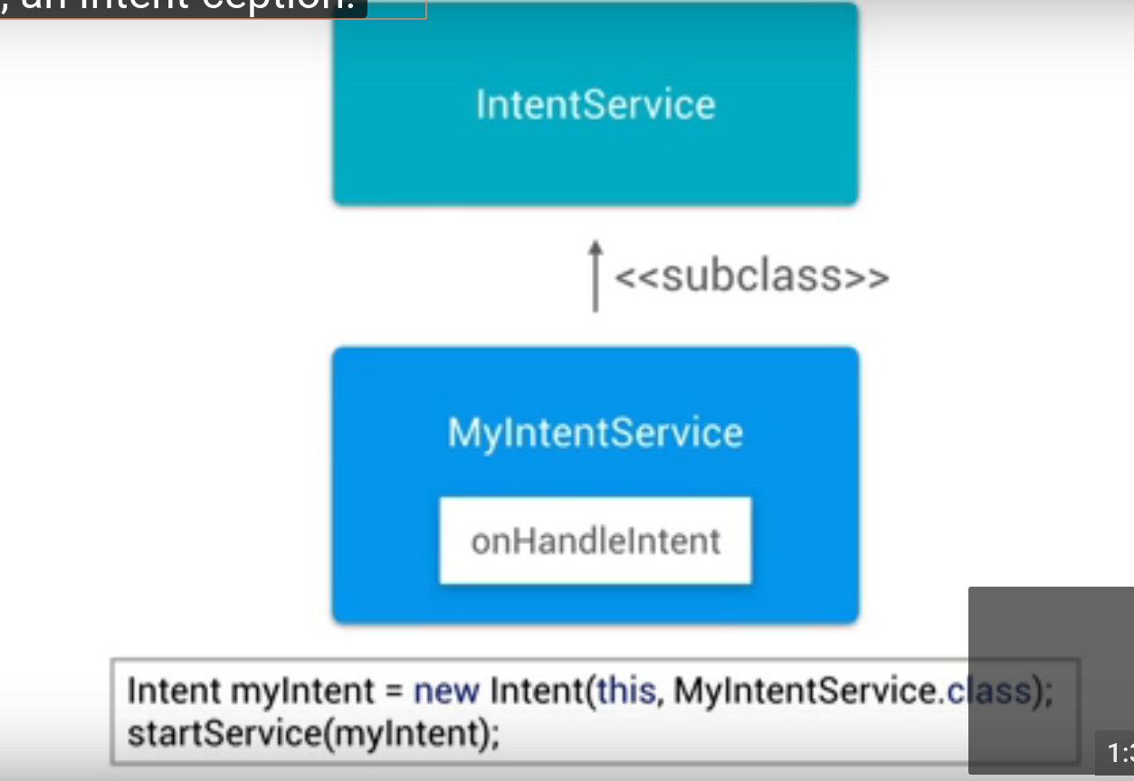
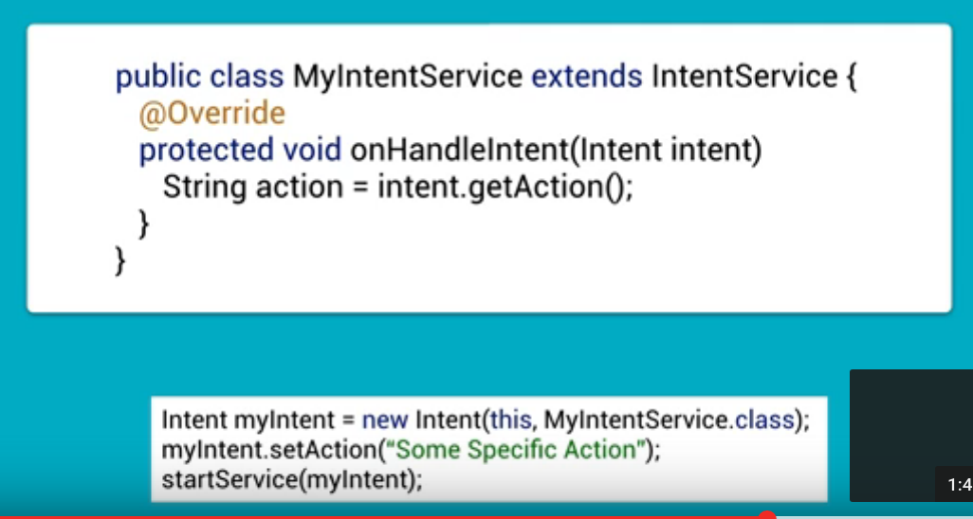

Slide 6
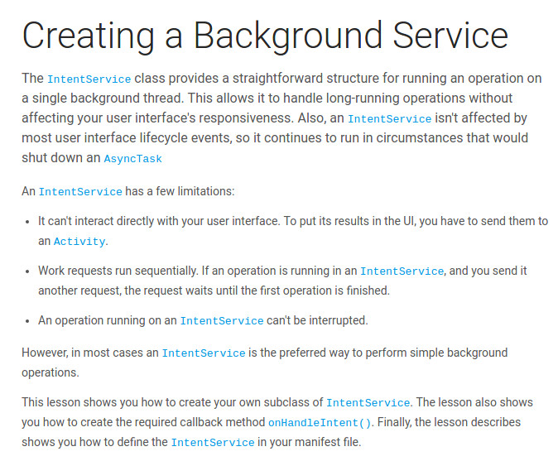

Slide 7
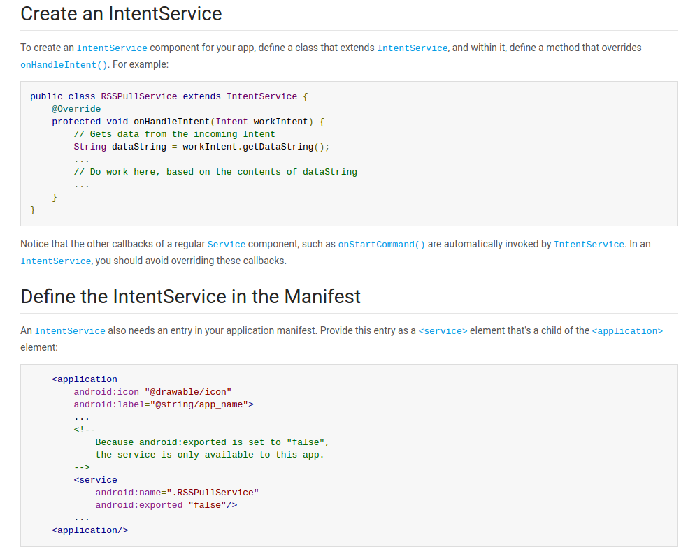

Slide 8
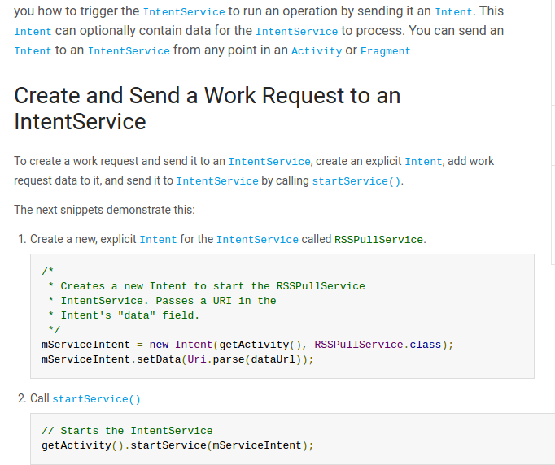
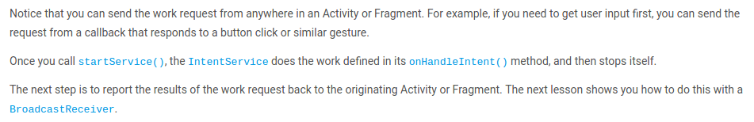

Slide 9
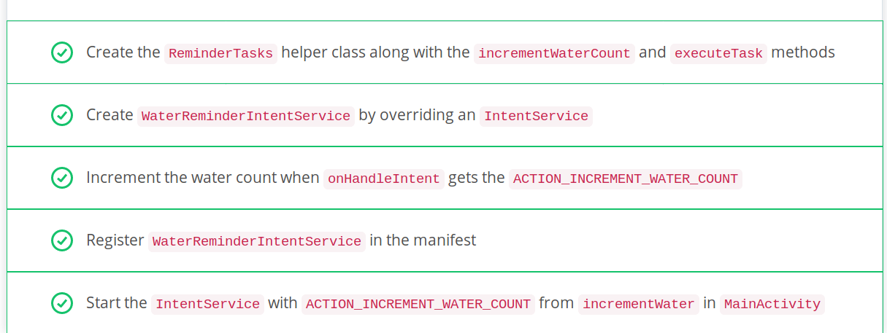
Sample example where on click of image button , we start a service , in Onhandleintent of service class , we call a function “executeTask” which checks whether intent’s action value is same ? If yes , it calls the increment function from Preference utitlity class.
Inshort , We are updating Sharedpreference with service and updating UI on click with Sharedpreference on change listener

Slide 10
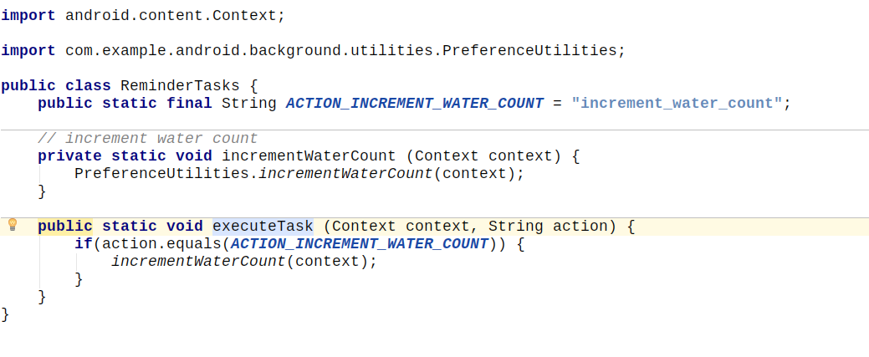

Slide 11
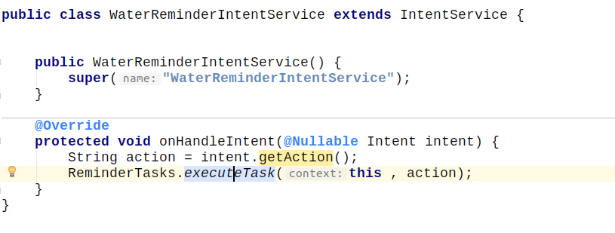
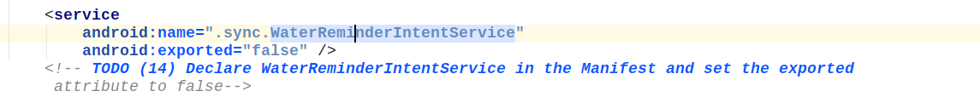
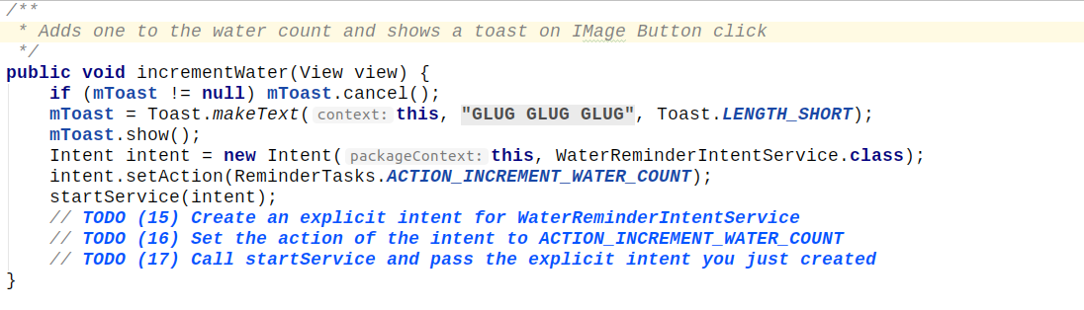

Slide 12
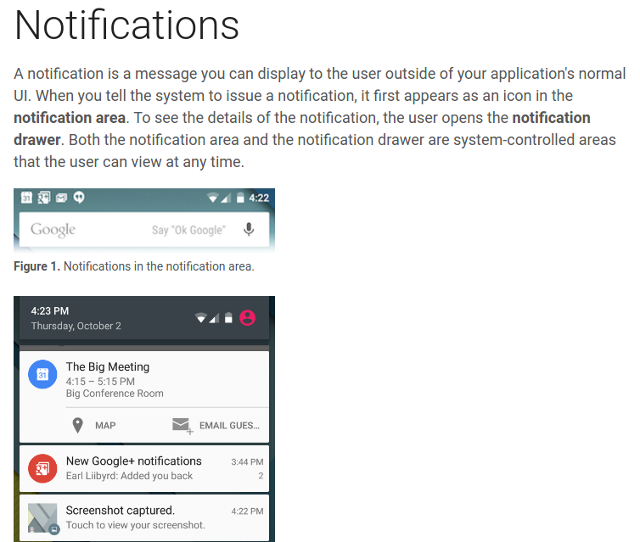
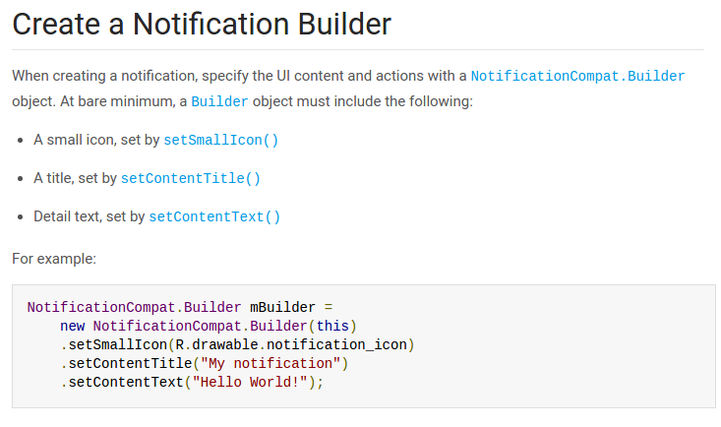
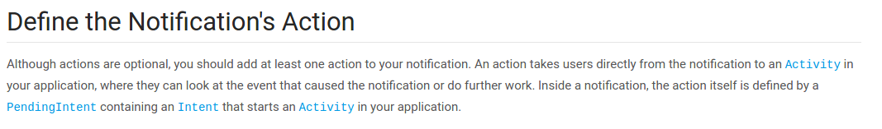
https://material.io/guidelines/patterns/notifications.html
https://developer.android.com/guide/topics/ui/notifiers/notifications.html

Slide 13
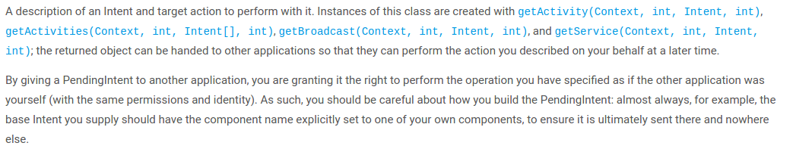
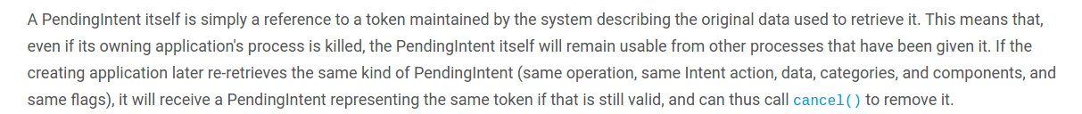
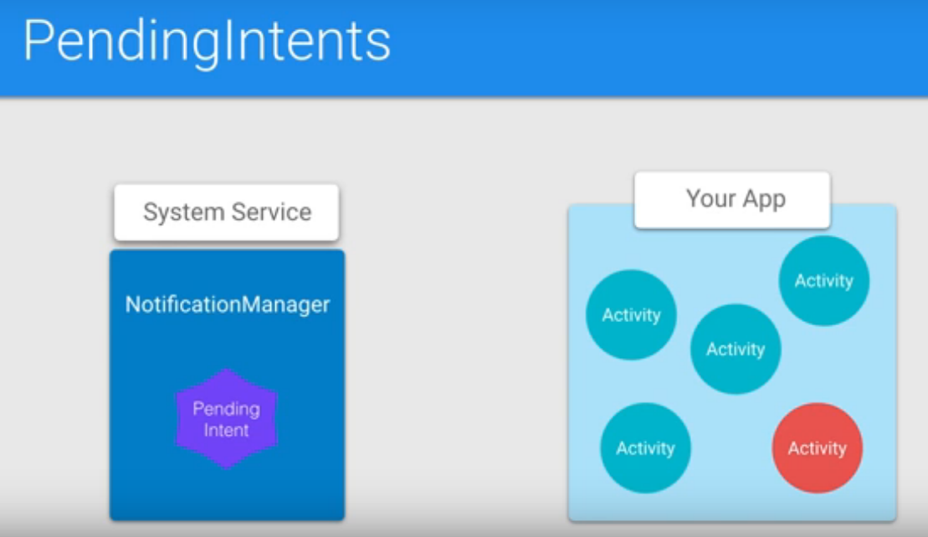
Pending Intent

Slide 14
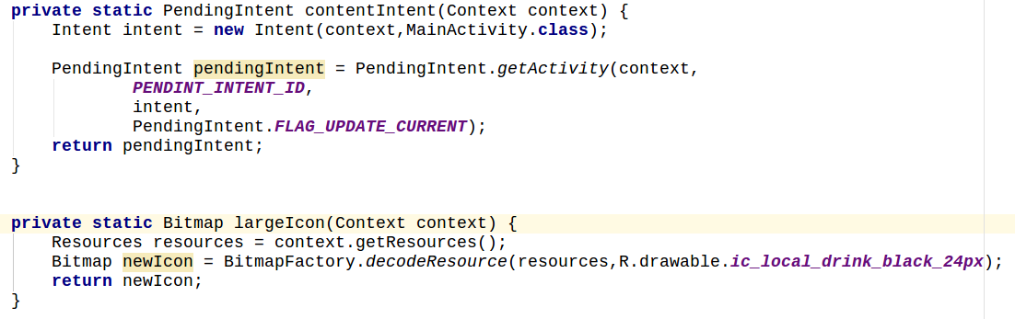
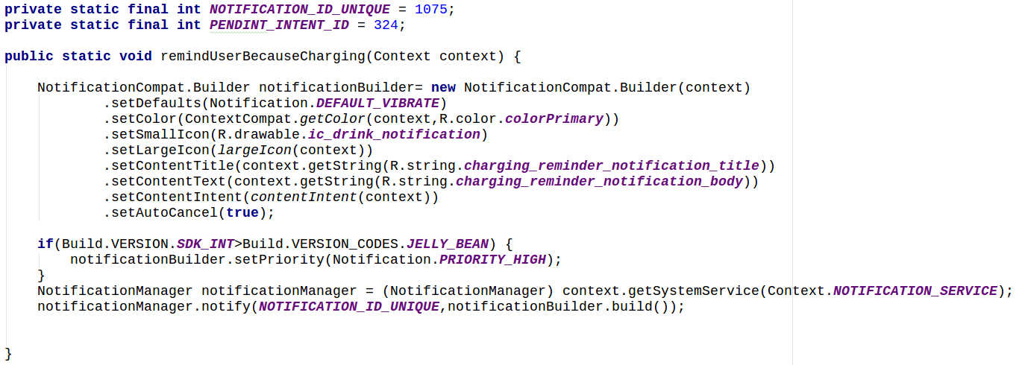
Implementation of pending intent
Make a function named contentIntent which will return Pending intent.
Make another function which will return Bitmap version of a image.
Make a unique id for identyfying pending intent and make another unique id for notification manager.
You can test it using a button in mainactivity.
Add vibration permission in menifest file and singletop for activity, call reminderUserBecauseCharging

Slide 15
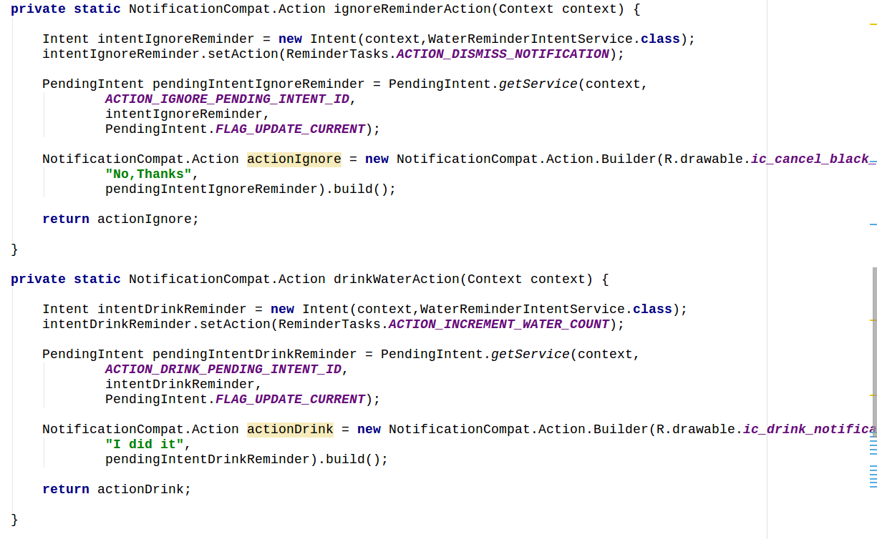
Add action to the notification

Slide 16
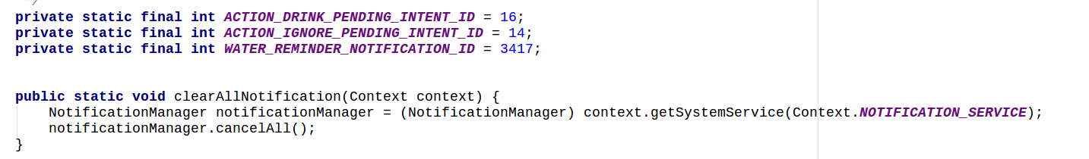
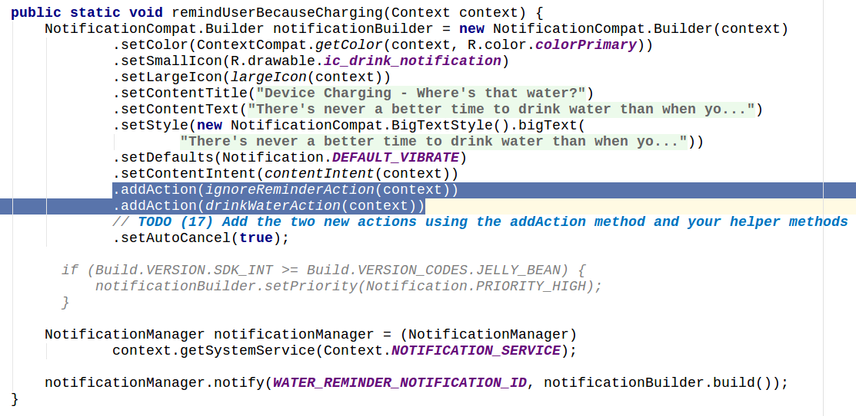
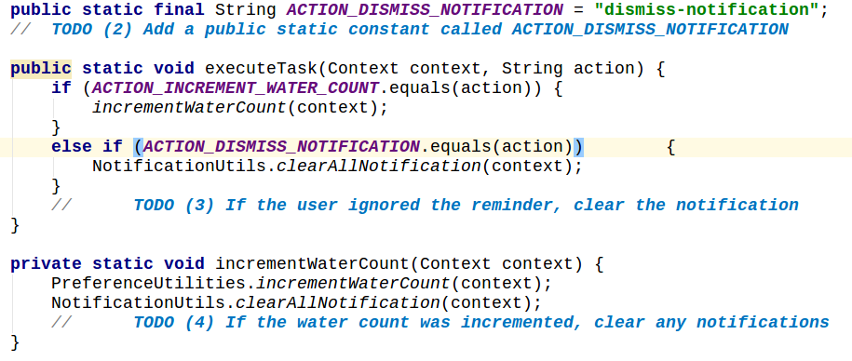

Slide 17
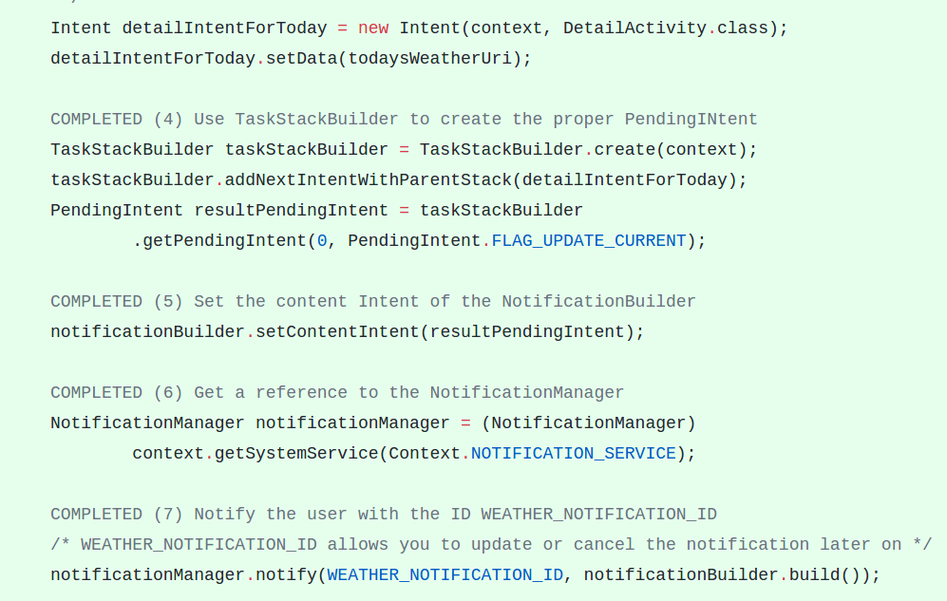

Slide 18
Creating pending intent anotherway

Slide 19
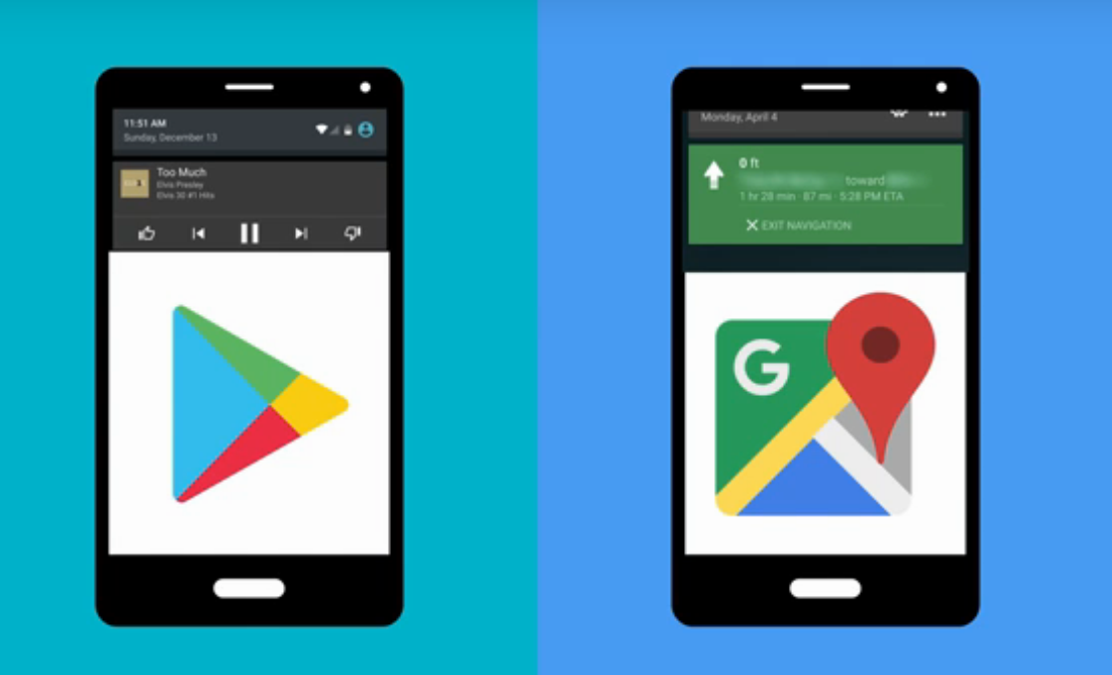
Foreground Service

Slide 20
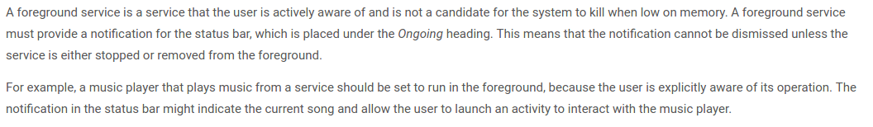
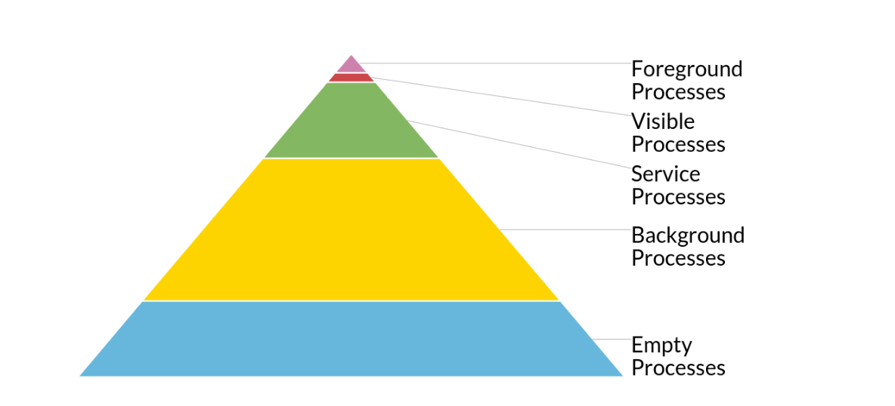
Foreground Service

Slide 21
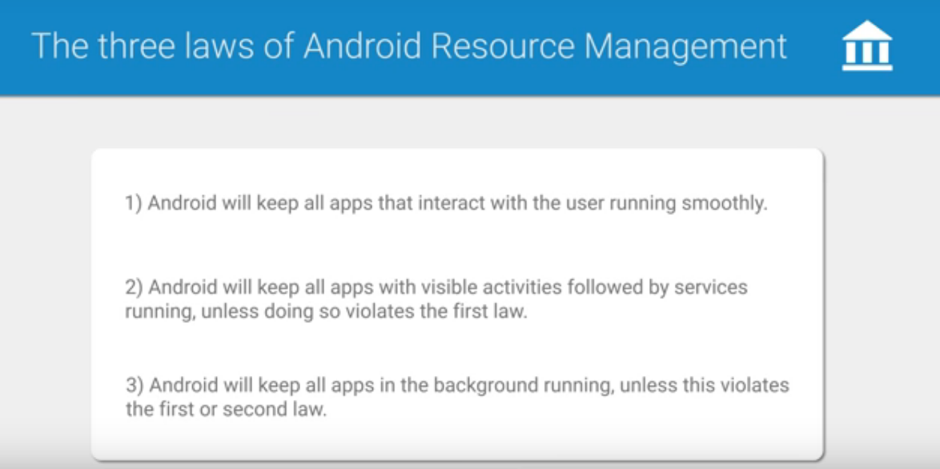

Slide 22
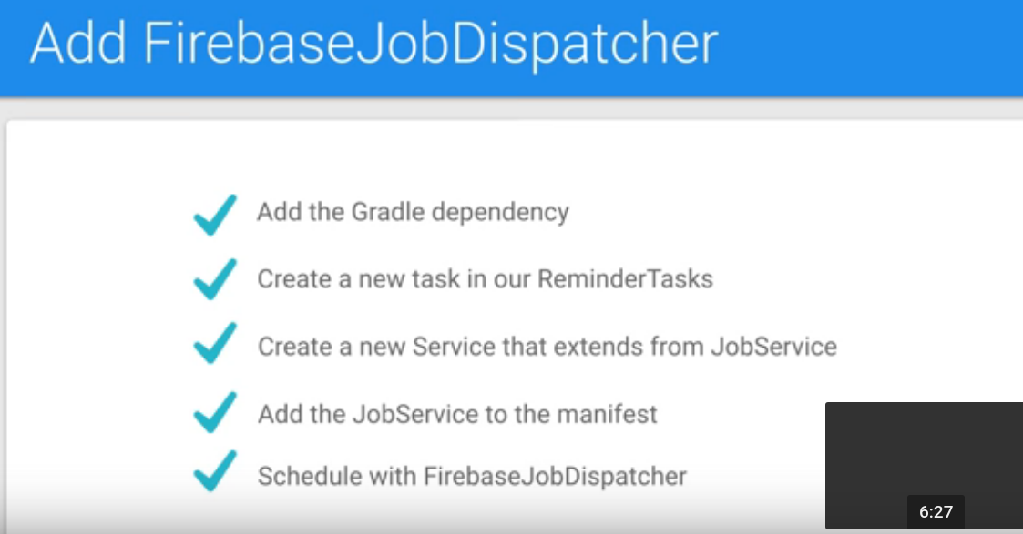

Slide 23
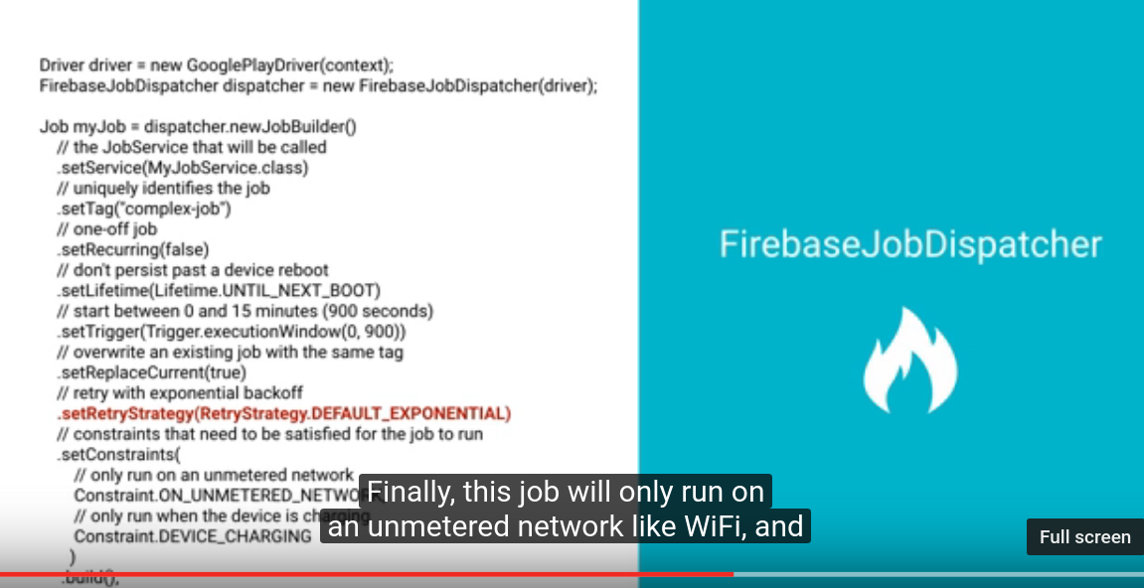

Slide 24
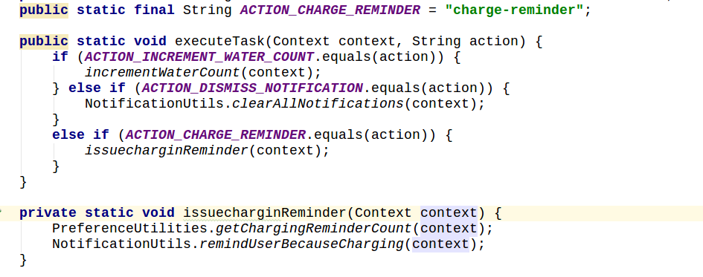
Steps to create firebase jobdispatcher
add gradle dependency
Make a new class which extends Job
Service from firebasedispatcher. (See pics in next slide)
Add the newly create service to manifest file.
Create new function , create job there and schedule it.
Call the function in mainactivity when u want to start the job

Slide 25
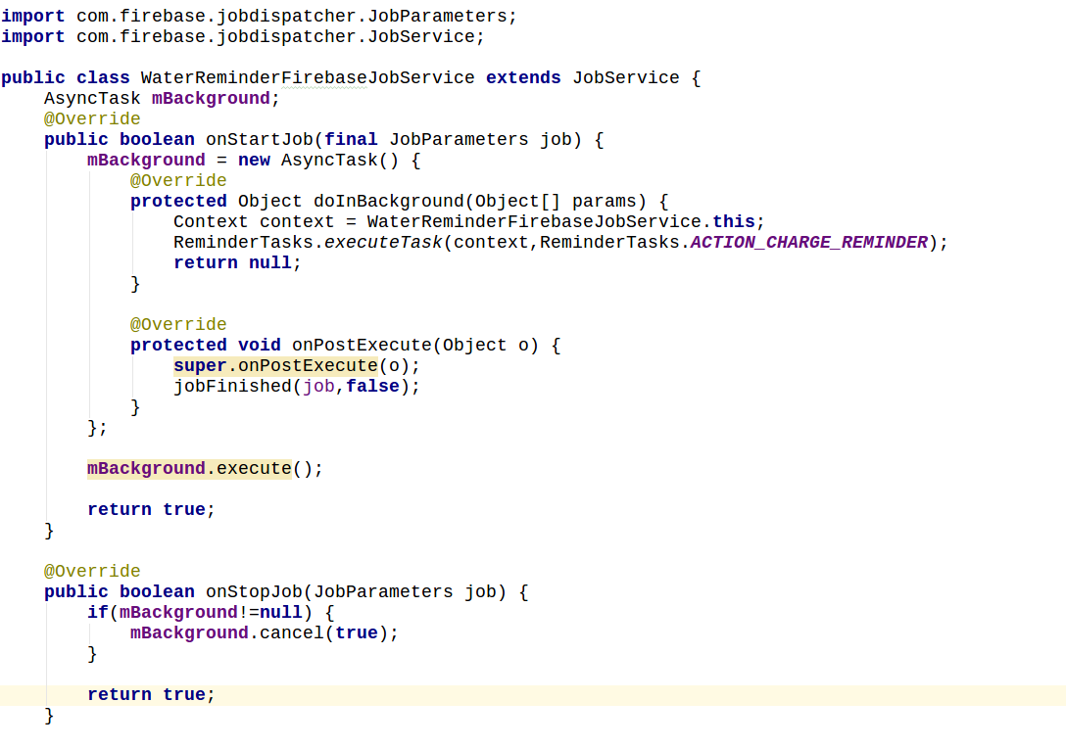
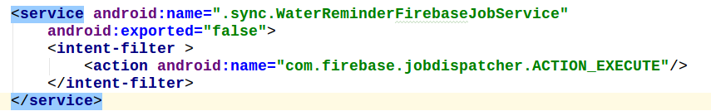

Slide 26
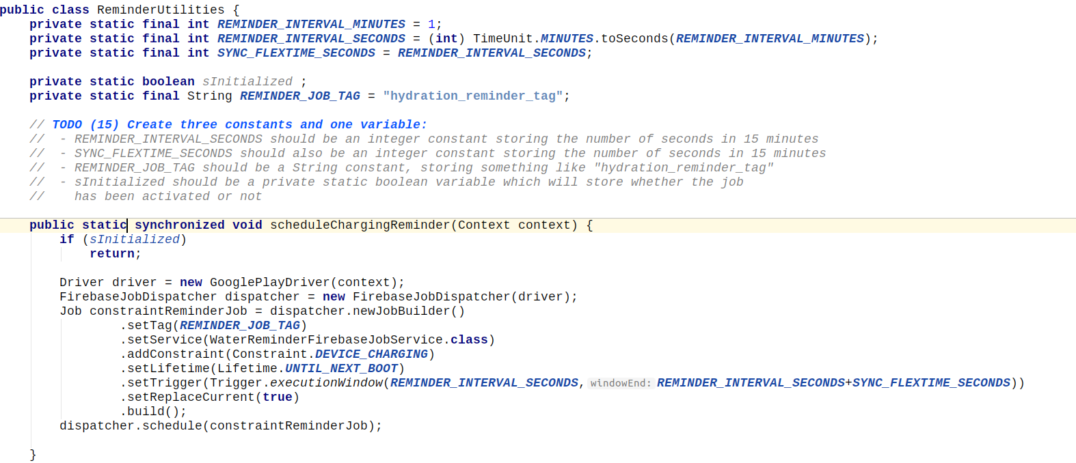


Slide 27
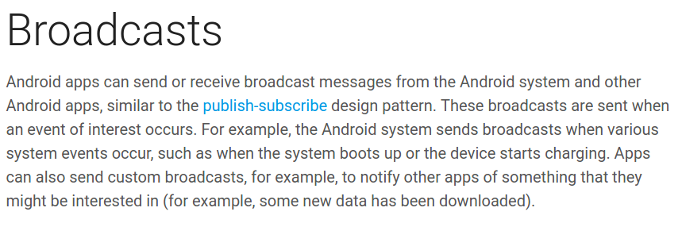
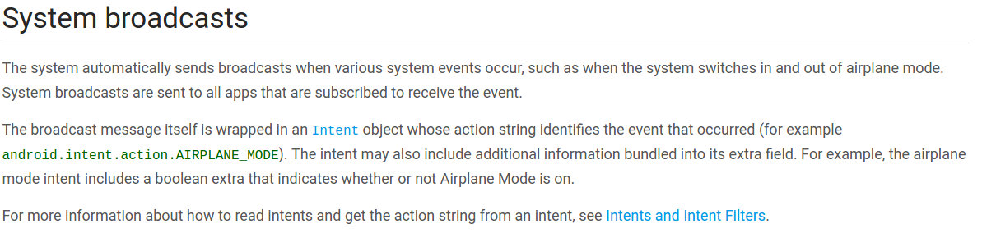

Slide 28
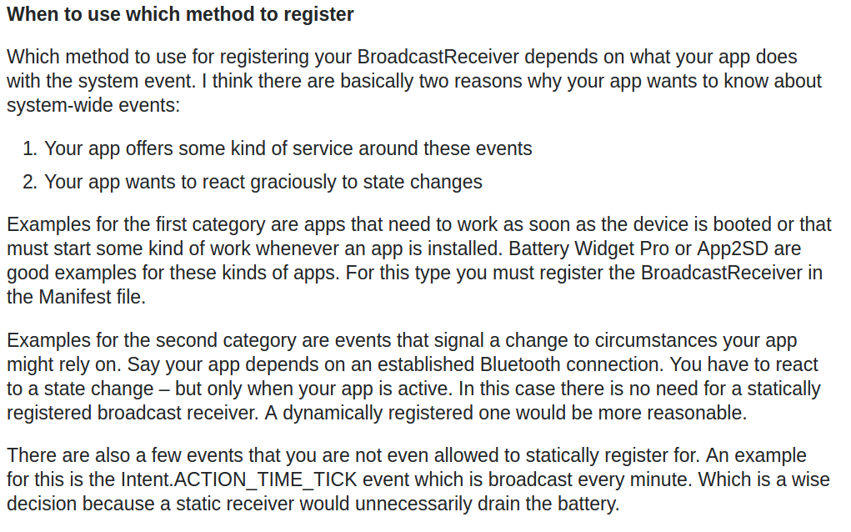

Slide 29
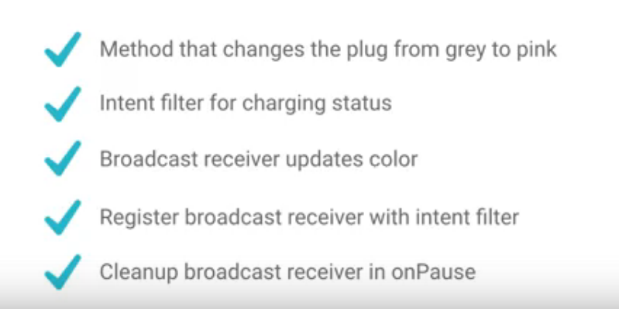
Broadcast Receiver

