Slide 1
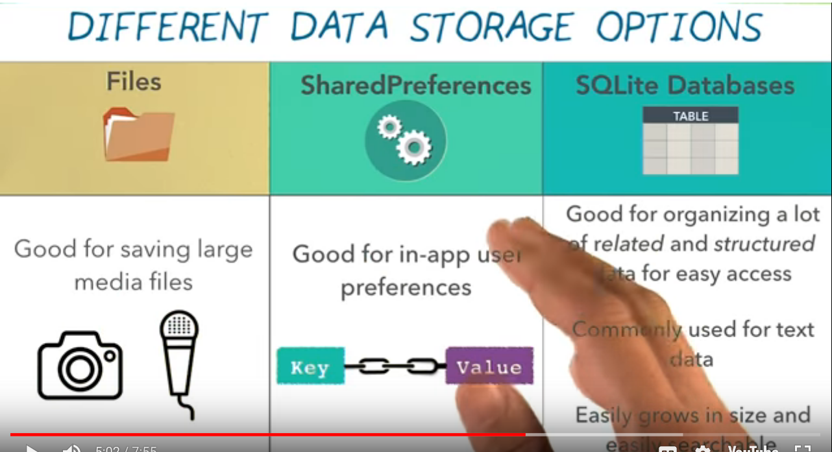
https://developer.android.com/training/basics/data-storage/databases.html#DefineContract
https://developer.android.com/training/basics/data-storage/databases.html#ReadDbRow
https://developer.android.com/reference/android/database/sqlite/SQLiteDatabase.html#query(java.lang.String,%20java.lang.String[],%20java.lang.String,%20java.lang.String[],%20java.lang.String,%20java.lang.String,%20java.lang.String)

Slide 2
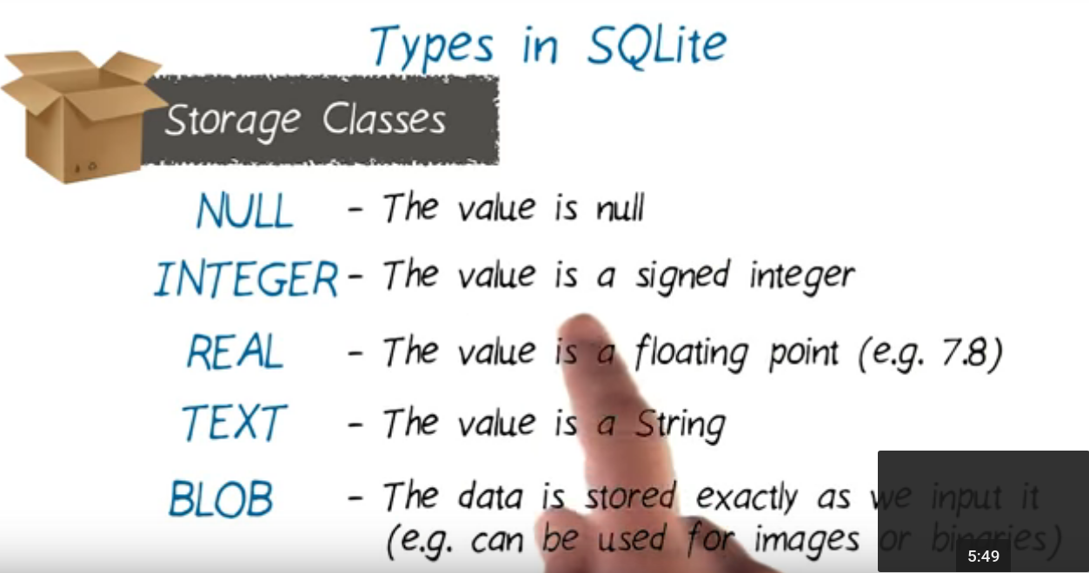

Slide 3
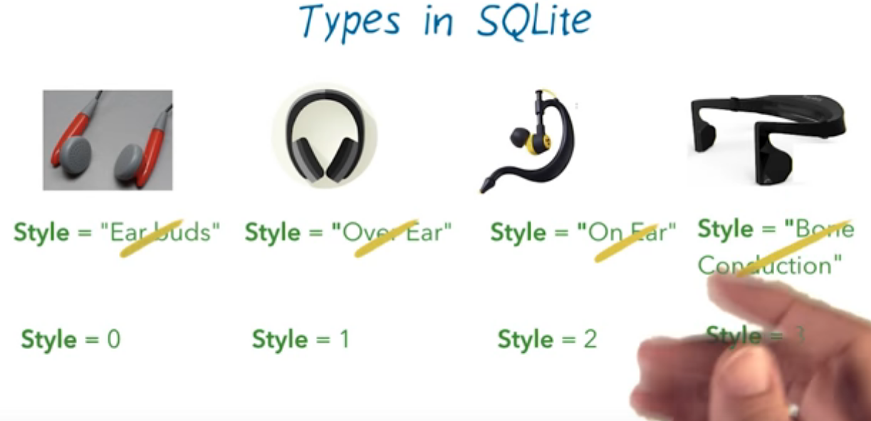

Slide 4
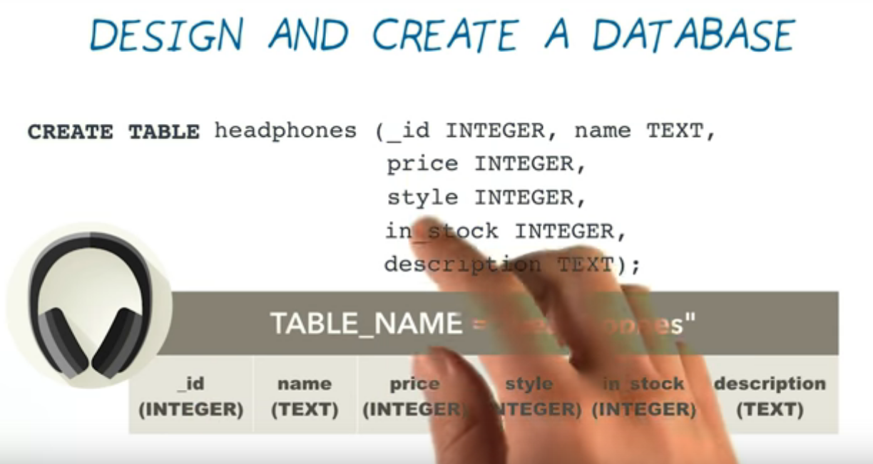

Slide 5


Slide 6


Slide 7
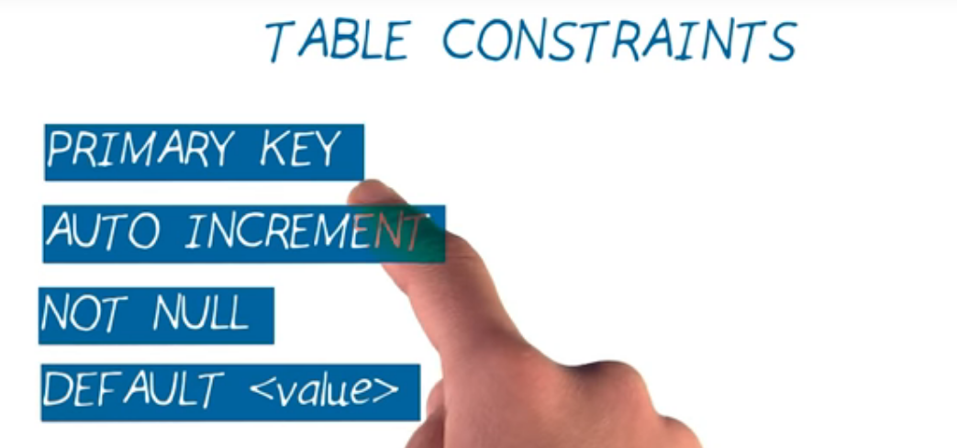

Slide 8
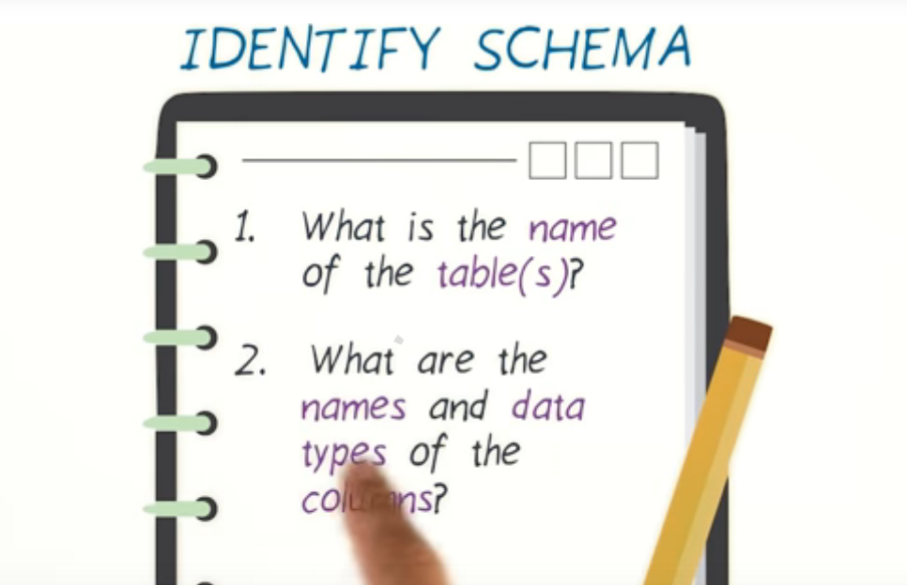

Slide 9
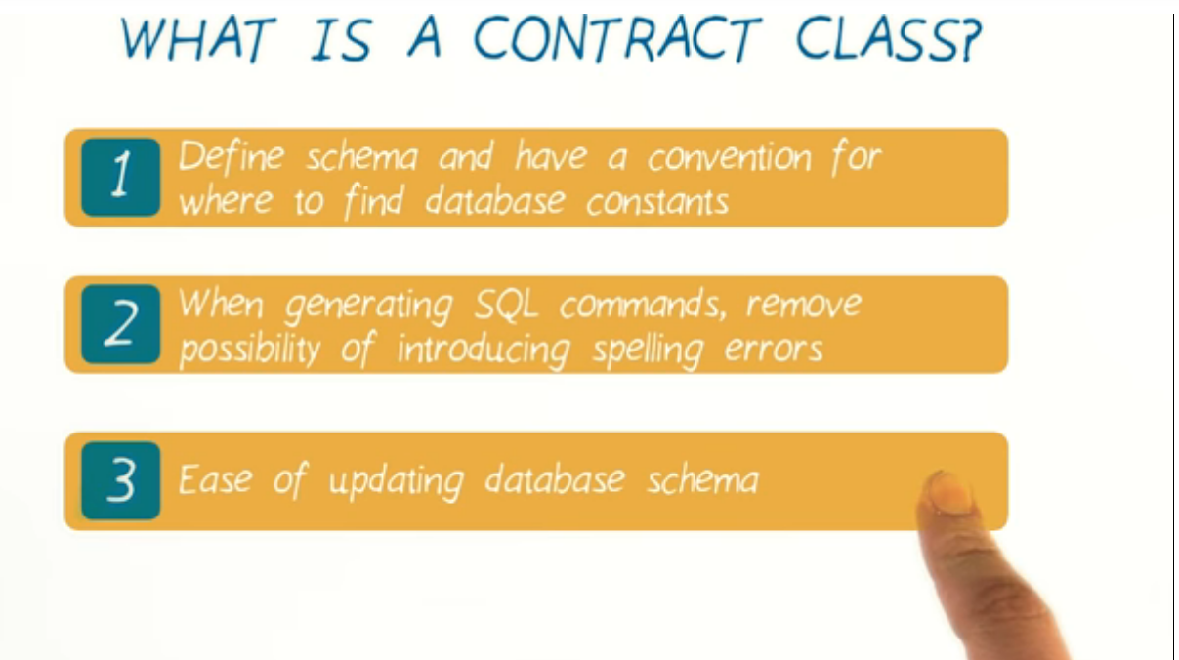

Slide 10
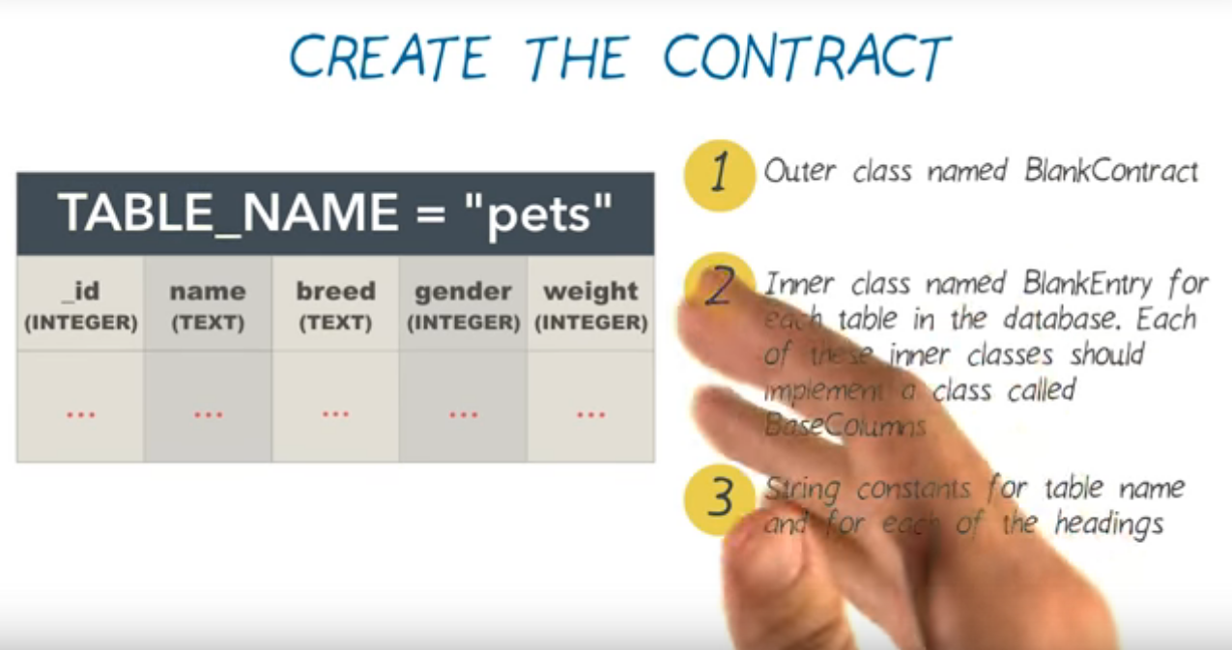
Steps used to create a contract Class

Slide 11
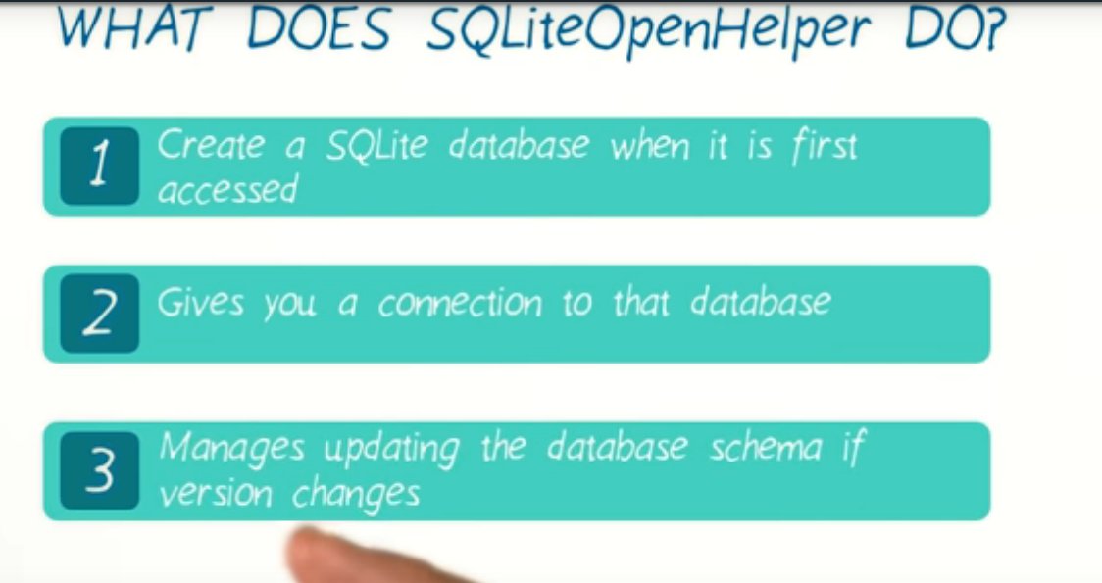

Slide 12
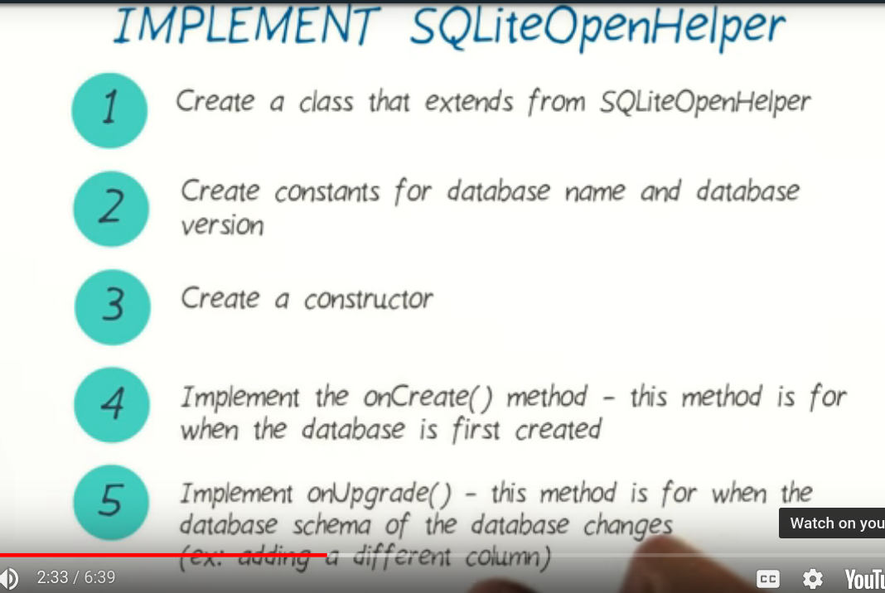

Slide 13
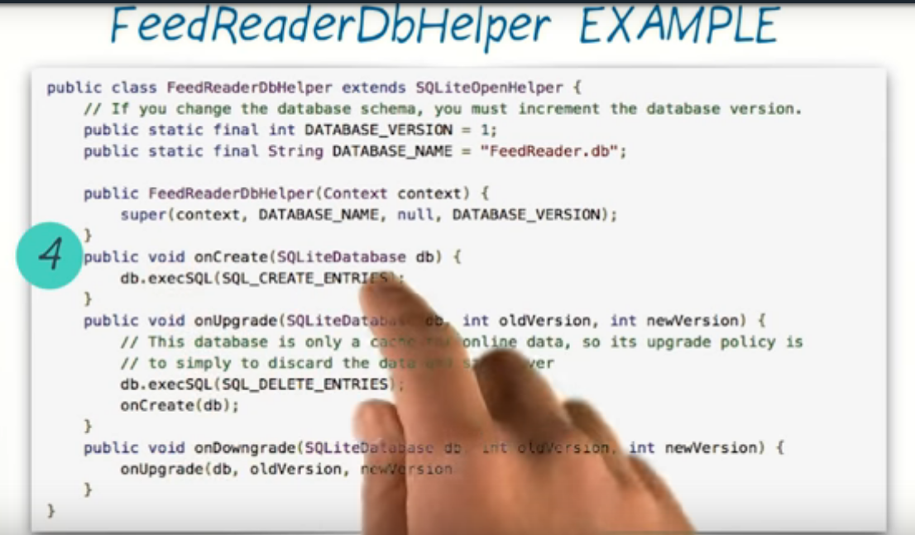

Slide 14
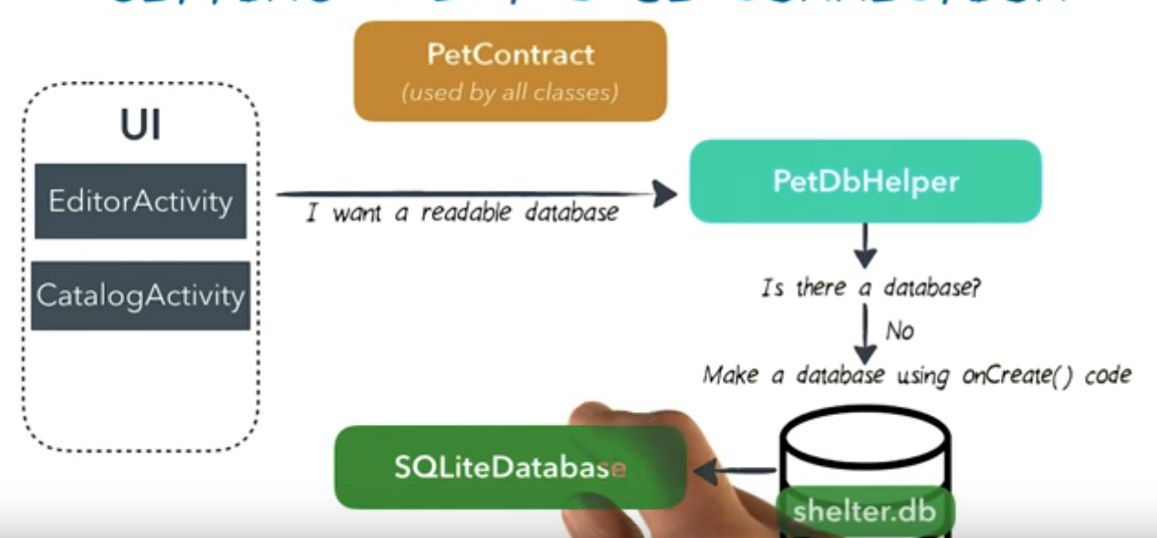
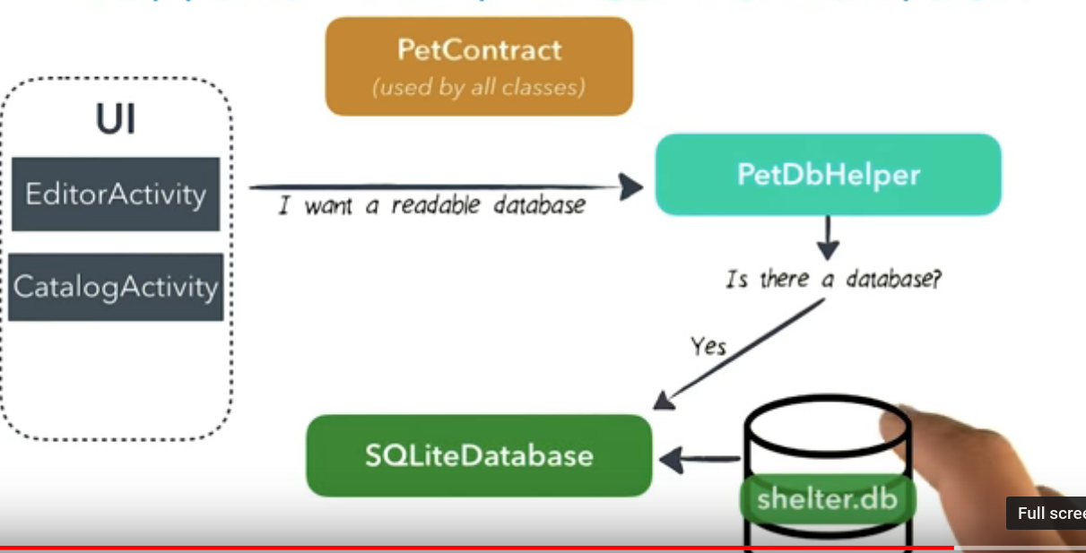

Slide 15

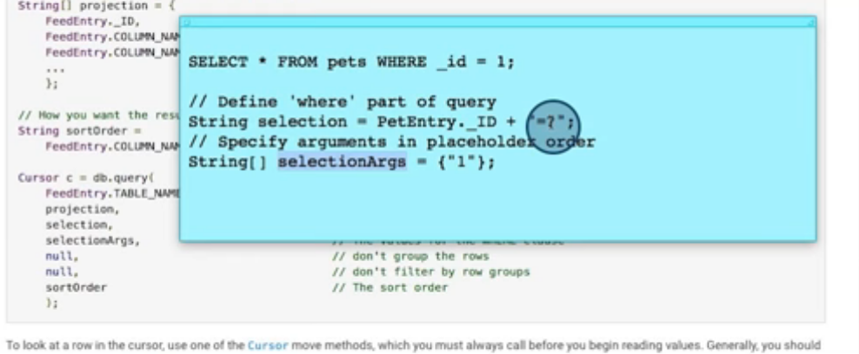

Slide 16

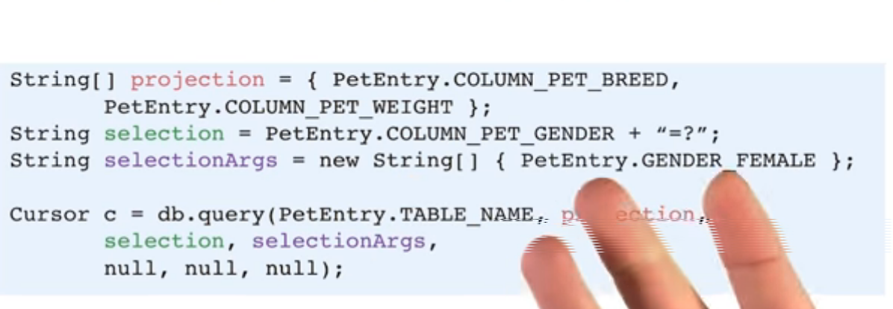

Slide 17
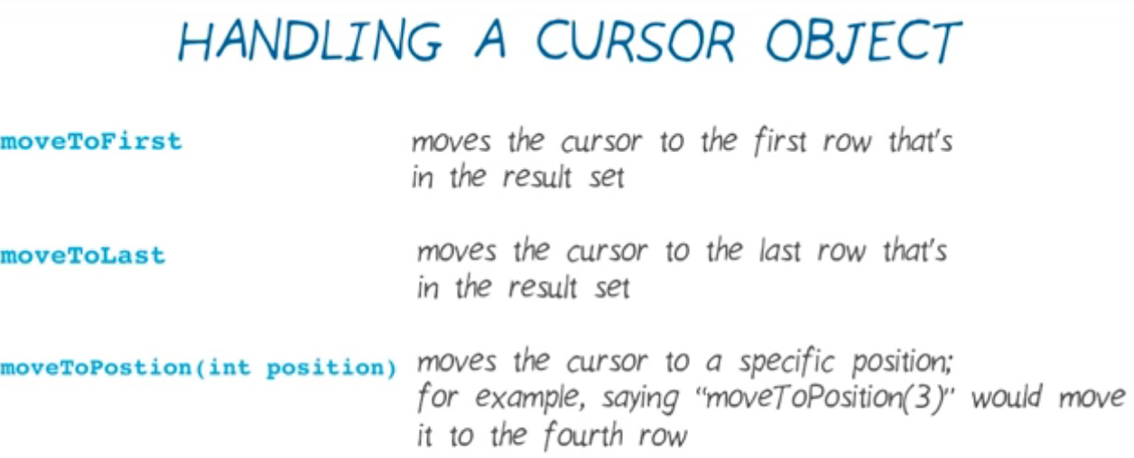

Slide 18
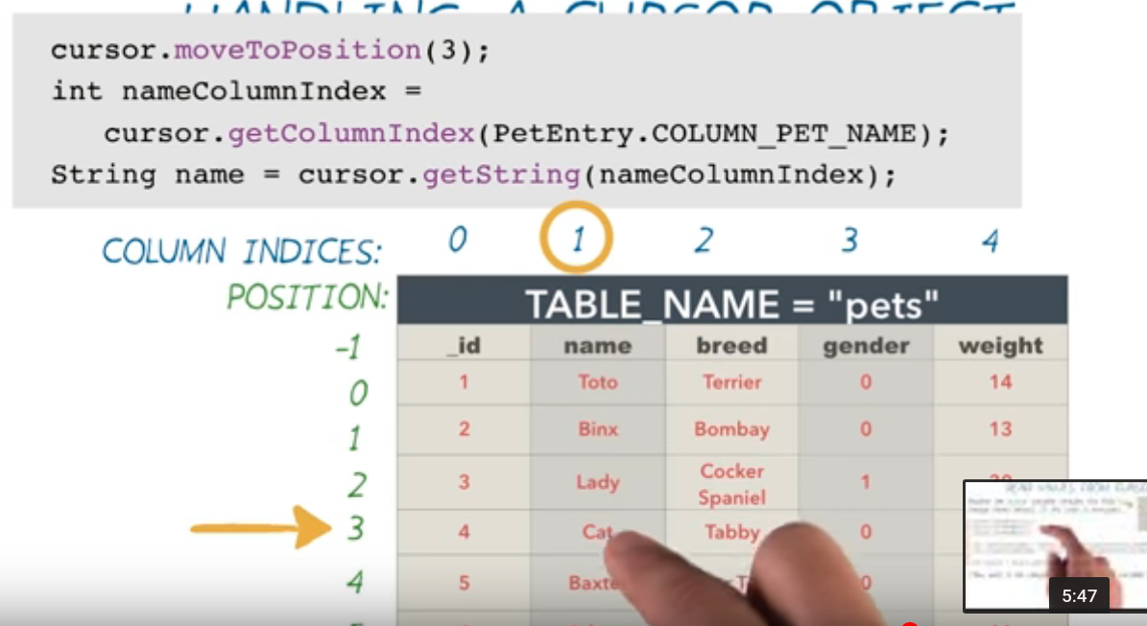

Slide 19
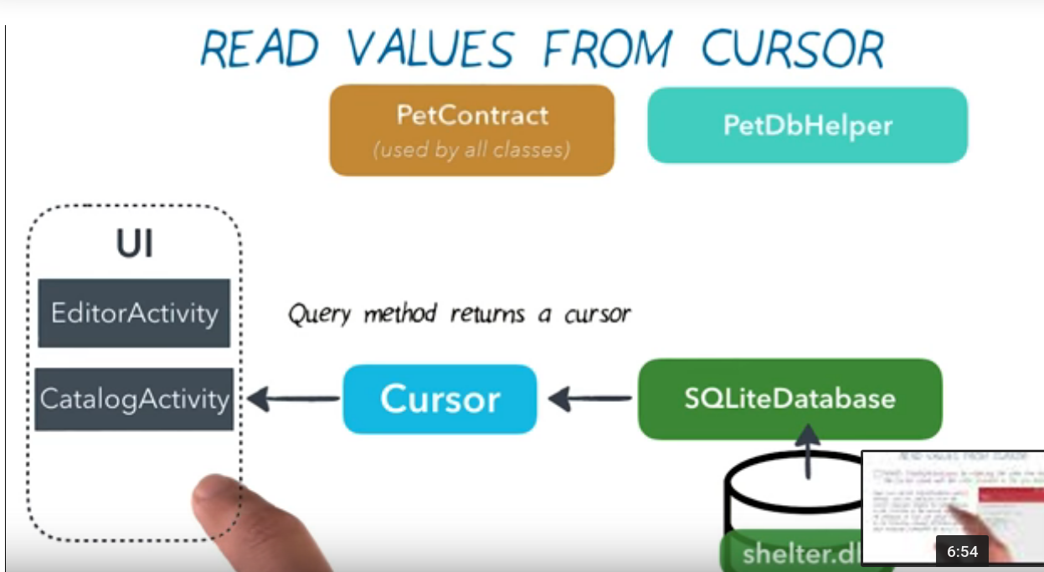

Slide 20

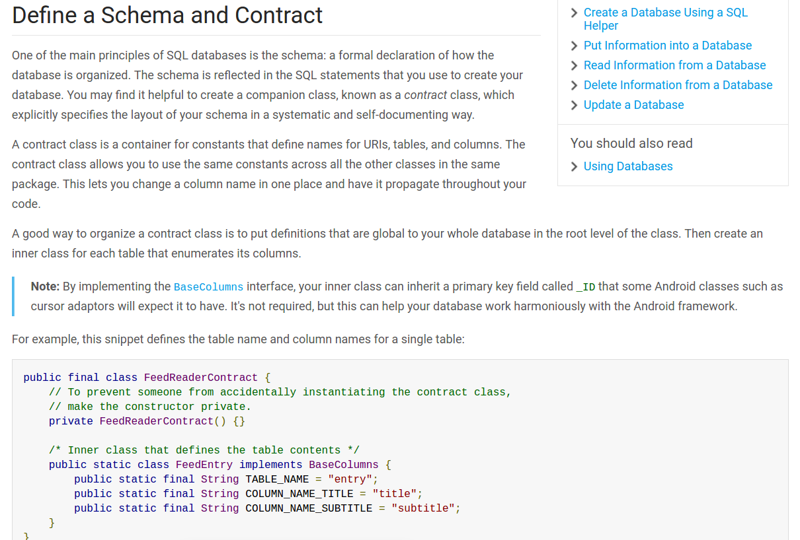

Slide 21



Slide 22
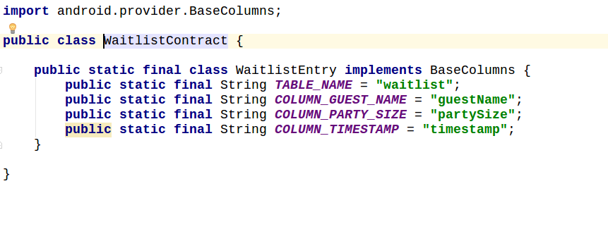
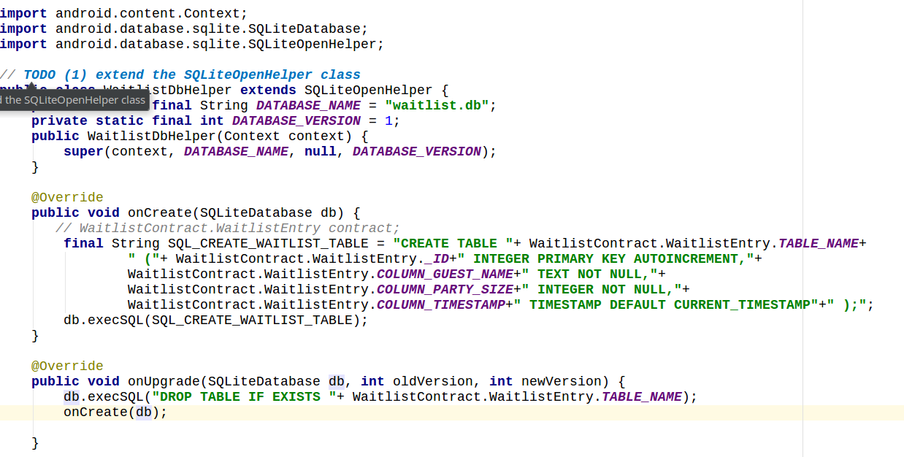
creating database
Creating contract

