Slide 1
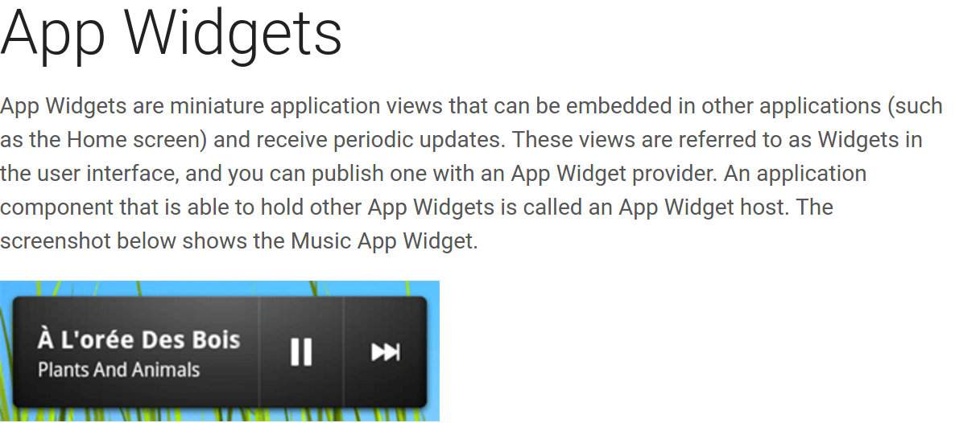

Slide 2
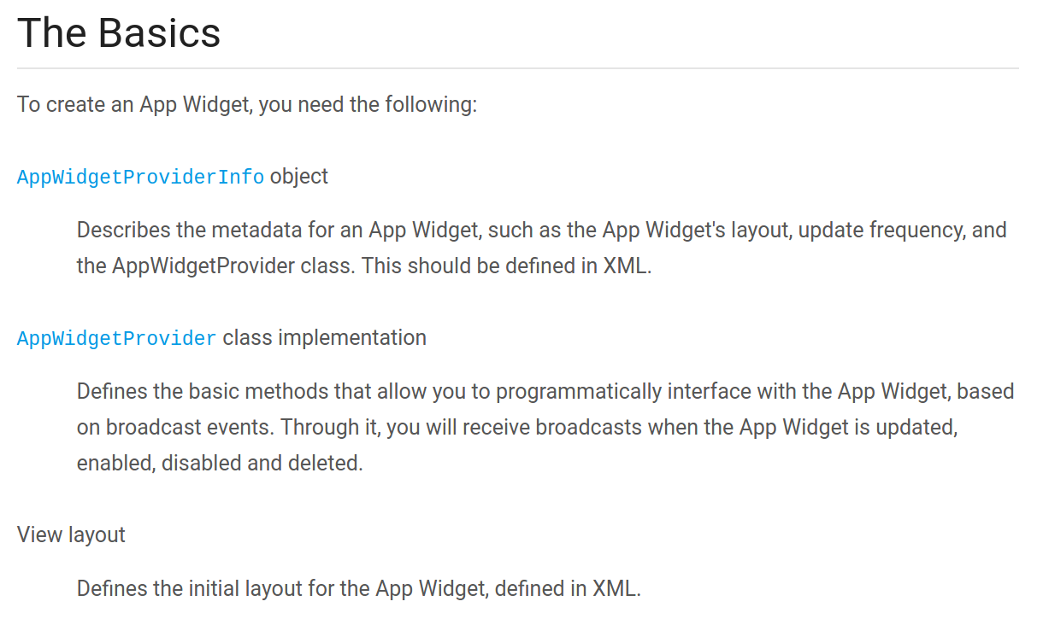

Slide 3
1. First create an app widget by going through New- > Widget->App widget.
2.Create initial layout for your App Widget in XML and save it in the project's res/layout/ directory
3. By default when you create a widget, a xml file inside xml folder, a java class with onupdate method and inside android manifest , a receiver tag will be created with necessary details.
4. set onlayout in widget provider info in xml folder, as created new layout , set different time in mili seconds if u want, minimum time allowed is 30minutes to reduce battery drainage.
5. Read Declaring an App Widget in the Manifest
Adding the AppWidgetProviderInfo Metadata from link :
https://developer.android.com/guide/topics/appwidgets/index.html

Slide 4
RemoteViews
https://developer.android.com/reference/android/widget/RemoteViews.html
A class that describes a view hierarchy that can be displayed in another process. The hierarchy is inflated from a layout resource file, and this class provides some basic operations for modifying the content of the inflated hierarchy.

Slide 5
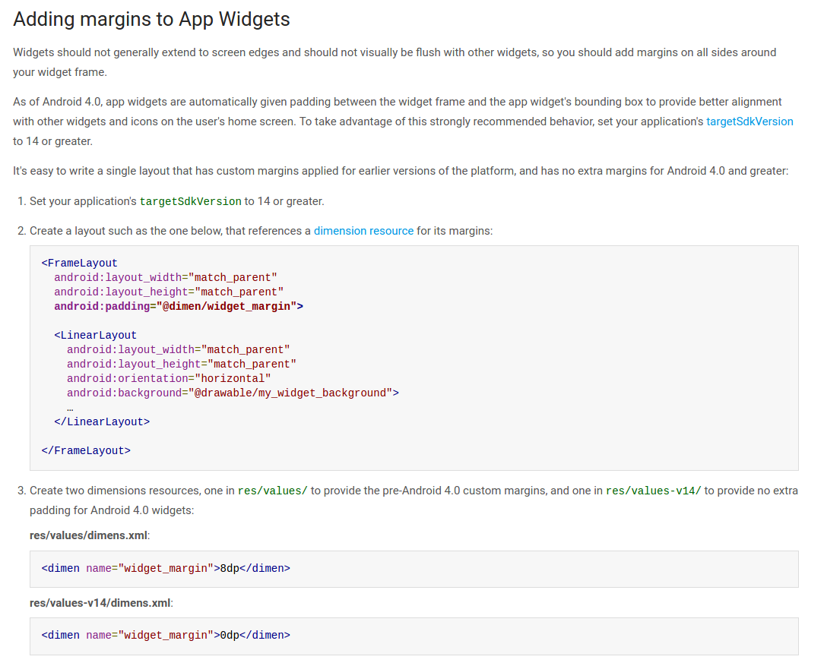

Slide 6

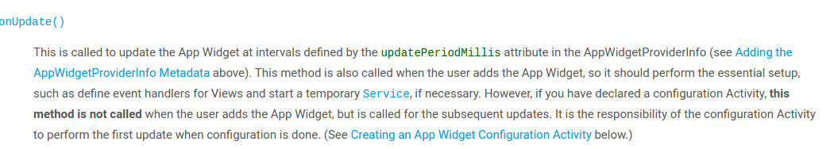

Slide 7
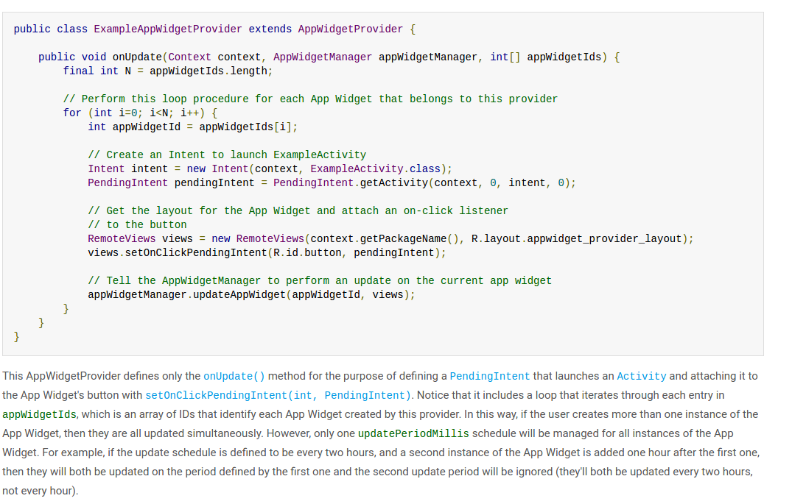

Slide 8
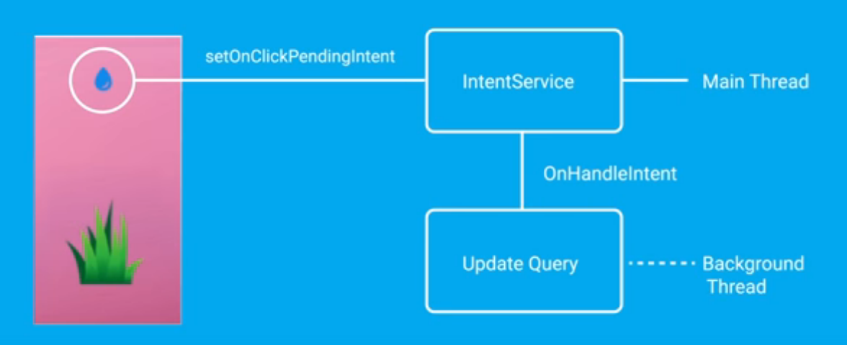
Starting a service instead of activity on click event.

