Slide 1
Itmd-362 Week 5
February 06, 2018

Slide 2
Tonight’s Agenda
TA Contacts
Introduce Project 1
Break Points
Responsive Videos
MDN Forms

Slide 3
WE Have a Teaching Assistant
Name: Manish Vishwakarma
Email: mvishwakarma@hawk.iit.edu
Office: Perlstein Hall - Room 223
Office Times:
TBA

Slide 4
Project 1

Slide 5
Project Description
You will create a compelling single-page design that features a sign-up process to get new users to join some type of project, such as an email list, a software beta test, or an open-source community. Focus on designing for an effortless, engaging entry of personal information; and friendly, frictionless client-side tests and alerts for malformed, missing, or incomplete information. The goal of this project is to experiment with patterns of interaction that persuade someone to sign up for whatever it is you’re offering, which is not at all an easy task.

Slide 6
Project Goals
Create a touch-friendly, mobile-first responsive web design
Experiment with design and interaction patterns for pleasing user experience
Design and execute a progressively enhanced page focused on system users and tasks
Apply design principles including typography, color, and material design
Engage in agile, iterative web design and development, supported by version control

Slide 7
Deliverables & Milestones
Create a Basecamp post describing your work in progress. Title the post with your name and project number (example Daniel Krieglstein: Project 1). Your post should include the URL to your GitHub repository, live link (GitHub pages), and two questions eliciting feedback on from fellow students.
Give constructive comments to help at least three other students.
Edit your original basecamp post under Project 1 by fixing your code based on feedback from the professor and fellow students.
Add a 3-4 sentence self-critique memo of your project and your progress in class to this point

Slide 8
Requirements
Project must be built with only one valid well-formed HTML file, one valid CSS file, and one JavaScript file.
All source files in UTF-8/Unicode character encoding
Organized, readable source that is hand-written and original (no WYSIWYGs or code-generators, no Bootstrap or other off-the-shelf HTML or CSS frameworks)
HTML, CSS, and JavaScript files should both be indented with 2 spaces per level of indent; indent all CSS style rules inside the declaring block, and further indent all rules and blocks inside your media queries

Slide 9
HTML Requirements
Only structural, semantic uses of HTML elements and attributes. Absolutely no table markup, break tags, or any other use of HTML to achieve a particular page layout.
At least three HTML form elements, written in conjunction with <label> tags and the for attribute
Semantically structured text-based HTML content to accompany any media elements (image, audio, video)

Slide 10
CSS Requirements
CSS file should open with a set of reset styles
Use at least two min-width media queries to enhance your mobile-first styles for larger screens

Slide 11
JavaScript Requirements
JavaScript that throws no uncaught errors and is loaded unobtrusively (no JavaScript event attributes in your HTML, in other words; attach events to any elements requiring interaction)
JavaScript that uses function closures and other techniques to avoid polluting the global window namespace
JavaScript that uses only asynchronous methods and callbacks

Slide 12
Git requirements:
A Git repository with frequent commits and meaningful commit messages that accurately reflect each set of changes that you make
GitHub repository must contain only the files and commits from this project

Slide 13
Breaks points: Font Size

Slide 14
Easy Break Points (bootstrap 3)
@media only screen and (min-width : 320px)
320px /* Custom, iPhone Retina */
480px /* Extra Small Devices, Phones */
768px /* Small Devices, Tablets */
992px /* Medium Devices, Desktops */
1200px /* Large Devices, Wide Screens */

Slide 15
Rules of Typography: Best Break Points
Line Hight = 120% or 1.2em
# of Characters = 45-65
In CSS set these rules on html
html {
line-height: 1.2em;
font-family:
font-size:
}
Test at 480 and 768

Slide 16
Maximum Text Area per breakpoint
Viewport(screen) = 480px (wide)
Padding = 19.2px (1.2em * 16px font size)
Viewport – Padding = 460px (rounded; maximum text area)
max 460px to fit 45-65 characters
Explanations:
1.2em padding same as line height.
16 px font size come from chrome default

Slide 17
Responsive Videos

Slide 18
iframe
<style>
div {
position: relative;
padding-bottom: 56.25%; /* this is 16:9 aspect ratio */
padding-top: 25px;
height: 0;
}
iframe {
position: absolute;
top: 0;
left: 0;
width: 100%;
height: 100%;
}
</style>

Slide 19
Imbedded Video
<style>
div {
width: 80%;
height: 500px;
}
video {
width: 100%;
height: auto;
}
</style>

Slide 20
MDN Forms

Slide 21
MDN <form>: Link
Action: URI
“signup.py”
“#null”
autocapitalize: none
enctype: (only use with upload files)
method: (post vs get)

Slide 22
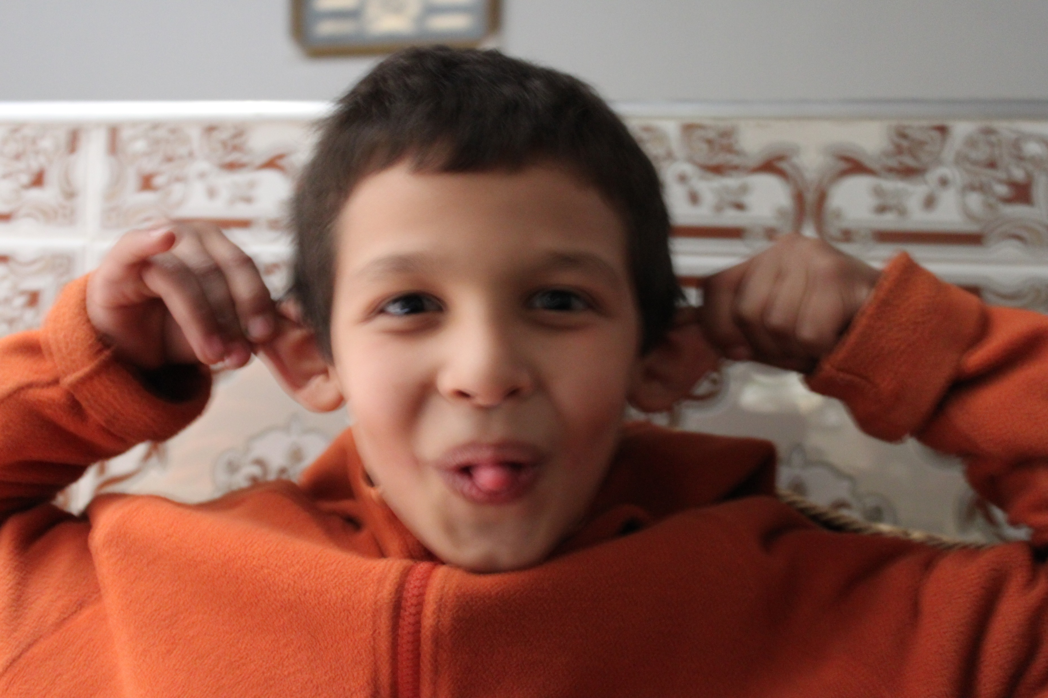
MDN <input>: link

Slide 23
Forms Design

Slide 24
Where users go to die
Mobile Friendly
When to ask for registration
Messaging
Why does this form exist?
Did this form just do something?

Slide 25
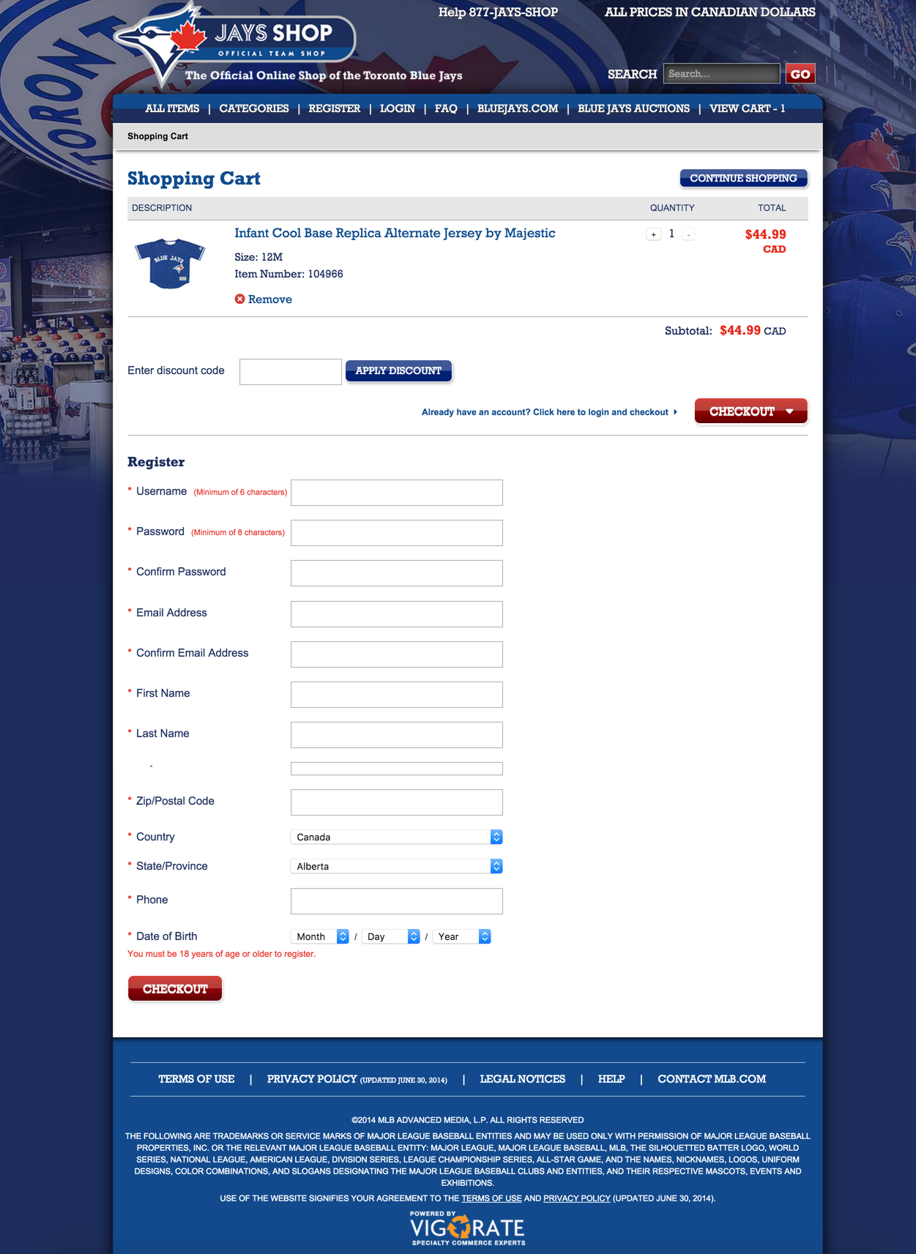
Toronto Blue Jay’s Shop

Slide 26
NEVER DO!
Never Require registration for merch
Form follows actual cost
Shipping address? Billing address?

Slide 27
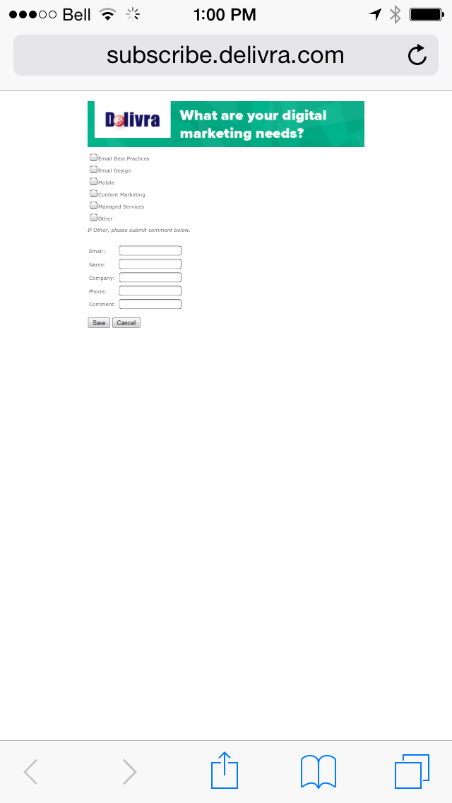
Delivera
Post-unsubscribe Screen
Mobile un-friendly

Slide 28
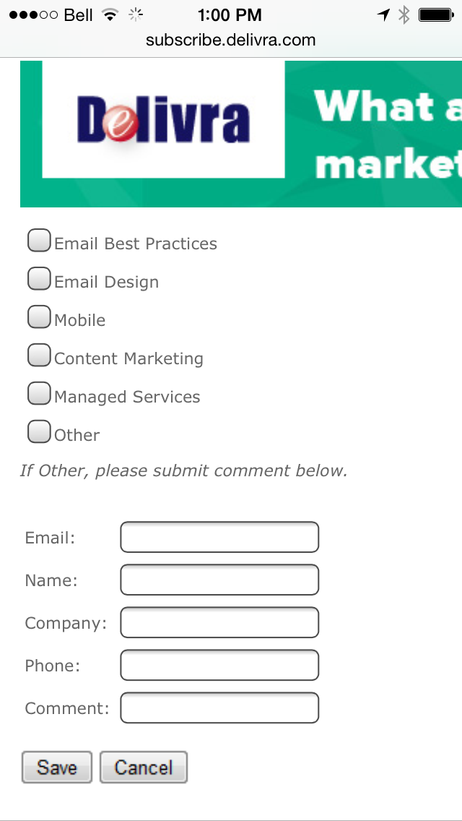
Messaging
“State the purpose of your form”

Slide 29
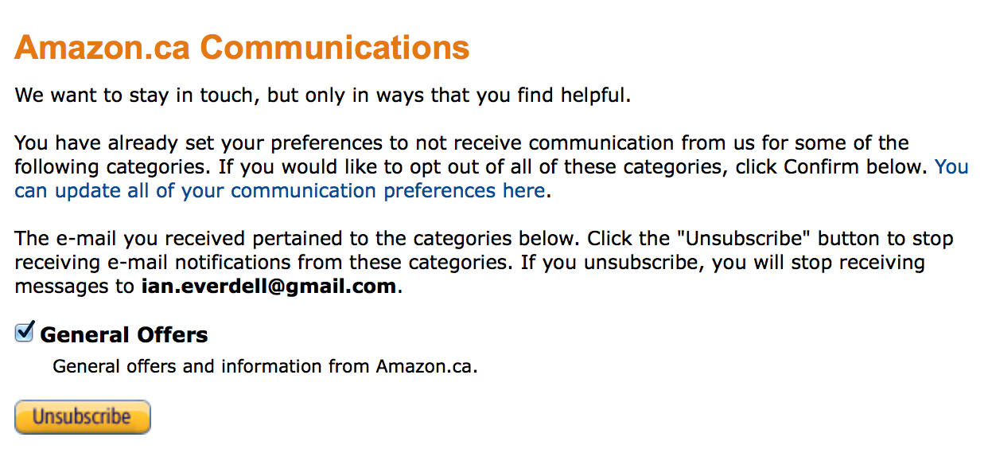
Amazon: check or not to check

Slide 30
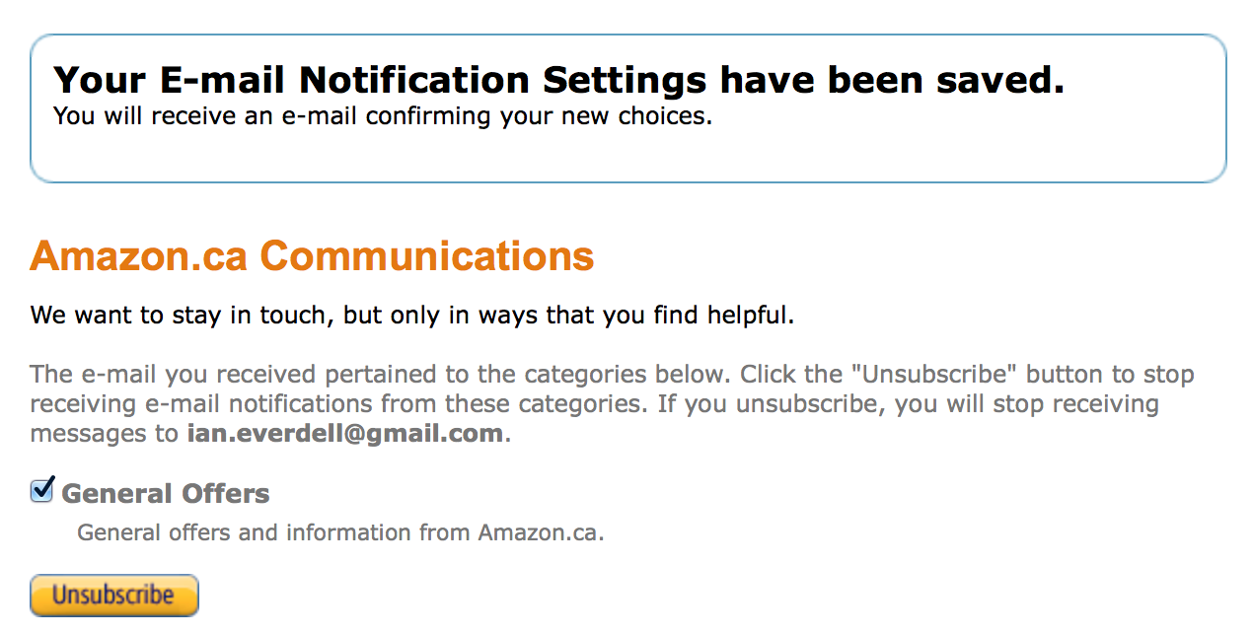
Screen after hitting “Unsubscribe”

Slide 31
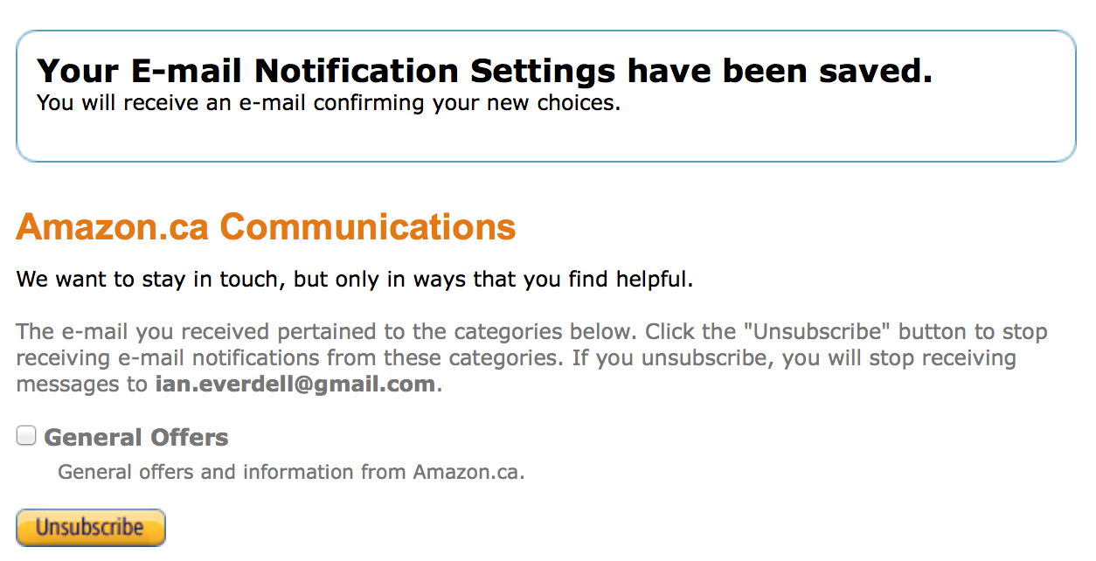
SO…unclick the button?

Slide 32
…and get the same message.

Slide 33
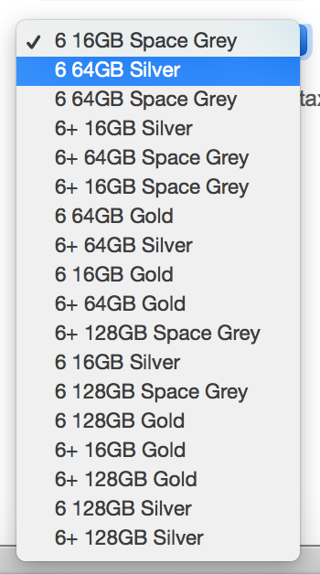
Where lists go to die
Lists need order!
This is an order list for a new iPhone

Slide 34
Mobile First Forms

Slide 35
Normalize Forms

Slide 36
Just the forms part
Use Meyer reset
But drop Form section of Normalize Reset below.

