Slide 1
Chapter 19: Collections and The Stream API

Slide 2
Chapter Topics
Introduction to the Java collections Framework
Lists
Sets
Maps
The Collections Class
Functional Interfaces
The Stream API

Slide 3
The Java Collection Framework
The Java Collections Framework is a library of classes and interfaces for working with collections of objects.
A collection is an object which can store other objects, called elements. Collections provide methods for adding and removing elements, and for searching for a particular element within the collection.

Slide 4
The Main Types of Collections
Lists
Sets
Maps

Slide 5
Lists
Lists: List type collections assign an integer (called an index) to each element stored.
Indices of elements are 0 for the element at the beginning of the list, 1 for the next element, and so on.
Lists permit duplicate elements, which are distinguished by their position in the list.

Slide 6
Sets
Set: a collection with no notion of position within the collection for stored elements. Sets do not permit duplicate elements.

Slide 7
Maps
A map is a collection of pairs of objects:
  A value: this is the object to be stored.
  A key: this is another object associated with the value, and which can be used to quickly find the value within the collection.
A map is really a set of keys, with each key having a value attached to it.
Maps do not allow duplicate keys.

Slide 8
Part of the JCF Hierarchy

Slide 9
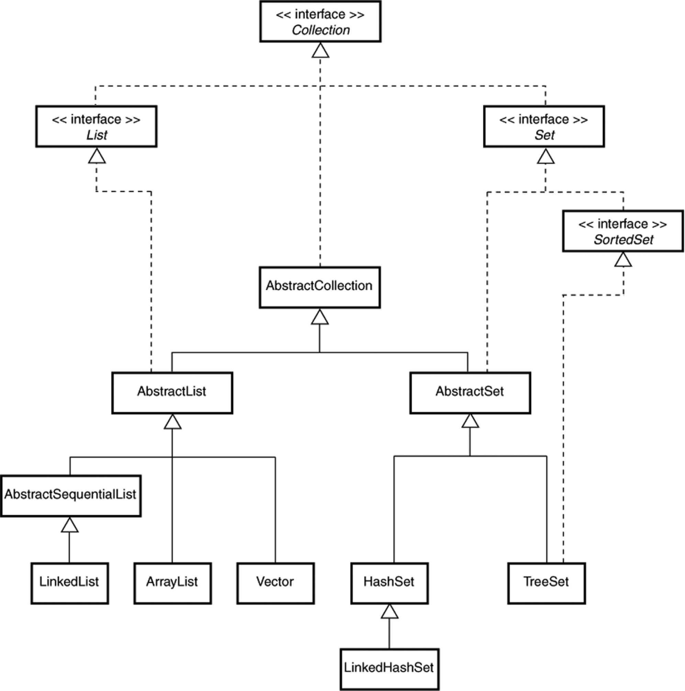

Slide 10
The Collection Interface
Lists and Sets are similar in many ways.
The Collection Interface describes the operations that are common to both.
Maps are fundamentally different from Lists and Sets and are described by a different interface.

Slide 11
Some Methods in the Collection Interface
Method | Description
add(o : E) : boolean | Adds an object o to the Collection. The method returns true if o is successfully added to the collection, false otherwise.
clear() : void | Removes all elements from the collection.
contains(o : Object): boolean | Returns true if o is an element of the collection, false otherwise.
isEmpty() : boolean | Returns true if there are no elements in the collection, false otherwise.
iterator() : Iterator<E> | Returns an object called an iterator that can be used to examine all elements stored in the collection.
remove(o : Object) : boolean | Removes the object o from the collection and returns true if the operation is successful, false otherwise.
size() : int | Returns the number of elements currently stored in the collection.

Slide 12
Iterators
An iterator is an object that is associated with a collection. The iterator provides methods for fetching the elements of the collection, one at a time, in some order.
Iterators have a method for removing from the collection the last item fetched.

Slide 13
The Iterator Interface
Iterators implement the Iterator interface. This interface specifies the following methods:
hasNext() : boolean
next() : E
remove() : void
The remove() method is optional, so not all iterators have it.

Slide 14
Methods of the Iterator Interface
Method | Description
hasNext() : boolean | Returns true if there is at least one more element from the collection that can be returned, false otherwise.
next() : E | Returns the next element from the collection.
remove() : void | Removes from the collection the element returned by the last call to next(). This method can be called at least one time for each call to next().

Slide 15
Iterator Example
This program uses an iterator to fetch and print all elements in a list of strings
List<String> names = new ArrayList();
names.add("Anna");
names.add("Bob");
names.add("Carlos");
// Get the iterator
Iterator<String> it = names.iterator();
// Do the iterator thing
while (it.hasNext())
{
String s = it.next();
System.out.printf("%s\n", s);
}

Slide 16
The Iterator remove() method
The remove() method removes the element returned by the last call to next().
The remove() method can be called at most one time for each call to next().

Slide 17
The Enhanced For Loop
This manner of using an iterator to access elements of a collection shown below is so common, there is a shorthand for it that is called the enhanced for loop. Instead of writing
// Get the iterator
Iterator<String> it = names.iterator();
// Do the iterator thing
while (it.hasNext())
{
String s = it.next();
System.out.printf("%s\n", s);
}
You write:
for (String s : names)
{
System.out.printf("%s\n", s);
}

Slide 18
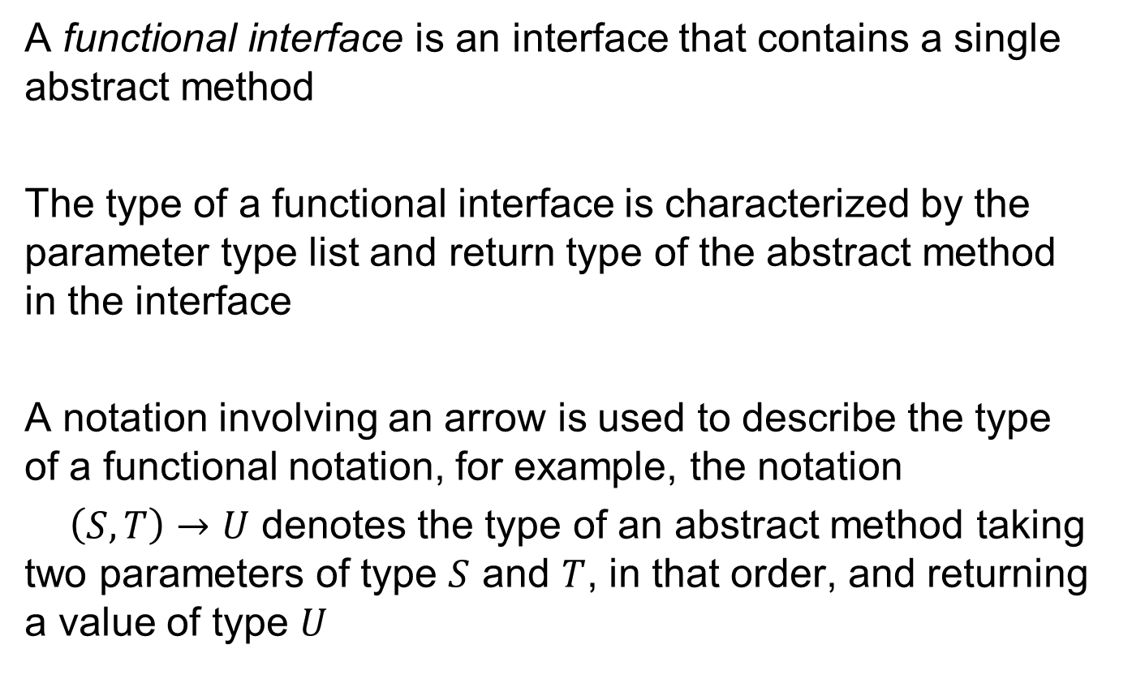
Functional Interfaces

Slide 19
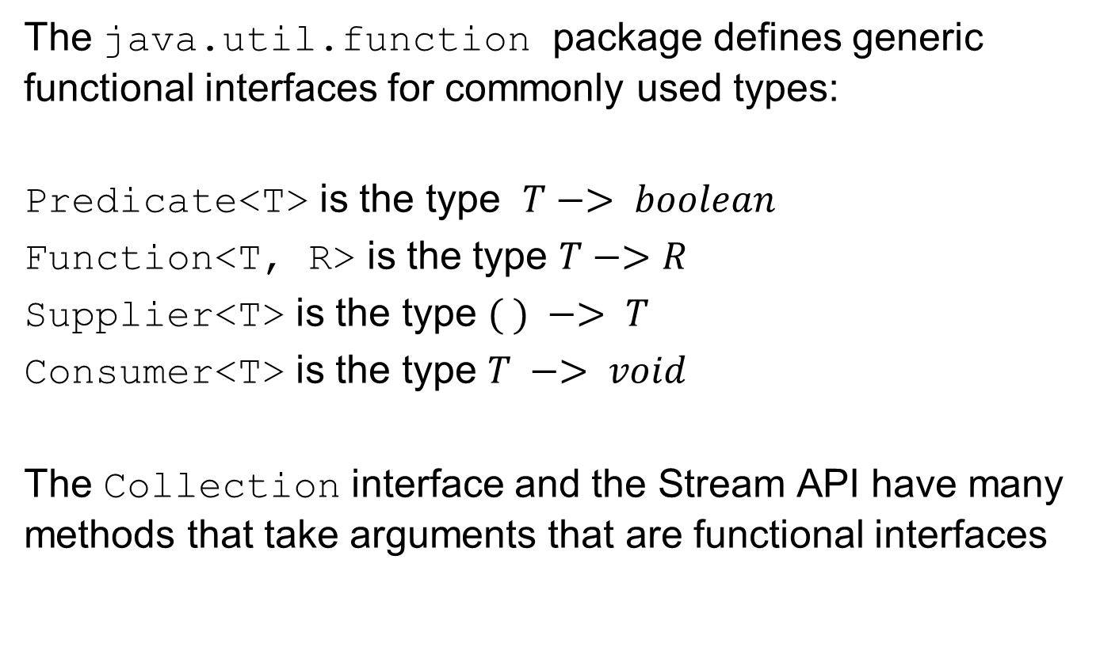
Functional Interfaces

Slide 20
The forEach() Method
The Collection method
void forEach(Consumer<? super E> action)
applies an action to each element of a collection. The action is usually specified by a lambda expression.
The following code prints the length of every string in a list of strings:
names.forEach(
s -> {System.out.printf("%d\n", s.length());}
);

Slide 21
The removeIf() Method
The Collection method
void removeIf(Predicate<? super E> filter)
removes from the collection all elements on which the filter predicate returns true.
The following code removes from the collection every string that starts with the letter ‘B’.
names.removeIf(s -> s.charAt(0) == ‘B’ );

Slide 22
Lists

Slide 23
The List Interface
The List interface extends the Collection interface by adding operations that are specific to the position-based, index-oriented nature of a list.

Slide 24
List Interface Methods
The methods in the List interface describe operations for adding elements and removing elements from the list based on the index of the element.
There are also methods for determining the index of an element in the list when the value of an element is known.

Slide 25
The List Interface Methods
add(index:int, el:E) : void | Adds the element el to the collection at the given index. Throws IndexOutOfBoundsException if index is negative, or greater than the size of the list.
get(index:int):E | Returns the element at the given index, or throws IndexOutBoundsException if index is negative or greater than or equal to the size of the list.
indexOf(o:Object):int | Returns the least (first) index at which the object o is found; returns -1 if o is not in the list.
lastIndexOf(o:Object):int | Returns the greatest (last) index at which the object o is found; returns -1 if o is not in the list.
listIterator():ListIterator<E> | Returns an iterator specialized to work with List collections.
remove(index:int):E | Removes and returns the element at the given index; throws IndexOutOfBoundsException if index is negative, or greater than or equal to the size of the list.
set(index:int, el:E):E | Replaces the element at index with the new element el.

Slide 26
ArrayList
ArrayList is an array-based list.
Internally, it uses an array to store its elements: whenever the array gets full, a new, bigger array is created, and the elements are copied to the new array.

Slide 27
AbstractSequentialList and LinkedList
Array-based lists have high overhead when elements are being inserted into the list, or removed from the list, at positions that are not at the end of the list.
LinkedList is a concrete class that stores elements in a way that eliminates the high overhead of adding to, and removing from positions in the middle of the list.
LinkedList extends AbstractSequentialList, which in turn, extends AbstractList.

Slide 28
Using the Concrete List Classes
The concrete classes ArrayList, and LinkedList work in similar ways, but have different performance characteristics.
Because they all implement the List interface, you can use List interface references to instantiate and refer to the different concrete classes.
Using a List interface instead of the concrete class reference allows you to later switch to a different concrete class to get better performance.

Slide 29
Example: ArrayList
import java.util.*;
public class Test
{
public static void main(String [ ] args)
{
List<String> nameList = new ArrayList<String> ();
String [ ] names = {"Ann", "Bob", "Carol"};
// Add to arrayList
for (int k = 0; k < names.length; k++)
nameList.add(names[k]);
// Display name list
for (int k = 0; k < nameList.size(); k++)
System.out.println(nameList.get(k));
}
}

Slide 30
An Example: LinkedList
Because we used a List reference to refer to the concrete class objects, we can easily switch from an ArrayList to a LinkedList : the only change is in the class used to instantiate the collection.

Slide 31
Example: LinkedList
import java.util.*;
public class Test
{
public static void main(String [ ] args)
{
List<String> nameList = new LinkedList<String> ();
String [ ] names = {"Ann", "Bob", "Carol"};
// Add to arrayList
for (int k = 0; k < names.length; k++)
nameList.add(names[k]);
// Display name list
for (int k = 0; k < nameList.size(); k++)
System.out.println(nameList.get(k));
}
}

Slide 32
ListIterator
The ListIterator extends Iterator by adding methods for moving backward through the list (in addition to the methods for moving forward that are provided by Iterator)
hasPrevious() : boolean
previous() : E

Slide 33
Some ListIterator Methods
Method | Description
add(el:E):void | Adds el to the list at the position just before the element that will be returned by the next call to the next() method.
hasPrevious():boolean | Returns true if a call to the previous() method will return an element, false if a call to previous() will throw an exception because there is no previous element.
nextIndex():int | Returns the index of the element that would be returned by a call to next(), or the size of the list if there is no such element.
previous():E | Returns the previous element in the list. If the iterator is at the beginning of the list, it throws NoSuchElementException.
previousIndex():int | Returns the index of the element that would be returned by a call to previous(), or -1.
set(el:E):void | Replaces the element returned by the last call to next() or previous() with a new element el.

Slide 34
Iterator Positions
Think of an iterator as having a cursor position that is initially just before the element that will be returned by the first call to next().
A call to next() puts the cursor just after the element returned, and just before the element that will be returned by the next call to next().
At any time, in a ListIterator, the cursor is in between two list elements: A call to previous()will skip backward and return the element just skipped, a call to next() will skip forward and return the element just skipped.

Slide 35
Iterator and ListIterator Exceptions
A call to previous() throws NoSuchElementException when there is no element that can be skipped in a backward move.
A call to next()throws NoSuchElementException when there is no
element that can be skipped in a forward move.

Slide 36
Example Use of a ListIterator
public static void main(String [ ] args)
{
List<String> nameList = new ArrayList<String>();
String [ ] names = {"Ann", "Bob", "Carol"};
// Add to arrayList using a ListIterator
ListIterator<String> it = nameList.listIterator();
for (int k = 0; k < names.length; k++)
it.add(names[k]);
// Get a new ListIterator for printing
it = nameList.listIterator();
while (it.hasNext())
System.out.println(it.next());
}

Slide 37
Sets

Slide 38
Sets
Sets are collections that store elements, but have no notion of a position of an element within the collection.
The distinguishing feature of a set as a collection is that it does not allow duplicates.

Slide 39
The Set Part of the JCF Hierarchy
AbstractCollection
AbstractSet
HashSet
TreeSet
LinkedHashSet

Slide 40
The Set Part of the JCF
AbstractSet implements the Set Interface.
TreeSet implements the SortedSet interface, which has methods for working with elements that have an order that allows them to be sorted according to their value.

Slide 41
HashSet
HashSet containers store elements according to a hash code.
A hash code of an element is an integer computed from the value of the element that can be used to help identify the element.
The procedure used to compute the hash code of an element is called the hashing function or the hashing algorithm.

Slide 42
Examples of Hashing Functions
For Integer objects, you can use the integer value of the object (or its absolute value).
For Character objects, you can use the UNICODE value for the character.
For String objects, you can use a function that takes into account the UNICODE values of the characters that make up the string, as well as the position occupied by each character.

Slide 43
A Simplistic Hashing Function
A very simple (but not very good) hashing function for strings might assign to each string the UNICODE value of its first character.
Note that all strings with the same first character are assigned the same hash code.
When two distinct objects have the same hash code, we say that we have a collision.

Slide 44
Implementation of a HashSet
A HashSet can be regarded as a collection of “buckets.”
Each bucket corresponds to a hash code, and stores all objects in the set that have that particular hash code.
Some buckets will have just one element, whereas other buckets may have many.
A good hashing scheme should distribute elements among the buckets so that all buckets have approximately the same number of elements.

Slide 45
Implementation of a HashSet
The HashSet is a collection of buckets, and each bucket is a collection of elements.
The collection of buckets is actually a list of buckets, perhaps an ArrayList.
Each bucket may also be a list of elements, usually a linked list.

Slide 46
How a HashSet Works
To add an element X, the hash code for X is used (as an index) to locate the appropriate bucket. X is then added to the list for that bucket. If X is already in the bucket (The test is done using the equals method), then it is not added.
To remove an item X, the hash code for X is computed. The corresponding bucket is then searched for X, and if it is found, it is removed.

Slide 47
Efficiency of HashSet Operations
Given an item X, computing the hash code for X and locating the corresponding bucket can be done very fast.
The time to search for, or remove X from the bucket depends on how many elements are stored in the bucket.
More collisions mean more elements in some buckets, so we try to find a hashing scheme that minimizes collisions.

Slide 48
HashSet Performance Considerations
To have good performance with a HashSet:
Have enough buckets: fewer buckets means more collisions.
Have a good hashing function that spreads elements evenly among the buckets. This keeps the number of elements in each bucket small.

Slide 49
HashSet Capacity and Load Factor
The load factor of a HashSet is the fraction of buckets that must be occupied before the number of buckets is increased.
The number of buckets in a HashSet is called its capacity.

Slide 50
Some HashSet Constructors
HashSet() | Creates an empty HashSet object with a default initial capacity of 16 and load factor of 0.75.
HashSet(int initCapacity, float loadFactor) | Creates an empty HashSet object with the specified initial capacity and load factor.
HashSet(int initCapacity) | Creates an empty HashSet object with the specified initial capacity and a load factor of 0.75.

Slide 51
The hashCode()Method
The Java Object class defines a method for computing hash codes
int hashCode()
This method should be overriden in any class whose instances will be stored in a HashSet.
The Object class’s hashCode() method returns a value based on the memory address of the object.

Slide 52
Overriding the hashCode() Method
Observe these guidelines:
  Objects that are equal according to their equals method should be assigned the same hash code.
  Because of 1), whenever you override a class’s equals() method, you should also override hashCode().
  Try to minimize collisions.

Slide 53
A Car Class for Use With a HashSet
class Car
{
String vin, description;
public boolean equals(Object other) // Depends on vin only
{
if (!(other instanceof Car))
return false;
else
return vin.equalsIgnoreCase(((Car)other).vin);
}
public int hashCode() { return vin.hashCode();} // Depends on vin only
public Car(String v, String d) { vin = v; description = d; }
public String toString() { return vin + " " + description; }
}

Slide 54
A Car Class for use with a HashSet
Note that the Car class overrides both equals() and hashCode().

Slide 55
Use of the Car Class with a HashSet
public static void main(String [ ] args)
{
Set<Car> carSet = new HashSet<Car>();
Car [ ] myRides =
{
new Car("TJ1", "Toyota"),
new Car("GM1", "Corvette"),
new Car("TJ1", "Toyota Corolla")
};
// Add the cars to the HashSet
for (Car c : myRides)
carSet.add(c);
// Print the list using an Iterator
Iterator it = carSet.iterator();
while (it.hasNext())
System.out.println(it.next());
}

Slide 56
HashSet<Car> Program Output
GM1 Corvette
TJ1 Toyota
Note:
  The iterator does not return items in the order added to the HashSet.
  The entry of the Toyota Corolla is rejected because it is equal to an entry already stored (same vin).

Slide 57
LinkedHashSet
A LinkedHashSet is just a HashSet that keeps track of the order in which elements are added using an auxiliary linked list.

Slide 58
TreeSet
A TreeSet stores elements based on a natural order defined on those elements.
The natural order is based on the values of the objects being stored .
By internally organizing the storage of its elements according to this order, a TreeSet allows fast search for any element in the collection.

Slide 59
Order
An order on a set of objects specifies for any two objects x and y, exactly one of the following:
x is less than y
x is equal to y
x is greater than y

Slide 60
Examples of Natural Orders
Some classes have a “natural” order for their objects:
  Integer, Float, Double etc has the obvious concept of natural order which tells when one number is less than another.
  The String class has a natural alphabetic order for its objects.

Slide 61
The Comparable Interface
In Java, a class defines its natural order by implementing the Comparable interface:
public interface Comparable<T>
{
int compareTo(T other);
}
The compareTo method returns a negative value, or zero, or a positive value, to indicate that the calling object is less than, equal to, or greater than the other object.

Slide 62
Using a TreeSet with Comparable Elements
Make sure the class of your objects implements Comparable.
Create an instance of TreeSet specialized for your class
Set<String> mySet = new TreeSet<String>();
Add elements.
Retrieve elements using an iterator. The iterator will return elements in sorted order.

Slide 63
Sorting Strings Using a TreeSet
import java.util.*;
public class Test
{
public static void main(String [ ] args)
{
// Create TreeSet
Set<String> mySet = new TreeSet<String>();
// Add Strings
mySet.add("Alan");
mySet.add("Carol");
mySet.add("Bob");
// Get Iterator
Iterator it = mySet.iterator();
while (it.hasNext())
{
System.out.println(it.next());
}
}
}

Slide 64
The SortedSet Interface
TreeSet implements the SortedSet interface.
SortedSet methods allow access to the least and greatest elements in the collection.
SortedSet methods allow various views of the collection, for example, the set of all elements greater than a given element, or less than a given element.

Slide 65
Comparators
A comparator is an object that can impose an order on objects of another class.
This is different from the Comparable interface, which allows a class to impose an order on its own objects.

Slide 66
The Comparator Interface
Interface Comparator <T>
{
int compare(T obj1, T obj2);
boolean equals(Object o);
}
The compare(x,y)method returns a negative value, or zero, or a positive value, according to whether x is less than, equal to, or greater than y.
The equals method is used to compare one comparator object to another. It does not have to be implemented if the equals inherited from Object is adequate.

Slide 67
Using TreeSet with a Comparator
A TreeSet that stores objects of a class that does not implement Comparable must use a comparator to order its elements.
The comparator is specified as an argument to the TreeSet constructor.
A comparator can also be used to make a TreeSet order its elements differently from their natural order.

Slide 68
A Comparator for Ordering Strings in Reverse Alphabetic Order
  import java.util.*;
  class RevStrComparator implements Comparator<String>
  {
  public int compare(String s1, String s2)
  {
  return - s1.compareTo(s2); // Note the negation
  }
  }

Slide 69
Using a TreeSet to Sort Strings in Reverse Alphabetic Order
public class Test
{
public static void main(String [ ] args)
{ // Create Comparator
RevStrComparator comp = new RevStrComparator();
Set<String> mySet = new TreeSet<String>(comp);
// Add strings
mySet.add("Alan");
mySet.add("Carol");
mySet.add("Bob");
// Get Iterator
Iterator it = mySet.iterator();
while (it.hasNext())
{
System.out.println(it.next());
}
}
}

Slide 70
Maps

Slide 71
Maps
A map is a collection whose elements have two parts: a key and a value.
The combination of a key and a value is called a mapping.
The map stores the mappings based on the key part of the mapping, in a way similar to how a Set collection stores its elements.
The map uses keys to quickly locate associated values.

Slide 72
The Map Part of the JCF Hierarchy
Map
AbstractMap
HashMap
TreeMap
LinkedHashMap

Slide 73
The Map Interface
Map is a generic interface Map<K, V>
Map specifies two type parameters, K for the key, and V for the value part of the mapping.

Slide 74
Some Methods of the Map Interface
clear() : void | Removes all elements from the map.
containsValue(value: Object):boolean | Returns true if the map contains a mapping with the given value.
containsKey(key : Object) : boolean | Returns true if the map contains a mapping with the given key.
get(key : Object) : V | Returns the value associated with the specified key, or returns null if there is no such value.
isEmpty() : boolean | Returns true if the key contains no mappings.
keySet() : Set<K> | Returns the set of all keys stored in the map.

Slide 75
Some Methods of the Map Interface
put(key : K, value : V) : V | Adds a mapping that associates V with K, and returns the value previously associated with K. Returns null if there was no value associated with K.
remove(key : Object) : V | Removes the mapping associated with the given key from the map, and returns the associated value. If there is not such mapping, returns null.
size() : int | Returns the number of mappings in the map.
values() : Collection<V> | Returns a collection consisting of all values stored in the map.

Slide 76
Concrete Map Classes
Maps store keys with attached values. The keys are stored as sets.
  HashMap stores keys according to their hash codes, just like HashSet stores its elements.
  LinkedHashMap is a HashMap that can iterate over the keys in insertion order (order in which mappings were inserted) or in access order (order of last access).
  TreeMap stores mappings according to the natural order of the keys, or according to an order specified by a Comparator.

Slide 77
The Stream API
A stream is an object that permits a pipeline of operations to be performed on a sequence of elements drawn from a source
A pipeline is sequence of operations where the output of one operation becomes the input to the next operation in the sequence
The source may be a collection, an array, or any object that can produce elements on demand

Slide 78
Pipeline Operations
An intermediate operation is applied to a stream and produces another stream– i.e. it transforms a stream into another stream.
A terminal operation is applied to a stream and produces a non-stream result.
A terminal operation is also called a reduction.

Slide 79
Types of Streams
A stream of a reference type is created as an instance of the generic stream interface Stream<T>.
A stream of the primitive type int is created as an instance of the stream interface IntStream.
The stream interfaces DoubleStream and LongStream represent streams of the primitive types double and long.

Slide 80
A Stream Terminal Operation
One of the simplest terminal operations on a stream of elements of type T is
void forEach(Consumer<? Super T> action)
This operation is similar to the Collection <T> method of the same name: it applies the given action to each element drawn from the stream.

Slide 81
Creating Streams
The Arrays class has static stream()methods that take an array as parameter and return a stream of the same element type as the array:
static Stream<T> stream(T[ ] array)
static DoubleStream stream(double [ ] array)
static IntStream stream(int[ ] array)
static LongStream stream(long[ ] array)

Slide 82
Creating a Stream from an Array
The following code creates a Stream<String> from an array and uses the forEach terminal operation to print the elements of the stream:
String [] names = {"Anna", "Bob", "Carlos"};
Stream<String> namesStream = Arrays.stream(names);
namesStream.forEach(s -> {System.out.println(s);});

Slide 83
Creating a Stream from a Collection
The Collection interface defines an instance method
Stream<E> stream()
that returns a stream of elements drawn from the collection.
The following code creates an list from an array, and then obtains a stream from the list:
String [] names = {"Anna", "Bob", "Carlos"};
List<String> namesList = Arrays.asList(names);
Stream<String> namesStream = namesList.stream();
namesStream.forEach(s -> {System.out.println(s);});

Slide 84
Creating a Stream from a Collection
The Collection<E> interface defines an instance method
Stream<E> stream()
that returns a stream of elements drawn from the collection.
The following code creates an list from an array, and then obtains a stream from the list:
String [] names = {"Anna", "Bob", "Carlos"};
List<String> namesList = Arrays.asList(names);
Stream<String> namesStream = namesList.stream();
namesStream.forEach(s -> {System.out.println(s);});

Slide 85
Stream Reduction Operators
This operator returns the number of elements in the stream:
long count()
This operator applies an action to each element of the stream:
void forEach(Consumer<? super T> action)
These operators determine whether none, all, or any elements of a stream match a given predicate:
boolean noneMatch(Predicate<? super T> p)
boolean allMatch(Predicate<? super T> p)
boolean anyMatch(Predicate<? super T> p)

Slide 86
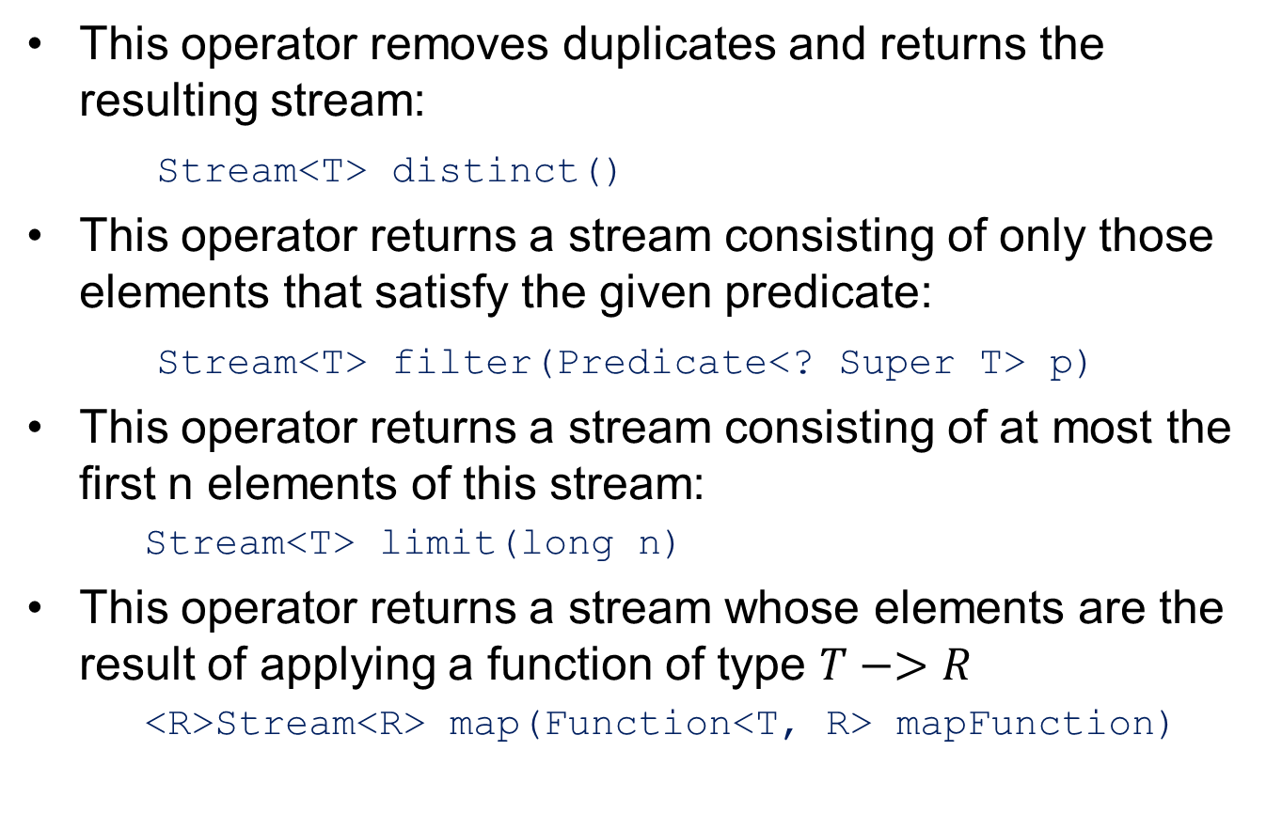
Intermediate Stream<T> Operators

Slide 87
Intermediate Stream<T> Operators
This operator returns a stream that results from discarding the first n elements:
Stream<T> skip(long n)
This operator returns a stream consisting of the same elements, but sorted according to natural order:
Stream<T> sorted()
This operator returns a stream consisting of the same elements, but sorted according to the given comparator:
Stream<T> sorted(<? super T> comparator)
This operator returns a stream whose elements are the same as this stream. The given action is called for each element as it flows from this stream to the new.
Stream<T> peek(Consumer<? Super T> action)

