Slide 2
Chapter Topics
Introduction to Linked Lists
Linked List Operations
Doubly Linked and Circularly Linked Lists
Recursion on Linked Lists
2

Slide 3
Elementary Facts About Lists
A list is a collection of objects organized in a sequence.
Each list element is assigned an integer index based on its position in the sequence.
The first element in the sequence has index 0, and each succeeding element has index 1 greater than its predecessor.

Slide 4
Contiguous Allocation
Implementation of lists can be array-based, this is known as contiguous memory allocation.
In contiguous allocation, list elements occupy consecutive memory locations.

Slide 5
Contiguous Allocation
index 0
index 1
index 2
index 3

Slide 6
Random Access
Access to a contiguously allocated list element is very fast: given any index k, we can compute the memory address of the list element at that position by adding the size (in bytes) of k items to the address of the first element in the list.
Contiguous allocation is said to allow random access because we can directly jump to any given element without going through its predecessors.

Slide 7
Contiguous Allocation
Contiguous allocation is used by array-based list implementations such as ArrayList and Vector.

Slide 8
Disadvantages of Contiguous Allocation
Insertion or deletion of elements in the middle of the list involves the laborious relocation of all elements that come after.
For example, if a list has a thousand elements, then to insert a new element at position 5 means all elements from position 5 on up must be moved up.
This overhead is bad for applications that do a lot of insertions and deletions.

Slide 9
Linked Allocation
In linked allocation, the list keeps a reference to its first element: this is the head reference
Every element in the list keeps a reference to its successor, the element that follows it on the list.
Memory for list elements does not have to be consecutive.

Slide 10
Linked Allocation
head
Index 3
index 1
index 2
index 0

Slide 11
Nodes and Links
The objects that hold the list element and the reference (link) to its successor are called nodes.
The references to successors are called successor links.

Slide 12
Disadvantages of Linked Allocation
Given a node in the list, we can only access it by starting at the first node and following the successor links till we come to the desired node.
This is called sequential access.
Sequential access takes a lot longer than random access to get to nodes near the end of a long list.

Slide 13
Java Implementation of Linked Lists
Requires a Java implementation of a node object.
A list is represented using a reference to the node with the first element.
An empty list is represented with a reference whose value is null.
Each node has a reference to its successor.
The successor link of the last node is set to null.

Slide 14
Java Implementation of Nodes
A class that implements a node must hold a list element plus a successor link:
// A node for a list of string elements:
class Node
{
String element; // list element
Node next; // successor link
Node(String el, Node n)
{
element = el;
next = n;
}
Node(String el)
{
element = el;
next = null;
}
}

Slide 15
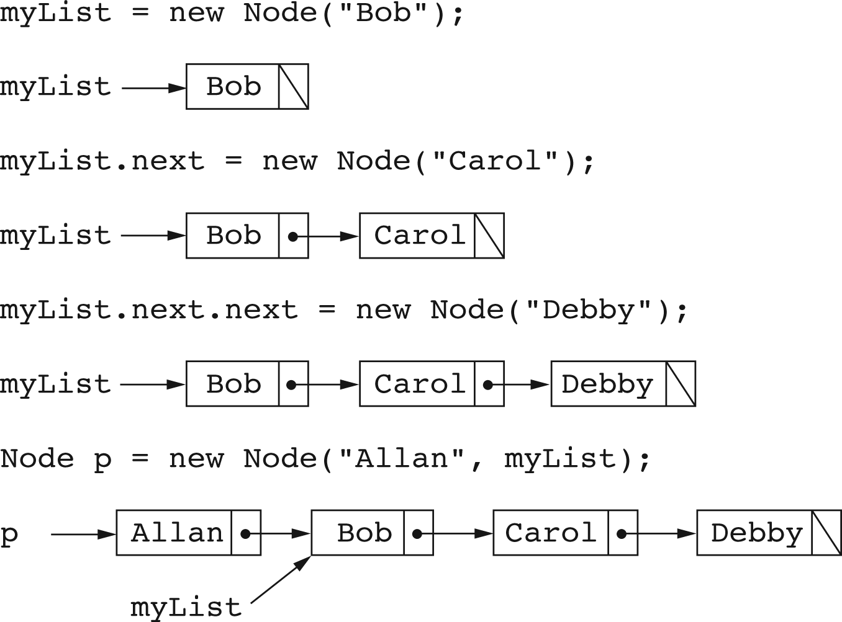
Creation of Linked Lists

Slide 16
Inserting Nodes into a Linked List
To add new elements in the middle of a list:
Node b = p.next; // b points to “Bob”
Node c = b.next; // c points to “Carol”
b.next = new Node(“Brad”, c);
This is illustrated in the next slide:

Slide 17
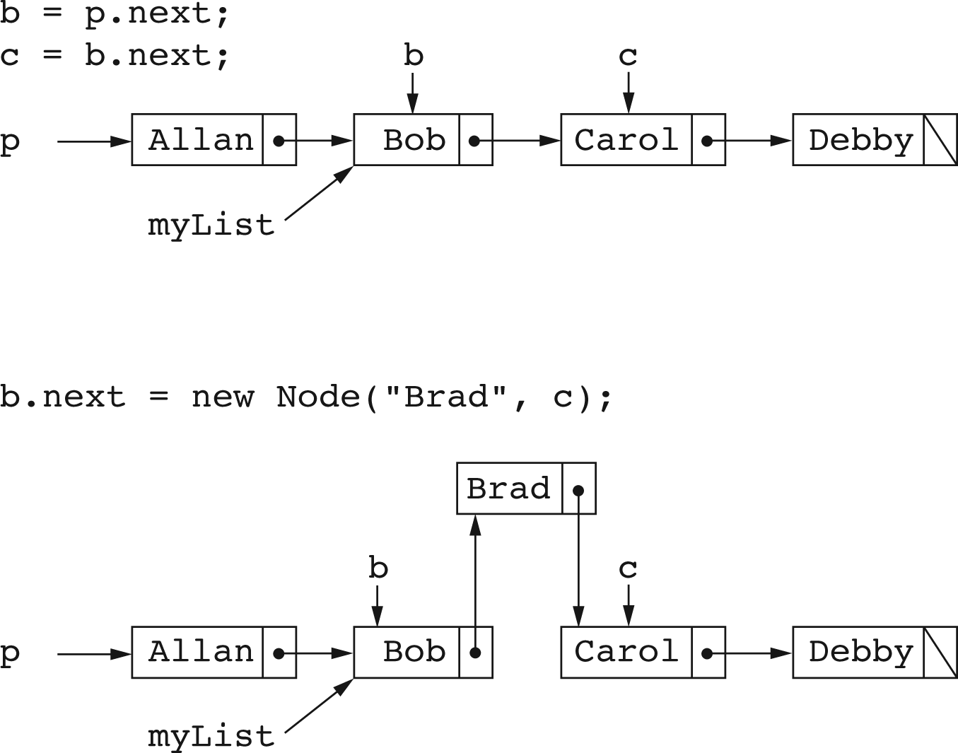
Figure 2 - Inserting Nodes

Slide 18
Removing a Node
To remove the first node of a list, set the head reference to its successor:
Node myList = ….;
// Remove first item
myList = myList.next;

Slide 19
Removing a Node
To remove a node other than the first:
  Set a reference to the predecessor of the targeted node.
  Route the successor link in the predecessor around the targeted node.

Slide 20
Remove Carol from “Alan Bob Carol Debby”
Set b to predecessor of Carol (Bob)
Set d to successor of Carol (Debby)
Make d the successor of b:
b.next = d;

Slide 21
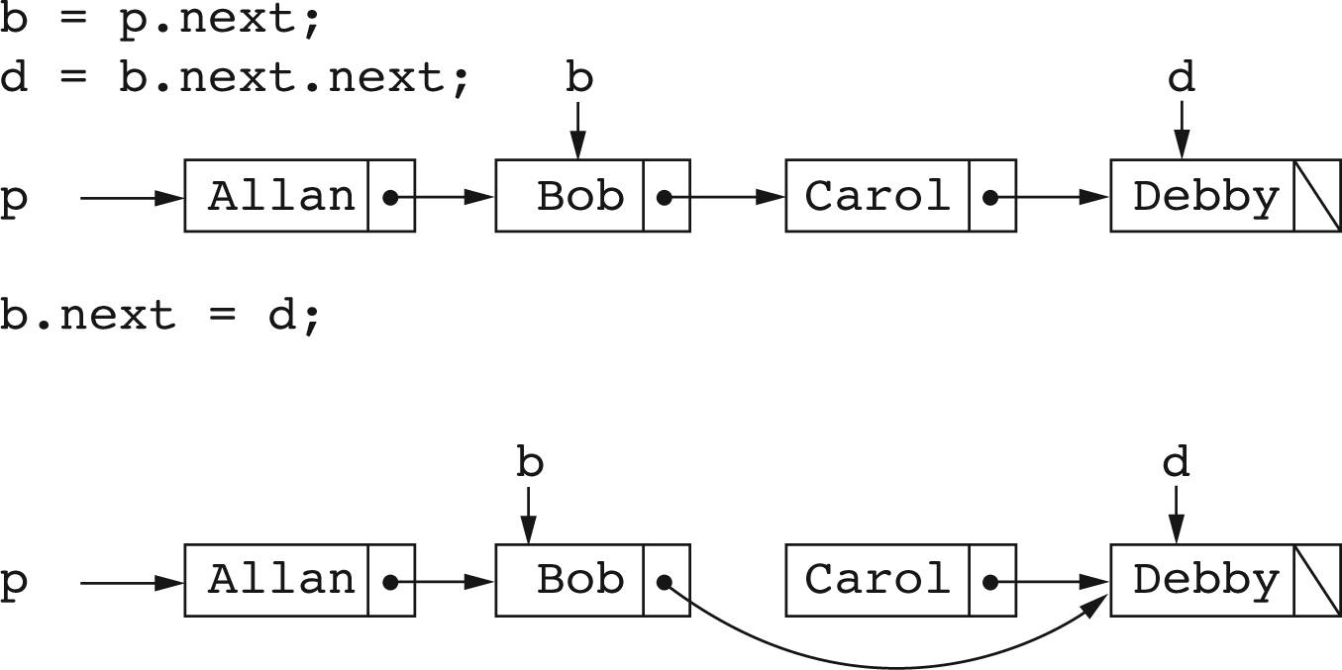
Removing a Node

Slide 22
Traversal of a Linked List
A traversal of a linked list is a systematic method of examining, in order, every element of the list.
A traversal usually performs some operation as it visits each element.

Slide 23
Traversal of a Linked List
To traverse a linked list, start a reference at the head of the list, and keep moving it from a node to a successor:
Node ref = myList;
while (ref != null)
{
System.out.println(ref.value);
ref = ref.next;
}

Slide 24
Implementation of A Linked List
A linked list class needs
  A node class Node.
  A head reference first to point to the first node:
  Node first;
  A reference last to point to the last node in the list:
  Node last;
The reference last facilitates quick addition
of a new node at the end of the list.

Slide 25
Implementation of a Linked List Class
Class LinkedList1
{
private class Node
{
String value;
Node next;
Node(String val, Node n)
{
value = val;
next = n;
}
Node(String val)
{
// Call the other (sister) constructor.
this(val, null);
}
}
private Node first; // list head
private Node last; // last element in list
}

Slide 26
Class Initialization
The constructor sets first and last to null:
public LinkedList1()
{
first = null;
last = null;
}

Slide 27
Checking for an Empty List
A list is empty when first is equal to null:
public boolean isEmpty()
{
return first == null;
}

Slide 28
Determining the Size of a List
This is done by traversing the list while incrementing a count for each node visited:
public int size()
{
int count = 0;
Node p = first;
while (p != null)
{
// There is an element at p
count ++;
p = p.next;
}
return count;
}

Slide 29
Adding to the End of the List
To add e, consider two cases:
  If list is empty:
  first = new Node(e);
  last = first;
  2. If list is not empty:
  last.next = new Node(e);
  last = last.next;

Slide 30
Adding to the End of the List
public void add(String e)
{
if (isEmpty())
{
first = new Node(e);
last = first;
}
else
{
// Add to end of existing list
last.next = new Node(e);
last = last.next;
}
}

Slide 31
Adding an Element at a Given Index
Check index: if out of bounds, throw an exception.
Is index 0? Put new element at beginning of the list, set last and return.
Is index > 0? Skip index nodes from beginning of the list and splice in the new node.
If the new node was added at the end, set last to the new node.

Slide 32
public void add(int index, String e)
{
if (index < 0 || index > size())
throw new IndexOutOfBoundsException();
// Index is at least 0
if (index == 0)
{ // New element goes at beginning
first = new Node(e, first);
if (last == null) last = first;
return;
}
// Set pred to node that will be the predecessor of new node
Node pred = first;
for (int k = 1; k <= index - 1; k++) pred = pred.next;
// Splice in a node containing the new element
pred.next = new Node(e, pred.next);
// Is there a new last element ?
if (pred.next.next == null)
last = pred.next;
}

Slide 33
Removing a List Element Based on Value
Use a list traversal to locate the node containing the given value, return false if there is no such node.
If the target node is the first node, remove it by moving first forward and resetting last if necessary, and then return true.
Otherwise, find the predecessor of the target node and remove the target node. If the target node was the last node in the list, reset last.

Slide 34
public String remove(int index)
{
if (index < 0 || index >= size())
throw new IndexOutOfBoundsException();
String element; // The element to return
if (index == 0)
{ // Removal of first item in the list
element = first.element;
first = first.next;
if (first == null) last = null;
return element;
}
// To remove an element other than the first
// find the predecessor of the element to be removed.
Node pred = first;0
// Move pred forward index - 1 times
for (int k = 1; k <= index -1; k++) pred = pred.next;
// Store the element to return
element = pred.next.element;
// Route link around the node to be removed
pred.next = pred.next.next;
// Check if pred is now last
if (pred.next == null) last = pred;
return element;
}

Slide 35
Doubly Linked Lists

Slide 36
Doubly Linked Lists
Singly-linked lists allow one way traversal: one can move from a node to its successor.
Limitation: one cannot easily move from a node to its predecessor.
Doubly-linked lists allow easy transitions in both directions.

Slide 37

Nodes for Doubly Linked Lists
A node for a doubly linked list must have both a successor link and a predecessor link:

Slide 38
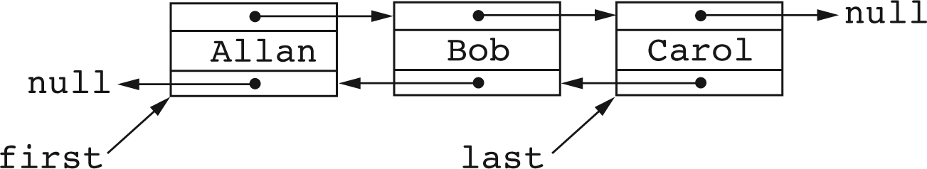
Doubly-Linked Lists
Can be represented by a head (first) reference and a reference to the last node (for efficiency)

Slide 39
Node Class for Doubly-Linked Lists
class Node
{
String element; // Element
Node next; // Reference to successor
Node prev; // Reference to predecessor
Node(String val, Node n, Node p)
{
element = val;
next = n;
prev = p;
}
Node(String val)
{
// Call the other constructor
this(val, null, null);
}
}

Slide 40
Operations on Doubly-Linked Lists
Implementations of size(), isEmpty() are similar to those of singly-linked lists
Addition and removals are also similar, but require care to manipulate the two links for successor and predecessors.

Slide 41
Addition at beginning of a doubly linked List
To add a new element e to an empty list:
first = new Node(e, null, null);
last = first;
To add e to beginning of a nonempty doubly linked list:
first = new Node(e, first, null);
first.next.prev = first;

Slide 42
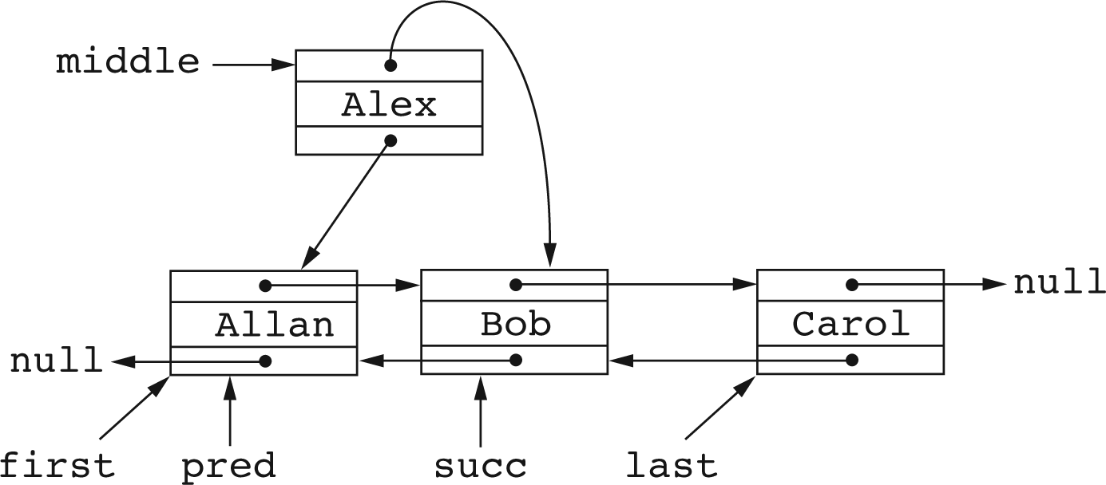
Addition After the First Element
Set pred to what will be predecessor of the new node.
Set succ to what will be the successor of the new node.
Put the new node in the middle (between) pred and succ.

Slide 43
public void add(int index, String e)
{
if (index < 0 || index > size())
throw new IndexOutOfBoundsException();
// Index is at least 0
if (index == 0)
{
// New element goes at beginning
Node p = first; // Old first
first = new Node(e, p, null);
if (p != null) p.prev = first;
if (last == null) last = first;
return;
}
// pred will point to the predecessor of the new node.
Node pred = first;
for (int k = 1; k <= index - 1; k++)
pred = pred.next;
// Splice in the new node: pred-- succ becomes pred--middle--succ
Node succ = pred.next;
Node middle = new Node(e, succ, pred);
pred.next = middle;
if (succ == null) last = middle; else succ.prev = middle;
}

Slide 44
Recursion on Linked Lists

Slide 45
Recursion on Singly-Linked Lists
Recursion is natural on lists because a list is a recursive data structure:
  The empty collection is a list.
  A non empty list consists of a head (the first element) and a tail.
  The tail of a list is also a list.

Slide 46
Recursive Implementation of size
A private int size(Node list) method for computing the size of a list:
The size of an empty list is 0.
The size of a non empty list is one greater than the size of the tail: size(list.next) + 1.

Slide 47
Recursive implementation of size
int size(Node list)
{
if (list == null)
return 0;
else
return size(list.next) + 1;
}

Slide 48
Recursive add to End of List
The Node add(String e, Node list) method adds e to the end of list and returns a reference to the first node of the resulting list:
  If list is null, return new Node(e);
  If list is not empty, add e to the end of the tail, attach the original head to the beginning of the modified tail, and return a reference to the original head.

Slide 49
Add e to the End of a List
Node add(String e, Node list)
{
if (list == null)
return new Node(e);
else
{
// Replace the tail with result of adding e to the end
// of the tail
list.next = add(e, list.next);
return list;
}
}

Slide 50
Adding an Element at an Index
In a method
Node add(int index, String e, Node list)
the value of index must be nonnegative and less or equal to the size of the list.
The base case is when index is 0: place e at the beginning of the list.
If index != 0, the list cannot be empty. Place e at position index -1 in the tail of the original list.

Slide 51
Recursive add at an index
private Node add(int index, String e, Node list)
{
if (index < 0 || index > size())
{
String message = String.valueOf(index);
throw new IndexOutOfBoundsException(message);
}
if (index == 0)
return new Node(e, list);
// 0 < index and index <= size so list is not empty
// Replace the tail with result of adding e at index - 1
// in the tail
list.next = add(index-1, e, list.next);
return list;
}

Slide 52
Removing a Value From a List
A method for removing needs to return a pair of results:
class RemovalResult
{
Node node; // Node containing removed element
Node list; // List remaining after removal of node
}

Slide 53
RemovalResult remove(int index, Node list)
{
if (index < 0 || index >= size())
throw new IndexOutOfBoundsException();
if (index == 0)
{
// Remove the first node on list
RemovalResult remRes = new RemovalResult(list, list.next);
list.next = null;
return remRes;
}
// Recursively remove the element at index-1 in the tail
RemovalResult remRes = remove(index-1, list.next);
// Replace the tail with the results and return
// after modifying the list part of RemovalResult
list.next = remRes.list;
remRes.list = list;
return remRes;
}

Slide 54
The public Interface to Recursive Methods
In general, recursive methods need to access parameters that refer to private implementation details, and must themselves be private.
Such recursive methods must be called through a public interface that calls a corresponding recursive method.

Slide 55
A Public Interface to size()
public int size()
{
// Call the private recursive size(Node p) method
return size(first);
}
Here
Node first;
is a private reference to the head element of the list.

Slide 56
A Public Interface to remove(int)
This method passes an index to the private method
RemovalResult remove(int index, Node List)
The public method extracts its return value from the returned RemovalResult object.

Slide 57
Public remove(int)
public String remove(int index)
{
// Pass the job on to the recursive version
RemovalResult remRes = remove(index, first);
String el = remRes.node.value; // Element to return
first = remRes.list; // Remaining list
return el;
}

