Slide 1
Chapter 21 : Stacks and Queues

Slide 2
Chapter Topics
Stacks and Their Applications
Array Implementation of Stacks
Linked Implementation of Stacks
Queues and Their Applications
Array Implementation of Queues
Linked Implementation of Queues

Slide 3
Stacks
A stack is a collection of items that allows the following operations:
  boolean empty() checks if the stack is empty.
  void push(E o) adds an object o to the stack.
  E pop() removes and returns the item most recently added to the stack.

Slide 4
Last In First Out
A stack is a Last in-First-Out container: the last item added is the first to be removed.

Slide 5
The Stack peek() Operation
Most stacks support a
E peek()
operation: this returns, but does not remove from the stack, the item most recently added to the stack
peek() returns the item that will be removed by the next call to pop()

Slide 6
Applications of Stacks
Many collections of items are naturally regarded as stacks:
  A stack of plates in a cafeteria.
  Cars packed in a narrow driveway.
  Return addresses of method calls in an executing program.

Slide 7
Plates in a Cafeteria
Plates are stacked in a column.
A new plate is added to the top of the column of plates.
Plates are removed from the top of the column of plates, so that the last plate added is the first removed.

Slide 8
Method Return Addresses
Programs often make chains of method calls.
The last method called is the first to return.
The compiler uses a stack to maintain the list of return addresses for executing methods in a stack.

Slide 9
Java Collection Framework Stack Class
The JCF provides a generic implementation of a stack:
  Stack<E>() (constructor)
  E push(E element)
  E pop()
  E peek()
  boolean empty()

Slide 10
The JCF Stack Class
The JCF stack can be used to create stacks of String, numeric values, or any other types.
Following example demonstrates the use of the JCF Stack class to work with strings.

Slide 11
The JCF Stack Class
import java.util.Stack;
public class StackDemo
{
public static void main(String [] args)
{
// Create a stack of strings and add some names
Stack<String> stack = new Stack<String>();
String [ ] names = {"Al", "Bob", "Carol"};
System.out.println("Pushing onto the stack the names:");
System.out.println("Al Bob Carol");
for (String s : names)
stack.push(s);
// Now pop and print everything on the stack
String message = "Popping and printing all stack values:";
System.out.println(message);
while (! stack.empty() )
System.out.print( stack.pop() + " “ );
}
}

Slide 12
Stacks of Primitive Values
The JCF Stack class does not support stacks of primitive types.
To create a stack that can store a primitive type, create a stack of the corresponding wrapper type.

Slide 13
Stack of Primitive Types
These statements will not compile:
Stack<int> myIntStack;
Stack<boolean> myBoolStack;
Use stacks of the corresponding wrapper class types:
Stack<Integer> myIntStack;
Stack<Boolean> myBoolStack;

Slide 14
Autoboxing
Once a stack of a wrapper type has been declared and instantiated, you can use the primitive type in all stack methods.
The compiler automatically boxes primitive values passed as parameters to the stack methods to form the required wrapper class types.

Slide 15
Unboxing
The compiler automatically unboxes wrapper types returned as values by the stack methods to form the corresponding
primitive value.

Slide 16
Autoboxing and Unboxing
public class StackDemo
{
public static void main(String [] args)
{
Stack<Integer> intStack = new Stack<Integer>();
// Push some numbers onto the stack
for (int k =1 ; k < ; k++)
intStack.push(k*k);
// Pop and print all numbers
while (!intStack.empty())
{
int x = intStack.pop();
System.out.print( x + " ");
}
}
}

Slide 17
Array Implementation of Stacks

Slide 18
Array Implementation of Stacks
A stack can be implemented by using an array to hold the items being stored.

Slide 19
Array Implementation of Stacks
A stack can be implemented by using an array to hold the items being stored.
push can be implemented so it stores items at the end of the array.

Slide 20
Array Implementation of Stacks
A stack can be implemented by using an array to hold the items being stored.
push can be implemented so it stores items at the end of the array.
pop can be implemented so it returns the item at the end of the array.

Slide 21
Array Implementation of Stacks
A stack can be implemented by using an array to hold the items being stored.
push can be implemented so it stores items at the end of the array.
pop can be implemented so it returns the item at the end of the array.
A variable top can be used to track the actual end of the array, where the next item will be added.

Slide 22
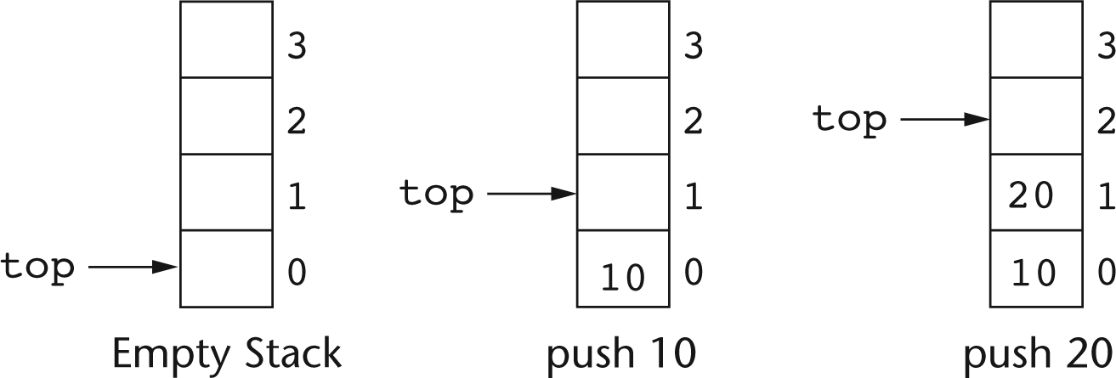
Pushing Items Onto a Stack

Slide 23
Array Implementation of a Stack
Use a class ArrayStack with private fields:
int [ ] s;
int top; // points to actual end of the stack
Constructor:
ArrayStack(int capacity)
{
s = new int[capacity];
top = 0;
}

Slide 24
Array Implementation of a Stack
The method for adding an item to the stack:
void push(int x)
{
if (top == s.length)
throw new IllegalStateException();
s[top] = x;
top ++;
}

Slide 25
Array Implementation of a Stack
The method to retrieve an item from the stack:
int pop()
{
if (top == 0)
then throw new IllegalStateException();
top --;
return s[top];
}

Slide 26
Stack Overflow and Underflow
The exception thrown when an attempt is made to push a value onto a stack whose array if full is called a stack overflow exception.

Slide 27
Stack Overflow and Underflow
The exception thrown when an attempt is made to push a value onto a stack whose array if full is called a stack overflow exception.
The exception thrown when an attempt is made to pop an empty stack is sometimes called stack underflow.

Slide 28
Checking for an Empty Stack
You check for an empty stack by looking to see if top is 0 :
boolean empty()
{
return top == 0;
}

Slide 29
Peek()
To return the item currently at the “top” of the stack:
int peek()
{
if (top ==0 )
throw new IllegalStateException();
return s[top-1];
}

Slide 30
Array-Based Stacks of Other Types
Implementing stacks of other types is similar to implementing a stack of int.
Main difference: when a value of a reference type is removed from the stack, the array entry must be set to null.
s[top-1] = null;
Forgetting to set the array entry to null will keep the removed item from being garbage collected.

Slide 31
Popping a Reference Type
public String pop()
{
if (empty())
throw new EmptyStackException();
else
{
int retVal = s[top-1];
s[top-1] = null; // Facilitate garbage collection
top--;
return retVal;
}
}

Slide 32
Linked Implementation of Stacks
A linked list can be used to implement a stack by using the head of the list as the “top” of the stack:

Slide 33
Linked Implementation of Stacks
A linked list can be used to implement a stack by using the head of the list as the “top” of the stack:
push(E o) adds a new item as the new head of the linked list.

Slide 34
Linked Implementation of Stacks
A linked list can be used to implement a stack by using the head of the list as the “top” of the stack:
push(E o) adds a new item as the new head of the linked list.
E pop() removes and returns the head of the linked list.

Slide 35
Implementing a Stack with a Linked List
A reference
Node top; // list head
is used to represent the linked list that holds the stack items.

Slide 36
Linked Implementation of a Stack
class LinkedStack
{ // Node class used for linked list
private class Node
{
String element;
Node next;
Node (String e, Node n)
{
element = e;
next = n;
}
}
private Node top = null; // head of list is top of stack
}

Slide 37
Linked Implementation of a Stack
A linked stack after pushing two items:

Slide 38
Linked Implementation of Stacks
The linked stack of the previous slide after pushing the string Carol.

Slide 39
Linked Implementation of Stack Methods
All of the stack methods have straightforward implementations using linked lists:
  boolean empty()
  String pop()
  void push(String e)
  String peek()

Slide 40
Checking for an Empty Stack
The stack is empty if the head pointer top is null:
boolean empty()
{
return top == null;
}

Slide 41
The Stack push Operation
Adds a new item at the beginning of the underlying linked list:
void push(String s)
{
top = new Node(s, top);
}

Slide 42
The Stack pop Operation
Removes and returns the element at the head of the stack’s linked list:
public String pop()
{
if (empty())
throw new IllegalStateException();
else
{
String retValue = top.element;
top = top.next;
return retValue;
}
}

Slide 43
The Stack peek Operation
Return without removing the element stored in the head of the list.
public String peek()
{
if (empty())
throw new IllegalStateException();
else
return top.element;
}

Slide 44
Queues

Slide 45
Queues
A Queue is a collection that allows elements to be added and removed in a First-In-First-Out order.
Elements are removed from the queue in the same order in which they are added.

Slide 46
Queue Applications
Many applications have clients that arrive needing service, and depart after being served.
Clients who arrive are added to a queue.
Clients are removed from the queue, receive service, and leave.

Slide 47
Queue Applications
A print server may service many workstations in a computer network. The print server uses a queue to hold print job requests waiting to be sent to the printer.
A simulation of cars going through a toll booth would use a queue to hold cars lining up to pay toll.

Slide 48
Queue Operations
enqueue(E x) : adds an item to the queue.

Slide 49
Queue Operations
enqueue(E x) : adds an item to the queue.
E dequeue() : removes and returns an item from the queue.

Slide 50
Queue Operations
enqueue(E x) : adds an item to the queue.
E dequeue() : removes and returns an item from the queue.
E peek() : returns, but does not remove, the item that will be returned by the next call to dequeue().

Slide 51
Queue Operations
enqueue(E x) : adds an item to the queue
E dequeue() : remove and return an item from the queue
E peek() : return, but do not remove, the item that will be returned by the next call to dequeue()
boolean empty() : check to see if the queue is empty

Slide 52
Implementation of Queues
An array-based implementation uses an array to hold queue elements.

Slide 53
Implementation of Queues
An array-based implementation uses an array to hold queue elements.
A linked list implementation uses a linked list to hold queue elements.

Slide 54
Conceptual View of an Array
A queue can be viewed as a linear sequence of items where
  new items are added at one end (the rear of the queue)
  new items are removed from the other end (the front of the queue)

Slide 55
Array Implementation of a Queue
Requires an array to hold the queue elements:
String [ ] q; // Queue will hold strings

Slide 56
Array Implementation of a Queue
Requires an array to hold the queue elements:
String [ ] q; // Queue will hold strings
Requires an index to keep track of the array slot that will hold the next item to be added to the queue:
int rear; // Where next item will be added

Slide 57
Array Implementation of a Queue
Requires an array to hold the queue elements:
String [ ] q; // Queue will hold strings
Requires an index to keep track of the array slot that will hold the next item to be added to the queue:
int rear; // Where next item will be added
Requires an index to keep track of the array slot the holds the next item to be removed from the queue:
int front; // Next item to be removed

Slide 58
An Invariant for the Array Implementation
front: index of next item to be dequeued. This slot is normally filled, but is unfilled when the queue is empty.
rear: index of slot that will receive the next item to be enqueued. This slot is normally unfilled, but is filled when the array is completely filled.

Slide 59
Simplistic Implementation of enqueue
Initially rear points to the first available unfilled position in the array.
A new item x is added to the queue at rear as follows:
q[rear] = x;
rear ++;
As a new item is added, rear is incremented to point to the next unfilled position in the array.

Slide 60
Simplistic Implementation of dequeue
The item is removed from the queue at the index front.
The item at front is saved so it can be returned, and front is incremented to point to the next item in the queue:
String element = q[front];
q[front] = null;
front ++;

Slide 61
Use of the Array as a Circular Buffer
The simplistic enqueue fills array slots in order of increasing index
The simplistic dequeue empties array slots behind enqueue, also in order of increasing index.
By the time enqueue gets to the end of the array, dequeue may have emptied out slots at the beginning, so enqueue should wrap around to the beginning of the array when it gets to the end.

Slide 62
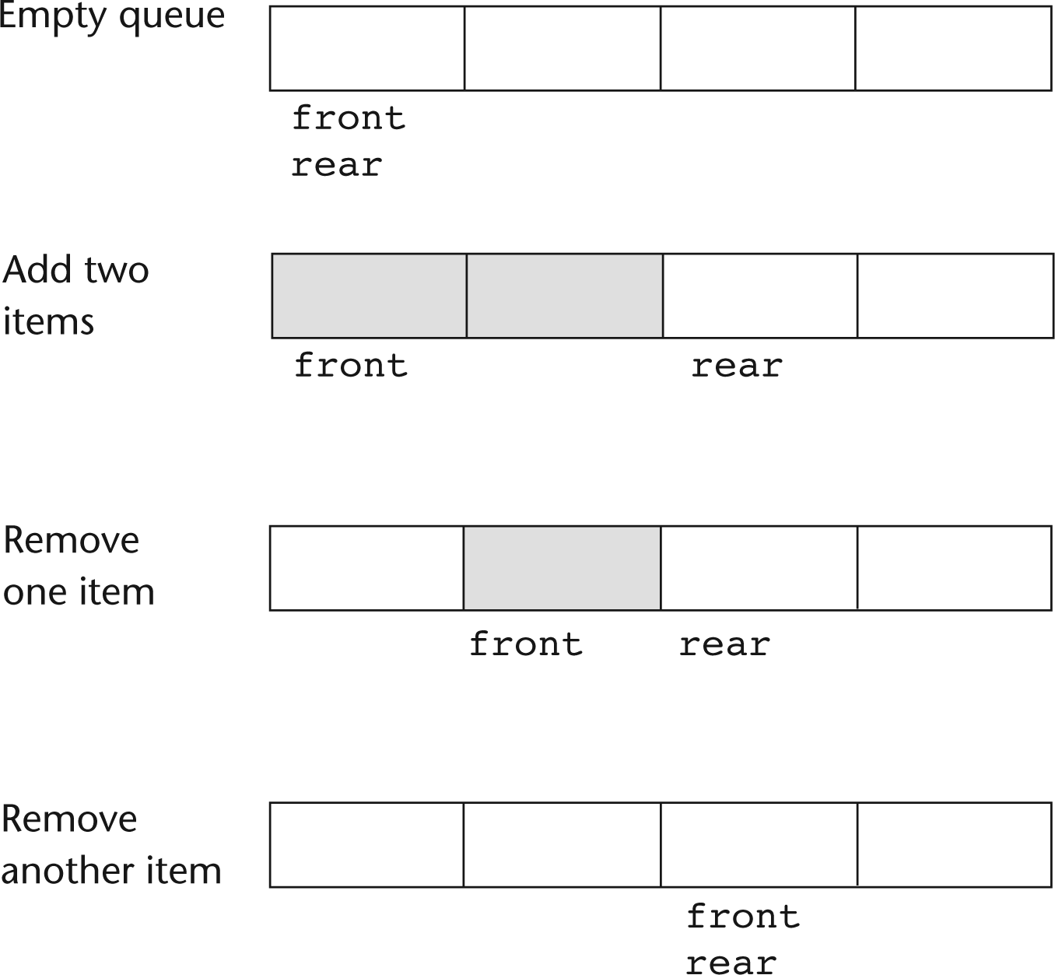
Use of an Array-Based Queue

Slide 63
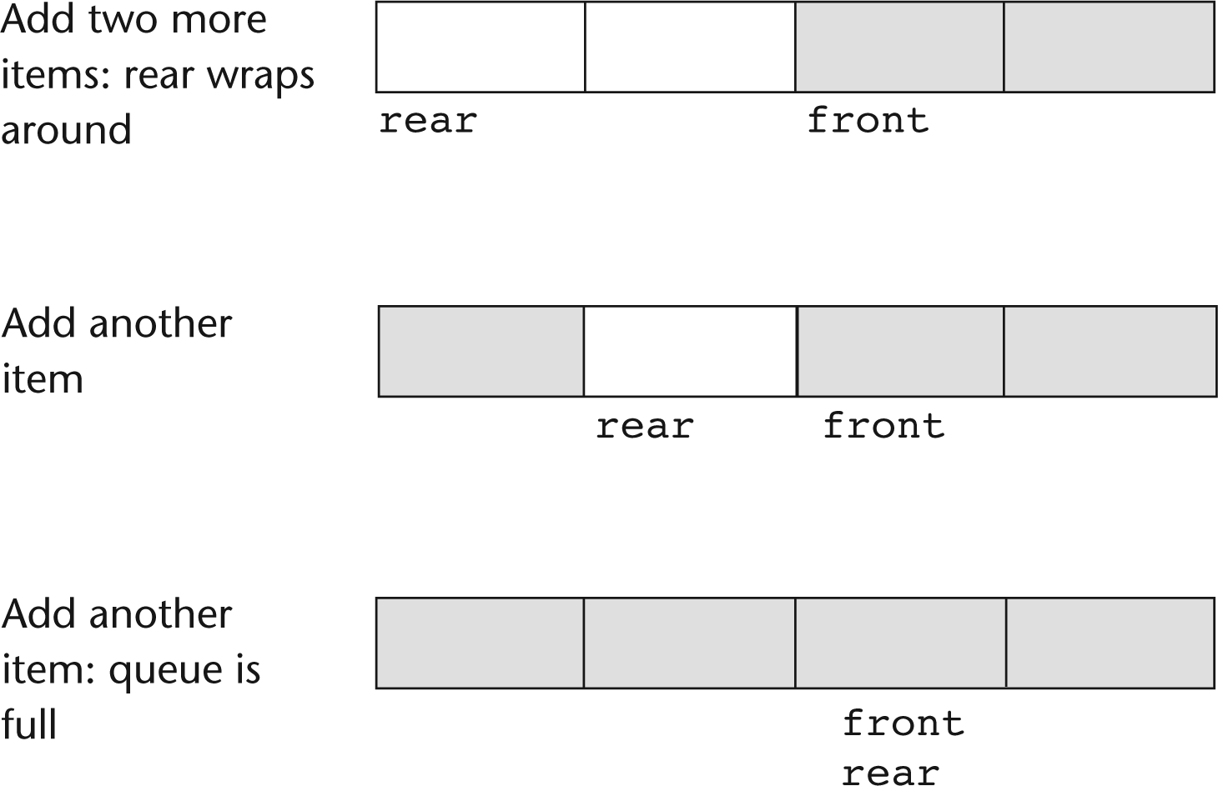
Using an Array as a Circular Buffer

Slide 64
Tracking the Size of the Queue
Tracking the number of elements in the queue is useful in determining if the queue is empty, and when the queue is full.
An integer variable is used to track the size:
int size = 0;
The variable size is incremented by enqueue, and decremented by dequeue.

Slide 65
Implementation of enqueue
The correct implementation of enqueue must
  Increment the size variable.
  Add the new item at rear.
  Increment rear and wrap around to 0 when rear reaches the end of the array.

Slide 66
The Array-Based Enqueue Method
public void enqueue(String s)
{
if (size == q.length)
throw new IllegalStateException();
else
{
// Add to rear
size ++;
q[rear] = s;
rear ++;
// If at end of array, wrap around
if (rear == q.length) rear = 0;
}
}

Slide 67
Implementation of dequeue
The correct implementation of dequeue must
  Decrement the size variable.
  Remove an item at front.
  Increment front and wrap around to 0 when front reaches the end of the array.

Slide 68
Implementation of dequeue
public String dequeue()
{
if (empty())
throw new IllegalStateException();
else
{
size --;
// Remove from front
String value = q[front];
// Facilitate garbage collection
q[front] = null;
// Update front
front++;
if (front == q.length) front = 0 ;
return value;
}
}

Slide 69
Linked Implementation of Queues

Slide 70
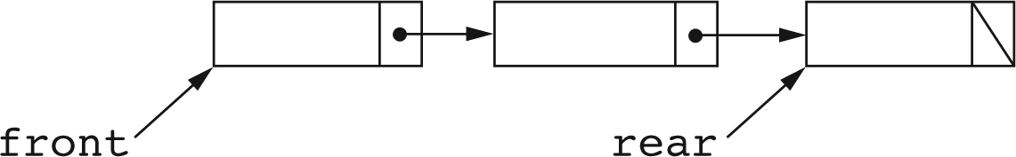
Linked Implementation of Queues
A linked list can be used to implement a queue.
The head of the linked list is used as the front of the queue.
The end of the linked list is used as the rear of the queue.

Slide 71
Linked Implementation of a Queue
class LinkedQueue
{
private class Node
{
String element;
Node next;
Node(String e, Node n)
{
element = e; next = n;
}
}
Node front = null; // head of list, where items are removed
Node rear = null; // last node in list, where items are added
}

Slide 72
Checking if Queue is Empty
This is done by looking to see if there is a node at front, that is, if front is null:
boolean empty()
{
return front = null;
}

Slide 73
Linked Implementation of Enqueue
public void enqueue(String s)
{
if (rear != null)
{
rear.next = new Node(s, null);
rear = rear.next;
}
else
{
rear = new Node(s, null);
front = rear;
}
}

Slide 74
Linked Implementation of dequeue
public String dequeue()
{
if (empty())
throw new IllegalStateException();
else
{
String value = front.element;
front = front.next;
if (front == null)
rear = null;
return value;
}
}

