Slide 1
Chapter 22 : Binary Trees, AVL Trees, and Priority Queues

Slide 2
Chapter Topics
Binary Trees and Their Applications
Binary Search Trees
AVL Trees
Priority Queues

Slide 3
Binary Trees
A binary tree is like a linked list, except each node may have up to two successors.
A successor of a node X in a binary tree is called a child of X.
In a binary tree, each node has at most one predecessor. The predecessor of X is called the parent of X.
A child of a node in a binary tree is either a left child or a right child.

Slide 4
Facts About Binary Trees
If a node C is a child of another node P, then P is called the parent of C.
A binary tree may be empty.
A nonempty binary tree has a unique node that has no parent. This node is called the root of the binary tree.
A node with no children is called a leaf.

Slide 5
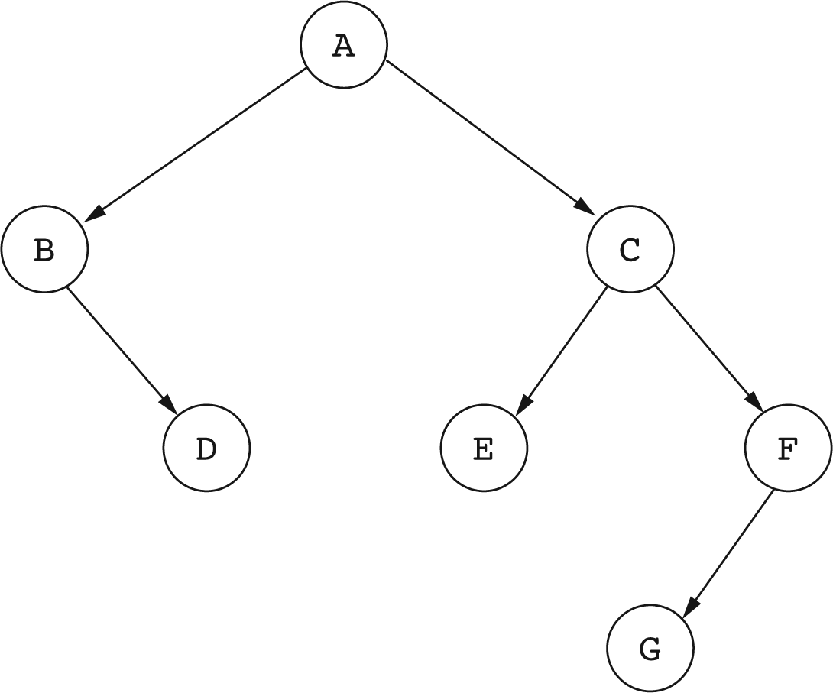
A Binary Tree
C is the right child of A.
E is the left child of C.
D and G are leaves.
A is the root.

Slide 6
Additional Terminology
Let X be a node in a binary tree T. A node Y is a descendant of X if Y is on the path from X to a leaf of T.

Slide 7
Descendants of a Node
Descendants of C are C, E, F, and G.
Descendants of B are B and D.

Slide 8
Subtrees
The collection of all descendants of a node X forms a binary tree, called the subtree of T rooted at X.
If R is the root of T, then the subtree rooted at the left child of R is called the left subtree of T, and the subtree rooted at the right child of R is called the right subtree of T.

Slide 9
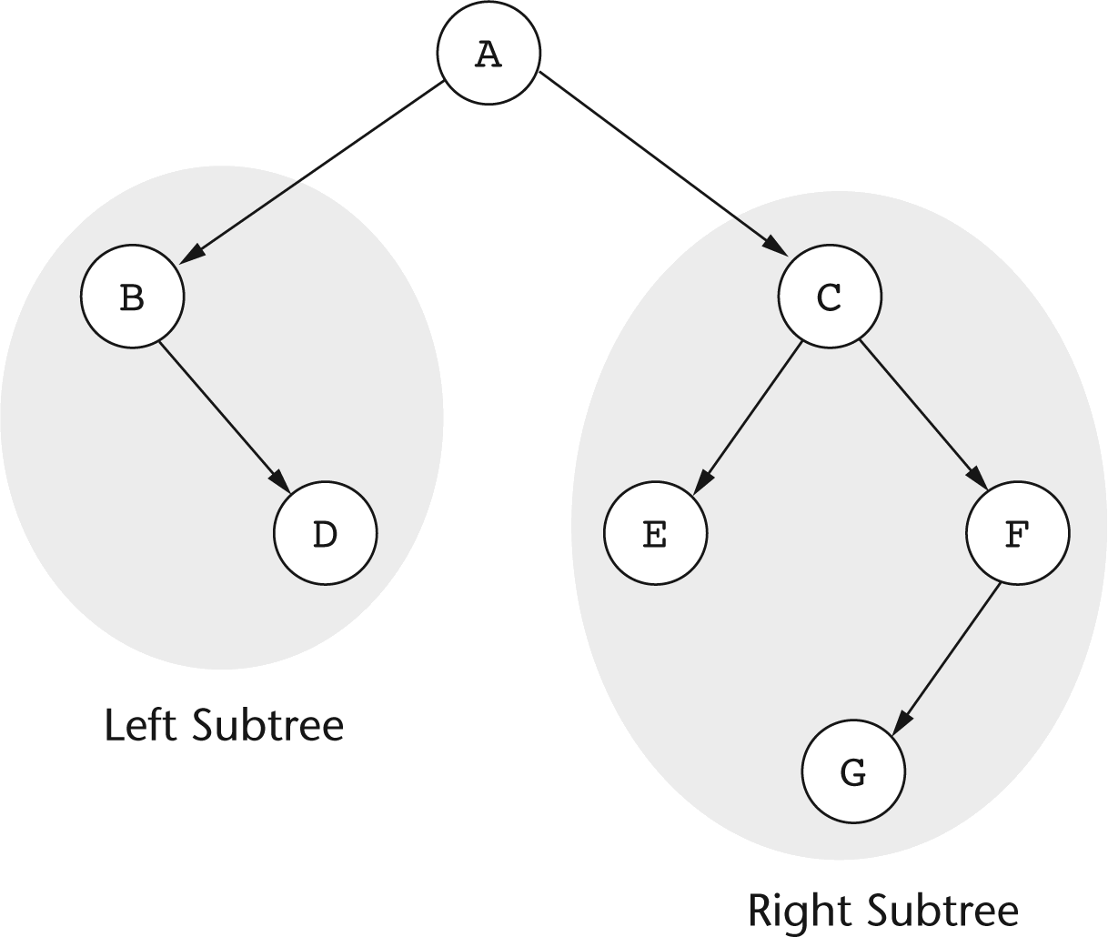
Subtrees of a Binary Tree

Slide 10
Applications of Binary Trees
Binary trees are used to organize information to support fast search.
Generalizations of binary trees are used in database systems to store data.

Slide 11
Implementation of Binary Trees
Implementation is based on a Node class similar to what is used in linked lists.
class Node
{
String element;
Node left; // Left child
Node right; // Right child
Node(String e, Node left, Node right)
{
element = e;
this.left = left;
this.right = right;
}
}

Slide 12
Representing a Binary Tree
A binary tree is represented by a reference to its root node.
Node myTree;
An empty binary tree is represented with a reference whose value is null.

Slide 13
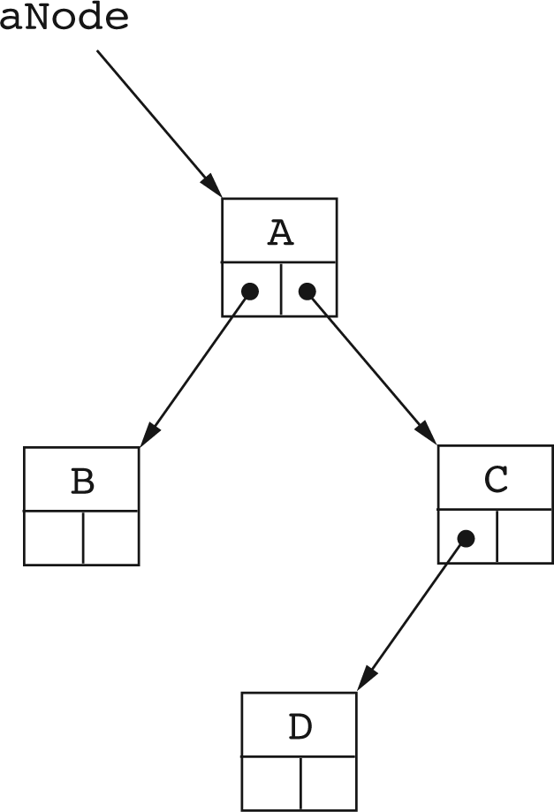
Using the Node Class to Build Binary Trees.
dNode = new Node(‘D’, null, null);
cNode = new Node(‘C’, dNode, null);
bNode = new Node(‘B’, null, null);
aNode = new Node(‘A’, bNode, cNode);

Slide 14
A Class For Representing Binary Trees
public class BinaryTree
{
private class Node
{
int element; // Value stored in node
Node left, right; // Left and right child
Node(int val)
{
element = val;
left = null; right = null;
}
Node(int val, Node leftChild, Node rightChild)
{
element = val;
left = leftChild; right = rightChild;
}
}
Node root = null; // Root of the binary tree
}

Slide 15
Recursive Nature of Binary Trees
The concept of a binary tree has a natural recursive definition:
A binary tree is a collection of nodes that is either empty (base case), or consists of a root node, with the rest of the nodes being divided into two collections that are also binary trees (the left and right subtrees)

Slide 16
Traversal of Binary Trees
A traversal of a binary tree is a systematic method of visiting each node in the binary tree.
There are three binary tree traversal techniques:
  Preorder traversal
  Inorder traversal
  Postorder traversal

Slide 17
Binary Tree Traversal
All three traversal techniques are recursive:
a nonempty binary tree is traversed by visiting the root and then recursively traversing the left and right subtrees.

Slide 18
Preorder Traversal
Preorder traversal visits the root first, and then recursively traverses the left and right subtrees.
void preorder(Node tree)
{
if (tree != null)
{
System.out.print(tree.element + “ “); // root first
preorder(tree.left);
preorder(tree.right);
}
}

Slide 19
Inorder Traversal
Inorder traversal recursively traverses the left subtree, then visits the root, and then traverses the right subtree.
void inorder(Node tree)
{
if (tree != null)
{
inorder(tree.left);
System.out.print(tree.element + “ “); // root IN between
inorder(tree.right);
}
}

Slide 20
Postorder Traversal
Postorder traversal recursively traverses the left and right subtrees, and then visits the root.
void postorder(Node tree)
{
if (tree != null)
{
postorder(tree.left);
postorder(tree.right);
System.out.print(tree.element + “ “); // root last
}
}

Slide 21
Binary Search Trees
Binary search trees are binary trees that organize their nodes to allow a form of binary search.
Binary search trees work with values such as strings or numbers, that can be sorted.
The idea is to store values in nodes so that small values are stored in the left subtree, and larger values are stored in the right subtree.

Slide 22
Binary Search Trees
A binary search tree is a binary tree that stores nodes in such a way that at each node X,
  Every value stored in the left subtree of X is less than the value stored at X.
  Every value stored in the right subtree of X is greater than the value stored at X.

Slide 23
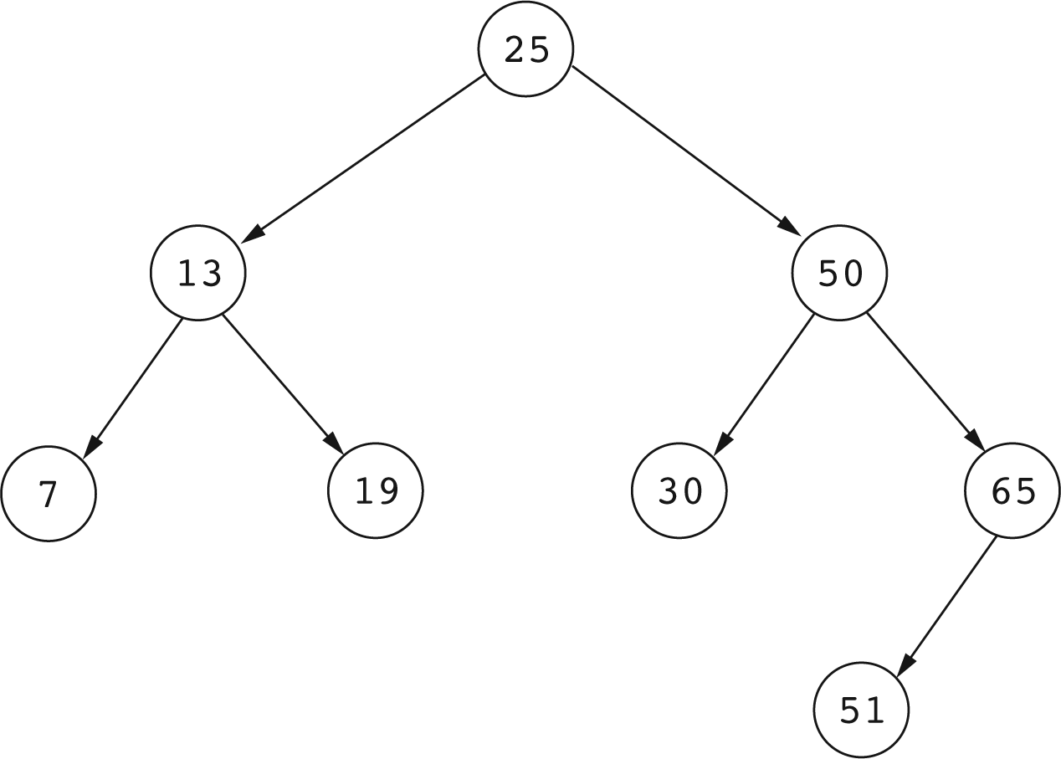
Example of a Binary Search Tree

Slide 24
Adding Values to Binary Search Trees
The strategy for adding X to a binary search tree is recursive:
  Base case: if the tree is empty, create and return a tree with a single node containing X.
  Non base case: Compare X to the value in the root.
    If X is less, recursively add X to the left subtree.
    If X is greater, recursively add X to the right subtree.
    Return the resulting tree.

Slide 25
Adding a Value to a Binary Search Tree
private Node add(int x, Node bstree)
{
if (bstree == null) return new Node(x);
// bstree is not null.
if (x < bstree.element)
{
// Add x to the left subtree and replace the
// current left subtree with the result
bstree.left = add(x, bstree.left);
}
else
{
// Add x to the right subtree
bstree.right = add(x, bstree.right);
}
return bstree;
}

Slide 26
Add: The Public Interface
The public add method calls the private add method on the root of the search tree:
public boolean add(int x)
{
root = add(x, root);
return true;
}

Slide 27
Checking for the Presence of a Value
The strategy for checking if a binary search tree contains a value X is recursive:
Base case: if the tree is empty, return false.
Non base case: Compare X to the value stored in the root:
  If X equals the value in the root, return true.
  If X is less, recursively check if the left subtree contains X.
  If X is greater, recursively check if the right subtree contains X.

Slide 28
Checking if a Tree Contains X
private boolean contains(int x, Node bstree)
{
if (bstree == null)
return false;
if (x == bstree.element)
return true;
if (x < bstree.element)
{
// Recursively look in left subtree
return contains(x, bstree.left);
}
else
{
// Recursively look in right subtree
return contains(x, bstree.right);
}
}

Slide 29
Contains: The Public Interface
The public contains method calls the private contains method on the root of the binary search tree:
public boolean contains(int x)
{
// Call the private recursive method
return contains(x, root);
}

Slide 30
Removing Elements From Binary Search Trees

Slide 31
Removing Elements
To remove a leaf node, just delete the node: That is, replace it with null.
To remove a node with one child, replace the node with its one child.

Slide 32
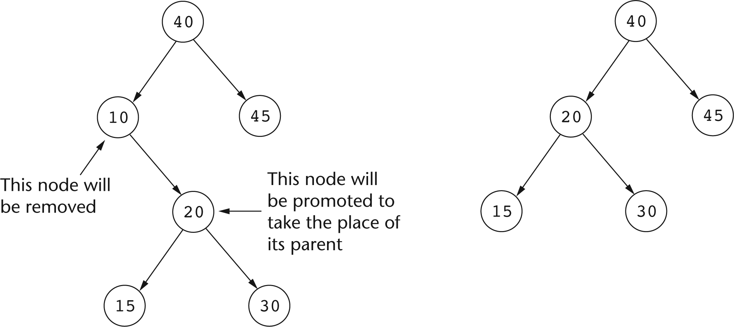
Before and After Removing a Node With One Child.

Slide 33
Removing a Node
To remove a node with 2 children, the subtrees of the deleted node need to be combined into a single tree that takes the place of the deleted node.
This is done by removing the greatest node in the left subtree and using it to replace the removed node.

Slide 34
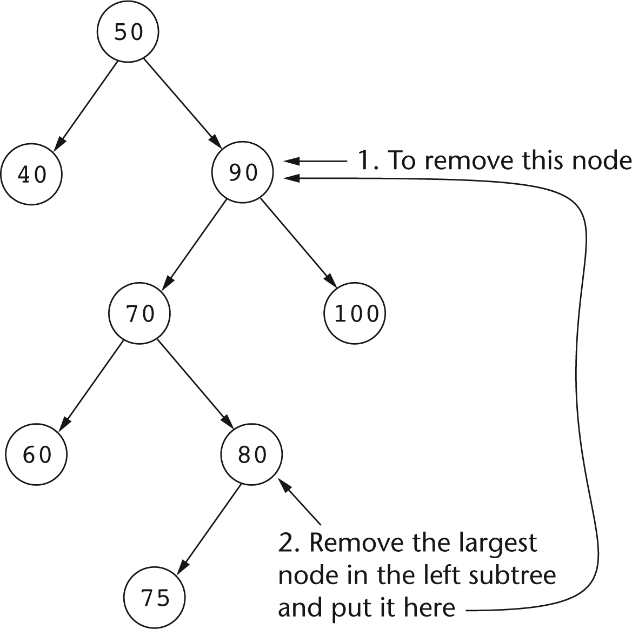
Removing a node with 2 Children

Slide 35
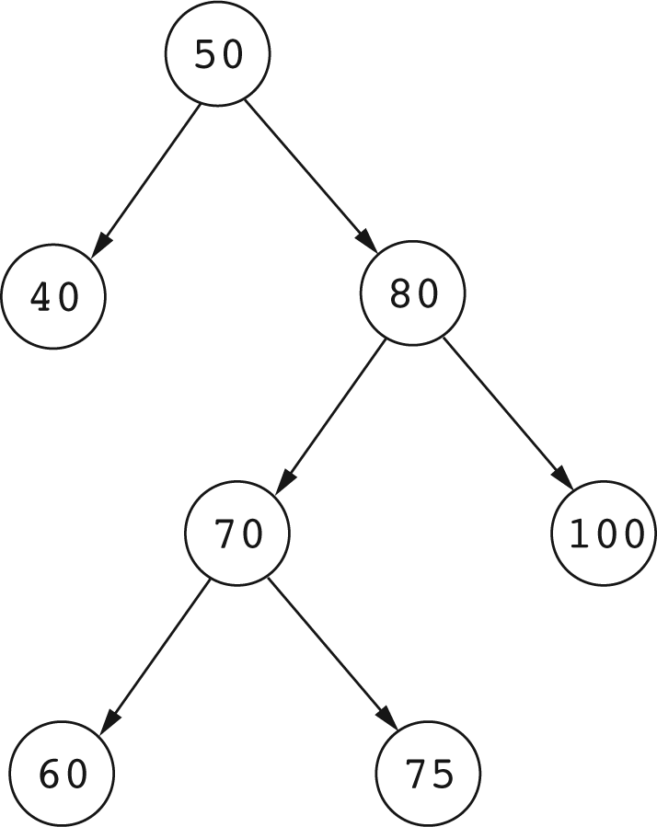
The Tree of Last Slide After Removing 90

Slide 36
Removing X From a Search Tree
Removing a value X from a binary search tree returns a RemovalResult object:
class RemovalResult
{
Node node;
Node tree;
RemovalResult(Node n, Node t)
{
node = n; tree = t;
}
}
node is the node that contains X, unhooked from the search tree.
tree is the tree that remains after removing the node containing X.

Slide 37
Removing X from a Binary Search Tree
If X is the root, remove it.
Otherwise compare X to the value in the root:
  If X is less, recursively remove X from the left subtree.
  If X is greater, recursively remove X from the right subtree.
Removing X from a binary search tree boils down to removing the root of some subtree of the binary search tree.

Slide 38
Removing roots of Subtrees
Suppose that the method
RemovalResult remove(Node bTree, int x)
finds x in the root of the subtree bTree.
If the root (bTree) has no children, the method returns
  new RemovalResult(bTree, null)
  This means that the root node has been removed,
  and the remaining tree is empty.

Slide 39
If
RemovalResult remove(Node bTree, int x)
finds a root node that has one child, then the root node (bTree) is the removed node, and the remaining tree is the one subtree of the root:
Node node = bTree; // Removed node
Node tree; // Remaining tree
// Remaining tree is the one nonempty subtree
if (bTree.left != null)
tree = bTree.left;
else
tree = bTree.right;
node.left = null;
node.right = null;
return new RemovalResult(node, tree);

Slide 40
Removing a Root with 2 children
When removing a root node that has two children: deleting the root leaves two children, which somehow must be combined into one tree.
We can combine the two subtrees into one by removing the greatest node in the left subtree and making it the root of the remaining tree.

Slide 41
RemovalResult remove(Node bTree, int x)
To remove a root Node with 2 children:
// Remove largest node in left subtree and
// make it the root of the remaining tree
RemovalResult remResult = removeLargest(bTree.left);
Node newRoot = remResult.node;
// Use the remaining tree from the left subtree
newRoot.left = remResult.tree;
newRoot.right = bTree.right;
// Prepare the result to be returned
bTree.left = null;
bTree.right = null;
return new RemovalResult(bTree, newRoot);

Slide 42
Removing the Largest Node
Removing the largest node in a binary search tree is part of the procedure for removing a root node with two children.
In a binary search tree T, the largest node is the root if T has no right subtree, otherwise it is the largest node in the right subtree of T.
The largest node can be removed with a natural recursive strategy.

Slide 43
Removing the Largest Node
RemovalResult removeLargest(Node bTree)
{
if (bTree == null) return null;
if (bTree.right == null)
{
// Root is the largest node
Node tree = bTree.left;
bTree.left = null;
return new RemovalResult(bTree, tree);
}
else
{
// Remove the largest node from the right subtree
RemovalResult remResult = removeLargest(bTree.right);
bTree.right = remResult.tree;
remResult.tree = bTree;
return remResult;
}
}
}

Slide 44
Remove: The public Interface
The public interface calls the private remove on the root of the binary search tree:
public boolean remove(int x)
{
RemovalResult result = remove(root, x);
if (result == null)
return false;
else
{
root = result.tree;
return true;
}
}

Slide 45
AVL Trees

Slide 46
AVL Trees
AVL trees are binary search trees that obey a balance condition at each node.
The balance condition constrains the height of the subtrees at each node to differ by no more than 1.

Slide 47
Height of Binary Trees
The height of a binary tree is the length of the longest path from the root to a leaf.
A binary tree with one node has height 0.
An empty binary tree is has height -1 by convention.

Slide 48
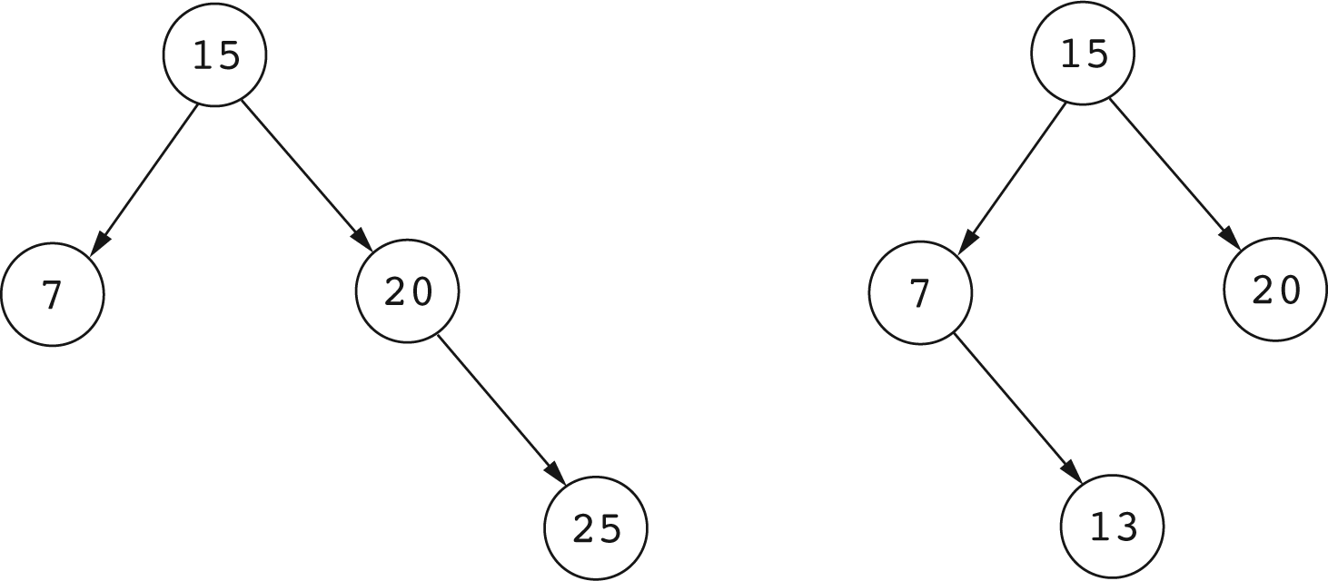
Examples of AVL Trees

Slide 49
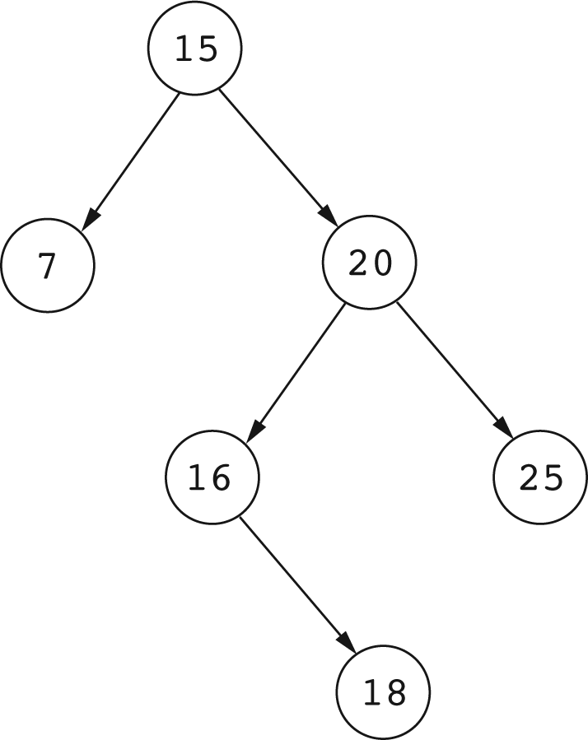
A non-AVL Tree

Slide 50
Building AVL Trees
AVL trees are built by starting with an empty binary tree and adding elements one at time.
Additions are made as to any binary search tree, then an operation is executed to restore the AVL balance condition.

Slide 51
LL imbalance
An LL imbalance occurs at a node N with a left child K when N and K are both left-heavy.
A node is left-heavy if its left subtree has greater height then its right subtree.

Slide 52
Single Right Rotations
An LL imbalance is corrected by executing a single right rotation at the node with the imbalance.

Slide 53
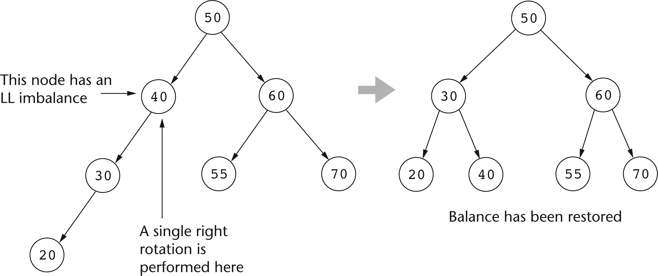
Correcting LL Imbalances

Slide 54
RR Imbalance
An RR imbalance occurs at a node N with a right child M when N and M are both right-heavy.
An RR imbalance is the mirror image of an LL imbalance.

Slide 55
Single Left Rotations
An RR imbalance is corrected by executing a single left rotation at the node with the imbalance.

Slide 56
LR imbalance
An LR imbalance occurs at a node N with a left child K when N is left-heavy and K is right-heavy.

Slide 57
Double LR Rotation
An LR imbalance is corrected by executing a double LR rotation at the node with the imbalance.

Slide 58
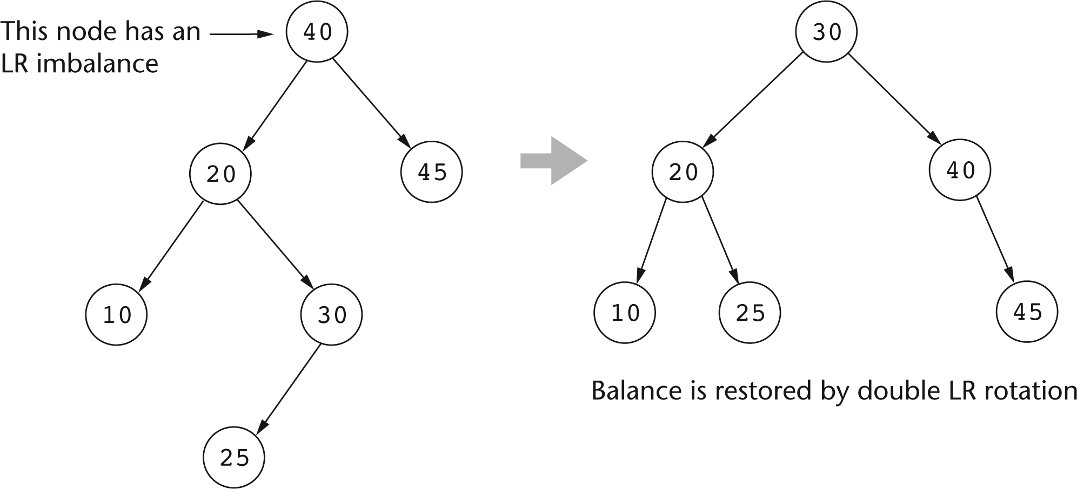
Double LR rotation Corrects An LR Imbalance

Slide 59
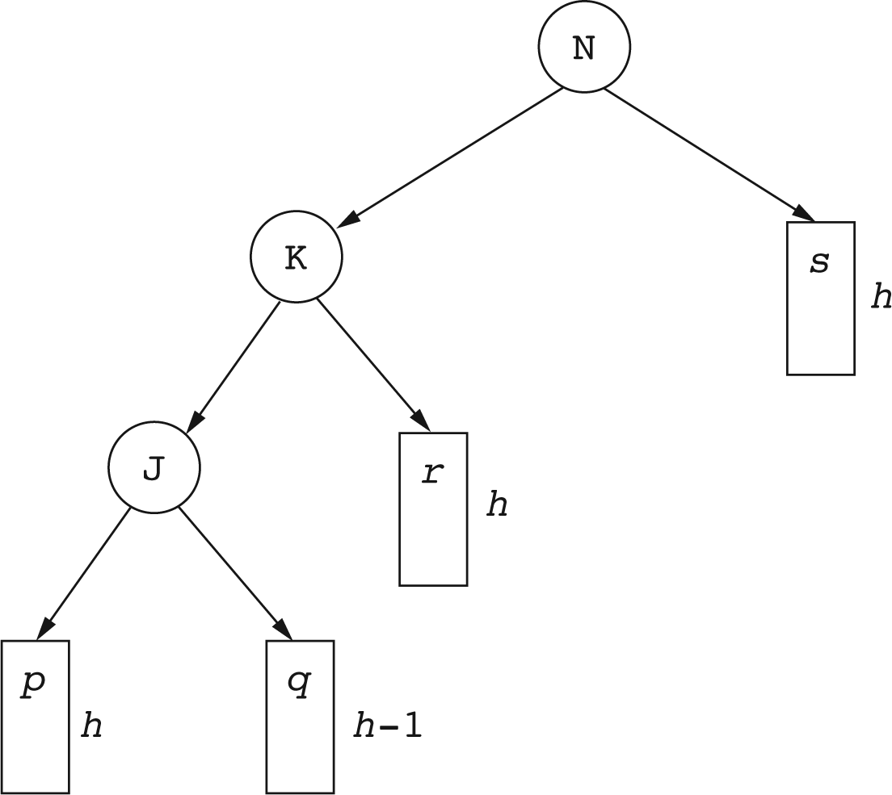
Fixing an LL Imbalance
A node with an LL imbalance generally looks like this

Slide 60
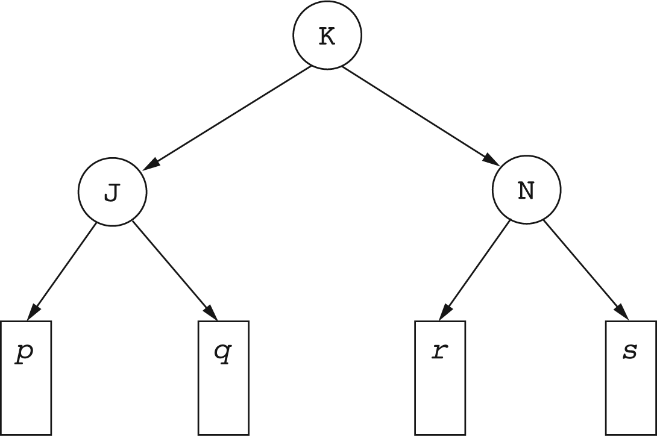
Fixing an LL Imbalance
Executing an LL rotation yields a tree like this:

Slide 61
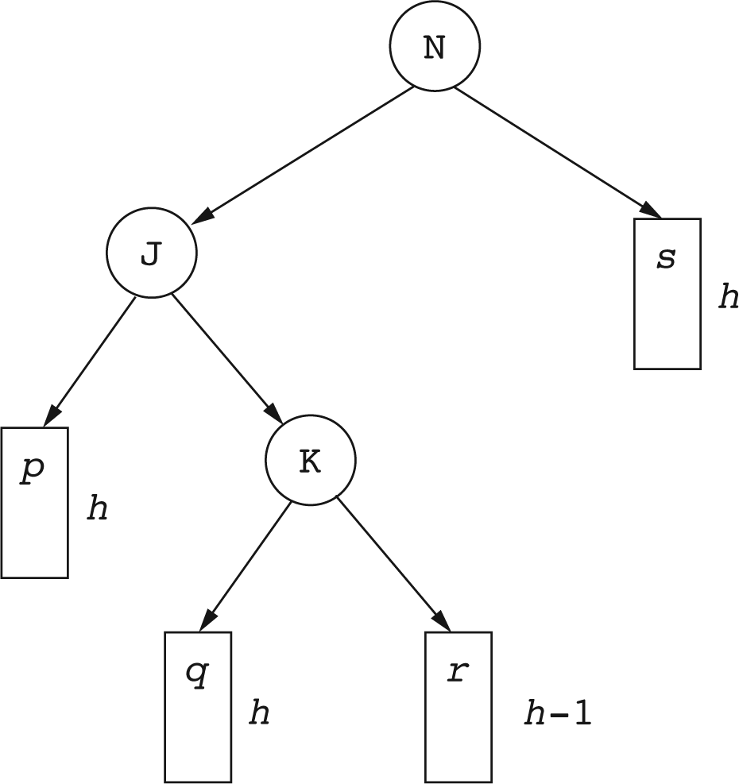
Fixing an LR Imbalance
A node with an LR imbalance generally looks like this:

Slide 62
Fixing an LR Imbalance
Executing an LR rotation yields a tree like this Figure:

Slide 63
An AVL Tree Class
A class representing an AVL Tree is as uses an inner class that represents an AVL node:

Slide 64
public class AVLTree
{
private class AVLNode
{
int element; // Value stored in this node.
AVLNode left, right; // Left and right subtree.
int height; // Height of node.
public AVLNode(int value)
{
this(value, null, null);
}
public AVLNode(int val, AVLNode left, AVLNode right)
{
element = val;
left = left; right = right;
height = ;
}
}
}

Slide 65
Utility Methods
This AVLNode method is called on the root node of an AVL tree to reset its height when the height of one of its subtrees has changed.
void resetHeight()
{
int leftHeight = AVLTree.getHeight(left);
int rightHeight = AVLTree.getHeight(right);
height = 1 + Math.max(leftHeight, rightHeight);
}
This AVLTree method is called to detemine the height of an AVL tree with the given root node.
static int getHeight(AVLNode tree)
{
if (tree == null) return -1; else return tree.height;
}

Slide 66
llBalance
This method performs a single LL rotation on a node and returns a reference to the root of the balanced AVL tree.
private AVLNode llBalance(AVLNode bTree)
{
AVLNode leftChild = bTree.left;
AVLNode lrTree = leftChild.right;
leftChild.right = bTree;
bTree.left = lrTree;
bTree.resetHeight();
leftChild.resetHeight();
return leftChild;
}

Slide 67
rrBalance
This method performs a single RR rotation on a node and returns a reference to the root of the balanced AVL tree.
private AVLNode rrBalance(AVLNode bTree)
{
AVLNode rightChild = bTree.right;
AVLNode rightLeftChild = rightChild.left;
rightChild.left = bTree;
bTree.right = rightLeftChild;
bTree.resetHeight();
rightChild.resetHeight();
return rightChild;
}

Slide 68
lrBalance
This method performs a double LR rotation on a node and returns a reference to the root of the balanced AVL tree.
private AVLNode lrBalance(AVLNode bTree)
{
AVLNode root = bTree;
AVLNode lNode = root.left;
AVLNode lrNode = lNode.right;
AVLNode lrlTree = lrNode.left;
AVLNode lrrTree = lrNode.right;
// Build the restructured tree
lNode.right = lrlTree;
root.left = lrrTree;
lrNode.left = lNode;
lrNode.right = root;
// Adjust heights
lNode.resetHeight();
root.resetHeight();
lrNode.resetHeight();
return lrNode;
}

Slide 69
rlBalance
This method performs a double RL rotation on a node and returns a reference to the root of the balanced AVL tree.
private AVLNode rlBalance(AVLNode bTree)
{
AVLNode root = bTree;
AVLNode rNode = root.right;
AVLNode rlNode = rNode.left;
AVLNode rlrTree = rlNode.right;
AVLNode rllTree = rlNode.left;
// Build the restructured tree
rNode.left = rlrTree;
root.right = rllTree;
rlNode.left = root;
rlNode.right = rNode;
// Adjust heights
rNode.resetHeight();
root.resetHeight();
rlNode.resetHeight();
return rlNode;
}

Slide 70
The AVL balance Method
The balance method is called after an element has been added to restore the AVL balance condition.
The method determines the type of imbalance and calls one of the ll, lr, rr, or rl balance methods to perform the appropriate rotation.

Slide 71
private AVLNode balance(AVLNode bTree)
{
int rHeight = getHeight(bTree.right);
int lHeight = getHeight(bTree.left);
if (rHeight > lHeight) {
AVLNode rightChild = bTree.right;
int rrHeight = getHeight(rightChild.right);
int rlHeight = getHeight(rightChild.left);
if (rrHeight > rlHeight)
return rrBalance(bTree);
else
return rlBalance(bTree);
}
else {
AVLNode leftChild = bTree.left;
int llHeight = getHeight(leftChild.left);
int lrHeight = getHeight(leftChild.right);
if (llHeight > lrHeight)
return llBalance(bTree);
else
return lrBalance(bTree);
}
}

Slide 72
The AVL add Method
This method first adds a new element using the same strategy as for a regular binary search tree.
It then checks for an imbalance, and calls the balance method if needed.

Slide 73
The AVL add Method
private AVLNode add(AVLNode bTree, int x)
{
if (bTree == null)
return new AVLNode(x);
if (x < bTree.value)
bTree.left = add(bTree.left, x);
else
bTree.right = add(bTree.right, x);
// Compute heights of the left and right subtrees
// and rebalance the tree if needed
int leftHeight = getHeight(bTree.left);
int rightHeight = getHeight(bTree.right);
if (Math.abs(leftHeight - rightHeight) == 2)
return balance(bTree);
else
{
bTree.resetHeight();
return bTree;
}
}

Slide 74
Priority Queues

Slide 75
Priority Queues
A priority queue is a collection that stores elements that have a natural order.
Removing an item from a priority queue always yields the least element.

Slide 76
Operations on a Priority Queue
The main operations on a priority queue are
  add(E x) : adds an element to the priority queue.
  E removeMin() : removes and returns the least element in the queue.

Slide 77
The JCF PriorityQueue Class
The JCF provides a priority queue class whose methods are shown in the next slide.

Slide 78
JCF PriorityQueue Methods
Method | Description
PriorityQueue<E>() | This constructor creates a priority queue that orders elements according to the natural order of E.
boolean add(E item) | Adds the item to the priority queue and returns true.
E poll() | Removes and returns a minimum element from the priority queue. Returns null if the queue is empty.
E peek() | Returns the item that is currently at the head of the queue, but does not remove it. Returns null if the queue is empty.
int size() | Returns the number of items currently stored in this priority queue.

Slide 79
Heapsort
Heapsort is a very efficient sorting method based on priority queues.
Given a list or array of elements, add them to an initially empty priority queue.
Remove the elements from the priority queue, one at a time. They come out in sorted order.

Slide 80
public class Heapsort
{
public static void main(String [] args)
{
// Create and display an array of random integers
Random randy = new Random();
int [ ] arr = new int[];
System.out.println("Here is the array to be sorted:");
for (int k = 0 ; k < arr.length; k++)
{
arr[k] = randy.nextInt();
System.out.print(arr[k] + " ");
}
// Create a priority queue of integers
// and use it to sort the array
PriorityQueue<Integer> pQueue = new PriorityQueue<Integer>();
for (int x : arr)
pQueue.add(x);
for (int k = 0; k < arr.length; k++)
arr[k] = pQueue.poll();
// Print the array
System.out.println("\nHere is the sorted array:");
for (int x : arr) System.out.print(x + " ");
}
}

Slide 81
Using Comparators with PriorityQueue
By default, the JCF PriorityQueue works with objects that implement the Comparable interface.
Objects that do not implement Comparable can be compared through a Comparator object.

Slide 82
The Comparator Interface
Comparator is a generic interface that is part of the java.util package
interface Comparator<T>
{
int compare (T x, T y);
boolean equals(Object o);
}

Slide 83
Comparators
A class that implements Comparator<T> can be used to create objects that compare objects of type T.
Comparators allow objects that do not implement Comparable to be compared.
Comparators allow alternative ways of comparing objects that implement Comparable.

Slide 84
Comparators
Consider a comparator for comparing integers by alphabetical order of their string representations:
class AlphaOrder implements Comparator<Integer>
{
public int compare(Integer x, Integer y)
{
return x.toString().compareTo(y.toString());
}
}

Slide 85
Equality of Comparators
Different comparators can be used with the same class type.
The equals method in the Comparator interface can be overriden to check if two comparator objects are equal.
If comparators will not be checked for equality, the equals method does not have to be implemented: the version inherited from Object is then used.

Slide 86
Use of a Comparator
int [ ] arr = new int [10];
// Store values in arr
// Create a priority queue of integers
// and use it to sort the array arr
AlphaOrder c = new AlphaOrder();
PriorityQueue<Integer>
pQueue = new PriorityQueue<Integer>(arr.length, c);
for (int x : arr)
pQueue.add(x);
for (int k = 0; k < arr.length; k++)
arr[k] = pQueue.poll();
// Print the array
System.out.println("\nHere are the numbers sorted " +
"in alphabetical order:");
for (int x : arr)
System.out.print(x + " ");

Slide 87
Implementing Priority Queues
For heapsort to be efficient, a priority queue needs to implement both the add and removeMin operations in O(log n) time.
Here n is the number of items stored.

Slide 88
Implementing Priority Queues
An unsorted linked list supports add in constant time, but requires O(n) time for removeMin.
A sorted linked list supports removeMin in constant time, but requires O(n) time for add.

Slide 89
Implementing Priority Queues
The right data structure for a priority queue turns out to be a “balanced” binary search tree in which each path from the root to a leaf is sorted in increasing order.

Slide 90
The Heap Order Property
A binary tree has the heap order property if at each node N, the value stored in N is greater than the value stored in the parent of N.
Note that this means the values on each path from the root to a leaf are sorted in increasing order.

Slide 91
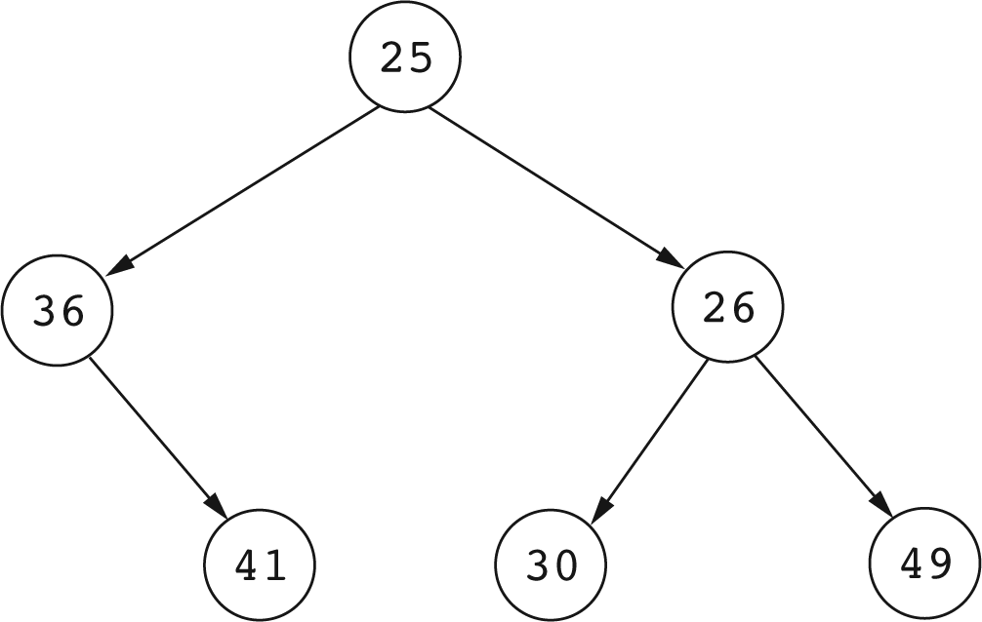
Heap Order Property

Slide 92
Efficiency of the Add Operation
Heap order ensures that the minimum element can be found quickly.
However, adding a “large” element while maintaining heap order may mean we have to traverse an entire path from the root to some leaf. Long paths mean more comparisons are needed to add an element.

Slide 93
More Binary Tree Terminology
Let T be a binary tree.
The level of a Node N in T is the length of the path from the root to N.
The depth of T is the maximum level of a node in T: this is the longest path from the root to a leaf.

Slide 94
Complete Binary Trees
An efficient add operation needs a binary tree with depth as small as possible for the number of nodes in the tree.
A complete binary tree meets this criterion.

Slide 95
Complete Binary Trees
A binary tree T with depth D is complete if
  T has pow(2, L) nodes for each level L, where 0 <= L <= D-1. That is, each level other than the last has the maximum number of nodes possible.
  All leaf nodes at level D are as far to the left as possible.

Slide 96
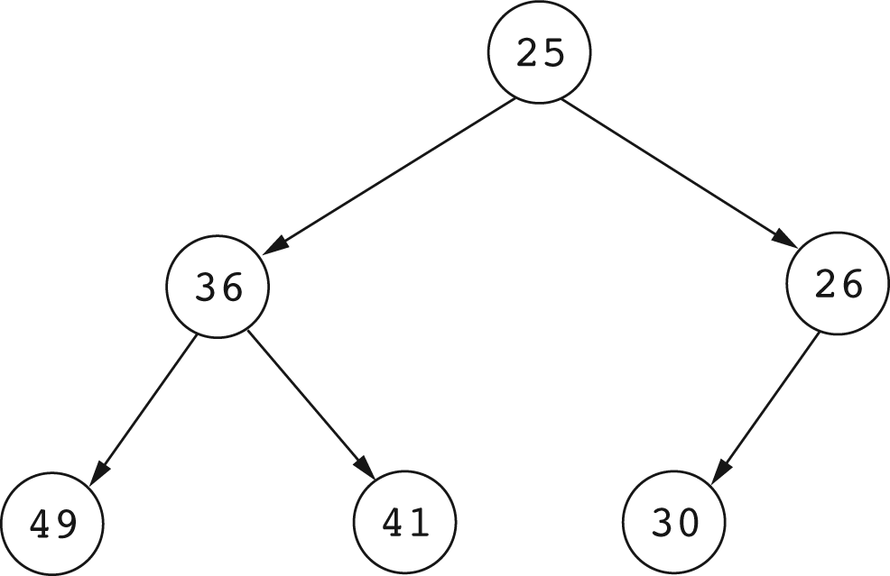
A Complete Binary Tree

Slide 97
Depth of Complete Binary Trees
If we disregard the nodes at the last level,
then a complete binary tree is perfectly balanced in that at each node, the left subtree has the same number of nodes as the right subtree.

Slide 98
Depth of a Complete Binary Tree
If the tree has N nodes, then in descending along any path from the root to a leaf, the number of nodes decreases is approximately halved each time we descend through a level.
Thus the maximum number of levels is at most log n + 1.

Slide 99
Depth of a Complete Binary Tree
A complete binary tree with N nodes has depth at most log n + 1.
Thus a complete binary tree that also has the heap order property will support the add operation in O(log n) time.

Slide 100
Heaps
A complete binary tree with the heap order property is called a heap.

Slide 101
A Heap

Slide 102
Storing Heaps in Arrays
The structure of a complete binary tree allows us to do away with nodes with left and right links and store the tree in an array.

Slide 103
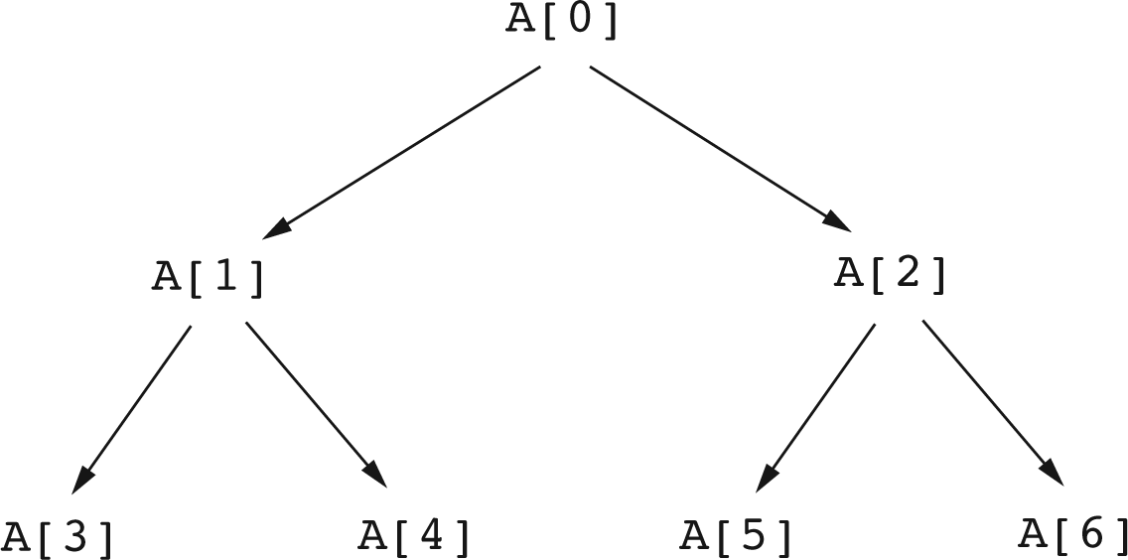
Storing Heaps in an Array

Slide 104
Storing Heaps in an Array
The root of the tree is at A[0]
The parent of A[k] is A[(k-1)/2]
The left child of A[k] is A[2k+1]
The right child of A[k] is A[2k+2]
The rightmost leaf in the last level is at A[n-1]
A node A[k] is a leaf if 2k + 1 >= n
A node A[k] has a left child if 2k + 1 < n
A node A[k] has a right child if 2k+2 < n

Slide 105
Adding an Item to a Heap
To add x to a heap, first add x as a leaf, so as to preserve the complete binary tree structure of the heap.

Slide 106
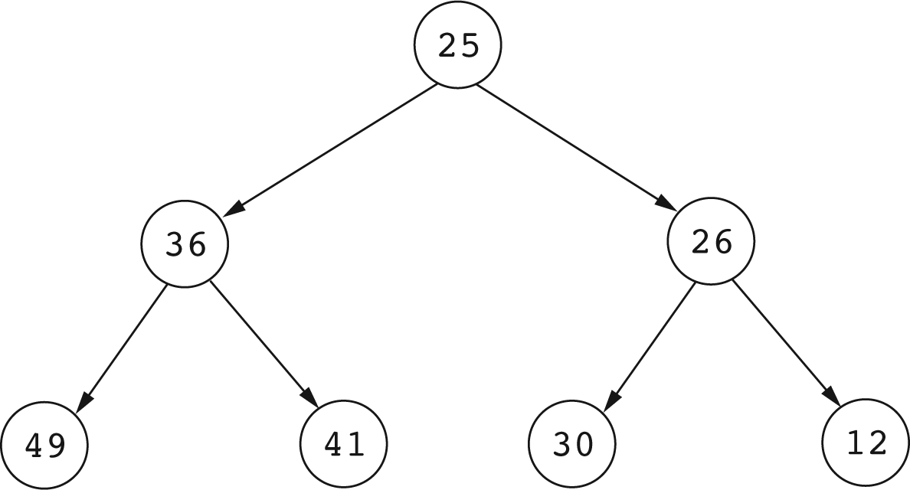
Adding a new Leaf

Slide 107
The Sift Up Operation
Adding a new element as a leaf may violate the heap order property.
A sift up operation is then performed to restore the heap property:
Repeatedly swap the new element with its parent until the heap order property is restored.

Slide 108
The Heap Add Method
(Assume that a heap is stored in an ArrayList)
ArrayList<Integer> arrayHeap;
boolean add(int x)
{
// Add x at the end of the array list
arrayHeap.add(x);
// Sift up
siftUp();
return true;
}

Slide 109
The sift up Operation
private void siftUp()
{
int p = arrayHeap.size()-1; // Position to sift up
while (p != 0)
{
int parent = (p-1) / 2; // Index of parent
if (valueAt(p) >= valueAt(parent))
return; // We are done
else
{ // Do a swap
Integer temp = arrayHeap.get(parent);
arrayHeap.set(parent, arrayHeap.get(p));
arrayHeap.set(p, temp);
// Move up
p = parent;
}
}
}

Slide 110
Removing the Minimum Element
Remove the minimum in two steps:
  Remove the root.
  Remove the deepest rightmost leaf and use it to replace the root.
  Do a sift down operation to restore the heap order property.

Slide 111
A Heap Before Removing the Minimum element
Before deleting the minimum (root)

Slide 112
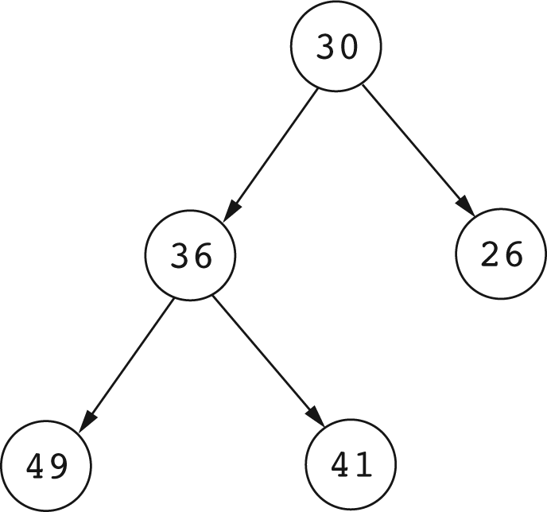
Replacing the Root of a Heap With a Leaf
After replacing the root, but before a sift down:

Slide 113
RemoveMin
public int removeMin()
{
if (isEmpty())
throw new RuntimeException("Priority Queue is empty.");
else
{
int val = arrayHeap.get(0);
// Replace root by last leaf
arrayHeap.set(0, arrayHeap.get(arrayHeap.size()-1));
// Remove the last leaf
arrayHeap.remove(arrayHeap.size()-1);
siftDown();
return val;
}
}

Slide 114
private void siftDown()
{
int p = 0; // Position to sift down
int size = arrayHeap.size();
while (2*p + 1 < size)
{
int leftChildPos = 2*p + 1;
int rightChildPos = leftChildPos + 1;
int minChildPos = leftChildPos;
// Is there a right child?
if (rightChildPos < size)
{ // Which child is smaller
if (valueAt(rightChildPos) < valueAt(leftChildPos))
minChildPos = rightChildPos;
}
// If less than children we are done,
//otherwise swap node with smaller child
if (valueAt(p) <= valueAt(minChildPos)) break;
else
{ // Do the swap
Integer temp = arrayHeap.get(p);
arrayHeap.set(p, arrayHeap.get(minChildPos));
arrayHeap.set(minChildPos, temp);
}
p = minChildPos; // Go down to the child position
}
}

