Slide 1


ITMD 411
Abstraction

Slide 2
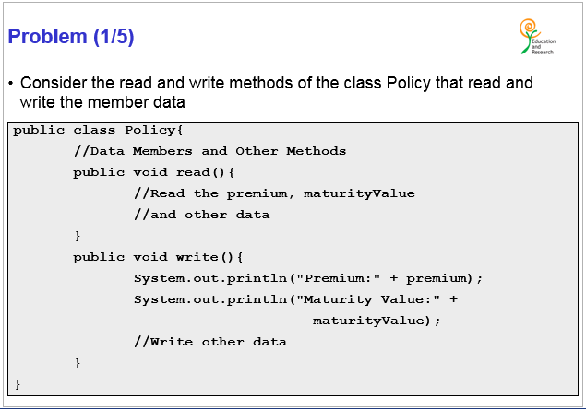
ITMD 411
Key word - extends

Slide 3
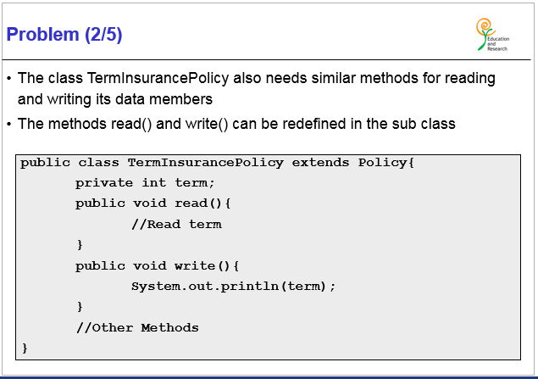
ITMD 411

Slide 4
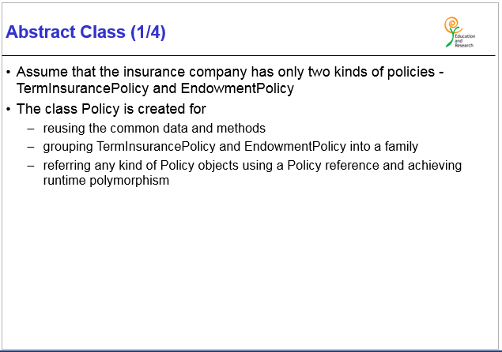
ITMD 411

Slide 5
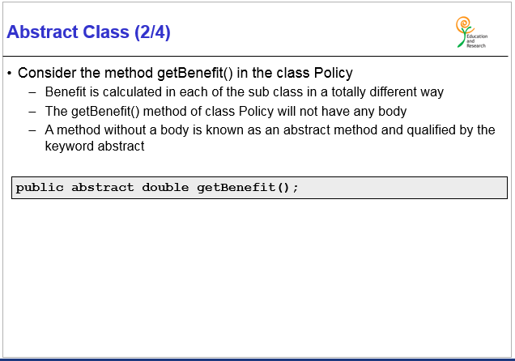
ITMD 411

Slide 6
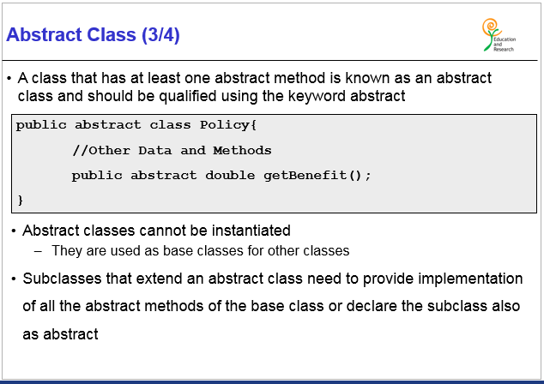
ITMD 411

Slide 7
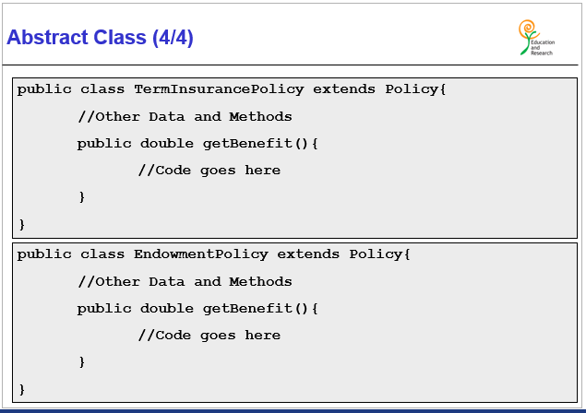
ITMD 411

Slide 8
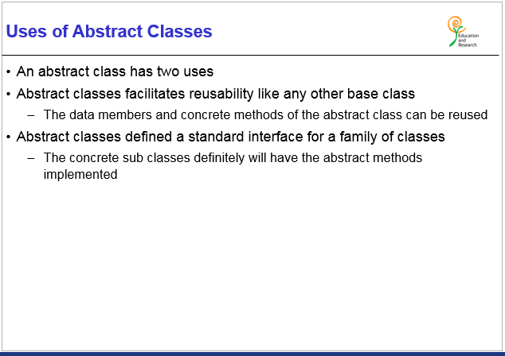
ITMD 411

Slide 9
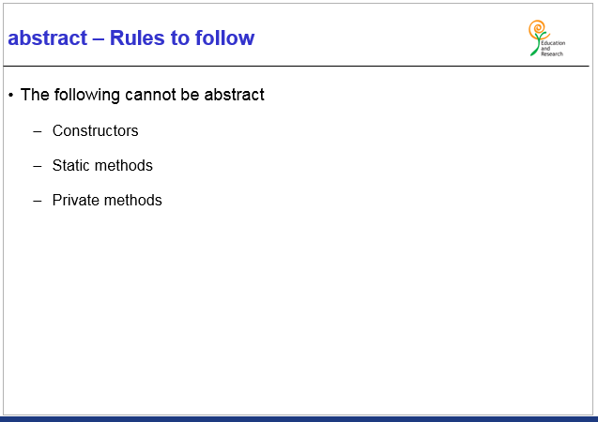
ITMD 411

Slide 10
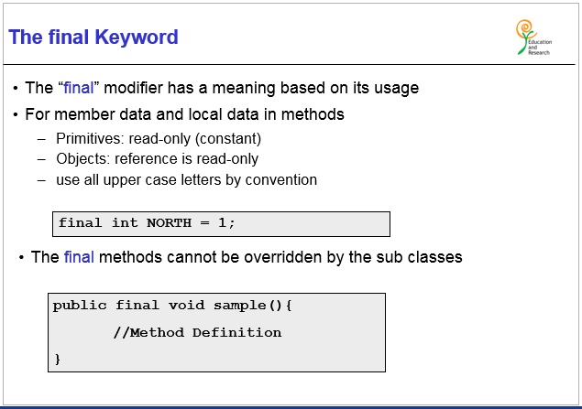
ITMD 411

Slide 11
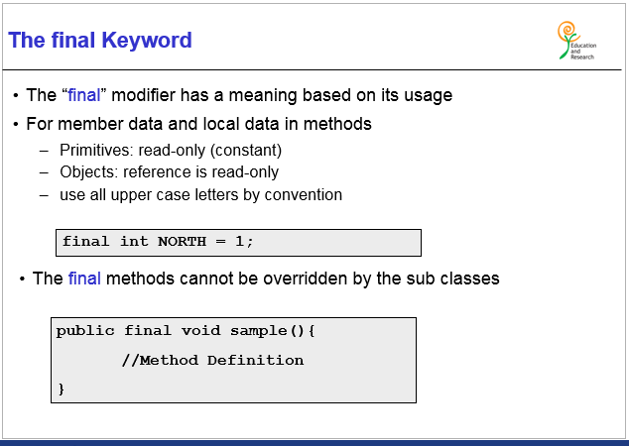
ITMD 411

Slide 12
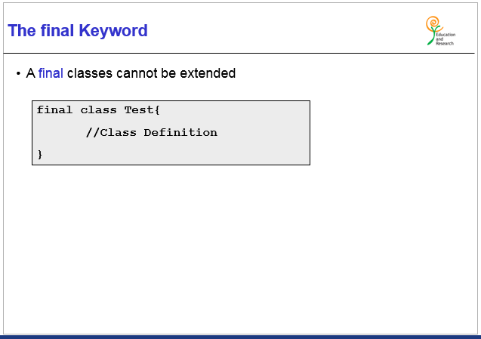
ITMD 411

Slide 13
Questions ?????????

