Slide 1


ITMD 411
JAVA DOCS

Slide 2
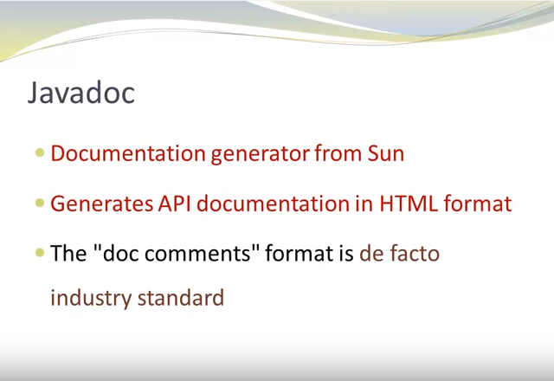
ITMD 411

Slide 3
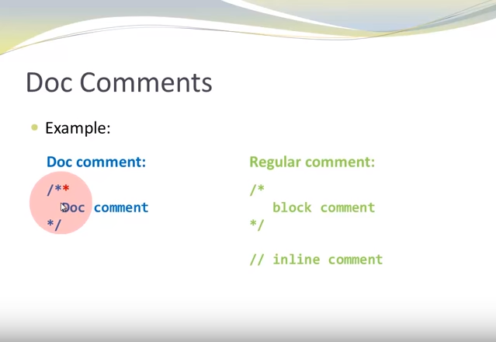
ITMD 411

Slide 4
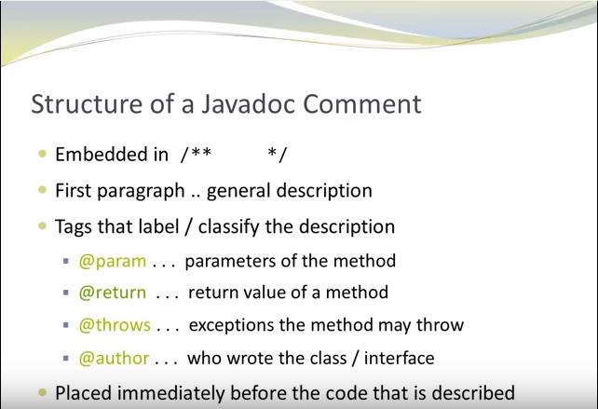
ITMD 411

Slide 5
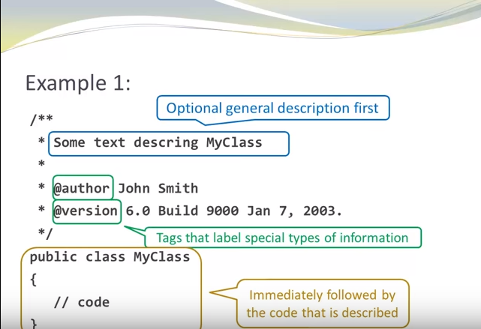
ITMD 510

Slide 6
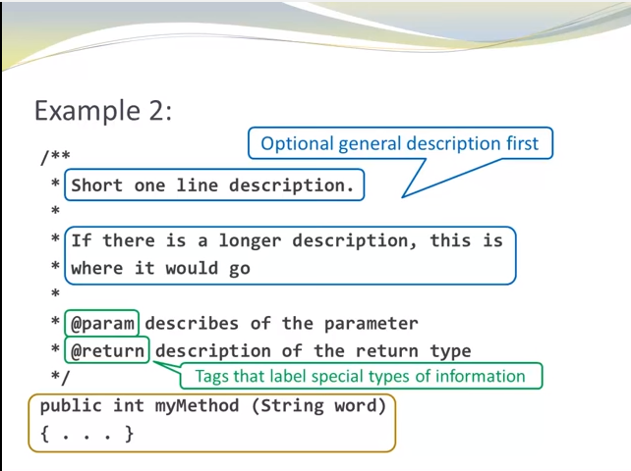
ITMD 411

Slide 7
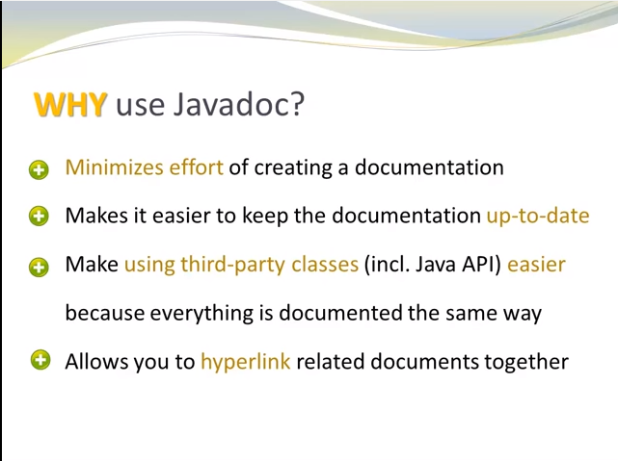
ITMD 411

Slide 8
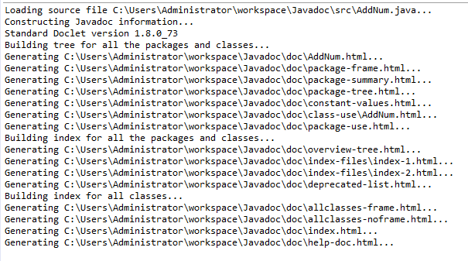
ITMD 411
Generating Java Docs

Slide 9
Questions ?????????

