Slide 1
Android’s LogCat

Slide 2
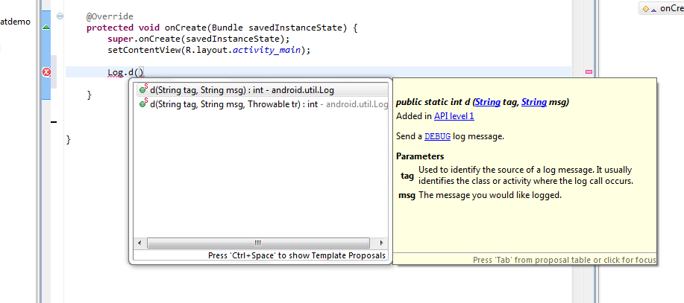
Type Log.d and view the drop-down help – the parameters are tag and msg

Slide 3
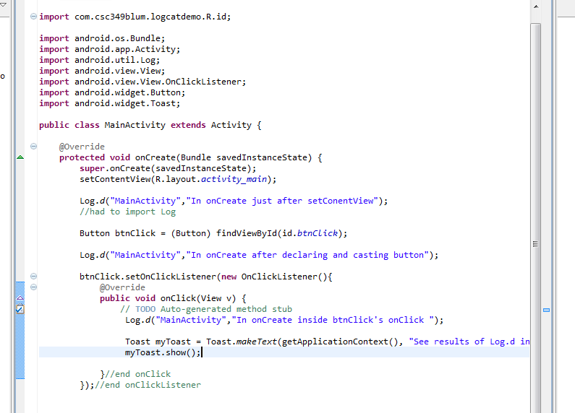
Some code with Log.d

Slide 4
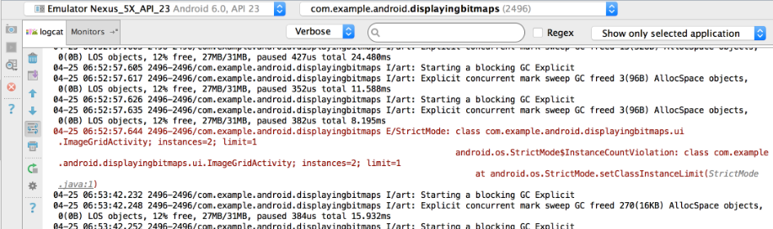
Viewing LogCat
Run the app on a hardware device or emulator.
Display Android Monitor.
Click the logcat tab.
By default, the logcat Monitor displays just the log messages for your app running on the device or emulator:

Slide 5
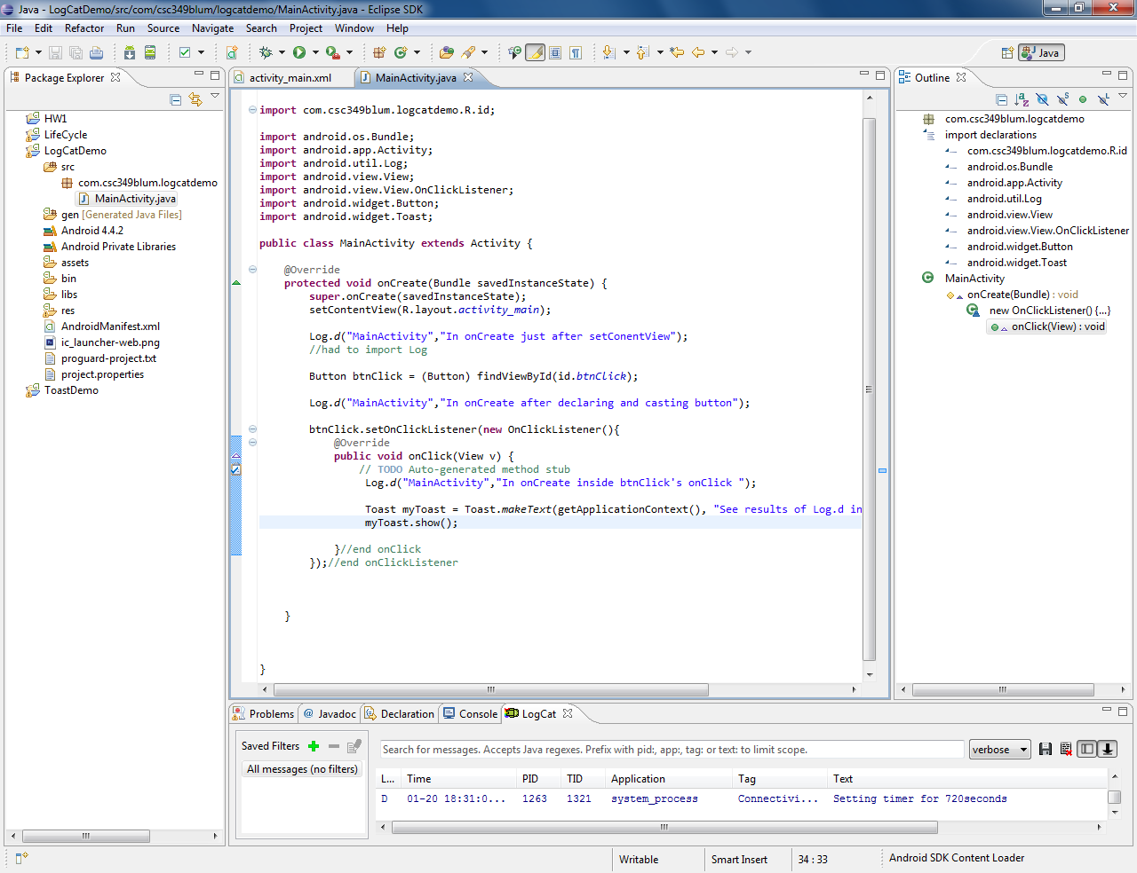
LogCat appears at bottom

Slide 6
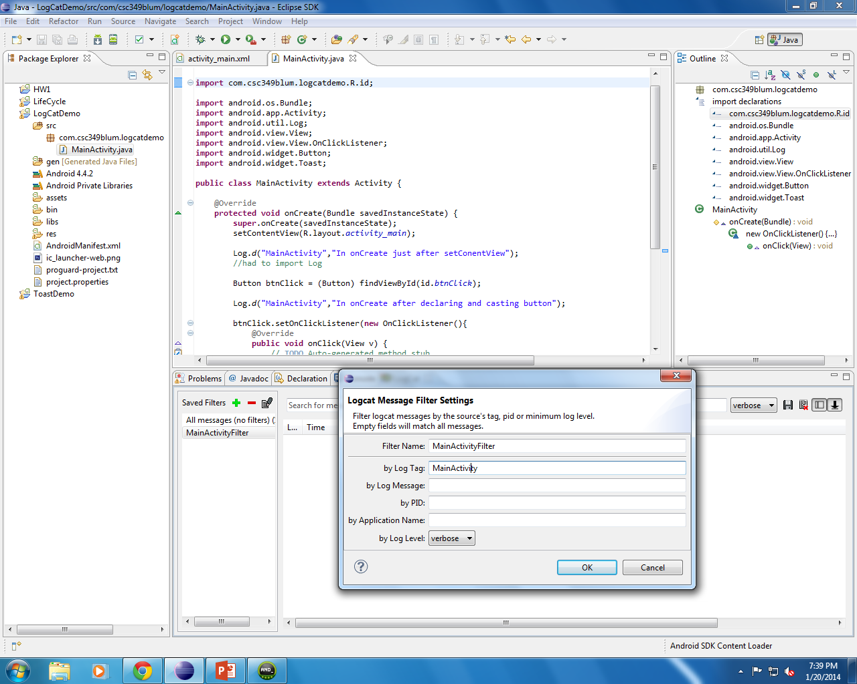
You might need a LogCat filter

Slide 7
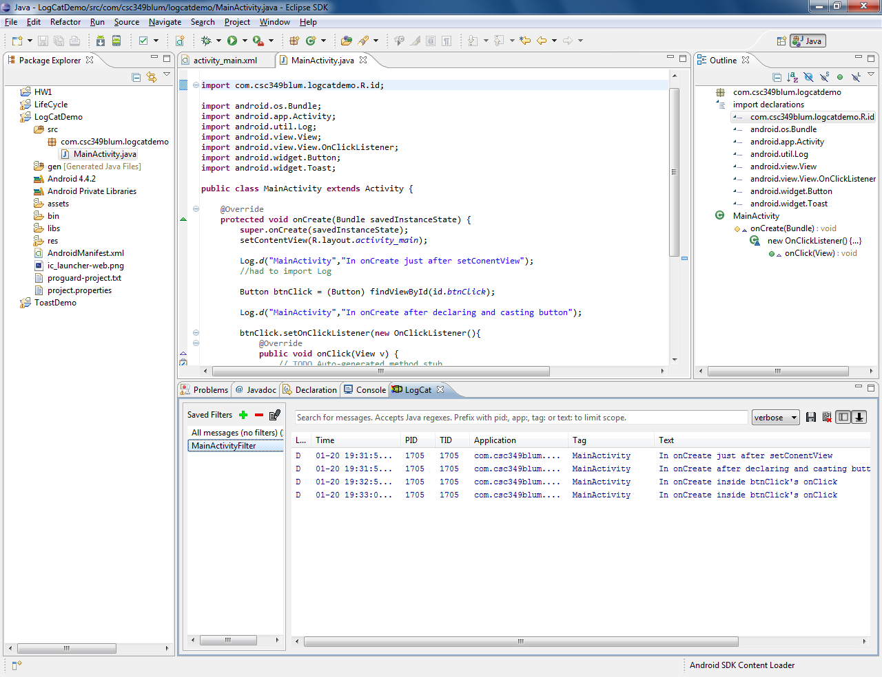
Results in LogCat with filter on (I clicked the button twice)

Slide 8
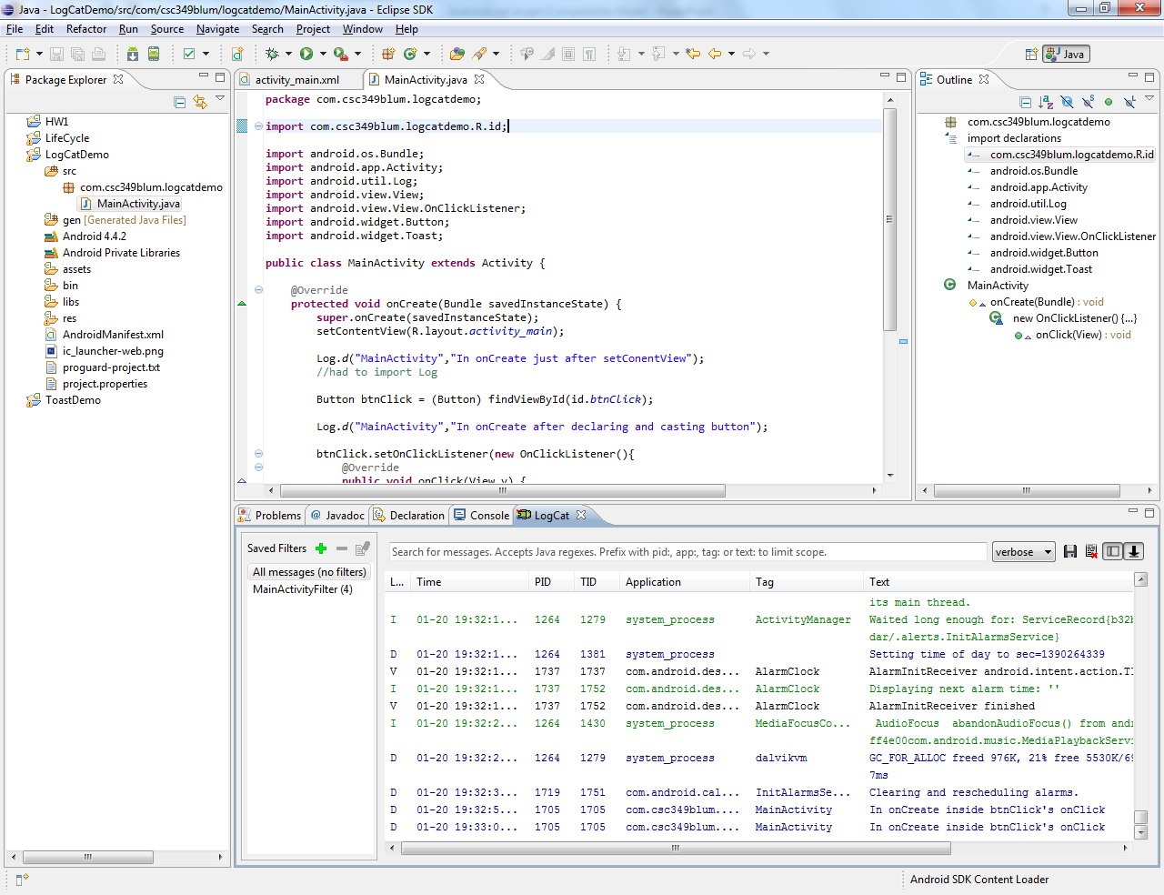
LogCat without filter

Slide 9
LogCat- class messages (or modes)
Log is a logging class that you can utilize in your code to print out messages to the LogCat. Common logging methods include:
v(String, String) (verbose)
d(String, String) (debug)
i(String, String) (information)
w(String, String) (warning)
e(String, String) (error)

Slide 10
Code Examples/Displays
Code…
Log.i("MyActivity", "MyClass.getView() — get item number " + position);
Displays…
I/MyActivity( 1557): MyClass.getView() — get item number 1

