Slide 1
Android
Persistency: SQL Databases

Slide 2
SQL Databases
Using SQL databases in Android.
Android (as well as iPhone OS) uses an embedded standalone
program called sqlite3 which can be used to:
Create a database, | Insert rows,
define SQL tables, | delete rows,
indices, | change rows,
queries, | run queries and
views, | administer a SQLite database file
triggers

Slide 3
SQL Databases
Using SQLite
1. SQLite implements most of the SQL-92 standard for SQL.
2. It has partial support for triggers and allows most complex queries
(exception made for outerjoins).
3. SQLITE does not implement referential integrity constraints through the
foreign key constraint model.
4. SQLite uses a relaxed data typing model.
5. Instead of assigning a type to an entire column, types are assigned to
individual values. This is similar to the Variant type in Visual Basic.
6. Therefore it is possible to insert a string into numeric column and so on.
Documentation on SQLITE available at http://www.sqlite.org/sqlite.html
Good GUI tool for SQLITE available at: http://sqliteadmin.orbmu2k.de/

Slide 4
SQL Databases
How to create a SQLite database?
Method 1
public static SQLiteDatabase.openDatabase (
String path, SQLiteDatabase.CursorFactory factory, int flags)
Open the database according to the flags OPEN_READWRITE, OPEN_READONLY
CREATE_IF_NECESSARY . Sets the locale of the database to the system's
current locale.
Parameters
path to database file to open and/or create
factory an optional factory class that is called to instantiate a cursor when
query is called, or null for default
flags to control database access mode
Returns the newly opened database
Throws SQLiteException if the database cannot be opened

Slide 5

SQL Databases
Example 1. Create a SQLite Database
package com.example.sqldatabases;
import android.app.Activity;
import android.database.sqlite.*;
import android.os.Bundle;
import android.widget.Toast;
public class SQLDemol extends Activity {
SQLiteDatabase db;
@Override
public void onCreate(Bundle savedlnstanceState) {
super.onCreate(savedlnstanceState);
setContentView(R.layout.main);
// filePath is a complete destination of the form
// "/data/data/<namespace>/<databaseName>"
// "/sdcard/<databasename>"
try {
db = SQLiteDatabase.openDatabase(
"/data/data/com.example.sqldatabases/myfriendsDB",
null,
SQLiteDatabase.CREATE_IF_NECESSARY);
db.close();
}
catch (SQLiteException e) {
Toast.makeText(this, e.getMessage(),l).show();
}
}// onCreate
} //class

Slide 6
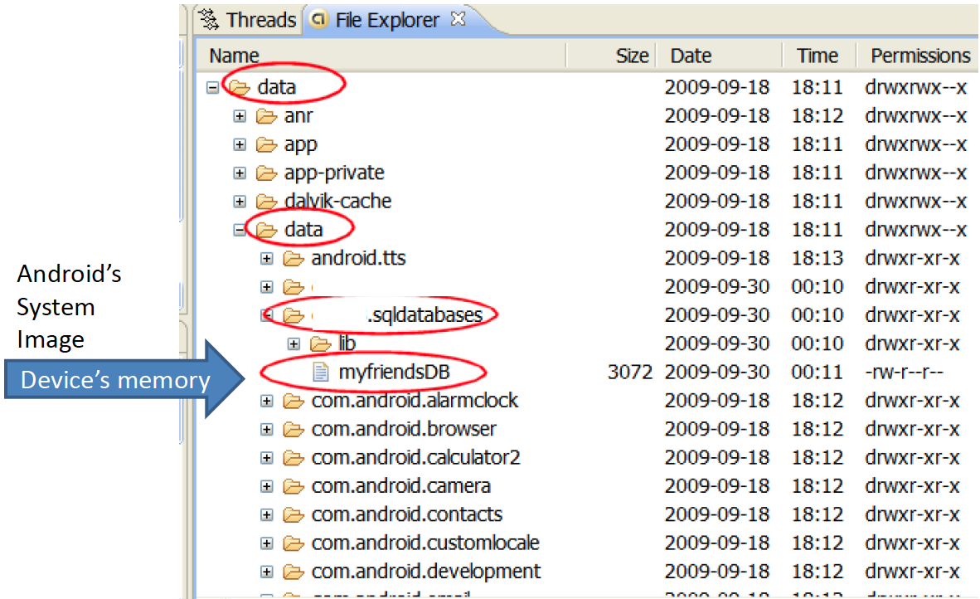
SQL Databases
Example 1. Create a SQLite Database
-%?t

Slide 7
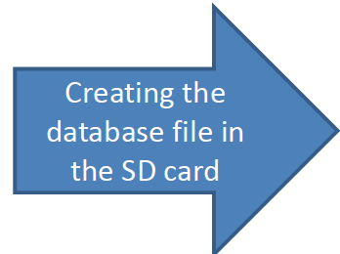
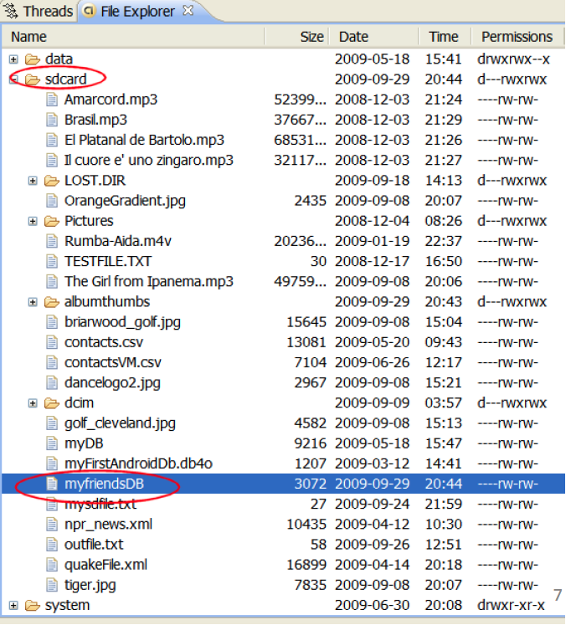
SQL Databases
Example 1. Create a SQLite Database
Using:
db = SQLiteDatabase.openDatabase
"sdcard/myfriendsDB",
null,
SQLiteDatabase.CREATE IF NECESSARY);

Slide 8

SQL Databases
Warning
1. Beware of sharing issues. You cannot access other people’s
database resources (instead use Content Providers or SD
resident DBs).
2. An SD resident database requires the Manifest to include:
<uses-permission android:name="android.permission.WRITE_EXTERNAL_STORAGE" />
NOTE: SQLITE (as well as most DBMSs) is not case sensitive.

Slide 9
SQL Databases
Example2
An alternative way of opening/creating a SQLITE database in your local
Android's data space is given below
SQLiteDatabase db= this.openOrCreateDatabase(
"myfriendsDB",
MODE_PRIVATE,
null);
where the assumed prefix for the database stored in the devices ram is:
'data/data/<CURRENT_namespace>/databases/". For instance if this app is
created in a namespace called ”ITMD455.sql", the full name of the newly created
database will be: data/data/ITMD455.sql/databases/myfriendsDB".
This file could later be used by other activities in the app or exported out of the
emulator (adb push...) and given to a tool such as SQLITE_ADMINISTRATOR (see
notes at the end).
9

Slide 10
SQL Databases
Example2
An alternative way of opening/creating a SQLITE database in your local
Android's System Image is given below
SQLiteDatabase db = this.openOrCreateDatabase(
"myfriendsDB2",
MODE_PRIVATE,
null);
Where:
1. "myFriendsDB2" is the abbreviated file path. The prefix is assigned by
Android as: /data/data/<app namespace>/databases/myFriendsDB2.
2. MODE could be: MODE_PRIVATE, MODE_WORLD_READABLE, and
MODE_WORLD_WRITEABLE. Meaningful for apps consisting of multiples
activities.
3. null refers to optional factory class parameter (skip for now)
10

Slide 11
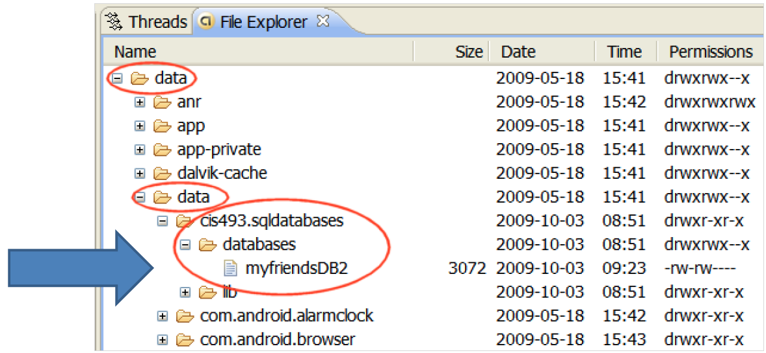
SQL Databases
Example2. Database is saved in the device's memory

Slide 12
SQL Databases
Executing SQL commands on the Database
Once created, the database is ready for normal operations such as:
creating, altering, dropping resources (tables, indices, triggers, views, queries
etc.) or administrating database resources (containers, users,...).
Action queries and Retrieval queries represent the most common operations
against the database.
• A retrieval query is typically a SQL-Select command in which a table holding
a number of fields and rows is produced as an answer to a data request.
• An action query usually performs maintenance and administrative tasks
such as manipulating tables, users, environment, etc.
13

Slide 13
SQL Databases
Transaction Processing
Transactions are desirable because they contribute to maintain
consistent data and prevent unwanted losses due to abnormal
termination of execution.
In general it is convenient to process action queries inside the
protective frame of a database transaction in which the policy of
"complete success or total failure" is transparently enforced.
This notion is called: atomicity to reflect that all parts of a method
are fused in an indivisible-like statement.

Slide 14
SQL Databases
Transaction Processing
The typical Android way of running transactions on a SQLiteDatabase is
illustrated in the following fragment (Assume db is defined as a SQLiteDatabase)
db.beginTransaction();
try {
//perform your database operations here ...
db.setTransactionSuccessful(); //commit your changes
}
catch (SQLiteException e) {
//report problem
}
finally {
db.endTransaction();
}
The transaction is defined between the methods: beginTransaction and
endTransaction. You need to issue the setTransactionSuccessful() call to commit
any changes. The absence of it provokes an implicit rollback; consequently the
database is reset to the state previous to the beginning of the transaction

Slide 15
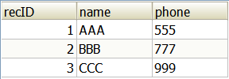
SQL Databases
Creating-Populating a Table
SQL Syntax for the creating and populating of a table looks like this:
create table tblAMIGO(
recID integer PRIMARY KEY autoincrement,
name text,
phone text );
insert into tblAMIGO(name, phone) values ('AAA', '555' );

Slide 16
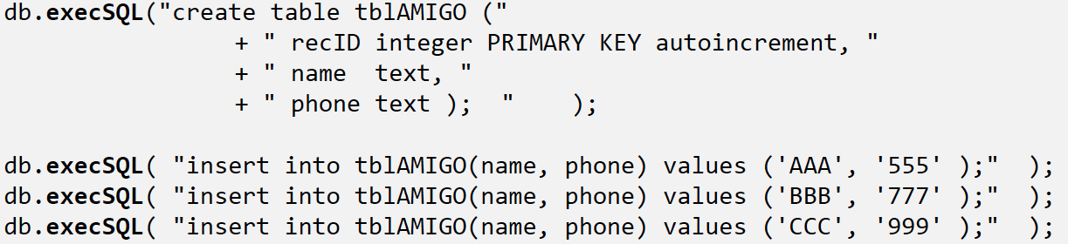
SQL Databases
Creating-Populating a Table
We will use the execSQL(...) method to manipulate SQL action queries. The following example creates a new table called tblAmigo.
The table has three fields: a numeric unique identifier called recID, and two string fields representing our friend's name and phone. If a table with such a name exists it is first dropped and then created anew. Finally three rows are inserted in the table.
Note: for presentation economy we do not show the entire code which should include a transaction frame.

Slide 17

SQL Databases
Creating-Populating a Table
Comments
1. The field recID is defined as PRIMARY KEY of the table. The "autoincrement"
feature guarantees that each new record will be given a unique serial
number (0,1,2,...).
2. The database data types are very simple, for instance we will use:
text, varchar, integer, float, numeric, date, time, timestamp, blob, boolean,
and so on.
1. In general, any well-formed SQL action command (insert, delete, update,
create, drop, alter, etc.) could be framed inside an execSQL(...) method.
2. You should make the call to execSQL inside of a try-catch-finally block. Be
aware of potential SQLiteException situations thrown by the method.

Slide 18
1
SQL Databases
Creating-Populating a Table
NOTE:
SQLITE uses an invisible field called ROWID to uniquely
identify each row in each table.
Consequently in our example the field: recID and the
database ROWID are functionally similar.

Slide 19
SQL Databases
Asking SQL Questions
1. Retrieval queries are SQL-select statements.
2. Answers produced by retrieval queries are always held in an output table.
3. In order to process the resulting rows, the user should provide a cursor
device. Cursors allow a row-by-row access of the records returned by the
retrieval queries.
Android offers two mechanisms for phrasing SQL-select statements:
rawQueries and simple queries. Both return a database cursor.
1. Raw queries take for input a syntactically correct SQL-select statement. The
select query could be as complex as needed and involve any number of
tables (remember that outerjoins are not supported).
2. Simple queries are compact parametized select statements that operate on
a single table (for developers who prefer not to use SQL).

Slide 20
SQL Databases
SQL Select Syntax (see http://www.sqlite.org/lang.html)
SQL-select statements are based on the following components
select field1, field2, … , field_{n}
from table1, table2, … , table_{n}
where ( restriction-join-condition )
order by field_{n1}, …, field_{nm}
group by field_{m1}, … , field_{mk}
having (group-condition)
The first two lines are mandatory, the rest is optional.

Slide 21
SQL Databases
SQL Select syntax
Examples
select LastName, cellPhone
from ClientTable
where state = ‘Ohio’
order by LastName
select city, count(*) as TotalClients
from ClientTable
group by city

Slide 22
SQL Databases
Examplel. Using RawQuery (version 1)
Consider the following code fragment
Cursor cl = db.rawQuery(
"select count(*) as Total from tblAMIGO",
null);
1. The previous rawQuery contains a select-statement that counts the rows in the table
tblAMIGO.
2. The result of this count is held in a table having only one row and one column. The
column is called "Total".
The cursor cl will be used to traverse the rows (one!) of the resulting table.
4. Fetching a row using cursor cl requires advancing to the next record in the answer set.
5. Later the (singleton) field total must be bound to a local Java variable.
We soon will show how to do that

Slide 23
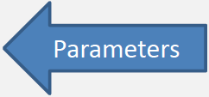
SQL Databases
Example2. Using Parameterized RawQuery (version 2)
Using arguments. Assume we want to count how many friends are there
whose name is 'BBB' and their recID > 1. We could use the following
construction
String mySQL = "select count(*) as Total "
+ " from tblAmigo "
+ " where recID > ? "
+ " and name = ? ";
String[] args = {"1", "BBB"};
Cursor cl = db.rawQuery(mySQL, args);

Slide 24
SQL Databases
Example2. Using Parameterized RawQuery (version 2)
Using arguments.
After the substitutions are made the resulting SQL statement is:
select count(*) as Total
from tblAmigo
where recID > 1
and name = ‘BBB’
NOTE:
Partial matching using expressions such as: name like '?%' are not working now. Wait
for an Android fix! (see similar issue: http://code.google.com/p/android/issues/detail?id=2619)
Similarly String.format...) fails to properly work in cases such as: name like '%s%'.
note the second % is the SQL wild-character symbol, not an invalid string format!

Slide 25
SQL Databases
Example2. Using RawQuery (version 3)
Using arguments. Assume we want to count how many friends are there
whose name is 'BBB' and their recID > 1. We could concatenate pieces of the
string. Special care around (single) quoted strings.
String[] args = {"1", "BBB"};
String mySQL = " select count(*) as Total "
+ " from tblAmigo "
+ " where recID > " + args[0]
+ " and name = '" + args[l] + "'";
Cursor cl = db.rawQuery(mySQL, null);

Slide 26
SQL Databases
Simple Queries
Simple queries use a template implicitly representing a condensed version of a
typical (non-joining) SQL select statement. No explicit SQL statement is made.
Simple queries can only retrieve data from a single table.
The method's signature has a fixed sequence of seven arguments representing:
1. the table name,
2. the columns to be retrieved,
3. the search condition (where-clause),
4. arguments for the where-clause,
5. the group-by clause,
6. having-clause, and
7. the order-by clause.

Slide 27
SQL Databases
Simple Queries
The signature of the Android's simple query method is:
query( String table,
String[] columns,
String selection,
String[] selectionArgs,
String groupBy,
String having,
String orderBy )

Slide 28
SQL Databases
Simple Queries. Example 1
Query the EmployeeTable, find the average salary of female employees
supervised by123456789. Report results by Dno. List first the highest average,
and so on, do not include depts. having less than two employees.
String[] columns =
{"Dno","Avg(Salary) as AVG"};
String[] conditionArgs=
{"F","123456789"};
Cursor c = db.query(
"EmployeeTable",
columns,
"sex = ? And superSsn= ? " ,
conditionArgs,
"Dno",
"Count(*) > 2",
"AVG Desc"
);
← table name
← columns
← condition
← condition args
← group by
← having
← order by

Slide 29
SQL Databases
Simple Queries. Example 2
The following query selects from each row of the tbIAMIGO table the columns:
recID, name, and phone. RecID must be greater than 2, and names must begin
with 'B' and have three or more letters.
String [] columns = {"recID", "name", "phone"};
Cursor c1 = db.query(
"tblAMIGO",
columns,
"recID > 2 and length(name) >= 3 and name like 'B%' ",
null, null, null,
"recID" );
int theTotal = c1.getCount();

Slide 30

SQL Databases
Simple Queries. Example 2 (cont.)
1. The String array columns holds the name of fields to be selected.
2. The retrieval condition is explicitly provided.
3. Several fields are missing in the call including: selectionArgs, group-by, and
having-clause. Instead the null value is used to signal their absence.
4. The last argument indicates the result should be sorted on "recID"
sequence.
String [] columns = {"recID", "name", "phone"};
Cursor cl = db.query (
"tbIAMIGO",
columns,
"recID > 2 and length(name) >= 3 and
name like 'B%' ",
null, null, null,
"recID" );

Slide 31
SQL Databases
Simple Queries. Example 3
In this example we will construct a more complex SQL select statement.
We are interested in tallying how many groups of friends whose recID > 3
have the same name. In addition, we want to see 'name' groups having no
more than four people each.
A possible SQL-select statement for this query would be something like:
select name,count(*) as TotalSubGroup
from tblAMIGO
where recID > 3
group byname
having count(*)<= 4;

Slide 32
SQL Databases
Simple Queries. Example 3 (cont.)
An Android solution for the problem using a simple template query follows.
String [] selectColumns = {"name", "count(*) as TotalSubGroup"};
String whereCondition = "recID > ?";
String [] whereConditionArgs = {"3"};
String groupBy = "name";
String having = "count(*) <= 4";
String orderBy = "name";
Cursor myCur = db.query (
"tblAMIGO",
selectColumns,
whereCondition, whereConditionArgs,
groupBy,
having,
null );

Slide 33
SQL Databases
Simple Queries. Example 3 (cont.)
Observations
1. The selectColumns array indicates two fields name which is already part of
the table, and TotalSubGroup which is to be computed as the count(*) of
each name sub-group.
2. The symbol ? in the whereCondition is a place-marker for a substitution. The
value "3" taken from the whereConditionArgs is to be injected there.
3. The groupBy clause uses 'name' as a key to create sub-groups of rows with
the same name value. The having clause makes sure we only choose
subgroups no larger than four people.

Slide 34
SQL Databases
Cursors
Android cursors are used to gain (random) access to tables produced by SQL
select statements.
Cursors primarily provide one row-at-the-time operations on a table.
Cursors include several types of operator, among them:
1. Positional awareness operators (isFirst(), isLast(), isBeforeFirst(), isAfterLast()),
Record Navigation (moveToFirst(), moveToLast(), moveToNext(), moveToPrevious(),
move(n))
3. Field extraction (getlnt, getString, getFloat, getBlob, getDate, etc.)
4. Schema inspection (getColumnName, getColumnNames, getColumnlndex,
getColumnCount, getCount)

Slide 35
SQL Databases
Example 4. Cursors
1. The following example uses a cursor to handle the individual results of a SQL
statement.
2. The select-command extracts from the tblAMIGO table the values indicated
in the columns array, namely: recID, name, and phone.
3. The getColumnIndex method is called to determine the position of chosen
columns in the current row.
4. The getters: getInt, getString commands are used for field extraction.
5. The moveToNext command forces the cursor to displace from its before-first
position to the first available row.
6. The loop is executed until the cursor cannot be advanced any further.

Slide 36
SQL Databases
Example 4. Cursors
String [] columns ={"recID", "name", "phone"};
Cursor myCur = db.query("tbIAMIGO", columns,
null, null, null, null, "recID");
int idCol = myCur.getColumnIndex("recID");
int nameCol = myCur.getColumnIndex("name");
int phoneCol = myCur.getColumnIndex("phone");
while (myCur.moveToNext()) {
columns[0] = Integer.toString ((myCur.getInt(idCol)));
columns[1] = myCur.getString(nameCol);
columns[2] = myCur.getString(phoneCol);
txtMsg.append("\n" + columns[0] + " "
+ columns[1] + " "
+ columns[2] );
}

Slide 37
SQL Databases
SQL Action Queries
Action queries are the SQL way of performing maintenance operations on tables
and database resources (i.e. insert, delete, update, create table, drop,...).
Examples:
insert into tbIAmigos values ('Macarena', '555-1234');
update tbIAmigos set name = 'Maria Macarena' where phone = '555-1234';
delete from tbIAmigos where phone = '555-1234';
create table Temp ( column1 int, column2 text, column3 date );
drop table Temp;

Slide 38
SQL Databases
SQL Action Queries
Cursors provide READ_ONLY access to records.
2. Early versions of the Android SDK included cursor commands to sequentially
modify records. Those operators have been deprecated in Release 1.0.
3. Methods such as cursor.updatelnt(...) and cursor.deleteRow(...) are not valid
anymore.
4. Instead use an action SQL command in an execSQL(...) method (explained in
the next section).
39

Slide 39
SQL Databases
ExecSQL - Action Queries
Perhaps the simplest Android way to phrase a SQL action query is to 'stitch'
together the pieces of the SQL statement and give it to the execSQL(...) method.
As an example consider the following case
db.execSQL(
"update tblAMIGO set name = (name | | 'XXX') where phone >= '001' ");
this statement appends 'XXX' to the name of those whose phone number is equal
or greater than '001'.

Slide 40
SQL Databases
ExecSQL - Action Queries (cont.)
Consider the action query:
db.execSQL(
"update tbIAMIGO set name = (name | | 'XXX') where phone >= '001' ");
Alternatively, the SQL statement could be 'pasted' from pieces as follows:
String theValue = "..."; //some phone value goes here
db.execSQL( "update tblAMIGO set name = (name | | 'XXX') " +
" where phone >= ' " + theValue + " ' " );
The same strategy could be applied to other SQL statements such as:
"delete from ... where...", "insert into ....", etc.

Slide 41
SQL Databases
Other Android Solutions for Table Maintenance
Although they are not as general as the technique suggested in the previous
section, Android provides a number of additional methods to perform insert,
delete, update operations.
public long insert(String table,
String nullColumnHack,
ContentValues values )
public int update(String table,
ContentValues values,
String whereClause, String[] whereArgs )
public int delete(String table,
String whereClause, String[] whereArgs)

Slide 42
SQL Databases
Database insert Operator
public long insert(String table, String nullColumnHack, ContentValues values)
Convenient method for inserting a row into the database.
Parameters
table the table to insert the row into
nullColumnHack SQL doesn't allow inserting a completely empty row,
so if argument values is empty this column will
explicitly be assigned a NULL value.
values this map (name, value) contains the initial column
values for the row. The keys should be the column
names and the values the column values
Returns the row ID of the newly inserted row, or -1 if an error
occurred

Slide 43
SQL Databases
Example - Database insert Operator
1. ContentValues initialValues = new ContentValues();
initialValues.put("name", "ABC");
initialValues.put("phone", "101");
4. int rowPosition = (int) db.insert("tblAMIGO", null, initialValues);
5. initialValues.put("name", "DEF");
6. initialValues.put("phone", "202");
7. rowPosition = (int) db.insert("tblAMIGO", null, initialValues);
8. initialValues.clear();
9. rowPosition = (int) db.insert("tblAMIGO", null, initialValues);
10. rowPosition = (int) db.insert("tblAMIGO", "name", initialValues);

Slide 44
SQL Databases
Example - Database insert Operator - Comments
Lines 1-3 define the set of <key, values> called initialValues to be later inserted in a
record of the form <reclD, name, phone> . Remember that recID is an autoincremented
field. All this work is done to pre-assemble the record < ???, "ABCC", "101">. Here ???
will be the reclD field to be determined by the database when the record is accepted.
Line 4 requests the set of <key, values> held in initialValues to be added to the table
tblAMIGO. If the operation fails the insert method returns -1, otherwise the position of
the row identifier is returned.
Lines 5-7 define a new set of values to be used as input to the insert operator. The
record <???, "DEF", "202"> is placed after the row previously inserted in table tblAMIGO.
Line 9 resets the map to empty.
Line 10 attempts the insertion of an empty record. SQL rejects the operation and returns -1.
Line 11 is similar to the code in Line 10, however the presence of a nullColumnHack
variable ("name" in this case) makes SQL change its behavior; the row is generated
with null values everywhere except the key autonumber (recID).

Slide 45
SQL Databases
Database update Operator
public int update ( String table,
ContentValues values,
String whereClause, String[] whereArgs )
Convenient method for updating rows in the database.
Parameters
table the table to update in
values a map <name,value> from column names to new column values.
null is a valid value that will be translated to NULL.
whereClause the optional WHERE clause to apply when updating.
Passing null will update all rows.
Returns the number of rows affected

Slide 46
SQL Databases
Example - Database update Operator
We want to use the "update” method to express the SQL statement:
Update tbIAmigo set name = 'maria' where (recID > 2 and recID < 7)
Here are the steps to make the call using Android Update Method
1. String [] whereArgs = {"2","7" };
2. ContentValues updValues = new ContentValues();
3. updValues.put("name","Maria");
4. int recAffected =
db.update( "tbIAMIGO",
updValues,
"recID > ? and recID < ?",
whereArgs );

Slide 47
SQL Databases
Example/Comments - Database update Operator
Line 1 defines the String array holding the (two) arguments used by the
whereClause.
Lines 2-3 define and populate a map <key, value> to be used by the update
operator. The map expresses the idea "set given column to given value". In
our case the "name" field will acquire the value "maria".
Line 4 invokes the execution of the update operator. After completion it
returns the number of records affected by the update (0 If it fails).
In the example a filter is given to select the rows to be updated. In this case
the condition is "recID > ? and recID < ?". The ? symbols represent
placeholders for values supplied by the array whereArgs. After the
substitutions are made the new filter is: "recID > 2 and recID < 7".

Slide 48
SQL Databases
Database delete Operator
Convenient method for deleting rows in the database.
Parameters
table
whereClause
Returns
the table to delete from
the optional WHERE clause to apply when deleting. Passing
null will delete all rows.
the number of rows affected if a whereClause is passed in,
0 otherwise.
To remove all rows and get a count pass "1" as the whereClause.

Slide 49
SQL Databases
Example - Database delete Operator
Consider the following SQL statement:
Delete from tbIAmigo wehere recID > 2 and recID < 7
An equivalent version using the delete method follows:`
1. String [] whereArgs = {"2","7"};
2. recAffected = db.delete("tblAMIGO",
"recID > ? and recID < ?",
whereArgs);
Line 2 requests the deleting from the tblAMIGO of those records whose recID is in
between the values 2, and 7. The actual values are taken from the whereArgs
array shown in Line 1. The method returns the number of rows deleted after
executing the command.

Slide 50
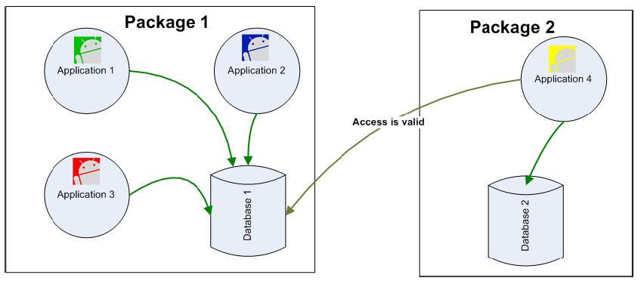
SQL Databases
Database Visibility
Any Application can access an SD stored database. All it's needed is knowledge
of the path where the database file is located. Other (ContentProvider) ways of
sharing will be explored later.
51

Slide 51
SQL Databases
Using SQLITE Command Line
The Android SDK contains a command line interface to SQLITE databases.
To open/Create a database use the command
C:> sqlite3 myNewDatabase
You may directly reach the Emulator's data folder and operate on existing
databases.
Assume an emulator is running.
We will use adb shell to tap in the emulator's internal memory

Slide 52
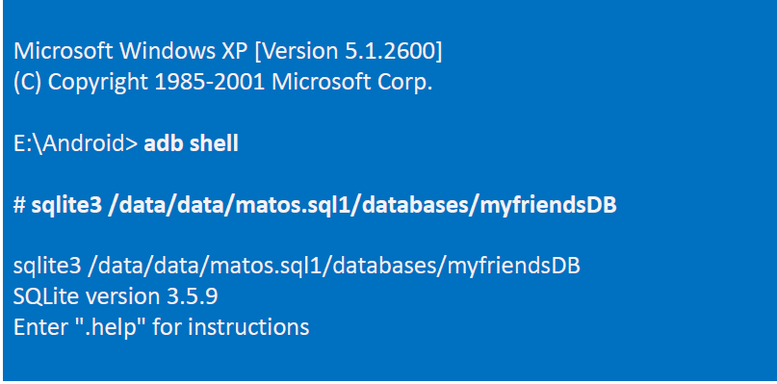
SQL Databases
Using SQLITE Command Line
After opening the DOS command window type the following commands:

Slide 53
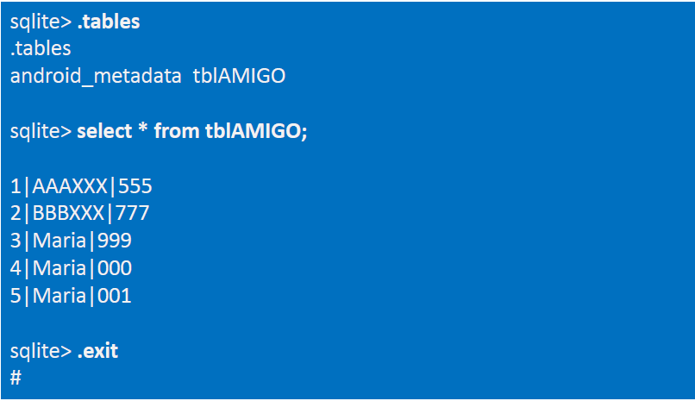
SQL Databases
Using SQLITE Command Line
After opening the DOS command window type the following commands:

Slide 54
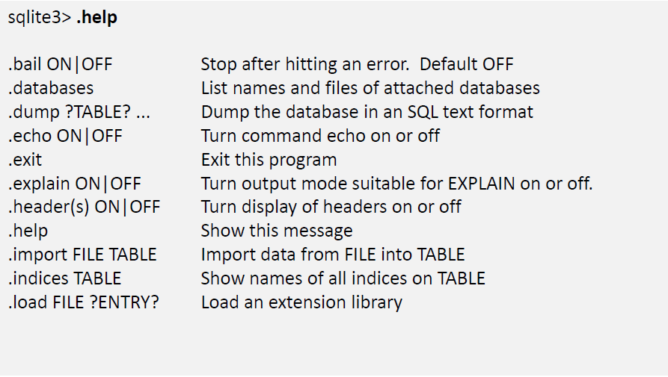
SQL Databases
Summary of SQLITE3 commands

Slide 55
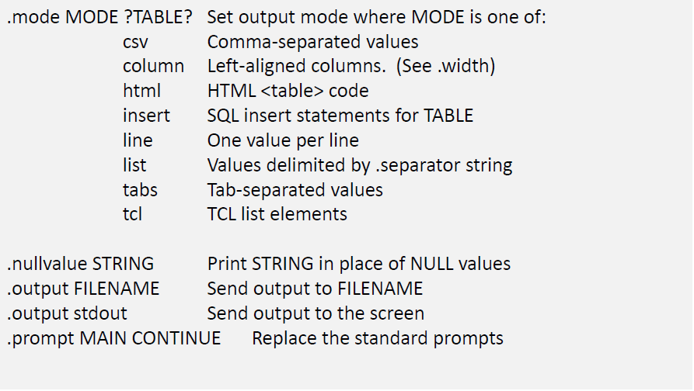
SQL Databases
Summary of SQLITE3 commands

Slide 56
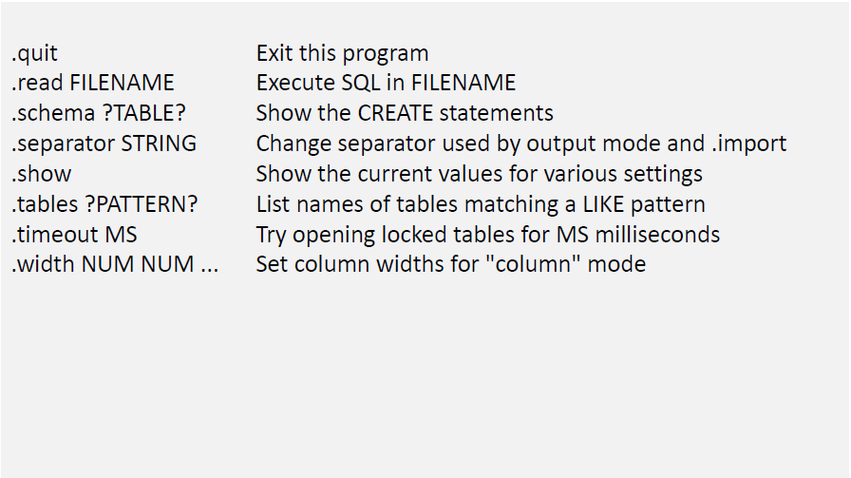
SQL Databases
Summary of SQLITE3 commands

Slide 57

SQL Databases
Using GUI Tools for SQLITE
In order to move a copy of the database in and out of the Emulator's storage
space and either receive or send the file into/from the local computer's file
system you may use the commands:
adb pull <full_path_to_database> and
adb push <full_path_to_database>.
You may also use the Eclipse's DDMS Perspective to
push/pull files in/out the emulator's file system.
Once the database is in your computer's disk you may manipulate the database
using a 'user-friendly' tool such as:
SQLite Manager (Firefox adds-on)
SQLite Administrator (http://sqliteadmin.orbmu2k.de)

Slide 58
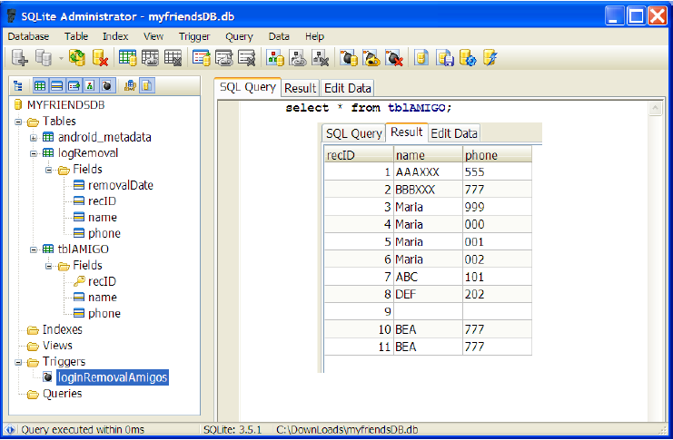
SQL Databases
Using SQLite Administrator

Slide 59
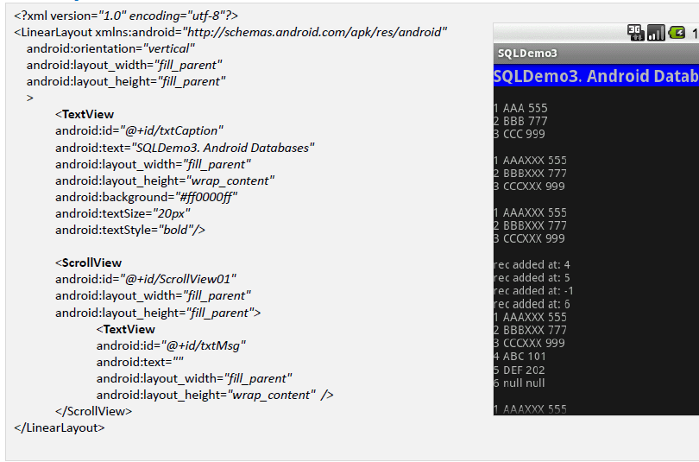
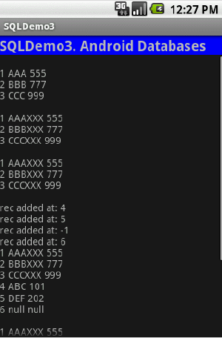
SQL Databases
Example: Complete Listing for Fragments

Slide 60
SQL Databases
Example: Complete Listing for Fragments
//USING ANDROID-SQLITE DATABASES
package com.example.sqldatabases;
import android.app.Activity;
import android.content.ContentValues;
import android.database.Cursor;
import android.database.SQLException;
import android.database.sqlite.SQLiteDatabase;
import android.database.sqlite.SQLiteException;
import android.os.Bundle;
import android.widget.TextView;
import android.widget.Toast;
public class SQLDemo3 extends Activity {
SQLiteDatabase db;
TextView txtMsg;
@Override
public void onCreate(Bundle savedlnstanceState) {
super.onCreate(savedlnstanceState);
setContentView(R.layout.main);
txtMsg = (TextView) findViewByld(R.id.txtMsg);

Slide 61
SQL Databases
Exampl6: Complete Listing for Fragments
try {
openDatabase();
dropTable();
insertSomeDbData();
useRawQueryl()
useRawQuery2()
useRawQuery3()
useSimpleQueryl();
useSimpleQuery2();
useCursorl();
updateDB();
uselnsertMethod();
useUpdateMethod();
useDeleteMethod();
//open (create if needed) database
//if needed drop table tbIAmigos
//create-populate tbIAmigos
//fixed SQL with no arguments
//parameter substitution
//manual string concatenation
//simple query
//nontrivial 'simple query'
//retrieve rows from a table
//use execSQL to update
//use insert method
//use update method
//use delete method
db.close();//make sure to release the DB
Toast.makeText(this, "All done!",1).show();
} catch (Exception e) {
Toast.makeText(this, e.getMessage(),1).show();
}
}// onCreate

Slide 62
SQL Databases
Example: Complete Listing for Fragments [ openDatabase ]
private void openDatabase() {
try{
db= SQLiteDatabase.openDatabase(
"data/data/com.example.sqldatabases/myfriendsDB",
//"sdcard/myfriendsDB",
null,
SQLiteDatabase.CREATE_IF_NECESSARY);
Toast.makeText(this, "DB was opened!", 1).show();
}
catch(SQLiteException e) {
Toast.makeText(this, e.getMessage(), 1).show();
}
}//createDatabase

Slide 63
SQL Databases
Example: Complete Listing for Fragments [insertSomeDbData]
private void insertSomeDbData() {
//create table: tblAmigo
db.beginTransaction();
try{
db.execSQL("create table tblAMIGO("
+ " recIDvinteger PRIMARY KEY autoincrement, "
+ " name text, "
+ " phone text ); ");
//commit your changes
db.setTransactionSuccessful();
Toast.makeText(this, "Table was created",1).show();
} catch(SQLException e1) {
Toast.makeText(this, e1.getMessage(),1).show();
}
finally{
//finish transaction processing
db.endTransaction();
}

Slide 64
SQL Databases
Example: Complete Listing for Fragments [insertSomeDbData]
// populate table: tblAmigo
db.beginTransaction();
try{
//insert rows
db.execSQL( "insert into tblAMIGO(name, phone) "
+ " values ('AAA', '555' );");
db.execSQL("insert into tblAMIGO(name, phone) "
+ " values ('BBB', '777' );");
//commit your changes
db.setTransactionSuccessful();
Toast.makeText(this, “2 records were inserted",1).show();
}
catch(SQLiteException e2) {
//report problem
Toast.makeText(this, e2.getMessage(),1).show();
}
finally{
db.endTransaction();
}
}//insertSomeData

Slide 65
SQL Databases
Example: Complete Listing for Fragments [useRawQuery1]
private void useRawQueryl() {
try {
//hard-coded SQL-select command with no arguments
String mySQL ="select count (*) as Total from tblAMIGO";
Cursor cl = db.rawQuery(mySQL, null);
int index = cl.getColumnIndex("Total");
//advance to the next record (first rec. if necessary)
cl.moveToNext();
int theTotal = cl.getInt(index);
Toast.makeText(this, "Total1:“ + theTotal,1).show();
} catch (Exception e) {
Toast.makeText(this, e.getMessage(),1).show();
}
}//useRawQuery1

Slide 66
SQL Databases
Example: Complete Listing for Fragments [useRawQuery2]
private void useRawQuery2() {
try {
// ? arguments provided for automatic replacement
String mySQL = " select count(*) as Total "
+ " from tblAmigo "
+ " where recID > ? "
+ " and name = ? ";
String[] args = {"1", "BBB"};
Cursor cl = db.rawQuery(mySQL, args);
int index = cl.getColumnIndex("Total");
//advance to the next record (first rec. if necessary)
cl.moveToNext();
int theTotal = cl.getInt(index);
Toast.makeText(this, "Total2:" + theTotal,1).show();
} catch (Exception e) {
Toast.makeText(this, e.getMessage(),l).show();
}
}//useRawQuery2

Slide 67
SQL Databases
Example: Complete Listing for Fragments [useRawQuery3]
private void useRawQuery3() {
try{
//arguments injected by manual string concatenation
String[] args= {"1", "BBB"};
String mySQL= " select count(*) as Total "
+ " from tblAmigo"
+ " where recID > " + args[0]
+ " and name = '" + args[1] + "'";
Cursor c1 = db.rawQuery(mySQL, null);
int index = c1.getColumnIndex("Total");
//advance to the next record (first rec. if necessary)
c1.moveToNext();
int theTotal= c1.getInt(index);
Toast.makeText(this, "Total3: "+ theTotal, 1).show();
} catch(Exception e) {
Toast.makeText(this, e.getMessage(), 1).show();
}
}//useRawQuery3

Slide 68
SQL Databases
Example: Complete Listing for Fragments [simpleQuery1]
private void useSimpleQueryl() {
try {
//simple (implicit) query on one table
String [] columns = {"recID", "name", "phone"};
Cursor cl = db.query (
"tblAMIGO",
columns,
"recID > 2 and length(name) >= 3 and name like 'B%' ",
null, null, null,
"recID" );
int theTotal = cl.getCount();
Toast.makeText(this, "Total4:" + theTotal,l).show();
} catch (Exception e) {
Toast.makeText(this, e.getMessage(),l).show();
}
}//useSimpleQueryl

Slide 69
SQL Databases
Example: Complete Listing for Fragments [simpleQuery2]
private void useSimpleQuery2() {
try{
//nontrivial 'simple query' on one table
String [] selectColumns= {"name", "count(*) as TotalSubGroup"};
String whereCondition= "recID >= ?";
String [] whereConditionArgs= {"1"};
String groupBy= "name";
String having = "count(*) <= 4";
String orderBy= "name";
Cursor c = db.query("tblAMIGO",
selectColumns,
whereCondition, whereConditionArgs,
groupBy,
having,
orderBy);
int theTotal= c.getCount();
Toast.makeText(this, "Total5: "+ theTotal, 1).show();
} catch(Exception e)
{ Toast.makeText(this, e.getMessage(), 1).show(); }
}//useSimpleQuery2

Slide 70
SQL Databases
Example: Complete Listing for Fragments [ useCursor1 ]
private void useCursor1() {
try{
txtMsg.append("\n");
// obtain a list of <recId, name, phone> from DB
String[] columns = { "recID", "name", "phone"};
Cursor c = db.query("tblAMIGO", columns,
null, null, null, null, "recID");
int theTotal= c.getCount();
Toast.makeText(this, "Total6: "+ theTotal, 1).show();
int idCol= c.getColumnIndex("recID");
int nameCol= c.getColumnIndex("name");
int phoneCol= c.getColumnIndex("phone");
while(c.moveToNext()) {
columns[0] = Integer.toString((c.getInt(idCol)));
columns[1] = c.getString(nameCol);
columns[2] = c.getString(phoneCol);
txtMsg.append( columns[0] + " “ + columns[1] + " “
+ columns[2] + "\n");
}
} catch(Exception e)
{ Toast.makeText(this, e.getMessage(), 1).show(); }
}//useCursor1

Slide 71
SQL Databases
Example: Complete Listing for Fragments [ updateDB]
private void updateDB(){
//action query using execSQL
String theValue;
try {
theValue = "222";
db.execSQL ( " update tbIAMIGO "
+ " set name = (name || 'XXX') "
+ " where phone >= '" + theValue + "' " ) ;
useCursorl();
} catch (Exception e) {
Toast.makeText(this,"updateDB" + e.getMessage(), l).show();
}
useCursorl();
}

Slide 72
SQL Databases
Example: Complete Listing for Fragments [ dropTable]
private void dropTable(){
//(clean start) action query to drop table
try{
db.execSQL( " drop table tblAmigo; ");
Toast.makeText(this, "Table dropped", 1).show();
} catch(Exception e) {
Toast.makeText(this, "dropTable()\n"+ e.getMessage(), 1).show();
}
}// dropTable
Toast.makeText(this, e.getMessage(), 1).show();
}
}//dropTable

Slide 73
SQL Databases
Example: Complete Listing for Fragments [ uselnsertMethod ]
public void uselnsertMethod() {
ContentValues initialValues = new ContentValues();
initialValues.put("name", "ABC");
initialValues.put("phone", "101") ;
int rowPosition = (int) db.insert("tblAMIGO", null, initialValues);
txtMsg.append("\nrec added at: " + rowPosition);
initialValues.put("name", "DEF");
initialValues.put("phone", "202") ;
rowPosition = (int) db.insert("tblAMIGO", null, initialValues);
txtMsg.append("\nrec added at: " + rowPosition);
initialValues.clear();
rowPosition = (int) db.insert("tblAMIGO", null, initialValues);
txtMsg.append("\nrec added at: " + rowPosition);
rowPosition = (int) db.insert("tblAMIGO", "name", initialValues);
txtMsg.append("\nrec added at: " + rowPosition);
useCursorl();
}// uselnsertMethod

Slide 74
SQL Databases
Example: Complete Listing for Fragments [ useUpdateMethod]
private void useUpdateMethod() {
//using the update method to change name of selected friend
String [] whereArgs = {"2", "7"};
ContentValues updValues = new ContentValues();
updValues.put("name", "Maria");
int recAffected = db.update("tblAMIGO",
updValues,
"recID > ? and recID < ?",
whereArgs );
Toast.makeText(this, "Total!': " + recAffected,l).show();
useCursorl();
}

Slide 75
SQL Databases
Example: Complete Listing for Fragments [ useDeleteMethod ]
private void useDeleteMethod() {
//using the delete method to remove a group of friends
//whose id# is between 2 and 7
String [] whereArgs = {"2", "7"};
int recAffected = db.delete("tblAMIGO",
"recID > ? and recID < ?",
whereArgs);
Toast.makeText(this,"Total8:" + recAffected,l).show();
useCursorl();
}// useDeleteMethod
} //class

Slide 76
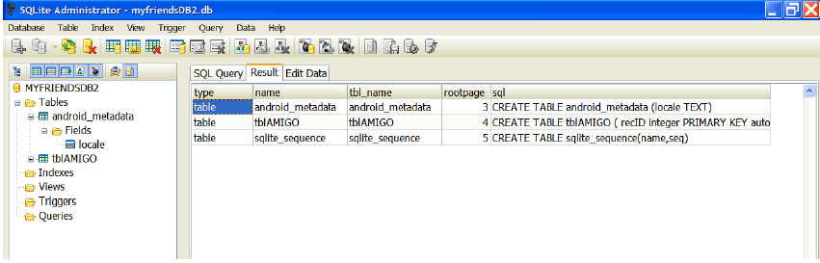
SQL Databases
Appendix 1: Database Dictionary - SQLITE Master Table
You may query the SQLITE master table (named: sqlite_master) looking for a
table, index, or other database object.
Example
select * from sqlite_master;

Slide 77
SQL Databases
Appendix 1: Database Dictionary - SQLITE Master Table
In Java code you may phrase the test for existence of a database object using
something similar to the following fragment
public boolean tableExists(SQLiteDatabase db, String tableName)
{
//true if table exists, false otherwise
String mySql = " SELECT name FROM sqlite_master "
+ " WHERE type='table'
+ " AND name='" + tableName + "'";
int resultSize = db.rawQuery(mySql, null).getCount();
if (resultSize ==0) {
return true;
} else
return false;
}

Slide 78
SQL Databases
Appendix 2: Convenient Database Command
In Java code you may phrase the request for "CREATE or REPLACE" a table using
the following safe construct:
db.execSQL("DROP TABLE IF EXISTS tableXYZ";

