Slide 1
JEE APPLICATION ARCHITECTURE
JEE Components
Java EE Clients
Web Components
Business Components
ORM

Slide 2
Java EE Components
Java EE applications are made up of components.
  A Java EE component is a self-contained functional software unit that is assembled into a Java EE application with its related classes and files and that communicates with other components.
The Java EE specification defines the following Java EE components:
  Application clients and Applets are components that run on the client.
  Web Components.
    Java Servlet,
    JavaServer Faces (JSF), and
    JavaServer Pages (JSP) technology components are web components that run on the server.
    EJB components (enterprise beans) are business components that run on the server.

Slide 3
Java EE Clients
A Java EE client is usually either a web client or an application client:
  Web Clients (Thin Client). A web client consists of two parts:
    Dynamic web pages containing various types of markup language (HTML, XML,and so on), which are generated by web components running in the web tier.
    A web browser, which renders the pages received from the server
  Application Clients. Runs on client machine (standalone):
    GUI (Swing and AWT) APIs
    FX API
  Applets. A web page received from the web tier can include an embedded applet.
    an applet is a small client application that executes in the Java virtual machine installed in the web browser

Slide 4
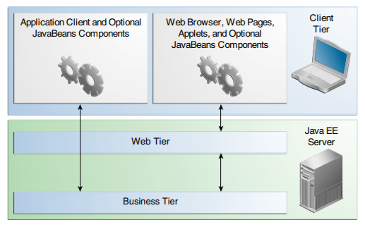
Server Communication: CLIENT
Clients: Web browser, Web pages, Applets

Slide 5
Web Components
Java EE web components are either servlets or web pages created using JavaServer Faces technology and/or JSP technology (JSP pages).
Servlets are Java programming language classes that dynamically process requests and construct responses.
JSP pages are text-based documents that execute as servlets but allow a more natural approach to creating static content.
JavaServer Faces (JSF) technology builds on servlets and JSP technology and provides a user interface component framework for web applications

Slide 6

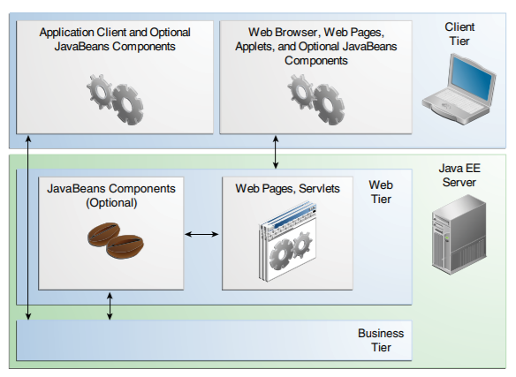
Web Tier and Java EE Applications

Slide 7
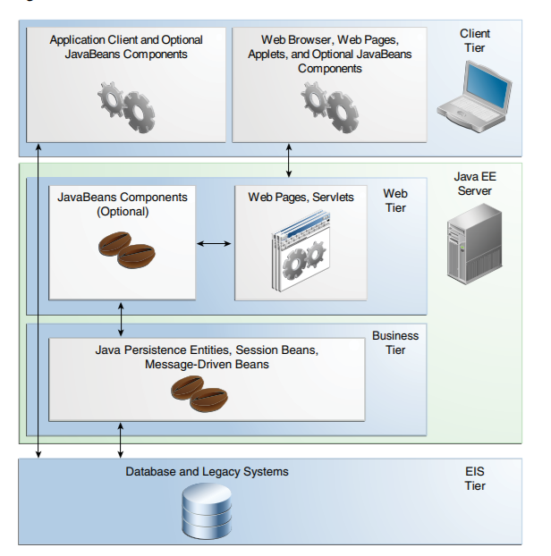
Business Components: EJB
Business Components. Business code, which is logic that solves or meets the needs of a particular business domain such as banking, retail, or finance, is handled by enterprise beans running in either the business tier or the web tier.

Slide 8
JEE Web Applications – Model 1
Model 1 – First Generation JEE
  No Servlets
  JSP compiles into a Servlet
  Request from browser to JSP
  JSP calls Model Layer
Browser
JSP1
JSP2
Model

Slide 9
JEE Web Applications – Model 2
Browser
Servlet Driven
MVC
  Front Controller Pattern
  Application Controller – business logic implementation
  Data Layer – database or calls to other systems using:
    JMS (queue messages) or
    Web Services using HTTP (JAXB, JAX-RS, JAX-WS)
Servlet 1
Servlet 2
View 2
View 2
Model

Slide 10
Business Logic Layer
Provides abstractions of entities
  e.g. students, instructors, courses, etc
Enforces business rules for carrying out actions
  E.g. student can enroll in a class only if she has completed prerequsites, and has paid her tuition fees
Supports workflows which define how a task involving multiple participants is to be carried out
  E.g. how to process application by a student applying to a university
  Sequence of steps to carry out task
  Error handling
    e.g. what to do if recommendation letters not received on time
  Workflows discussed in Section 26.2

Slide 11
Object-Relational Mapping
Allows application code to be written on top of object-oriented data model, while storing data in a traditional relational database
  alternative: implement object-oriented or object-relational database to store object model
Schema designer has to provide a mapping between object data and relational schema
  e.g. Java class Student mapped to relation student, with corresponding mapping of attributes
  An object can map to multiple tuples in multiple relations
Application opens a session, which connects to the database
Objects can be created and saved to the database using session.save(object)
  mapping used to create appropriate tuples in the database
Query can be run to retrieve objects satisfying specified predicates

Slide 12
MVC
Model-View-Controller (MVC) frameworks also use Observer pattern where Model is the Subject and Views are observers that can register to get notified of any change to the model

Slide 13
Model-View-Controller
MVC Pattern
  Decouples views and models by establishing subscribe / notify protocol between them
  Views represent the state of the model
  Model contains data values
  Controller mediates between views and model
  See MVC Next Slide
<number>/

Slide 14
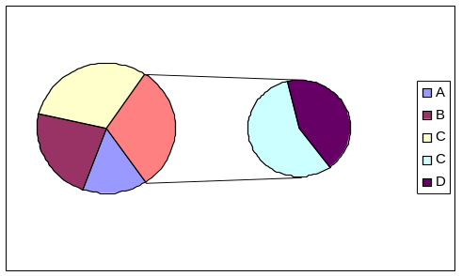
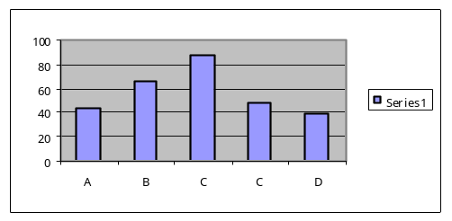
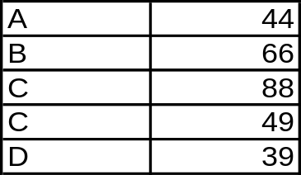
MVC Example of Design Patterns
View
Model
A=50%
B=30%
C=55%
MVC Architecture
  The model object holds the information
  Views objects draw the visible parts of the view (or do something else)
    Display number in tables
    Display a bar chart
  Each view has a controller which is an object that processes user interaction
    Mouse or keyboard events
<number>/

Slide 15
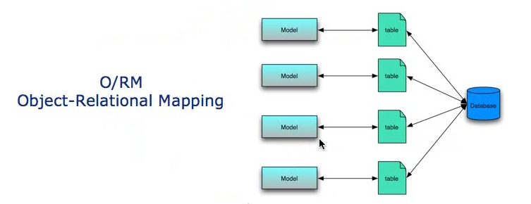
The Model Object
represent the state, what the current data is the database, does it need to be updated. also the model code represent the relationships between tables (m-m)
Code that interacts directly with the db and maintains the state of the db
a model corresponds directly to a table in a db. Elements in the table corresponds to attributes in the model class
4 tables for example corresponds to 4 models
Object Relation Mapping OR/M
<number>/

Slide 16
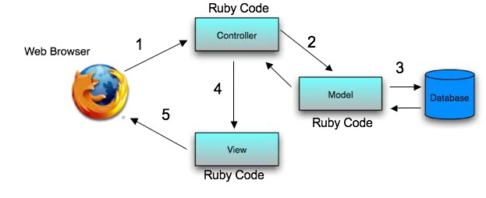
The View and Controller Objects
View Object
  generates the code that the web browser renders
  html, javascript and other presentation technologies
Controller object
  The code that coordinates between the Model and the views
  controls which model to invoke and which view to show
  Called by the web browser
<number>/

Slide 17
MVC
web browser calls the Controller
Controller interacts with the model
the model interacts with the database
database respond back to the controller
views are generated and a respond sent back to the web browser
<number>/

Slide 18
MVC – Oracle ADF
Oracle Application Development Framework
  The model layer represents the business information needed by the application,
  The controller layer handles user input, interfaces with the model layer, and picks the presentation
  The view layer presents the model data to the end-user.
The model layer consists of one or more business services that expose application functionality and access to model data through a business service interface that is easy to test.
These business services, in turn, rely on query components to retrieve that data and on business objects to validate and persist any new or modified data.
Code implementing the business delegate design pattern abstracts the details of locating and using the business services.
<number>/

Slide 19
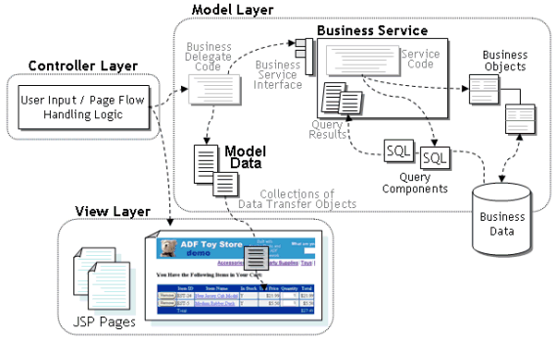
MVC – Oracle ADF
<number>/

Slide 20
Application Architectures
Application layers
  Presentation or user interface
    model-view-controller (MVC) architecture
      model: business logic
      view: presentation of data, depends on display device
      controller: receives events, executes actions, and returns a view to the user
  business-logic layer
    provides high level view of data and actions on data
      often using an object data model
    hides details of data storage schema
  data access layer
    interfaces between business logic layer and the underlying database
    provides mapping from object model of business layer to relational model of database

Slide 21

Application Architecture

