Slide 1
Java Platform, Enterprise Edition -Java EE
Server-Side Scripting
Java Beans

Slide 2
JSP Demo
JavaBeans. In computing based on the Java Platform, JavaBeans are classes that encapsulate many objects into a single object (the bean).
They are serializable,
have a zero-argument constructor, and
allow access to properties using getter and setter methods.
https://en.wikipedia.org/wiki/JavaBeans
Using JavaBeans in JSP
“A Java Bean is a reusable software component that can be manipulated visually in a builder tool.”

Slide 3
What Are Beans?
Java classes that follow certain conventions:
Must have a zero-argument (empty) constructor
You can satisfy this requirement either by explicitly defining such a constructor or by omitting all constructors
Should have no public instance variables (fields)
You should already follow this practice and use accessor methods instead of allowing direct access to fields
Persistent values should be accessed through methods called getXxx and setXxx
If class has method getTitle that returns a String, class is said to have a String property named title
Boolean properties may use isXxx instead of getXxx • It is the name of the method, not instance var that matters!
For more on beans, see http://www.oracle.com/technetwork/articles/javaee/spec-136004.html

Slide 4
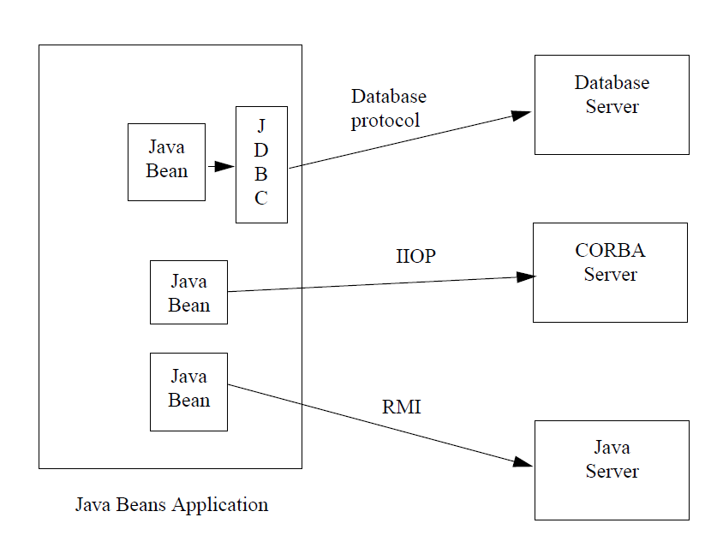
Properties, events, and methods
The three most important features of a Java Bean are:
the set of properties it exposes,
the set of methods it allows other components to call, and
the set of events it fires.

Slide 5
Using JavaBeans in JSP
Normally you create an instance of a class in a program and use it in that program. This method is for sharing the class, not the object.
JSP allows you to share the object of a class among different pages. To enable an object to be shared, its class must be a JavaBean’s component.
This entails the following three features:
The class is public.
The class has a public constructor with no arguments.
The class is serializable.

Slide 6
JavaBeans
To create an instance for a JavaBeans component, use the following syntax:
<jsp:useBean id = "objectName" scope = "scopeAttribute“ class = "ClassName" />
This syntax is roughly equivalent to:
<% ClassName objectName = new ClassName() %>

Slide 7
<!-- TestBeanScope.jsp -->
<%@ page import = "Count" %>
<jsp:useBean
id = "count" scope = "application“ class = "Count">
</jsp:useBean>
<html>
….
<body>
<h3>Testing Bean Scope in JSP (Application)</h3>
<% count.increaseCount(); %>
You are visitor number <%= count.getCount() %><br />
From host: <%= request.getRemoteHost() %>
and session: <%= session.getId() %>
</body>
</html>
The scope attribute specifies the scope of the bean. scope=”application” specifies that the bean is alive in the JSP engine and
available for all clients to access.
The bean can be shared by any client with the directive <jsp:useBean id="count" scope="application“ class="Count" >

Slide 8
Scope: Application
Every client accessing TestBeanScope.jsp causes the count to increase by 1.
The first client causes count object to be created, and subsequent access to TestBeanScope uses the same object.
If scope="application" is changed to scope="session", the scope of the bean is limited to the session from the same browser.
The count will increase only if the page is requested from the same browser.
If scope="application" is changed to scope="page", the scope of the bean is limited to the page, and any other page cannot access this bean.
The page will always display count 1.

Slide 9
Getting and Setting Properties
You can get the property in JSP using the syntax shown below:
<jsp:getProperty name = "beanId" property = "sample" />
This is roughly equivalent to <%= beanId.getSample() %>
You can set the property in JSP using the following syntax:
<jsp:setProperty name = "beanId“ property = "sample" value = "test1" />
This is equivalent to
<% beanId.setSample("test1"); %>

Slide 10
Associating Properties with Input Parameters
Suppose you want to get the value of the input parameter named score and set it to the JavaBeans property named score. You could write the following code:
<% double score = Double.parseDouble(request.getParameter("score")); %>
<jsp:setProperty name = "beanId" property = "score“ value = "<%= score %>" />
This is cumbersome. JSP provides a convenient syntax that can be used to simplify it:
<jsp:setProperty name = "beanId" property = "score" param = "score" />
In CalculateLoan2.jsp
associates the bean properties loanAmount, annualInteresteRate, and numberOfYears with the input parameter values and performs type conversion automatically.

Slide 11
<!-- ComputeLoan2.jsp -->
Often the bean property and the parameter have the same name. You can use the following convenient statement to associate all the bean properties in beanId with the parameters that match the property names: <jsp:setProperty name = "beanId" property = "*" />
<html> <head> <title>ComputeLoan Using the Loan Class</title> </head>
<body>
<%@ page import = "chapter43.Loan" %>
<jsp:useBean id = "loan" class = "chapter43.Loan“ scope = "page" ></jsp:useBean>
<jsp:setProperty name = "loan" property = "*" />
Loan Amount: <%= loan.getLoanAmount() %><br />
Annual Interest Rate: <%= loan.getAnnualInterestRate() %><br />
Number of Years: <%= loan.getNumberOfYears() %><br />
<b>Monthly Payment: <%= loan.monthlyPayment() %><br />
Total Payment: <%= loan.totalPayment() %><br /></b>
</body></html>

Slide 12
Factorial Example
Factorial Bean
Following the preceding design guide, you may improve the preceding
example by moving the Java code in lines 23–25 to the FactorialBean class.
The new FactorialBean.java and FactorialBean.jsp are given in Listings newFactorialBean.jsp and .

Slide 13
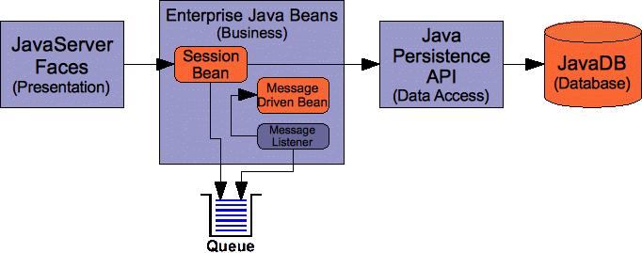
More Bean Types
Session Bean
Message Driven Bean

Slide 14
JSF
JSF applications are developed using the Model-View-Controller (MVC) architecture, which separates the application’s data (contained in the model) from the graphical presentation (the view).
The controller is the JSF framework that is responsible for coordinating interactions between view and the model.
In JSF, the facelets are the view for presenting data.
Data are obtained from Java objects.
Objects are defined using Java classes.
In JSF, the objects that are accessed from a facelet are JavaBeans objects

Slide 15
JSF Example
Example to develop a JSF facelet to display current time. We will create JavaBean with a getTime() method that returns the current time as a string. The facelet will invoke this method to obtain current time.
CurrentTime.xhtml
<?xml version='1.0' encoding='UTF-8' ?>
<!DOCTYPE html PUBLIC "-//W3C//DTD XHTML 1.0 Transitional//EN"
"http://www.w3.org/TR/xhtml1/DTD/xhtml1-transitional.dtd">
<html xmlns="http://www.w3.org/1999/xhtml"
xmlns:h="http://java.sun.com/jsf/html">
<h:head><title>Display Current Time</title></h:head>
<h:body>
The current time is #{timeBean. getTime() }
</h:body>
</html>

Slide 16
TimeBean.java
import javax.faces.bean.ManagedBean;
import javax.faces.bean.RequestScoped;
@ManagedBean
@RequestScoped
public class TimeBean {
public String getTime() {
return new java.util.Date().toString();
}
}
JSF framework will create and manage the TimeBean objects used in the application.

Slide 17
timeBean
JSF expression #{timeBean.time} to obtain the current time.
timeBean is an object of the TimeBean class.
The object name can be changed in the @ManagedBean annotation using the following syntax:
@ManagedBean(name="anyObjectName")
By default the object name is the class name with the first letter in lowercase.
The syntax of a JSF expression is:
#{expression}
JSF expressions bind JavaBeans objects with facelets.

Slide 18
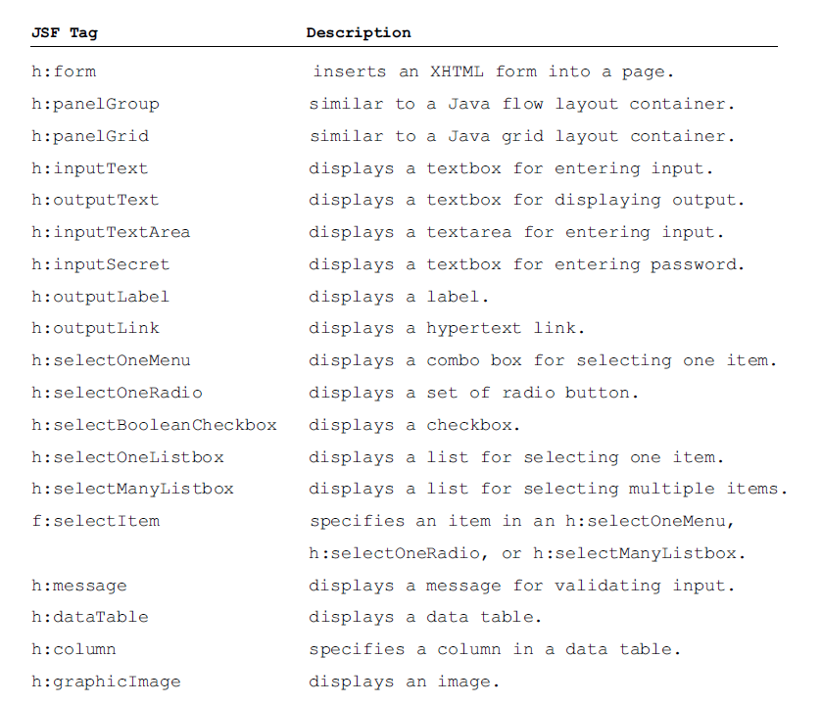
JSF GUI Components
JSF provides many elements for displaying GUI components.
The tags with the h prefix are in the JSF HTML Tag library.
The tags with the f prefix are in the JSF Core Tag library.

Slide 19
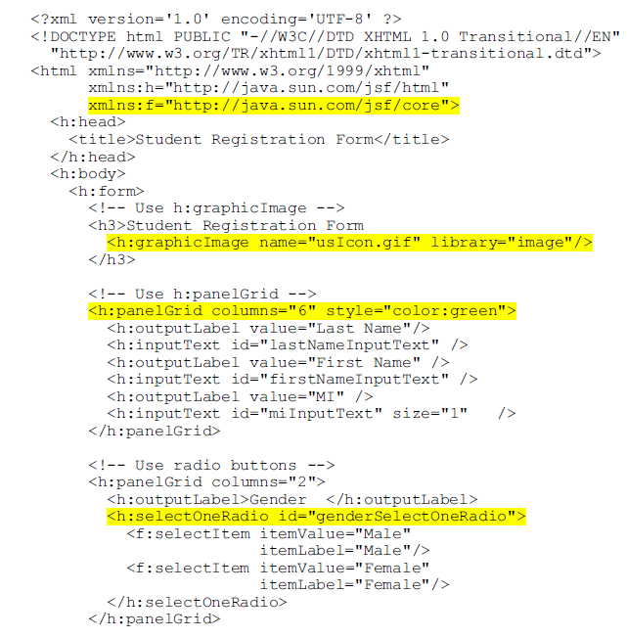
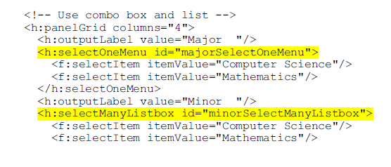
StudentRegistrationForm.xhtml (1/2)

Slide 20
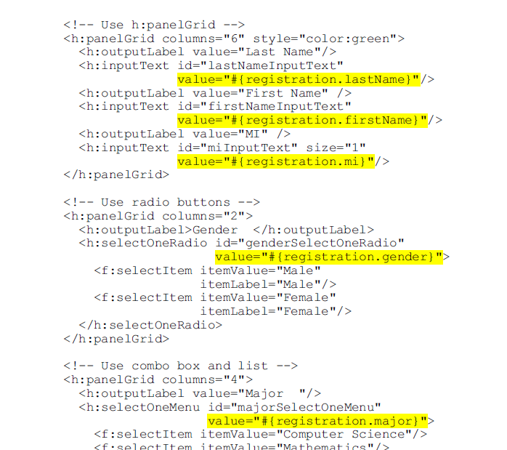
StudentRegistrationForm.xhtml (2/2)
ProcessStudentRegistrationForm.xhtml

Slide 21
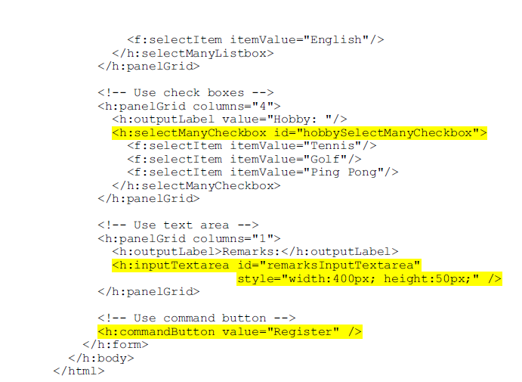

Slide 22
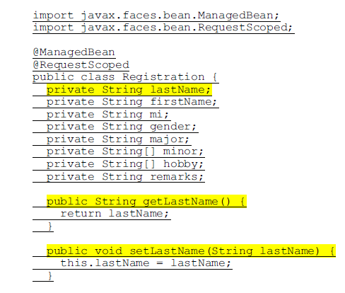
Processing the Form
To obtain input from the form, simply bind each input element with a property in a managed bean.
Here is the managed bean named Registration
…
public String getResponse() {
if (lastName == null)
return ""; // Request has not been made
else {
String allMinor = "";
for (String s: minor) { allMinor += s + " "; }
String allHobby = "";
for (String s: hobby) { allHobby += s + " "; }
return "<p style=\"color:red\">You entered <br />" +
"Last Name: " + lastName + "<br />" +
"First Name: " + firstName + "<br />" +
"MI: " + mi + "<br />" +
"Gender: " + gender + "<br />" +
"Major: " + major + "<br />" +
"Minor: " + allMinor + "<br />" +
"Hobby: " + allHobby + "<br />" +
"Remarks: " + remarks + "</p>";
}}}

Slide 23
ProcessStudentRegistrationForm.xhtml

Slide 24
JSP, Java beans and jdbc
example

Slide 25
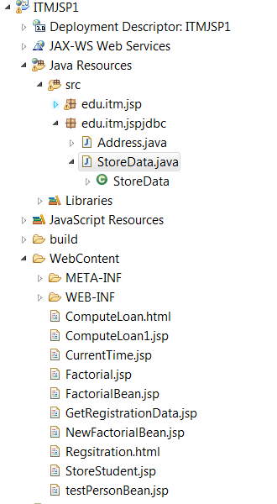
JSP/BEANS/JDBC Example
See package edu.itm.jspjdbc:
Address.java (bean)
StoreData.java (bean)
Regsieration.html
GetRegsitrationData.jsp
StoreStudent.jsp

Slide 26
Jave server faces (JSF)
You need to know XHTML (eXtensible HyperText Markup Language) and CSS (Cascading Style Sheet) to start this chapter.

Slide 27
Java Server Faces (JSF)
Servlets
The use of servlets, introduced in so far, is the foundation of the Java Web technology.
It is a primitive way to write server-side applications.
JSP
provides a scripting capability and allows you to embed Java code in XHTML.
It is easier to develop Web programs using JSP than servlets.
However, JSP has some problems.
It can be very messy, because it mixes Java code with HTML.
Using JSP to develop user interface is tedious.
Java Server Faces (JSF)
JSF enables you to completely separate Java code from HTML.
You can quickly build web applications by assembling reusable UI components in a page, connecting these components to Java programs, and wiring client-generated events to server-side event handlers.
The application developed using JSF is easy to debug and maintain.

