Slide 1
A set of human actions that contributes to a functional objective and to the goal of the system.
Scope or size of a task is determined by the definition of the objectives.
Each task should be approximately equal in size.
    But not always the case
What’s a Task

Slide 2
Task Decomposition
Goal
Task
Action

Slide 3
Goal - state of the system that a human wants to accomplish.
Task - activities required, used, or deemed necessary to achieve a goal.
Actions - steps required to complete the task.
Definitions

Slide 4
Develop concrete, detailed examples of tasks, users perform or want to perform.
Determine what the user wants to do, not how to do it.
    No assumptions about interface
    Allows design alternatives
    Task descriptions are very specific
    Task descriptions are context-specific
    Task descriptions are user-specific
Task Analysis

Slide 5
0.
make
cups
of
tea
plan
0.
do
1
at
the
same
time,
if
the
pot
is
full
2
then
3
-
4
after
4/5
minutes
do
5
1.
2.
3.
4.
wait
4
or
5
5.
boil
water
empty
pot
make
pot
minutes
pour
tea
Task Steps Example 1
plan
5.
plan
1.
5.1.
put
milk
5.2.
fill
cup
5.3.
in
cup
with
tea
do
sugar
plan
3.
plan
5.3.
3.1.
3.2.
3.3.
5.3.1.
5.3.2.
put
tea
leaves
pour
in
ask
guest
add
sugar
warm
pot
in
pot
boiling
water
about
sugar
to
taste
1.1.
1.2.
put
kettle
1.3.
1.4.
1.5.
fill
kettle
on
stove
turn
on
and
wait
for
kettle
turn
off
gas
light
gas
to
boil

Slide 6
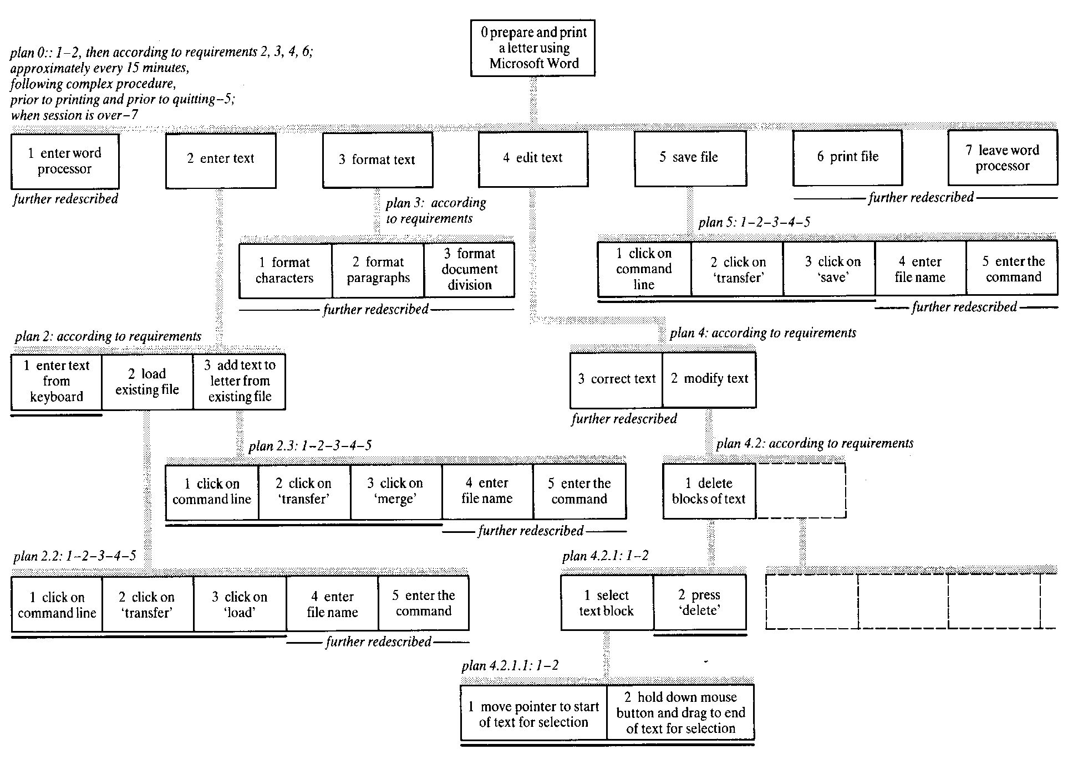
Task Steps Example 2

