Slide 1
Structure & Style
HTML & CSS
Week 2

Slide 2
Hello, HTML!
What?
<tags> vs content
<p> is for paragraph </p>
<!– Comments -->
<h1>Headings</h1><a>Anchors</a>, <li><ul>Lists</ul></li>
Generalizations
<html> wrapper tags
Indentation
Save often

Slide 3
The DOM and Trees
elements
Make up the DOM
Tree diagrams
Helpful for hierarchical visualization

Slide 4
HTML Validation
If at first you don’t succeed. Let the computer try.
https://validator.w3.org/

Slide 5
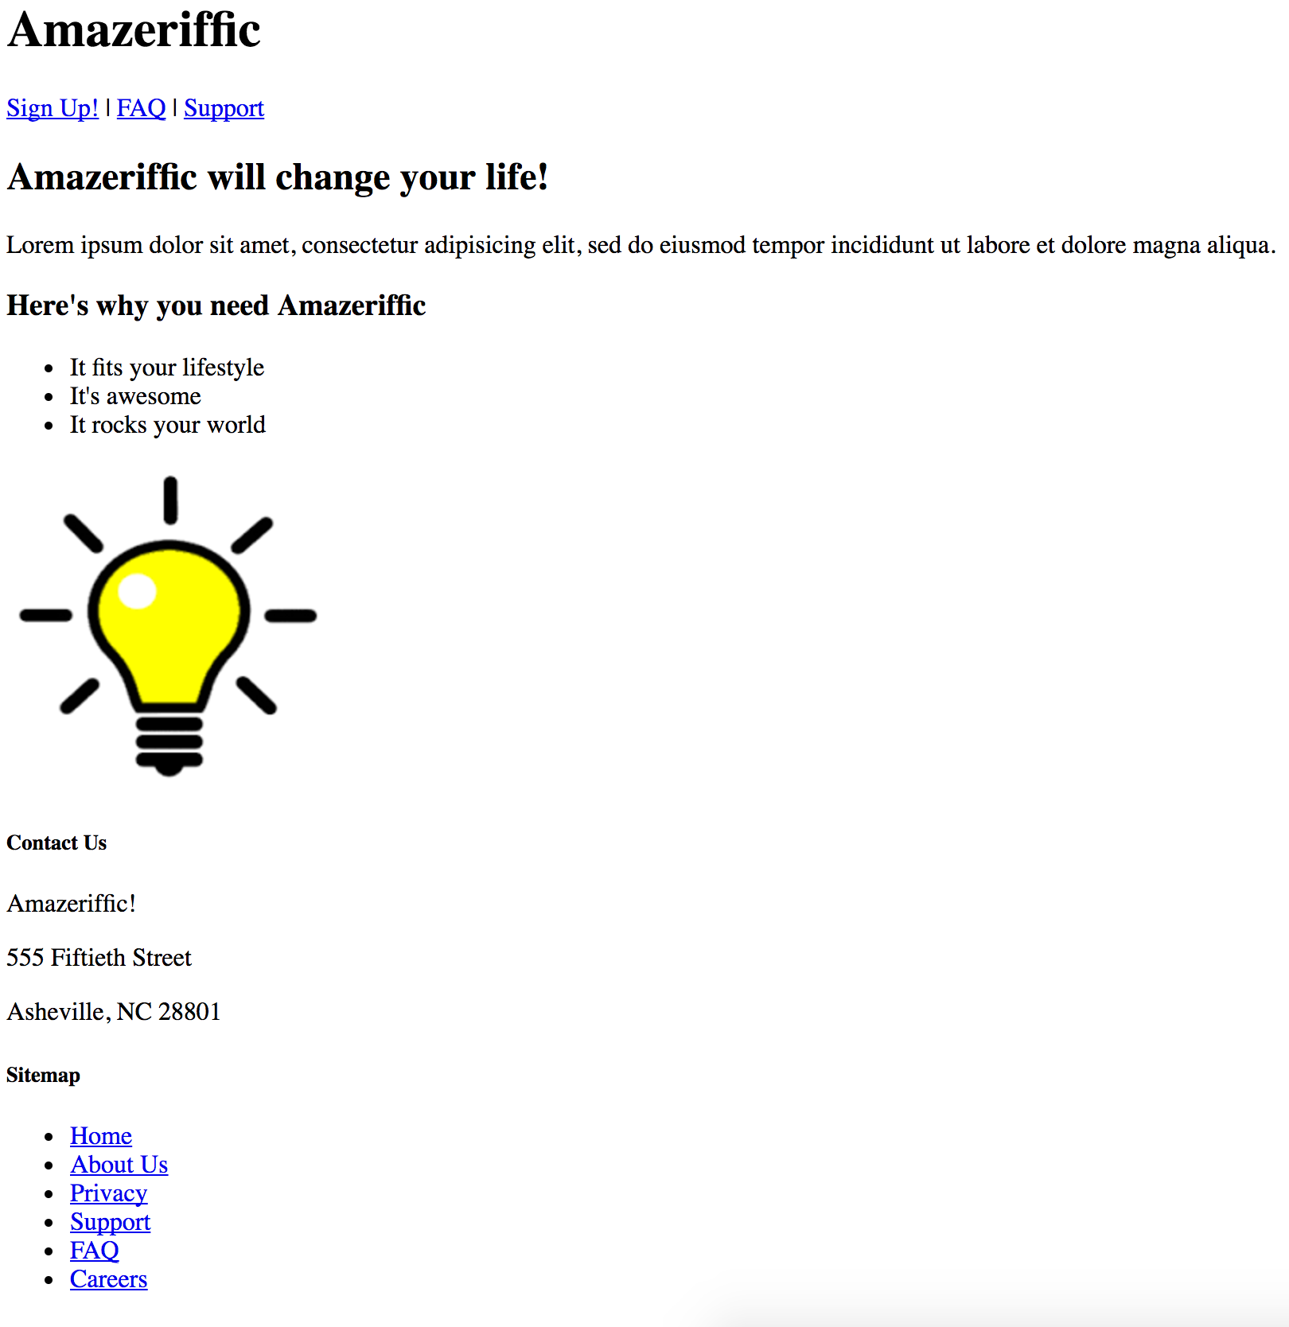
Ex1 - Amazeriffic
Example

Slide 6
Hello, CSS!
Adding stylesheets
<link href=“my-stylesheet.css” rel=“stylesheet” type=“text/css”>
Rulesets
Rules applied to some subset of the DOM
Uses selectors and properties
/* Comments */
Padding, Border and Margin
Inline vs block
Content > Padding > Border > Margin

Slide 7
Selectors
.Classes
Explicitly added
:Pseduoclasses
Implicitly added
More complex selectors
.class tag:pseudoclass { … }
Cascading Rules
LIFO when determining ruleset preference
Inheritance
Inherit parent rulesets unless overridden

Slide 8
Layouts with Floats
Float - Left / Right
Removes from normal flow
Moves as far as parent allows
The clear property – Left / Right / Both
No floating elements adjacent

Slide 9
Working with Fonts
Using standard fonts
font-family property
Adding custom fonts
Link to custom font in header
Font properties
font-size
Bold, Italic, and Underline
Fonts as icons
Fontawesome

Slide 10
Browsers and Troubleshooting
Browser inconsistencies
Reset.css
Browser defaults controversy
CSS Lint
csslint.net
Chrome Developer Tools

Slide 11
Ex2 – Styling Amazeriffic
Add reset.css and style.css to Amazeriffic
Two column, fixed-width design. 855px width

Slide 12
Food for thought
SASS / LESS
Bootstrap
Responsive design
Media queries

Slide 13
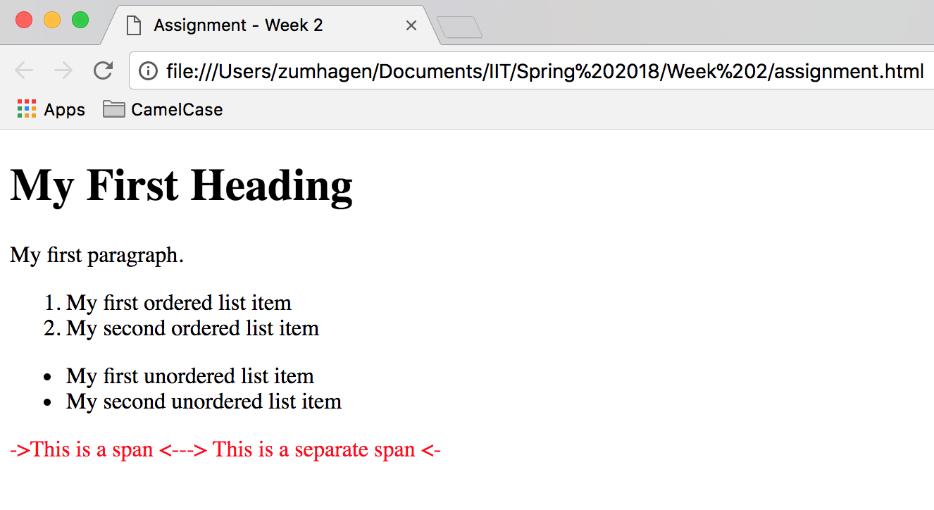
Homework
Recreate the below using HTML and CSS. Full details on Blackboard.

