Slide 1
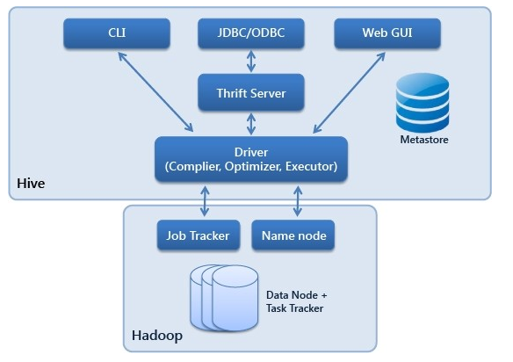

Slide 2
Read
Read
Schema
RDBMS
Hadoop/HDFS
Schema
write
write

Slide 6
