Slide 1
Spark cluster
Worker Nodes
Worker service
Storage
Executor 1
Tasks
Text file/Json File
1
Executor N
Tasks
Java(any) Objects
Mater Node
Cluster Manger
Executor 1
HDFS
2
Cloud like S3
Driver
YARN
Executor N
Spark context
RDBMS
Mesos
Standalone(Spark scheduler)
Executor 1
RDD
3
NO SQL
Executor N
Text file
Executor 1
4
Executor N

Slide 2
RDD
New RDD
Execution
JOB: one action is one job
Action (count)
transformation
shuffle
STAGE:1
TASKS: Num of partitions
STAGE:N
Operations
Transformation: new RDD
Action: Analyze RDD
DataFrame
Col1 | Col2 | Col3 | Col4
Pair RDD

Slide 3
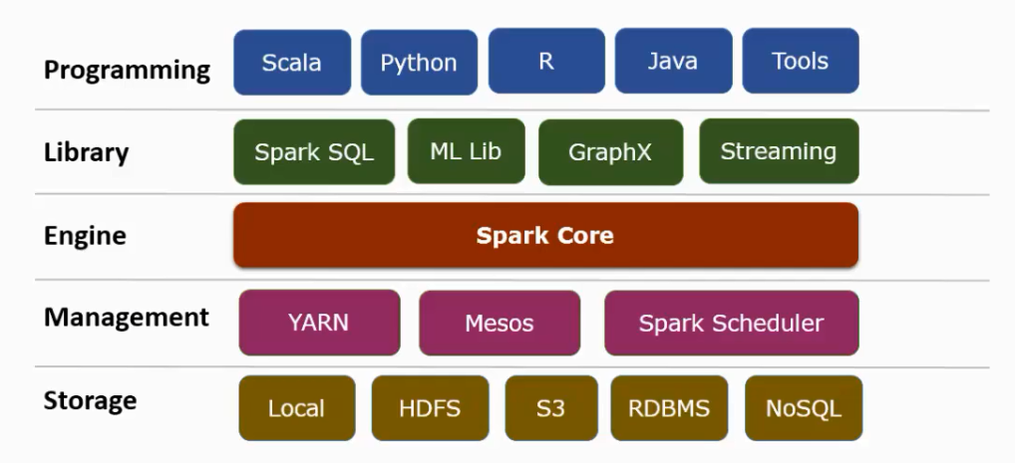
Spark eco system

Slide 4
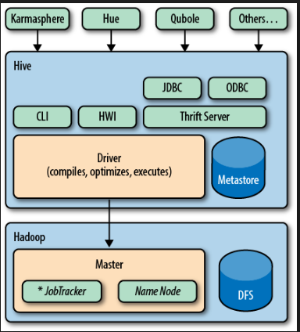

Slide 5
Dstream
One RDD will be created per batch interval (1sec)
RDD
RDD
RDD
Input data batches
Receivers
Live stream of data
Data Sources
Apache kafka
Apache Flume
Amazon kenesis
Flat files
Social media
TCP/IP

Slide 6
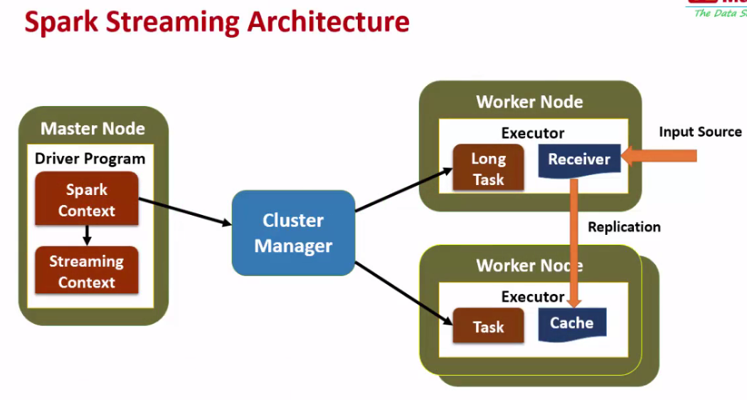

Slide 7
DStream
One RDD will be created per batch interval (1sec)
rdd
rdd
rdd

Slide 8


