Slide 1
Specifying Formative Constructs in Empirical Research
Colloquium Speech
University of Virginia
McIntire School
February 18, 2011
Detmar Straub
J. Mack Robinson Distinguished Professor of IS
Robinson College of Business
Georgia State University, Atlanta, Georgia, USA
Presentation Based on Article:
Petter, S., Straub, D., and Rai, A. “Specifying Formative Constructs in Information Systems Research,”
MIS Quarterly, Vol. 31, No. 4, pp. 623-656, December 2007.

Slide 2

Development of Research Models
Many focus on the relationship between constructs…
But give less consideration on the relationship between measures and the associated construct.
Structural Equation Modeling (SEM) is used to evaluate both the structural and measurement model.
  However…we sometimes neglect the
  measurement model.
Misspecifying the measurement model may lead to
mispecification in the structural model.
Notes:
We are often trained as researchers to search for that interesting research question and identify the constructs and relationships that explain the phenomenon under study. We may look to existing measures or even create measures for our constructs. We will go through valiant attempts to validate our constructs, but often will not consider if the relationship between the measures and our constructs are formative or reflective.
Premise is that this misspecification is a problem in the IS field. By having this type of error at the measurement level, it impacts our ability to interpret the results from our empirical studies and develop meaningful theory.

Slide 3

Agenda
What Are We Talking about Anyway?
Why Should We Care about ‘Specifying Constructs?’
How Do I Identify Formative Constructs?
I Have a Formative Construct, Now What?
Where Do I Go From Here?
Notes:
Brief review of terminology
Relevance or importance of topic
Specifying formative constructs
Analyzing and validating formative constructs
Guidelines, conclusions

Slide 4
Agenda
What Are We Talking about Anyway?
Why Should We Care about ‘Specifying Constructs?’
How Do I Identify Formative Constructs?
I Have a Formative Construct, Now What?
Where Do I Go From Here?
Notes:
Brief review of terminology
Relevance or importance of topic
Specifying formative constructs
Analyzing and validating formative constructs
Guidelines, conclusions

Slide 5
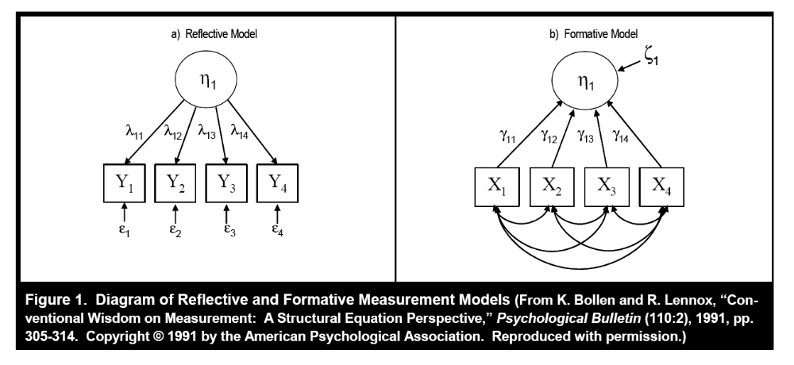
Terminology
Formative vs. Reflective
A construct could be measured reflectively or formatively.
Constructs are not necessarily (inherently) reflective or formative. (When we talk about the “nature” of a construct being formative or reflective in our MISQ paper, we mean “the construct-once-measured.”)
Notes:
Measures (indicators, items) – observable, quantifiable scores obtained through self-report, interview, observation or other empirical means
Constructs – abstractions that describe a phenomenon of “theoretical interest”
Reflective constructs – changes in the construct create changes in the indicators. When one measure changes, they all change. Internal consistency (i.e., reliability) is paramount. Want measures that are unidimensional.
Formative constructs – composite of measures. Changes in the measures cause changes in the construct. Content validity is paramount. Internal consistency is irrelevant)
Example: Computer Self-Efficacy
Reflective – I am capable at performing tasks on my computer. I feel confident in my ability to perform computer-related tasks.
Formative – I am confident at my ability to perform tasks in MS Word. I am skillful at using Excel.
Example: System Quality
Reflective – Overall, I would rate the system quality of the system highly. The quality of the system is appropriate for my needs.
Formative – Reliability, Ease of Use, Complexity, Accessibility, Responsiveness

Slide 6
Terminology
Formative vs. Reflective
  Let’s take firm performance as an example.
  We can create a reflective scale that measures top managers’ views of how well the firm is performing.
    These scale items can be interchangeable, and in this way let the researcher assess the reliability of the measures in reflecting the construct.
  Or we can create a set of metrics for firm performance that measure disparate elements such as ROI, profitability, return on equity, market share, etc.
    These items are not interchangeable and, thus, are formative.
Notes:
Measures (indicators, items) – observable, quantifiable scores obtained through self-report, interview, observation or other empirical means
Constructs – abstractions that describe a phenomenon of “theoretical interest”
Reflective constructs – changes in the construct create changes in the indicators. When one measure changes, they all change. Internal consistency (i.e., reliability) is paramount. Want measures that are unidimensional.
Formative constructs – composite of measures. Changes in the measures cause changes in the construct. Content validity is paramount. Internal consistency is irrelevant)
Example: Computer Self-Efficacy
Reflective – I am capable at performing tasks on my computer. I feel confident in my ability to perform computer-related tasks.
Formative – I am confident at my ability to perform tasks in MS Word. I am skillful at using Excel.
Example: System Quality
Reflective – Overall, I would rate the system quality of the system highly. The quality of the system is appropriate for my needs.
Formative – Reliability, Ease of Use, Complexity, Accessibility, Responsiveness

Slide 7
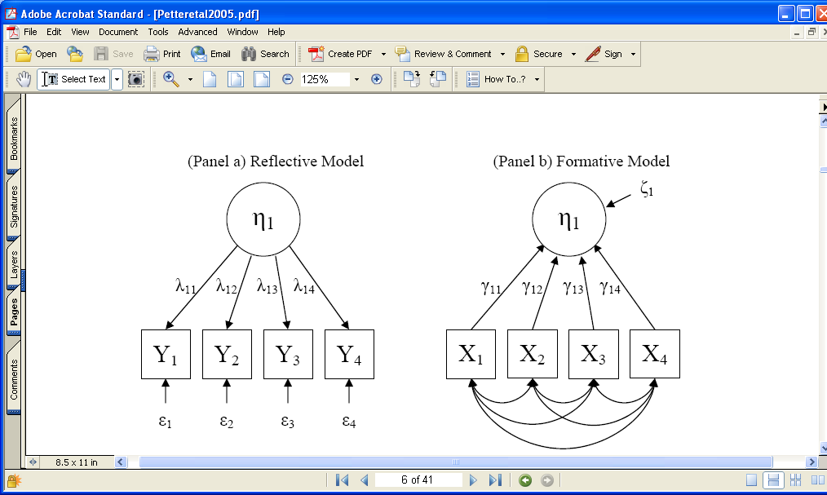
Reflective and Formative Constructs
MGS 9940
October 19, 2005

Slide 8
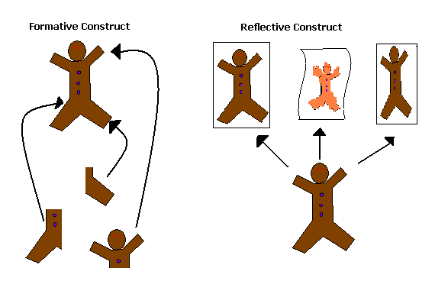
An Analogy
Not Interchangeable
Interchangeable
[Graphic courtesy of Robert Sainsbury, Mississippi State University]

Slide 9
One Construct: Measured Reflectively & Measured Formatively
Reflective Measures of Intention to Omit Security Actions
Code | Item | Loading | T-stat | Composite reliability
OMIT7 | I take measures to protect my information from security violations: Never…always | 0.9383 | 53.2516 | .959
OMIT13 | I take precautions against information security violations: Never..always | 0.9514 | 70.2334
OMIT57 | I use information security protections: Never..always | 0.9357 | 50.1780
Scale developed according to Ajzen’s (2002) recommendations for measuring intentions.
Formative Measures of Intention to Omit Security Actions
Code | Item | Weight | T-stat
PWDOMIT | Computer logs of password changes | 0.6051 | 18.2871
UPOMIT | Computer logs of security updates | 0.5162 | 15.8049
BACKOMIT | Computer logs of backups | -0.1002 | 4.7784

Slide 10
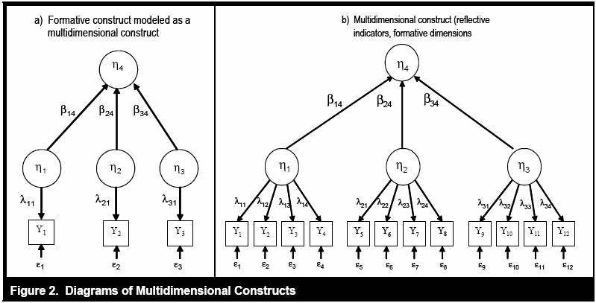
Terminology
Multidimensional Constructs
  Each dimension can be measured using formative or reflective indicators.
  The dimensions may be formatively or reflectively related to the construct.
Petter, Straub, Rai, MISQ 2007
Notes:
A reflective construct should be unidimensional. The measures are tightly centered around a concept. Multidimensional constructs contain multiple dimensions and are grouped because there is some theoretical relationship between the various dimensions.
A formative construct, as described, is essentially a unidimensional construct with one measure for each dimension.
Example: Organizational Performance as Net Benefits
Profitability
Productivity
Market Share
Could capture measures for each of these dimensions either reflectively or formatively. However, in this case, there would be a formative relationship between dimension and construct.
Consider the use of multidimensional constructs based on the “generality or specificity of one’s theoretical interest” (MacKenzie et al. 2005, p. 713).

Slide 11
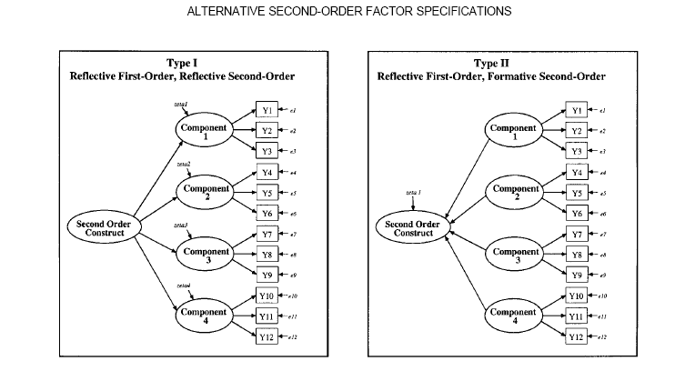
Jarvis et al, 2003
Notes:
In their work, Jarvis et al. (2003) diagrammed various types of multidimensional constructs that are possible.
Both of these panels show reflective subdimensions (or first-order constructs) and then show either a formative or reflective relationship between the first order and second-order constructs.

Slide 12
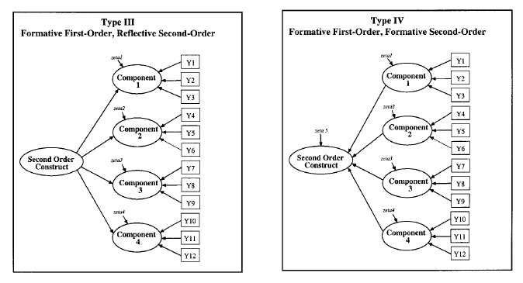
Jarvis et al, 2003
Notes:
In their work, Jarvis et al. (2003) diagrammed various types of multidimensional constructs that are possible.
Both of these panels show formative subdimensions (or first-order constructs) and then show either a formative or reflective relationship between the first order and second-order constructs.

Slide 13
The Problem with Misspecification
Jarvis et al. (2003)
  Bias when a single formative construct was misspecified as reflective (five construct model)
    Structural paths from misspecified constructs – Upward bias
    Structural paths leading to misspecified constructs - Downward bias
MacKenzie et al. (2005)
  Bias when one or two formative constructs were misspecified as reflective (two construct model)
    Exogenous construct was misspecifed – Upward Bias
    Endogenous construct was misspecified – Downward Bias
    Both constructs misspecified – Slight downward bias
These simulations focused on accuracy of parameter estimates.
What about the significance of the parameter estimates?
Notes:
Two separate studies performing simulations found that there were problems when the measurement model was misspecified.
When a formative construct was misspecified as reflective, biases occurred in the parameter estimates. We wanted to know if these biases in the estimates would affect the statistical significance of the estimates.

Slide 14

The Problem with Misspecification
Is the downward bias strong enough to lead to a Type II error (i.e., false negative)?
Is the upward bias strong enough to lead to a Type I error (i.e., false positive)?
The answer…

Slide 15
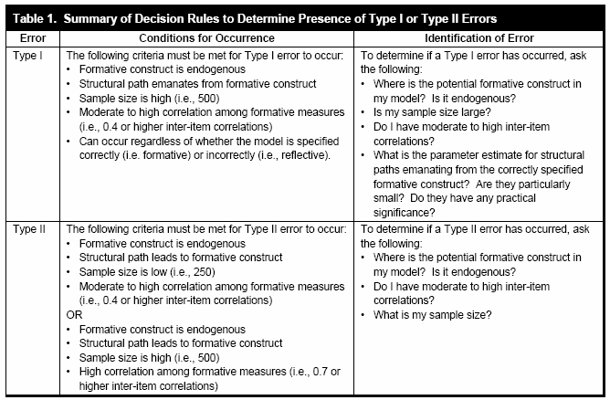
Likelihood of Type I or Type II Error
Petter, Straub, Rai, MISQ 2007
Notes:
We identified based on our simulations some situations in which Type I or Type II error was likely to occur.
Something interesting to note: Type I error (i.e., upward bias) can occur for paths emanating from the formative construct when there is high correlation among the formative measures and at higher sample sizes.

Slide 16
Agenda
What Are We Talking about Anyway?
Why Should We Care about ‘Specifying Constructs?’
How Do I Identify Formative Constructs?
I Have a Formative Construct, Now What?
Where Do I Go From Here?
Notes:
Brief review of terminology
Relevance or importance of topic
Specifying formative constructs
Analyzing and validating formative constructs
Guidelines, conclusions

Slide 17
Why Do We Care about Misspecification?
Errors in the measurement model may lead researchers to wrong conclusions about theory confirmation when, in fact, the theory was disconfirmed. Or vice versa.
However…maybe measurement misspecification is not a problem in the IS field.
  Unfortunately, this is not the case.
  Consistent with marketing (29% as reported in Jarvis et al., 2003), approximately 30% of constructs measured in three top IS journals over a three year period suffered from misspecified constructs.

Slide 18
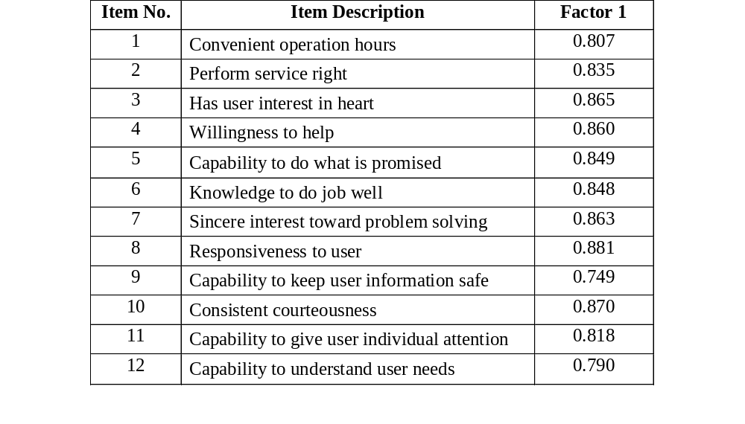
Servqual: Usually Specified as Reflective…..Is It?
If, in their factor analysis, the researchers had forced the SPSS software to find more factors, the construct will start to break apart.

Slide 19
Agenda
What Are We Talking about Anyway?
Why Should We Care about ‘Specifying Constructs?’
How Do I Identify Formative Constructs?
I Have a Formative Construct, Now What?
Where Do I Go From Here?

Slide 20
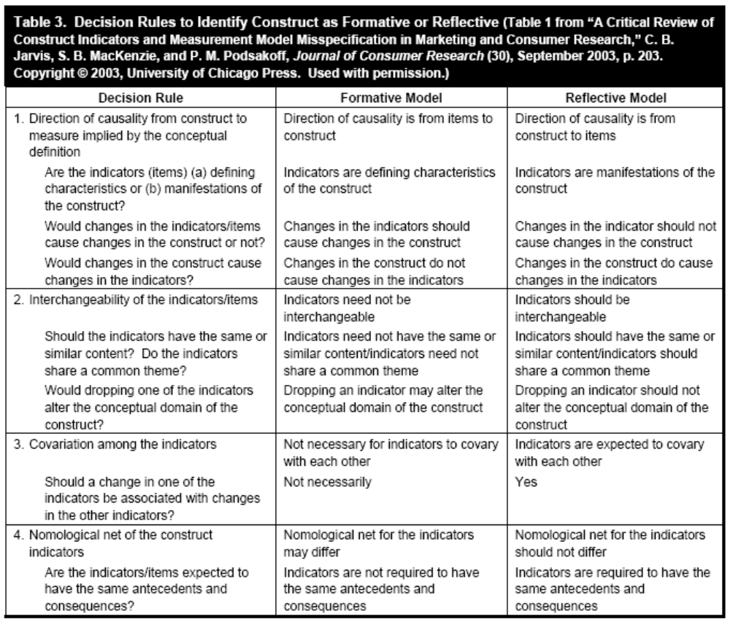
Identifying Formative Constructs
Petter, Straub, Rai, MISQ 2007
Notes:
The following is a reproduction of a table from our paper that was original adapted from Jarvis et al. (2003). There are four basic decision rules that can be used to assess whether the relationship between the measures and construct are formative or reflective.
Direction of causality – the indicators define the construct. The change in the indicator causes changes in the construct (rather than a change in the construct causes a change in the indicators)
Interchangeability of the indicators – If you drop a formative indicator, the construct meaning may be changed
Covariation among indicators – formative do not have to necessarily covary with one another (e.g., Market Share and productivity may not be correlated within Organizational Performance construct)
Nomological net for the individual indicators within the construct may have some variation in terms of the antecedents and consequences. (the predictors for market share may be different than those for productivity)
Many well-known constructs have not really been examined in terms of these decision rules. For example, some of the items used for Perceived Usefulness in TAM research suggest there is a mixture of both formative and reflective items. Some items focus on efficiency, others on effectiveness. Some may argue this is a reflective construct due to the high Cronbach’s alphas. Important to consider the theory and items prior to data collection rather than using statistics to justify the interprettion.

Slide 21
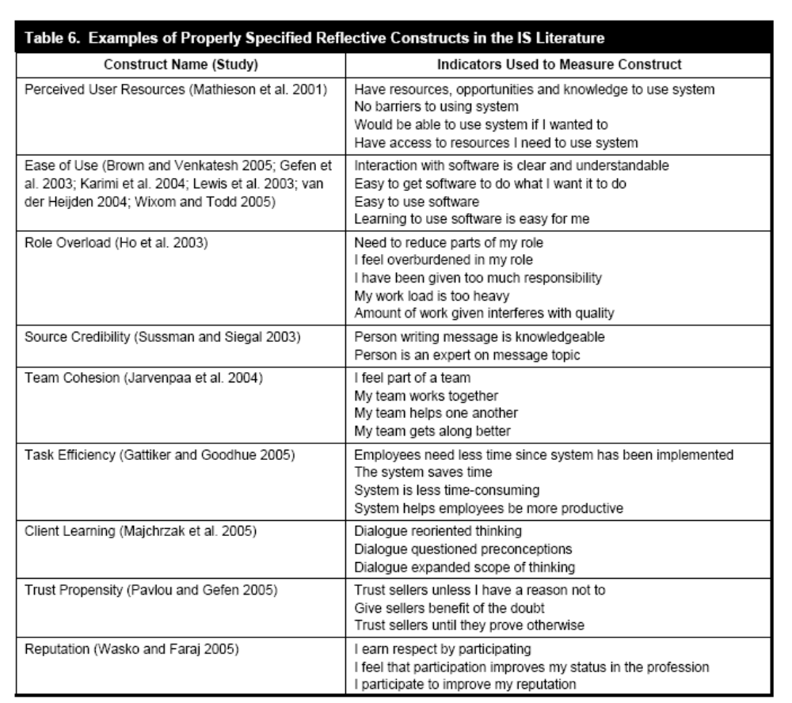
Petter, Straub, Rai, MISQ 2007

Slide 22
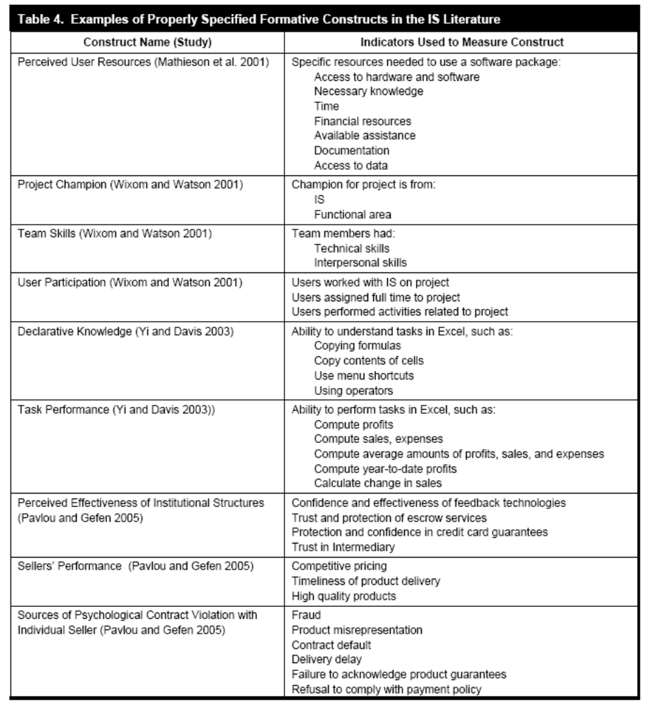
Petter, Straub, Rai, MISQ 2007

Slide 23
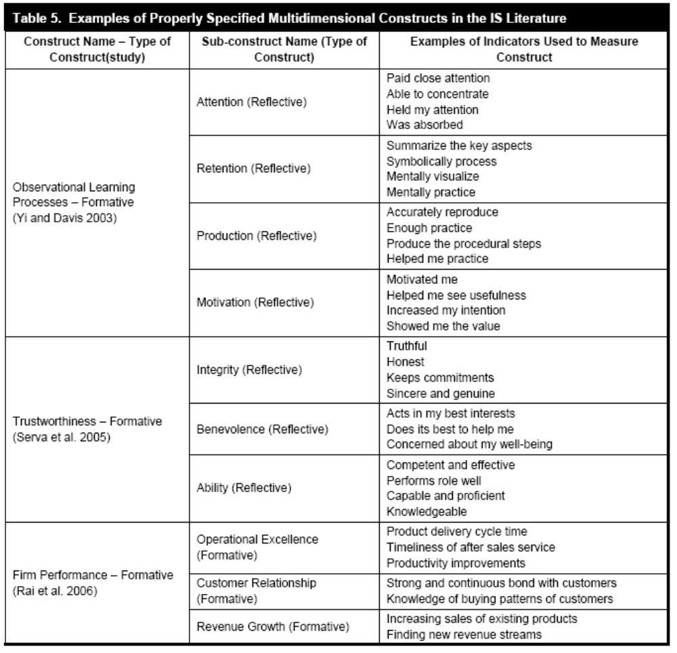
Petter, Straub, Rai, MISQ 2007

Slide 24
Agenda
What Are We Talking about Anyway?
Why Should We Care about ‘Specifying Constructs?’
How Do I Identify Formative Constructs?
I Have a Formative Construct, Now What?
Where Do I Go From Here?

Slide 25
Before Data Collection
Content Validity
  Ensure full domain of construct is captured.
  Establishing content validity
    Literature review
    Expert panel
    Q-sort
  While often neglected for reflectively measured constructs, formatively measured constructs should ALWAYS be examined for content validity.
Notes:
Content validity is paramount with formative measures. Sometimes neglected in reflective constructs, but is critical in formative constructs. Recall that the indicators define the construct (part of the decision rules). If something is missing, the construct meaning is changed.
Goal with content validity is to determine if all facets of the construct are measured.
Establish content validity prior to data collection using a literature review, expert panel, and/or Q-sort.
Two-step Q-Sort
Person examines series of cards containing measures used for each of the constructs and places each card into one of several categories (categories represent constructs)
Person is given the list of categories and tries to put the cards with measures into the correct categories

Slide 26
Before Data Collection
Consider your choice of statistical analysis tool…
  If using CB-SEM, consider if the model is identified.
  If not, then…
    Could you constrain structural paths or error terms (consider theoretical implications of this choice)?
    Could you have two structural paths from formative construct to reflective constructs?
    Could you include two reflective measures as part of the construct?
    Could you decompose model if formative construct has only one emanating path?
Notes:
If plan is to use CB-SEM, need to consider identification of model.
Identification is necessary to ensure that parameters can be estimated. Without identification, the model will often not run in the CB-SEM programs, parameter estimates will be inconsistent, and fit cannot be interpreted. Formative constructs alone are underidentified. Must be part of a larger model to achieve identification.
There are some ways to ensure the formative construct is identified.

Slide 27
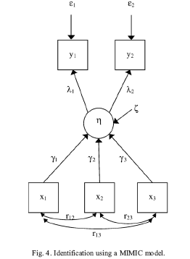
Multiple Indicator, Multiple Cause Construct (MIMIC)
See example in Barki et al, ISR, 2007

Slide 28
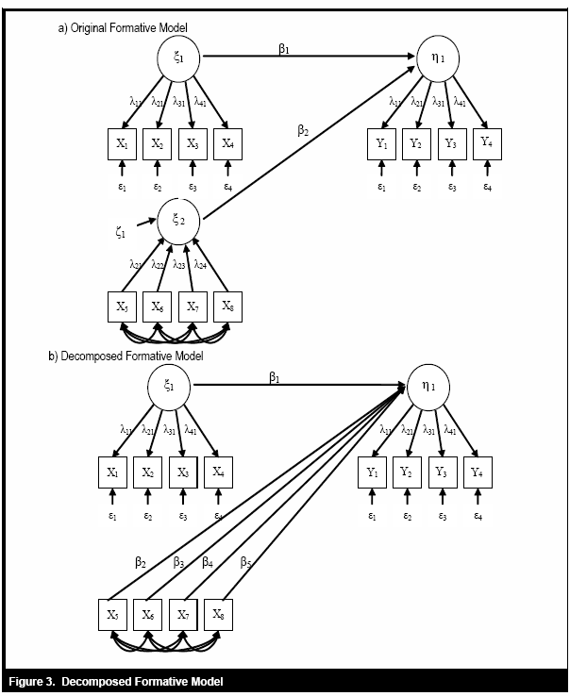
Petter, Straub, Rai, MISQ 2007

Slide 29

After Data Collection: Validation
Construct Validity
  Convergent and discriminant validity may not be as relevant for formative constructs.
  Use Principal Components Analysis (not Common Factor Analysis) to evaluate weights.
  Nonsignificant weights need careful consideration.
  But………………
Notes:
Convergent validity – are measures for a construct more correlated with one another than with measures of another construct
Discriminant validity – are the measures isolated as distinct constructs
Since one of our decision rules (#3) states that formative measures do not necessarily have to covary, then assessing construct validity becomes less relevant.
Would want to consider the weights of the items in the model. When performing a factor analysis for reflective constructs, look at the loadings. With formative models, the focus is on the weights. If the weight is nonsignificant, may still retain item (with reflective constructs, would often purge item). Removing the item may change the theoretical meaning of the construct.

Slide 30
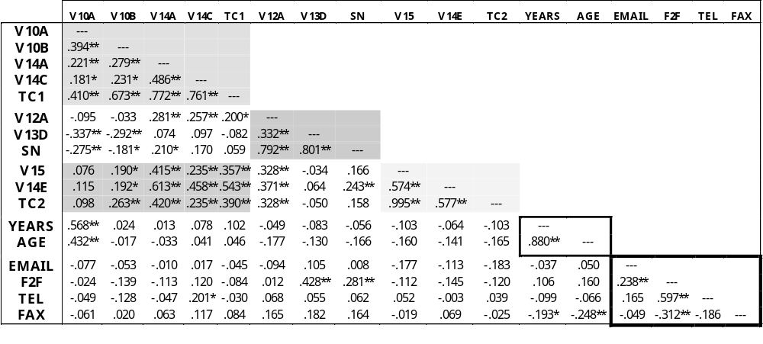
Modified MTMM (Loch et al. 2003)
N.B. TC1 is the technological culturation composite value for Model 1. Similarly with TC2 and Model 2. SN is the composite value for social norms.
** Correlation is significant at the .05 level (2-tailed).
*Correlation is significant at the .10 level (2-tailed).
[Based on: Loch, K., Straub, D., and Kamel, S. "Diffusing the Internet in the Arab World: The Role of Social Norms and Technological Culturation," IEEE Transactions on Engineering Management (50:1, February) 2003, pp. 45-63.]

Slide 31
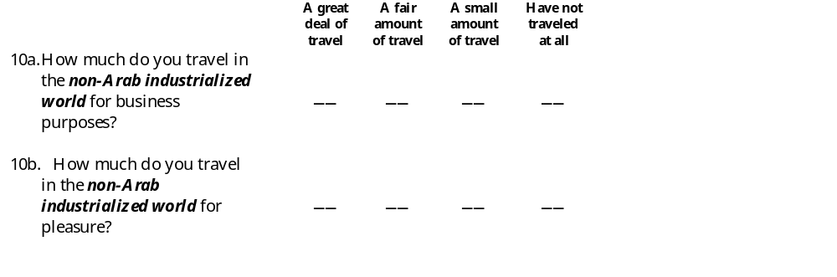
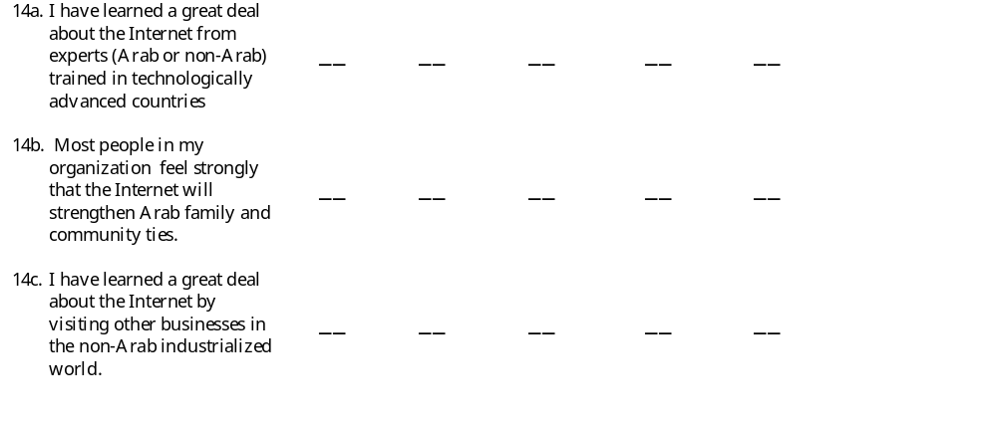
Instrument (Loch et al. 2003)

Slide 32
Modified MTMM (Loch et al. 2003)
Derived values for latent constructs
N.B. TC1 is the technological culturation composite value for Model 1. Similarly with TC2 and Model 2. SN is the composite value for social norms.
** Correlation is significant at the .05 level (2-tailed).
*Correlation is significant at the .10 level (2-tailed).
[Based on: Loch, K., Straub, D., and Kamel, S. "Diffusing the Internet in the Arab World: The Role of Social Norms and Technological Culturation," IEEE Transactions on Engineering Management (50:1, February) 2003, pp. 45-63.]

Slide 33
Modified MTMM (Loch et al. 2003)
From the paper….
“The logic for discriminant validity is that the inter-item and item-to-construct correlations should correlate more highly with each other than with the measures of other constructs, and, in our case, with the composite constructs themselves.
By comparing values in the TC1, TC2 , and SN rectangles with values in their own rows and columns, we can see that there are only a few violations of this basic principle.
Campbell and Fiske (1959) point out that normal statistical distributions in a large matrix will result in exceptions that are not necessarily meaningful.
They suggest that one uses judgment in determining whether the number of violations is low enough to conclude that the instrument items discriminate well.”

Slide 34

After Data Collection: Validation
Reliability
  Reliability is more difficult to determine for formative constructs.
    Multicollinearity destabilizes research model.
    Suggests construct may be multidimensional.
  Use a multicollinearity assessment based on VIF.
    VIF>10 (Cohen: based on multiple regression assessment)
    VIF > 3.3 – 4 (Petter et al, 2007; Diamantopolous et al, 2008)
  With covarianced-based SEM, use the construct disturbance term.
  Test-retest reliability does not depend on relationships between the items, and so it also works.
Notes:
Reliability or internal consistency, as is traditionally measured, is more difficult in formative constructs. We want multicollinearity and unidimensionality in reflective constructs. Formative constructs are destabilized when this occurs. May need to eliminate items if they are redundant. May need to consider building a multidimensional construct.

Slide 35

After Data Collection: Analysis
Covariance-Based SEM
  Model specification (co-varying exogenous items)
    Consider nested models.
    Perform chi-square difference test to determine best model
  Examine measurement and structural model.
    Error term of formative construct
      Large error term may suggest problems with items
    Examine other measures of model fit .
Components-Based SEM
  Examine weights for formative measures,
  loadings for reflective measures.
  Examine R² values and other parameters.
Notes:
Error term – f-square of 0.02 (R2 = 0.0196); 0.15 (R2 = 0.13); and 0.35 (R2 = ).26 are small, medium, and large effect sizes

Slide 36

After Data Collection: Analysis
Covariance-Based and Components-Based SEM
  Cenfetelli & Basselier (2009, MISQ) offer guidelines for how to interpret formative statistics and to validate the constructs.
  These guidelines are fairly detailed, but they include:
the examination of multicollinearity,
the number of indicators,
the possible co-occurrence of negative & positive indicator weights,
the absolute versus relative contributions made by a formative indicator,
the nomological network effects, and
the possible effects of using PLS versus CB SEM techniques.

Slide 37
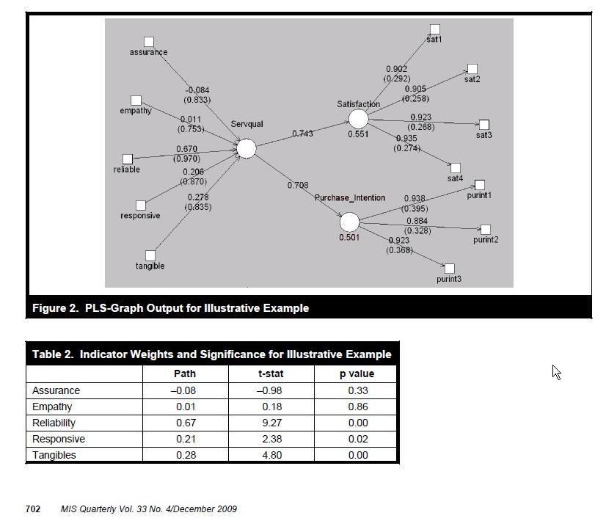
After Data Collection: Analysis
Illustration from Cenfetelli & Basselier (2009, MISQ)

Slide 38
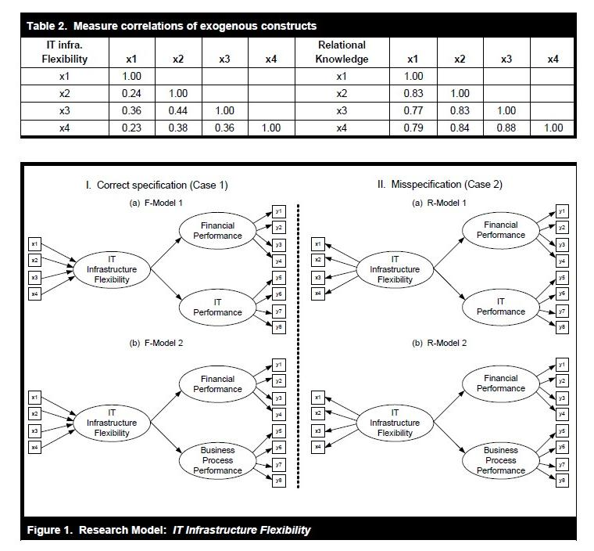
After Data Collection: Analysis
Do further tests listed in Kim, Shin & Grover (2010, MISQ)
Their sample dataset showed problems with formative constructs whether they were misspecified or not.
Can we abandon formative constructs, though?

Slide 39
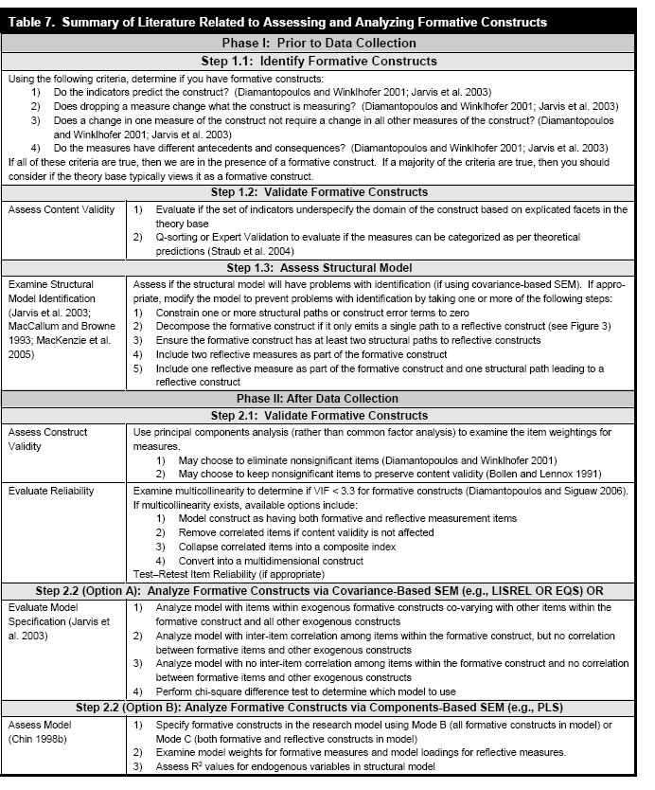
Petter, Straub, Rai, MISQ 2007

Slide 40
Agenda
What Are We Talking about Anyway?
Why Should We Care about ‘Specifying Constructs?’
How Do I Identify Formative Constructs?
I Have a Formative Construct, Now What?
Where Do I Go From Here?

Slide 41

Where Do You Go From Here as a Reviewer?
Examine if constructs are specified correctly as formative or reflective.
Consider the validation approaches used for examining formatively measured constructs.
Do not assume that all research models using formative constructs must be analyzed using PLS.

Slide 42

Where Do You Go From Here as a Researcher?
Remember to consider the measurement model.
BEFORE collecting data, consider the types of measures you want to use.
  Consider the measures and analysis before collecting data.
  Is there a good reason for using formative vs. reflective measures?
  Focus on content validity – especially if using formative or multidimensional constructs.
  Consider the tool you want to use.
    Is the research model identified?
    CB-SEM can be used with formative constructs. If
    choose to use PLS, have a reason other than “it’s
    easier to use”

Slide 43

Where Do You Go From Here as a Researcher?
AFTER collecting data, validate formative measures appropriately.
  You may still have to educate reviewers (i.e., no need to examine reliability or maybe even construct validity).
Decomposed models or indices can change the meaning of the theoretical relationship.
  Consider the theoretical implications (not just empirical).
Tune into ongoing debates about formatively measured constructs.
Notes:
There are some mixed opinions about the use of formative constructs in the field. Some are opposed to formative constructs because weights often vary from study to study. Also, if a weight is nonsignificant, doesn’t this change the meaning of the construct? A formative construct is statistically dependent on the nomological network in which it is placed and some people believe this weakens the value of a construct measured formatively. The alternatives to formative constructs, though, are equally troublesome. Without them, we must break constructs down into the elements and this greatly complicated research models and destroys parsimony.

Slide 44
Where Do You Go From Here as a Researcher?
Forthcoming (2011) MISQ Research Commentaries (for copies, http://misq.org )
1. “Measurement and Meaning in Information Systems and Organizational Research: Methodological and Philosophical Foundations” by Richard P. Bagozzi (preprints available)
2. “Incorporating Formative Measures into Covariance-Based Structural Equation Models” by Adamantios Diamantopoulos
3. “Construct Measurement and Validation Procedures in MIS and Behavioral Research: Integrating New and Existing Techniques” by Scott B. MacKenzie, Philip M. Podsakoff, and Nathan P. Podsakoff
4. “Evaluating Effect, Composite, and Causal Indicators in Structural Equation Models” by Kenneth A. Bollen

