Slide 1

Topic Modeling
2022/4/29

Slide 2
Content
What is topic modeling ?
How to deal with topic modeling?
Coding
Latent Dirichlet Allocation
Related work of topic modeling
Demographic Information Topic Modeling
Decomposition (in a semantic way)

Slide 3
1 What is topic modeling ?
In the social sciences, coding is an analytical process in which data, in both quantitative form (such as questionnaires results) or qualitative form (such as interview transcripts) are categorized to facilitate analysis. Prior to coding, an annotation scheme is defined. The coding scheme ensures that the codes are added consistently across the data set and allows for verification of previously tagged data.
In ML and NLP, a topic model is a type of statistical model for discovering the abstract "topics" that occur in a collection of documents. Topic models are referred to as probabilistic topic models, which refers to statistical algorithms for discovering the latent semantic structures of an extensive text body.

Slide 4
2 How to deal with topic modeling?
Coding: https://en.wikipedia.org/wiki/Coding_(social_sciences)
LDA(Latent Dirichlet Allocation): https://zhuanlan.zhihu.com/p/31470216
Dirichlet Distribution AND Beta Distribution
MCMC AND Gibbs Sampling
So, can we explain LDA in a brief way?

Slide 5
2.1 Brief LDA
In fact, though LDA is the essential part of topic modeling, the mathematic definition of LDA is not necessary in this process at all. Learning by code is a simpler way to have an intuitive understanding of LDA. Here we use ‘Gensim’ (one of the most famous Python package to deal with topic modeling) as example.
[1]stopwords = codecs.open('stopwords.txt','r',encoding='utf8').readlines()
[2]dictionary = Dictionary(train_set)
[3]corpus = [ dictionary.doc2bow(text) for text in train_set]
[4]lda = LdaModel(corpus=corpus, id2word=dictionary, num_topics=20)
Define Stopwords
What is it?
Training Text
Bag-Of-Word
Model Genrator

Slide 6
2.2 Bag-of-Word
Example in Wikipedia:
(1) John likes to watch movies. Mary likes movies too.
(2) Mary also likes to watch football games.
“John”, “likes”, “to”, “watch”, “movies”, “Mary”, “likes”, “movies”, “too”, "Mary", "also", "likes", "to", "watch", "football", "games”
BoW1 = {"John":1, "likes":2, "to":1, "watch":1, "movies":2, "Mary":1, "too":1};
BoW2 = {"Mary":1, "also":1, "likes":1, "to":1, "watch":1, "football":1, "games":1};

Slide 7
2.2 Bag-of-Word
 | John | Likes | To | Watch | Movies | Mary | …
Text 1 | 1 | 2 | 1 | 1 | 2 | 1
Text 2 | 0 | 1 | 1 | 1 |  | 1
…
Total | 1 | 3 | 2 | 2 | 2 | 2
Which word can represent the whole text?
John? Likes? (Actually, John!)
And why? → tf-idf: https://en.wikipedia.org/wiki/Tf%E2%80%93idf

Slide 8
2.3 Model Generator
What happens in model generator?
[4]lda = LdaModel(corpus=corpus, id2word=dictionary, num_topics=20)
2 Matrix in model
Topic-Word Matrix
Topic-Text Matrix
 | Topic 1 | Topic 2 | Topic 3 | …
Word 1 | freq(1, 1) | freq(1, 2) | freq(1, 3)
Word 2 | e.g. 0.96 | e.g. 0.04 | e.g.0.13
…
 | Topic 1 | Topic 2 | Topic 3 | …
Text 1 | freq(1, 1) | freq(1, 2) | freq(1, 3)
Text 2 | e.g. 0.45 | e.g. 0.16 | e.g.0.52
…

Slide 9
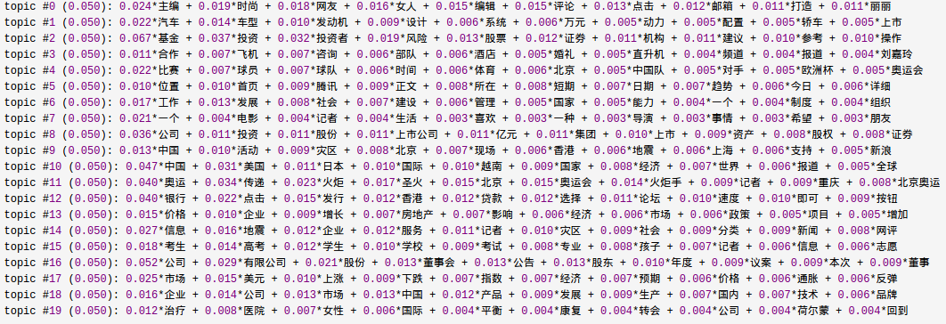
2.3 Model Generator
Here is an example of topic vectors.

Slide 10
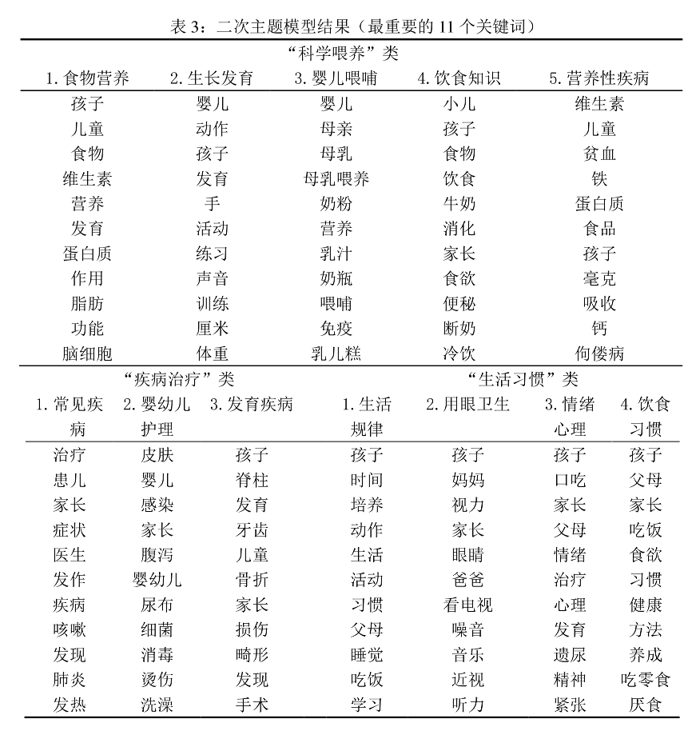
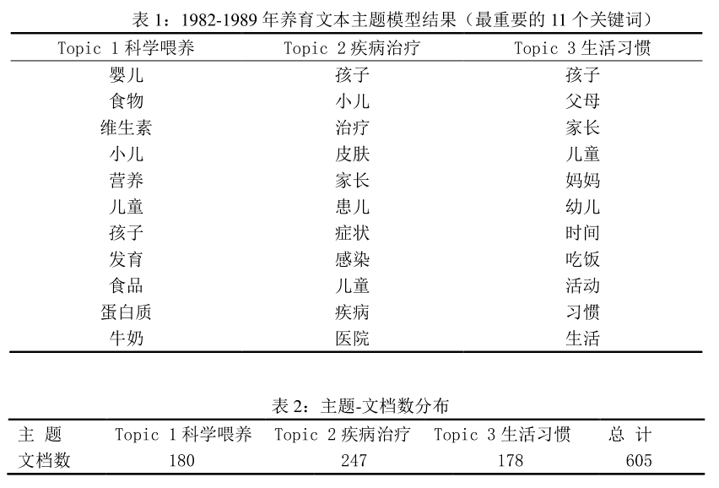
2.4 Related Paper
 | Topic 1 | Topic 2 | Topic 3 | …
Word 1 | freq(1, 1) | freq(1, 2) | freq(1, 3)
Word 2 | e.g. 0.96 | e.g. 0.04 | e.g.0.13
…
[1]陈倩. 社会转型中的大众媒介育儿话语变迁_陈倩(1)[D]. 上海大学, 2019.

Slide 11
3 Related work of topic modeling
Demographic Information Topic Modeling
Jiang, S., Qian, X., Shen, J., Fu, Y., & Mei, T. (2015). Author topic model-based collaborative filtering for personalized POI recommendations. IEEE transactions on multimedia, 17(6), 907-918.
Trusov, M., Ma, L., & Jamal, Z. (2016). Crumbs of the cookie: User profiling in customer-base analysis and behavioral targeting. Marketing Science, 35(3), 405-426.
Decomposition (in a semantic way)
Scale-invariant feature transform (SIFT)
https://en.wikipedia.org/wiki/Bag-of-words_model_in_computer_vision

