Slide 1
Philly Tech Sistas
CSS & JavaScript
Class 3

Slide 2
Responsive Design
Web page, text and images adjust depending on screen size of browser (desktop, tablet, phone)
An introduction
Notes:
So now that we're experimenting with colors via CSS we should keep accessibility in mind
508 compliance was created in 1998, mandating that websites should be accessible to those with disabilities
As 20% of the US is disabled, you want to make certain your site is accessible to all
There are multiple assistive readers nowadays and Well-formatted and well-tested HTML only make the browsing experience better
In addition to using semantic and alt tags, now that we're using CSS we want to test the visual element as well for those suffering from color impairment
We can use responsive design to make elements and layouts automatically adjust in size or shape depending on the window size of the browser.
If pressed for time skip or go through at a high level
https://www.section508.gov/manage/laws-and-policies

Slide 3
CSS Media Queries: Responsive Images
We can use CSS media queries to display different images (or adjust the width) depending on the window size:
If Window greater than 400px display the large logo
If Window less than 400px display small logo
img {
width: 100%;
}
@media only screen and (min-width: 400px) {
img {
width: 50%;
}
}
Notes:
Yo
media queries are rules specific to the size of your screen
That's why it's called responsive
You can create rules for the size of a tablet screen, size of a mobile phone & size of a desktop monitor
MEdia queries are typically preceded by an at sign and the word media, then the size of the screen its focused on
Then you place everything applicable to that media setting within those curly braces
You can use chrome or BSD to test what a page looks like in different sizes
You can also adjust your browser width
DEMO: Upload 2 images to the folder resources

Slide 4
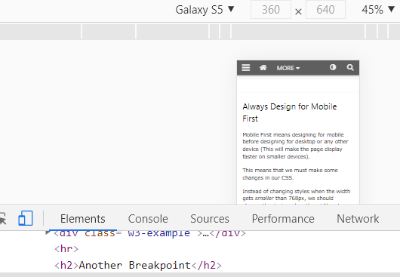
Testing Media Queries in the Browser
Click inspect element
Click the double monitor icon

Slide 5

Exercise: Responsive Media Queries
Create a new project, Week 3, Tablet & Mobile CSS
Add 3 images to the HTML.
Add the CSS below to the CSS tab.
Adjust the width of the page to very small and very wide, watch the image shrink or disappear.
@media screen and (max-width: 300px) {
img {
display: none;
}
}
@media screen and (max-width: 600px) {
img {
width: 25%;
}
}
@media screen and (max-width: 800px) {
img {
width: 50%;
}
}
Notes:
You can

Slide 6

<break /> !

Slide 7
CSS Frameworks
CSS Frameworks are software frameworks that outsource much of the design effort and web standard enforcement.
Using CSS frameworks you can make complex websites quickly and easily.
Bootstrap

Slide 8
CSS Frameworks
A few notable CSS frameworks are:
Bootstrap
Grumby
Foundation
Materialize
Pure
The best known, and most used of the bunch, is Bootstrap. So let’s take a look at that!
Notes:
Boostrap isn't used as much anymore, but many coding companies still ask about it in interviews. Additionally, many boot camps like codecademy still cover it

Slide 9

What is Bootstrap?
Pre-packaged code that creates stylized site
Built-In Responsive Design
Built-In Styles you can use!
Examples
Template with Bootstrap: https://bootstrapmade.com/demo/OnePage/
Template without Bootstrap: https://www.free-css.com/assets/files/free-css-templates/preview/page1/modular-business/
Notes:
developed by twitter, based on flexbox (improved in 2011)
framework of readily available code that integrates with HTML to create stylized websites
think about how annoying it is to think about how to properly style your site
THEN, think about how difficult it is to create rules for each window size
Bootstrap comes with styles and responsive design built in
Site with Bootstrap: https://bootstrapmade.com/#featured-templates
Site without Bootstrap: https://www.free-css.com/free-css-templates/page1/modular-business
it was considered am easy way to modernize websites, with that write once run anywhere mentality without a lot of coding
It also simplified the layout of a website using a grid system (similar to the grid CSS framework)
BS isn't used as much anymore b/c became overly complex, with a ton of nested divs, which makes it difficult to review the code and difficult for accessibility

Slide 10
How to include Bootstrap
Bootstrap is like a huge premade style sheet.
To include Bootstrap in a project, add a link to it inside the head element.
<head>
<link rel="stylesheet" href="https://maxcdn.bootstrapcdn.com/bootstrap/3.4.0/css/bootstrap.min.css">
<link rel=”stylesheet” href=”css/style.css” type=”text/css”>
</head>
Notes:
<link rel="stylesheet" href="https://maxcdn.bootstrapcdn.com/bootstrap/3.4.0/css/bootstrap.min.css">
<link rel="stylesheet" href="https://stackpath.bootstrapcdn.com/bootstrap/4.1.3/css/bootstrap.min.css" integrity="sha384-MCw98/SFnGE8fJT3GXwEOngsV7Zt27NXFoaoApmYm81iuXoPkFOJwJ8ERdknLPMO" crossorigin="anonymous">
https://getbootstrap.com/docs/4.1/getting-started/introduction/

Slide 11

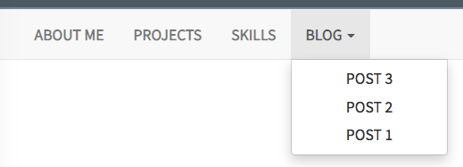
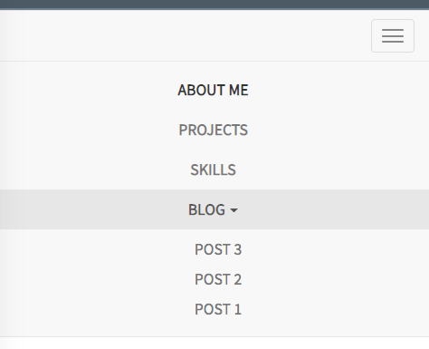
Bootstrap Nav
If you add the boostrap stylesheet to your page, Presto!
Your page is automatically styled!
Notes:
Bootstrap not used as frequently anymore b/c people found it overly complicated but you might come across legacy sites that use it so the labs will cover this further

Slide 12
Exercise: Bootstrap
Add a couple H1 and P tags to your image project
Now Add the boostrap link to your header tag
<head>
<link rel="stylesheet" href="https://maxcdn.bootstrapcdn.com/bootstrap/3.4.0/css/bootstrap.min.css">
<link rel=”stylesheet” href=”css/style.css” type=”text/css”>
</head>
Now play again with the different browser/mobile sizes
Notes:
You can

Slide 13
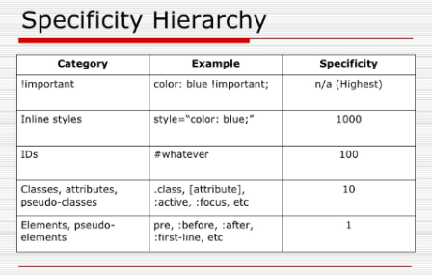
More About Stylesheets
If using Bootstrap, did some of your custom styles disappeared?
If two CSS rules are applied to the same element, the one with higher specificity wins. Bootstrap’s CSS selector might have taken precedence over your CSS.
If you think bootstrap is overwhelming your HTML, then give the element a class or id and then style that.

Slide 14
What is JavaScript?
A Quick Overview

Slide 15
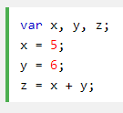


Programming Language Types
Scripting
JavaScript
ReactJS
Python
Object Oriented \ Compiled
Java
C#
C++
Tagging Language
HTML
XML
Notes:
Scripting – Traditionally, scripting languages are easy to code in. They also run quickly because they are not compiled in. Previously, scripting languages were not complex, but that has changed.
Compiled –Java, C#, C and C++ were originally created to handle coding complexity. To run, they needed to be compiled to the machine language native to Windows computers or macintosh computers. Initially, C++ and C# created windows desktop applications but now they are also used to create mobile apps and websites. It is more structured/formal way of coding

Slide 16
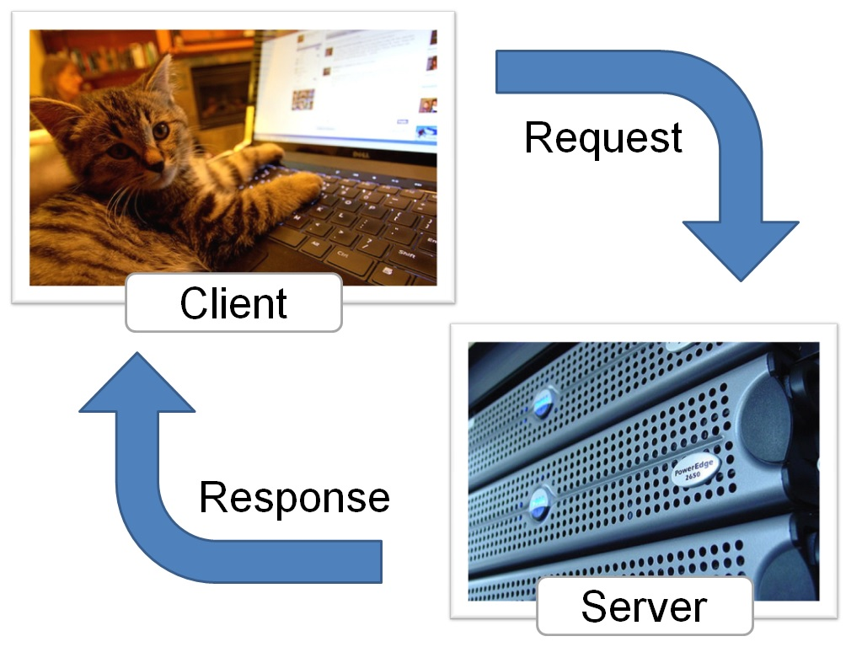
What is JavaScript?
Interfaces with HTML and CSS
Builds dynamic webpages
Responds to user input
Client-side (browser) language.
Notes:
JavaScript is standardized by the "ECMAScript" specifications.
JavaScript interfaces with HTML and CSS.
JavaScript lets you build dynamic webpages that respond to input from users.
JavaScript is a client-side processing language. A browser reads the code and runs it directly.

Slide 17
Javascript can modify your webpage
Multiple ways to print a message
Open a popup box
alert('Hello World!');
Write to your console
console.log('Hello World!');
Write to the Web Page
document.write('Hello World!');
Notes:
More than one way to skin a cat in JS. There are multiple ways you can print out a message to your users. Take note, with multiple lines of code, after each line, you must add a semicolon.
Console.log is typically used more for coders. Pop up boxes aren't used as much anymore. writing directly to the DOM, document object model or HTML page, is used more frequently through modern frameworks like React

Slide 18
Class Exercise: Your first JS Script
Start a new project, Hello World. Click the JS tab
Type the below in the JavaScript side. Refresh your code.
alert('Hello World!');
Now comment out the alert line . Refresh your code.
//alert('Hello World!');
Now add the below line. . Refresh your code. Click the > in app.bsd to see the console.
console.log('Hello World!');
Now comment out the console line.
/* alert('Hello World!'); */
Now print to the HTML window
document.write("Hello World!")
Notes:
You can mix JavaScript and HTML. The script tag tells your browser the stuff inside is JavaScript, not HTML.
<script> CODE GOES HERE </script>

Slide 19
What is a Variable?
Place to store values
Can change over time
Can hold strings, numbers, booleans or arrays
Can use let or var to create variables
let kittenAmount= 5; // Store numbers
let catName= 'Jane'; // Store words
var kittenName = 'Josie';
var catAge = 8;
Notes:
A variable is a place to store values.
The value of a variable can change over time.
When you first create a variable, it can be undefined (it has no value) or you can give it a value. To declare (create) a variable, just type the word "var" and the variable name.
It is a good idea to give your variable a starting value. This is called initializing the variable.\Variables can hold different types of information, like words, numbers, and collections of data.
The variable name is case-sensitive.A new variable needs to have a unique name.Variable names need to start with a letter, $, or _.Variable names can only be made of letters, numbers, $, or _.
let kittenAmount; //undefined variable

Slide 20
Variables and Text
Variable can also manipulate words including strings or groups of characters.
To Combine Variables Use the Plus
console.log("My cat's name is " + kittensName ); //combine two strings
Functions to Play with variables
Return String Length: kittensName.length;
Position of a character in a string: kittensName.search("kitten");
Make a string upper-case: kittensName.toUpperCase();
Replace: kittensName.replace("Fluff","puff");
Notes:
Variable can be strings, groups of characters. You put your string in quotes.
var kittensName = 'Fluffy'; If you want to use a quote in your string, you'll need to "escape" it with a backslash.
String interpolation - put a variable within a quotation, have to use a backtick character (it's beneath esc button)

Slide 21
Exercise: Play with Variables
In the JS tab.
Create the below variables with info about yourself;
city, job, hobby, age;
Hint: let job = 'web developer';
Print the variables to the Screen
Hint: console.log("Your name is " + name + " and your age is " + age);
Now do some math calculate your .
let birthYear = currentYear - age;
Hint: console.log("You were born in " + birthYear );
Notes:
Need help, see https://github.com/philly-tech-sistas/intro-to-javascript/blob/gh-pages/solutions/fortune-teller.js

Slide 22
What Are Functions?
Reusable code
Automates tasks
Javascript Has Its own functions
alert("My popup!");
console.log("My hidden warning");
But You can create your own!
function whatIsMyAge(birthyear)
{
console.log("I am " + (2022-birthyear) );
}
function createPopup(message)
{
Alert("Hi! " + message);
}
Notes:
Variable can be strings, groups of characters. You put your string in quotes.
var kittensName = 'Fluffy'; If you want to use a quote in your string, you'll need to "escape" it with a backslash.
String interpolation - put a variable within a quotation, have to use a backtick character (it's beneath esc button)

Slide 23
Exercise: Basic Functions
Do the following functions in order.
//Click to the JS tab. Create the below function.
function writeToWebPage()
{
document.write ("Hello, Gorgeous!");
}
//Invoke or 'call' the function
writeToWebPage()
//Now hit Run
//Now create a new function
function writeToConsole()
{
console.log("Hiya, Friend!");
}
//Call it
writeToConsole();
//Hit Run
//Create a third function
function writePopup()
{
alert("Hello!");
}
//Call it
writePop();
//Create another function that calls all three
function writeEverywhere()
{
writeToWebPage();
writeToConsole();
writePopup();
}
writeEverywhere();
Notes:
You can mix JavaScript and HTML. The script tag tells your browser the stuff inside is JavaScript, not HTML.
<script> CODE GOES HERE </script>

Slide 24
Exercise: Pass Info to Functions
Create the following functions with parameters
function myCat(catName) {
document.write ("My cat is called " + catName);
}
myCat("Juniper");
function myMath(num1, num2) {
document.write("<p>");
document.write (num1+num2);
}
myMath(5,6);
myMath(6,9);
function myAge(myAge) {
document.write("<p>");
document.write("My Age is " + myAge);
}
myAge(59);
Notes:
You can mix JavaScript and HTML. The script tag tells your browser the stuff inside is JavaScript, not HTML.
<script> CODE GOES HERE </script>

Slide 25
Web Accessibility
Websites should be usable by everyone. We need to make conscious effort to remove barriers to interaction and access.
Specifically, we need to be mindful of our visitors’:
Vision
Hearing
Motor skills
Cognitive abilities
Medical conditions (such as epilepsy)
https://www.webdevelopmentgroup.com/2017/09/508-compliance-making-websites-accessible-for-people-with-disabilities/
https://www.section508.gov/manage/laws-and-policies

Slide 26
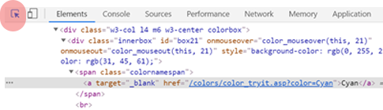
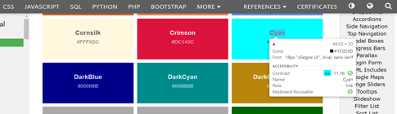
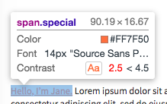
Exercise: Web Accessibility Test color contrast in Browser
Go to https://www.w3schools.com/cssref/css_colors.asp
Click the select icon (the arrow)
Hover over the different boxes
You will see if they're accessible and have contrast
Get inspired by high contrast color schemes.
Notes:
You can use color contrast through browser extensions but both firefox and chrome now have this embedded by default
If pressed for time, skip the demo
Above is in chrome, but it's almost the same in forefox and chrome. However, FF must enable accessibility first
Firefox: Open inspector → Enable Accessibility Features → Click the select icon → Hover over element

Slide 27
Can I Do This?
YES! You Can!!! You don't have to be a programmer to do Tech!
Indeed's Fastest Tech Jobs:
Technical Director
Architect
Consultant
Tech Support
Helpdesk
Developer
https://www.indeed.com/career-advice/finding-a-job/rising-tech-jobs-and-skills
Notes:
You don't have to be a programmer to do tech
https://www.indeed.com/career-advice/finding-a-job/rising-tech-jobs-and-skills
Requirements Gatherer
Agile Lead
Data Analyst

Slide 28
Homework

Slide 29
Exercise: Say My Name
Create the below custom function -
function sayMyName() {
let firstName = 'Kelly ';
var lastName = 'Rowland';
var fullName = firstName + lastName;
document.getElementById('headline').innerHTML = fullName;
}
sayMyName(); // don't forget to call it!
Refresh practice.html
Bonus: If you finish early, create a function, add, that receives two parameters
Notes:
You can mix JavaScript and HTML. The script tag tells your browser the stuff inside is JavaScript, not HTML.
<script> CODE GOES HERE </script>

Slide 30
Exercise: Return My Name
Go to myname.js - Update the function to accept and print parameters-
function sayMyName(firstName , lastName ) {
var fullName = firstName + lastName;
return fullName;
}
console.log(sayMyName()); // don't forget to call it!
Refresh practice.html
Bonus: If you finish early, update the function, add, to return the results of the addition
Notes:
You can mix JavaScript and HTML. The script tag tells your browser the stuff inside is JavaScript, not HTML.
<script> CODE GOES HERE </script>

Slide 31
Exercise: The Calculator
Write a function called squareNumber that will take one argument (a number), square that number, and return the result. Hint: https://github.com/philly-tech-sistas/intro-to-javascript/blob/gh-pages/solutions/calculator-squareNumber.js
Write a function called halfNumber that will take one argument (a number), divide it by 2, and return the result. Hint: https://github.com/philly-tech-sistas/intro-to-javascript/blob/gh-pages/solutions/calculator-halfNumber.js
Write a function called percentOf that will take two numbers, figure out what percent the first number represents of the second number, and return the result. It should also log a string like "2 is 50% of 4." Hint: https://github.com/philly-tech-sistas/intro-to-javascript/blob/gh-pages/solutions/calculator-percentOf.js
Write a function called areaOfCircle that will take one argument (the radius), calculate the area based on that, and return the result. It should also log a string like "The area for a circle with radius 2 is 12.566370614359172." (Use Math.floor to round down to two decimal places) Hint: https://github.com/philly-tech-sistas/intro-to-javascript/blob/gh-pages/solutions/calculator-areaOfCircle.js
Notes:
You can mix JavaScript and HTML. The script tag tells your browser the stuff inside is JavaScript, not HTML.
<script> CODE GOES HERE </script>

Slide 32
Exercise: String Functions
Create a function, wordLength, that receives a parameter and returns its length. Then, print out the results. let wordParam = "Supercali"; let wordLength = (word) => { return word.length ; } console.log("The word " + wordParam + " has " + wordLength + " letters ");
Create a function, findWord, that searches for a word in a phrase. If the word does not exist let users know. Check https://www.w3schools.com/jsref/jsref_search.asp for more.
let searchParam = "Flakes";
let phraseParam = "Corn Flakes are Great!"; let findWord= (word, phrase) => {
let wordExists = false;
if (phrase.search(word) > 0)
wordExists = true;
return wordExists;
}
console.log("Does " + searchParam + " exist in phraseParam ? " + findWord(searchParam, phraseParam) );

Slide 33
Learn More

Slide 34
Learn More
CSS Transitions: https://css-tricks.com/almanac/properties/t/transition/
CSS Transitions are used to allow elements to change value over a specific duration to animate the property changes instead of having them change immediately.
To see the transition property at work: https://codepen.io/impressivewebs/pen/zqpEg
CSS Animations: https://css-tricks.com/almanac/properties/a/animation/
Here’s some inspiration for what you can do with CSS animations:
https://codepen.io/jcoulterdesign/pen/BrdPaw
https://codepen.io/astrixsz/pen/RRxyKz
https://codepen.io/miocene/pen/jLzmJq

Slide 35
Learn More
CSS Variables: https://developer.mozilla.org/en-US/docs/Web/CSS/Using_CSS_custom_properties
See how variables can be used: https://codepen.io/danwilson/pen/oBrOGW

Slide 36
Learn More
A Complete Guide to Flexbox: https://css-tricks.com/snippets/css/a-guide-to-flexbox/
Offers clear visuals and instructions for each flexbox property
Flexbox Froggy: https://flexboxfroggy.com/
A fun game that helps you learn flexbox
CSS Grid: https://css-tricks.com/snippets/css/complete-guide-grid/
CSS Grid is a responsive layout system based on rows and columns.

Slide 37
Free Resources to Continue Learning
Codecademy: https://www.codecademy.com/
Offers a variety of courses for front end, back end, and more
Has a free version, pro subscription, and paid 8-10 week specialized courses
Freecodecamp: https://www.freecodecamp.org/
Offers curriculums for a variety of paths with certificates upon completion
Completely free

Slide 38
More Slides

Slide 39
Web Accessibility
Websites should be usable by everyone. We need to make conscious effort to remove barriers to interaction and access.
Specifically, we need to be mindful of our visitors’:
Vision
Hearing
Motor skills
Cognitive abilities
Medical conditions (such as epilepsy)
An introduction
https://www.webdevelopmentgroup.com/2017/09/508-compliance-making-websites-accessible-for-people-with-disabilities/
Notes:
So now that we're experimenting with colors via CSS we should keep accessibility in mind
508 compliance was created in 1998, mandating that websites should be accessible to those with disabilities
As 20% of the US is disabled, you want to make certain your site is accessible to all
There are multiple assistive readers nowadays and Well-formatted and well-tested HTML only make the browsing experience better
In addition to using semantic and alt tags, now that we're using CSS we want to test the visual element as well for those suffering from color impairment
My section 508 story - Jay
If pressed for time skip or go through at a high level
https://www.section508.gov/manage/laws-and-policies

Slide 40
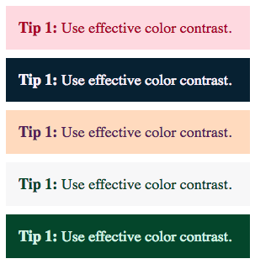
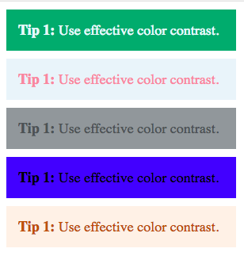
Tip 1: Aim for a high contrast ratio
Effective contrast
Ineffective Contrast
→ 6.0
→ 2.8
→ 14.7
→ 2.0
→ 8.7
→ 2.7
→ 10.5
→ 2.4
→ 9.2
→ 4.3
Notes:
If you don't have a graphic designer, and it's rare you won't, but for your own websites make certain the contrast is stark

Slide 41
Exercise: Test color contrast in Browser
Right Click inspect element
Click the select icon
Hover over the <th> elements
Get inspired by high contrast color schemes.
Notes:
You can use color contrast through browser extensions but both firefox and chrome now have this embedded by default
If pressed for time, skip the demo
Above is in chrome, but it's almost the same in forefox and chrome. However, FF must enable accessibility first
Firefox: Open inspector → Enable Accessibility Features → Click the select icon → Hover over element

Slide 42
CSS: Box Model
p {
height: 80px;
width: 240px;
border: 3px solid coral;
margin: 0;
padding: 0;
}
You can use CSS to manipulate:
the height of the box
borders of the box
margins of the box
padding around the box

Slide 43


Flexbox
flex-direction: column;
flex-direction: column-reverse;
Notes:
flex-direction displays vertically or horizontally
flex-flow

Slide 44



Flexbox
Use the align-items property to align the flex items vertically.
.flex-container {
display: flex;
height: 200px;
align-items: center;
background-color: #ff5050;
}
align-items: center;
align-items: flex-start;
align-items: flex-end;
Notes:
item alignment

Slide 45

Bootstrap Typography
<p>To make an image responsive, simply set its max-width and height as follows:</p>
<code>
img {
max-width: 100%;
height: auto;
}
</code>

Slide 46
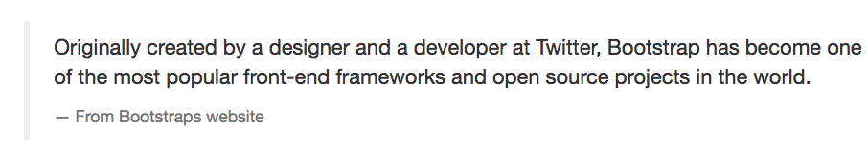
Bootstrap Typography
<blockquote>
<p>Originally created by a designer and a developer at Twitter, Bootstrap has become one of the most popular front-end frameworks and open source projects in the world.</p>
<footer>From Bootstraps website</footer>
</blockquote>

Slide 47
Bootstrap Typography
<p>Use <kbd>cmd + c</kbd> to copy and <kbd>cmd + v</kbd> to paste</p>

