Slide 1
Philly Tech Sistas
SQL
Class 5
Notes:
Do a bootstrap recap

Slide 2
What is SQL?
Structured Query Language
Created in 1970 @ IBM
An introduction
Notes:
Language is little unwieldy - it's a throwback to the 1970s when we are at the beginning of using what approximates modern desktop computers, we were still using punchcard coding and mainframes
Old school
Created to query one of IBM's internal databases
in 1979 IBM and Oracle released databases for public usage
In 1986 the international standards group started standardizing the language

Slide 3
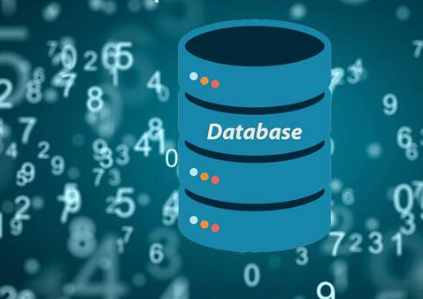
What are Databases?
Type of Software to hold a lot of information
Notes:
Can anyone think of what dbs are
typically called database engines

Slide 4




Where are DBs used?
Notes:
walk through imdb as example
Can anyone else think of other sites that might uses databases or in your local life

Slide 5


Sample Database Companies
Oracle
Microsoft (SQL Server)
Amazon
MySQL
Sql Lite
Notes:
Like there are different browsers, different companies make database engines
Demonstrate MS Access and SQL SERVER
Each database software has pros and cons
Oracle is more established but is very complex
SQL Server easier to learn
Amazon recently came on the scene with their own version
MySQL is free

Slide 6
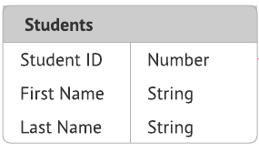
Database Tables
The table holds information about a specific topic, like students.
Each row represents an individual student.
Each column can hold information that describes each student like age or grade.
Notes:
First, we will need to understand Tables and Columns.

Slide 7
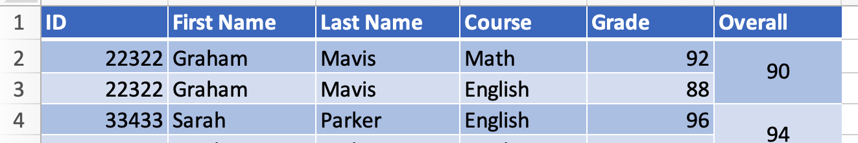
Spreadsheets!
Think of databases as spreadsheets
Each spreadsheet tab represents a different table
Data contained in a grid like manner
Notes:
Think of databases as spreadsheets
Consider each tab represents a different topic
Consider each tab in a spreadsheet as a table
Each Row a unique entry in that tab
Each column in that row contains discrete information
IDs are used to share data between the different tabs
Walk through sample spreadsheet
Databases- software that can contain many objects like tables, stores information in files
Tables- help store data in an organized way
Relationships/Keys- SQL is used for communicating with relational databases. Referential integrity ensures that data does not get out of sync.
Attributes- e.g. NULL (not required) / NOT NULL (required) for columns. Table have properties that tell the database how to access the data within or where the data should be stored
Databases can also contain information in an unstructured manner – e.g. NoSQL databases and Data Lakes. We are not going to cover that today.
How do you find information in a database? (This is what we are going to learn today!)

Slide 8
Why Use Databases Instead of Spreadsheets?
Need to easily find data
Large Amounts of Data
Complex relationships

Slide 9
Types of Data Tables Can hold
Words / paragraphs / names | Varchar
Numbers | Int
Currency, Decimals | Float or Double
Images (binary image data) | Blobs
Large amounts of text (articles) | Large text

Slide 10
Basic Table Structure
Each table should have ....
Name
Columns
Information related to its category
DOG TABLE
dog_id (ID, INT) | breed (VARCHAR) | age (INT)
1 | Chinese Shar-Pei | 12
2 | Italian Greyhound | 15
3 | Irish Water Spaniel | 12

Slide 11
How do we get data in & out?
SQL is a Data Manipulation Language to retrieve and store information
Main Types Of SQL Statements:
Select - gets info from table
Insert - adds info in table
Delete - removes info from table
Update - updates data
Notes:
Now that we understand the concepts of a database, we will pull information out of the database in a structured fashion SQL is the tool that allows us to do that.
From the SQL (Wikipedia): https://en.wikipedia.org/wiki/SQL
SQL was initially developed at IBM by Donald D. Chamberlin and Raymond F. Boyce after learning about the relational model from Ted Codd^{[15]} in the early 1970s.^{[16]} This version, initially called SEQUEL(Structured English Query Language), was designed to manipulate and retrieve data stored in IBM's original quasi-relational database management system, System R, which a group at IBM San Jose Research Laboratory had developed during the 1970s.^{[16]}
Chamberlin and Boyce's first attempt of a relational database language was Square, but it was difficult to use due to subscript notation. After moving to the San Jose Research Laboratory in 1973, they began work on SEQUEL.^{[15]} The acronym SEQUEL was later changed to SQL because "SEQUEL" was a trademark of the UK-based Hawker Siddeley aircraft company.^{[17]}

Slide 12
Select Statement Format
SELECT * FROM table_name;
SELECT column1, column2, column3
FROM table_name;
SELECT column1, column2, column3
FROM table_name
WHERE conditional_selection;
Notes:
SELECT * FROM tablename; (Simplest form)
The WHERE clause (optional) specifies which data values or rows will be returned or displayed, based on the criteria described after the keyword where;
Parts of SELECT statement
SELECT clause: For Selection
FROM clause: Which ‘Relation/Relations’ to use
WHERE clause: For Join conditions, and Filtering (i.e. search condition)
ORDER BY: For sorting the output
GROUP BY: For creating ‘data buckets’
HAVING: For ‘filtering’ the ‘data buckets’

Slide 13
Creating a Sample Database
Go to http://sqlfiddle.com/
Type the Below into the left window CREATE TABLE dogs (dog_id integer PRIMARY KEY, breed varchar(50)); INSERT INTO dogs (dog_id, breed) VALUES (16, 'Dalmatian');
Click Blue Build Schema Button
Click in the right window.
Type the below Select * from dog;
Click run sql button
If any issues, try it with https://www.tutorialspoint.com/execute_sql_online.php

Slide 14
Take a Break!
5 min!

Slide 15

Group Lab
1. Run the Database Creation Script
2. Run the Insert Statements
3. Run the Sample Queries
Notes:
Anita Demo each first
don't break out into groups, but if anyone has questions ta will respond

Slide 16
Database Creation Script
DROP TABLE IF EXISTS intelligence;
CREATE TABLE intelligence (
breed varchar(50),
classification varchar(50),
obey numeric(5,2),
reps_lower Integer,
reps_upper Integer
);
DROP TABLE IF EXISTS popularity;
CREATE TABLE popularity (
breed varchar(50),
2016_rank Integer,
2015_rank Integer,
2014_rank Integer,
2013_rank Integer
);
DROP DATABASE IF EXISTS techgirlz;
CREATE DATABASE techgirlz;
USE techgirlz;
DROP TABLE IF EXISTS dogs;
CREATE TABLE dogs (
dog_id integer PRIMARY KEY,
breed varchar(50),
type varchar(30),
max_height integer,
max_weight integer,
max_life_span integer,
general_health varchar(30),
intelligence varchar(10),
friendly varchar(10)
);
INSERT INTO dogs (dog_id, breed, type, max_height, max_weight, max_life_span, general_health, intelligence, friendly)
VALUES (1, 'Chinese Shar-Pei', 'Working Dogs', 20, 55, 12, 'Poor', 'Low', 'Rarely');
Notes:
Before sourcing the dogs.sql file, review it with the class.
Make note of some of the different data types.
Discuss some of the field names and why they are as they are.
Talk about PRIMARY KEY and what that means.
Explain DROP TABLE IF EXISTS.
Talk about the concept of a database, especially in the context of multiple databases on a single server. The database we created and are using, techgirlz, encapsulates related data into a single container.
Explain the use of the "syntactic sugar" – commas and semicolons.
Commas separate a list of column names or values
Semi-columns terminate statements. A semi-colon may or may not be optional depending on the type of SQL server you are using. It is good practice to use them. In fact, within the MySQL command line tool, if you press RETURN without having entered a semicolon, a new line will appear to continue typing the SQL command. So, SQL commands can span many lines. It is often good practice to make your SQL "pretty" by using multiple lines and appropriate indentation.

Slide 17
Insert Statements
INSERT INTO dogs
(dog_id, breed, type, max_height, max_weight, max_life_span, general_health, intelligence, friendly)
VALUES (16, 'Dalmatian', 'Companion', 24, 55, 16, 'Poor', 'High', 'Sometimes');
INSERT INTO dogs
(dog_id, breed, type, max_height, max_weight, max_life_span, general_health, intelligence, friendly)
VALUES (30, 'Pug', 'Companion', 14, 18, 15, 'Poor', 'Medium', 'Usually');
INSERT INTO dogs
(dog_id, breed, type, max_height, max_weight, max_life_span, general_health, intelligence, friendly)
VALUES (193, 'Saint Bernard', 'Working Dogs', 30, 180, 10, 'Poor', 'Medium', 'Sometimes');
Notes:
Let’s take a look at one way of putting data in a table.
Can you imagine doing this for every record in a table? Don’t worry – you won’t have to. There is a script to populate the tables for you with all this data.
Notice how the columns line up with the values.
There are other more efficient ways to get data into tables. Can you think of what would go into a table and how?
Why do some of the words have quotes around them?
What do you think would happen in a number had quotes around it? What would that mean?

Slide 18
Sample Select Queries
Simple queries
dog_id | breed | type
1 | Chinese Shar-Pei | Working Dogs
2 | Italian Greyhound | Companion
3 | Irish Water Spaniel | Sporting Dogs
4 | Sussex Spaniel | Sporting Dogs
5 | Affenpinscher | Companion
SELECT dog_id, breed, type
FROM dogs LIMIT 5;
SELECT dog_id, breed, max_weight
FROM dogs
WHERE max_weight > 175;
dog_id | breed | max_weight
84 | Irish Wolfhound | 180
181 | Great Dane | 200
187 | Mastiff | 220
188 | Neapolitan Mastiff | 200
193 | Saint Bernard | 180
SELECT dog_id, breed, type
FROM dogs
WHERE breed LIKE '%German% ';
dog_id | breed | type
57 | German Shepherd | Herding Dogs
124 | German Shorthaired Pointer | Sporting Dogs
125 | German Wirehaired Pointer | Sporting Dogs
179 | German Pinscher | Working Dogs
Notes:
Here are some simple examples of selecting data.
Spend time on the last example, explaining LIKE, %, and single quotes.
LIKE only works on String-type fields. Does anyone recall what a string-type field is? (answer: varchar, char. Bonus points: text. Extra bonus points: nvarchar, nchar)
LIKE is a way of filtering a result set to return only rows where the field's value matches the LIKE expression.
Percent (%) matches zero or more characters. So, if you want to find all dogs that have the word "German" in any part of the breed, surround German with percent symbols.
Single quotes must always be used with strings, even if the string is as simple as a single character. The quotes tell the SQL interpreter that was is between the two quotes is a string.
Bonus for asking this question:
What is I want to search on a field that contains a single quote? (Answer: "escape" the quote with another quote, that is, precede the quote with another single quote).
Example: select * from dogs where breed like '%''%'; (Note that is two single quotes and not a double quote)

Slide 19
Other SQL Commands
DML Command | Description
SELECT | Retrieves certain records from one or more tables
INSERT | Creates records
UPDATE | Modifies records
DELETE | Deletes records
Notes:
ANITA DEMO
Not focusing on ALTER today.
NOTE: Although the students will learn about the DCL language used to grant and revoke user rights to data, the workshop will NOT focus on DCL. Instead, the workshop will focus on the DDL and DML language subsets with hands-on exercises to help the students understand those aspects of SQL.
May want to speak to why security is important within a database.

Slide 20
Breakout Lab
Experiment with
Inserting Data,
Updating Data,
Deleting Data and
Inserting Data
Notes:
You can mix JavaScript and HTML. The script tag tells your browser the stuff inside is JavaScript, not HTML.
<script> CODE GOES HERE </script>

Slide 21
Lab: Insert Data
Structure:
INSERT INTO TABLENAME (col1, col2) values (value1, value2, ...)
Example:
INSERT INTO DOGS (id, name) values (1, 'spot');
Lab:
Create 2 Insert statements to insert data into the dogs table

Slide 22
Lab: Update Data
Structure:
UPDATE table_name SET column1 = value1, column2 = value2, ... WHERE condition;
Example:
Update DOGS
SET name='Scooby'
WHERE id=1;
Lab:
Create 1 update statement. Change the name of the dog at id 1 to 'Chester'

Slide 23
Lab: Delete Data
Structure:
DELETE FROM table_name WHERE condition;
Example:
DELETE FROM DOGS
WHERE name='Scooby'
Lab:
Create 1 create a delete statement.
Delete the entry where name is Scooby.
Create a new insert to add another dog to your table

Slide 24
Sample Select Queries
Organize Alphabetically
SELECT dog_id, breed, type
FROM dogs ORDER BY type;
Does Not Equal
SELECT breed, max_weight
FROM dogs
WHERE max_weight != 175;
Pattern Match
SELECT dog_id, breed, type
FROM dogs
WHERE breed LIKE '%German% ';
Compound Query - And
SELECT dog_id, breed, max_weight
FROM dogs
WHERE max_weight > 175
AND
max_weight < 200
Compound Query - Or
SELECT dog_id, breed, max_weight
FROM dogs
WHERE max_weight > 175
OR
breed != 'poodle';
Notes:
LIKE only works on text fields. Does anyone recall what a text field is called in ? (answer: varchar, char.
LIKE is a way of filtering a result set to return only rows where the field's value matches the LIKE expression.
Percent (%) matches zero or more characters. So, if you want to find all dogs that have the word "German" in any part of the breed, surround German with percent symbols.
Single quotes must always be used with strings, even if the string is as simple as a single character. The quotes tell the SQL interpreter that was is between the two quotes is a string.
Bonus for asking this question:
What is I want to search on a field that contains a single quote? (Answer: "escape" the quote with another quote, that is, precede the quote with another single quote).
Example: select * from dogs where breed like '%''%'; (Note that is two single quotes and not a double quote)

Slide 25
Take a Break!
5 min!

Slide 26
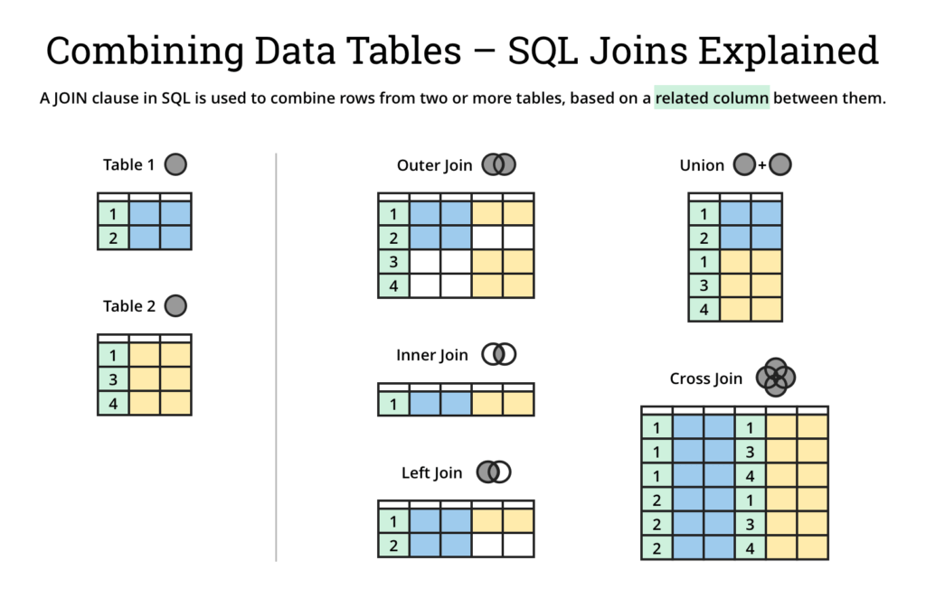
DB Relationships
We use SQL Queries to reflect the relationships between the different tables
Joins are queries that connect tables together through ids
Keeping data in separate tables avoids overloading the database
https://dataschool.com/how-to-teach-people-sql/inner-join-animated/

Slide 27
Homework

Slide 28
Lab: Create Database
Run this command in sql fiddle or db fiddle
create table movies (
id integer NOT NULL PRIMARY KEY,
name varchar(255),
description varchar(255),
rating integer,
typeid integer
);
create table filmtype (
id integer NOT NULL PRIMARY KEY,
name varchar(255));
Notes:
Run this command in sql fiddle or db fiddle
create table movies (
id integer NOT NULL PRIMARY KEY,
name varchar(255),
description varchar(255),
rating integer,
typeid integer
);
create table filmtype (
id integer NOT NULL PRIMARY KEY,
name varchar(255));

Slide 29
Lab: Insert Data
REMEMBER:
Movies table has fields
id, name, description, rating, typeid
Filmtype table identifies movie type i.e. DC, MCU, ROMCOM
Movie table points to type table
Type table has fields
id, name
INSERT INTO TABLENAME (col1, col2) values (value1, value2, ...)
INSERT INTO filmtype (id, name) values (99, 'MCU');
INSERT INTO filmtype (id, name) values (100, 'DCU');
INSERT INTO movies (id, name, description, rating, typeid) values (1, 'Avengers','About heroes',5,99);
INSERT INTO movies (id, name, description, rating, typeid) values (2, 'Superman','By Zac Snyder',4,100);
Lab:
Create 2 Insert statements to filmtype
Create 2 Insert Statements to movies
Notes:
create table movies (
id integer NOT NULL PRIMARY KEY,
name varchar(255),
description varchar(255),
typeid integer
);
create table type (
id integer NOT NULL PRIMARY KEY,
name varchar(255));
create table rating (
id integer NOT NULL PRIMARY KEY,
rating varchar(255));

Slide 30
Bonus: Create SQL Join Statement
Create old school join on product & type table
Create standard join
SELECT table1.fieldname, table2.fieldname
FROM
table1, table2
WHERE
table1.foreignkey = table2.primarykey
SELECT table1.fieldname, table2.fieldname
FROM table1
JOIN table2
ON
table1.foreignkey = table2.primarykey

Slide 31
Learn More

Slide 32
Learn More
w3schools.com
tutorialspoint.com/sql
geekgsforgeeks.org/sql-tutorial
sqltutorial.org
Notes:
JavaScript Guide, from the Mozilla Developers Network.Code Academy, with interactive JavaScript lessons to help you review.JavaScript Weekly, an email round-up of JavaScript news and articles.

Slide 33
Resources to Continue Learning
Codecademy: https://www.codecademy.com/
Offers a variety of courses for front end, back end, and more
Has a free version, pro subscription, and paid 8-10 week specialized courses
Lynda : https://Lynda.com
Typically included in library , university or linkedin memberships

