Slide 1
Philly Tech Sistas
Intro to HTML Class 1

Slide 2

About Us
We are developers, innovators, and thought leaders and we are trying to increase the number of women of color in tech.
Notes:
According to BuiltIn.com in January of this year,
26% of computing-related jobs are held by women.
Only 3% of those are held by African-American women, 6% held by Asian women and 2% held by Hispanic women.
PTS's goal is to diversify the tech industry by empowering women of color. :
gain technical and professional skills
through low-cost workshops
so they can move up in the tech industry
https://builtin.com/women-tech/women-in-tech-workplace-statistics -
They want to help women of all hues and levels gain technical skills to move up in the tech industry through accessible workshops

Slide 3
Join Us on...
Meetup.com: https://www.meetup.com/Philly-Tech-Sistas/
Slack: Women of Color in Technology Slack Channel http://bit.ly/2HqZc4b
Twitter: @phillytechsista
Instagram: @philly_tech_sistas
Web: https://www.phillytechsistas.org/ Github: https://github.com/philly-tech-sistas
Email: phillytechsistas@gmail.com
Notes:
Paste all links in chat
Meetup.com: https://www.meetup.com/Philly-Tech-Sistas/
Slack: Women of Color in Technology Slack Channel http://bit.ly/2HqZc4b
Twitter: @phillytechsista
Instagram: @philly_tech_sistas
Web: https://www.phillytechsistas.org/ Github: https://github.com/philly-tech-sistas
Email: phillytechsistas@gmail.com

Slide 4


Meet Today's Team
Instructor (Anita)
Lifelong Tech
Constantly Relearning
GeekGirlWisdom@gmail.com
Mentors/TAs:
Notes:
I Started coding in elementary school & t/o hs & college and have professionally worked as a developer for 15-16 years.
I took time off in between for about 5 years to work on my graduate degree
So, although I worked in this field a long time, I have to constantly update my skills. What I knew 6 years ago, isn't relevant to today. My skills are considered equal to an entry level developer. What I bring to the table is typically logic and
I know how it feels to re-enter the workforce and have to continuously retrain. Whenever I learn something new I take courses, bootcamps, online training
Ashley Turner
Bianca Dennis is a software engineer at Scoir.
Maura F I currently work at Cigna as a software engineer after making a career change into tech in 2019. My background is in web development, but I also have experience in Salesforce. I enjoy travelling, taking care of my plants, and cooking!
Jason M Software engineer with 3 years of experience, who used to teach math to college students.
Miriam P full-stack developer, just graduated from Flatiron School, and author of Code Like a Girl and The Daring Book for Girls.
Zenzi A Zenzi is a Backend Engineer that uses technology to advocate for social justice and economic empowerment for women. She's the current Code for Philly Engineering Fellow working to develop an app to prevent food insecurity.

Slide 5
Code of Conduct
Our Standards
Philly Tech Sistas is dedicated to providing a positive experience for everyone within our community. Examples of behavior that contributes to creating a positive environment include:
Using welcoming and inclusive language
Being respectful of differing viewpoints and experiences
Referring to people by their preferred pronouns and using gender-neutral pronouns when uncertain such as you all, everyone, and friends
Gracefully accepting constructive criticism
Focusing on what is best for the community
Showing empathy towards other community members
For more info, see our Code of Conduct: https://www.phillytechsistas.org/code-of-conduct
Notes:
The code of conduct for this workshop is a focus on positivity
Paste the CoC in the chat
https://www.phillytechsistas.org/code-of-conduct
Safe space - Tech world is all about bro culture and competition, this is all about support., so if you have questions, don't be afraid to ask. And, if you know something don't be afraid to share.
We want to avoid Harassment, which includes but is not limited to:
Offensive comments related to gender, gender identity and expression, sexual orientation, race, religion, physical appearance, body size, mental illness and/or disability
Threats of violence
Use of sexual language or imagery at any time
Harassing photography or recording
Sustained disruption of talks or events
Deliberate intimidation, stalking or following
Inappropriate physical contact
Unwelcome sexual attention
Unwelcome comments regarding a person’s lifestyle choices and practices

Slide 6
What we will cover
Week 1: Intro to HTML
Week 2: Intro to CSS & Responsive Design
Week 3: Intro to More CSS & JavaScript
Week 4: Intro to JavaScript (cont.)
Week 5: Intro to SQL
Week 6: Intro to GitHub
Notes:
First 3 weeks - cover HTML & CSS
Mid week cover GitHub, a crtical developer tool
Final 2 weeks cover JavaScript
It's OK if this is new, that's what we're here for and if you already have experience, this will be great practice

Slide 7
Introduce Yourselves
What is your name?
What are your preferred pronouns?
Why are you joining us today?

Slide 8
What is HTML
A Quick Review
Notes:
Ask group if they know what HTML is what it represents

Slide 9
Web Page Structure
<!DOCTYPE html>
<html>
<head>
<meta name="description" content="about web development" />
<meta name="keywords" content="html, coding, intro" />
<link href="style.css" />
<title>Title of the page</title>
</head>
<body> The page content here. </body>
</html>
Notes:
Ask group - What is HTML?
HTML is what we use to make websites. It is a tagging language that structures, contains and displays content (like text, images, links, and videos) on a webpage.
HTML - SGML 1960s document markup language
None of the tags above are technically required, but they make up standard HTML template. The first 2 tags are typically not seen by end users. But they tell the browser how to process the HTML.
DOCTYPE first thing on an HTML page tells the browser which version of html you're using.
HEAD - Contains the page title and meta information about the page Meta information is invisible to the user, it provides information to search engines like SEO tags , the head tag also links to external resources like stylesheets.
BODY
Holds the visible content of the page. This is where you put anything you wish the user to see.
HTML is not case sensitive, but you should still be careful. None of the below tags are required, but they make up standard HTML template

Slide 10
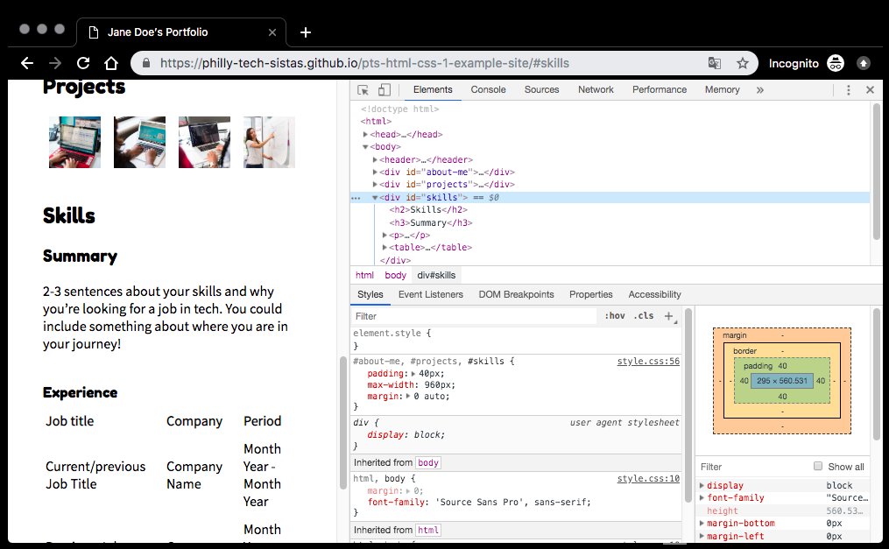
Inspect Element
As you can see, all websites have the same structure ...
Notes:
Almost all websites are the same -
I want you guys to do this with me.
Go to your browser, I'm using Chrome on a Windows machine, right click
Chrome/Firefox/Edge Developer tools allow you to examine the code of a website. You can use the tools to make temporary changes to the site in order to see how different adjustments would look in real time.
Have everyone navigate to their favorite site and do inspect element to see what's under the hood
To open the developer tools “right” click anywhere on the page, then... In Chrome, click “Inspect” In Firefox, click “Inspect Element”
To do so, open the Safari browser, click on Safari -> Preferences. Click on Advanced. Check the Show Develop menu in menu bar checkbox.

Slide 11
Basic Tags
Standard Format
Open Tag: <TAG>
Closing Tag: </TAG>
Headers (h1-h6): <h1>My Header</h1>
Paragraphs: <p>My Para</p>
Span: <span color=red>Use me to format text</span>
Lists (ul, ol):
<ul> <li>Pasta</li> <li>Macaroni</li>
</ul>
Div: <div><p>I hold</p><p>a lot of other tags</p></div>
Image: <img src=https://amazon.com/bridgerton.jpg />
Links: <a href=http://amazon.com>Amazon Link</a>
Notes:
Describe tags above and then use verbiage below:
Standard Tag (open/close tag): Content must be contained within the opening tag and the closing tag. Does anyone notice the difference between the open and closing tag? Because HTML is a document markup language, it's meant to be very easy to remember. Anything that should be a title is within the header tag. Anything that's a paragraph should be . It's like Microsoft Word but you're typing your formatting instead of allowing word to do it for you.
SELF-CLOSING TAGS: Tags that don't contain content but display data like image tags <img src="image.jpg" alt="Your image">
Container Tags: <body>
Nested Tags: Any tag within another tag is considered nested like Lists. But by default all tags are nested as they go within body tag two types of list tags, ordered where numbered by default and undordered listul, typically reflected by bullets

Slide 12
Link Types
Link to External Page: <a href="http://mywebsite.com/page.html">Link to an external page.</a>
Relative Link: <a href="page.html">Link to a page on the site.</a>
Anchor links: <a name="header1">Header</a> <a href="#header1">Go to Header</a>
Link Attributes <a href="website.html" target="_blank">Opens in another tab.</a>
<a href="mailto:email@youremail.com">E-mail us!</a>
Notes:
Links can take users to another web site, another page, or a specific part of a page. With some adjustments, links can open in a new tab or perform a special action, like opening the user’s default mail application.
You can link to an external website which is called called absolute, because you use the full http URL
Or you can link to a page within your own domain or folder, that's called relative as you aren't using the full http domain location, just the page name
Anchor links aren't used as much anymore - but if you want to link from one section of your page to another section on that same page, you use anchor links
Absolute links: Links to external site or same directory <a href="http://mywebsite.com/page.html">Link to an external page.</a>
Relative links: Links to site within the same domain/directory <a href="page.html">Link to an external page.</a>
Anchor links: Links within the page <a href="#projects">Link to a section on the page.</a>

Slide 13
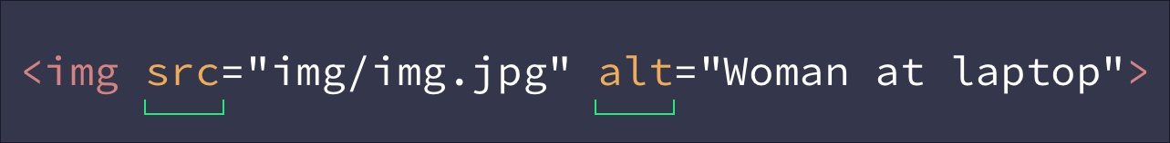
Attributes
Attributes give more information about your element.
Required Attributes:
src (on IMG tag)
href (on A tag)
Optional (but heavily suggested)
Unique Identifier - id="unique-id-1"
Name - name="username"
Alternative Text - alt
Notes:
Attributes are similar to meta tags, they are not seen by the user. They provide additional information about that element that the website or developer can use
Some attributes are required for the element to work, such as the src on the <img> tag. Some are optional like the id or name attributes.
Some are heavily suggested like the alt tag. Alt text is needed on image tags for accessibility and stands for “alternative text”.
It is heavily suggested all attribute data should be in quotations
Walk through text above

Slide 14


Group Exercise: Introduce Yourself
First, we'll demo. Then, you'll sign up and create your HTML in groups.
Go to online IDE either https://app.bsd.education/ or https://jsfiddle.net/
Create an account for yourself
Create a new sandbox / project
Click in the HTML
Create a professional portfolio webpage
Your name in H1 Tags
About yourself in P tags
Add Image & link
Save the page
<body>
<h1>Jane White</h1> <img src=https://m.media-amazon.com/images/I/81OEjjAyVXL._AC_UL480_FMwebp_QL65_.jpg />
<p>I am a programmer of over 15 years. For more about me, go to <a href=http://phillytechsistas.com>PhillyTechSistas</a>
</body>
Notes:
BSD or JSFiddle?
Demo what to do then h
Don't forget to save your page so youc an modify it later. Also refresh to see changes rendered
Royalty free Image sites you can use:
https://unsplash.com/s/photos/women-in-tech
https://www.flickr.com/photos/wocintechchat/
pixabay.com
morguefile.com

Slide 15
<BREAK />

Slide 16
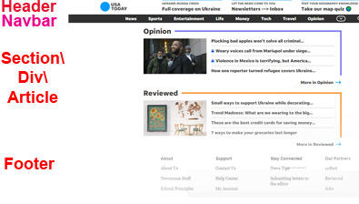
Standard Page Structure
Body
Header
Nav
Section
p \ul
Footer
Notes:
Section \ div are content areas

Slide 17
Standard page structure - HTML
<Body> <header>
<h1>Title of your site</h1>
<nav>
<ul>
<li> <a href="#about">About</a> </li>
<li> <a href="#projects">Projects</a> </li>
</ul>
</nav>
</header>
<Section>
<p>Where the actual content goes</p>
</p>
</section>
<footer>Disclaimers/ Copyright / Nav Links </footer>
</body>
<body> - Contains all tags
<header> - Site Information
<nav> - Site Navigation
<Section> \ <Div> - Container Tags
<footer> - Disclaimers, etc.
Notes:
Header & nav elements are an example of Semantic elements, when you look at it you know what it contains, other elements like that are footer tags, you see that tag name, you know it'll be the website footer. HTML5 has increasingly worked to make tags more meaningful
however, non-semantic elements are typically holdovers from html4 and before. Samples includes div, body, list or span tags. They help organize content, they are typically container tag, where they hold other tags, or are used to format HTML.
Semantic elements typically hold text or words, but footer and header tags also increase accessibility for those who are sight impaired and utilize screen readers to navigate websites - if a screen reader sees a header or nav tag they automatically know this contains navigation information. If they come across a div tag, they won't know what it contains. So a lot of websites are shifting away from non-semantic elements like div tags over to header tags, but a lot still use them
Header & nav elements are used to organize website links, specifically the main site navigation
<header>
Typically contains a logo, a search box and maybe a banner image
<nav>
Typically contains the actual site navigation either links to pages within the Site or links on a specific page
You guys have no doubt probably noticed this on other sites you've navigated to. Can you think of a couple sites that had navigation you appreciated and felt was easy to follow?
--------------------------------------------------------
EXERCISE
Let’s make our site navigation more semantic. Contain the unordered list (and our site title!) in a <header> and <nav> element.
<header> <h1>Title of your site</h1> <nav> <ul> <li> <a href="#about">About</a> </li> <li> <a href="#projects">Projects</a> </li> <li> <a href="#skills">Skill</a> </li> </ul> </nav> </header>IMAGE
The image tag has two required attributes: src and alt. You can use a relative link or link to any image on the internet with an absolute link.
<img src="img/image.jpg" alt="Person in chair." height="300px" width="200px"><img src="https://www.website.com/image.jpg" alt="Person in chair." height="300px" width="200px">

Slide 18
Group Exercise: Update your portfolio
Fit Your Portfolio into standard page structure
Put the content you created within a section or div tag
Create another section, My tech focus
Create another div / section tag
Add an h1
Add content within p tags
Create a header tag
Add a header tag at top with logo
Add Nav tag up top
Add footer link at bottom
Add Anchor Links
Add <a name> links inside each of the h1 tags
Add <a href=#> links inside the nav tag that point to the subsections
<header>
<nav>
</nav> </header>
<div id="aboutme">
<h1><a name="aboutjane">Jane White</a></h1> <img src=https://m.media-amazon.com/images/I/81OEjjAyVXL._AC_UL480_FMwebp_QL65_.jpg />
<p>I am a programmer of over 15 years. For more about me, go to <a href=http://phillytechsistas.com>PhillyTechSistas</a>
</div>
<div id="newsection">
</div>
Notes:
Make it clear just watch me - and demo
In this exercise you are going to use non-semantic div tags. Next week we'll use article or section tags, but this week I want you to familiarize yourself with using div container tags, as they're still used in many websites.
You created an about me section
NOW enter into breakout room

Slide 19
COMMENTS
<!-- HTML Comment! -->
<!--
<ul>
<li>Order</li>
<li>Doesn’t</li>
<li>Matter</li> </ul>
-->
Hint: Select code you want to “comment out” and click ⌘ + / (Mac) or CTRL + / (PC).
Notes:
Annotations that can act as notes, commentary or explanations within your code. They show up in the browser, but don’t do anything.

Slide 20
Can I Do This?
YES! You Can!!!
Since the pandemic, 55% of non-technicals are considering re-training https://www.theguardian.com/careers/2020/dec/14/tech-careers-for-women-what-are-the-main-roles-and-how-do-you-retrain
By hiring non-technical people, Etsy increased female engineers by 30% https://www.wired.com/story/dangers-keeping-women-out-of-tech/
Programs focused on women sends a strong message to technical staff. https://www.wired.com/story/how-to-buck-the-brogrammer-culture-and-get-women-into-stem/
Notes:
Etsy convinced people who weren’t in software development jobs to be trained for technical roles, and they managed to get to almost 30 percent female in their engineering population relatively quickly. Accenture is doing extremely well and came in at roughly 40 percent female in their hires last year.
Wired Opinion piece
Companies should give women the opportunity to lead from day one. This means creating programs that tell women, "

Slide 21
Take Home Exercises
Finish your portfolio
Download portfolio
Modify Template
Complete Attributes
Bonus: Create Table

Slide 22
Exercise: Update your portfolio
Give all of the div tags an id attribute
i.e. <div id="aboutme">
Add a Contact me section
Add a link in the nav section called contact me using an href:mailto link
Put all of the nav links inside a ul / li
Check Your Code
Make certain ALL images, headers, links and div tags have IDs, Names and alt attributes
<header>
<nav>
</nav> </header>
<div id="aboutme">
<h1><a name="aboutjane">Jane White</a></h1> <img src=https://m.media-amazon.com/images/I/81OEjjAyVXL._AC_UL480_FMwebp_QL65_.jpg />
<p>I am a programmer of over 15 years. For more about me, go to <a href=http://phillytechsistas.com>PhillyTechSistas</a>
</div>
<div id="newsection">
</div>
Notes:
In this exercise you are going to use non-semantic div tags. Next week we'll use article or section tags, but this week I want you to familiarize yourself with using div container tags, as they're still used in many websites.
You created an about me section

Slide 23
Exercise: Create a calendar
Create a new project called calendar inside the table tag
Inside that calendar.html, create a 7-day calendar using your weekly google or outlook or personal calendar as an example using the table tags
The following slide outlines how to use table tags
<table style="width:100%"> <tr> <th>Mon</th> <th>Tue</th> <th>Wed</th> </tr> <tr> <td>Mon@12: Go Running</td> <td>Tue@1: Go Walking</td> <td>Wed@2: Nap</td> </tr>
</table>
Notes:
Don't forget to save!

Slide 24
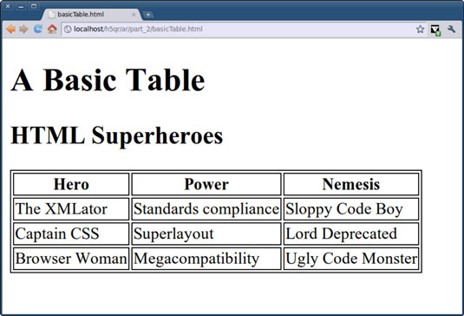
TABLES
<table>
<caption>Table Title</caption>
<tr>
<th>Column header 1</th> <th>Column header 2</th>
</tr>
<tr>
<td>Data 1</td>
<td>Data 2</td>
</tr>
</table>
Notes:
Tables are a way to represent complex information in a grid format. They are made up of rows and columns.

Slide 25
Learn More

Slide 26
Learn More
W3Schools: https://www.w3schools.com/html/
Relative Paths: https://www.coffeecup.com/help/articles/absolute-vs-relative-pathslinks/
HTML5: https://developer.mozilla.org/en-US/docs/Web/Guide/HTML/HTML5
Web accessibility: https://developer.mozilla.org/en-US/docs/Web/Accessibility
Web accessibility: https://developers.google.com/web/fundamentals/accessibility/ Web accessibility: https://www.w3schools.com/html/html_accessibility.asp Web accessibility: http://web-accessibility.carnegiemuseums.org/foundations/semantic/

