Slide 1
Introduction to Software Engineering
Software Engineering: A Practitioner’s Approach
by Roger S. Pressman

Slide 2

The Law of Unintended Consequence（非故意结果）
Computer software can have profound and unexpected effects on:
Science
Business
Engineering
Commercial
People, and
Culture
None could have foreseen!

Slide 3
Where is Software?
Transportation
Medical
Telecommunications
Military
Industrial
Entertainment
Office Machines
Education
etc.
软件已运用到政府、银行和金融、教育、交通、娱乐、医疗、农业和法律等方面：
以网络为中心的系统
信息系统和数据处理
金融和电子商务系统
生物医学系统
多媒体、游戏和娱乐系统
嵌入式和实时系统
容错和免疫系统
。。。。。。
有没有或不能用软件的地方吗？

Slide 4
Key Point
Ideas and technological discoveries are the driving engines of economic growth.
------ The Wall Street Journal

Slide 5


Software’s Dual Role（双重作用）
Software is a product
Transforms information - produces, manages, acquires, modifies, displays, or transmits information
Delivers computing potential of hardware and networks
Notes:
Information transformer - function behavior
Computing potential - non-functional behavior
Example of functional behavior?
Type characters into keyboard => word processor displays them on screen
Input program file => compiler translates to byte code
Example of non-functional behavior?
Type character in instant messenger => appears on friend’s screen
Compile large program within a few seconds
Performance - time and space
Vehicle for product delivery
Examples of SW controllers (other than OS)
Examples of communication SW
Examples of development tools

Slide 6
Software’s Dual Role（双重作用）
Software is a vehicle（载体） for delivering
a product
Supports or directly provides system functionality
Controls other programs (operating system)
Effects communications (networking software)
Helps build other software (software tools & environments)
Software provides information
Software developers face many problems
Notes:
Information transformer - function behavior
Computing potential - non-functional behavior
Example of functional behavior?
Type characters into keyboard => word processor displays them on screen
Input program file => compiler translates to byte code
Example of non-functional behavior?
Type character in instant messenger => appears on friend’s screen
Compile large program within a few seconds
Performance - time and space
Vehicle for product delivery
Examples of SW controllers (other than OS)
Examples of communication SW
Examples of development tools

Slide 7
Historical Insight
http://www.softwarehistory.org/
http://www.yourdon.com/
None of us can really know the future of the systems we build.

Slide 8

The Definition of Software
What is Software?
Software is a set of items or objects that
form a “configuration” that includes
Programs
Document
Data…

Slide 9
The Definition of Software
Software is:
Instructions that when executed provide desired features, functions, and performance;
Data structures that enable the programs to adequately manipulate information;
Documents that describe the operation and use of the programs
Services that support users to apply software

Slide 10
The Definition of Software
作为软件工程的研究对象，软件是：
The collection of computer programs, procedures, rules, and associated documentation and data。 (IEEE)
软件是一种逻辑，用计算机语言表达，是可在计算机硬件上执行的指令集合。
For Example, ……
An Overview of Software

Slide 11
Hardware vs. Software
Hardware | Software
Manufactured Wears out Built using components Relatively simple | Developed/Engineered Deteriorates（退化） Custom built Complex

Slide 12
Characteristics of Software
Software is engineered, not manufactured.
Software doesn’t “wear out”, but it does deteriorate.
Most software continues to be custom built.

Slide 13
Manufacturing vs. Development
Once a hardware product has been manufactured, it is difficult or impossible to modify. In contrast, software products are routinely modified and upgraded.
In hardware, hiring more people allows you to accomplish more work, but the same does not necessarily hold true in software engineering.
Unlike hardware, software costs are concentrated in design rather than production.

Slide 14
Wear Out （用尽）vs. Deterioration（退化）
Failure
rate
idealized curve
Time
© 2010 Sichuan University All rights reserved. | Confidential

Slide 15
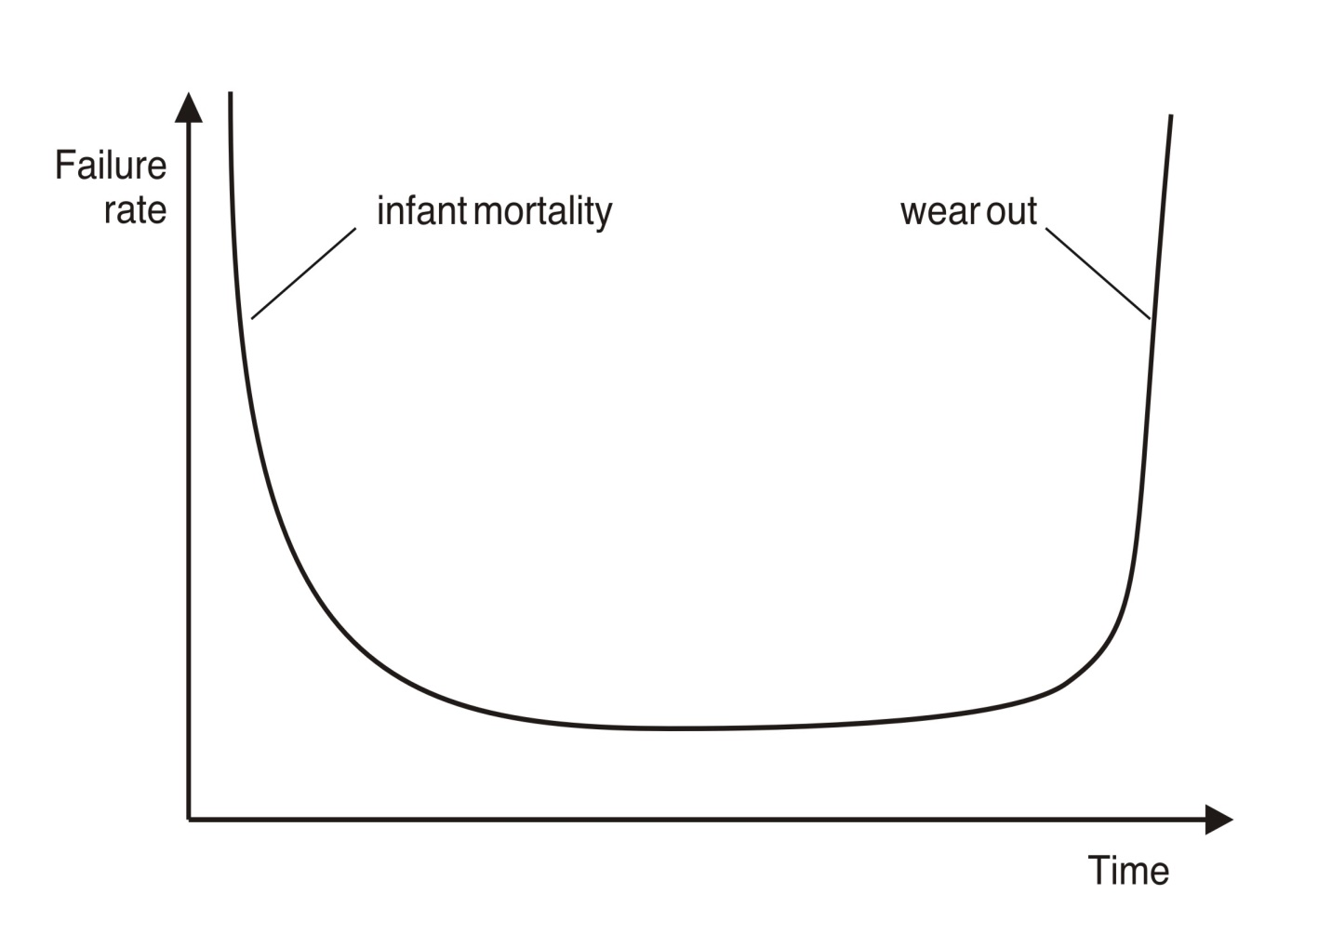
Wear Out （用尽）vs. Deterioration（退化）
Hardware wears out over time

Slide 16
Wear Out （用尽）vs. Deterioration（退化）
Software deteriorates over time
Most serious corporations control and constrain changes.

Slide 17
Component-Based vs. Custom Built
Hardware products typically employ many standardized design components.
Most software continues to be custom built. customer never really knows what she/he wants
The software industry does seem to be moving (slowly) toward component-based construction.

Slide 18
Software Categories
System Software: Service other programs
Compilers, editors and file management utilities
Operating system components, drivers, networking software
Application Software: standalone programs that solve a specific business need
Point-of-sale transaction processing
Flight booking system
Engineering/Scientific Software
Numerical computing in physics, chemistry, biology.
Computer-aided design, system simulation and other interactive applications

Slide 19
Software Categories
Embedded Software
keypad control for home appliances
digital functions in an automobile, e.g. fuel control, braking systems
Product-line Software: Designed to provide a specific capability for use
Word processing, spreadsheets, computer graphics
Multimedia, entertainment, database management
Web-applications
E-commerce, B2B, B2P, Blog, Twitter
AI Software
expert system, artificial neural networks, theorem proving, game playing, etc.

Slide 20




Software New Categories
Ubiquitous computing: wireless networking
3G or Wi-Fi oriented computing
Netsourcing
Web as a computing engine
Open source
“Free” source code open to the computing community
Furthermore …

Slide 21




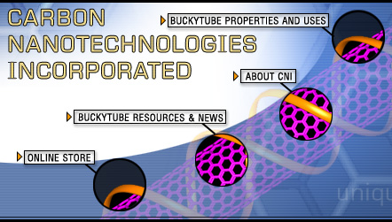
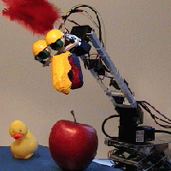
Software New Categories
Data Mining
Cloud Computing
Software for nanotechnologies
Cognitive Machines

Slide 22
Legacy Software
Why must it change?
Software must be fixed to eliminate errors.
Software must be enhanced to implement new functional and non-functional requirements
Software must be adapted to meet the needs of new computing environments or technology.
Software must be enhanced to implement new business requirements.
Software must be extended to make it interoperable with other more modern systems or databases.
Software must be re-architected to make it viable within a network environment.

Slide 23
Software Complexity
I believe the hard part of building software to be the specification, design, and testing of this conceptual construct, not the labor of representing it and testing the fidelity（逼真） of the representation.
If this is true, building software will always be hard. There is inherently no silver bullet.
- Fred Brooks, “No Silver Bullet”
http://www.computer.org/computer/homepage/misc/Brooks/

Slide 24
E-Type Systems
Software that has been implemented in a real-world computing context and will therefore evolve over time

Slide 25
Why Software Evolution?
Continuing Change (1974): E-type systems must be continually adapted else they become progressively less satisfactory.
Increasing Complexity (1974): As an E-type system evolves its complexity increases unless work is done to maintain or reduce it.
Self Regulation （自适应）(1974): The E-type system evolution process is self-regulating with distribution of product and process measures close to normal.

Slide 26
Why Software Evolution?
Conservation of Organizational Stability（保持组织稳定） (1980): The average effective global activity rate in an evolving E-type system is invariant over product lifetime.
Conservation of Familiarity（保持熟悉） (1980): As an E-type system evolves all associated with it, developers, sales personnel, users, for example, must maintain mastery of its content and behavior to achieve satisfactory evolution.
Continuing Growth (1980): The functional content of E-type systems must be continually increased to maintain user satisfaction over their lifetime.

Slide 27
Why Software Evolution?
Declining Quality （质量的下降）(1996): The quality of E-type systems will appear to be declining unless they are rigorously maintained and adapted to operational environment changes.
The Feedback System (1996): E-type evolution processes constitute multi-level, multi-loop, multi-agent feedback systems and must be treated as such to achieve significant improvement over any reasonable base.
Source: Lehman, M., et al, “Metrics and Laws of Software Evolution—The Nineties View,” Proceedings of the 4th International Software Metrics Symposium (METRICS '97), IEEE, 1997, can be downloaded from: http://www.ece.utexas.edu/~perry/work/papers/feast1.pdf

Slide 28
Software Engineering
(1)The application of a systematic, disciplined, quantifiable approach to the development, operation and maintenance of software; that is, the application of engineering to software.
(2) The study of approaches as in (1)

Slide 29
Software Engineering
SE is a layer technology.
The bedrock that support SE is a quality focus.
The foundation for SE is the process.
SE methods provide the technical how-to’s for building software.
SE tools provide automate or semi-automate support for the process and the methods.

Slide 30
Software Process
A process is a collection of activity, actions and tasks that are performed when some work product is to be created.
Process Framework: Communication, Planning, Modeling, Construction, Deployment.
Umbrella Activities: Software project tracking and control, Risk management, Software quality assurance, Technical reviews, Measurement, Software configuration management, Reusability management, Work product preparation and production.

Slide 31
Software Engineering Practice
The essence of SE practice:
Understand the problem(communication and analysis)
Plan a solution(modeling and software design)
Carry out the plan(code generation)
Examine and result for accuracy(testing and quality assurance)

Slide 32
General Principles
The reason it all exist
KISS( Keep it simple, stupid)
Maintain the vision
What you produce, others will consume
Be open to the future
Plan ahead to reuse
Think

Slide 33
Software Myths
Affect managers, customers (and other non-technical stakeholders) and practitioners
Are believable because they often have elements of truth,
but …
Invariably lead to bad decisions,
therefore …
Insist on reality as you navigate your way through software engineering

Slide 34
Software Myths
If we get behind schedule, we can add more programmers and catch up.
A general statement about objectives is sufficient to begin building programs.
Change in project requirements can be easily accommodated because software is flexible.

Slide 35
Software Myths
Once we write a working program, we are done.
Until I get the program running, I have no way of assessing its quality.
The only deliverable work product for a successful project is the working program.
Software engineering will make us create too much documentation and will slow us down.

Slide 36
Management Myths
“We already have a book of standards and procedures for building software. It does provide my people with everything they need to know …”
“If my project is behind the schedule, I always can add more programmers to it and catch up …” (a.k.a. “The Mongolian Horde concept”)
“If I decide to outsource the software project to a third party, I can just relax: Let them build it, and I will just pocket my profits …”

Slide 37
Management Myths
Reality:
Software development is not a mechanistic process like manufacturing.
In the words of Brooks “Adding people to a late, software project makes it later”
People can be added only in a planned and well-coordinated manner.

Slide 38
Customer Myths
“A general statement of objectives is sufficient to begin writing programs - we can fill in the details later …”
“Project requirements continually change but this change can easily be accommodated because software is flexible …”

Slide 39
Customer Myths
Reality:
The impact of change varies with the time at which it is introduced.
As time passes, cost impact grows rapidly.
Change can cause upheaval that requires additional resources and major design modification.

Slide 40
Practitioner’s Myths
“Let’s start coding ASAP, because once we write the program and get it to work, our job is done …”
“Until I get the program running, I have no way of assessing its quality …”
“The only deliverable work product for a successful project is the working program …”
“Software engineering is baloney. It makes us create tons of paperwork, only to slow us down …”

Slide 41
Practitioner’s Myths
Reality:
The formal technical review is one of most effective software quality assurance mechanisms.
Software reviews are a “quality filter” that have been found to be more effective than testing for finding certain classes of software errors.

Slide 42
Exercise
Which question no longer concerns the modern software engineering
Why does computer hardware cost so much?
Why does software take a long time to finish?
Why does it cost so much to develop a piece of software?
Why can't software errors be removed from products prior to delivery?
Answer: a
Today the increased power of the personal computer has brought about an abandonment of the practice of team development of software.
True
False
Answer: b
Software is a product and can be manufactured using the same technologies used for other engineering artifacts.
True
False
Answer: b
Software deteriorates rather than wears out because
Software suffers from exposure to hostile environments.
Defects are more likely to arise after software has been used often.
Multiple change requests introduce errors in component interactions.
Software spare parts become harder to order.
Answer: c
1-A
© 2010 Sichuan University All rights reserved. | Confidential

Slide 43
Exercise
5. Most software continues to be custom built because
a. Component reuse is common in the software world.
b. Reusable components are too expensive to use.
c. Software is easier to build without using someone else's components.
d. Off-the-shelf software components are unavailable in many application domains.
Answer: d
6. The nature of software applications can be characterized by their information
a. complexity
b. content
c. determinacy
d. both b and c
Answer: d
7. Change cannot be easily accommodated in most software systems, unless the system was designed with change in mind.
True
False
Answer: a
8. The functionality of most computer systems does not need to be enhanced the lifetime of the system.
True
False
Answer: b
© 2010 Sichuan University All rights reserved. | Confidential

Slide 44
Question for Chapter 1
How does software differ from the artifacts produced by other engineering disciplines?
How do software characteristics differ from hardware characteristics?
What is the difference between software that is determinate and software that is indeterminate?
Explain what is wrong with the notion that computer software does not need to evolve over time.
Notes:
How does software differ from the artifacts produced by other engineering disciplines?
Answer (Section 1.1):
Software is both a product and a vehicle for delivering a product. As a product, software is an information transformer. As a vehicle for delivering a product, software serves as a basis for computer control, communication, and creation of other programs.
How do software characteristics differ from hardware characteristics?
Answer (Section 1.2):
Software is developed, not manufactured. Software does not wear out, but it can deteriorate when changes are made. Most software is custom built, not assembled out of components.
What is the difference between software that is determinate and software that is indeterminate?
Answer (Section 1.3):
Software is determinate is the order and timing of its inputs, processing, and outputs is predictable and it is indeterminate if the order and timing of its input, processing, and outputs is not predictable in advance.
Final Exam Question
Explain what is wrong with the notion that computer software does not need to evolve over time.
Answer (Section1.4):
Computer software must be revised as errors are discovered and corrected. Software must be updated to accommodate changes in the computing environment. Many times a customer will request changes to add new functions to an existing product or to accommodate changes in the business environment. Sometimes an older system will need to be reengineered to provide benefits to the user in a modern context. The bottom line is that software that does not evolve will eventually become unusable.

