Slide 1
Testing
Software Engineering: A Practitioner’s Approach
by Roger S. Pressman

Slide 2

Content
Software testing fundamentals
White-Box testing
Basic path testing
Control structure testing
Block-Box testing
Equivalence partitioning
Boundary value analysis
OO testing method
Testing methods at class level
Testing methods at inter-class level
© 2010 Sichuan University All rights reserved. | Confidential
2
Notes:
2

Slide 3
Testability
Operability—it operates cleanly
Observability—the results of each test case are readily observed
Controllability—the degree to which testing can be automated and optimized
Decomposability—testing can be targeted
Simplicity—reduce complex architecture and logic to simplify tests（simple function structure code ）
Stability—few changes are requested during testing
Understandability—of the design
© 2010 Sichuan University All rights reserved. | Confidential
3
Notes:
3

Slide 4
What is a “Good” Test?
A good test has a high probability of finding an error
A good test is not redundant （冗余）.
A good test should be “best of breed”（繁殖）
A good test should be neither too simple nor too complex
© 2010 Sichuan University All rights reserved. | Confidential
4
Notes:
4

Slide 5
Internal and External Views Of Testing
Knowing the specified function that a product has been designed to perform, tests can be conducted that demonstrate each function is fully operational while at the same time searching for errors in each function.
Knowing the internal workings of a product, tests can be conducted to ensure that “all gears mesh,” that is, internal operations are performed according to specifications and all internal components have been adequately exercised.
© 2010 Sichuan University All rights reserved. | Confidential
5
Notes:
5

Slide 6
Software Testing
white-box
methods
black-box
methods
Methods
Strategies
Notes:
6

Slide 7
Methods of Testing
静态测试
静态分析
代码审查(Code Reading Review)
代码走查(Walkthroughs)
技术评审(Technical Review)
桌面检查(Desk Checking)
动态测试
白盒测试
基本路径测试
控制结构测试
黑盒测试
功能分解
等价类划分
边值分析
因果图
随机测试
猜错法

Slide 8
Exhaustive Testing
loop < 20 X
14
There are 10 possible paths! If we execute one
test per millisecond, it would take 3,170 years to
test this program!!
© 2010 Sichuan University All rights reserved. | Confidential
8
Notes:
8

Slide 9
Selective Testing
Selected path
loop < 20 X
Notes:
9

Slide 10
Test Case Design

Slide 11
Test Case Design
"Bugs lurk in corners
and congregate at
boundaries ..."
Boris Beizer
OBJECTIVE
to uncover errors
CRITERIA
in a complete manner
CONSTRAINT
with a minimum of effort and time

Slide 12
Whiter-Box Testing

Slide 13
White-Box Testing
white-box , or open-box, clear-box testing:
Use the structure of the program to test. —— Structural testing
... our goal is to ensure that all
statements and conditions have
been executed at least once ...
© 2010 Sichuan University All rights reserved. | Confidential
13
Notes:
13

Slide 14
Why Cover?
Logic errors and incorrect assumptions are inversely proportional to a path's execution probability
We often believe that a path is not likely to be executed; in fact, reality is often counter intuitive
Typographical errors are random;
it's likely that untested paths will contain some
© 2010 Sichuan University All rights reserved. | Confidential
14
Notes:
14

Slide 15
White-Box Testing
White-box testing, sometimes called glass-box testing or structural testing
uses the control structure described as part of component-level design to derive test cases.
(1) guarantee that all independent paths within a module
have been exercised at least once
(2) exercise all logical decisions on their true
and false sides
(3) execute all loops at their boundaries and within their operational bounds
(4) exercise internal data structures to ensure their validity
© 2010 Sichuan University All rights reserved. | Confidential
15
Notes:
15

Slide 16
Basis Path Testing

Slide 17
What is Basis Path Testing?
It is a white-box testing technique first proposed by Tom McCabe.
It enables the test case designer to derive a logical complexity measure of a procedural design and use this measure as a guide for defining a basis set of execution paths.
Test cases derived to exercise the basis set are guaranteed to execute every statement in the program at least one time during testing.

Slide 18
Flow Graph Notation
The structured constructs in flow graph form:
Sequence;
If;
While;
Until;
Case;
Where each circle represents one or more non branching PDL or source code statements.

Slide 19
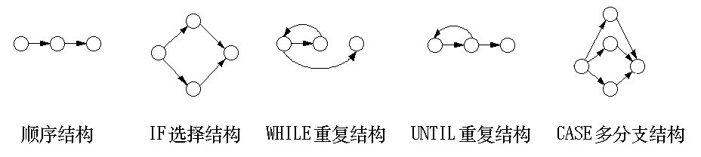
Flow Graph

Slide 20
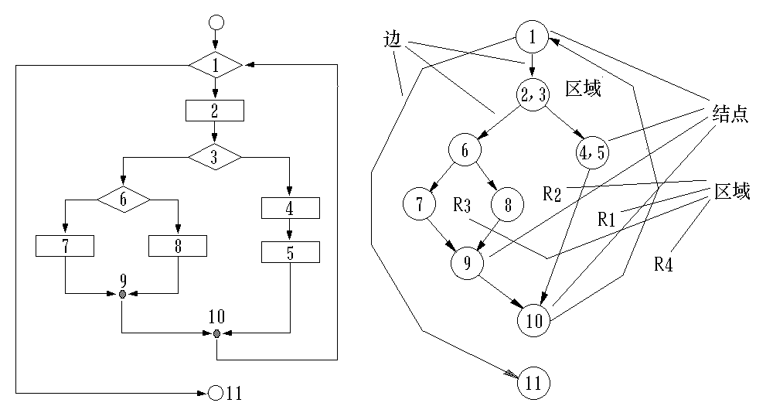
Flow Chart and Flow Graph

Slide 21
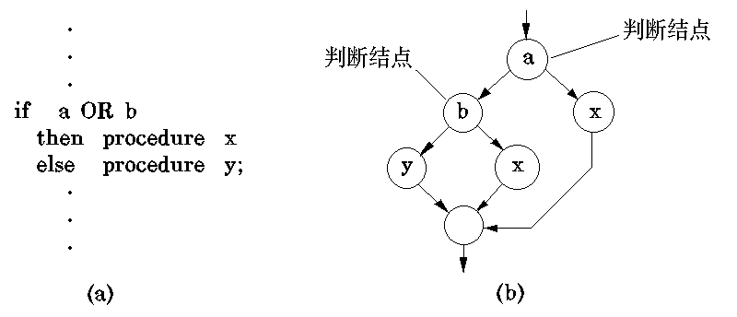
An Example of Flow Graph

Slide 22
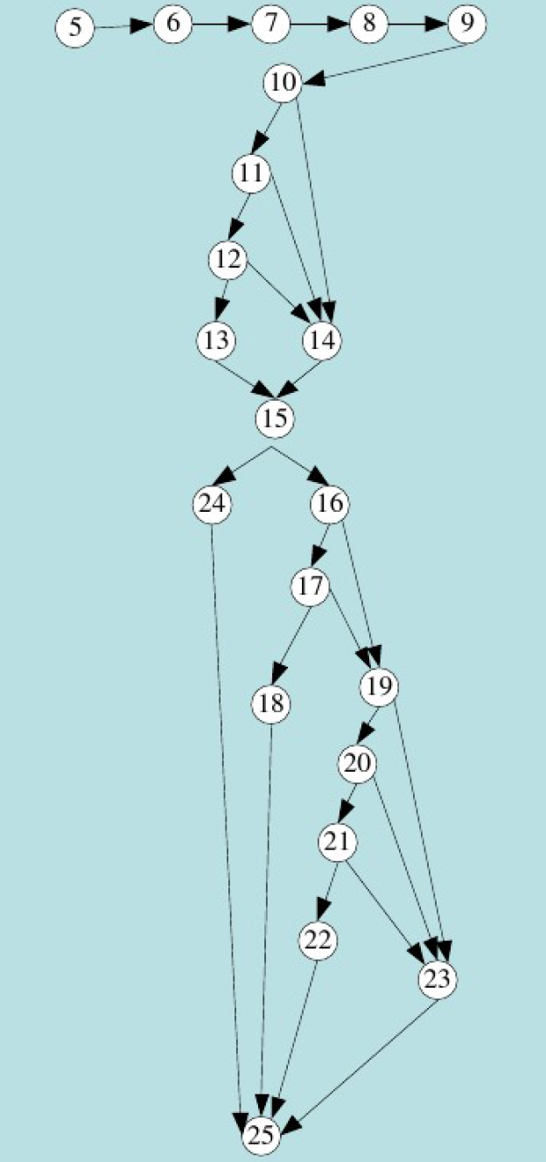
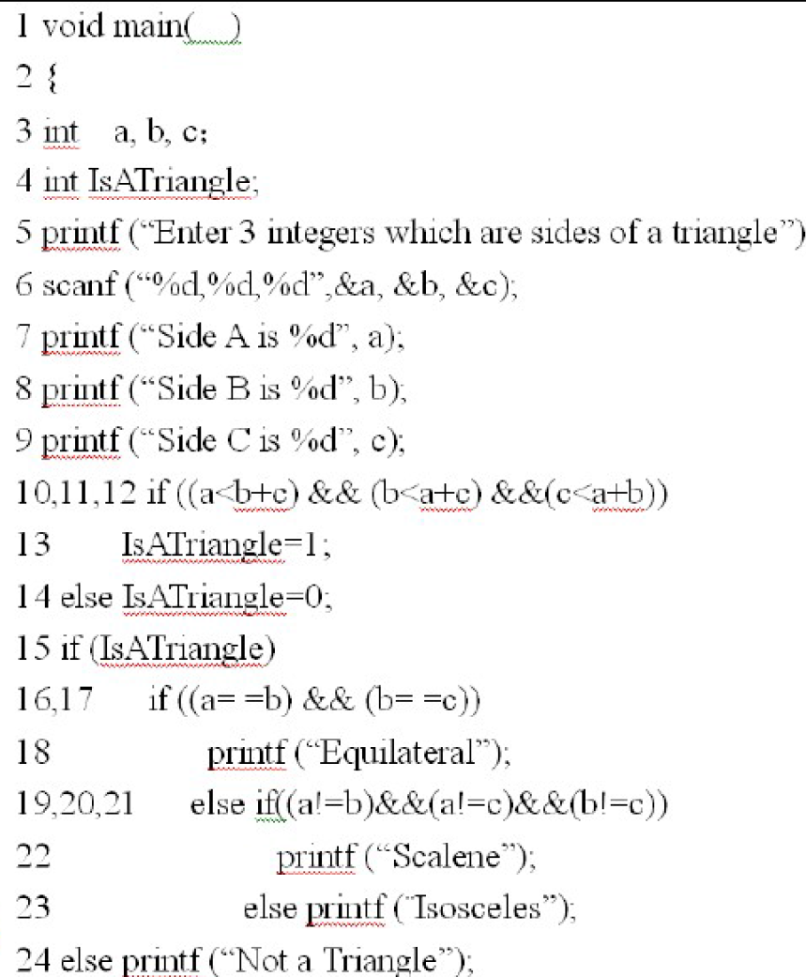
Example

Slide 23
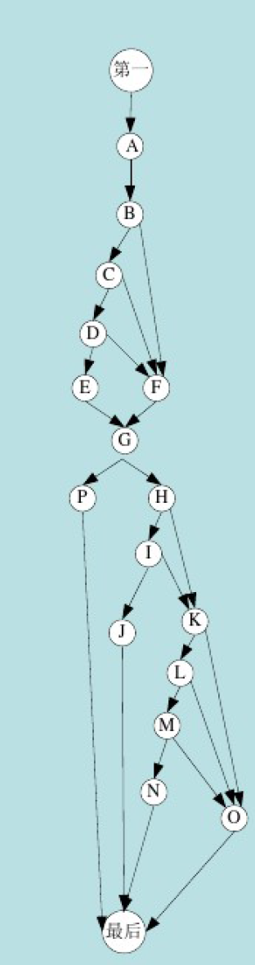
Example

Slide 24
Cyclomatic Complexity （秩复杂性）
Cyclomatic complexity is a software metric that provides a quantitative measure of the logical complexity of a program.
An independent path is any path through the program that introduces at least one new set of processing statements or a new condition.

Slide 25
Cyclomatic Complexity
A number of industry studies have indicated
that the higher V(G), the higher the probability
or errors.
modules
V(G)
modules in this range are
more error prone
Notes:
25

Slide 26
Computing Complexity
There are three ways:
The number of regions of the flow graph correspond to the cyclomatic complexity;
Cyclomatic complexity, V(g), for a flow graph G is defined as:
V(G) = E - N + 2
where E is the number of flow graph edges, N is the number of flow graph nodes;
Cyclomatic complexity, V(G), for a flow graph G is also defined as:
V (G) = P + 1
where P is the number of predicate nodes contained in the flow graph G.

Slide 27
An Example
First, we compute the cyclomatic complexity:
V(G) = 11 edges - 9 nodes + 2 = 4
or
V(G) = 3 predicate nodes + 1 = 4
In this case, V(G) = 4

Slide 28
Deriving Test Cases
The basis path testing method can be applied to a procedural design or to source code.
A series of steps:
Using the design or code as a foundation, draw a corresponding flow graph.
Determine the cyclomatic complexity of the resultant flow graph.
Determine a basis set of linearly independent paths.
Prepare test cases that will force execution of each path in the basis set.

Slide 29
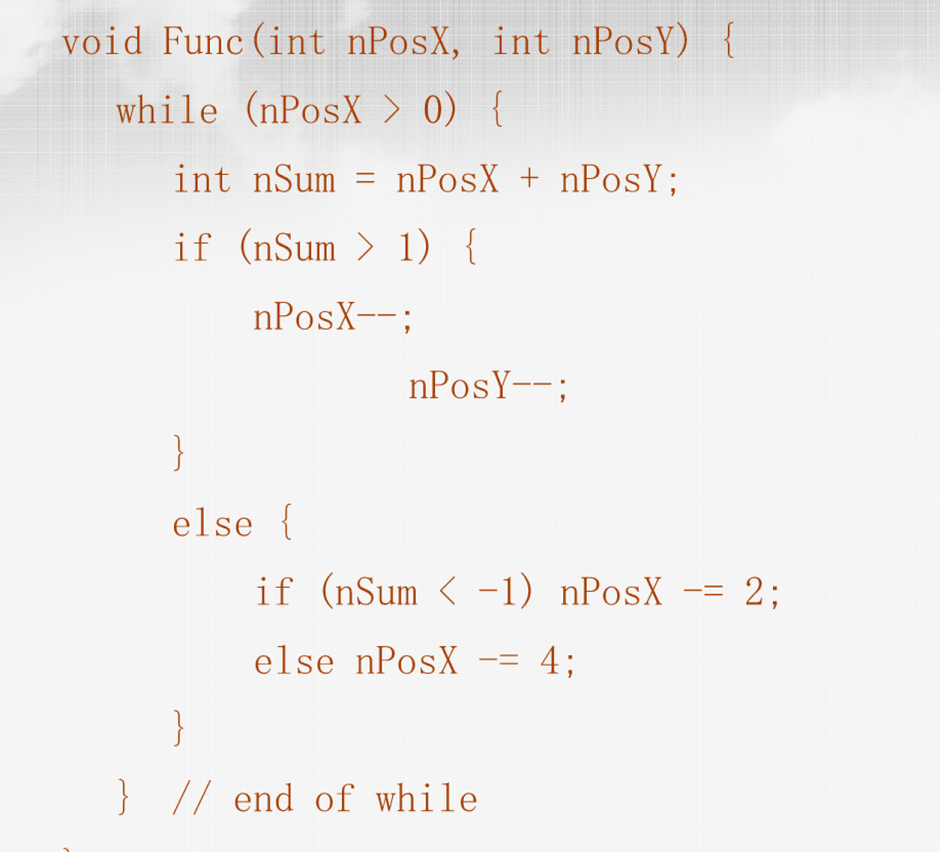
Deriving Test Cases

Slide 30
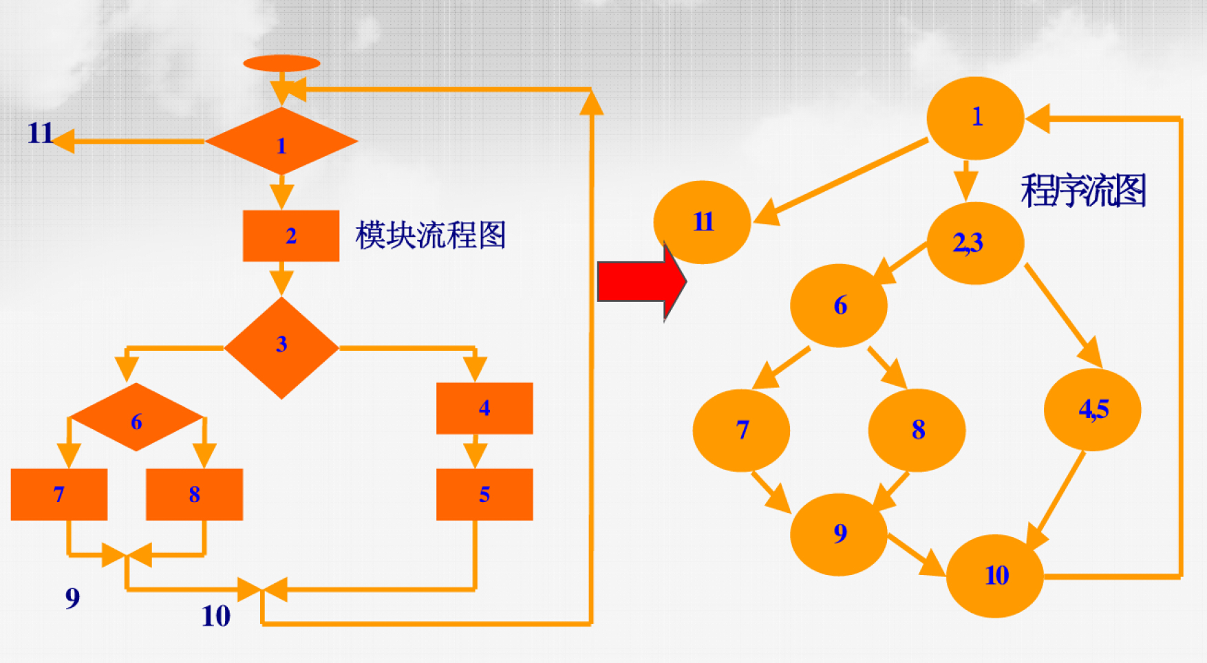
Deriving Test Cases
© 2010 Sichuan University All rights reserved. | Confidential
30
Notes:
30

Slide 31
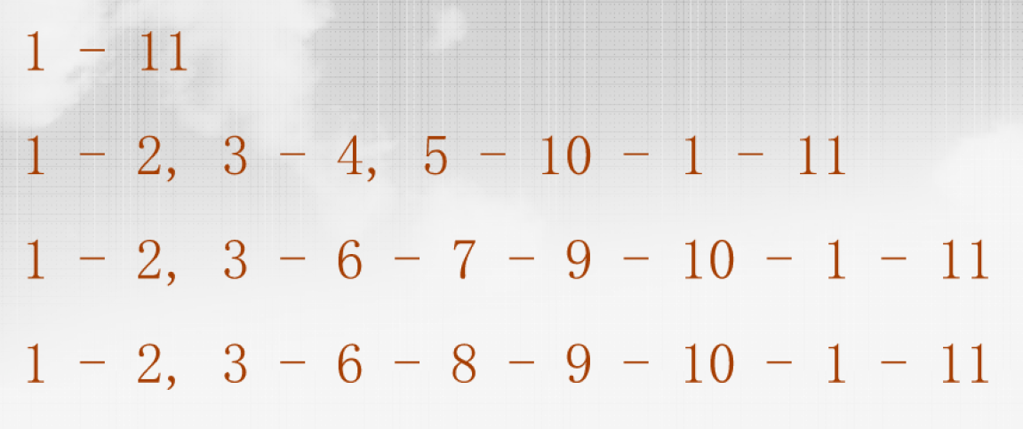
Deriving Test Cases
© 2010 Sichuan University All rights reserved. | Confidential
31
Notes:
31

Slide 32
Deriving Test Cases
independent paths:
1
Since V(G) = 4,
there are four paths
2
3
Path 1: 1,2,3,6,7,8
4
Path 2: 1,2,3,5,7,8
5
6
Path 3: 1,2,4,7,8
Path 4: 1,2,4,7,2,4,...7,8
7
Finally, we derive test
cases to exercise these
8
paths.
© 2010 Sichuan University All rights reserved. | Confidential
32
Notes:
32

Slide 33
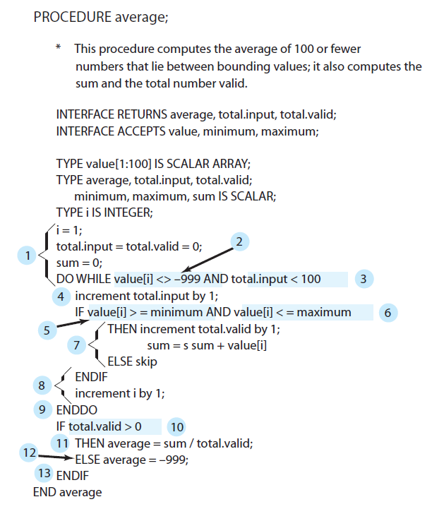
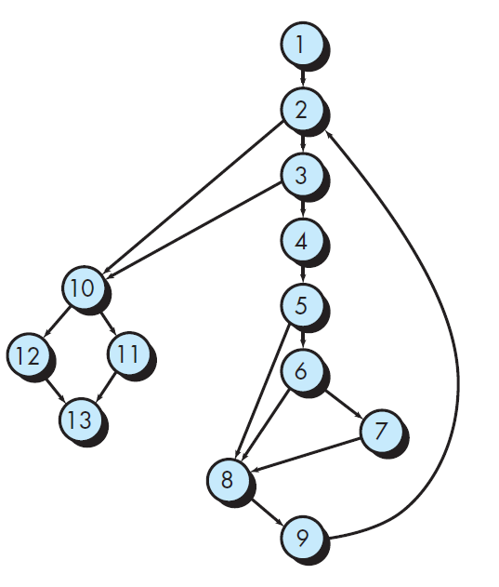
Deriving Test Cases

Slide 34
Deriving Test Cases
V ( G ) = 6 regions
V ( G ) = 17 edges - 13 nodes + 2 = 6
V ( G ) = 5 predicate nodes + 1 = 6

Slide 35
Deriving Test Cases
Path 1: 1-2-10-11-13
Path 2: 1-2-10-12-13
Path 3: 1-2-3-10-11-13
Path 4: 1-2-3-4-5-8-9-2-. . .
Path 5: 1-2-3-4-5-6-8-9-2-. . .
Path 6: 1-2-3-4-5-6-7-8-9-2-. . .

Slide 36
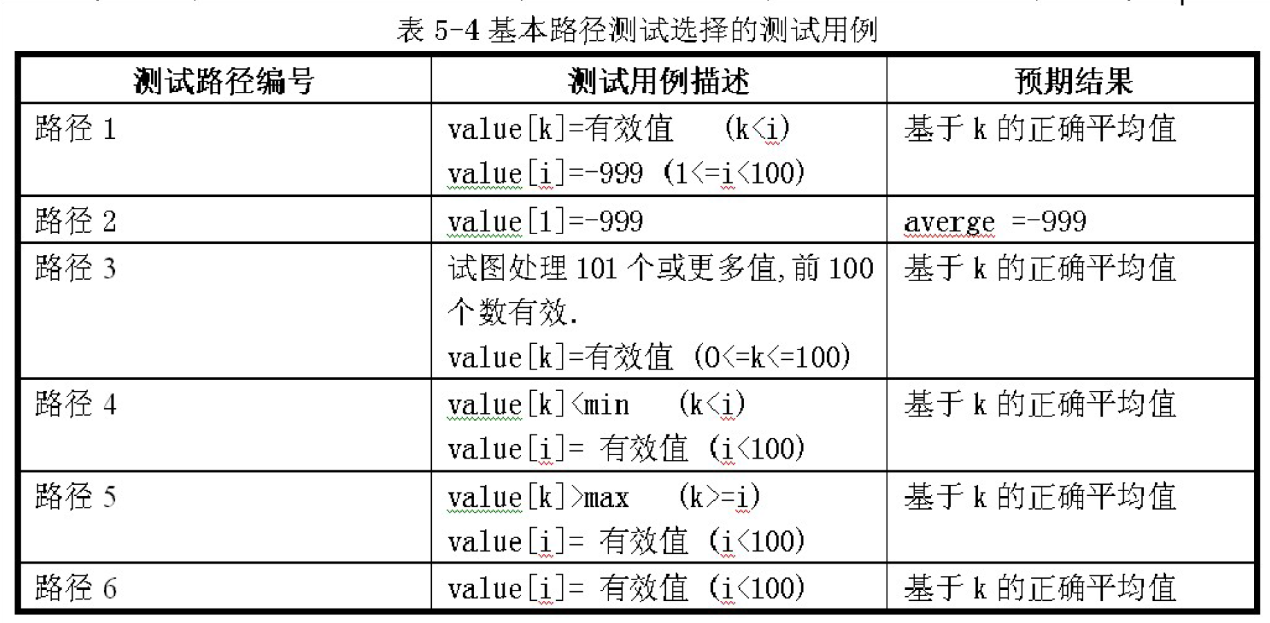
Deriving Test Cases

Slide 37
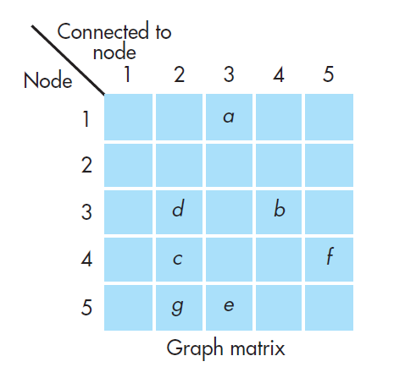
Graph Matrices
It is a square matrix whose size is equal to the number of nodes on the flow graph.
1
a
3
1-1=0
e
b
5
f
4
d
2-1=1
c
2-1=1
g
2
2-1=1
3+1=4
link weights :
The probability that a link (edge) will be executed.
The processing time expended during traversal of a link
The memory required during traversal of a link
The resources required during traversal of a link.
Cyclomatic complexity

Slide 38
Basis Path Testing Notes
you don't need a flow chart,
but the picture will help when
you trace program paths
count each simple logical test,
compound tests count as 2 or
more
basis path testing should be
applied to critical modules

Slide 39
Control Structure Testing
Condition testing — a test case design method that exercises the logical conditions contained in a program module
Data flow testing — selects test paths of a program according to the locations of definitions and uses of variables in the program
Loop testing — a white-box test that focuses exclusively on the validity of loop constructs
© 2010 Sichuan University All rights reserved. | Confidential
39
Notes:
39

Slide 40
Condition Testing
Condition testing is a test case design method that exercises the logical conditions contained in a program module.
Condition testing focuses on testing each condition in the program. The errors include the following:
Boolean operator error;
Boolean variable error;
Boolean parenthesis error;
relational operator error;
arithmetic expression error;

Slide 41
Condition Testing Strategies
Branch testing;
Domain testing;
Branch and Relational Operator (BRO);

Slide 42
Data Flow Testing
The data flow testing method selects test paths of a program according to the locations of definitions and uses of variables in the program.
Data flow testing strategies are useful for selecting test paths of a program containing nested if and loop statements.

Slide 43
Loop Testing
Simple
loop
Nested
Loops
Concatenated
Loops
Unstructured
Loops

Slide 44
Loop Testing: Simple Loops
Minimum conditions—Simple Loops
1. skip the loop entirely
2. only one pass through the loop
3. two passes through the loop
4. m passes through the loop m < n
5. (n-1), n, and (n+1) passes through the loop
where n is the maximum number of allowable passes

Slide 45
Loop Testing: Nested Loops
Nested Loops
Start at the innermost loop. Set all outer loops to their
minimum iteration parameter values.
Test the min+1, typical, max-1 and max for the
innermost loop, while holding the outer loops at their
minimum values.
Move out one loop and set it up as in step 2, holding all
other loops at typical values. Continue this step until
the outermost loop has been tested.
Concatenated Loops
If the loops are independent of one another
then treat each as a simple loop
else* treat as nested loops
endif*
for example, the final loop counter value of loop 1 is
used to initialize loop 2.

Slide 46
Example
a
func(int A,B,X)
{
if((A>1)&&(B=0))
{X:=X/A};
if((A=2)||(X>1))
{X:=X+1};
}
A>1 and
B=0
YES
c
NO
X=X/A
b
A=2 or
x>1
YES
e
NO
X=X+1
d

Slide 47
Sentences Coverage
a
取A=2，B=0，X=3
A>1 and
B=0
YES
c
NO
X=X/A
b
A=2 or
x>1
YES
e
NO
X=X+1
d

Slide 48
Branch Coverage
a
A=3，B=0，X=1
沿路径acbd执行
A=2，B=1，X=3
沿路径abed执行
A>1 and
B=0
YES
c
NO
X=X/A
b
A=2 or
x>1
YES
e
NO
X=X+1
d

Slide 49
Condition Coverage
a
共有四个条件：
A>1，B=0，A=2，X>1
A=2，B=0，X=4
沿路径acbe执行
A=1，B=1，X=1
沿路径abd执行
A>1 and
B=0
YES
c
NO
X=X/A
b
A=2 or
x>1
YES
e
NO
X=X+1
d

Slide 50
Condition Compound Coverage
a
共有8种条件：
①A>1,B=0②A>1,B≠0
③A≤1,B=0④A ≤1,B≠0
⑤A=2,X>1⑥A=2,X≤1
⑦A≠2,X>1⑧A≠2,X≤1
A=2,B=0,X=4(①⑤)
A=2,B=1,X=1(②⑥)
A=1,B=0,X=2(③⑦)
A=1,B=1,X=1(④⑧)
A>1 and
B=0
YES
c
NO
X=X/A
b
A=2 or
x>1
YES
e
NO
X=X+1
d

Slide 51
Path Coverage
四条路径：acbe,abd,abed,acbd
A=2,B=0,X=3(acbed)
A=1,B=0,X=1(abd)
A=2,B=1,X=1(abed)
A=3,B=0,X=1(acbd)
a
A>1 and
B=0
YES
c
NO
X=X/A
b
A>1 and
B=0
YES
e
NO
X=X/A
d

Slide 52
Black-Box Testing

Slide 53
Black-Box Testing
requirements
output
input
events
© 2010 Sichuan University All rights reserved. | Confidential
53
Notes:
53

Slide 54
What is Black-Box Testing?
black-box , or closed-box testing:
Make sure that every kind of input is submitted, and the output observed matches the output expected.
—— Functional testing

Slide 55
Black-Box Testing
How is functional validity tested?
How is system behavior and performance tested?
What classes of input will make good test cases?
Is the system particularly sensitive to certain input values?
How are the boundaries of a data class isolated?
What data rates and data volume can the system tolerate?
What effect will specific combinations of data have on system operation?
© 2010 Sichuan University All rights reserved. | Confidential
55
Notes:
55

Slide 56
Black-Box Testing
Black-box testing can find following errors:
incorrect or missing functions;
interface errors;
errors in data structures or external database access;
behavior or performance errors;
initialization and termination errors;
The methods of black-box testing:
Graph-based testing methods;
Equivalence partitioning;
Boundary value analysis;
Comparison testing;
Orthogonal array testing;

Slide 57
The Steps of Black-Box Testing
The steps of black-box testing :
to understand the objects and their relationships;
to define a series of tests;
to find the errors;

Slide 58
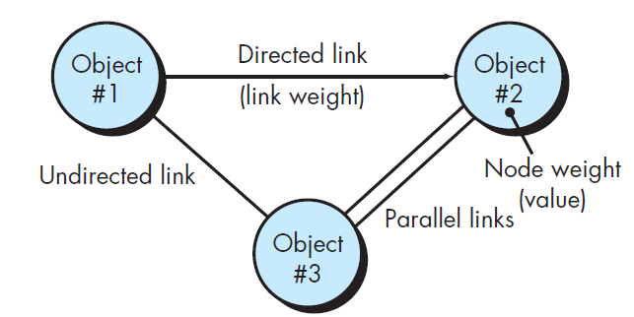
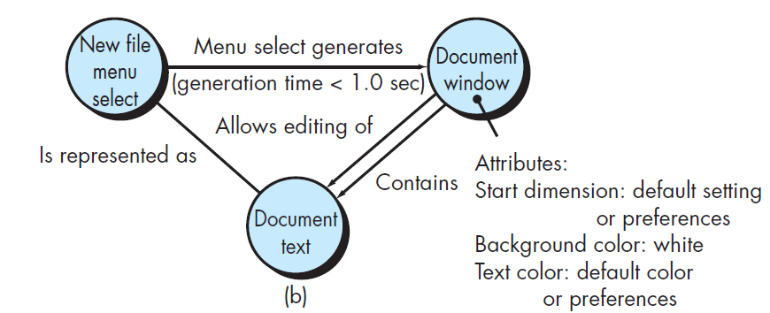
Graph-Based Testing Methods
Nodes represent objects
links represent the relationships between objects,
node weights describe the properties of a node (e.g., a specific data value or state behavior),
link weights describe some characteristic of a link.

Slide 59
Graph-Based Testing Methods
Transaction flow modeling
The nodes represent steps in some transaction, and the links represent the logical connection between steps. (data flow diagram)
Finite state modeling
The nodes represent different user observable states of the software, and the links represent the transaction that occur to move from state to state. (state transition diagram)

Slide 60
Graph-Based Testing Methods
Data flow modeling
the nodes are data object and the links are the transformations that occur to translate one data object into another.
Timing modeling
The nodes are program objects and the links are the sequential connections between those objects.

Slide 61
Equivalence Partitioning
Equivalence partitioning is a black-box testing method that divides the input domain of a program into classes of data from which test cases can be derived.
Test-case design for equivalence partitioning is based on an evaluation of equivalence classes for an input condition.
An equivalence class represents a set of valid or invalid states for input conditions.

Slide 62
Equivalence Partitioning
Equivalence classes may be defined according to the following guidelines:
If an input condition specifies a range, one valid and two invalid equivalence classes are defined.
例： 输入值是学生成绩，范围是0～100
有效等价类：①0≤成绩≤100
无效等价类：①成绩<0，②成绩>100
If an input condition requires a specific value, one valid and two invalid equivalence classes are defined.
例：一个学生每学期只能选修1～3门课
有效等价类：①选修1～3门
无效等价类：①不选 或 ②选修超过3门

Slide 63
Equivalence Partitioning
If an input condition specifies a member of a set, one valid and one invalid equivalence class are defined.
例：输入条件说明学历可为:专科、本科、硕士、博士四种之一
有效等价类：①专科、②本科、③硕士、④博士
无效等价类：①其它任何学历
If an input condition is Boolean, one valid and one invalid class are defined.
例：校内电话号码拨外线为9开头
有效等价类：① 9＋外线号码
无效等价类：①非9开头＋外线号码

Slide 64
对输入数据的规定
等价类划分
数值范围
（如1---999）
一个合理类（1 ≤ x ≤ 999）
二个不合理类（x ＜1,x＞999)
数据个数
一个合理类（个数合要求）
二个不合理类（个数太少，个数太多)
一组可能的值
每个可能值一个合理等价类
其他值为一个不合理等价类
规定输入值必须满足的条件（如串的首字符为字母）
满足条件者为一个合理等价类
不满足条件者为一个不合理等价类
若一个等价类的各值在程序中处理方法不同
把此等价类划分为更小的等价类

Slide 65
Sample Equivalence Classes
Valid data
user supplied commands
responses to system prompts
file names
computational data
physical parameters
bounding values
initiation values
output data formatting
responses to error messages
graphical data (e.g., mouse picks)
Invalid data
data outside bounds of the program
physically impossible data
proper value supplied in wrong place

Slide 66
Sample Equivalence Classes
在设计测试用例时应同时考虑有效等价类和无效等价类测试用例的设计。根据等价类表设计测试用例，具体步骤如下：
（1）为每个等价类规定一个唯一的编号。
（2）设计一个新的测试用例，尽可能多地覆盖尚未被覆盖的有效等价类，重复这一步，直到测试用例覆盖了所有的有效等价类。
（3）设计一个新的测试用例，使其覆盖并且只覆盖一个还没有被覆盖的无效等价类。重复这一步，直至测试用例覆盖了所有的无效等价类。

Slide 67
Sample Equivalence Classes
例1：报表日期
设某公司要打印2001～2005年的报表，其中报表日期为6位数字组成，其中，前4位为年份，后两位为月份。
第一步：划分等价类
输入及外部条件 | 有效等价类 | 无效等价类
报表日期的 类型及长度 | 6位数字字符① | 有非数字字符 ④ 少于6个数字字符 ⑤ 多于6个数字字符 ⑥
年份范围 | 在2001～2005之间② | 小于2001 ⑦ 大于2005 ⑧
月份范围 | 在1～12之间③ | 小于1 ⑨ 大于12 ⑩

Slide 68
Sample Equivalence Classes
第二步：为有效等价类设计测试用例
对表中编号为①②③的3个有效等价类用一个测试用例覆盖：
测试数据 | 期望结果 | 覆盖范围
200105 | 输入有效 | 等价类①②③

Slide 69
Sample Equivalence Classes
第三步：为每一个无效等价类至少设计一个测试用例
测试数据 | 期望结果 | 覆盖范围
001MAY | 输入无效 | 等价类④
20015 | 输入无效 | 等价类⑤
2001001 | 输入无效 | 等价类⑥
20000 | 输入无效 | 等价类⑦
20080 | 输入无效 | 等价类⑧
200100 | 输入无效 | 等价类⑨
200113 | 输入无效 | 等价类⑩
本例的10个等价类至
少需要8个测试用例
不能出现相同的测试用例

Slide 70
Sample Equivalence Classes
例：
例2：准考证号码
对招干考试系统“输入学生成绩”子模块设计测试用例
招干考试分三个专业,准考证号第一位为专业代号,
如: 1-行政专业, 2-法律专业, 3-财经专业.
行政专业准考证号码为:110001～111215
法律专业准考证号码为:210001～212006
财经专业准考证号码为:310001～314015
有效等价类: (1) 110001 ～ 111215 (2) 210001 ～ 212006 (3) 310001 ～ 314015
无效等价类: (4) - ∞ ～ 110000 (5) 111216 ～ 210000 (6) 212007 ～ 310000 (7) 314016 ～ + ∞

Slide 71
Sample Equivalence Classes
例3 电话号码
城市的电话号码由两部分组成。这两部分的名称和内容分别是：地区码：以0开头的三位或者四位数字（包括0）；电话号码：以非0、非1开头的七位或者八位数字。
假定被调试的程序能接受一切符合上述规定的电话号码，拒绝所有不符合规定的号码，就可用等价分类法来设计它的调试用例。

Slide 72
Sample Equivalence Classes
1.划分等价类并编号
输入数据 | 有效等价类 | 无效等价类
地区码 | 以0开头的3位数串 以0开头的4位数串 | 以0开头的含有非数字字符的串 以0开头的小于3位的数串 以0开头的大于4位的数串 以非0开头的数串
电话号码 | 以非0、非1开头的7位数串 以非0、非1开头的8位数串 | 以0开头的数串 以1开头的数串 以非0、非1开头的含有非法字符7或者8位数串 以非0、非1开头的小于7位数串 以非0、非1开头的大于8位数串

Slide 73
Sample Equivalence Classes
2.为有效等价类设计测试用例
测试数据 | 期望结果 | 覆盖范围
010 23145678 | 显示有效输入 | 1、8
023 2234567 | 显示有效输入 | 1、7
0851 3456789 | 显示有效输入 | 2、7
0851 23145678 | 显示有效输入 | 2、8

Slide 74
Sample Equivalence Classes
3. 为每一个无效等价类至少设计一个测试用例
测试数据 | 期望结果 | 覆盖范围
0a34 23456789 | 显示无效输入 | 3
05 23456789 | 显示无效输入 | 4
01234 23456789 | 显示无效输入 | 5
2341 23456789 | 显示无效输入 | 6
028 01234567 | 显示无效输入 | 9
028 12345678 | 显示无效输入 | 10
028 qw123456 | 显示无效输入 | 11
028 623456 | 显示无效输入 | 12
028 886234569 | 显示无效输入 | 13

Slide 75
Sample Equivalence Classes
例4 NextDate问题
NextDate 函数包含三个变量 month、day和year，函数的输出为输入日期后一天的日期。 例如，输入为1989年5月16日，则函数的输出为1989年5月17日。 要求输入变量 month、 day和year均为整数值，并且满足下列条件，也就是有效等价类：
(1) 1≤month≤12 (2)1≤day≤31 (3)1812≤year≤2012
若条件（1）~（3）中任何一个条件失效，则 NextDate 函数都会产生一个输出，指明相应的变量超出取值范围，比如 “month 的值不在 1-12 范围当中”。显然还存在着大量的 year、month、day 的无效组合，我们可以给出下列无效等价类：
(1) month<1 (2)month>12 (3)day<1 (4)day>31 (5)year<1812 (6)year>2012
测试用例的设计这里就略过

Slide 76
Sample Equivalence Classes
例：考察一个把数字串转变成整数的函数。用二进制补码表示整数，机器字长16位，即整数范围最小为- 32768，最大为32767。函数及参数的PASCAL说明如下：
function StrToInt (dstr : shortstr) : integer;
type shortstr = array [1..6] of char;
要求被处理的数字串是右对齐的，即在少于6个字符的串左边补空格。负号在最高位数字左边一位。
试用等价划分法设计测试方案。

Slide 77
Sample Equivalence Classes
解：首先根据规格说明划分等价类。考虑到PASCAL编译器的固有检错功能，测试时不需要使用长度不等于6的数组，也不需要用非字符数组类型的参数。
有效输入类：
(1) 1~6个数字字符组成的数字串（最高位非0）；
(2) 最高位为0的数字串；
(3) 最高位左邻负号的数字串；
无效输入类：
(4) 空字符串（6位空格）；
(5) 左边补位的既非0亦非空格；
(6) 最高位右边含有空格；
(7) 最高位右边含有其它非数字字符；
(8)负号与最高位间有空格；

Slide 78
Sample Equivalence Classes
有效输出类：
(9)在合法范围内的负整数；
无效输出类：
(12) 小于 - 32768的负整数；
(13) 大于 32767正整数。
(10) 0 ；
(11) 在合法范围内的正整数；
下面根据等价划分，设计出一套测试方案：
①1~6个数字字符组成的数字串，最高位非0；输出 为合法正整数。
输入： 预期输出：1
1
②最高位为0的数字串，输出为合法正整数。
输入： 预期输出：1
0
0
0
0
0
1
③负号与最高位数字相临；输出合法负整数。
输入： 预期输出：-1
-
0
0
0
0
1

Slide 79
Sample Equivalence Classes
④最高位为0；输出0。
输入： 预期输出：0
0
0
0
0
0
0
⑤太小的负整数。
输入： 预期输出：“错误，无效输入”
-
3
2
7
6
9
⑥太大的正整数。
输入： 预期输出：“错误，无效输入”
3
2
7
6
8
⑦空字符串。
输入： 预期输出：“错误：没有数字”
⑧左边补位的非0也非空格。
输入： 预期输出：“错误：非法填充”
a
a
a
a
a
1

Slide 80
Sample Equivalence Classes
⑨最高位右边也含空格。
输入： 预期输出：“错误：无效输入”
1
2
⑩最高位右边含其它非数字字符。
输入： 预期输出：“错误：无效输入”
0
0
1
x
x
2
⑩ 负号与最高位间有空格。
输入： 预期输出：“错误：负号位置非法”
-
1
2

Slide 81
Boundary Value Analysis
A greater number of errors occurs at the boundaries of the input domain rather than in the “center.”
Boundary value analysis leads to a selection of test cases that exercise bounding values.
常见的边界值
1)对16-bit 的整数而言 32767 和 -32768 是边界
2) 屏幕上光标在最左上、最右下位置
3) 报表的第一行和最后一行
4) 数组元素的第一个和最后一个
5) 循环的第 0 次、第 1 次和倒数第 2 次、最后一次

Slide 82
Guidelines for BVA
1. If an input condition specifies a range bounded by values a and b, test cases should be designed with values a and b and just above and just below a and b.
例如，如果程序的规格说明中规定："重量在10公斤至50公斤范围内的邮件，其邮费计算公式为……"。作为测试用例，我们应取10及50，还应取10.01,49.99,9.99及50.01等。
2. If an input condition specifies a number of values, test cases should be developed that exercise the minimum and maximum numbers. Values just above and below minimum and maximum are also tested.
例如，一个输入文件应包括1~255个记录，则测试用例可取1和255，还应取0及256等。

Slide 83
Guidelines for BVA
3. Apply guidelines 1 and 2 to output conditions
例如，某程序的规格说明要求计算出"每月保险金扣除额为0至1165.25元"，其测试用例可取0.00及1165.24、还可取一0.01及1165．26等。
例如一程序属于情报检索系统，要求每次"最少显示1条、最多显示4条情报摘要"，这时我们应考虑的测试用例包括1和4，还应包括0和5等。
4. If internal program data structures have prescribed boundaries, be certain to design a test case to exercise the data structure at its boundary

Slide 84
Boundary Value Analysis
规定了数据大小
选正好等于边界值的为合理的测试用例，刚好越过边界的为不合理的测试用例
规定了数据个数
个数刚好为边界值，少一个，多一个
对输出数据
也使用以上两条
数据是有序集合
注意集合的第一个和最后一个元素
规定了数据满足的条件
如（a+b>c)
合理： a=3 b=4 c=5
不合理：a=3 b=4 c=8
边界值，a=3 b=4 c=7

Slide 85
An Example
1: Rem Create a 10 element integer array
2: Rem Initialize each element to -1
3: Dim data(10) As Integer
4: Dim I As Integer
5: For I=1 To 10
6: data(I)=-1
7: Next I
8: End

Slide 86
Boundary Value Analysis
int a[10];
for（i=1;i<=10;i++）
a[i]=0;
很明显，这段代码的目的是创建包含10个元素的数组，并为数组中的每一个元素赋初值0。看看有什么问题？

Slide 87
白盒测试与黑盒测试对比
黑盒测试
白盒测试
优
点
适用于各测试阶段
从产品功能角度测试
容易入手生成测试数据
可以构成测试数据使特定程序部分得到测试
有一定的充分性度量手段
可获得较多工具支持
缺
点
某些代码段得不到测试
如果规格说明有误则无法发现
不易进行充分性度量
不易生成测试数据
无法对未实现规格说明的部分测试
工作量大，通常只用于单元测试，有引用局限
性
质
是一种确认技术，回答“我们在构造一个正确的系统吗？”
是一种验证技术，回答“我们在正确地构造一个系统吗？”

Slide 88
Orthogonal Array Testing
Orthogonal array testing can be applied to problems in which the input domain is relatively small but too large to accommodate exhaustive testing. The orthogonal array testing method is particularly useful in finding region faults

Slide 89
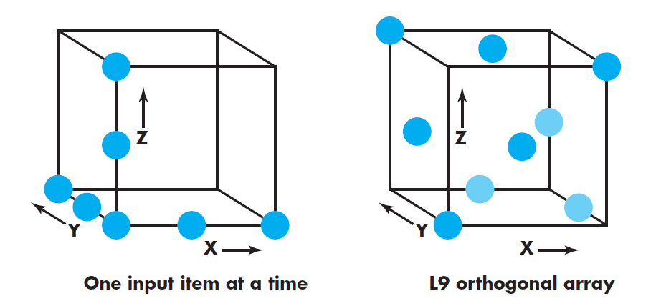
Orthogonal Array Testing
Consider a system that has three input items, X, Y, and Z. Each of these input items has three discrete values associated with it. There are 27 possible test cases.

Slide 90
Orthogonal Array Testing
Consider the send function for a fax application. Four parameters, P1, P2, P3, and P4, are passed to the send function. Each takes on three discrete values. For example, P1 takes on values:
P1 = 1, send it now
P1 = 2, send it one hour later
P1 = 3, send it after midnight
P2, P3, and P4 would also take on values of 1, 2 and 3, signifying other send functions.

Slide 91
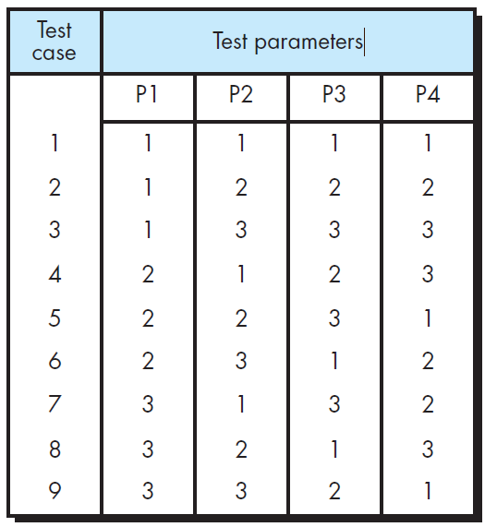
Boundary Value Analysis
1. exhaustive testing: 81
2. One input item at a time: (P1, P2, P3, P4) =
(1, 1, 1, 1), (2, 1, 1, 1), (3, 1, 1, 1),(1, 2, 1, 1), (1, 3, 1, 1), (1, 1, 2, 1), (1, 1, 3, 1), (1, 1, 1, 2), and (1, 1, 1, 3).
3. L9.

Slide 92
Testing of Client/Server Architectures
Testing become more difficulty, which deal with:
distribution system;
transaction process;
different hardware platform;
network communication;
multiple clients;
coordination requirements;

Slide 93
C/S Testing Approaches
Application function tests;
Server tests;
Database tests;
Transaction tests;
Network communication tests;

Slide 94
Testing for Real-Time System
Task testing
Behavioral testing
Inter task testing
System testing

Slide 95
Testing Patterns (1)
Benefits:
Provide a vocabulary for problem-solvers;
Focus attention on the forces behind a problem, that allows designers to better understand when and why a solution applies;
encourage iterative thinking, each solution creates a new context in which new problems can be solved.
Testing patterns can help a software team communicate more effectively about testing and better understand the forces that lead to a specific testing approach.

Slide 96
Testing Patterns (2)
Pattern name: pair testing
Abstract: A process-oriented pattern, pair testing describes a technique that is analogous to pair programming (Chapter 4) in which two testers work together to design and execute a series of tests that can be applied to unit, integration or validation testing activities.
Pattern name: separate test interface
Abstract: There is a need to test every class in an object-oriented system, including “internal classes” (i.e., classes that do not expose any interface outside of the component that used them). The separate test interface pattern describes how to create “a test interface that can be used to describe specific tests on classes that are visible only internally to a component.” [LAN01]
Pattern name: scenario testing
Abstract: Once unit and integration tests have been conducted, there is a need to determine whether the software will perform in a manner that satisfies users. The scenario testing pattern describes a technique for exercising the software from the user’s point of view. A failure at this level indicates that the software has failed to meet a user visible requirement. [KAN01]

Slide 97
OO Testing

Slide 98
Object-Oriented Testing
begins by evaluating the correctness and consistency of the OOA and OOD models
testing strategy changes
the concept of the ‘unit’ broadens due to encapsulation
integration focuses on classes and their execution across a ‘thread’ or in the context of a usage scenario
validation uses conventional black box methods
test case design draws on conventional methods, but also encompasses special features
© 2010 Sichuan University All rights reserved. | Confidential
98
Notes:
98

Slide 99
Testing the CRC Model
1. Revisit the CRC model and the object-relationship model.
2. Inspect the description of each CRC index card to determine if a delegated responsibility is part of the collaborator’s definition.
3. Invert the connection to ensure that each collaborator that is asked for service is receiving requests from a reasonable source.
4. Using the inverted connections examined in step 3, determine whether other classes might be required or whether responsibilities are properly grouped among the classes.
5. Determine whether widely requested responsibilities might be combined into a single responsibility.
6. Steps 1 to 5 are applied iteratively to each class and through each evolution of the OOA model.
© 2010 Sichuan University All rights reserved. | Confidential
99
Notes:
99

Slide 100
OOT—Test Case Design
Berard [BER93] proposes the following approach:
Each test case should be uniquely identified;
Each test case should be explicitly associated with the class to be tested;
The purpose of the test should be stated;
A list of testing steps should be developed for each test .

Slide 101
OOT—Testing Steps
A list of testing steps should contain [BER94]:
a list of specified states for the object that is to be tested;
a list of messages and operations that will be exercised as a consequence of the test;
a list of exceptions that may occur as the object is tested;
a list of external conditions (i.e., changes in the environment external to the software that must exist in order to properly conduct the test);
supplementary information that will aid in understanding or implementing the test.

Slide 102
Testing Methods
Fault-based testing
The tester looks for plausible faults (i.e., aspects of the implementation of the system that may result in defects). To determine whether these faults exist, test cases are designed to exercise the design or code.
Class Testing and the Class Hierarchy
Inheritance does not obviate the need for thorough testing of all derived classes. In fact, it can actually complicate the testing process.
Scenario-Based Test Design
Scenario-based testing concentrates on what the user does, not what the product does. This means capturing the tasks (via use-cases) that the user has to perform, then applying them and their variants as tests.
© 2010 Sichuan University All rights reserved. | Confidential
102
Notes:
102

Slide 103
Fault-based testing
The strategy for fault-based testing is to hypothesize a set of plausible faults（可能的错误） and then derive tests to prove each hypothesis;
The objective of fault-based testing within an OO system is to design tests that have a high likelihood（可能性） of uncovering plausible faults;
What types of faults are encountered in operation calls and message connections?
Unexpected result;
Wrong operation/message used;
Incorrect invocation;

Slide 104
Test Cases and Class Hierarchy
Even though a base class has been thoroughly tested, you will still have to test all classes derived from it.
Example:
Class Base: inherited(), redefined()
Subclass Derived: redefined()
Do we need to retest Derived::inherited()?
The Base::redefined() tests are applied to objects of class Derived; Test inputs may be appropriate for both base and derived classes, but the expected results may differ in the derived class.

Slide 105
Scenario-Based Test Design
Scenario-based testing will uncover errors that occur when any actor interacts with the software;
Fault-based testing misses two main types of errors:
incorrect specifications;
interactions among subsystems
Scenario-based testing concentrates on what the user does, not what the product does;
Scenario-based testing tends to exercise multiple subsystem in a single test.

Slide 106
Testing surface structure and deep structure
Testing surface structure is analogous to（类似于）black-box testing;
Deep structure testing is similar to white-box testing;

Slide 107
OOT Methods at Class Level
Random testing
The number of possible permutations（排列） for random testing can grow quite large;
A strategy similar to orthogonal array testing can be used to improve testing efficiency;
identify operations applicable to a class
define constraints on their use
identify a minimum test sequence
an operation sequence that defines the minimum life history of the class (object)
generate a variety of random (but valid) test sequences
exercise other (more complex) class instance life histories
© 2010 Sichuan University All rights reserved. | Confidential
107
Notes:
107

Slide 108
OOT Methods at Class Level
Consider a banking application in which an Account class has the following operations: open(), setup(), deposit(), withdraw(), balance(), summarize(), creditLimit(), and close()
The minimum behavioral life history of an instance of Account includes:
open•setup•deposit•withdraw•close
A wide variety of other behaviors may occur within this sequence:
open•setup•deposit•[deposit | withdraw | balance | summarize | creditLimit] n •withdraw•close
A variety of different operation sequences can be generated randomly.
Test case r1: open•setup•deposit•deposit•balance•summarize•withdraw•close
Test case r2: open•setup•deposit•withdraw•deposit•balance•creditLimit• withdraw•close
© 2010 Sichuan University All rights reserved. | Confidential
108
Notes:
108

Slide 109
OOT Methods at Class Level
Partition Testing
reduces the number of test cases required to test a class in much the same way as equivalence partitioning for conventional software
state-based partitioning
categorize and test operations based on their ability to change the state of a class
attribute-based partitioning
categorize and test operations based on the attributes that they use
category-based partitioning
categorize and test operations based on the generic function each performs
© 2010 Sichuan University All rights reserved. | Confidential
109
Notes:
109

Slide 110
OOT Methods at Class Level
State-based partitioning
Consider the Account class. State operations include deposit() and withdraw(), whereas nonstate operations includebalance(), summarize(), and creditLimit().
Test case p1: open•setup•deposit•deposit•withdraw•withdraw•close
Test case p2: open•setup•deposit•summarize•creditLimit•withdraw•close
© 2010 Sichuan University All rights reserved. | Confidential
110
Notes:
110

Slide 111
OOT Methods at Class Level
Attribute-based partitioning
Consider creditLimit().
(1) Using creditLimit().
(2) Modifying creditLimit().
(3) Neither of above.
Aategory-based partitioning
(1) Initial : open, setup
(2) Calculation: deposit, withdraw
(3) Querying: balance, summarize, creditLimit
(4) Termination: close
© 2010 Sichuan University All rights reserved. | Confidential
111
Notes:
111

Slide 112
OOT Methods at Class Level
Inter-class testing (Multiple Class Testing)
For each client class, use the list of class operators to generate a series of random test sequences. The operators will send messages to other server classes.
For each message that is generated, determine the collaborator class and the corresponding operator in the server object.
For each operator in the server object (that has been invoked by messages sent from the client object), determine the messages that it transmits.
For each of the messages, determine the next level of operators that are invoked and incorporate these into the test sequence
© 2010 Sichuan University All rights reserved. | Confidential
112
Notes:
112

Slide 113
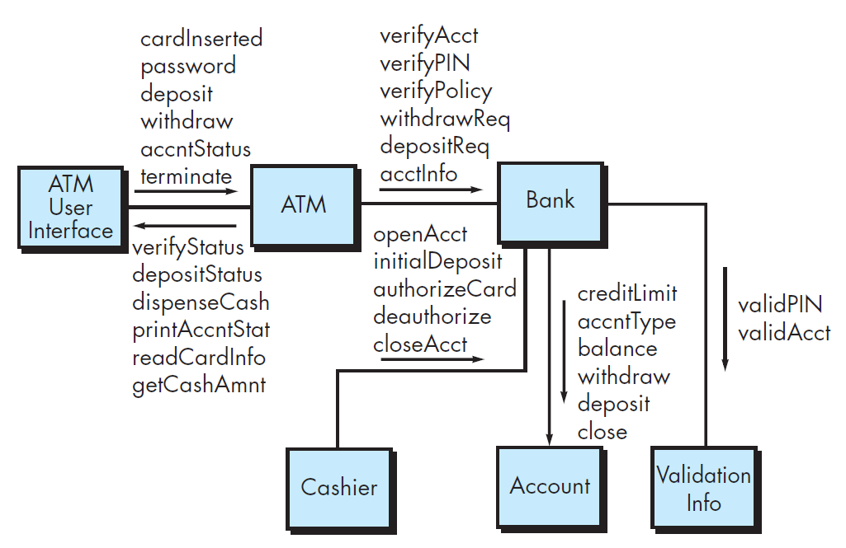
OOT Methods at Class Level
Inter-class testing (Multiple Class Testing)

Slide 114
OOT Methods at Class Level
Behavior Testing
The tests to be designed should achieve all state coverage [KIR94]. That is, the operation sequences should cause the Account class to make transition through all allowable states
© 2010 Sichuan University All rights reserved. | Confidential
114
Notes:
114

Slide 115
GUI Testing
A testing strategy similar to random or partition testing can be used to design UI tests;
Because many modern GUIs have the same look and feel, a series of standard tests can be derived;
Testing should be approached using automated tools;

Slide 116
Exercise
Which of the following are characteristics of testable software?
observability
simplicity
stability
all of the above
The testing technique that requires devising test cases to demonstrate that each program function is operational is called?
black-box testing
glass-box testing
grey-box testing
white-box testing
The testing technique that requires devising test cases to exercise the internal logic of a software module is called?
behavioral testing
black-box testing
grey-box testing
white-box testing
The cyclomatic complexity metric provides the designer with information regarding the number of
cycles in the program
errors in the program
independent logic paths in the program
statements in the program
© 2010 Sichuan University All rights reserved. | Confidential
116
Notes:
116

Slide 117
Exercise
5. Black-box testing attempts to find errors in which of the following categories
incorrect or missing functions
interface errors
performance errors
all of the above
none of the above
6. Testing OO class operations is made more difficult by
encapsulation
inheritance
polymorphism
both b and c
7. What is the differences between black-box testing and white-box testing?
8. What is equivalence partitioning as it applies to software testing? What is scenario-based testing?
© 2010 Sichuan University All rights reserved. | Confidential
117
Notes:
117

Slide 118
Exercise
5Answer: d
Answer: a
Answer: d
Answer: c
5. Answer: d
6. Answer: d
7. Answer: Black-box testing involves testing the functionality of a software component without knowing the details of its internal logic. White-box testing involves testing the independent logic paths with full implementation knowledge.
8. Answer: Equivalence partitioning technique divides the input domain into classes of equivalent data items. Test cases are derived from combinations of elements from each equivalence class. Exhaustive testing of all input domain values is not necessary. Scenario-based testing: The user tasks described in the use-cases are used to construct the test cases. It is used to uncover errors that occur when actors interact with the software (focus is on user behavior, not product behavior).
© 2010 Sichuan University All rights reserved. | Confidential
118
Notes:
118

Slide 119
Summary
Introduction To Software Engineering
What is software engineering?
The differences between software and hardware
Software is developed, not manufactured.
Software does not wear out, but it can deteriorate.
Most software is custom build, not assembled out of components.
Software Process
Generic View
Software Engineering Layers: Process, Methods, Tools
Generic Software Engineering Framework Activities:
Communication, Planning, Modeling, Construction, Deployment
CMMI : Incomplete, Performed, Managed, Defined, Quantitatively managed,
Optimized
Process Models
Waterfall Model (Linear Sequential Model)
Incremental Model
Prototyping Model
Spiral Model
Extreme Programming (XP)
Framework Activities: planning, design, coding, test
© 2010 Sichuan University All rights reserved. | Confidential
119
Notes:
119

Slide 120
Summary
Software Engineering Practice
Requirements Engineering
The definition of requirements engineering
Inception, Elicitation, Elaboration, Negotiation, Specification, Validation
Structural Analysis
Data dictionary
ERD
Object-oriented Analysis
Diagrams of UML for analysis modeling
Use-case diagram: visualizes the interaction of your system with the outside world
Activity diagram: shows the flow of events within your system
Class diagram: describes the structure of system by showing system’s classes, their attributes, and the relationship between the classes
State diagram: represents active states for each class and the events that cause changes between these active states
© 2010 Sichuan University All rights reserved. | Confidential
120
Notes:
120

Slide 121
Summary
Software Engineering Practice
Design Engineering
Four Design Models
Data Design, Architectural Design, Interface Design, Component-level Design
Structural Design
Cohesion
Coupling
Object-oriented Design
Information Hiding
Polymorphism
© 2010 Sichuan University All rights reserved. | Confidential
121
Notes:
121

Slide 122
Summary
Software Engineering Practice
Test Strategies
Unit Test
Integration Test
Top-down Integration
Bottom-up Integration
Validation Test
System Test
Test Tactics
White-box Test
Basic Path Testing
Black-box Test
Equivalence Partitioning
OO Test
Scenario-based Testing
© 2010 Sichuan University All rights reserved. | Confidential
122
Notes:
122

Slide 123
Summary
if((i>0)&&(j=0))
X:=X/i;
if((i=2)||(X>1))
X:=X+1;
a
Yes
i>0 && j=0
b
No
X:=X/i
c
Yes
i=2 || X>1
d
V(G)=3
Basic Path: ace, abce, acde
Test case:
ace: i=1,j=0,X=1 Expected result: X=1
abce: i=1,j=1,X=1 Expected result: X=1
acde: i=2,j=1,X=1 Expected result: X=2
No
X:=X+1
e
© 2010 Sichuan University All rights reserved. | Confidential
123
Notes:
123

